Slide 1
Budget request for Nb-on-Cu coated crab cavity prototype for LHC
Alexej Grudiev
BE-RF

Slide 2
Introduction
This work package covers design, construction and testing of 2 prototypes of a compact superconducting crab-cavity for LHC using Nb-on-Cu-coating technique.
The cavity shape is based on the ridged waveguide resonator with wide open apertures to provide access to the inner surface of the cavity for coating.
It also provides natural damping for HOMs and rather low longitudinal and transverse impedances.
The final goal is to validate the fabrication and coating of the cavity prototypes and to characterize its high gradient performance in a vertical test at 4K

Slide 3
Description of the prototype
Image: J.-F. Poncet (MME)
Ø420
~1400
Cost for two units:
Design: 45 kCHF
Material: 80 kCHF
Fabrication: 205 kCHF
Total: 330 kCHF
Weight: ~400kg

Slide 4
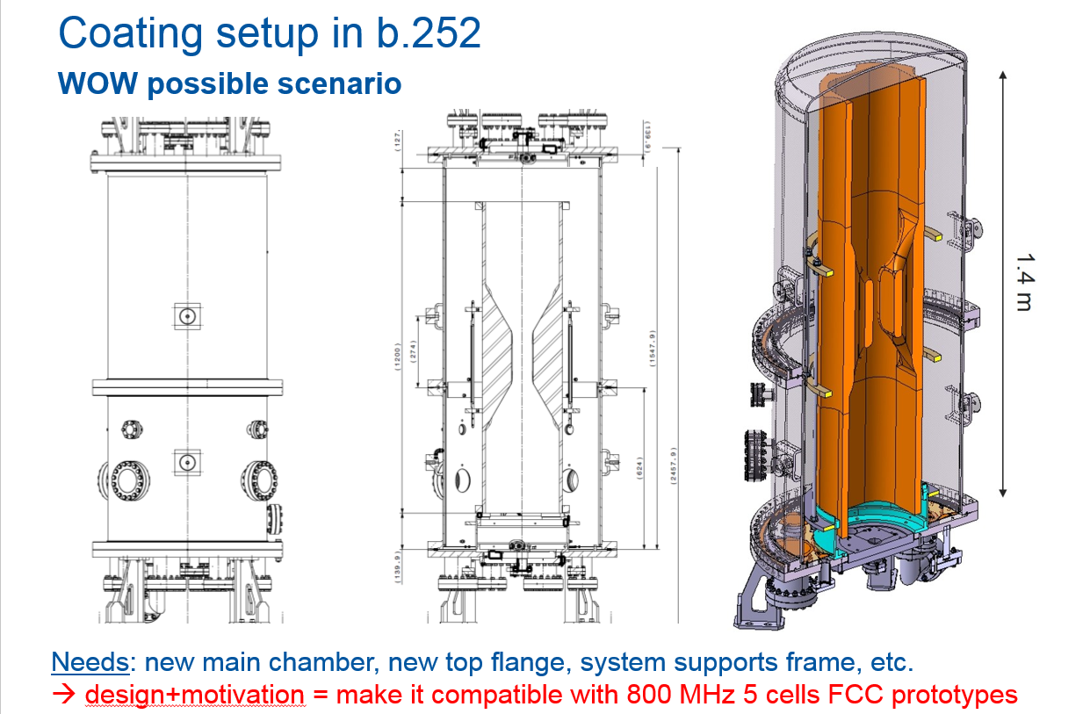
Courtesy:
Alban Sublet (VSC)
Cost of the system:
~250 kCHF
Can be also used for 800 MHz 5 cells cavities

Slide 5
Work package structure:
Task 1: RF design (Alexej Grudiev (RF))
Task 2: Mech. Design of the prototype and tooling (Ofelia Capatina (MME))
Task 3: Fabrication of the “substrates” (Pierre Naisson (MME))
Task 4: Surface treatment (Leonel Ferreira (VSC))
Task 5: Coating system and coating (Alban Sublet (VSC))
Task 6: Rinsing and clean room assembly of the prototypes for testing (Mathieu Therasse (RF))
Task 7: Cold Testing in cryostat (Mathieu Therasse (RF))

Slide 6
Schedule (technically limited)
 | 2016 |  |  |  | 2017 |  |  |  | 2018
 | Q1 | Q2 | Q3 | Q4 | Q1 | Q2 | Q3 | Q4 | Q1 | Q2 | Q3 | Q4
Material procurement
Fabrication 1st proto
Fabrication 2nd proto
Coating system design
Coating system construction
(Re-)Coating 1st proto
Cold testing 1st proto
(Re-)Coating 2nd proto
Cold testing 2nd proto

Slide 7
Budget and manpower profile
 |  | 2016 | 2017 | 2018 | Total
Budget [kCHF] | Design Material Fabrication Chemistry Coating RF infrastructure | 25 80 80 120 200 ? | 20 ~0 125 30 50 ?
 | Total | 505 | 225 |  | 730
Manpower [FTE]
 | Engineer (ENG) | 0.75 | 0.78 | 0.28 | 1.81
 | Technician (TEC) | 1 | 1.7 | 0.35 | 3.05
 | Fell/PJAS (FEL) | 0.68 | 0.34 | 0.07 | 1.09
The resources for SRF infrastructure modification in order to accommodate the WOWCC prototypes are not included yet

