Slide 1
Update on QuarkNet
Randy Ruchti, Notre Dame
Now beginning Year 12.
  Funding from NSF PHY EIR/EHR and DOE/OHEP
Have 51 Centers in 25 States and Puerto Rico
  Recent Additions
    Northern Illinois, Wisconsin, Black Hills State
On an annual basis, typically
  450 teachers
  100 high school student researchers
  100 physicist mentors

Slide 2
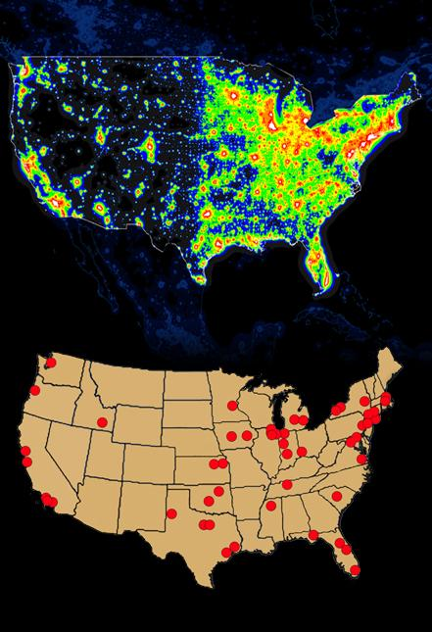
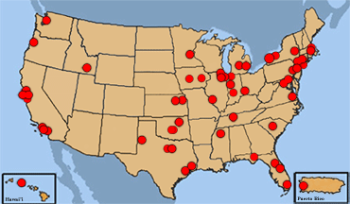
QuarkNet Reach
http://quarknet.fnal.gov

Slide 3
Program Elements
For Teachers
  Summer Research
  Fellows Programs
    Teaching and Learning
    LHC
    VLHC and Virtual Center
    Evaluation
  Bootcamp at Fermilab
  QuarkNet Weeks
  Professional Development and Academic Credit
  Development of instructional tools and demonstrations
For Students
  Summer Research
  eLabs
    LHC Data (from CMS and ATLAS)
    Cosmic Ray Detectors in Classrooms
  Masterclasses
    US/Europe
    Far East
LHC Awareness
  CERN Open Days
  LHC Discovery Video – development of instructional elements

