Slide 1




Probing the interplay between composite vector/fermionic resonances @ LHC
Bithika Jain
Work in progress with Mihailo Backovic (CP3 Louvain),
Thomas Flacke, Seung Lee (Korea University)
PHENO, May 10th, 2016
Notes:
Hi
I am Bithika Jain, I am a research felllow at KIAS and in the next 12 minutes , I will be talking about composite vector resonances and top partners @ LHC
Part of this presentation is based on the ongoing work with Mihailo, Thomas and Seung

Slide 2
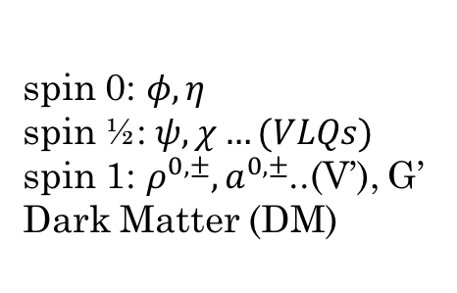
The name of the “game” is to identify the underlying
theory from data
Signatures
invariant mass peaks,
& non - resonant productions,
correlations
Data
Models
Underlying theories with symmetries, N_{c}, N_{f}
Particles
spin 0: $φ, η$
spin ½:$ψ, χ…(VLQs)$
spin 1: $ρ^{0,±},a^{0,±}$..(V’), G’ Dark Matter (DM)
Courtesy- Alexander Belyaev
Notes:
In this session we have heard about a lot of BSM searches
Collider Physics –
We are always dealing with this simple mind map, where the experimental/theorectical motivations make us propose models which are based on some underlying symmetries, Nc,Nf -> which yield a plethora of particles which may/may not have unque signatures like invariant ….correlations which are looked for at the experiments and the Data takes us back in the Loop
The viciuos circle in of life for a particle physicist

Slide 3
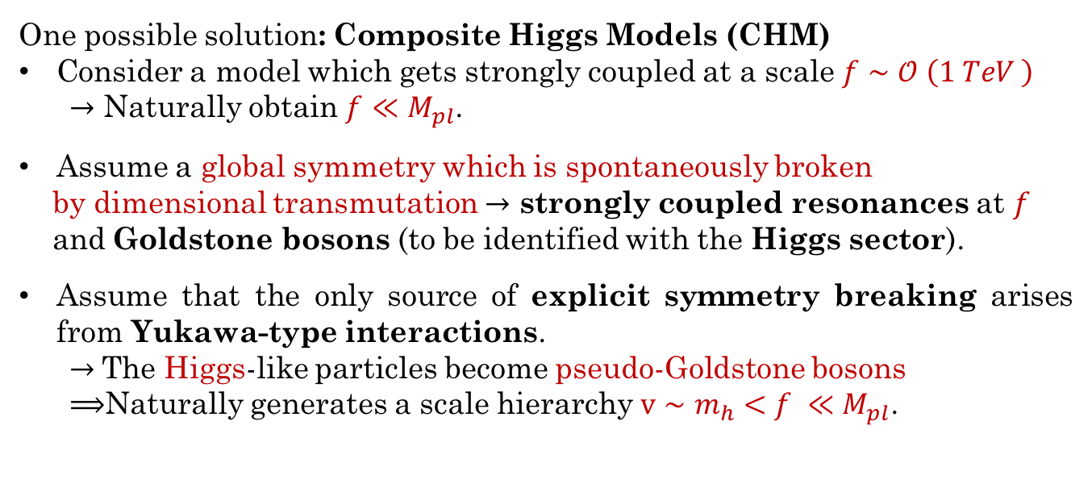
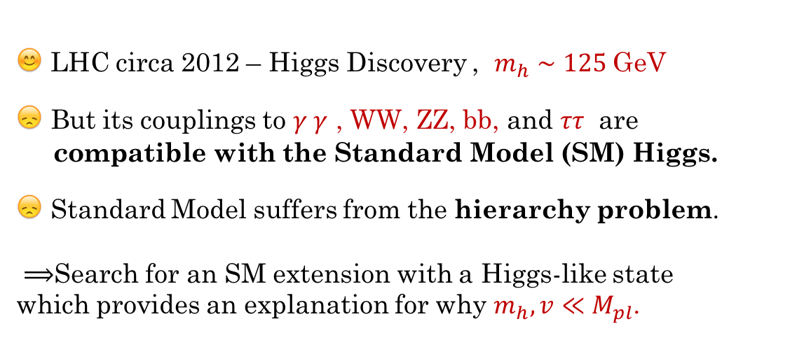
😊 LHC circa 2012 – Higgs Discovery , $m_{h}∼125$GeV
😞 But its couplings to $γ γ$ , WW, ZZ, bb, and $ττ$ are
compatible with the Standard Model (SM) Higgs.
😞 Standard Model suffers from the hierarchy problem.
$⟹$Search for an SM extension with a Higgs-like state
which provides an explanation for why $m_{h}, v≪M_{pl}$.
Models
One possible solution: Composite Higgs Models (CHM)
Consider a model which gets strongly coupled at a scale $f∼𝒪 \left(1 TeV \right)$
$→$ Naturally obtain $f$ $≪M_{pl}$.
Assume a global symmetry which is spontaneously broken
by dimensional transmutation $→$ strongly coupled resonances at $f$
and Goldstone bosons (to be identified with the Higgs sector).
Assume that the only source of explicit symmetry breaking arises from Yukawa-type interactions.
$→$The Higgs-like particles become pseudo-Goldstone bosons
$⟹$Naturally generates a scale hierarchy $v∼m_{h}<f ≪M_{pl}$.
Notes:
In the
Suppose Higgs is composite (Dugan, Kaplan, Georgi – 1980s)
Hierarchy problem is resolved
Corrections to m_{H} screened above 1/$l_{H}$
At low energies, Higgs behaves like an elementary particle

Slide 4
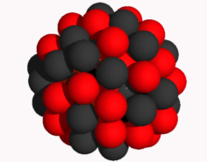
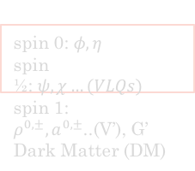
Signatures and Strategies
Data
Models
Underlying theories with symmetries, N_{c}, N_{f}
There are two main classes of signatures
Resonant – single or several bumps
Non-resonant typically effects in the tails of the distributions
Particles
spin 0: $φ, η$
spin ½:$ψ, χ…(VLQs)$
spin 1: $ρ^{0,±},a^{0,±}$..(V’), G’ Dark Matter (DM)
[see Alex Pomarol’s Talk]

Slide 5
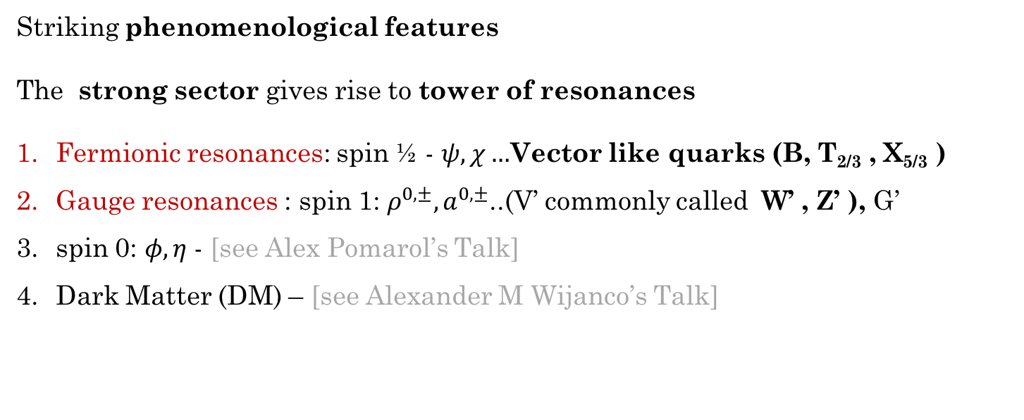
Particles
Striking phenomenological features
The strong sector gives rise to tower of resonances
Fermionic resonances: spin ½ - $ψ, χ…$Vector like quarks (B, T_{2/3} , X_{5/3} )
Gauge resonances : spin 1: $ρ^{0,±},a^{0,±}$..(V’ commonly called W’ , Z’ ), G’
spin 0: $φ, η$- [see Alex Pomarol’s Talk]
Dark Matter (DM) – [see Alexander M Wijanco’s Talk]
Non minimal cosets
Notes:
Higgs sector is modified
Modification of the Higgs couplings
Growth of WW scattering
Change in Higgs productions: $κ_{Z,W}=\sqrt{1−{v^{2}}/{f^{2}}}$
Double Higgs production- contributions grow with energy squared [Contino, Dolan….]
As I mentioned before we have several particles – our focus on -….

Slide 6
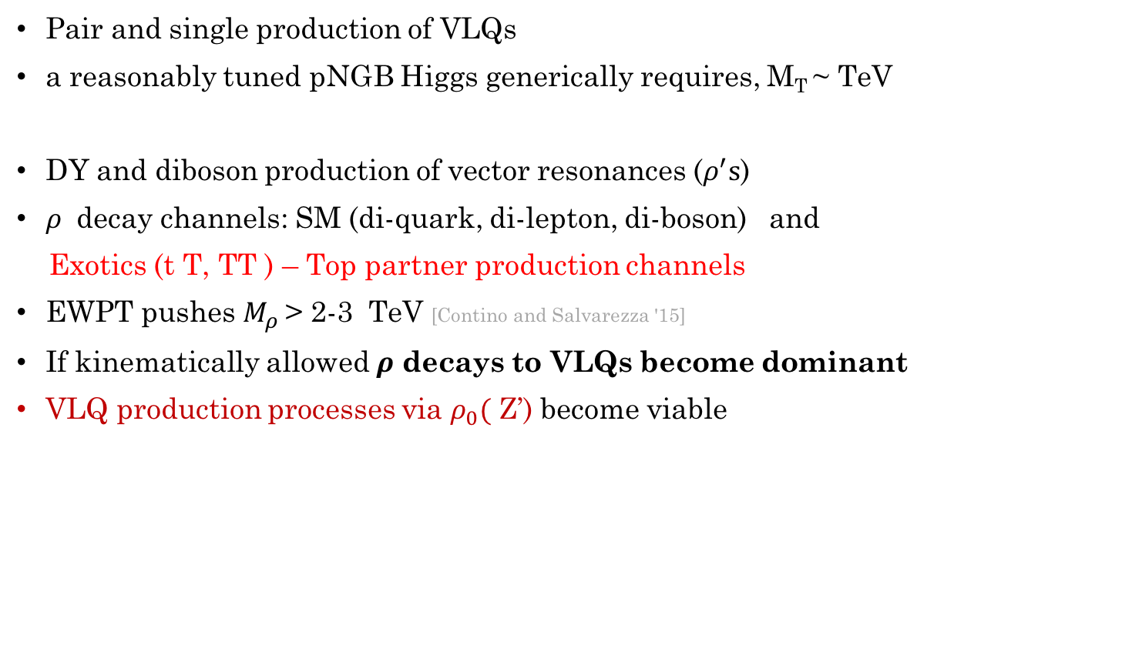





Status of natural CHMs
[comprehensive review see Panico, Wulzer ’15 , Csaki, Grojean, Terning’15]
Pair and single production of VLQs
a reasonably tuned pNGB Higgs generically requires, M_{T} ~ TeV
DY and diboson production of vector resonances ($ρ^{′}s$)
$ρ$ decay channels: SM (di-quark, di-lepton, di-boson) and
Exotics (t T, TT ) – Top partner production channels
EWPT pushes $M_{ρ}$ > 2-3 TeV [Contino and Salvarezza '15]
If kinematically allowed $ρ$ decays to VLQs become dominant
VLQ production processes via $ρ_{0}($ Z’) become viable
[Matsedonskyi et al. '12]
$$T′$$
$$ρ_{0}$$
$$T′$$
$$ρ_{0}$$
$$\overline{T′}$$
$$\overline{t}$$

Slide 7




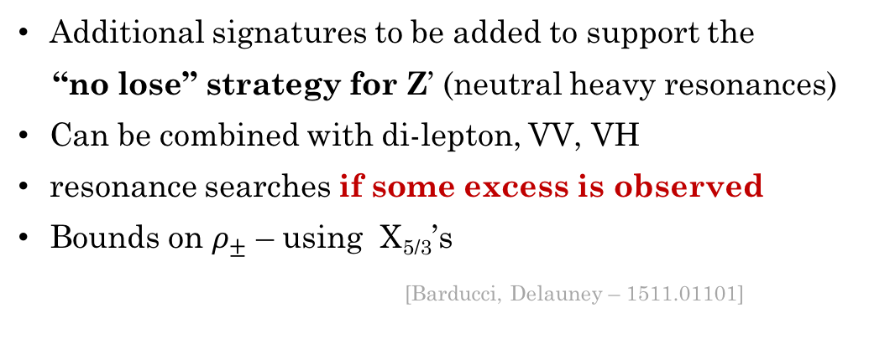



“No lose” strategy for $ρ^{′}s$
$$T′$$
W
$$ρ_{0}$$
$$T′$$
$$ρ_{0}$$
$$ρ_{0}$$
$$\overline{T′}$$
$$\overline{t}$$
Z
Additional signatures to be added to support the
“no lose” strategy for Z’ (neutral heavy resonances)
Can be combined with di-lepton, VV, VH
resonance searches if some excess is observed
Bounds on $ρ_{±}$ – using X_{5/3}’s
[Barducci, Delauney – 1511.01101]
$$ρ_{0}$$
l
l
$$ρ_{0}$$
W
H
Notes:
Apart from the usual culprits

Slide 8
Composite Higgs
Warped XD models: 5D dual (AdS/CFT correspondence) of Composite Higgs: [Randall & Sundrum,... ’90s]
nice frame work, providing explicit realization of 4D composite Higgs model
Little Higgs: collective symmetry breaking [Arkani-Hamed, Cohen, Georgi ’00s]
  Higgs is GB under multiple symmetries
  Two or more explicit symmetry breaking terms are needed to break all symmetries protecting the Higgs mass.
  No quadratic divergences at one-loop.
Holographic Higgs: Higss as a component of GB (A5)[Contino, Nomura, Pomarol; Agashe, Contino, Pomarol; Hosotani,...]
Simple 4D effective description (Strongly-Interacting Light Higgs) [Giudice, Grojean, Pomarol, Rattazzi ’07]
NB: Higgs does not need to be a usual PGB; it can arise from other mechanisms, i.e. it can be a light dilaton [Bellazzini, Csaki, Hubisz, Serra, Terning ’12, ’13]
Notes:
CH has several incarnations/ implementations
However, its always possible to look at a simplified description which can incorporate the relevant features of this huge class of models

Slide 9
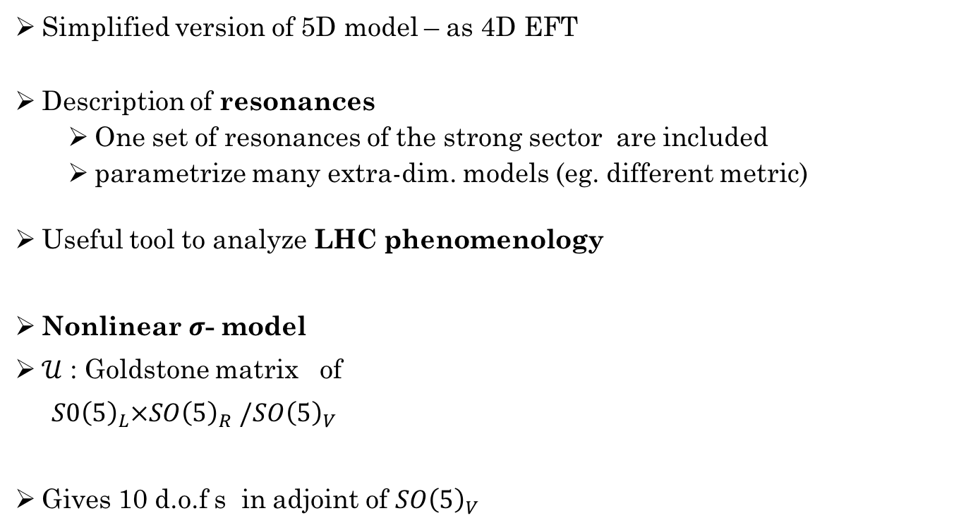


2 site Composite Higgs model
Simplified version of 5D model – as 4D EFT
Description of resonances
  One set of resonances of the strong sector are included
  parametrize many extra-dim. models (eg. different metric)
Useful tool to analyze LHC phenomenology
Nonlinear $σ$- model
$𝒰$ : Goldstone matrix of
$S0{\left(5\right)}_{L}×SO{\left(5\right)}_{R}$ $/SO{\left(5\right)}_{V}$
Gives 10 d.o.f s in adjoint of $SO{\left(5\right)}_{V}$
$$S0{\left(5\right)}_{L}$$
$$S0{\left(5\right)}_{R}$$
Elementary
sector
Composite
sector
[Panico, Wulzer’11, Matsedonskyi, Wulzer’12]
Notes:
Our approach is inspired by the 5d models and by the idea of dimensional deconstruction [8],
which consists in discretizing the extra coordinate in a finite number of points, or sites. We therefore
denote our setup as the \Discrete" Composite Higgs Model (DCHM) and, depending on the number
of deconstruction sites,

Slide 10
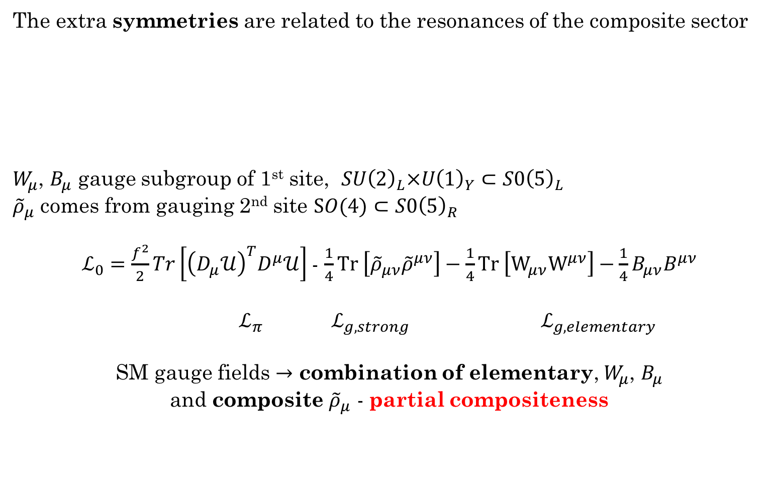
2-site model: gauge sector
The extra symmetries are related to the resonances of the composite sector
$W_{μ}$, $B_{μ}$ gauge subgroup of 1st site, $SU{\left(2\right)}_{L}×U{\left(1\right)}_{Y}⊂S0{\left(5\right)}_{L}$
${\tilde{ρ}}_{μ}$ comes from gauging 2nd site $SO(4)⊂S0{\left(5\right)}_{R}$
$ℒ_{0}=\frac{f^{2}}{2}Tr\left[{\left(D_{μ}𝒰\right)}^{T}D^{μ}𝒰\right]$- $\frac{1}{4}Tr \left[{\tilde{ρ}}_{μν}{\tilde{ρ}}^{μν}\right]−\frac{1}{4}Tr \left[W_{μν}W^{μν}\right]−\frac{1}{4}B_{μν}B^{μν}$
$ℒ_{π}$ $ℒ_{g,strong } ℒ_{g, elementary }$
SM gauge fields $→$ combination of elementary, $W_{μ}$, $B_{μ}$
and composite ${\tilde{ρ}}_{μ}$ - partial compositeness
[Kaplan (1991), Contino, Kramer, Son and Sundrum (2006)]
Notes:
- 3 fold purpose
Eats 6 Goldstones
Breaks extra $S0{\left(5\right)}_{R}$ invariance
a description of the massive vector resonances
we gauge the SO(4) subgroup of SO(5)R by introducing six gauge fields ${\tilde{ρ}}_{μ}$
Given that SO(5)R is spontaneously broken, the new gauge bosons become massive and acquire their longitudinal components by eating the $Π_{A}$ Goldstones.
The ${\tilde{ρ}}_{μ}$ states are then interpreted as resonances of the composite sector and we assign them a coupling grho of the order of the typical composite sector coupling g* . Their mass is given by mrho~ grho f
and is of the order of the typical composite sector mass m* .
For phenomenological reasons mrho~ TeV size and the coupling grho is “ large" though not maximal, 1 <grho< 4 pi .
The latter assumption is essential to ensure that the dynamics of the vector resonances
can be described perturbatively.
The EW bosons are introduced by gauging the SU(2)L U(1)Y subgroup
of SO(5)L with the gauge efilds W
and B . The W and B elds are interpreted
as elementary elds. Their couplings g0 and g00
almost coincide
with the SM g and g0 couplings and are typically much smaller than eg (see
Eq. (5.1.22 )). Notice that the SU(2)L U(1)Y subgroup of SO(5)L that is
gauged by the elementary gauge elds does not coincide exactly with the SM
gauge group. Indeed the SM group must be unbroken before EWSB, whereas
SO(5)L is spontaneously broken to its vector combination with SO(5)R . The
correct identication of the SM group is thus with the vector combination
of the elementary group SU(2)L U(1)Y inside SO(5)L and the analogous
subgroup inside SO(5)R . This combination belongs to the SO(5)V symmetry
group and is clearly unbroken before the Higgs takes a VEV. A direct
consequence of this construction is the fact that the SM gauge elds do not
correspond just to the elementary elds W and B , but they are a combination
of the latter with the composite vector resonances e . This structure
clearly corresponds to the assumption of partial compositeness

Slide 11
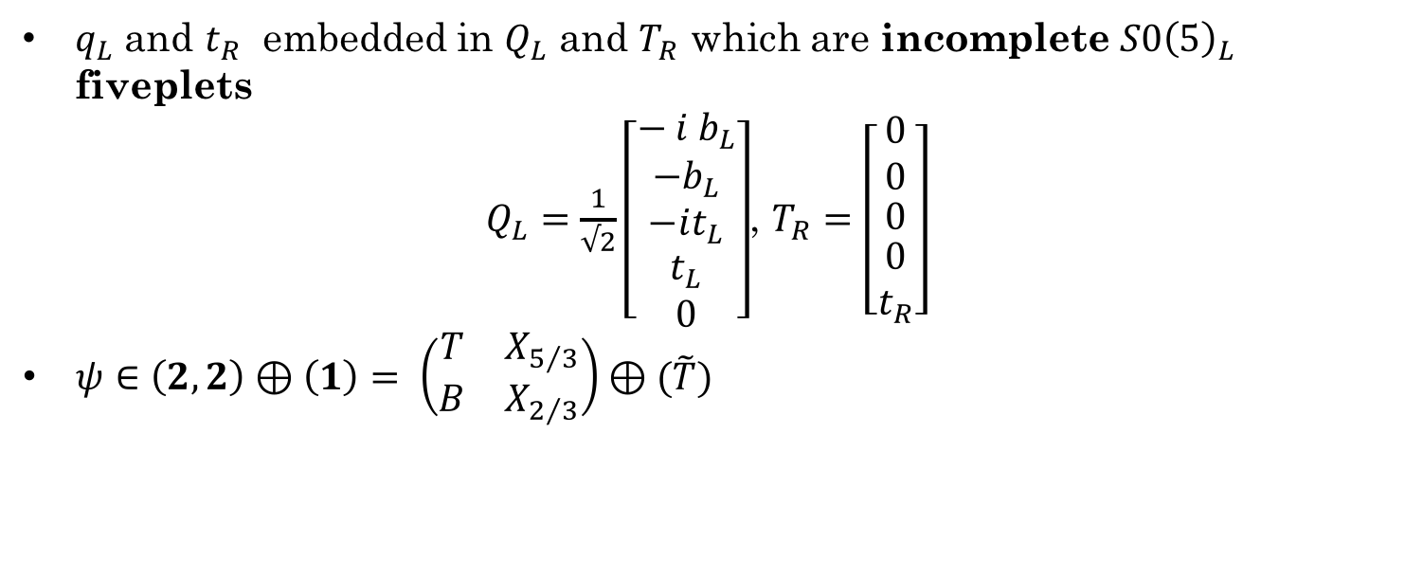


2-site model: top sector
$$S0{\left(5\right)}_{L}$$
$$S0{\left(5\right)}_{R}$$
$q_{L}$ and $t_{R}$ embedded in $Q_{L}$ and $T_{R}$ which are incomplete $S0{\left(5\right)}_{L}$ fiveplets
$Q_{L}=\frac{1}{√2}\left[\begin{matrix}− i b_{L} \\ {−b}_{L} \\ \begin{matrix}−it_{L} \\ \begin{matrix}t_{L} \\ 0\end{matrix}\end{matrix}\end{matrix}\right]$, $T_{R}=\left[\begin{matrix}0 \\ 0 \\ \begin{matrix}0 \\ \begin{matrix}0 \\ t_{R}\end{matrix}\end{matrix}\end{matrix}\right]$
$ψ∈\left(2,2\right)⊕\left(1\right)= \left(\begin{matrix}T & X_{5/3} \\ B & X_{2/3}\end{matrix}\right)⊕(\tilde{T})$
Notes:
A composite Higgs model is based on a coset G/H, and the usual rules of non-linear sigma models dictate that the top partner must carry a rep of H
In the case of two sites, focusing for simplicity on the top quark sector, we introduce only one Dirac fiveplet of fermionic resonances $\tilde{Ψ}$
This mixes with the elementary doublet $q_{L}=(t_{L}, b_{L})$ and with the singlet $t_{R}$
The mixing term is $ℒ_{mix}=y_{L}f \overline{Q_{L}^{I}}𝒰_{IJ}\tilde{ψ^{J}}+y_{R}f \overline{T_{R}^{I}}𝒰_{IJ}\tilde{ψ^{J}}$
Where $Q_{L}^{I}$ and $T_{R}$ are embeddings of q_L and t_r elementary fermions into incomplete SO(5)_L fiveplets
the elementary/composite mixing in units of f .
embed qL in the negative-charge doublet and tR in the singlet
The explit form of this embeddings are
$Q_{L}=\frac{1}{√2}\left[\begin{matrix}− i b_{L} \\ {−b}_{L} \\ \begin{matrix}−it_{L} \\ \begin{matrix}t_{L} \\ 0\end{matrix}\end{matrix}\end{matrix}\right]$, $T_{R}=\left[\begin{matrix}0 \\ 0 \\ \begin{matrix}0 \\ \begin{matrix}0 \\ t_{R}\end{matrix}\end{matrix}\end{matrix}\right]$
Ψ contains a fourplet and singlet.
The four Ψ components decompose into two SM doublets (T, B) and (X5/3, X2/3) of hypercharge 1/6 and 7/6 respectively. The first doublet has therefore the same quantum numbers as the (tL, bL) doublet while the second one contains a state of exotic charge 5/3 plus another top-like quark X2/3.
The singlet is a top like state
The new Y = T3R + X where T3R comes from the U(1)Y of SO(5)L
Given that the Goldstones are not charged under the extra U(1)X, this change in the definition of
Y does not modify their couplings to B and the construction discussed in the previous sections
for the gauge sector is unaffected. The W and the massive resonances are included, again as
before, from gauging the SU(2)L subgroup of SO(5)L and the SO(4) subgroup of SO(5)R.

Slide 12


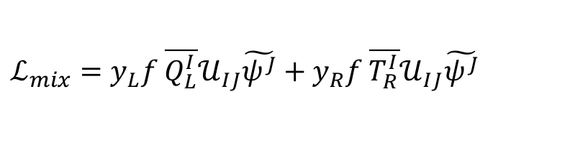
2-site model: top sector
Elementary and composite sector kinetic Lagrangians is
Parameters of the leading order lagrangian:
f and gauge couplings: $g, g^{′}, gρ$
the fourplet and singlet mass scales $M_{4}$ and $M_{1}$ and
the left and right-handed pre- Yukawa couplings, $y_{L}$_{, R}
$y_{L}$ fixed to reproduce the correct top mass
$g, g^{′}$ fixed to reproduce the correct W and Z mass
Mass term, $\tilde{m}=diag(M_{4}, M_{1})$
Invoking partial compositeness via y’s
$$ℒ_{mix}=y_{L}f \overline{Q_{L}^{I}}𝒰_{IJ}\tilde{ψ^{J}}+y_{R}f \overline{T_{R}^{I}}𝒰_{IJ}\tilde{ψ^{J}}$$
Notes:
For correct hypercharges, $B_{μ}$ comes out of gauging $S0{\left(5\right)}_{L}×U{\left(1\right)}_{X}$
${\tilde{W}}_{μ}$ and ${\tilde{ρ}}_{μ}$ come from gauging $SU{\left(2\right)}_{L}⊂$ $SU{\left(5\right)}_{L}$ and $SO(4)⊂$ $SU{\left(5\right)}_{R}$
Moreover we have not yet specified the covariant, derivatives Dµ associated with the SM gauge group, these are obviously given by
$$D_{μ}q_{L}=\left(∂_{μ}−i \frac{\hat{g}}{2}W_{μ}^{α}σ_{α}−i\frac{\hat{g}′}{2}B_{μ}\right)q_{L}$$
$$D_{μ}t_{R}=\left(∂_{μ}−i\frac{\hat{2g}′}{3}B_{μ}−ig_{s} G_{μ}\right)t_{R}$$
$$D_{μ}\tilde{ψ}=\left(∂_{μ}−i\frac{\hat{2g}′}{3}B_{μ}−i\tilde{g_{ρ}}{\tilde{ρ}}_{μ}\right)\tilde{ψ}$$
derivatives Dµ associated with the SM gauge group, these are obviously given by

Slide 13
Partially Composite vectors : Mass and couplings
Masses
Couplings (examples)
Post EWSB:
Physical vectors in mass basis
Notes:
Heavy resonances almost degenerate

Slide 14

Partially Composite fermions : Mass and couplings
SM like top
Partners in 4
Singlet Partner
Post EWSB:
Top sector
in mass basis @ leading order in v/f
Notes:
Lets focus on the fermionic spectrum. The mass-matrix after EWSB is easily computed by using the explicit form of U on the Higgs VEV . By restricting to the sector of 2/3-charged states we find
The peculiar structure of the mass-matrix has an interesting consequence. It implies that only one linear combination of T and X2/3, with coefficients proportional to the (1, 2) and (1, 3) entries, mixes with the qL, while the orthogonal combination does not mix either with the qL or with any other state
Indeed the X5/3 cannot mix because it is the only state with exotic charge and therefore it maintains the mass mX5/3 = MΨ it had before EWSB.
However the resulting expressions are rather involved and we just report here approximate expressions for the masses. We have
….
Mtf1 and Mx53 are degenerate in lowest order of v/f

Slide 15
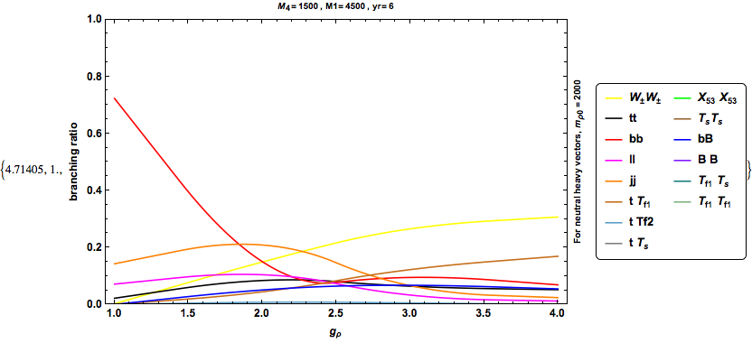
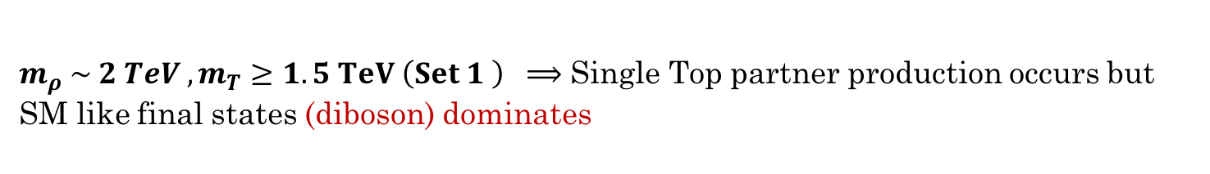
2-site: Benchmark points
$m_{ρ} \sim 2 TeV , m_{T}≥1.5 TeV \left(Set 1 \right) ⟹$ Single Top partner production occurs but SM like final states (diboson) dominates
Notes:
ξ = v²/ f² , where v = 2mW /g = 246 GeV is the EWSB scale. Since ξ controls the deviation from the SM at low energies it cannot be too large. Electroweak precision tests suggest ξ ’=0.2 or ξ = 0.1, which corresponds to f = 500 GeV or f ’=800 GeV. Smaller values of ξ would of course require more tuning. Finally, the strength of the elementary-composite coupling y is fixed by the need of reproducing the correct mass of the top quark. We will see in the following section that this implies yL ∼ yt = 1.
for f > 800 GeV ; g\[Rho]< 3.5 ; to satisy X53 searches constraints M4 > 960 GeV, sLq < 0.5 (3/g\[Rho])^(1/2) (from compositeness constraints of 1507.7557 )

Slide 16
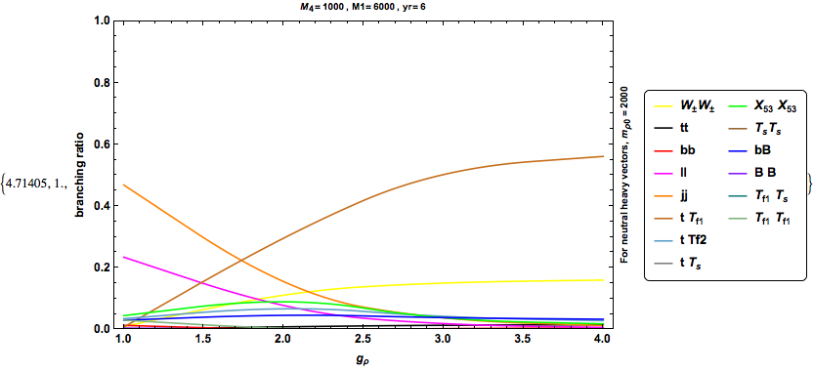
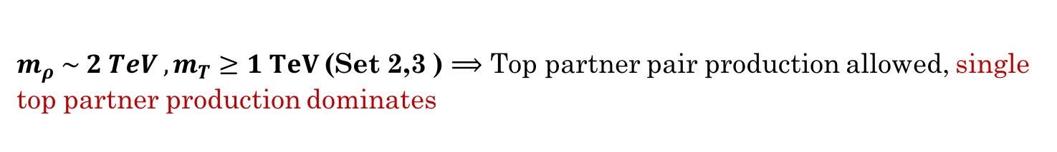
2-site: Benchmark points
$m_{ρ} \sim 2 TeV , m_{T}≥1 TeV$(Set 2,3 ) $⟹$ Top partner pair production allowed, single top partner production dominates
Notes:
ξ = v²/ f² , where v = 2mW /g = 246 GeV is the EWSB scale. Since ξ controls the deviation from the SM at low energies it cannot be too large. Electroweak precision tests suggest ξ ’=0.2 or ξ = 0.1, which corresponds to f = 500 GeV or f ’=800 GeV. Smaller values of ξ would of course require more tuning. Finally, the strength of the elementary-composite coupling y is fixed by the need of reproducing the correct mass of the top quark. We will see in the following section that this implies yL ∼ yt = 1.
for f > 800 GeV ; g\[Rho]< 3.5 ; to satisy X53 searches constraints M4 > 960 GeV, sLq < 0.5 (3/g\[Rho])^(1/2) (from compositeness constraints of 1507.7557 )

Slide 17
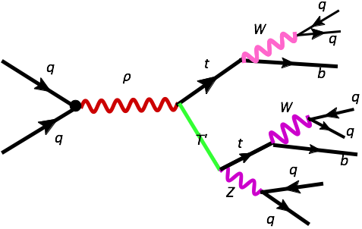
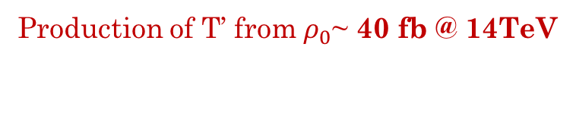
Search Strategy @ LHC run II
10 signal events expected with L = 100 fb⁻¹
3 Fat jets in an event
Production of T’ from $ρ_{0}$~ 40 fb @ 14TeV
Boosted
Top tagging
+
B-tagging
Madgraph 5 with Feynrules model implementation of a toy model with a Z-prime , interfaced with VLQ model and an effective Higgs model
Notes:
The firrst step is to simulate the signal processes. Rather than employing our complete model we
have used a set of simplified MadGraph models containing the SM fields and interactions plus the
VLQs and Z’ with the appropriate couplings to the single top partner production and the decay
Production of $X_{5/{3 }}$from $ρ_{∓}$ ~ 4 fb @ 14TeV
We generated parton level events
We also included the trigger effieciency as an overall multiplicative
Factor
simulated 10000 events with mZ’ = 2.7 TeV, mT’ = 1 TeV
This gave me a total production cross section of about 1 fb (including three hadronic branching ratios)… so maybe we can do something with this at 100+ fb^-1
Now, what I wanted to test is can we fit three fat jets into an event and how well does this configuration work.
I used a cone of R=1.0, and ptmin = 500, 500, 300 GeV for the first, second and third hardest jet. (eta < 2.5 of course)
40% of the events were compatible with 3 jet configuration and the above cuts… which is actually pretty good. Now, on top of this, say we use the 75% tagging efficiency for the two tops and the Z, giving another 40% efficiency in total… so at the end 0.1-0.2 total event selection efficiency, not including any cuts on the fat jet mass.
This means that 100 fb^-1 would give us about 10 events at the end of the day
********************
The main channels are two-body decays
to vector bosons and third-family quarks
For the partners
of charge 2/3 and -1/3 also the decay to the Higgs boson is allowed, and competitive with the
others in some cases. This originates from the interactions of the partners with the Higgs
The relevant couplings
can be computed analytically similarly to the gtL;RX and gbLX. Thus we easily obtain analytical
tree-level expressions for the partial widths and eventually for the branching fractions. In principle
cascade decays X ! X0V or X0H are also allowed, however these are never sizable

Slide 18
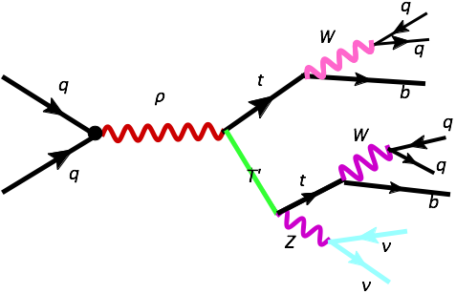
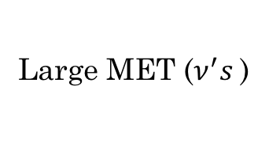
Search Strategy @ LHC run II
Boosted
Top tagging
+
B-tagging
Large MET ($ν^{′}s$)
Notes:
simulated 10000 events with mZ’ = 2.7 TeV, mT’ = 1 TeV
This gave me a total production cross section of about 1 fb (including three hadronic branching ratios)… so maybe we can do something with this at 100+ fb^-1
Now, what I wanted to test is can we fit three fat jets into an event and how well does this configuration work.
I used a cone of R=1.0, and ptmin = 500, 500, 300 GeV for the first, second and third hardest jet. (eta < 2.5 of course)
40% of the events were compatible with 3 jet configuration and the above cuts… which is actually pretty good. Now, on top of this, say we use the 75% tagging efficiency for the two tops and the Z, giving another 40% efficiency in total… so at the end 0.1-0.2 total event selection efficiency, not including any cuts on the fat jet mass.
This means that 100 fb^-1 would give us about 10 events at the end of the day

Slide 19


Summary
Composite Higgs model (with H as PGB) provides a viable solution to the hierarchy problem and generically predict partner states to the fermions
Top partner will be probed beyond the 1 TeV mass region at the Run 2 of LHC
mass of top partners < mass of heavy vector resonances.
vector resonances decay to top partners instead of pure Standard Model final states start can dominate
For run II, single-top partner production channels and strongly boosted top searches become important.
New search strategies can aid in hunting Top partners and also put more accurate bounds on heavy vector resonances
TH NK YOU!
Notes:
Models in which the naturalness problem of the Standard Model (SM) is solved by making the Higgs a composite, pseudo-Nambu-Goldstone boson (PNGB) of some as-yet-unknown strong dynamics have come to the fore in recent years as they have matured, incorporating symmetries and partial compositeness to mitigate unobserved corrections in electroweak precision tests and flavour physics. They are, by now, arguably just as good (or just as bad) a contender as supersymmetry for new physics at the TeV scale, and the LHC experiments ought to devote significant resources to looking for them
Just as for supersymmetry, the composite Higgs is more a paradigm than a model, in that it may be realised in arbitrarily many ways. Thus it is not clear, a priori, how best to search at the LHC for evidence of a composite Higgs. Na¨ıvely, the obvious place to look is in the Higgs sector itself, but the minimal model contains just a single SM Higgs doublet (for models with an extended Higgs sector, see, ). Moreover, the apparent absence of new physics in the electroweak and flavour sectors already forces us
The necessary suppression also implies that new states, beyond the SM, will generically be out of the mass reach of the LHC. However, the mechanism of partial compositeness requires the existence of additional states that mix with the top quark and several authors have argued that these “top partners” should be light, given the measured Higgs boson mass. In a nutshell, the connection arises because the Higgs potential (and, ergo, the Higgs mass) is predominantly induced by radiative corrections involving the top quark, which are cut off by the top partners.
Many suggestions for dedicated searches for such top partners have been put forward. Indeed, there are already more on the market than the experiments have the resources to implement, with just a few analyses having appeared thus far.
Reasonable coverage of the gamut of top partners and vector resonances in CHMs

