Slide 1
GEM-CSC Trigger Integration
Status and Plans
GEM Firmware Workshop
February 23, 2016

Slide 2
(Re-) Introduction
S-bit Processing for the Trigger Links
S-bits need to be compressed in the Optohybrid
  1536 input bits compressed to 112 by sending only clusters of non-zero bits.
    4 clusters per packet, 2 packets per Optohybrid:
    11 bits pad number (pads = 0-1535)
    3 bits cluster size (size = 0-7)
  Goal is to build a minimally latent, low sized implementation of this mechanism.
  The same firmware should be usable for both the OH->OTMB and OH->GLIB links.
    Designed to handle 8 clusters / chamber, but easily adaptable to 4 or to 16 (with some limitations, but no increase in latency).

Slide 3
Optohybrid “Cluster Packer”
Group neighboring S-bits into clusters and count the size of the clusters.
Find the addresses of 8 clusters
Pack cluster addresses and sizes into two 56 bit data words for transmission to OTMB & GLIB.
Concept is simple, but the firmware implementation can get be complex.
  Straightforward implementations are slow.
  Besides being slow, slow implementations are also big!
    Data flows in continuously, so logic that takes n clock cycles has to be pipelined and _{(largely)} replicated n times.
  cluster_packer module right now occupies ~18% of Virtex-6 LUTs,
  with latency of 3.5bx

Slide 4
Cluster Packer Basic Algorithm
Basic algorithm:
  S-bits from neighboring VFATs are grouped together into partitions.
  A cluster primary flag and cluster size are generated for every one of 192 pads in the partition.
    Cluster size == number of adjacent S-bits that are 1
    Cluster primary flag == A pad is primary if it is
    the beginning of the cluster,
    or it is preceded by a size=7 cluster (clusters > 16 are cut off..)
  Cluster sizes and primary flags are received in a priority encoding module, which returns the addresses of the “first 8” clusters in the chamber
      (in terms of firmware, it starts at the LSB. What this means in terms of chamber geometry is completely arbitrary)
  Latches two 56 bit data packets at 40MHz

Slide 5
“Cluster Packer” Status
Preliminary version of firmware is finished
  Overall latency of the packer is 3.5bx.
  Behavioral logic simulates OK.
  Compiles and passes PAR, timing analysis in ISE.
  Now working on developing sw/fw capabilities for testing in emulator hardware.
    Basic firmware mostly ready; need to fix a few bugs but should have results very soon.
    More sophisticated testing mechanisms are work in progress.
There are a few outstanding issues/questions (more details in backup slides):
  Need to adapt the firmware for VFAT-2s.
    Depending on implementation, this may not require any changes to existing firmware.
  Need to use correct enumeration convention for VFATs.
  Reversibility of priority encoding ?

Slide 6
Unresolved Issues
How to handle VFAT-2s
  Firmware is being designed for VFAT-3 case --- needed as proof of concept.
  But needs to support VFAT2.
  Have some ideas from discussions with Jason, but not sure which is best.
Method 1: The 192 S-bits from the VFAT2 chamber are dumped into the first 192 bits of the logic, and have it return an address from 0-191.
  Advantage: Clustering mechanism continues to work meaningfully.
  Advantage: Could modify the data format to fit an additional cluster per data packet.
Method 2: Stuff the S-bits only into every 8th position... Keeping the VFAT-3 data format and addresses from 0-1535. (i.e. only allow clusters at addresses 0, 8, 16, etc., and every cluster is size=7).
  Advantage: Addresses retain their geometric significance to the receiver. Trigger data format and unpacking would be identical in the switch from VFAT2 -> VFAT3.
  Advantage: Requires very little change to firmware on either OH or OTMB/GLIB.

Slide 7
Unresolved Issues.. Continued
Reversibility of Priority Encoding
A possibly desirable feature: in paired GEM chambers, allow for priority encoding to be done in reverse from one to the other.
  In the case of overflows (more than 8 clusters per chamber), this feature would maximize coverage.
  Is this already done by virtue of the chambers’ installation? (i.e. are paired chambers installed in the reverse orientation to each other.)
    If this is the case…. Do we still want this feature? So that we could, in effect, turn off the reversal and have both chambers prefer the same geometry.
  Switchable reversibility would add a small amount of latency.. Or could be en-/dis-abled at compilation with no added latency.

Slide 8
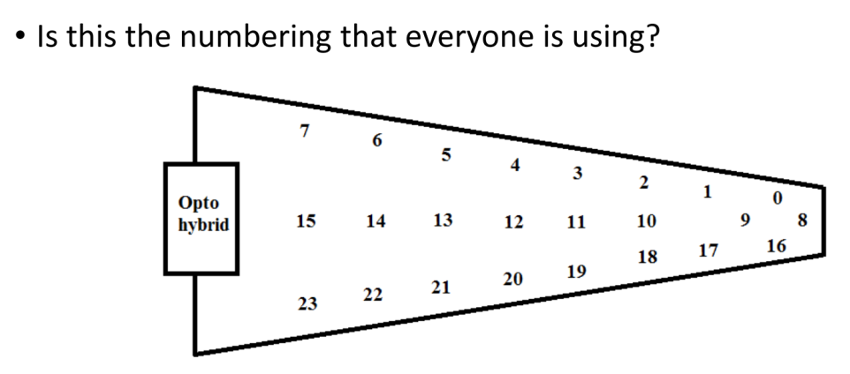
Unresolved Issues.. Continued
Convention for the enumeration of VFATs
I don’t know/care but it should be consistent..

Slide 9
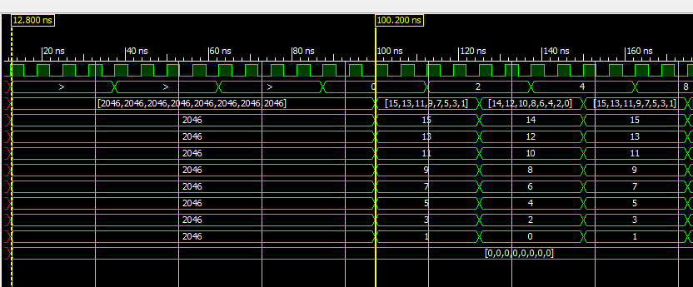
Testing
Firmware behavior has currently only been tested in simulation.. but it verifies OK and compiles comfortably in the Virtex-6.
Next to test on hardware… preliminary firmware exists now, but fixing a few bugs.
  Results soon…
S-bits
Cluster Result

Slide 10
Processing Sequence
S-bits
001110000110
Valid primary flag
000010000010
Priority Encoding Logic
Adr[0]=1, Cnt[0]=1
Adr[1]=7, Cnt[1]=2
Adr[2]=0x7FF, Cnt[2]=xxx
Adr[3]=0x7FF, Cnt[3]=xxx
Adr[4]=0x7FF, Cnt[4]=xxx
Adr[5]=0x7FF, Cnt[5]=xxx
Adr[6]=0x7FF, Cnt[6]=xxx
Adr[7]=0x7FF, Cnt[7]=xxx
S-bits are deserialized into a 1536 bit register.
Cnt[0]=2
Cnt[1]=1
Cnt[2]=0
Cnt[3]=0
Cnt[4]=0
Cnt[5]=0
Cnt[6]=3
Cnt[7]=2
Cnt[8]=1
Cnt[9]=0
Cnt[10]=0
Priority encoding logic returns the counts and addresses of the first 8 clusters in a GEM chamber.
Clusters that are not found are encoded with an invalid address (>1535).
Sizes are do-not-care for an invalid cluster.
A count of the number of consecutive active S-bits is generated for reach trigger pad.
The first pad in each cluster is assigned as a cluster primary.

Slide 11
Priority encoding logic: encoder_mux.v
₁₅₃₆
_{Cnts}
_{Vpfs}
8 addresses
8 cluster sizes
Even encoder
Odd encoder
Vpf==valid primary flag
40MHz Clock
40MHz Clock
The priority encoding logic is based around two identical sub-modules:
  The inputs, received at 40MHz, are alternatingly latched in “even” and “odd” encoders.
  The outputs from the two encoders are multiplexed together, to alternatingly generate the data packets that drive the fiber links.

Slide 12
Priority encoding logic: first8of1536.v
truncate_clusters
Adr[0]
768
Cnts
Vpfs
Adr[1]
1536
Cnts
Vpfs
Adr[2]
Adr[3]
Adr[4]
Adr[5]
priority768
Adr
Cnt
Vpf
Adr[6]
Adr[7]
merge16
8x Adr
8x Cnt
After 8 clock cycles
768
Cnts
Vpfs
truncate_clusters
Adr[8]
Adr[9]
Adr[10]
Adr[11]
Adr[12]
priority768
Adr
Cnt
Vpf
Adr[13]
Adr[14]
Adr[15]
The 1536 bits of valid cluster flags are split into two 768 bit registers.
At every 160Mhz clock cycle, the truncate_clusters module operates on each of the 768 bit register to Zero out the least significant valid cluster flag.
768 bit priority encoders act on each of the two registers, returning the address of the least significant cluster at every clock cycle.

Slide 13
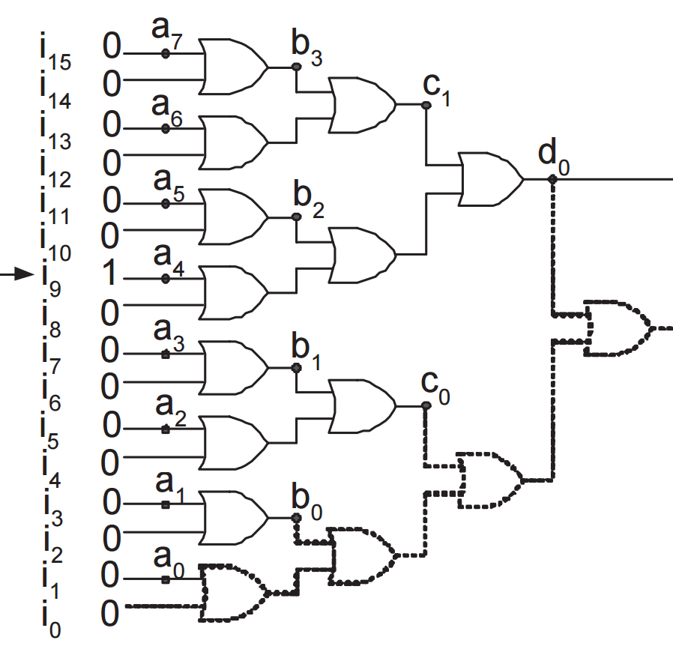
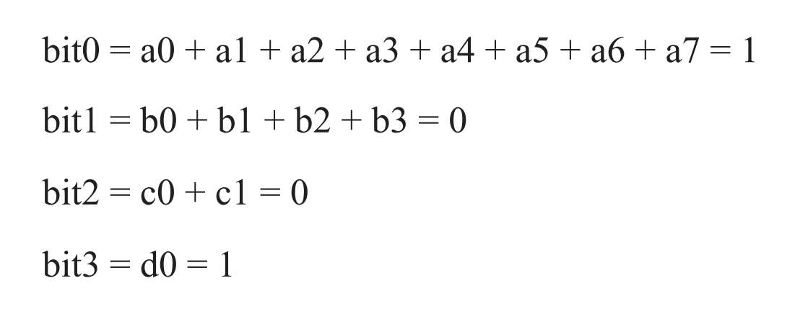
Priority encoding logic: priority768.v
//
// 3-Bit 1-of-9 Priority Encoder
//
(* priority_extract="force" *)
module v_priority_encoder_1 (sel, code);
input [7:0] sel;
output [2:0] code;
reg [2:0] code;
always @(sel)
begin
if (sel[0]) code = 3'b000;
else if (sel[1]) code = 3'b001;
else if (sel[2]) code = 3'b010;
else if (sel[3]) code = 3'b011;
else if (sel[4]) code = 3'b100;
else if (sel[5]) code = 3'b101;
else if (sel[6]) code = 3'b110;
else if (sel[7]) code = 3'b111;
else code = 3'bxxx;
end
endmodule
Simple priority encoders in firmware are very slow for large sizes.
Tree encoder parallelizes the operation, and takes care of the big mux job of extracting the cluster sizes for the returned address.
SLOW ☹
*diagram is not exactly the same as the firmware.. But it gives the right idea

Slide 14
Priority encoding logic: truncate_clusters.v
Priority encoder can return the address of the first non-zero bit… but we need the addresses of the first 8.
Simplest implementation would depend on the first output of the priority encoder to mask the inputs for the 2nd stage.. Depend on the 2nd result to mask the 3rd stage, etc.
  Done serially, there is a large about of logic between subsequent clusters, and severely limits the overall clock speed.
  But… we can parallelize these operations using a neat trick.
    Two’s complement always affects the least-significant non-zero bit.
    Can use this to mask off the least significant 1 in any number without any prior knowledge about the position of the 1:
      let a = 101100100 // our starting number
      ~a = 010011011 // bitwise inversion
      b = ~a+1 = 010011100 // b is just the twos complement of a
      ~b = 101100011 //
      a & b = 000000100 // one hot of first one set
      a &~b = 101100000 // copy of a with the first non-zero bit set to zero. Voila!

Slide 15
Priority encoding logic: truncate_clusters.v (continued)
  This gives us the very happy ability to be able to run the priority encoding logic, and next-stage masking logic in parallel with one another, rather than in series.
  With this trick, we can run the priority encoders at 160 MHz. Because it is based on adders, this code natively uses the FPGA’s fast-carry chain.
  | clock | | valid cluster flip-flop | priority encoder output |
  |-------+---------------------+----------------------------------+-------------------------|
  | 0 | new cluster latched | 10001000010001000010000100010001 | |
  | 1 | cluster-1 | 10001000010001000010000100010000 | adr=0 |
  | 2 | cluster-2 | 10001000010001000010000100000000 | adr=4 |
  | 3 | cluster-3 | 10001000010001000010000000000000 | adr=8 |
  | 4 | cluster-4 | 10001000010001000000000000000000 | adr=13 |
  | 5 | cluster-5 | 10001000010000000000000000000000 | adr=18 |
  | 6 | cluster-6 | 10001000000000000000000000000000 | adr=22 |
  | 7 | cluster-7 | 10000000000000000000000000000000 | adr=27 |
  | 8 | new cluster latched | 00000000000000010010000100000000 | adr=31 |
  | 9 | cluster-1 | 00000000000000010010000000000000 | adr=8 |
A simple example which shows the behavior of this module acting on a 32-bit register.
The priority encoder output is latent behind the cluster truncator, but the truncator is able to continue operating independently.

Slide 16
Priority encoding logic: truncate_clusters.v (continued)
This let’s us run faster… but 768 bit arithmetic is still slow (compared to what we want). But we can do better..
  Further subdivide the register into a number of “segments”
  A truncated version of each segment is generated quickly using this trick.
  The truncated, and untruncated versions of the segments are multiplexed back together, depending on whether there are S-bits in any preceding segment.
  Runs comfortably at 160MHz
Segment
1001000
Segment (truncated)
100000
flip-flop
Priority encoder
Preceeding segments have S-bits ?

Slide 17
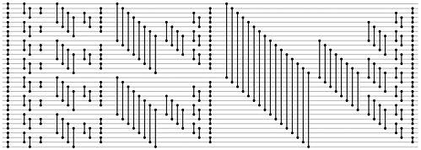
Priority encoding logic: merge16.v
Merge16 sorts the two lists of 8 addresses and returns the address and size of the first 8 clusters from the two.
Takes advantage of the fact that the two lists are already sorted independently, and performs half of a mergesort to produce the final list of 8 quickly (~10ns).
Addition of this final merge step is what allows splitting the 1536 bit input into two halves, which greatly improves the timing performance of the module.
The details..
Midway through a Betcher mergesort, the list can be divided into two sorted halves.
The second stage of the mergesort (i.e. the merge) merges the two sorted lists into one sorted list.
The implementation of this logic on
FPGA is both fast and fairly small
  (parallelized sorting)

