Slide 1
A Wall Current Transformer for bunch-by-bunch intensity measurements in the LHC
Michal Krupa
10/03/2016

Slide 2
Outline
Bunch-by-bunch intensity measurements
in the LHC
Wall Current Transformer design and installation
Laboratory and beam measurements
Summary

Slide 3
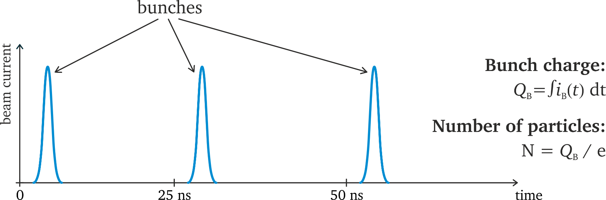
Bunches in the LHC
Typical LHC values:
Bunch intensity: 5·10⁹ – 1.5·10¹¹ particles
Bunch length: 1 - 2 ns
Bunch spacing: 25 ns

Slide 4
From FBCT to ICT / WCT
Run 1: Fast Beam Current Transformers (FBCT) used for bunch-by-bunch intensity measurements in the LHC. Sensitivity to the transverse beam position and bunch length.
LS1: Design of new monitors for absolute bunch-by-bunch intensity measurements. Two developments in parallel:
  Integrating Current Transformer (ICT) by Bergoz
  Wall Current Transformer (WCT) by CERN
2015: Commissioning of ICT and WCT
2016: Installation of two WCTs as the operational system

Slide 5
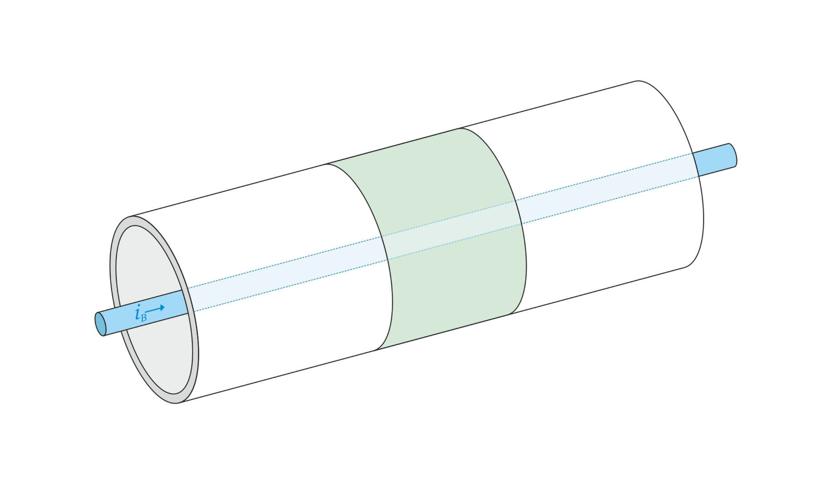
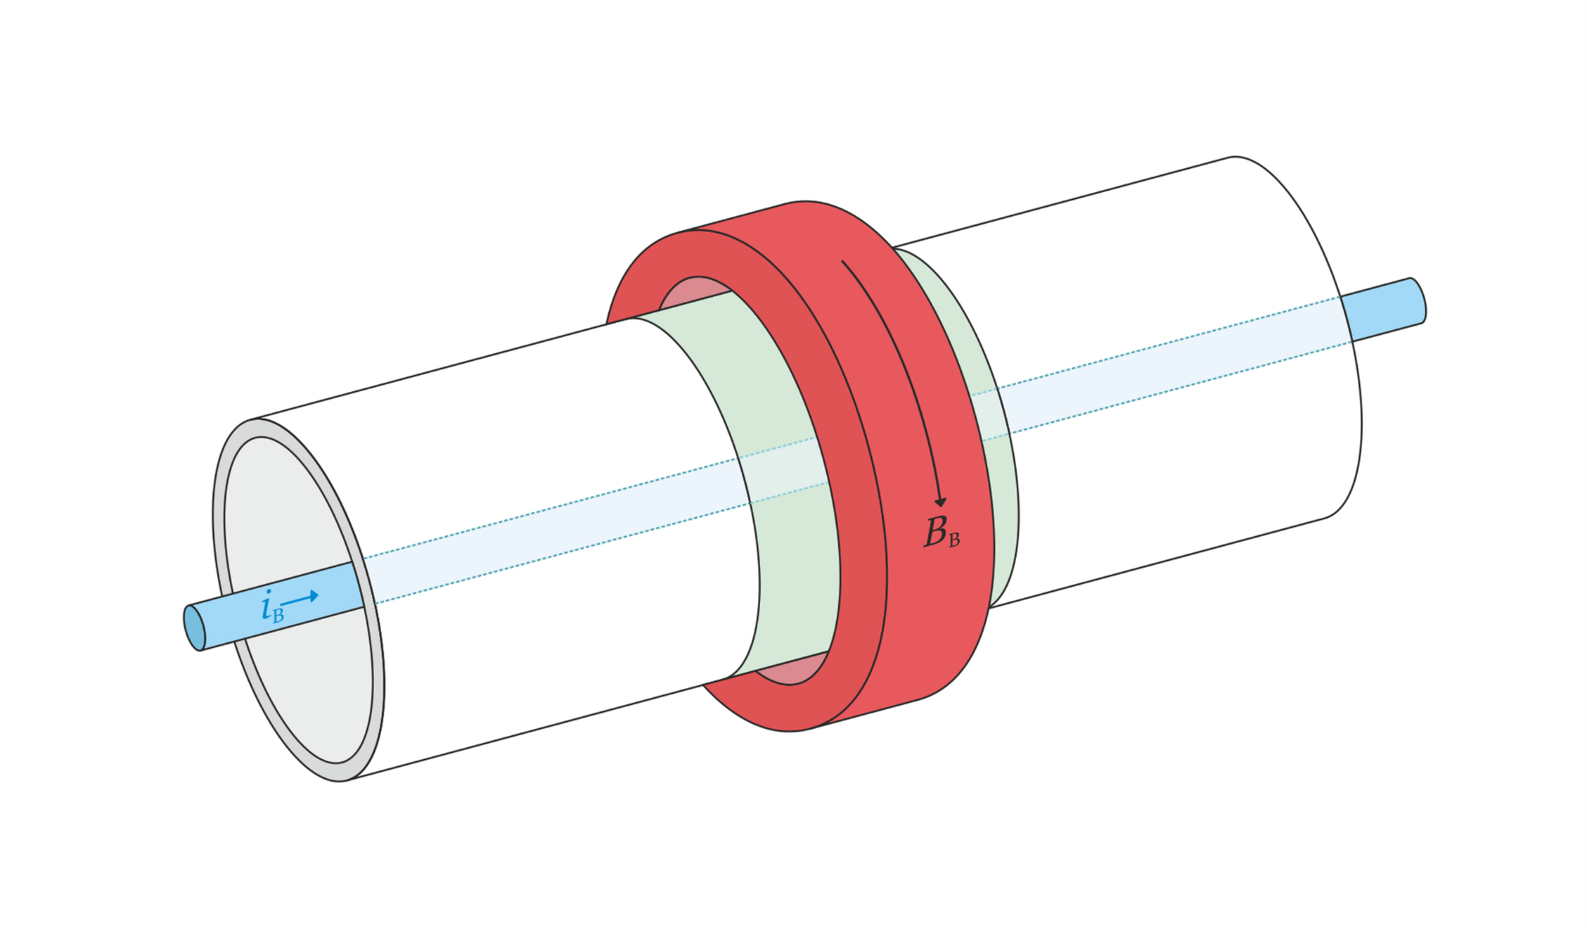
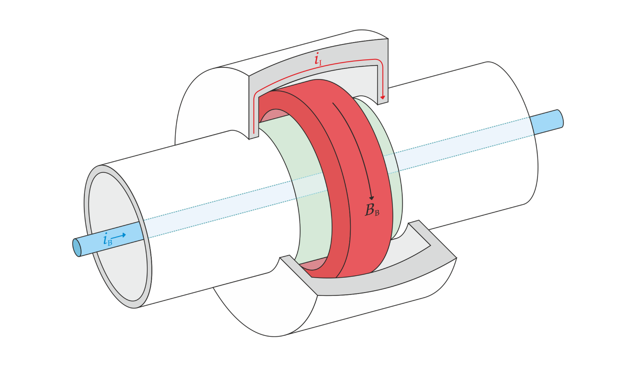
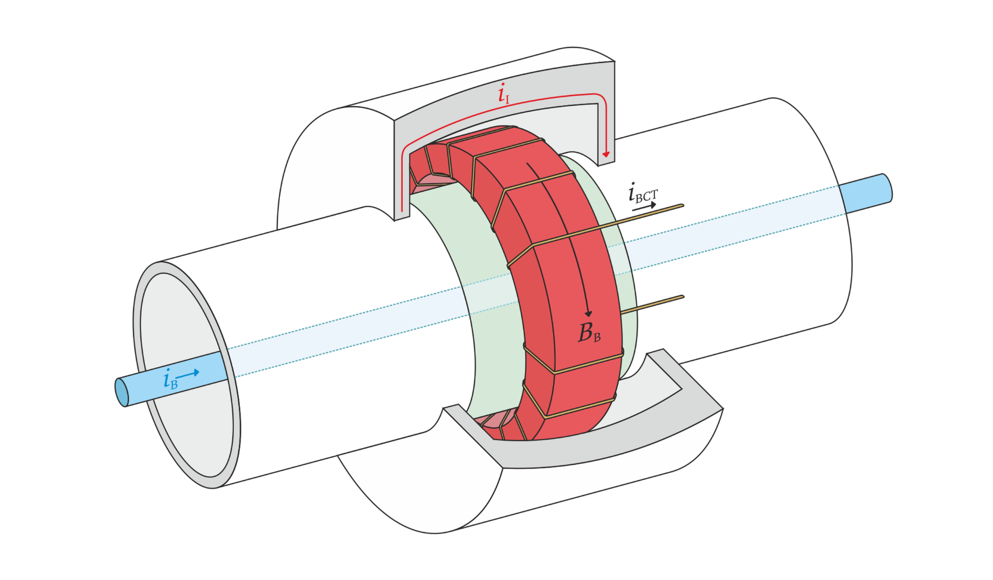
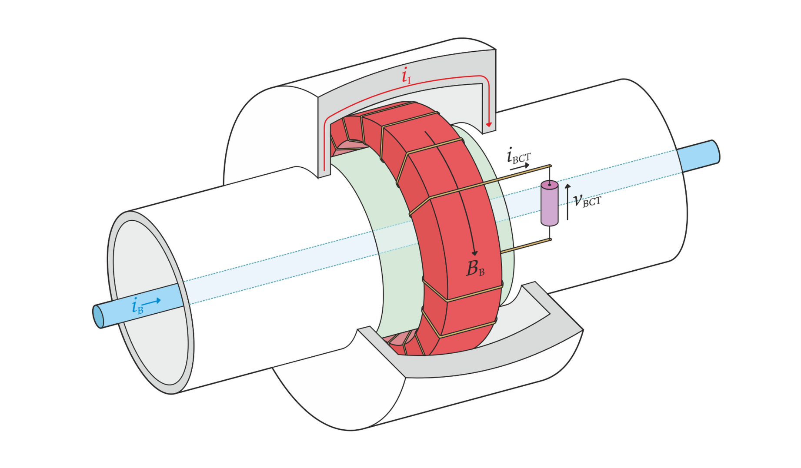
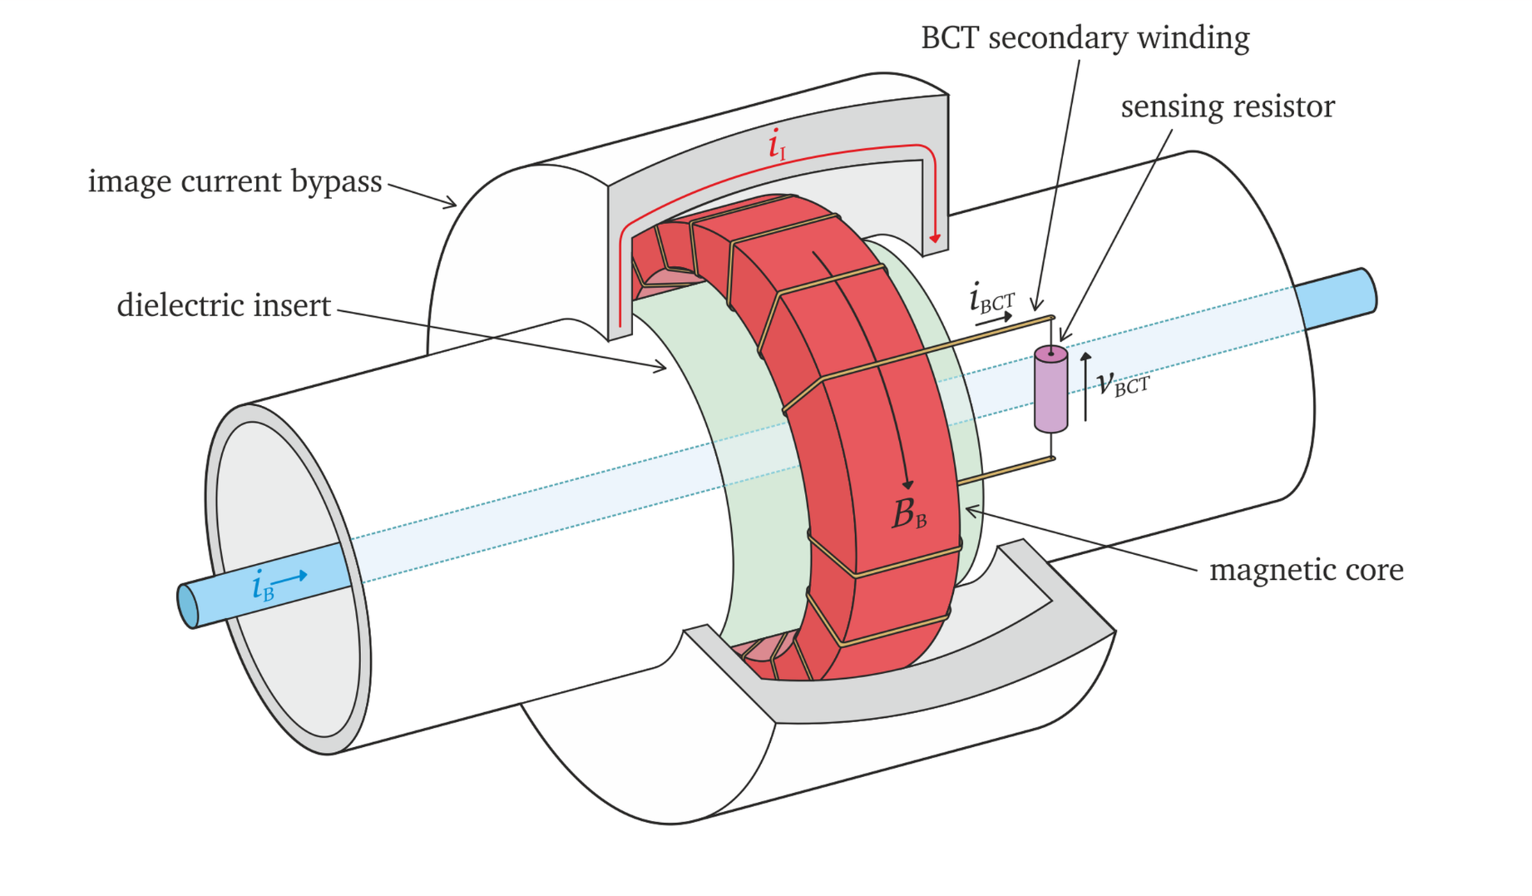
FBCT principle of operation

Slide 6
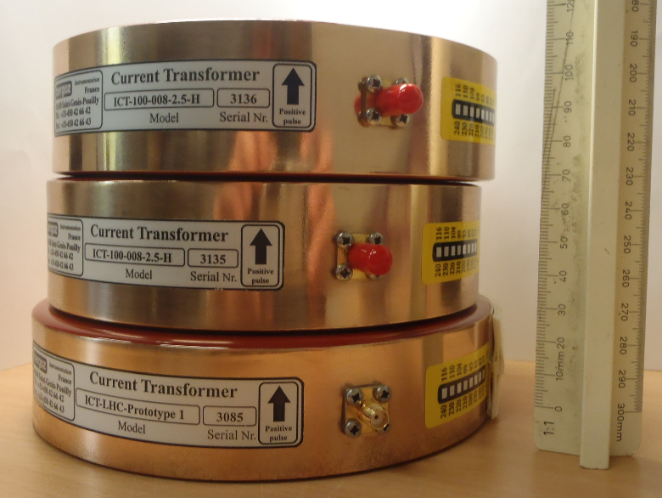

Bergoz ICT
Commercially available toroid compatible with the existing LHC FBCT mechanics and cooling system

Slide 7
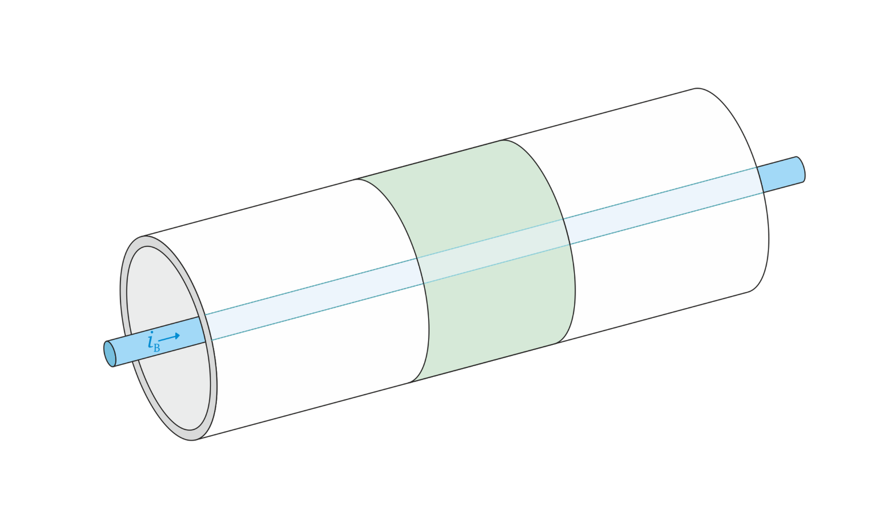
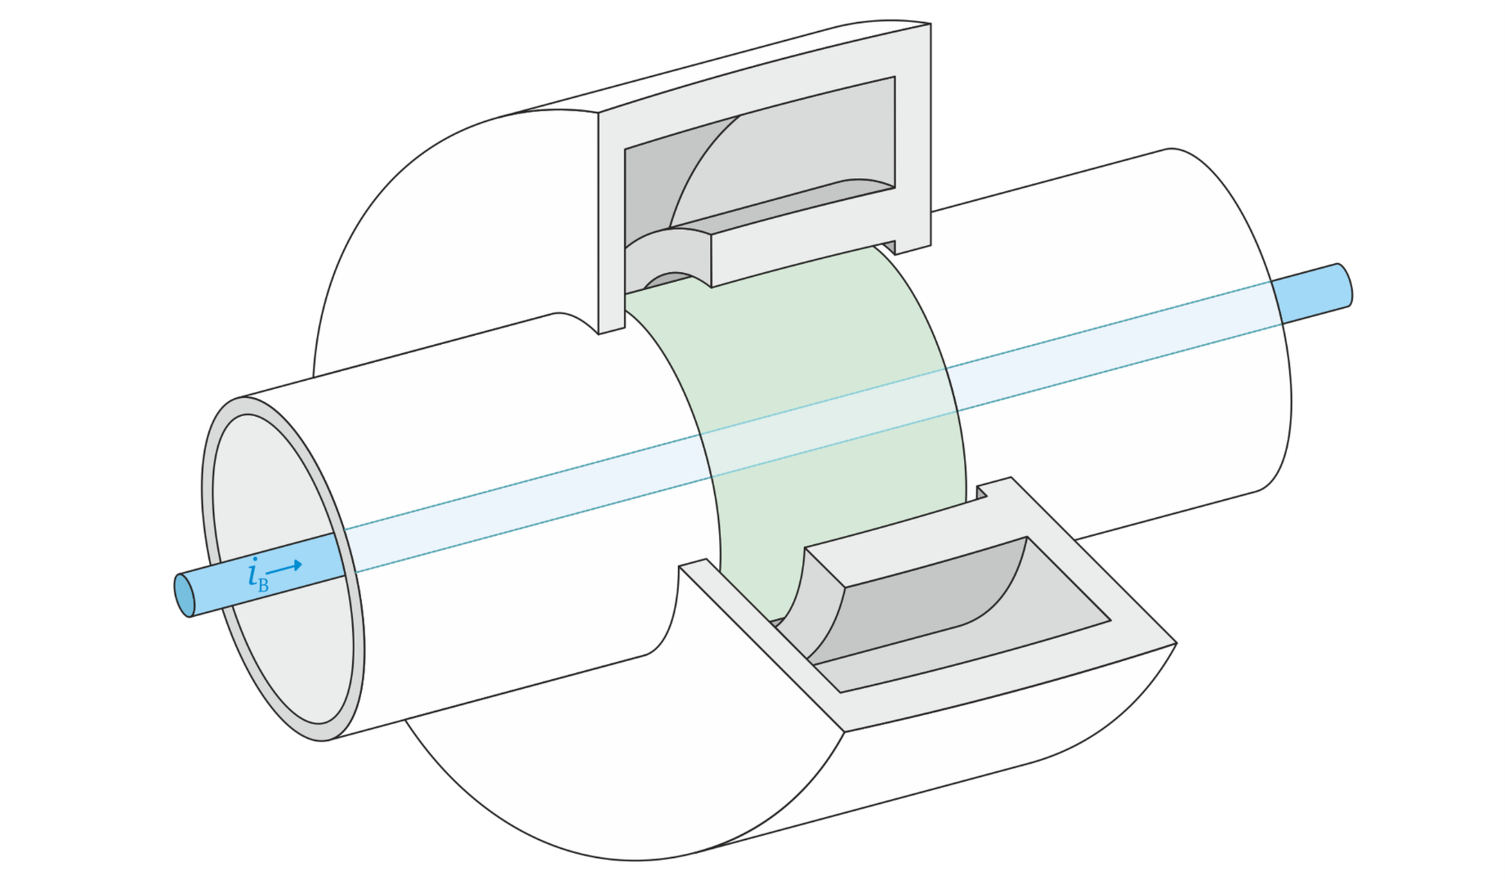
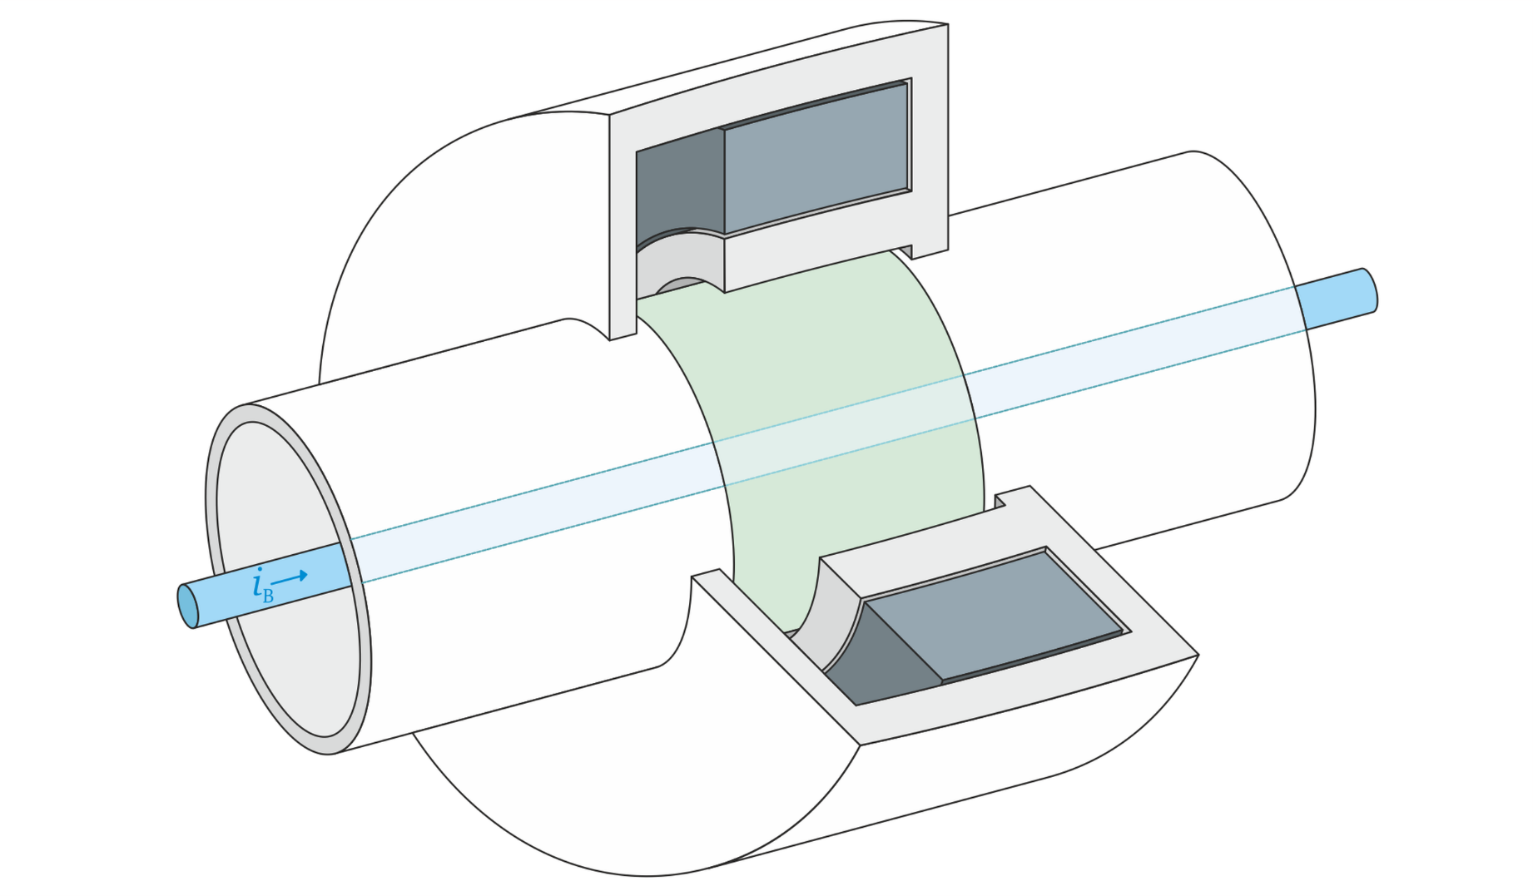
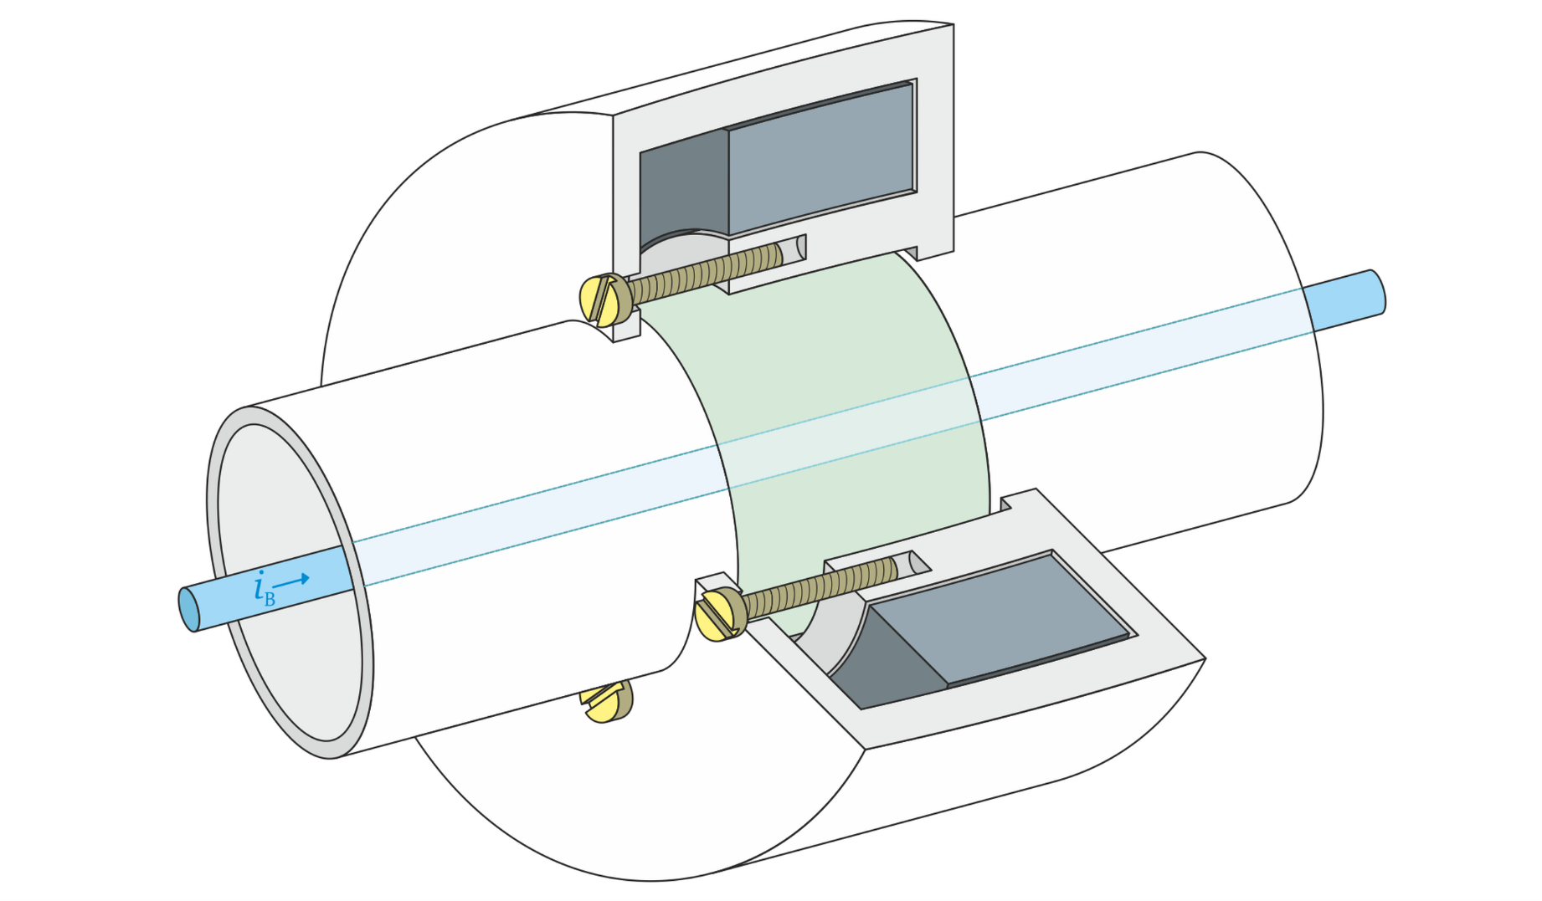
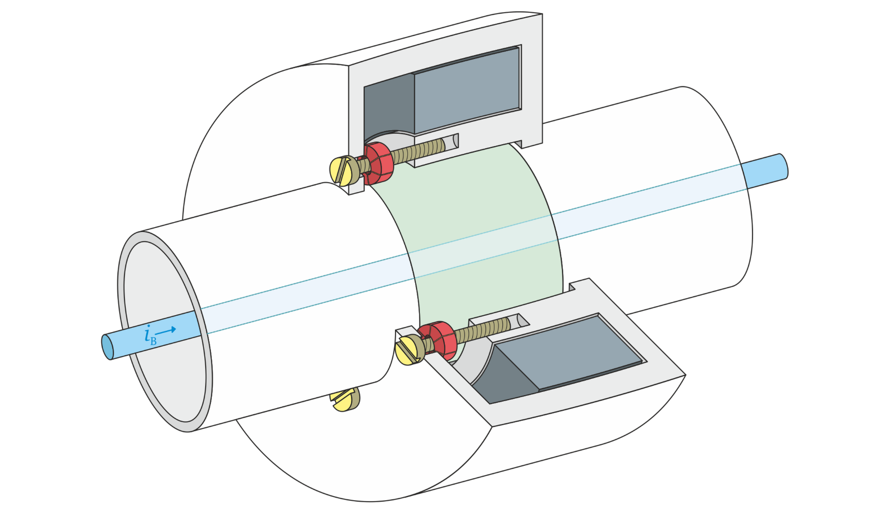
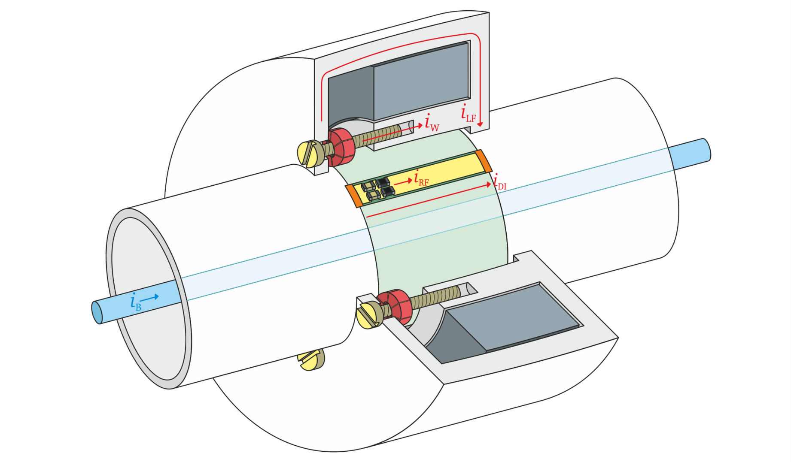
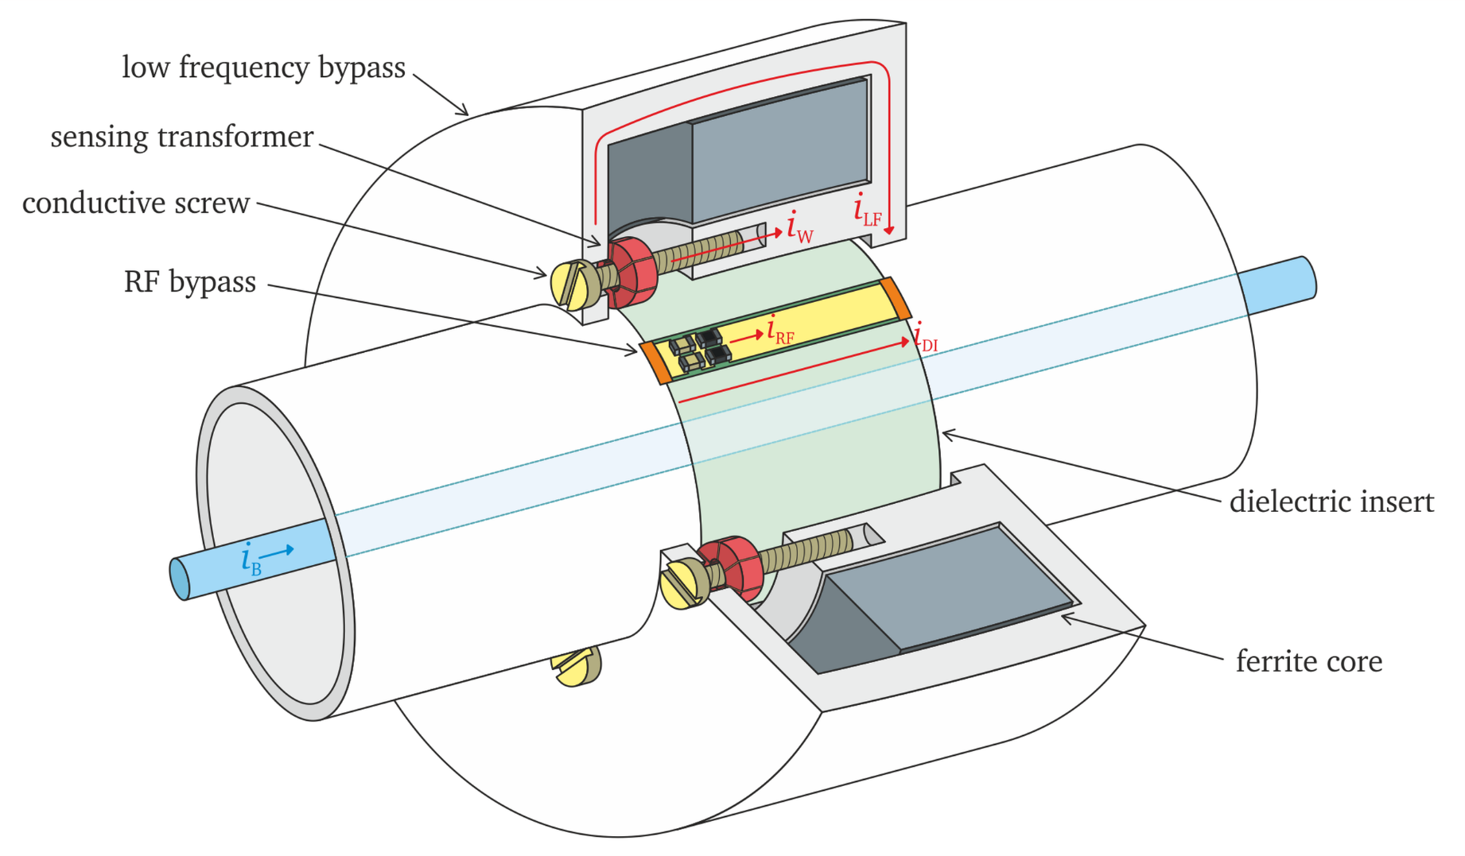
WCT principle of operation

Slide 8
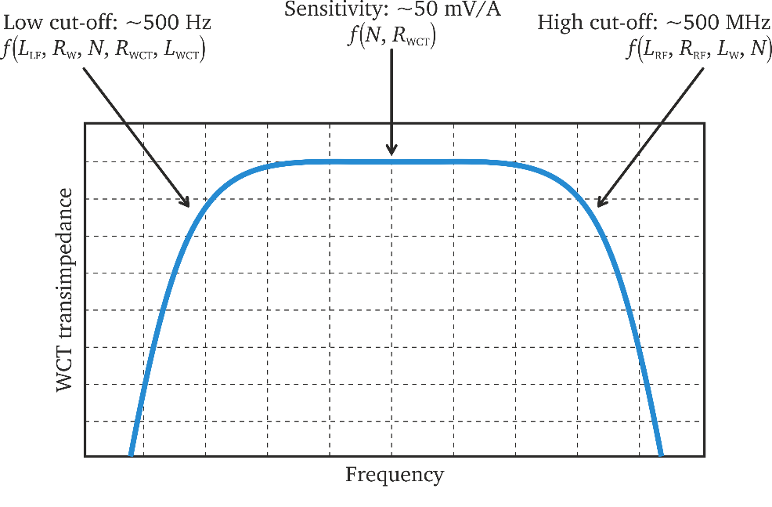
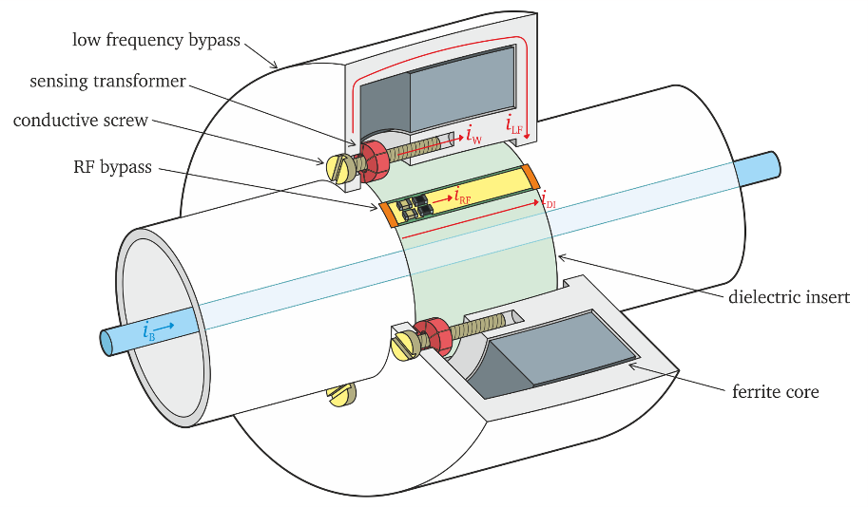
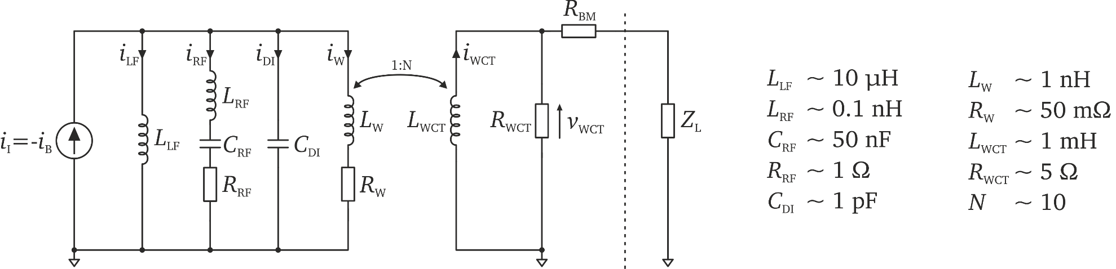
WCT principle of operation

Slide 9
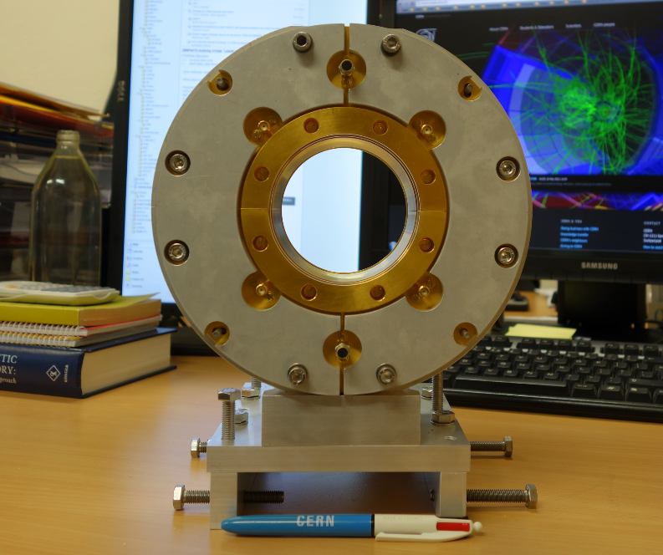
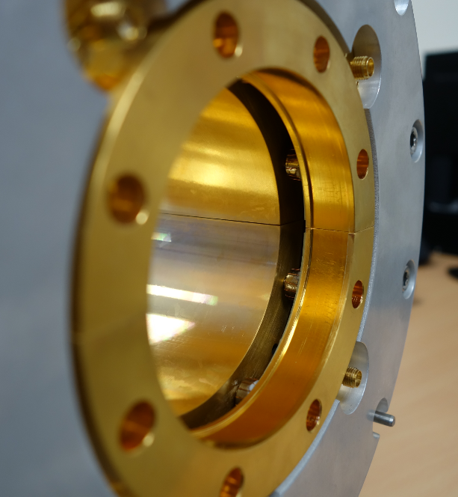
WCT design
All parts cut in half – installation and removal does not require breaking the accelerator vacuum

Slide 10
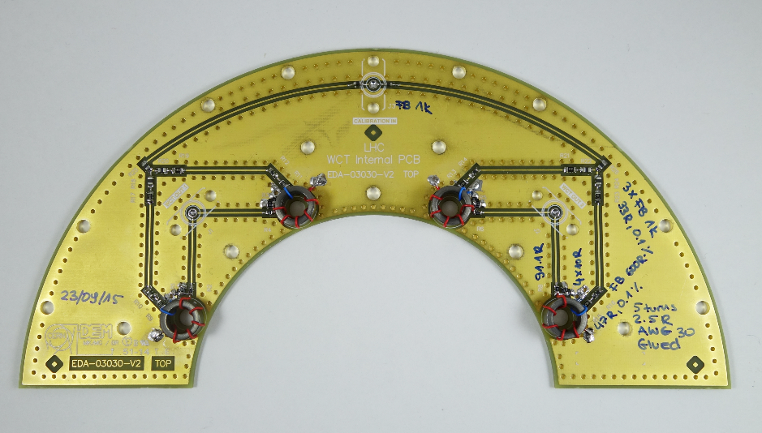
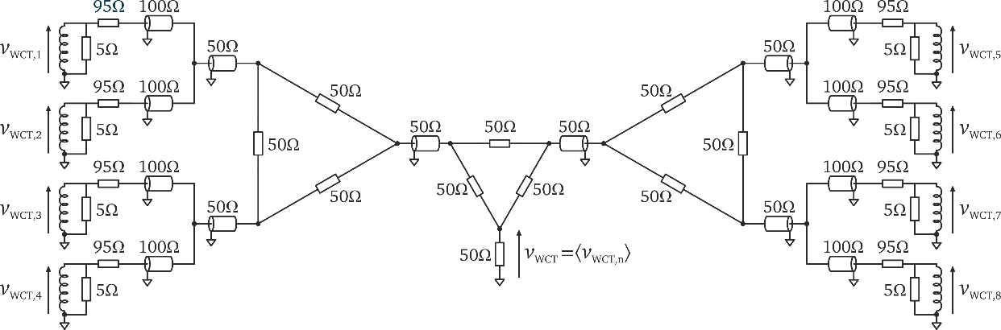
WCT design
Calibration winding:
- single turn
- calibration with current
- low resistance at low frequencies (minimising power dissipation)
- high impedance at high frequencies (decoupling from beam)
Signal winding:
- few turns
- low impedance
- averaging two nearest transformers on the PCB
Signal addition:
the four outputs are passively summed (averaged) outside, but close to, the monitor

Slide 11
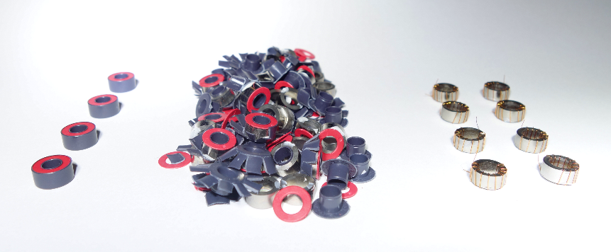
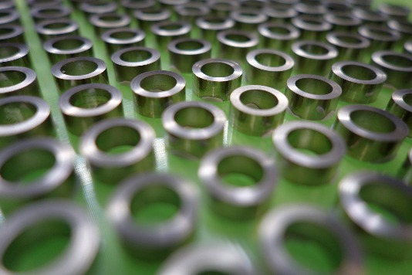
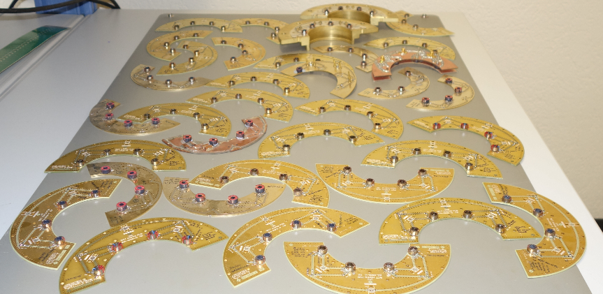
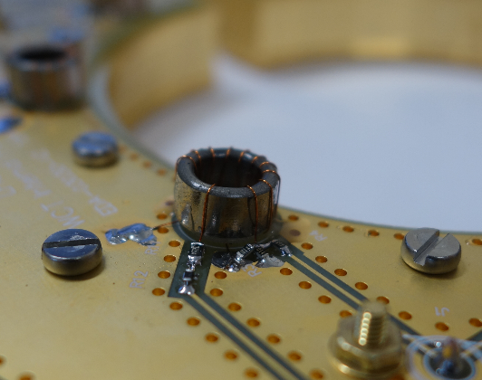
Magnetic cores

Slide 12
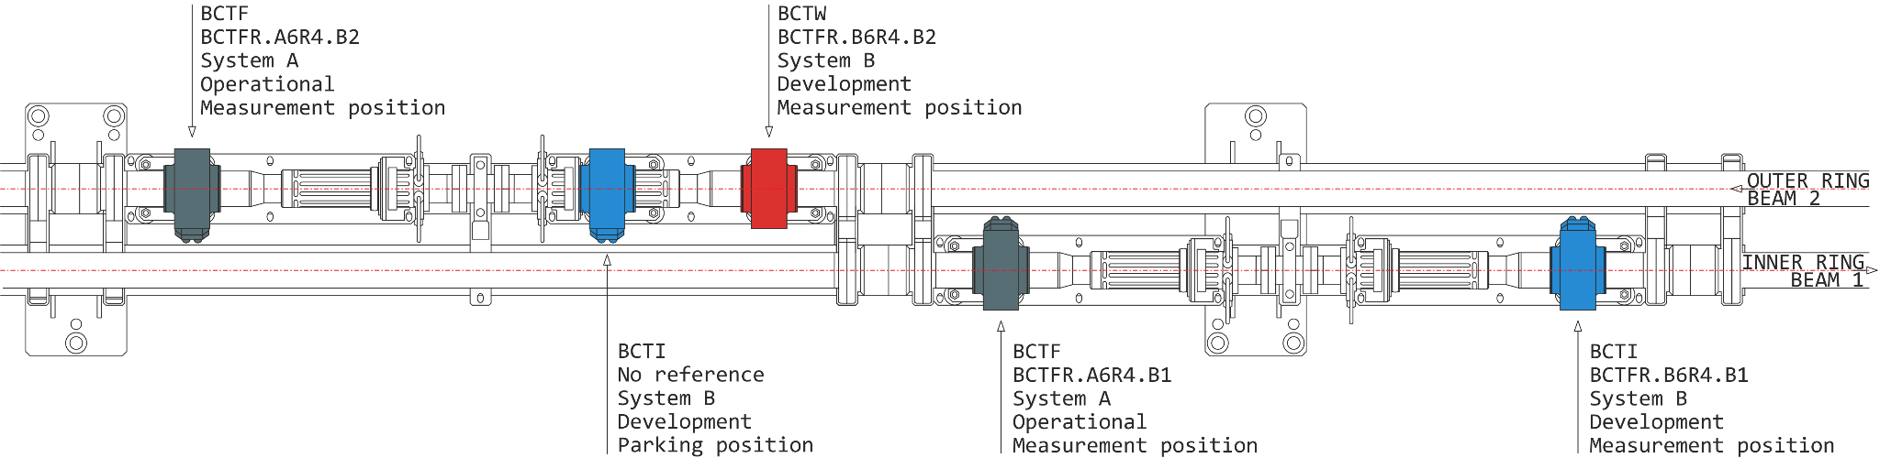
LHC Point 4 installation in 2015
System A (operational): no change during LS1
System B (development): two new monitors (WCT + ICT), digital acquisition in parallel to DABs

Slide 13
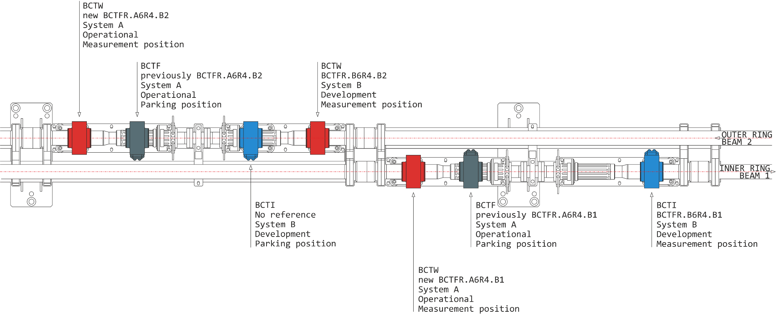
LHC Point 4 installation in 2016
System A (operational): two new WCTs installed during YETS 2015/2016 to be commissioned in 2016

Slide 14
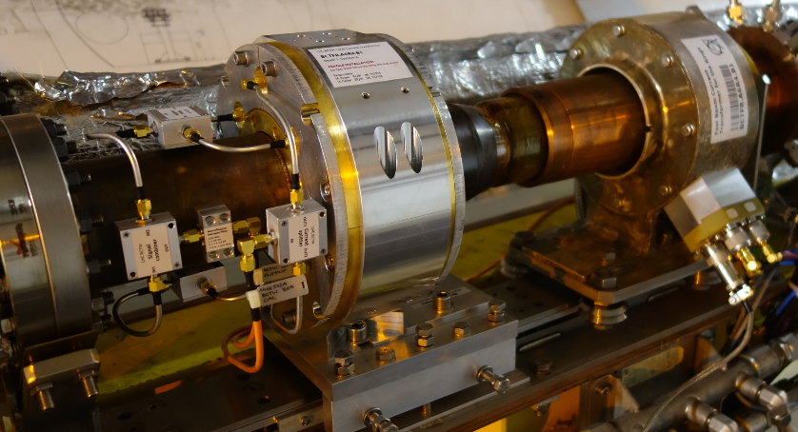
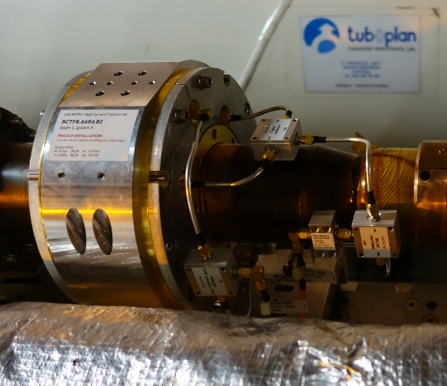
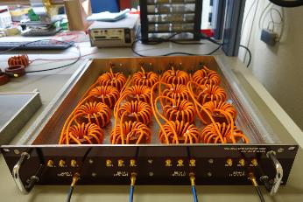
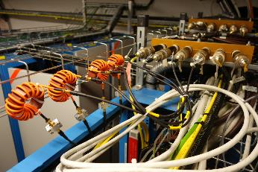
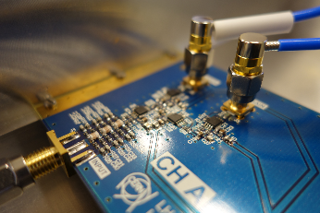
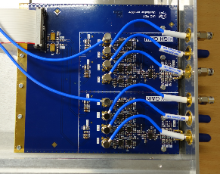
LHC WCT installation
Design launched: 01/10/2013 First installation in the LHC: 02/03/2015

Slide 15
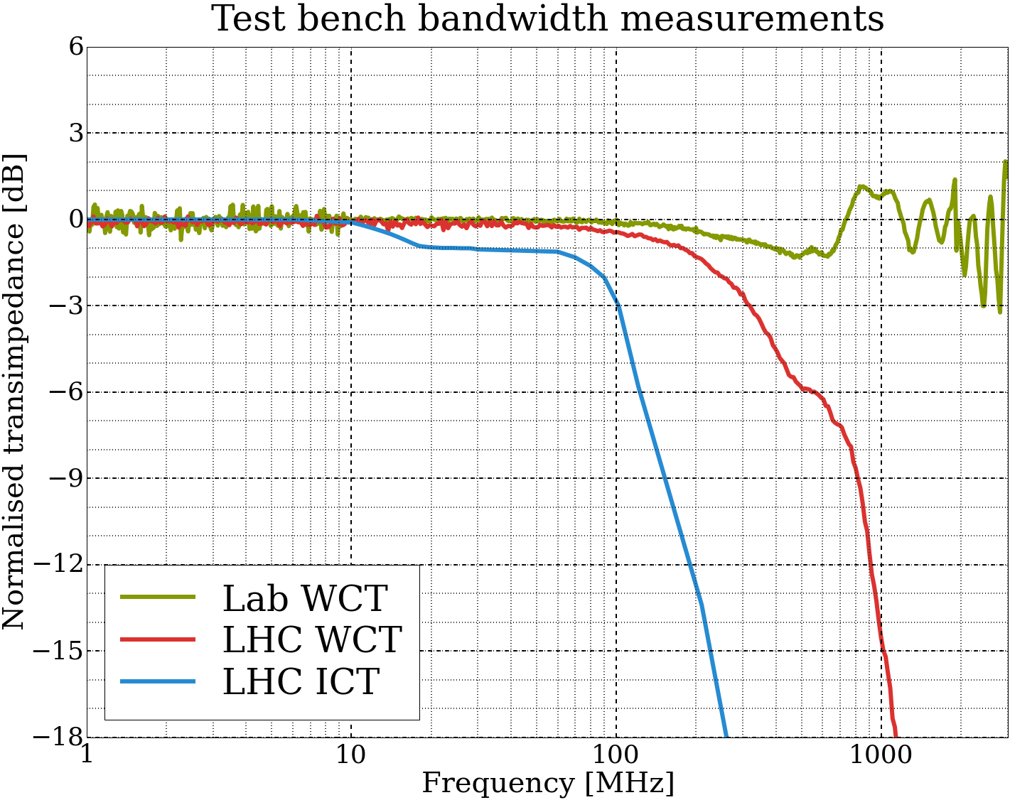
Bandwidth
Lab WCT:
- work in progress
- RF bypass
- 1.1 GHz filter
- low cut-off: 500 Hz
LHC WCT:
- RF bypass
- 400 MHz filter
- low cut-off: 500 Hz
LHC ICT:
- no filter
- low cut-off: 600 Hz
Test bench not very reliable above 1 GHz

Slide 16
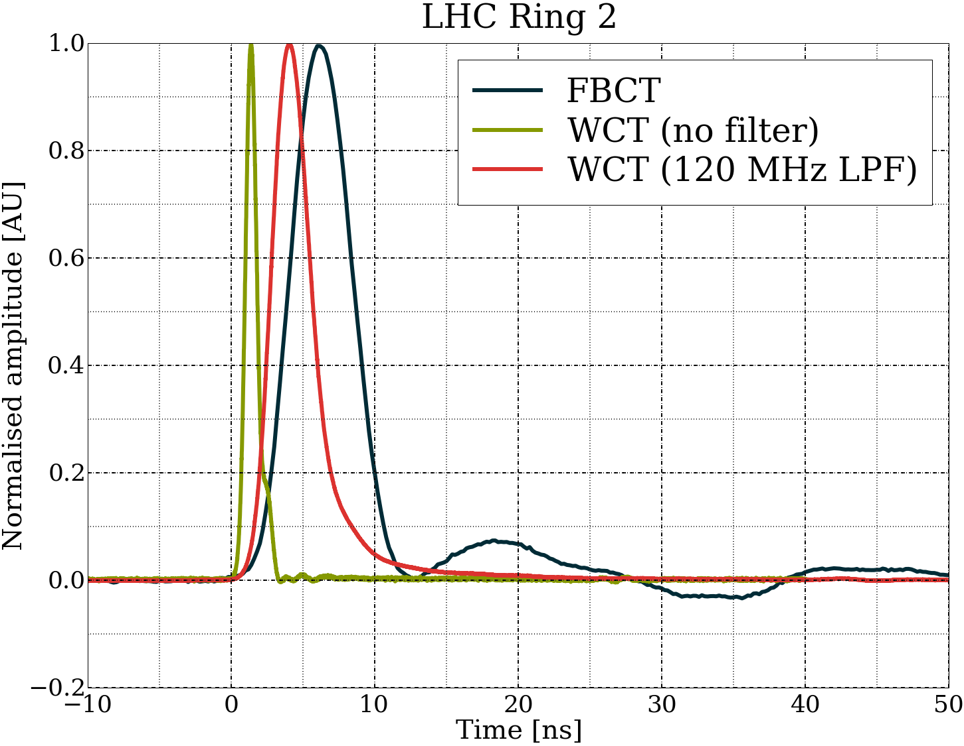
FBCT / WCT nominal bunch

Slide 17
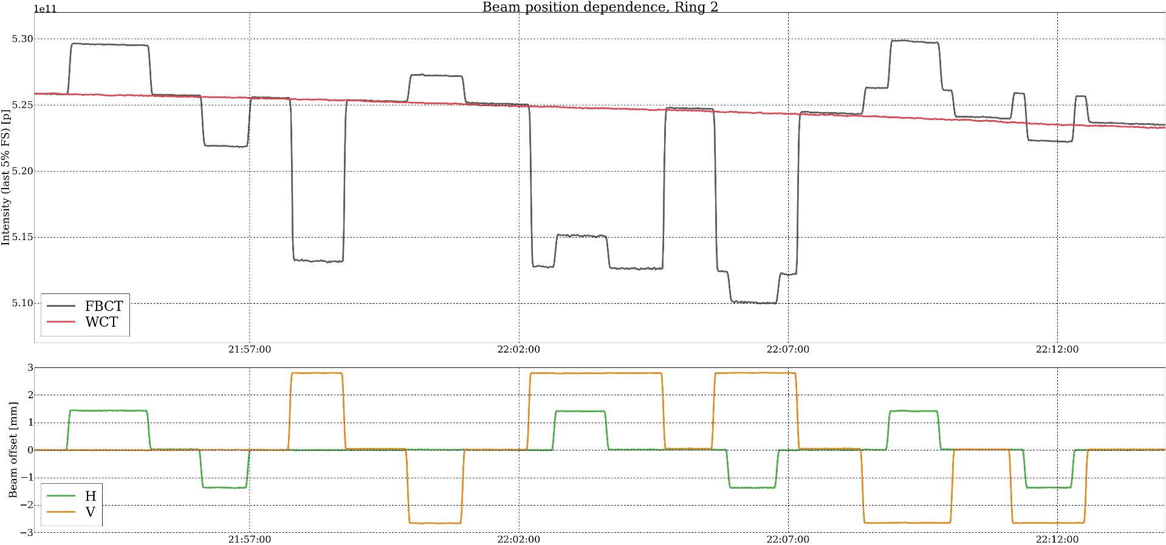
Bunch position sensitivity MD
Dedicated MD on 20/07/2015
FBCT ΔI/I ≈ (0.3 – 0.7)% / mm | WCT ΔI/I < 0.001% / mm Not measurable

Slide 18
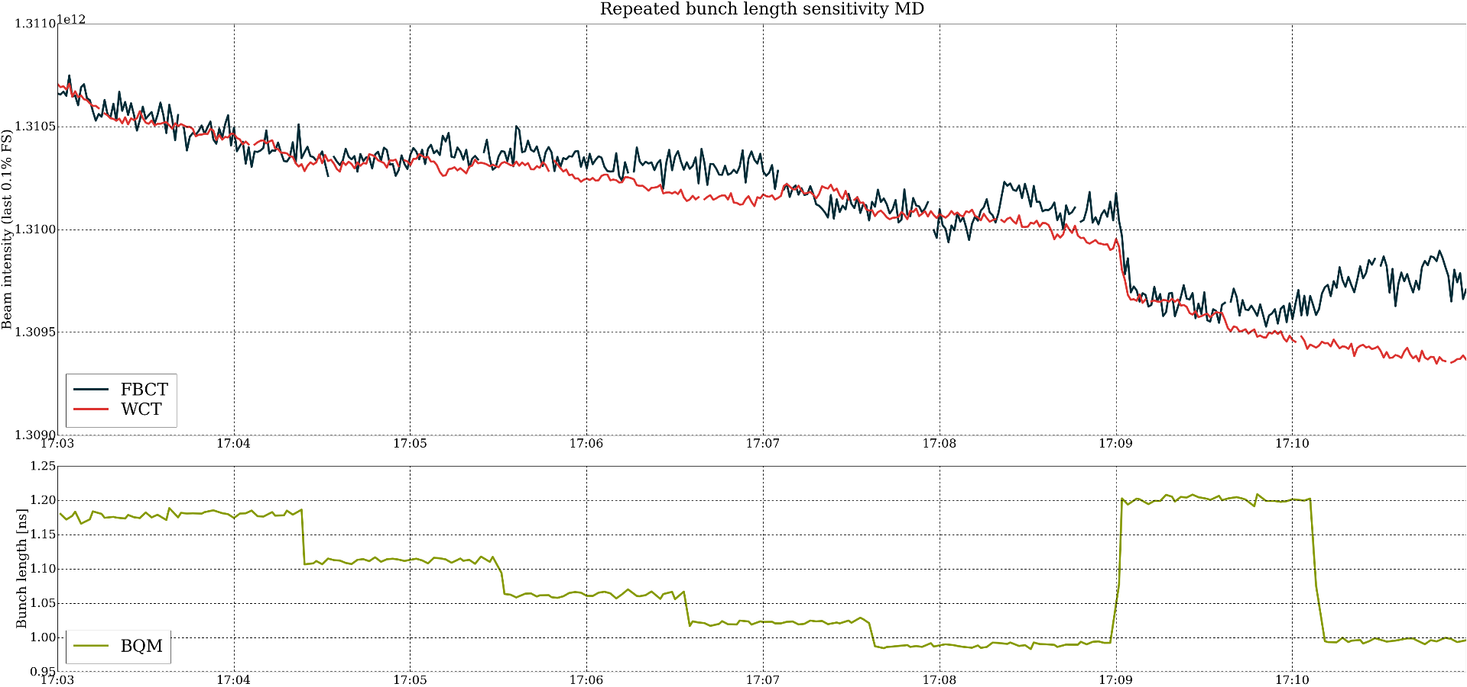
Bunch length sensitivity MD
Ad-hoc MD on 22/09/2015
FBCT ΔI/I < 0.2% / ns | WCT ΔI/I < 0.2% / ns

Slide 19
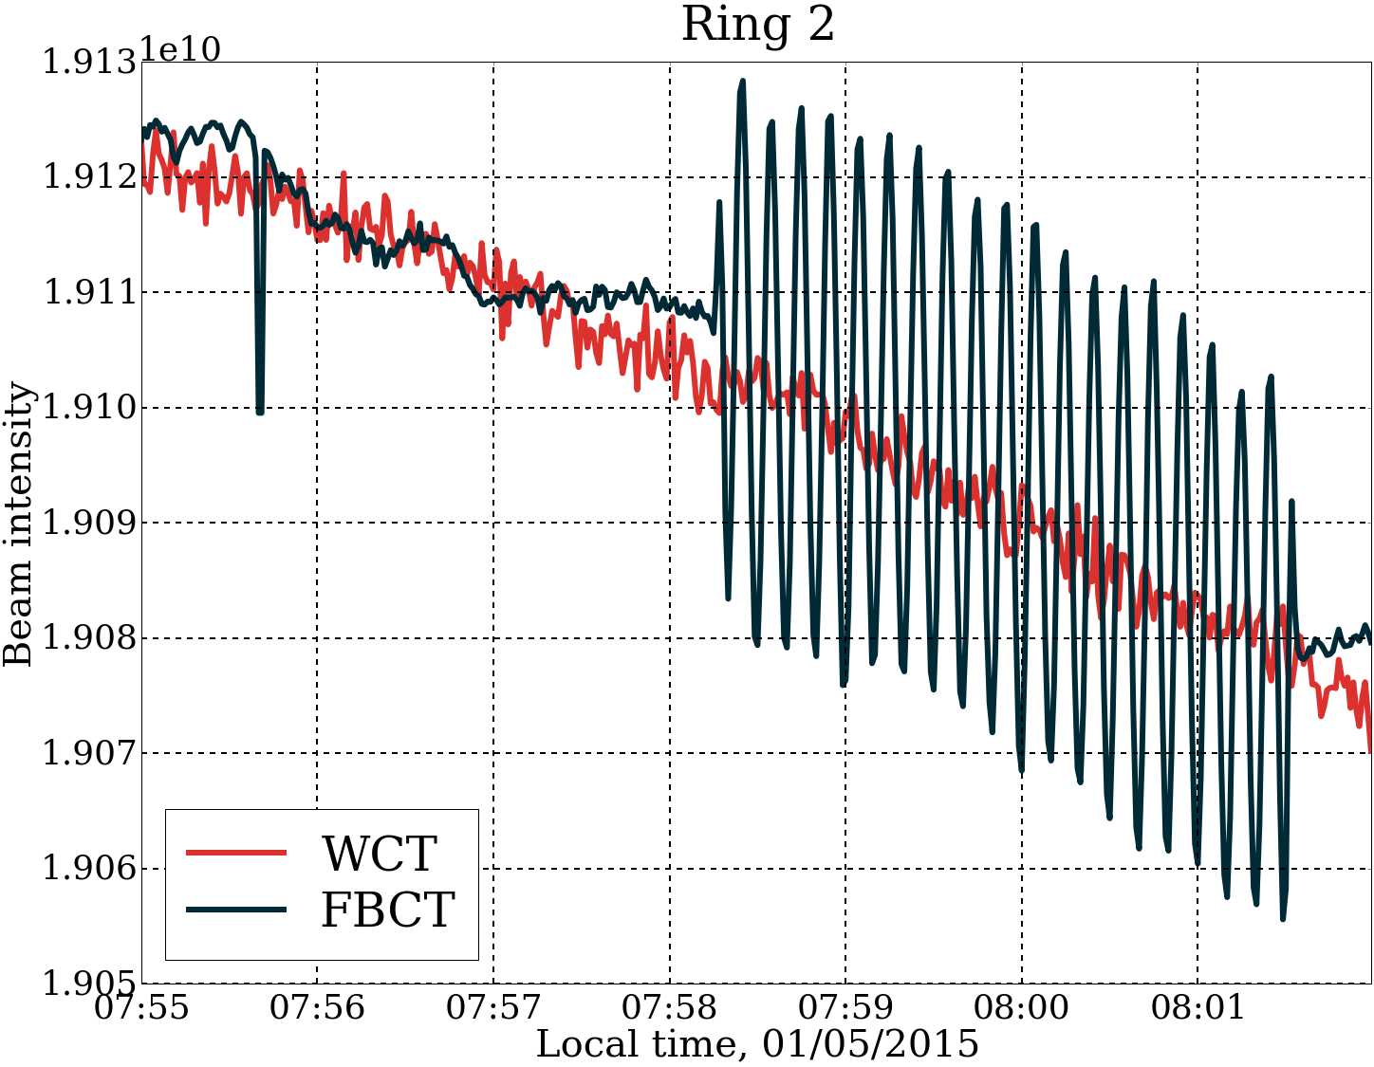
Radial modulation
Chromaticity measurement by modulation of the RF frequency.
LHC fill: 3670
01/05/2015
Post LS1 commissioning
WCT was rescaled to overlap
with the FBCT

Slide 20
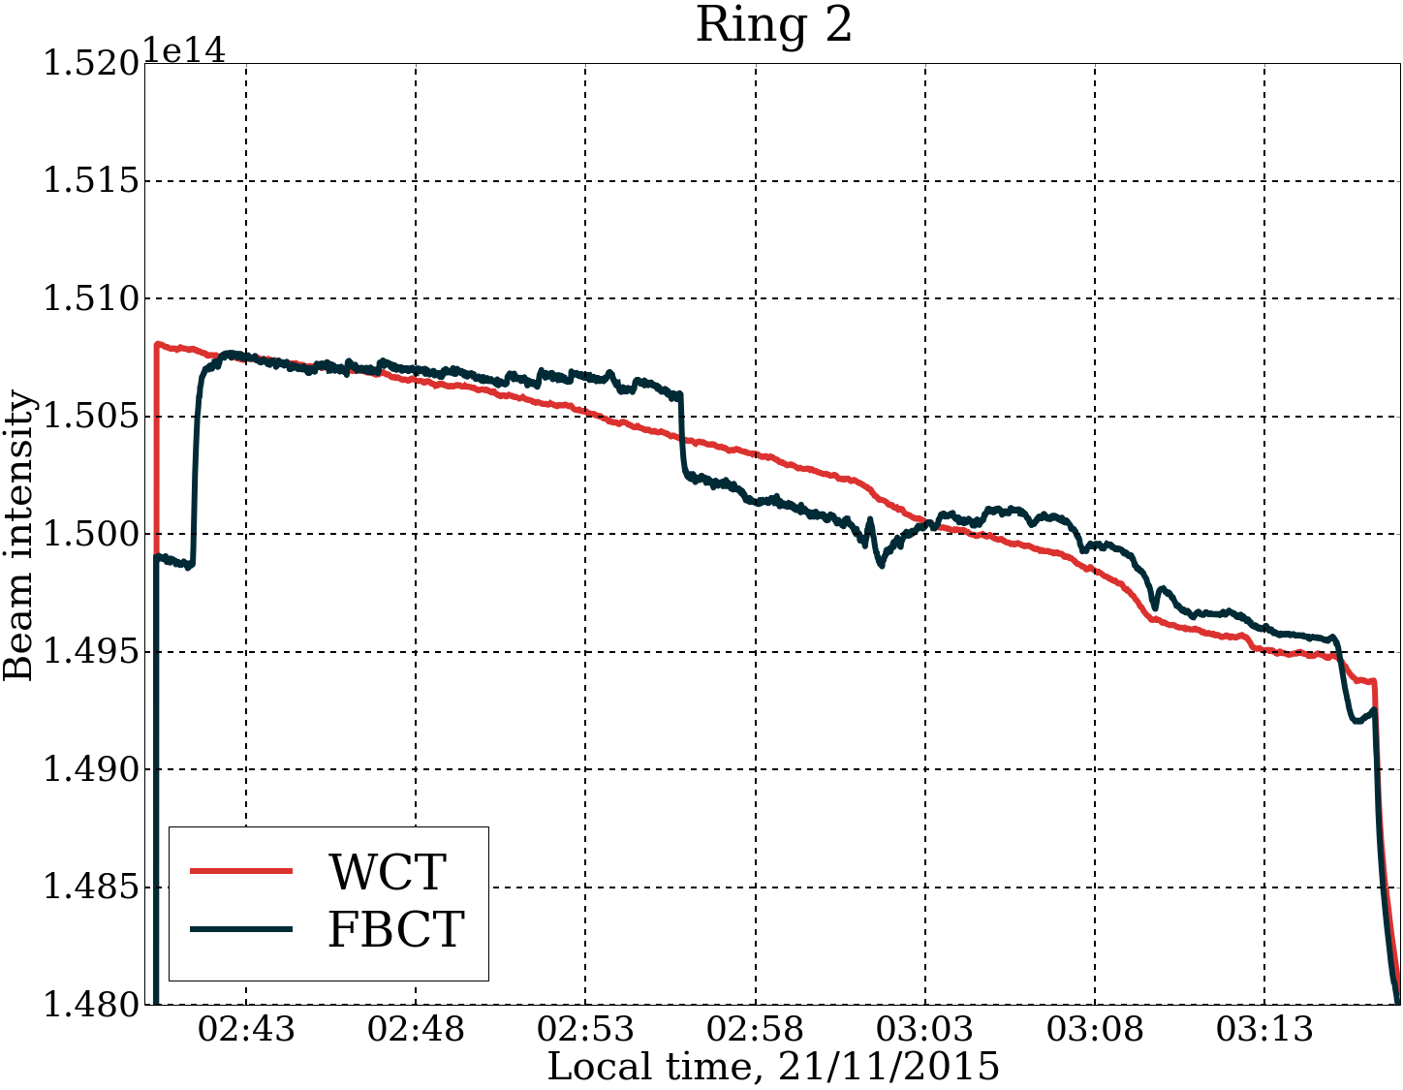
Orbit correction
LHC fill: 4640
21/05/2015
Proton physics
WCT was rescaled to overlap
with the FBCT

Slide 21
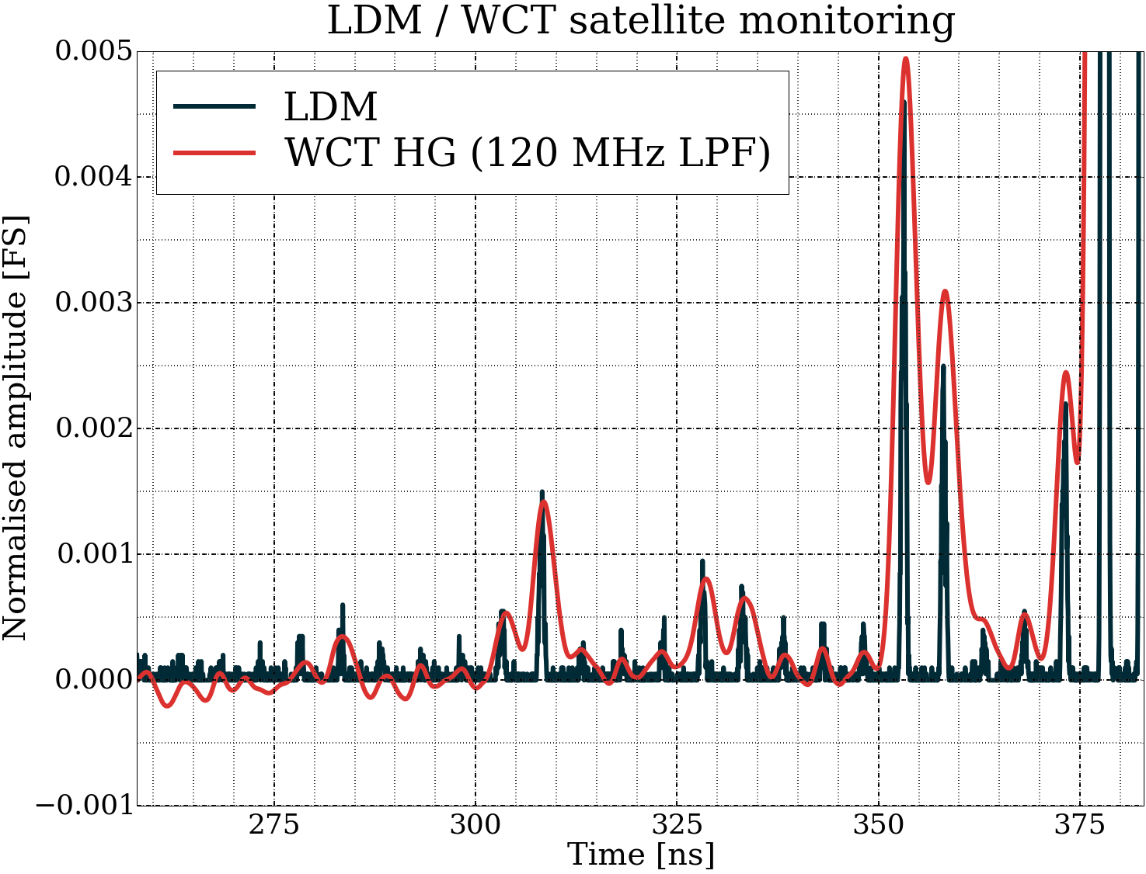
Satellite and ghost bunches
LDM:
single photon counting over 3 million turns
(5 min)
WCT:
averaging on a 12-bit oscilloscope over 500 turns (50 ms)
LHC fill: 4569
03/11/2015
Stable beams

Slide 22
Summary
During 2015 performance of the first prototype WCT was evaluated with the LHC beams
The WCT was shown to be insensitive to beam position and bunch length variations
The WCT output pulse is shorter than the output pulse of the FBCT – measurements are easier
During YETS 2015/2016 the two operational
FBCTs were replaced with the WCTs
The new WCTs are waiting for commissioning
with beam

Slide 23
Thanks for the attention
Questions?
Special thanks to:
M. Gasior and S. Bart Pedersen, D. Belohrad, N. Chritin, F. Guillot-Vignot, J. Kral, T. Lefevre, P. Odier, L. Soby, BI Day organisation

Slide 24
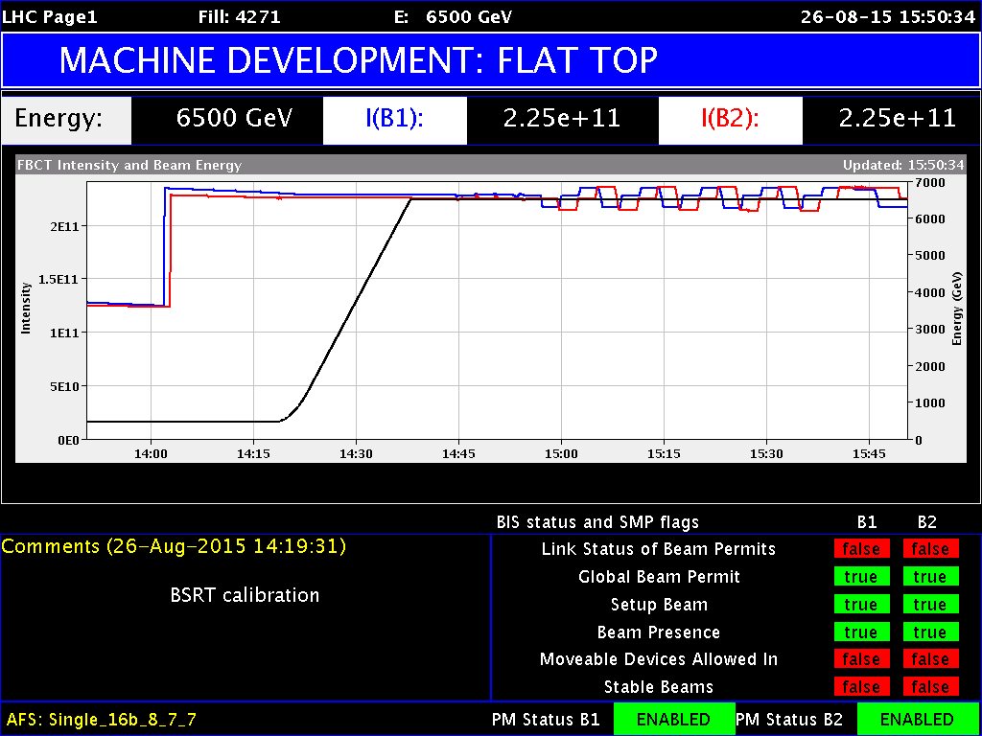
BSRT calibration

Slide 25
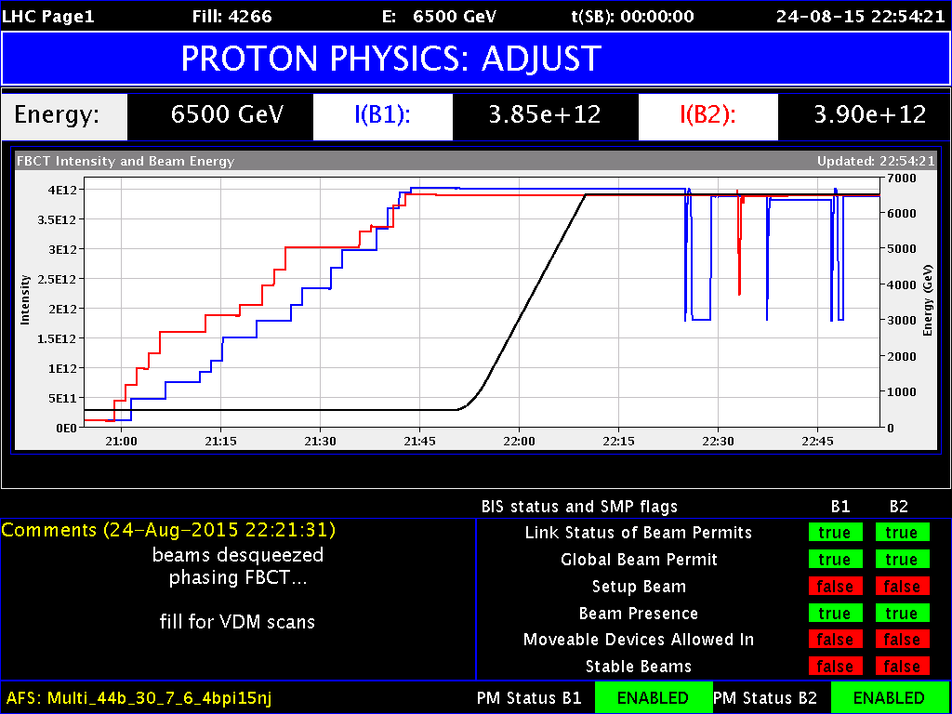
FBCT phasing

Slide 26
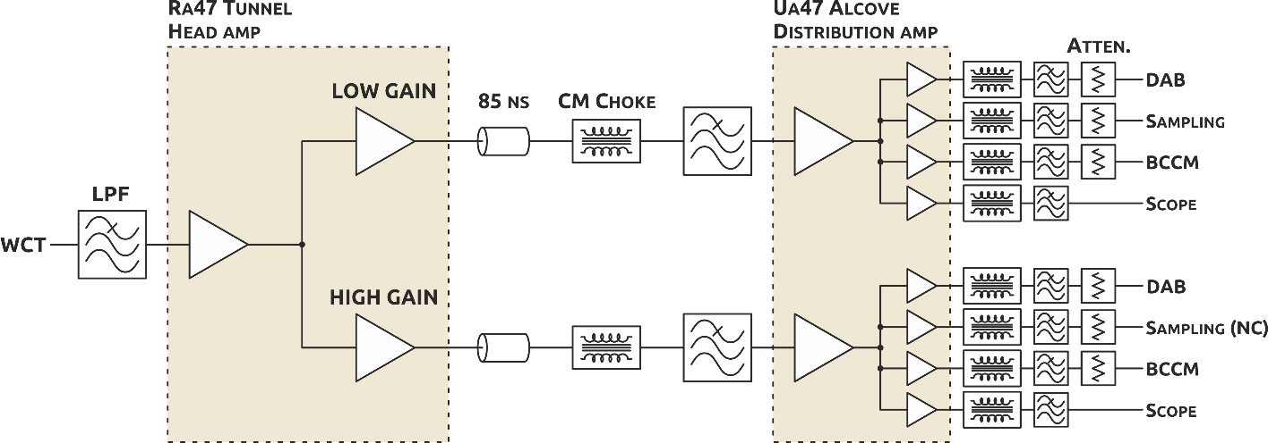
LHC WCT installation
Active splitting – no cross-channel reflections
Different gain and bandwidth for each channel

Slide 27
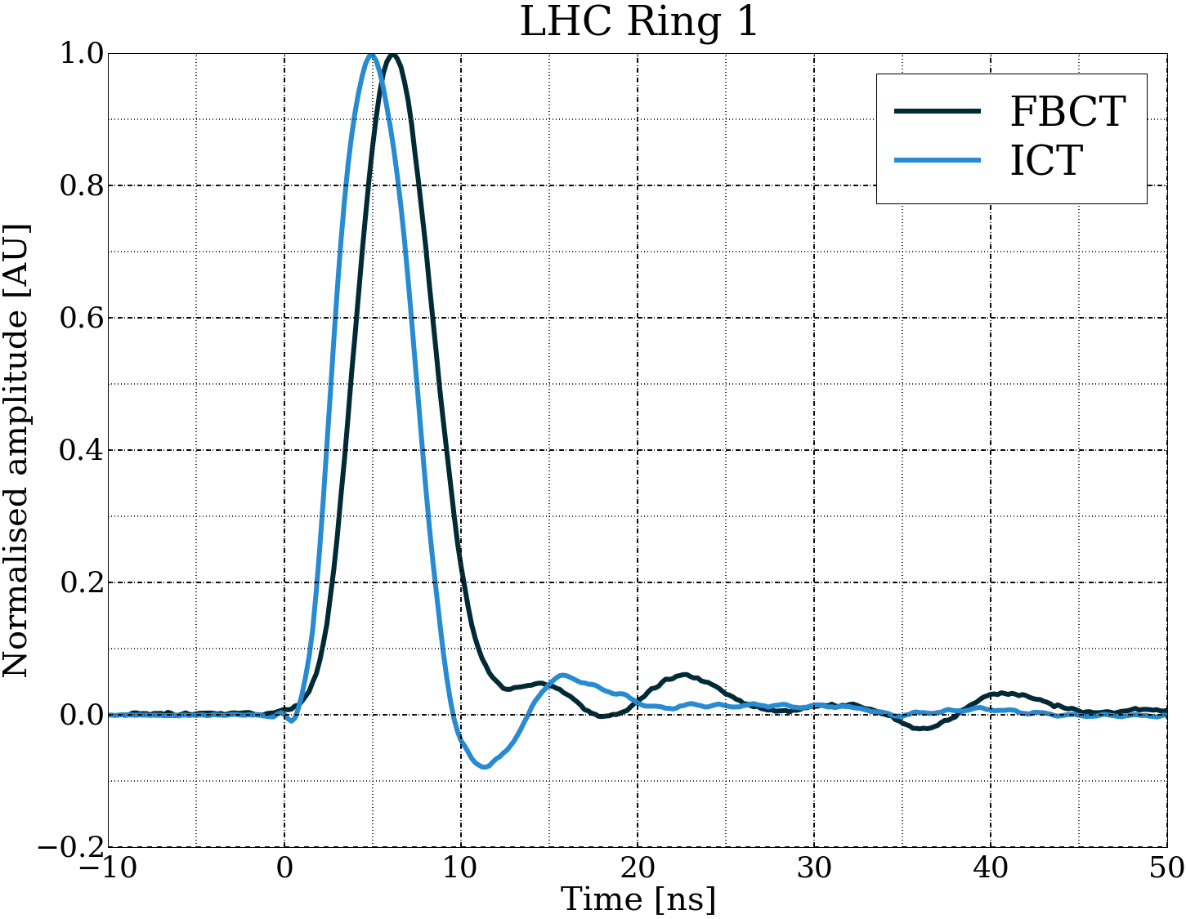
FBCT / ICT / WCT nominal bunch

Slide 28
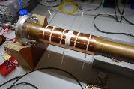
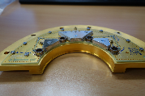
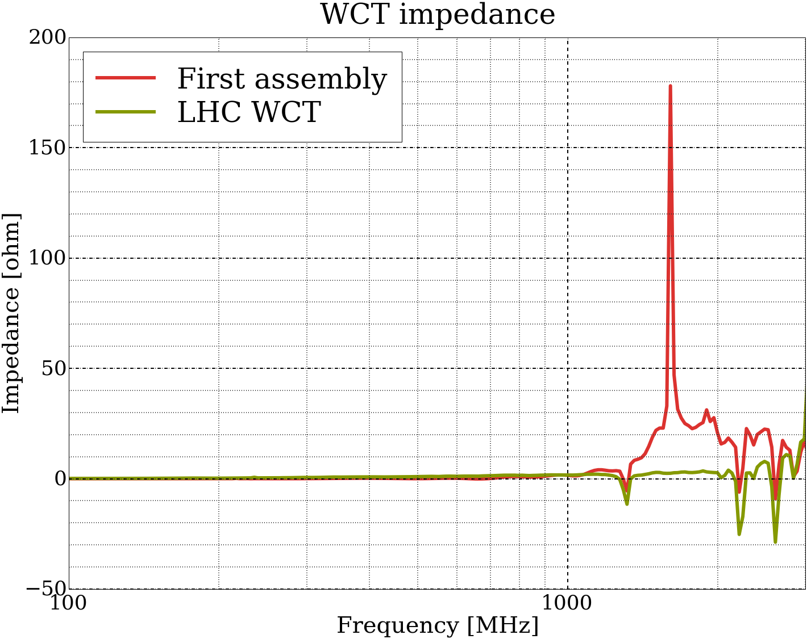
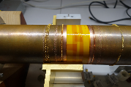
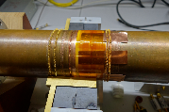








Impedance

Slide 29


Beam position sensitivity MD
Dedicated MD on 20/07/2015
FBCT ΔI/I ≈ (0.3 – 0.7)%·mm⁻¹ | ICT ΔI/I ≈ (0.01-0.02)%·mm⁻¹ | WCT ΔI/I < 0.001%·mm⁻¹ Not measurable

Slide 30


Bunch length sensitivity MD
Dedicated MD on 20/07/2015
FBCT ΔI/I < 0.2%·ns⁻¹ | ICT ΔI/I < 0.2%·ns⁻¹ | WCT ΔI/I ≈ 0.5%·ns⁻¹ Not understood at the time of the MD

Slide 31

Baseline droop and restoration
WCT:
low cut-off: 500 Hz
Beam:
1632 bunches
2.1e14 total intensity
LHC fill: 4567
02/11/2015
Injection energy

Slide 32


WCT bunch response

Slide 33

Doublet bunches
WCT:
averaging on a 12-bit oscilloscope over 50 turns (5 ms)
Old amplifiers
LHC fill: 4064
26/07/2015
Scrubbing run

Slide 34

Satellite and ghost bunches
LDM:
single photon counting over 3 million turns
(5 min)
WCT:
averaging on a 12-bit oscilloscope over 500 turns (50 ms)
LHC fill: 4640
21/11/2015
Stable beams

Slide 35


Energy ramp
Bunch length reduction, RF change, orbit change, unbunched beam loss
LHC fill: 4643 21/11/2015 Ramp
FBCT, ICT and WCT were rescaled to overlap with the DCCT

Slide 36


Van der Meer scans
Absolute bunch-by-bunch measurements
LHC fill: 4538 24-25/08/2015 VDM scans
No rescaling, all plots as logged

Slide 37


(un)Stable beams
LHC fill: 4538 26/10/2015 Stable beams
ICT and WCT were rescaled to overlap with the FBCT

Slide 38

WCT calibration circuit
Current source:
~10 ppm shot-to-shot stability
~100 ppm accuracy
~5 µs switch-on time
I_{CAL} limited by V_{CAL}
(~1.5 A for R_{CAL} ~ 10 Ω)
R_{REF}: 5 Ω ± 0.01%
< 0.2 ppm/ºC

Slide 39

WCT calibration circuit
Current measurement:
Half-bridge principle
Variable reference voltage source controlled by potentiometer and
DAC (coarse / fine)
R_{REF}: 10 Ω ± 0.01%
< 0.2 ppm/ºC
R_{HB}: 100 kΩ ± 0.01%
< 1 ppm/ºC

