Slide 1







Fibre Beam Loss Monitoring system development
BI - day
10 March 2016
M. Kastriotou, E. Nebot del Busto
M. Boland, F. S. Domingues Sousa, E. Effinger,
E.B. Holzer, W. Viganò, C. P. Welsch
all CTF3 operators …

Slide 2
Outlook
The OBLM system
OBLM at a linac: Test Beam Line (TBL)
  Long pulses
OBLM at a Storage Ring:
the Australian Synchrotron Light Source (ASLS)
  Single bunch
  Multi bunch
OBLM as an RF cavity diagnostics tool
Conclusions
Optical fibre BLM
Position resolution

Slide 3
Optical fibre Beam Loss Monitors (OBLMs)
OBLM system is based on Cherenkov light
Operation principle
  Beam loss shower particles cross the optical fibre
  Cherenkov photons propagate in the optical fibre
Covering long distances , cost-effective, n,γ insensitive → ideal for linacs
Optical fibre:
  variable core Ø depending on application (larger core for higher sensitivity)
  Pure Silica, high OH content (→radiation hardness)
  Nylon jacket to protect against: humidity, ambient light
Cherenkov photons
photosensor!
beam pipe
c
beam
2c/3
2c/3
γ_{Cherenkov}
Photo
sensor
optical fibre
Photo
sensor
e⁻, e⁺
μ⁻, μ⁺
p⁺, p⁻
0.2 MeV
38.5 MeV
341.8 MeV
Notes:
200/245/365 um core/cladding/coating pure Silica

Slide 4
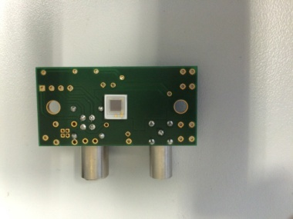
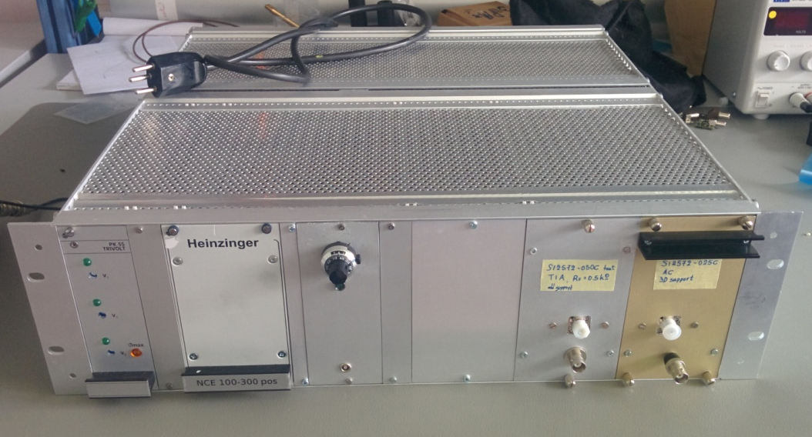
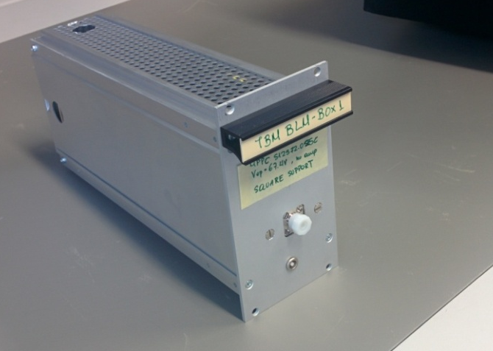
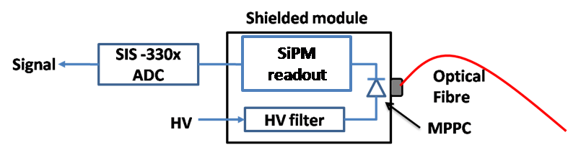
OBLM system development
Photosensor selection makes a timing / price difference
  Investigation on Silicon PhotoMultipliers (SiPM)
  (3x3 mm², default 40000 pixels, G =10⁺⁵ - 10⁺⁶)
Development of custom made , shielded photon sensing modules
  Low pass filters (bias input) for noise filtering
  SiPM with different readouts, depending on the application
Design of RF shielded chassis to include the modules & Power Supplies
High sampling (1-4 GS/s) and high bandwidth (250 MHz - 2 GHz) ADCs
SiPM
Photon sensing module
Fibre connector
Power supplies
SiPM readout
SiPM
Signal output
Notes:
200/245/365 um core/cladding/coating pure Silica

Slide 5
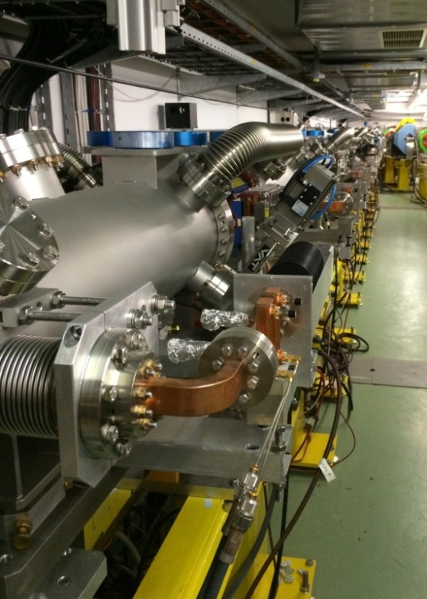
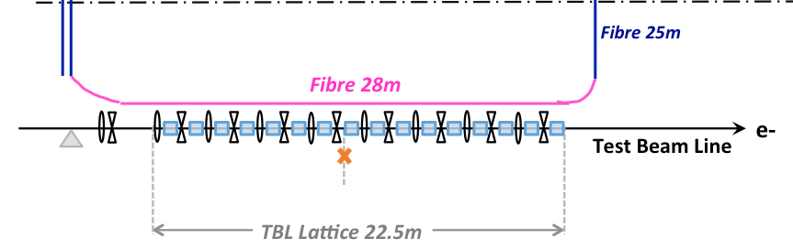
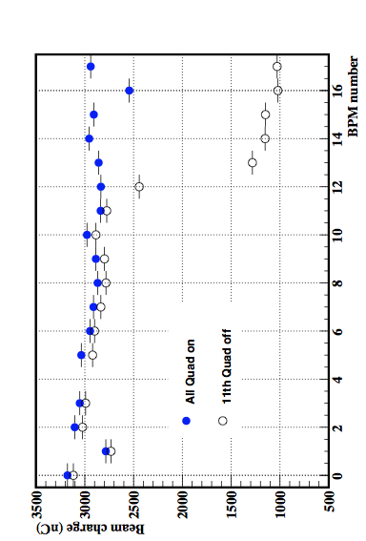
Losses with long bunch trains in linacs
Measurements at the CTF3 Test Beam Line (TBL)
Optical fibre at the TBL
signal fibre 28 m
120 MeV
3 A (peak)
3 GHz
0.1-1 µs
1µs long pulse
Controlled losses generated by switching off quadrupoles
BPM signals to correlate
TBL

Slide 6
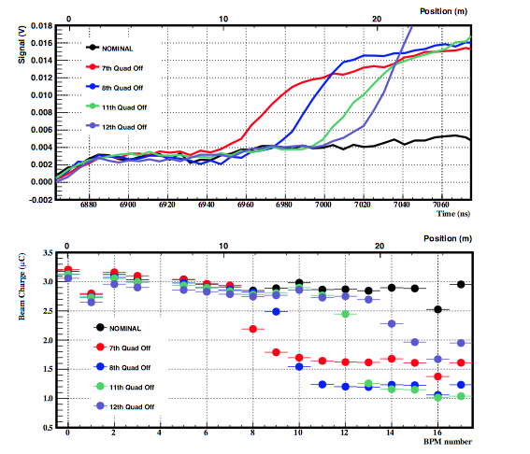
Resolution during losses with long bunch trains
Determination of loss location from signal leading edge
Good qualitative agreement between oBLM and BPM profile loss measurements
Localisation of loss down to (below) 2 m achieved!

Slide 7
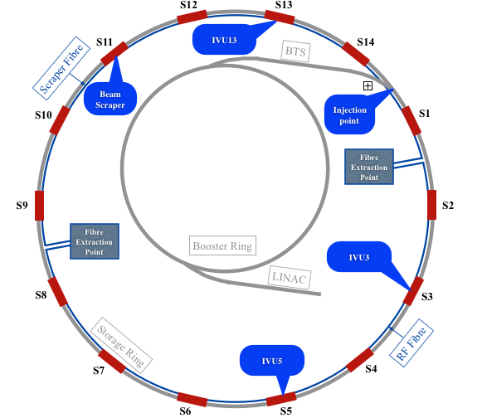
OBLMs at Storage Rings: The Australian Synchrotron
Australian Synchrotron Light Source
216 m storage ring
2 optical fibres covering the ring
  200 μm core Ø
  125 m
Scraper fibre
  Scraper
  Injection point
RF fibre
  2 In Vacuum Undulators (IVUs)
  2 RF cavities
3 GeV
200 mA
500 MHz
1-75 b inj.
100 MeV

Slide 8
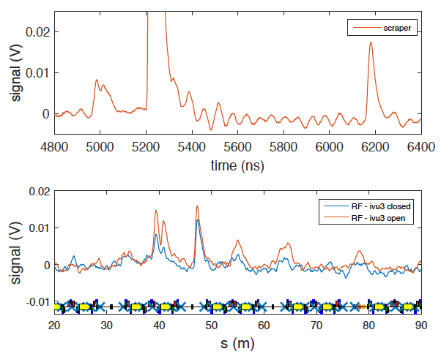
AS: understanding beam losses, single - bunch
Multi peaks observed due to losses in different positions
Transfer
Line
Scrapers
Storage Ring
Scrapers
Injection
Point
Reflexion
Scrapers
Scraper Fibre
1 turn
RF Fibre
IVU3
IVU5
1/10 turn
IVU3
IVU5
Notes:
What was the bunch charge do we remember?

Slide 9
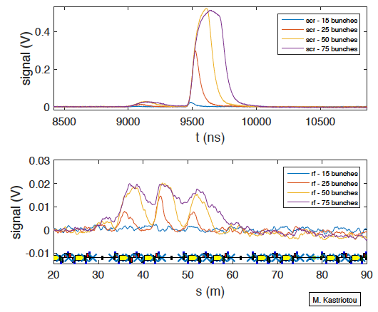
AS: understanding beam losses, multi - bunch
Multi peaks observed due to losses in different positions
Limited by pulse length
Rising edge still provides loss location information
Signal de-convolution required for losses in near positions
1 turn
Transfer
Line
Scrapers ??
Scraper Fibre
Injection
Point
Storage Ring
Scrapers
1/10 turn
RF Fibre
IVU3
IVU5
Notes:
Bunch length

Slide 10
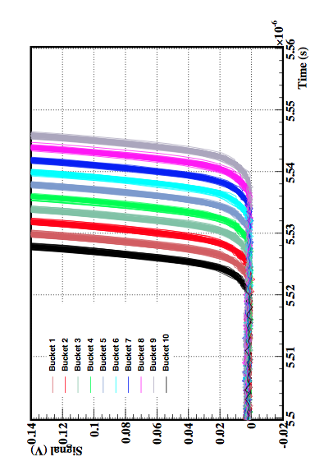
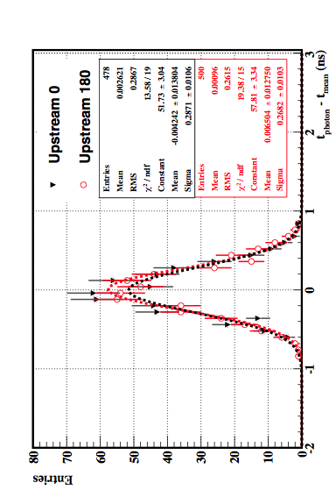
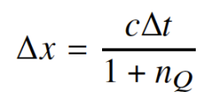
Intrinsic time resolution
Single bunch injection
Consecutive filling RF buckets 1-10
Looking at raising edge of losses at scrappers (well defined location)
One bucket (2 ns) shift disentangled shot by shot!
Δt = tphoton - tmean
(central time of n^{th} bucket)
V_{thr}
0
σt ≲ 300 ps
σx ≲ 4 cm
    Position resolution <10 cm achieved!

Slide 11
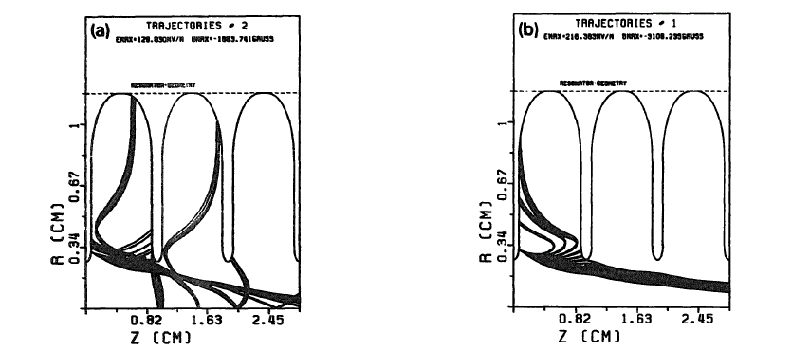
High gradient RF cavities
High gradient (~100MV/m accelerating gradient!) RF cavities are being investigated to be used in high energy linacs (CLIC), FELs etc.
Electron Field Emission
Electrons emitted from the cavity walls (mA), accelerated,
some impacting on the walls
RF Breakdowns
EM field collapses, emission of ~100 A of electrons in the cavity
Studies only for X-rays outside the cavity
Faraday Cups (e⁻ in cavity)
Radiation monitors
63 MV/m
105 MV/m
Capture field for LEP Injector Linac (LIL) type structure (10.5 GHz)
An investigation on the field emitted electrons in travelling wave accelerating structures – G. Bienvenu et al., NIM. A320 (1992) 1-8

Slide 12
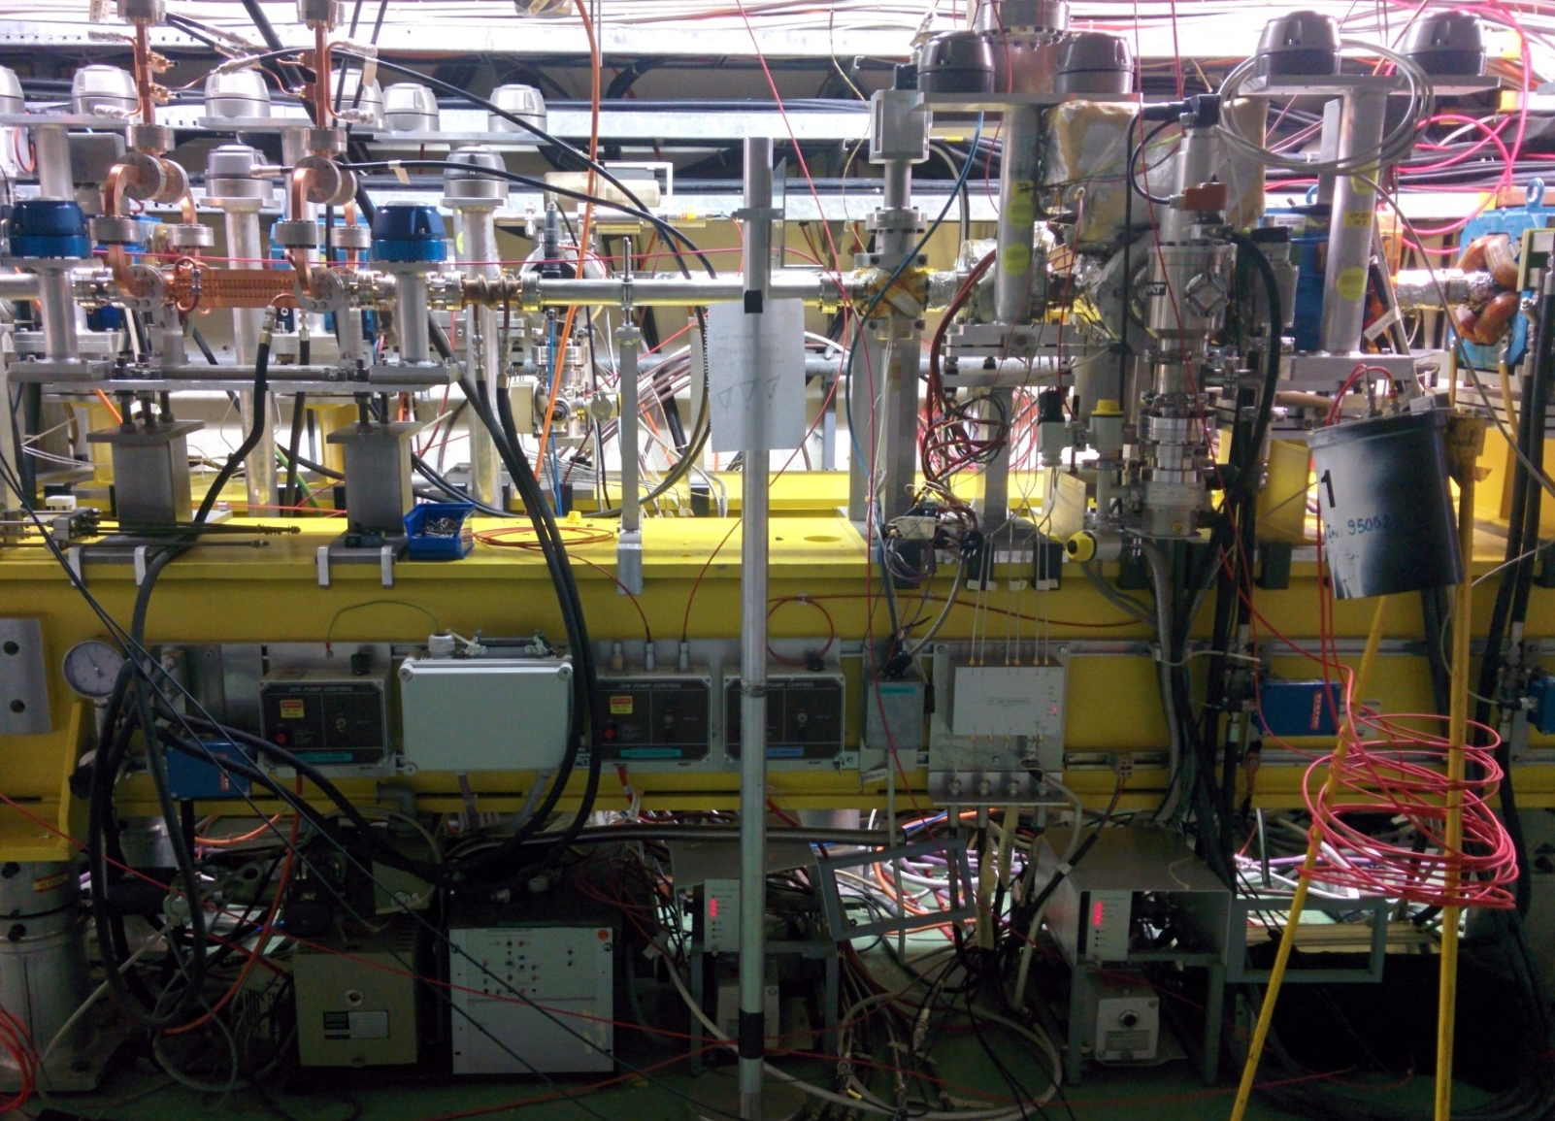
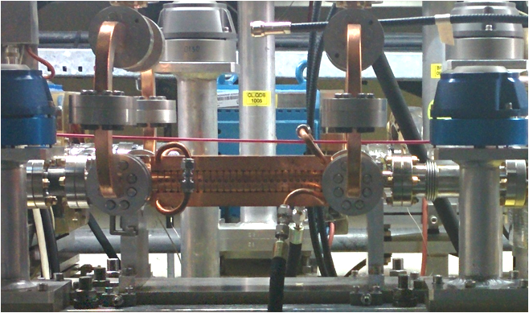
The dogleg experiment at CTF3
Study of loaded (with beam) and unloaded (only RF) accelerating structures
T24
OBLM
2.5 cm
electronics

Slide 13
Measurements of RF cavity electrons
Sensitivity to field emitted electrons
→ Signal length same as pulse length
Sensitivity to RF breakdowns
→ First measurement of breakdown electrons
RF cavity diagnostics!

Slide 14
Conclusions
  OBLMs are a cost-effective, customisable type of Beam Loss Monitor
  First attempt at loss location reconstruction with long (1μs) pulses
    Resolution better than 1.4 m achieved for single loss location
  Position resolution below 10cm can be achieved for single bunch
  Studies on de-convolution are necessary for the multi-bunch case
  OBLM system was demonstrated suitable for electron Storage Rings
  OBLM can be (and is being) used for RF cavity diagnostics
Thank you for your attention!

Slide 15
Spare Slides

Slide 16
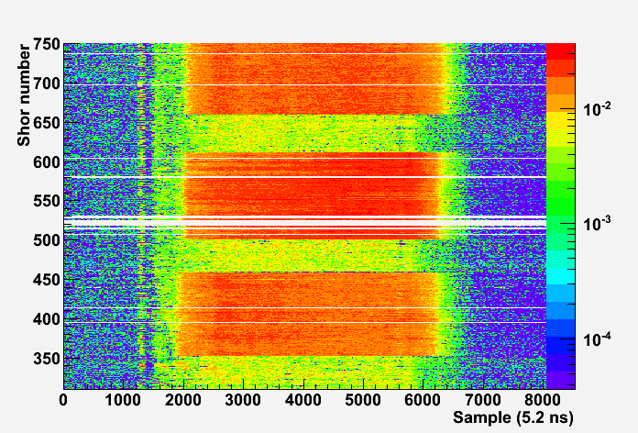
Losses with long bunch trains: measurements
Switching off of consecutive quadrupoles
Q600 off
Nominal
Signal (V)
Q550 off
Nominal
Q500 off
Nominal

Slide 17
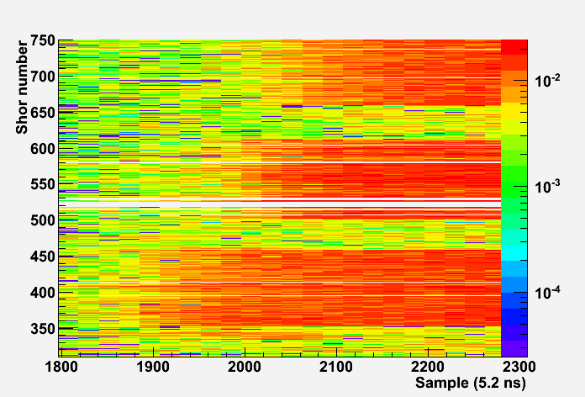
Losses with long bunch trains: measurements
Switching off of consecutive quadrupoles
Q600 off
Nominal
Signal (V)
Q550 off
Nominal
Q500 off
Nominal

Slide 18
θ
e⁻
  Photon Yield per e⁻ (β=1) crossing the fibre as a function of photon λ
  Light attenuation in the fibre as a function of photon λ
  Dependency of Cherenkov photon yield and photon propagation on crossing angle
  SiPM efficiency dependence on wavelength

Slide 19

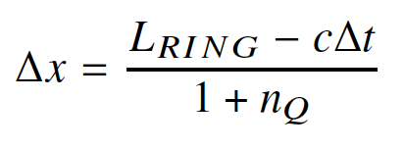
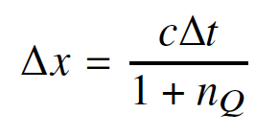

Understanding Beam Losses
Most studies performed on losses generated in the first turn
x = LFIB = 125 m
x = 0 m
x = x1
Sect
2
Sect
9
x = x2
FIBRE GAP
Upstr - Downstr
vQ = c/nQ ~ 0.7 c
Upstr - Downstr
vQ = c/nQ ~ 0.7 c
108 m
Beam in Storage Ring
Beam in Transfer Line
L = LRING - (x1 - x2)
LRING = 216m
Injection point (t0)
Scrapers (t0 + L/c)
Two loss points on opposite sides of FIBRE GAP
Two loss points on same side of FIBRE GAP

Slide 20
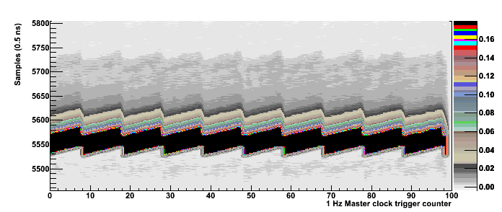
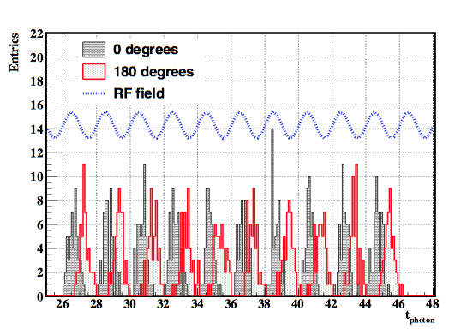
AS intrinsic time resolution & Booster phase shift
Repetition with Booster RF phase shift by 180◦
V_{oBLM} (t = t_{photon} ) = V_{thr}
t_{photon} → Photon arrival time (to upstream end)
Time resolution study based on
Δt = tphoton – tmean
tmean = toff + nbucket x TRF (central time of n^{th} bucket)
σt ≲ 300 ps
σx ≲ 4 cm

Slide 21
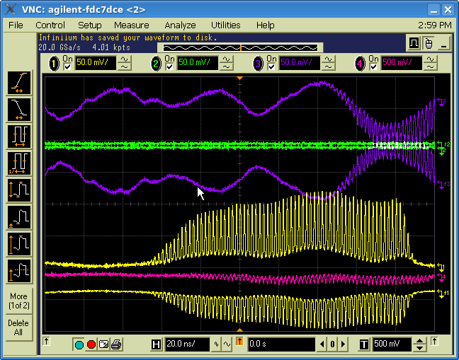
ASLS multi-bunch current
Current profile of 75 bunch train

Slide 22
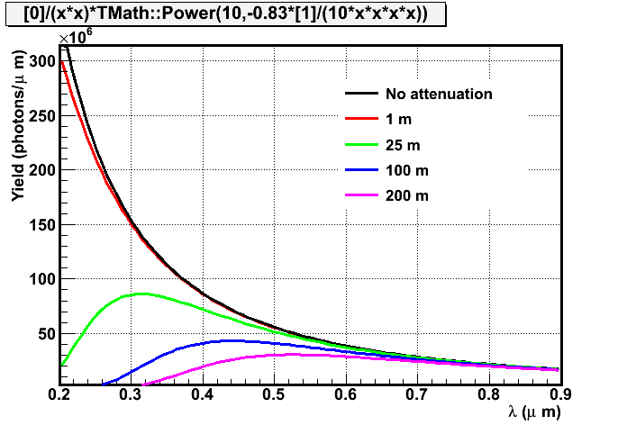
Cherenkov light spectrum and effect of fibre attenuation

Slide 23
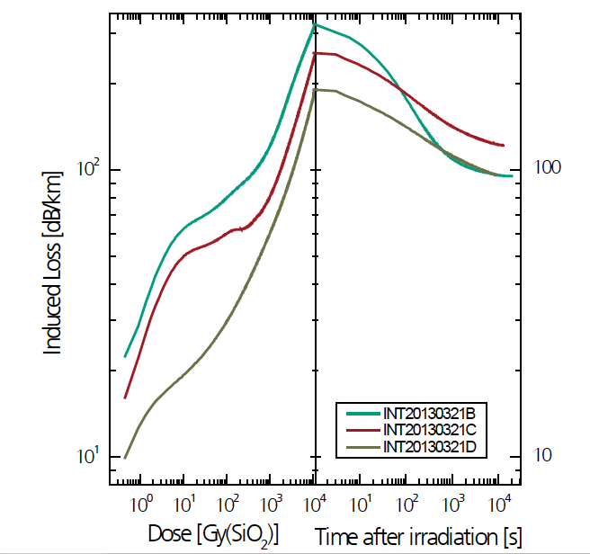
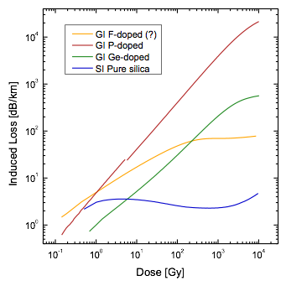
Cherenkov fibers: Radiation Hardness
Radiation hardness
  Material, manufacturer, type of radiation
  Pure Si core with high OH recommended
  Radiation Induced Attenuation strongly dependent on λ
  SiO₂ fibers rather insensitive for 800 nm and above.
oPAC Workshop, May 14
830nm LED
(Pure SiO2)
450nm LED
J. Kuhnhenn
Fiber irradiation test at Fraunhofer institute 10kGy@0.22Gy/s

