Slide 1
A coronagraph for beam halo measurements in the LHC
CERN BI DAY, 10 March 2016
Aurelie Goldblatt BE-BI-PM
Notes:
Hello everybody,
During the winter shut down, we installed in the LHC a coronagraph in order to measure the halo of the beam.
So what is a halo and what is a coronagraph?
I guess a lot of you already saw this kind of image:

Slide 2
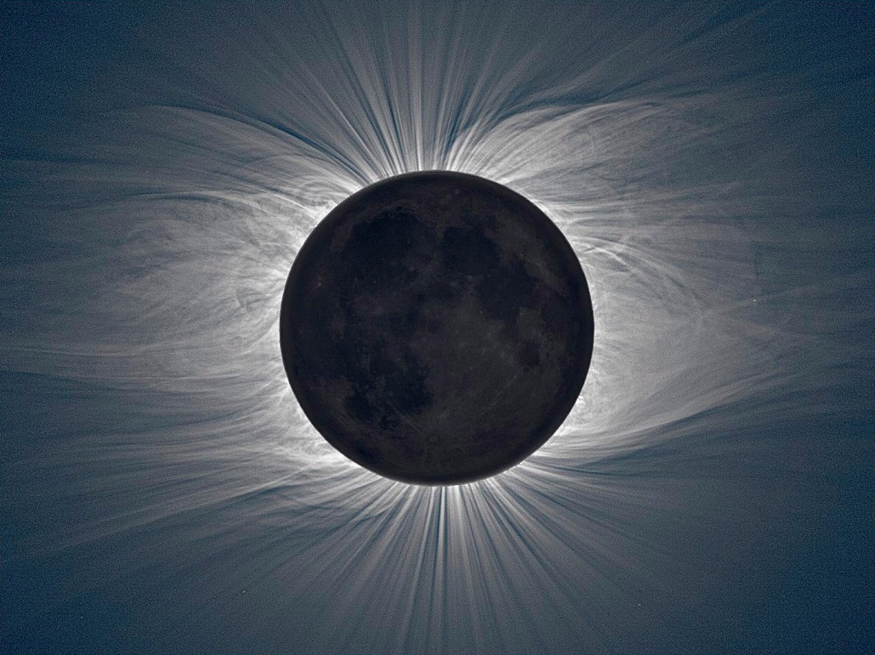
Notes:
This is an image of the sun hidden by the moon during a total eclipse.
The beautiful pattern we’re seeing is the halo of the sun and we are able to see it because our eyes are not anymore saturated by the brightness of the core.
The astrophysicists didn’t wait for a total eclipse to look at the halo of the sun.
They invented an instrument called a coronagraph to do the job.
And it’s the same instrument we installed in the tunnel of the LHC to look at the halo of the particle beam.
The next two slides are the only one which recquires some attention, the rest is only pictures. I will explain how works the coronagraph we installed.

Slide 3

Object
Image + Mask
Camera
Objective lens
Notes:
You understand that the physicists are not able to put a mask in front of the sun.
Maybe one day we’ll have the technologies, but for now it’s not the case.
Only the moon can do the job.
So the astrophysicists use a trick: they create and image of the sun with a lens, and they put a mask in front of the image.
And then they look at the image instead of looking at the object directly.
But if you do so, this is what you will see. This doesn’t look like the previous image of the sun.
This is because what we see is the pattern of the light diffracted by the edges of the lens and the mask. It’s like if you look at some light through a hole. You will see the same kind of pattern.

Slide 4

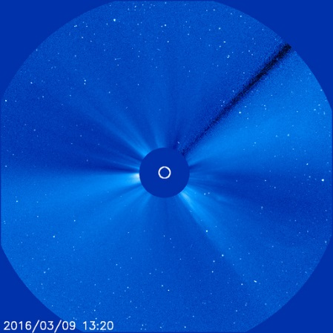
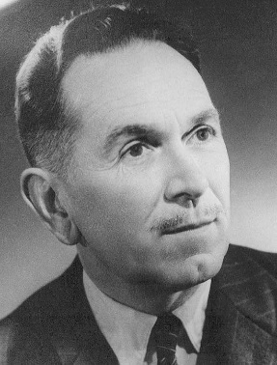
Lyot stop
Camera
Field lens
Rectangular
aperture
SOHO LASCO C3 coronagraph
Bernard Lyot: 1931
Notes:
A french astrophysicist, Bernard Lyot, had a really good idea to supress this effect, and the coronagraphs used today are still builded on his idea.
Bernards Lyot added some elements in order to shift the diffraction pattern to the edges of the field of view, and blocked it with an element which took his name, the Lyot stop, letting only the central light going through.
And here is the result, an image of the sun halo from the LASCO coronagraph embedded in the SOHO spacecraft.
The Large Angle and Spectrometric COronagraph (LASCO) instrument is one of 11 instruments included on the joint NASA/ESA SOHO (Solar and Heliospheric Observatory) spacecraft.
We are applying exactly the same technique for the particle beam of LHC. Our sun is the synchrotron light, the light emitted by the beam when it’s turning in the accelerator.
Just to get an idea of the values:
The sun is about 1.4km diameter, and 150 mio km far.
The beam in the LHC is about one millimeter (full size, not sigma) and we are looking at it from a distance of 30m.
In fact, looking at the particle beam halo is more challenging than looking at the sun halo!

Slide 5
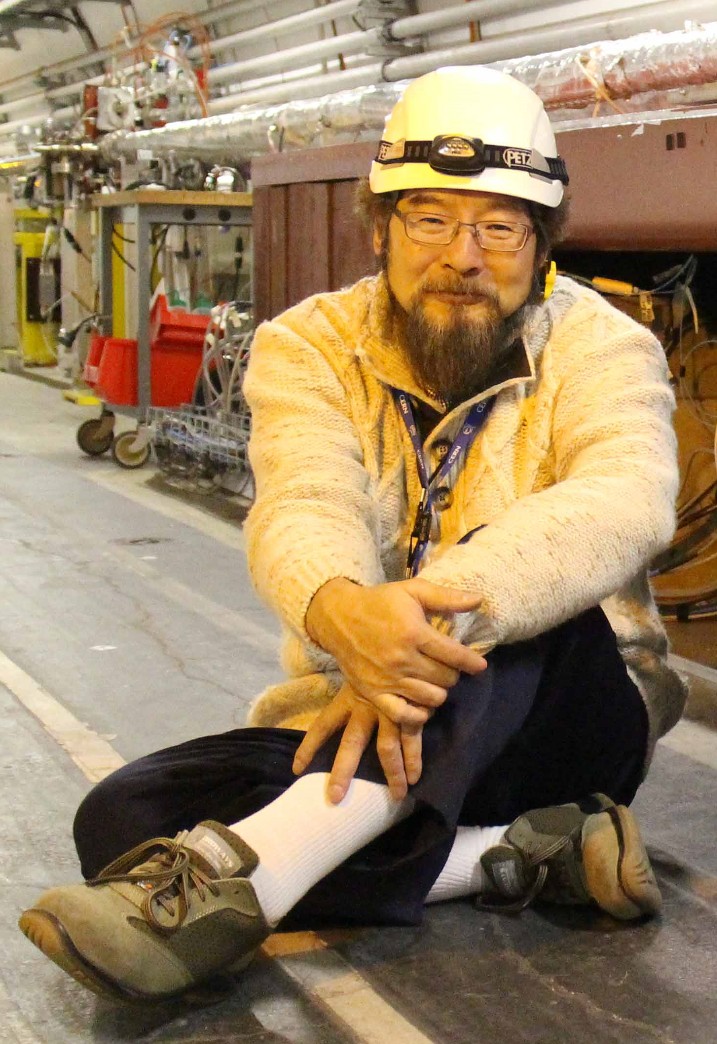
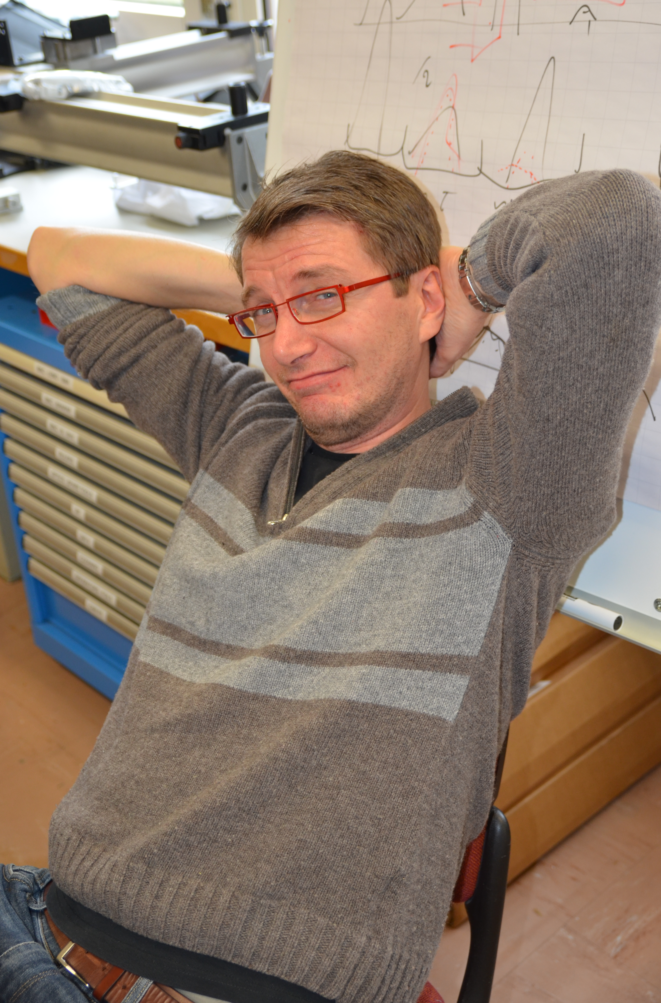
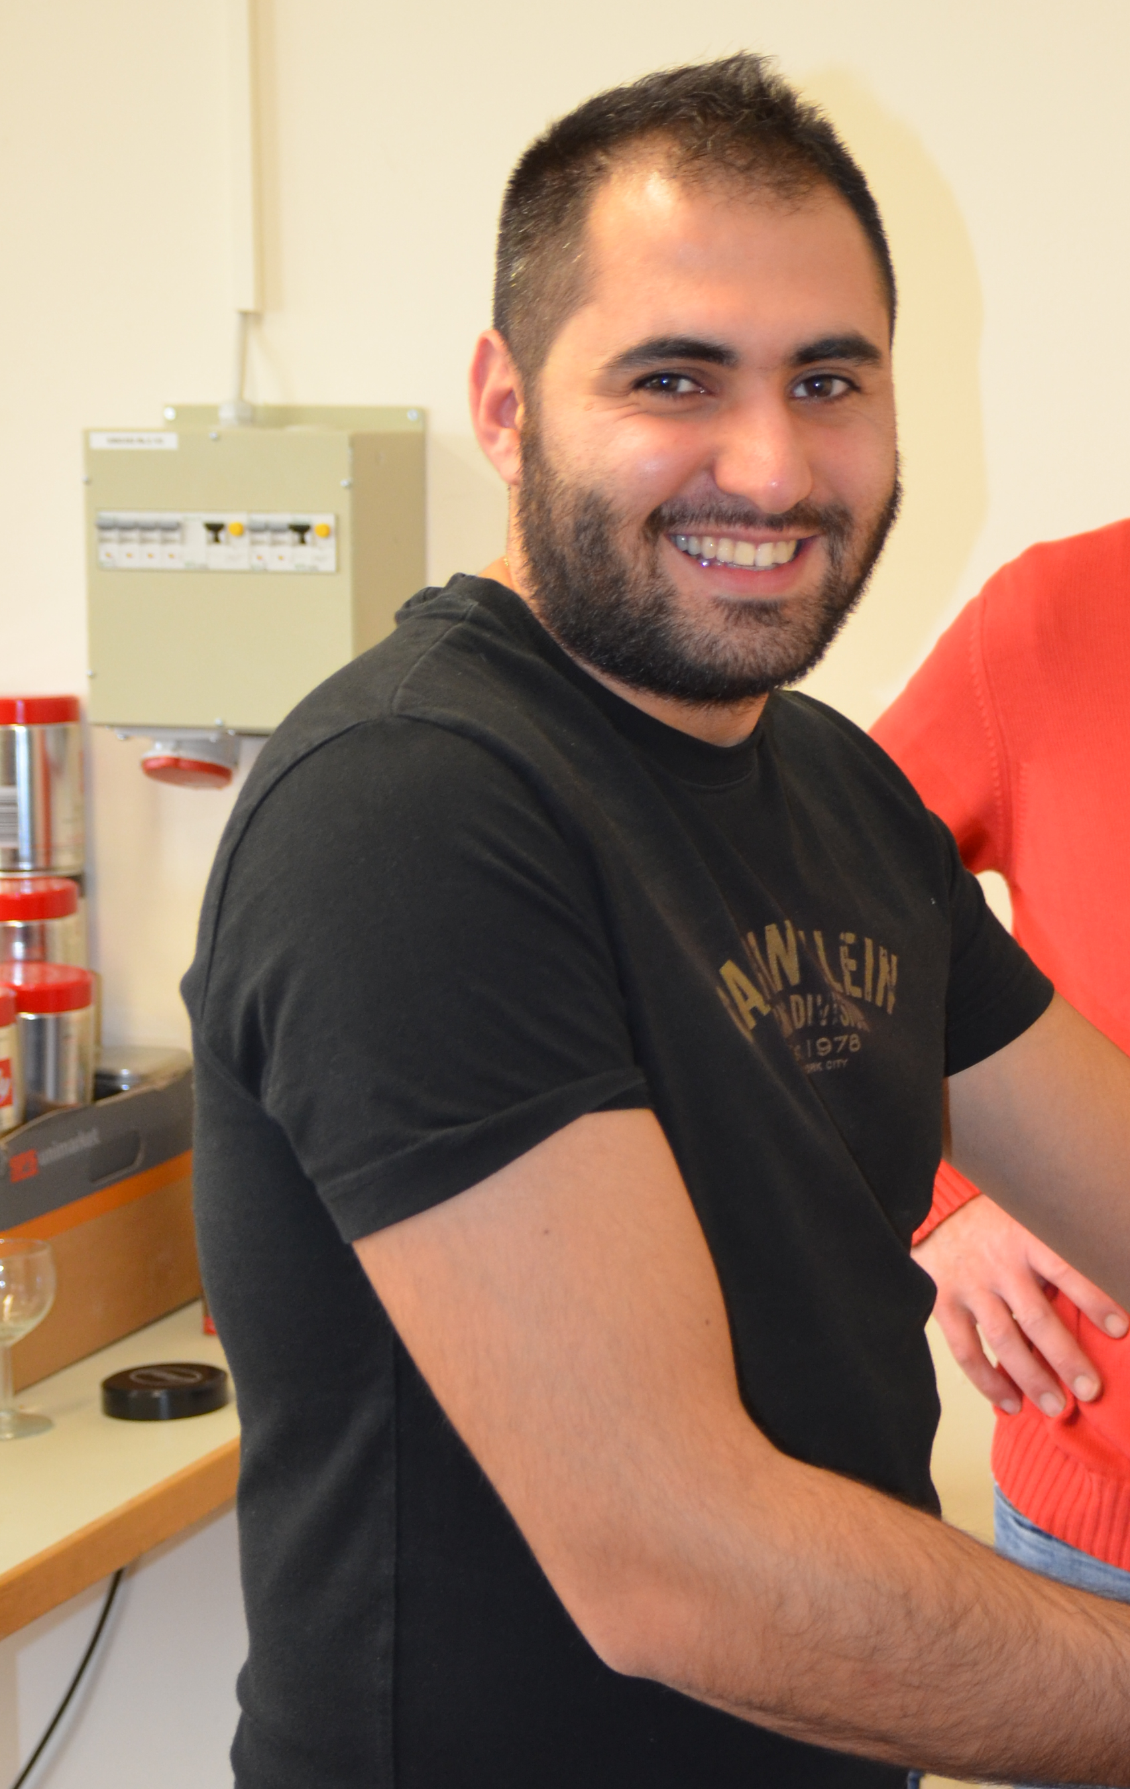
Enrico Bravin
BE-BI-PM
Toshiyuki Mitsuhashi
KEK
Georges Trad
BE-BI-PM
Notes:
The world master of the coronagraph for particle beams is Mr. Toshiyuki Mitsuhashi from Japan. He built a coronagraph for the Photon Factory (PF) in 2005 in KEK.
And we have the chance to collaborate with him for the installation of the coronagraph in the LHC.
In fact, Toshi lended us for undetermined period the KEK coronagraph which we adapted to the LHC conditions.
And here is the CERN team: Enrico is leading the project and Georges, who is now the second world master of the coronagraph.
Now I will explain a bit more my job, which was to implement the coronagraph in the LHC tunnel.

Slide 6
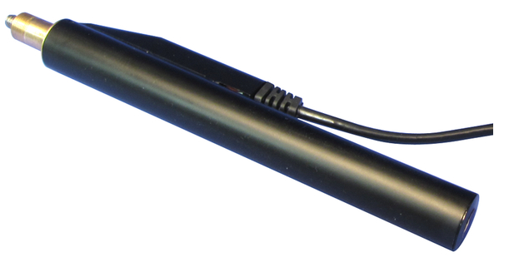
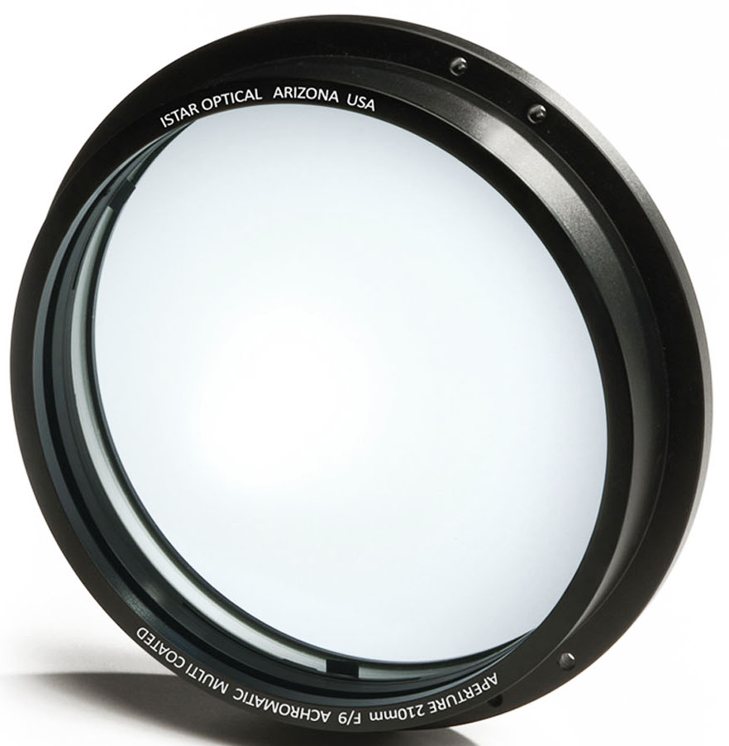
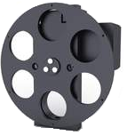
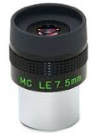

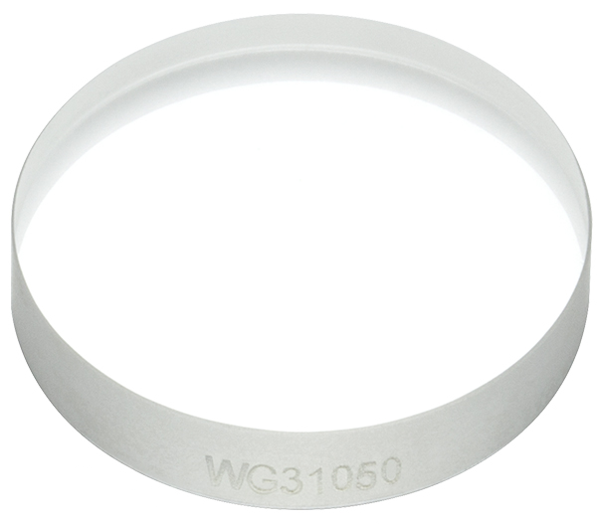
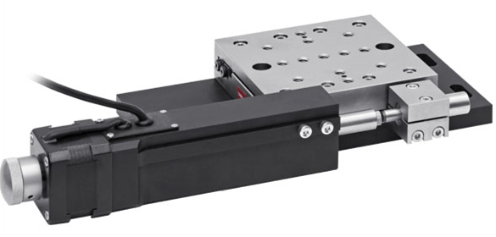
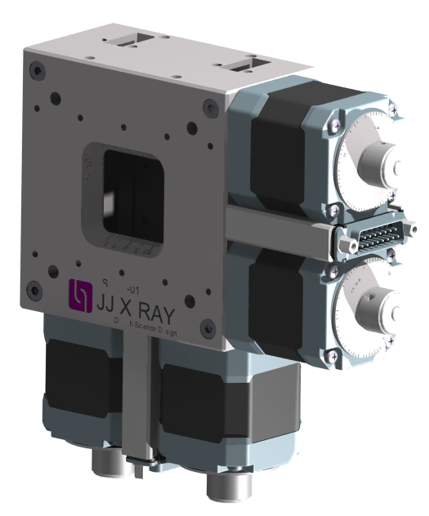
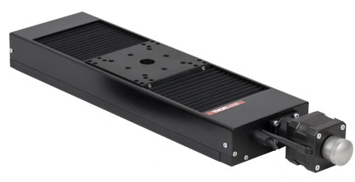
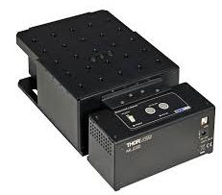
Notes:
As you can see, the coronagraph is not the simplest instrument which exists in the world.
Some elements are of really high quality and really special.
Another complication is coming from the fact that everything must be remote controlled. So here are the elements of the coronagraph:
-We have 4 lenses of really good quality. In fact we bought telescopes that we dismanteled to get the lens.
-We have 3 mirrors, one with extremly good quality.
-We have the mask which blocks the core of the beam. It is made of tiny aluminium spots of different sizes so we can choose, deposited on a glass window.
-We have 7 translation stages, two rectangular apertures, one for the aperture before the first lens, the other for the Lyot stop.
-We have 2 filter wheels, two actuators to adjust the path of the light.
All these elements are motorized. We have 19 motors in total.
-And we have a camera.

Slide 7
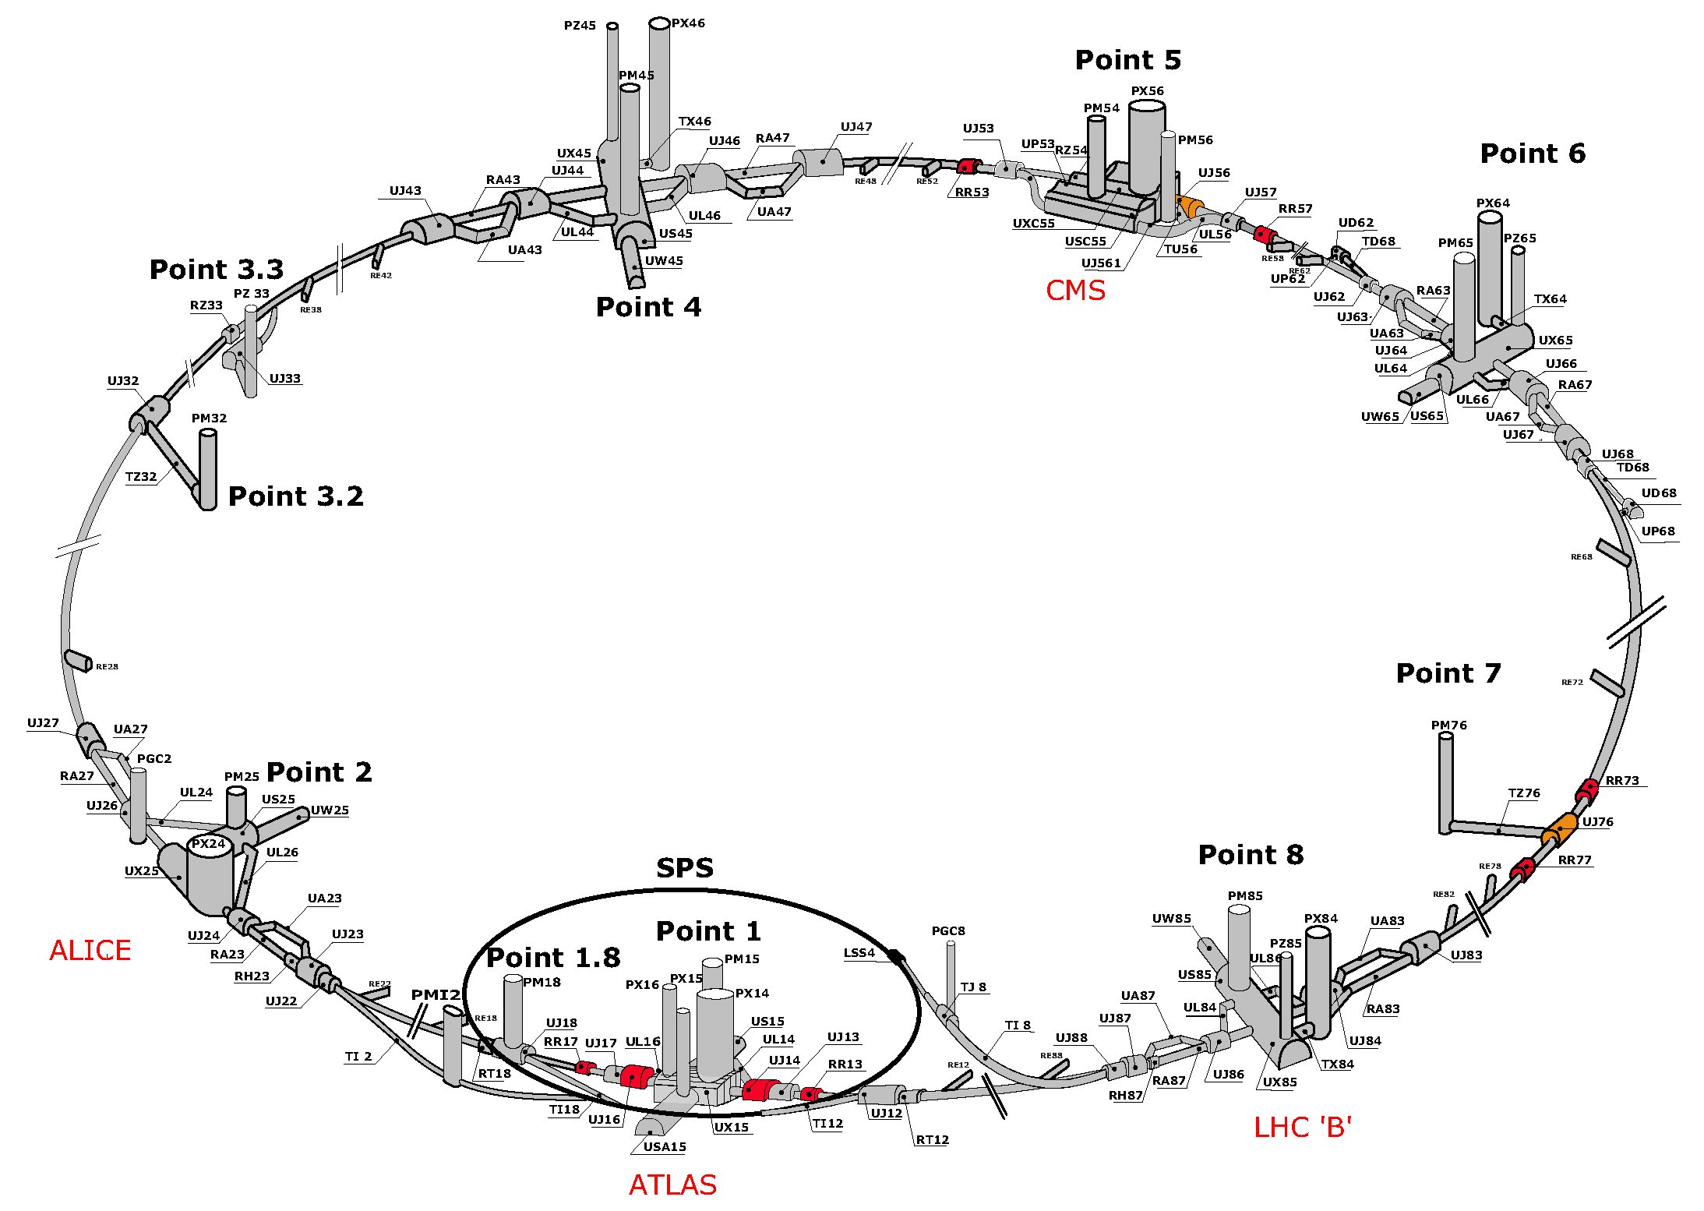
?
Notes:
So where to install the coronagraph in the LHC?
We already have an instrument which uses the synchrotron light to measure the size of the beam: the BSRT. We have two BSRTs, one for B1, the other for B2, in point 4 on each side of the RF zone.
They are installed on a big optical table below the beam pipe. A mirror is inserted in the beam pipe and send the synchotron light on the table.
So we decided to make room on one of these tables to install the coronagraph.
The table on B1 side is a bit crawded already, as you can see.

Slide 8
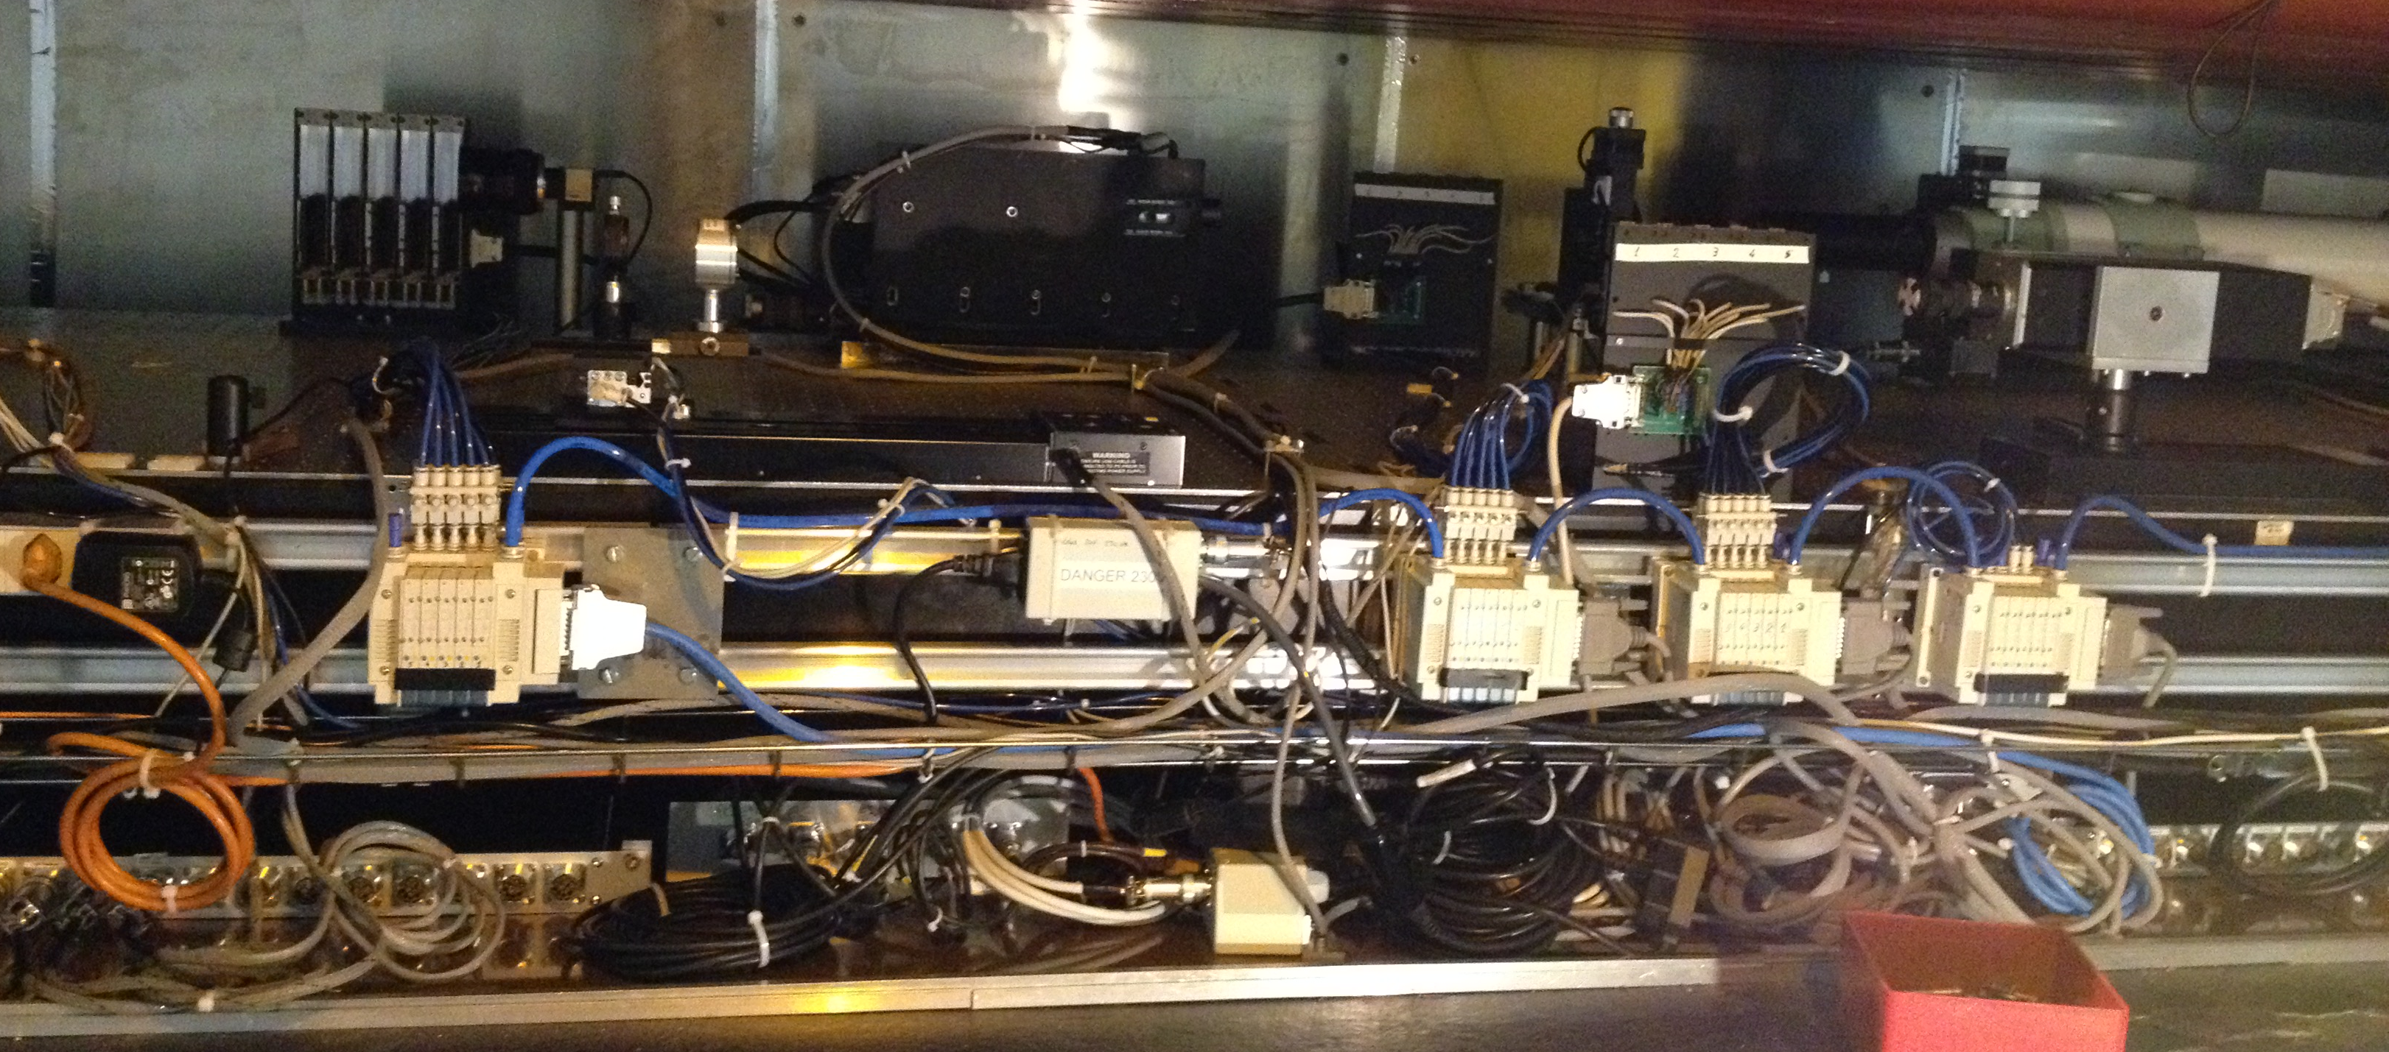

Slide 9
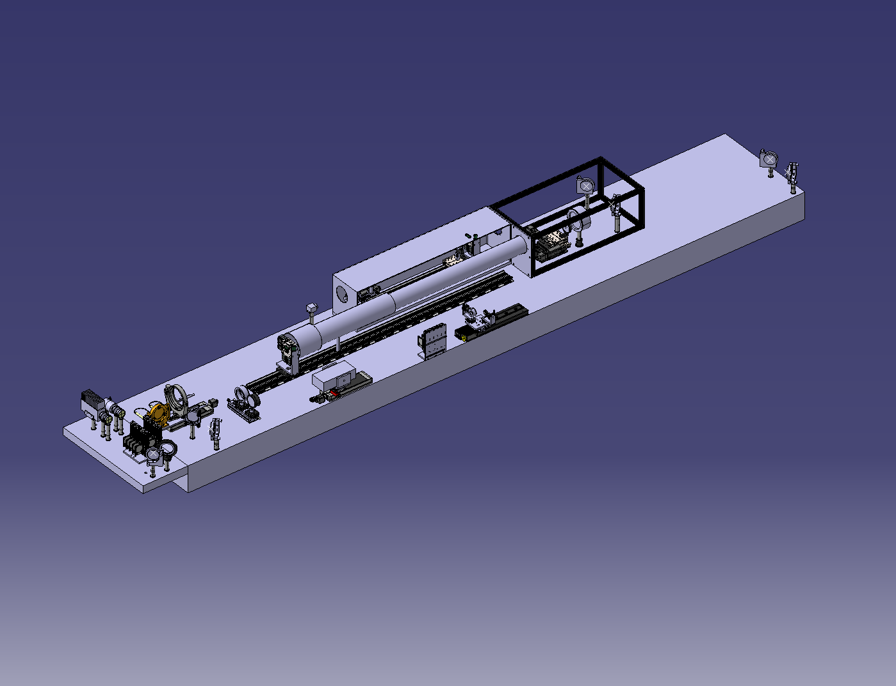
Notes:
So we did the implementation of the coronagraph on the B2 side and it looks like this.
But we needed a place to make a test bench before installing everything in the machine.
A place big enough to re-create the complete optical line of about 25m.
We found the BAF3 room, in a new bulding next to the control room.

Slide 10
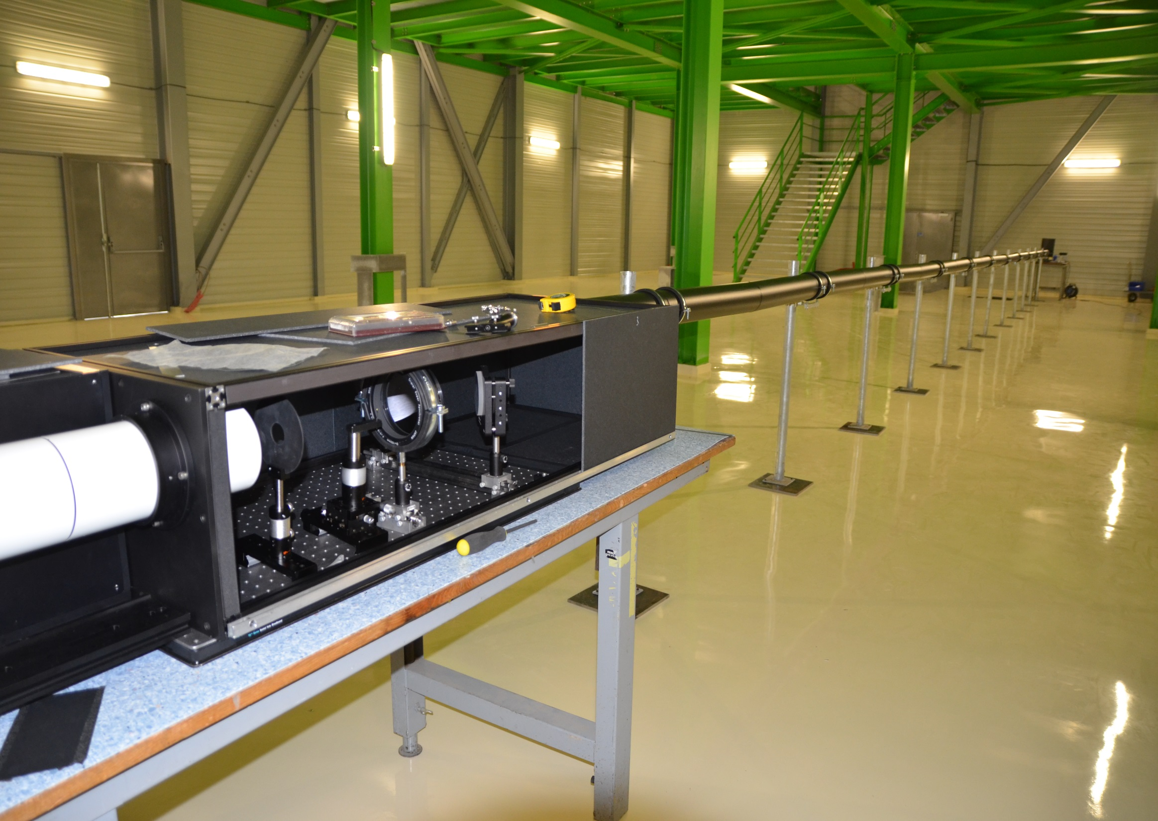
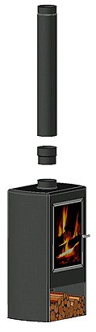
Notes:
We mounted the test bench there.
We installed the coronagraph on two tables, and we installed our lamp and other stuff to simulate the beam on another table, 25m faraway.
We had to protect the whole line from ambiant light, and here Enrico had a genious idea. We used stove pipes. They are black, light, and made in a way they can be fixed together.
Kind of a nice technological spillover!
Georges and Toshi worked hard on the test bench to optimize all the elements, and here is an image of what they got.

Slide 11
1 x 10-7
w.r.t core intensity !
Notes:
The managed to see a halo of a ten to the minus seven contrast with the core, which is a pretty good result and promising for the real measurement.

Slide 12
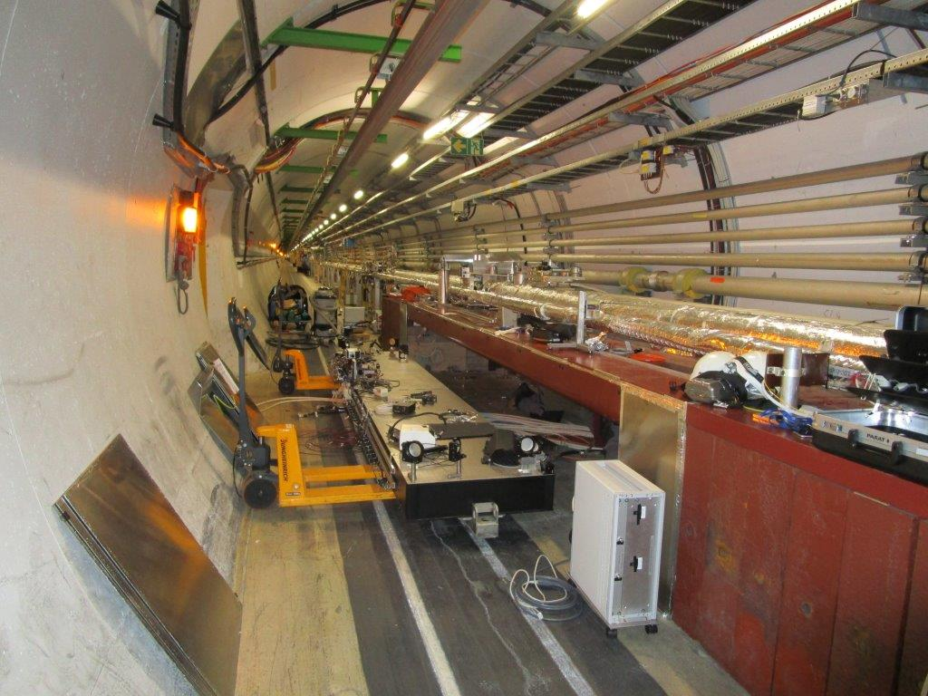
Notes:
And during the LHC shutdown, in January and February, we installed the coronagraph in the tunnel.
Here you can see the optical table which was slided out in order to install the elements.

Slide 13
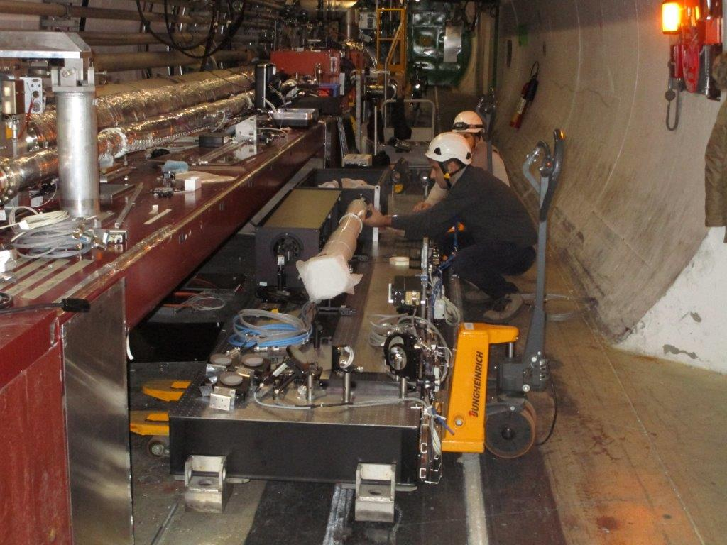
Notes:
Here you can see Georges working, the coronagraph is installed. But it’s still the mess!

Slide 14
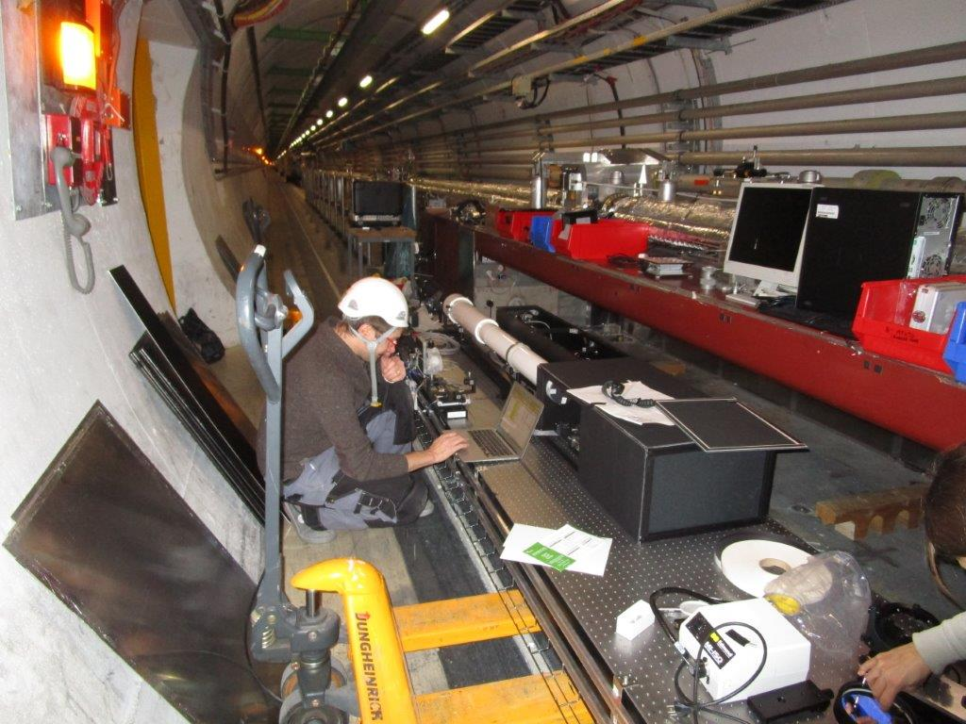
Notes:
Enrico working there, this time.

Slide 15
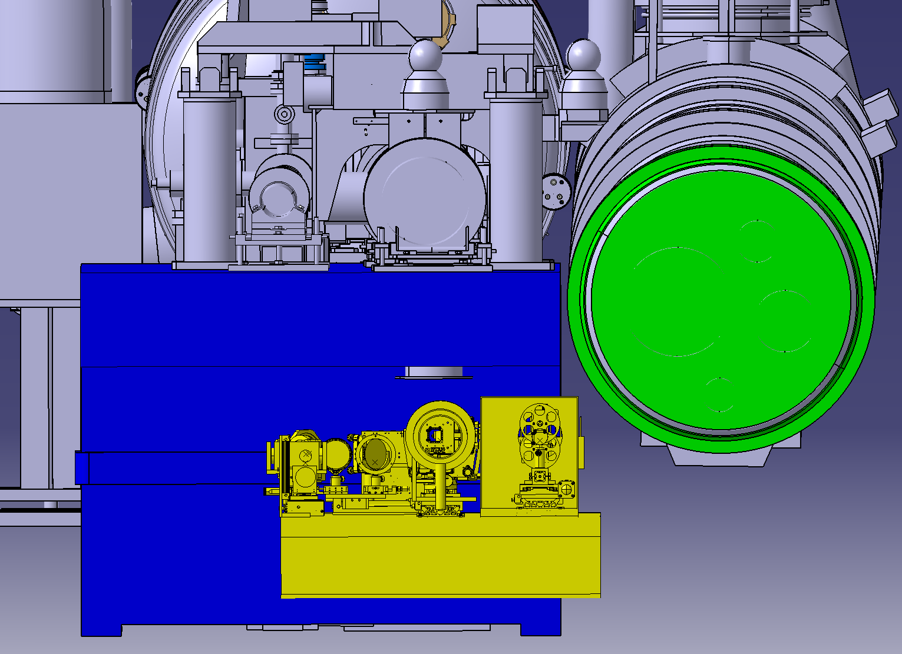

Unplanned events
Notes:
We had some unexpected problems.
When we slieded back the table to its place below the beam pipe, we found that the shielding boxes of the coronagraph were hiting therear pannels!
Hopefully, we were able to reduce the size of the boxes and the elements still fitted inside.
Problem solved, more fear than harm!

Slide 16
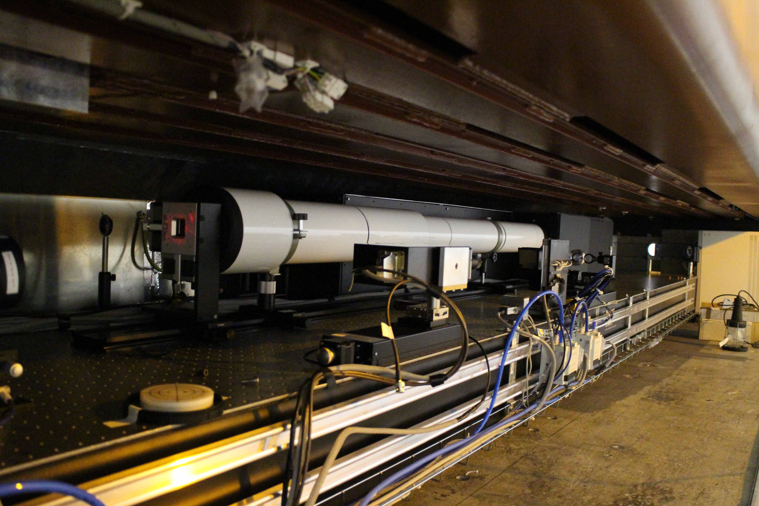
Notes:
Here is the picture of the coronagraph installed.

Slide 17
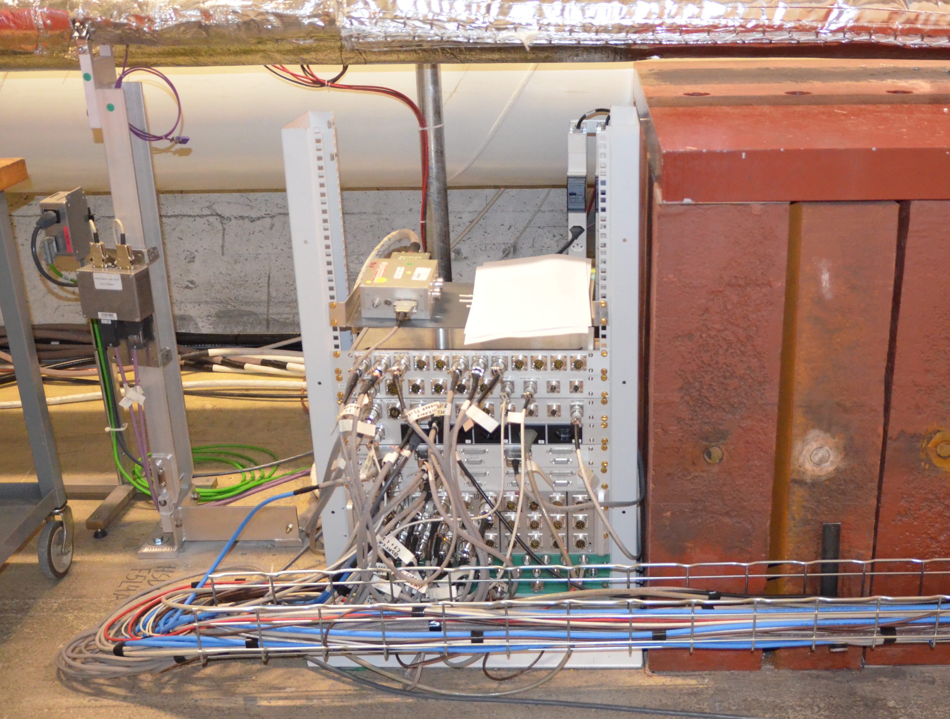
Notes:
Another thing we did was to move all the control boxes to the side. Before, everything was under the table.
This was quite a big job also, but now it’s much less messy!

Slide 18
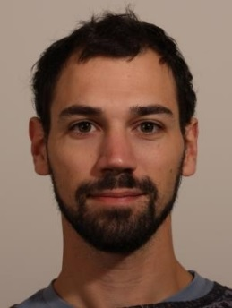
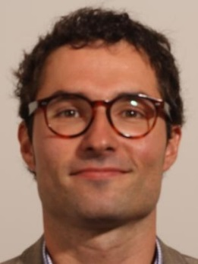
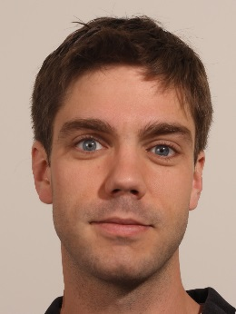
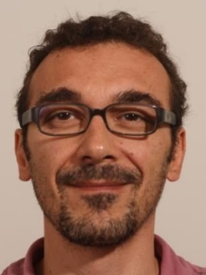
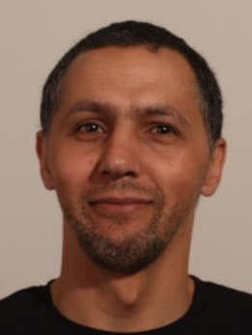
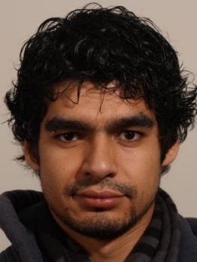
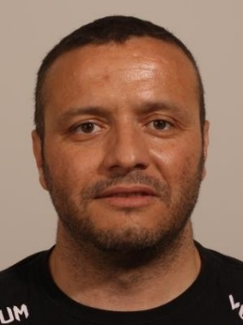
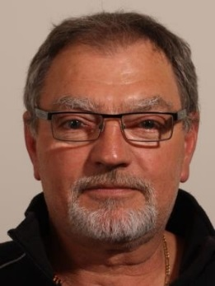
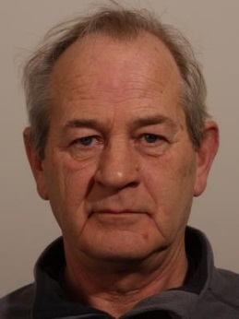
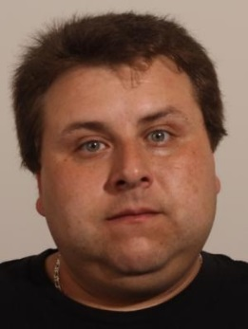
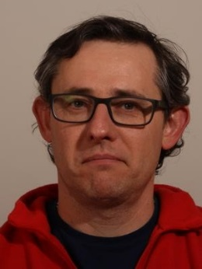
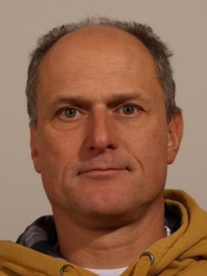
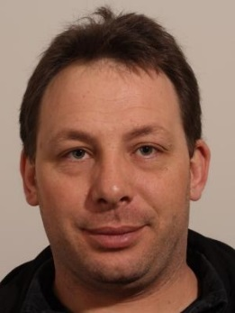
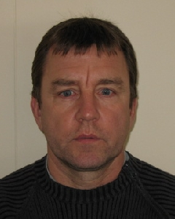
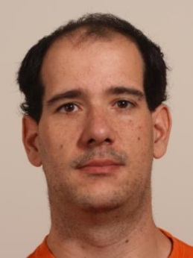
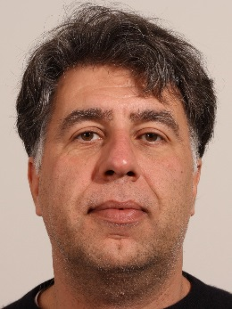
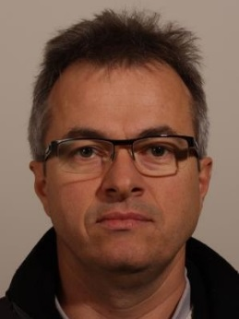
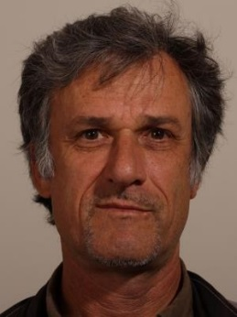
PM section
Robert Kieffer
BE-BI-PM
Stefano Mazzoni
BE-BI-PM
Marcus Palm
BE-BI-PM
Federico Roncarolo
BE-BI-PM
Karim Kessi
BE-BI-PM
François Rakotoarisen
BE-BI-PM
ML section
Morad Hamani
BE-BI-ML
Claude Rinaldi
BE-BI-ML
Sylvain Leblanc
BE-BI-ML
Frederic Camba
BE-BI-ML
Patrick Bouvier
BE-BI-ML
Gerhard Schneider
BE-BI-ML
EN-EL
BE-ICS
EN-ACE
Gaël Girardot
EN-EL-CF
Thierry Bourrel
EN-EL-BT
Cyril Neuhausen
BE-ICS
Samy Chemli
EN-ACE
Jean-Pierre Corso
EN-ACE-INT
Antoni Romano
EN-ACE-COS
Notes:
We didn’t do all this just the four of us. Many people helped us, some spent hours, like Robert who realized the mask of the coronagraph, learning the deposition and etching techniques at the EPFL in Lausanne, like François and Cyril who did all the new cables to be able to move the control boxes, like the ML section who made the parts to assemble the coronagraph.
Many people were involved in this project and I would like to thanks them all for their contribution, because thanks to them, we managed to finish the installation of the coronagraph just in time, at 5pm the day of the closure!

Slide 19

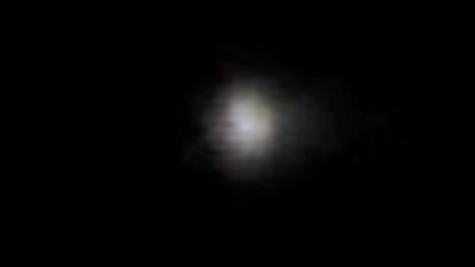
Notes:
And now we have to wait for the beam to be back in the LHC, to test the coronagraph for the first time.
And who knows, we might make some suprising discoveries.

Slide 20
THANK YOU!

