Slide 1


Instrumentation Performance in the SPS in 2015
& Requirements for the Future
Serge Massot
On behalf of SPS Operation

Slide 2
Outline
Issues
  SEM
  BTV
  BPM
  BLM
  BCT
  Wirescanners
Requirements
Outlook
Conclusion

Slide 3
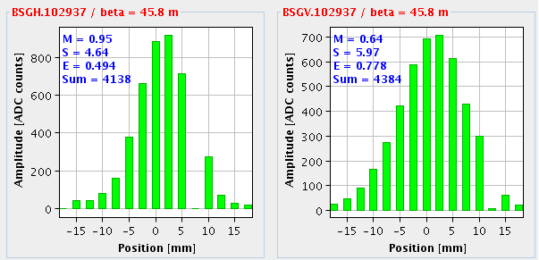
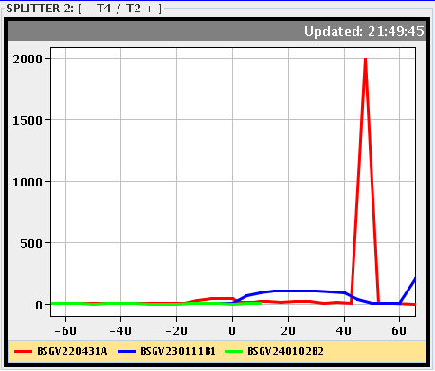
Issues
  SEM (position and profile monitors)
    SEM-grids in TT10 and TT20 have dysfunctional channels
    BBS.21638 : Stuck in OUT position. The coupling was loose
    → Good reaction by BI, now fixed
BSG.102937
BSGV.220431

Slide 4
BTV
  BTVS.11994 was misaligned → difficult alignment during YETS by EN-ACE
  BTV.21003 and BTV.61003 working fine but no longer used by OP
  → still to be removed
  BTV.42194 no longer used by OP and even disconnected → to be removed
  BTVE screen references in LSS4 and LSS6 are now coherent
  NA:
  - BTV.211628 → Screen stuck
- BTV.240119 and BTV.250118 → Lamp out of order
    - BTV.43061, BTV.43515 and BTV.45832 → no longer used by OP
Issues
FESA3 migration was a success for all BTVs (BA8 not concerned)

Slide 5
BPM
  Amplitude and phase drift on the cable length:
  Electronics failures:
  Hybrid changes:
Type | Position
BPH | 10208 | 11008 | 11408 | 23008 | 30208 | 32208 | 32408
 | 41008 | 41608 | 50608 | 51208 | 52808 | 60408 | 61608
BPV | 22508 | 31308 | 32508 | 40108 | 42108 | 60708
BPCN | 12308 | 12508
BPCE | 41801 | 61931
Issues
Type | Position
BPH | 31808 | 51408 | 52608
BPV | 10308
BPCE | 41705
Type | Position
BPH | 20808
BPD | 11833

Slide 6
BPM(2)
  Adaptor changes:
  Reconnected:
  Needed a calibration:
  Still an offset even after calibration:
Type | Position
BPH | 20808 | 23408 | 60808
Type | Position
BPH | 52008
Type | Position
BPH | 22408
BPV | 30708
Issues
Type | Position / Offset[mm]
BPH | 13008 / -0.9 | 20808 / -2.3
BPV | 42108 / 1.5

Slide 7
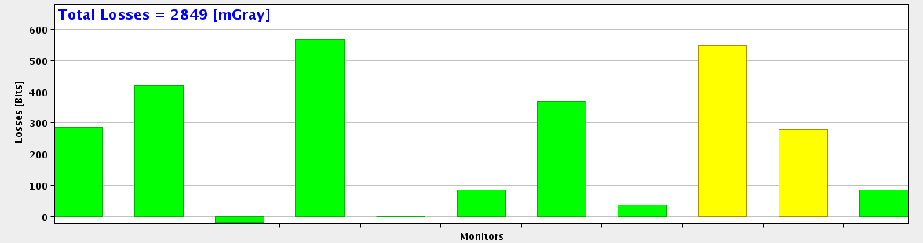
BLM
  SPS.BLM.21652.ZS2 and SPS.BLM.21674.ZS4 were out of order – no signal
    → All BLMs have been changed around the ZS – Efficiently
  NA:
  - TT20.BLM.211713 → Negative signal
  - TT20.BLM.211732 → No signal
Issues
BLM.211713
BLM.211732

Slide 8
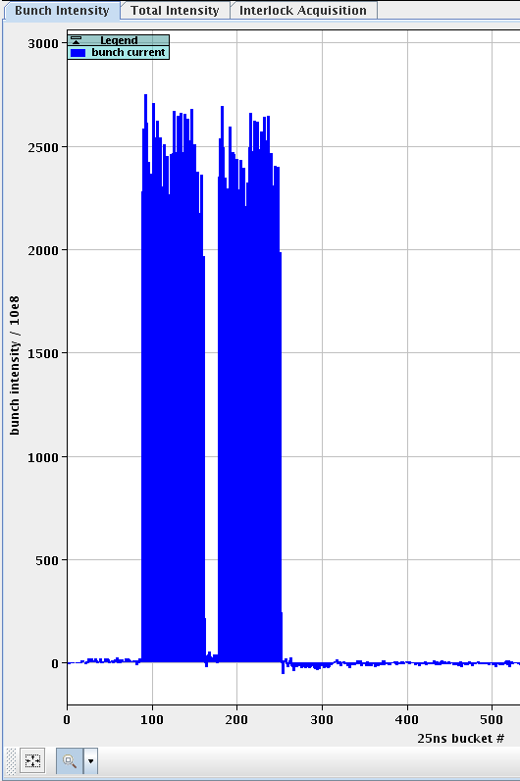
BCT
  BCTFR.31450 and BCTFR.51895
→ Intensity histogram doesn’t correspond
to reality
→ Difficulty to adjust the phase
→ Not possible to measure with
fixed frequency acceleration (Ions)
  BCTDC.11601 → still to be removed
Issues

Slide 9
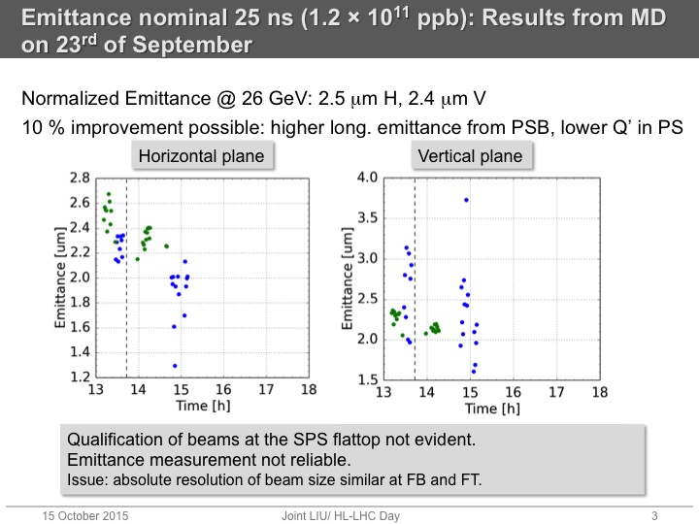
Wirescanners
  Wire scan reliability
Issues
Measurements at Flat Bottom
Measurements at Flat Top

Slide 10
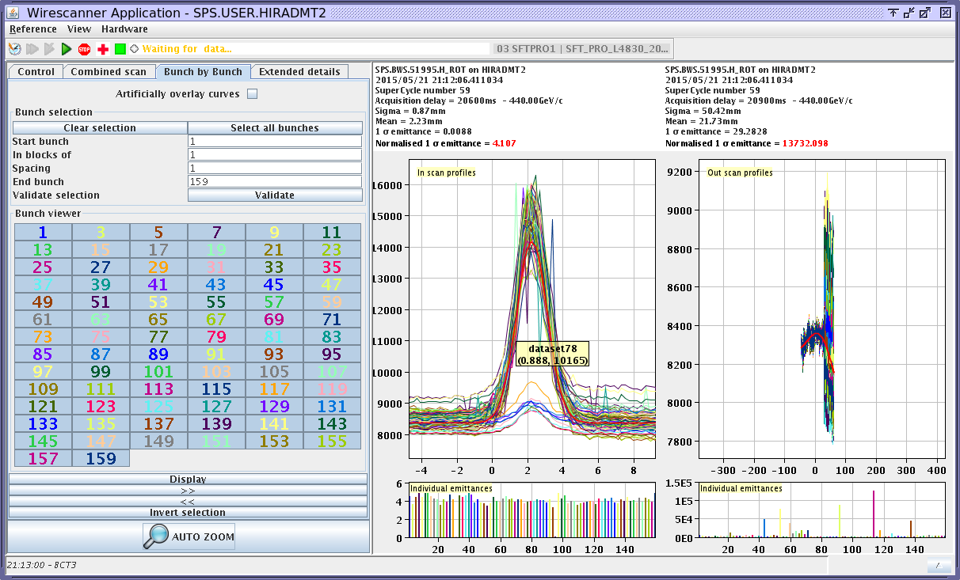
Wirescanners(2)
  Bunch by bunch measurements are now limited to 80 bunches:
Issues

Slide 11
Requirements
FBCT:
  - Improve accuracy and Phase adjustment → values from FBCT and BCTDC do not correspond
  - Ensure measurement for Ions with fixed frequency acceleration
BCT:
- Ensure cross-calibration between different machines
BLM:
- Diamond BLMs at LSS4 and LSS6 need to become operational
→ FESA class needed
BSRT:
- Available for operations
→ Unable to measure emittance at Flat Top with high intensity beam

Slide 12
MOPOS:
- Setting persistent when rebooting the FEC
→ the gate is changing to 30mm settings instead of staying in operational configuration
Wirescanners:
- More modern electronics and front end without memory restrictions
→ to be able to measure bunch by bunch without limitations
(now 80 bunches max.)
- New FESA class
→ less data treatment at application level (to be discussed with OP)
- Fitting/smoothing of the wire position readout data
- Prototype operational ASAP
Requirements

Slide 13
Outlook
SEM grid essential for setting-up and to minimize losses
BTV control is up to date and user friendly
Several BPMs were in a bad state which have now been fixed
Wirescanners highly solicited in 2015
Cross-calibration of emittance measurements needed along the injector
chain and the LHC
BSRT strongly demanded

Slide 14
Conclusion
Pending work in NA due to radiation levels
Not used devices still to be removed
Large amount of work done by BI to maintain the instrumentation
More MDs, more beams → more measurements
Intensive run to come and BI support is well appreciated

Slide 15
Thank you for your attention

