Slide 1



ELENA – Electron Cooler
on behalf of Electron Cooler team
Map Presentation :
  Electrons Cooling generalities
  Electron Cooler at CERN
  ELENA E-Cooler
  E-Gun & Collector
Jean Cenede
BI Day June 10th 2016

Slide 2
What‘s a Electron Cooling
Means to increase the phase space density of a stored ion beam.
Mono-energetic cold electron beam is merged with ion beam which is cooled through Coulomb interaction.
Electron beam is renewed and the velocity spread of the ion beam is reduced in all three planes.
BI Day March 10th 2016

Slide 3
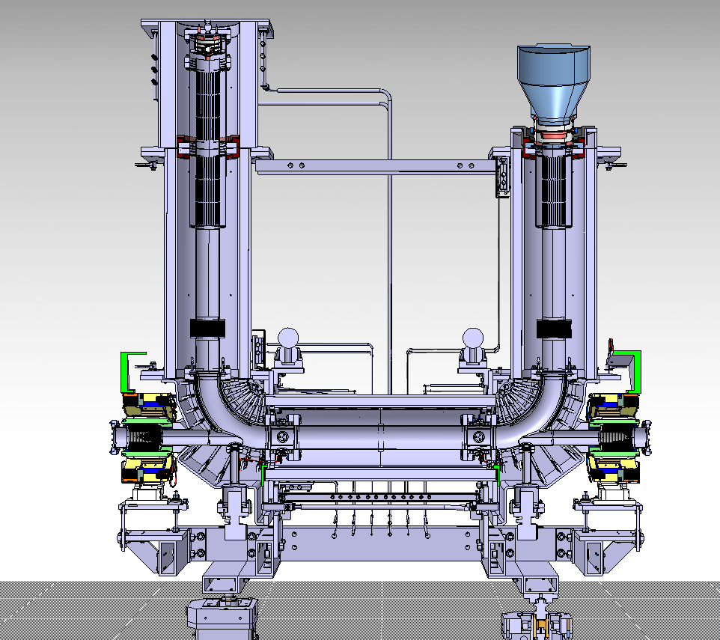
Concept overview of a E-cooler
e-Gun
e-Collector
Electron
Beam
Solenoïd
Drift
Circulating Beam Cooled
Circulating Beam
BI Day March 10th 2016

Slide 4
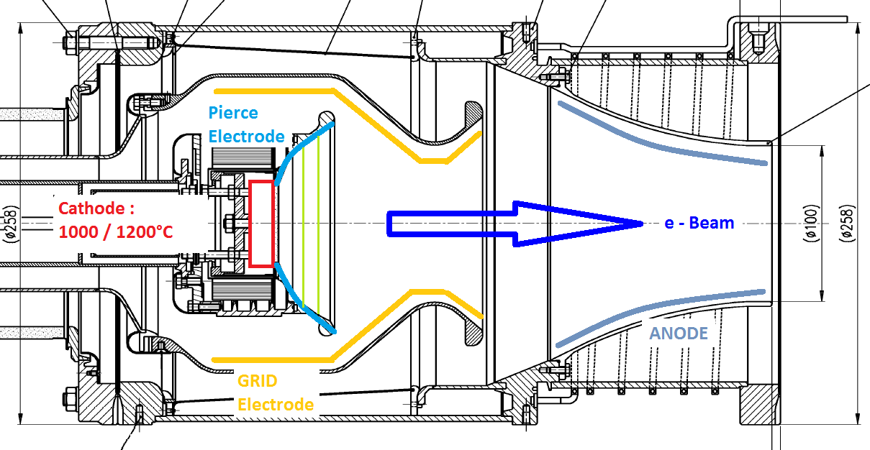
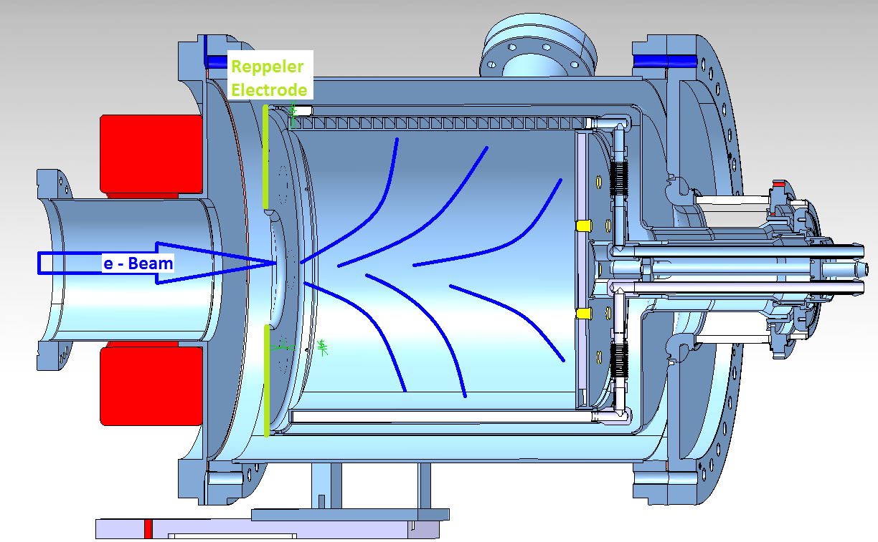
Electron Cooler system is composed of :
Low velocity Electrons Source :
The E-GUN
final current given by Child’s Law:
I = µ .V^{3/2}
A set of Magnetic circuit :
Expansion Solenoïd, Drift, Toroids, Squeezes coils ….
(Used to transport the electrons Beam)
A Electron Anode Recuperator :
The COLLECTOR
BI Day March 10th 2016

Slide 5
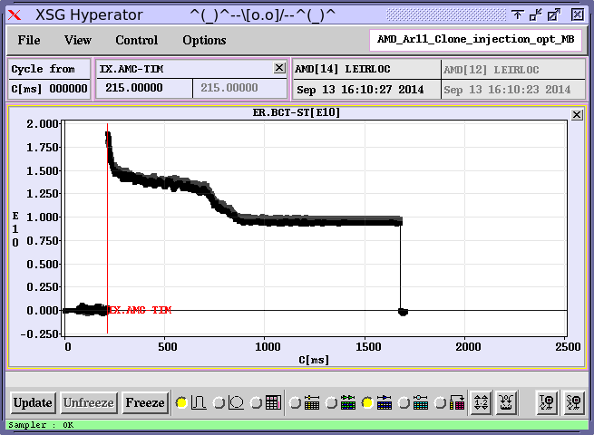
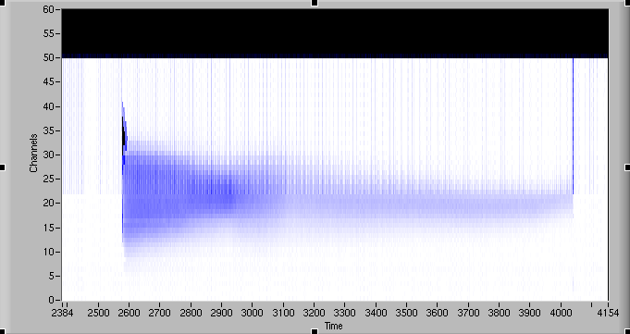
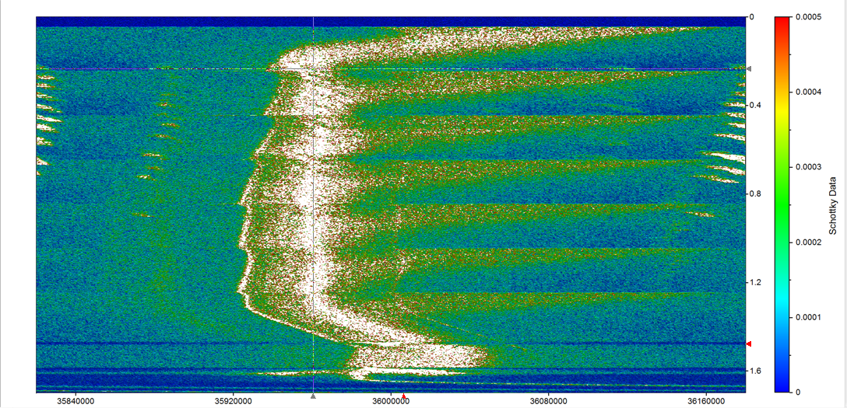
Cooling effects on Beam viewed by
Beam Ionization Profile Monitor
(LEIR Vertical datas acquisitions : A.Frassier)
Schottky Monitor
(Beam Revolution Frequences )
E-cooling
Acceleration
BI Day March 10th 2016

Slide 6
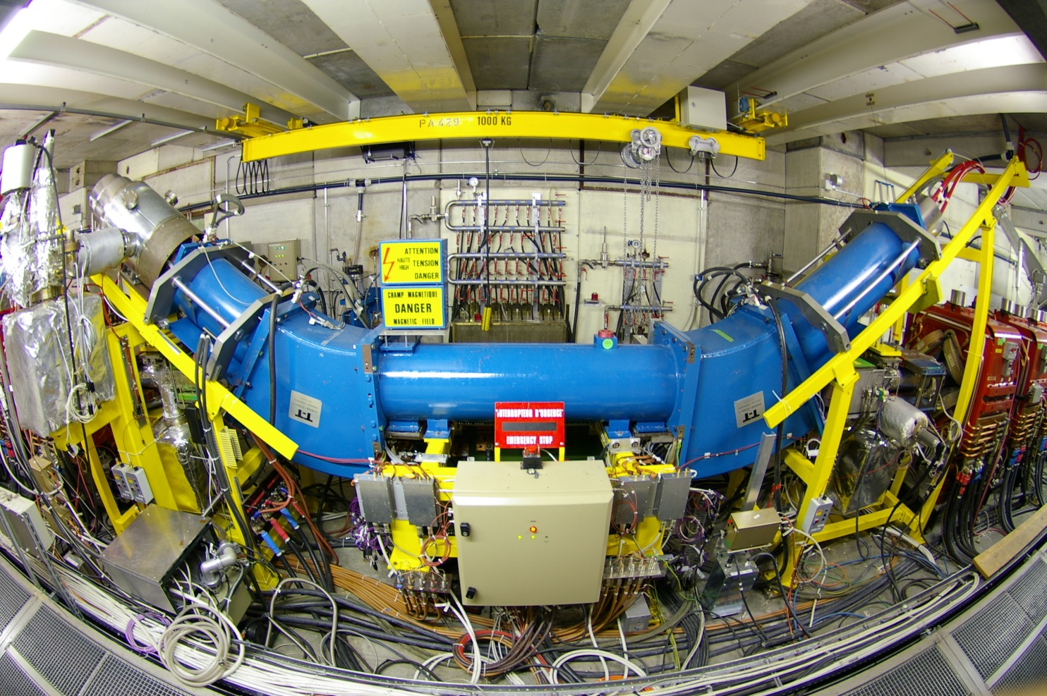
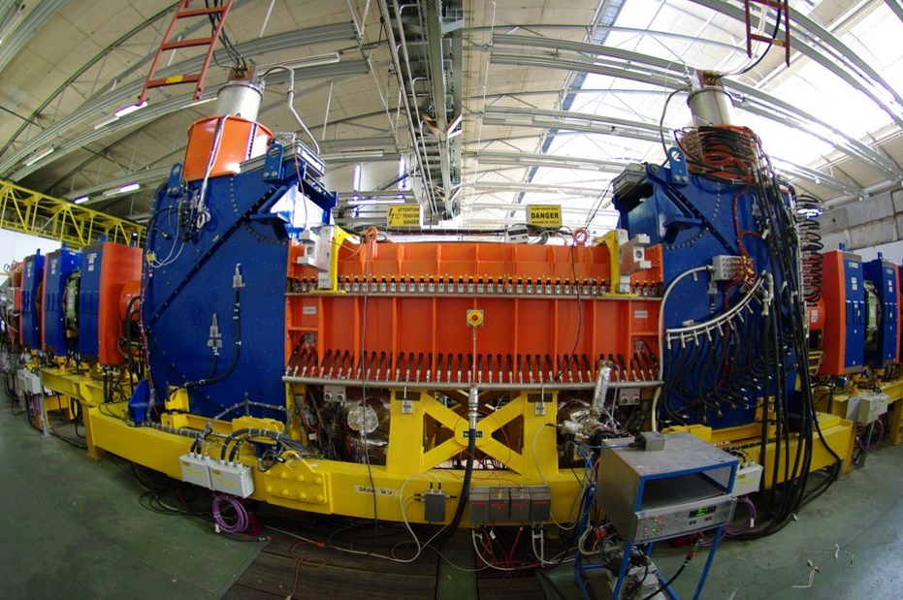
CERN’s Electron Cooler : AD and LEIR
BI Day March 10th 2016

Slide 7
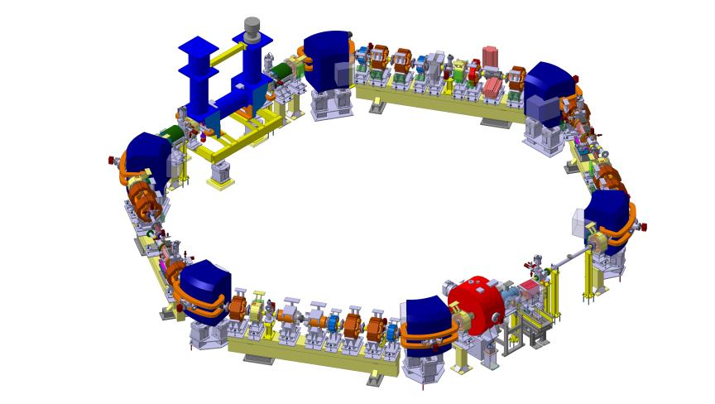
Location
Soon in ELENA Ring
4th Section
BI Day March 10th 2016

Slide 8
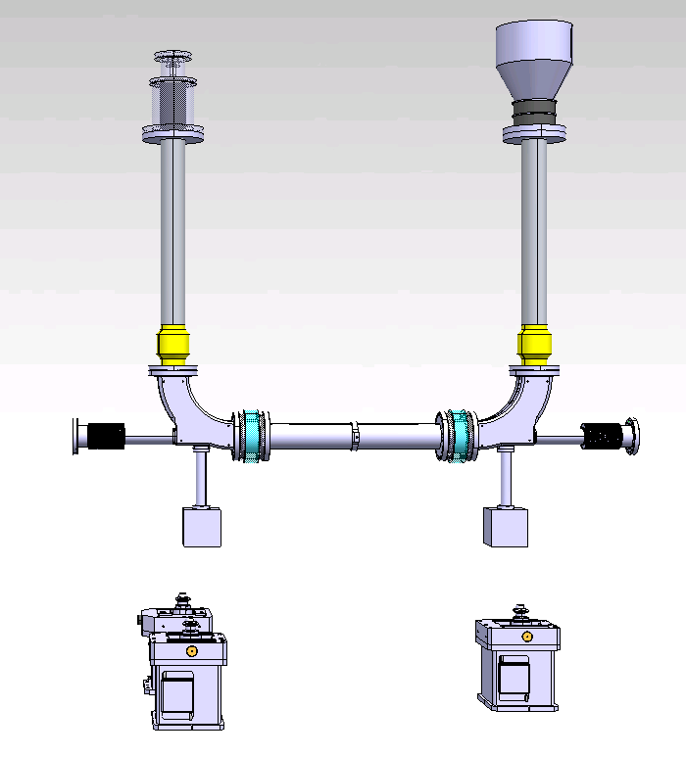

Concept overview of Vacuum Elements
Gun
Collector
Vacuum system
Gun & Collector
Vacuum
Chamber
BI Day March 10th 2016

Slide 9
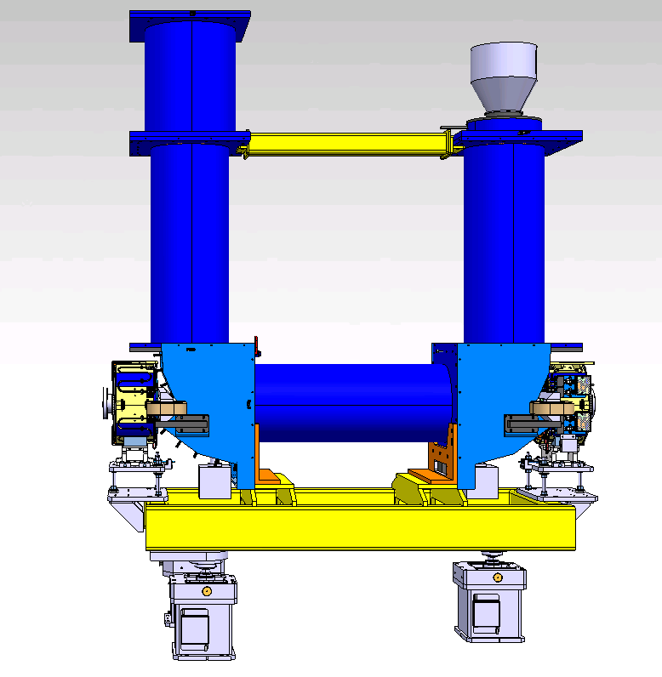

Concept overview of Magnets Elements
Magnets
Supporting system
Toroid

Slide 10
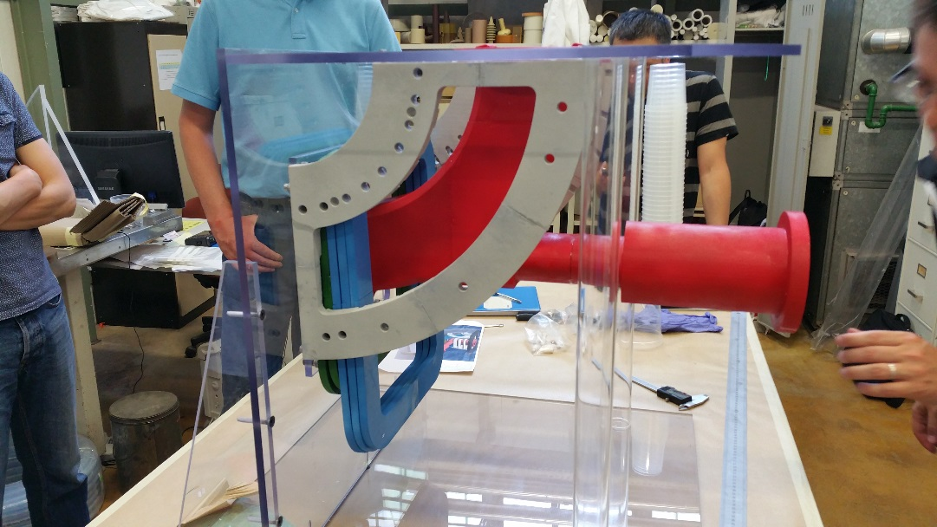
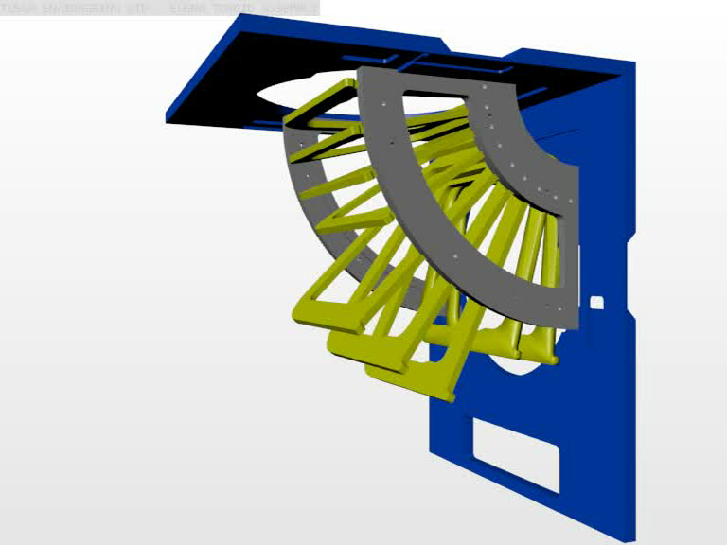
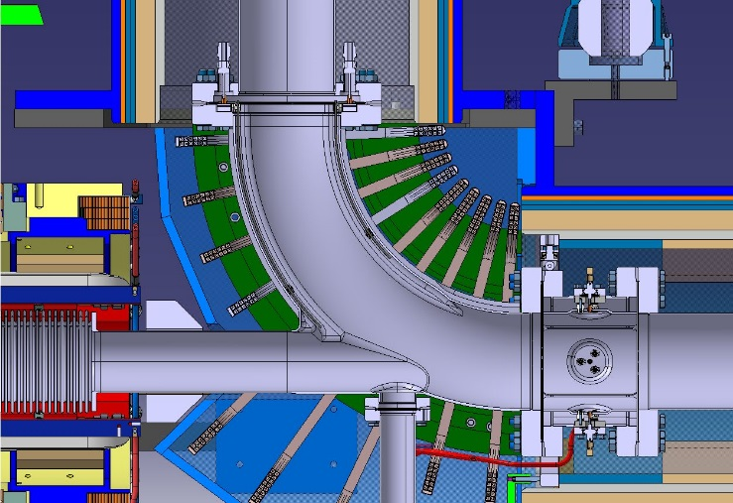
Toroid Assembling details
3D Printing Simulations
Assembling Sequences

Slide 11
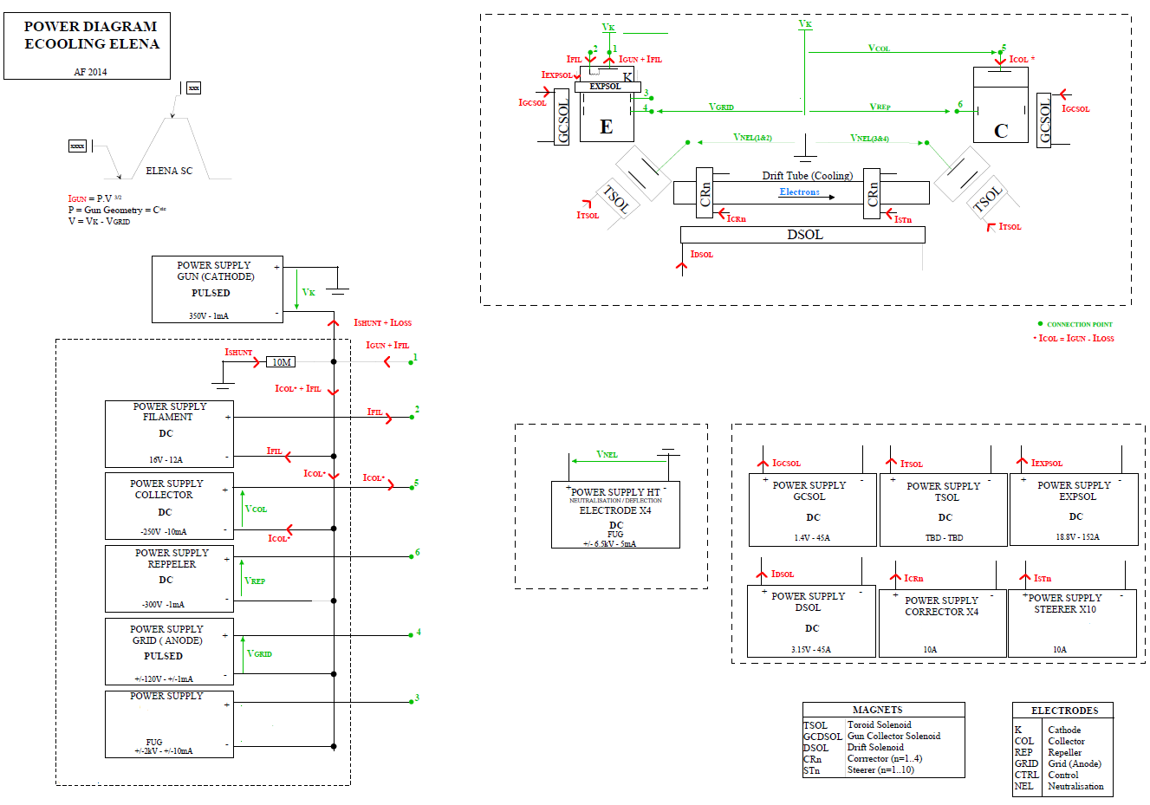
ELENA E-COOLER Power Diagram
Beam Specifications :
I e- : 1/5mA
U e- : -55/-355 V
No High Voltage Cage
Momentum | 35 MeV/c | 13.7 MeV/c
Pbar-beam energy | 648 keV | 100 keV
E-beam energy | 355 eV | 55 eV
I e | 5 mA | 2 mA
Bgun | 1000 G
Bdrift | 100 G
Toroid bending radius | 0.25 m
Cathode radius | 8 mm
E-beam radius | 25 mm
Cooling drift length | 1.0 m
BI Day March 10th 2016

Slide 12
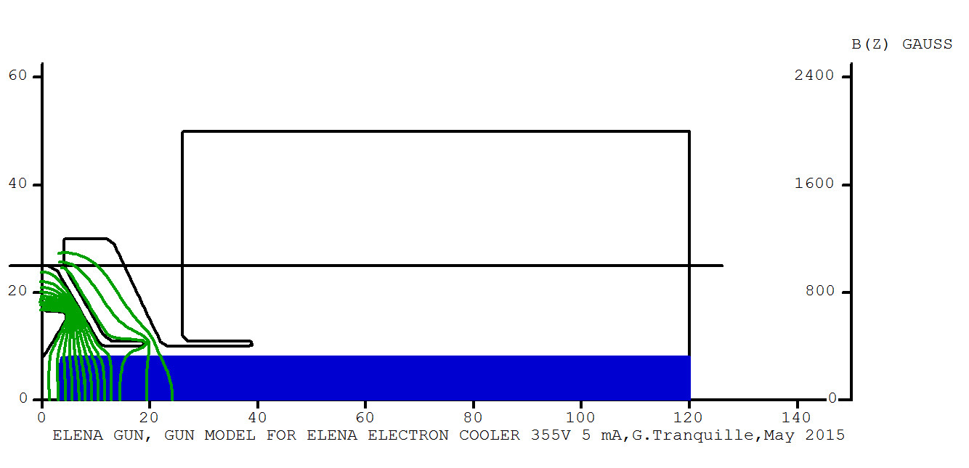
Gun & Collector Design
Gun and collector design optimization performed with EGUN
(I = µ .V^{3/2} )
BI Day March 10th 2016

Slide 13
Gun and Collector Specifications :
(Inspired by : AD, LEIR E-COOLER & FERMILAB design )
Adapted to cathode design, electricals, thermals requirements
Differents electrodes with differents forms, positions & voltages
Modularity for eventuality modifications
XH-Vacuum : 10-12 mmb
Hight temperature Back-out : 200 to 300°
BI Day March 10th 2016

Slide 14
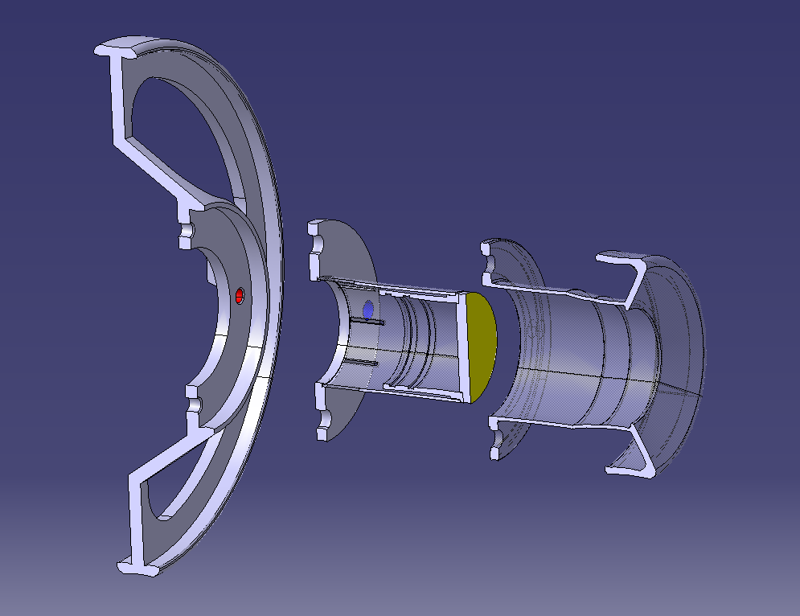
Cathode Assembly Concept overview
Support Cathode
Cathode :
(Provider SAES Getters)
Pierce Electrode
BI Day March 10th 2016

Slide 15
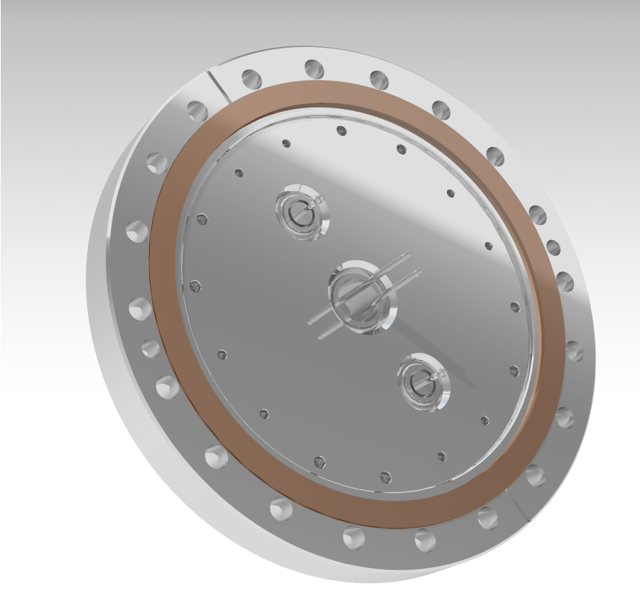
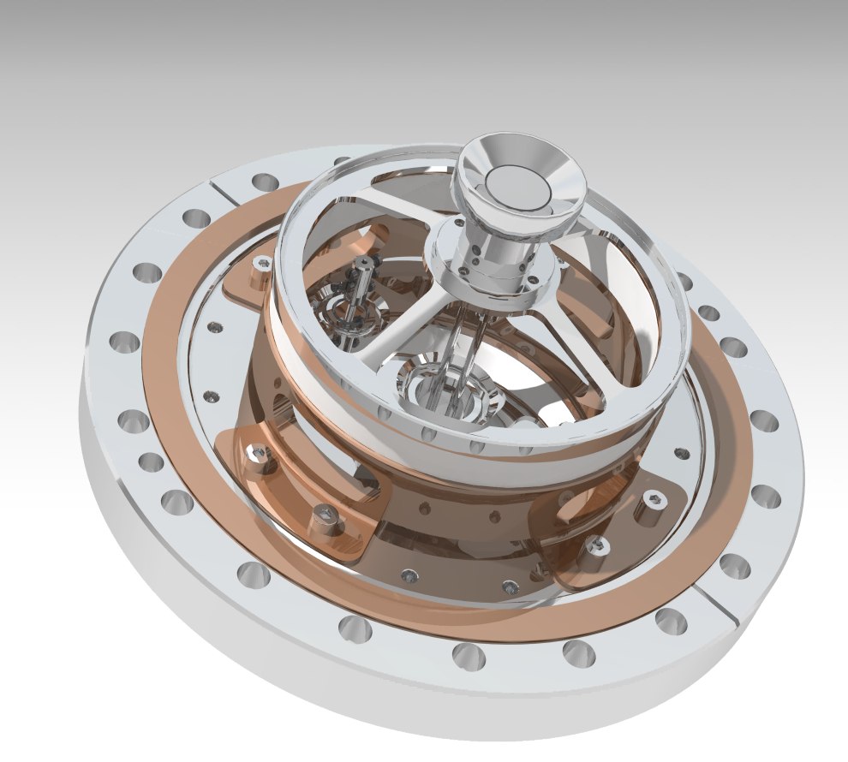
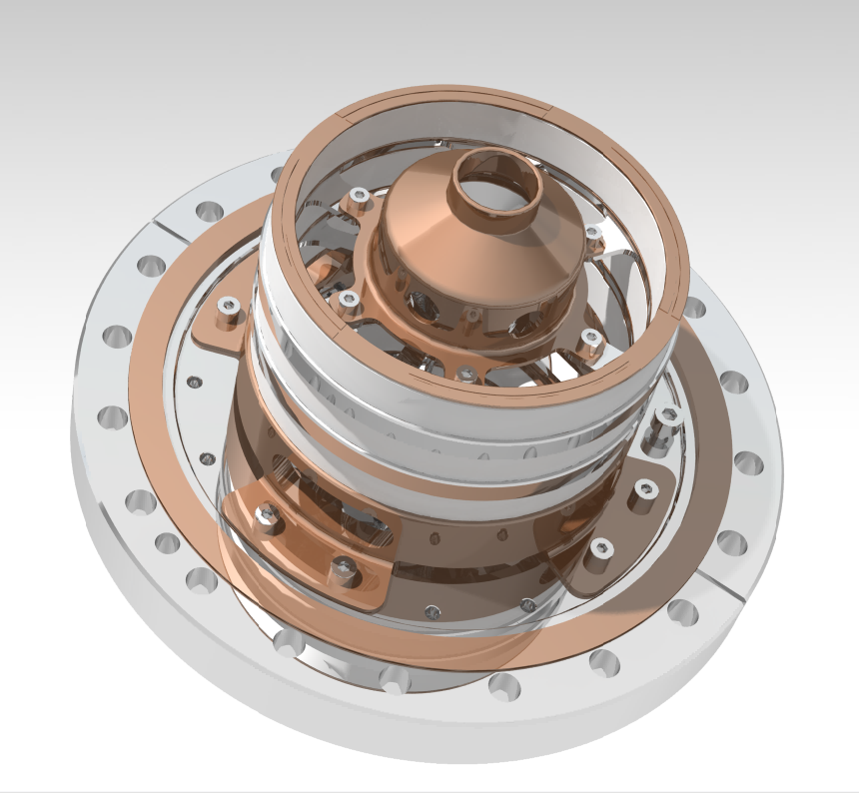
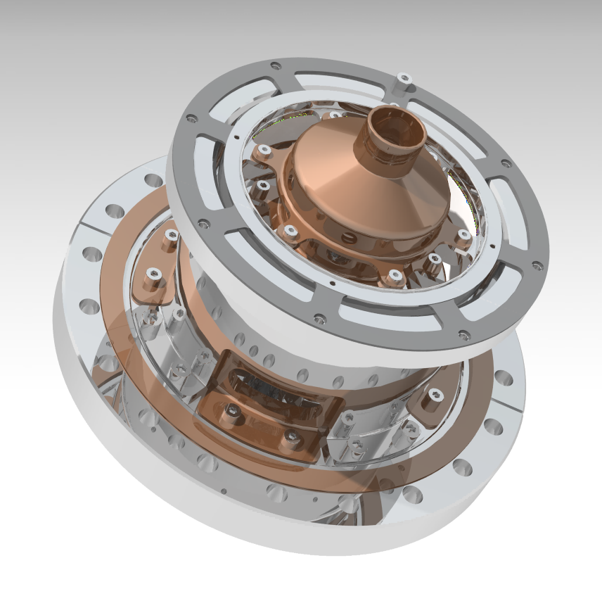
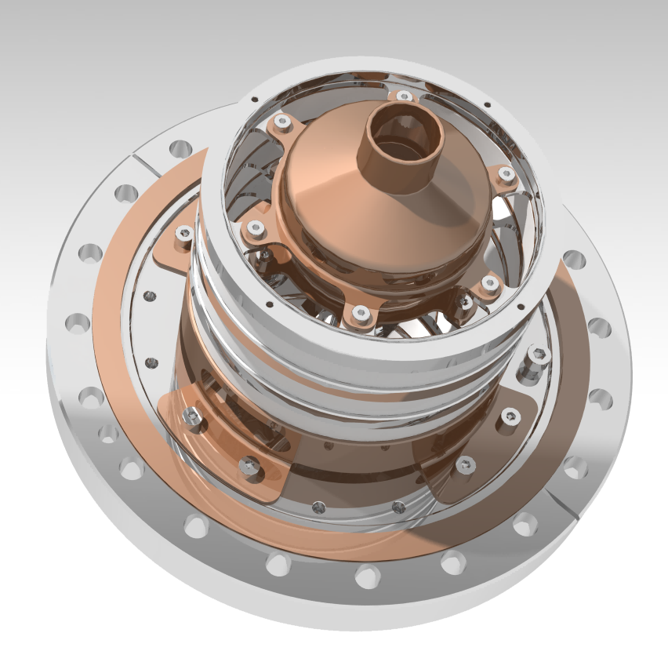
Gun Concept overview
(on CDD: AD_NECGA%)
Gun Flange
(DN160CF + SHV + Fil. connector )
Cathode Assembly
Grid Electrode
Anode Electrode
Each Potential is separate by
ceramic Isolator
Sleeve & Elastique compress ring
(total : 135mm height)
BI Day March 10th 2016

Slide 16
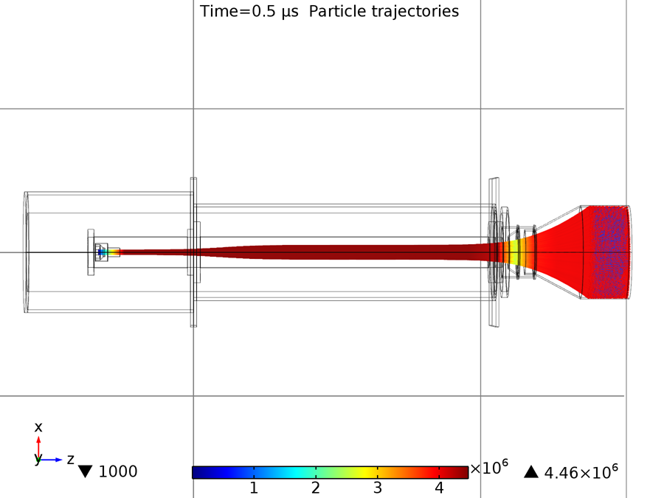
Gun to Collector Design
Gun and collector design optimization performed with COMSOL Multiphysics
(G. TRANQUILLE)
BI Day March 10th 2016

Slide 17
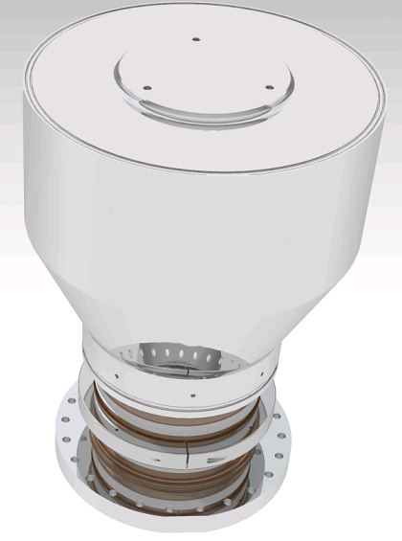
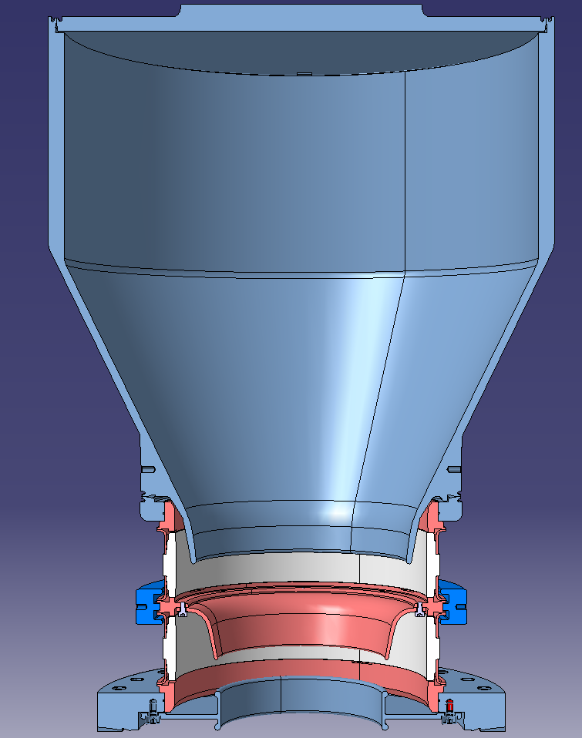
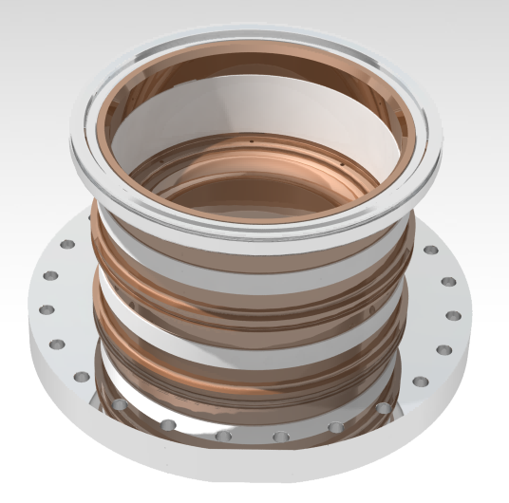
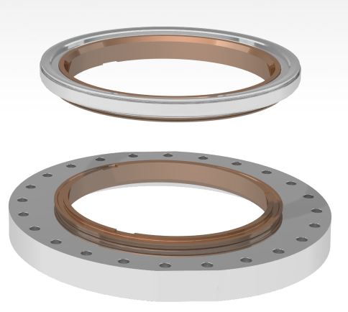
Collector Concept overview
(on CDD : AD_TER% dimensions Ø 314 x 455mm)
Collector (Anode)
Ceramic Isolator
Reppeler Electrode
Ceramic Isolator
Collector flange
(DN200CF)
BI Day March 10th 2016

Slide 18
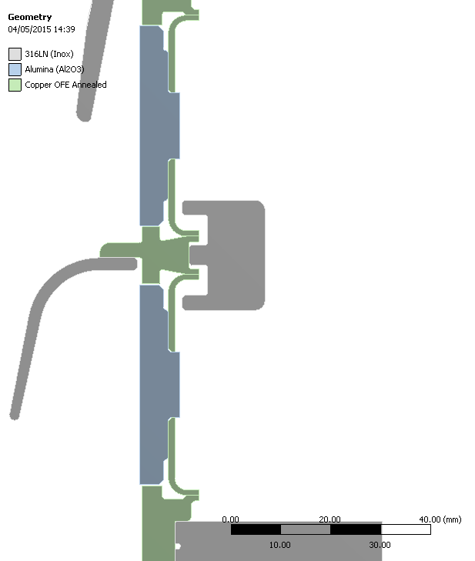
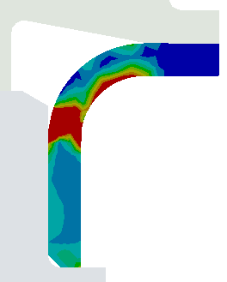
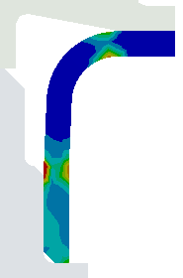
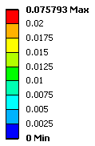

Bake Out Brazing Stress
Simulation modification & validation
(ANSYS by EN-MME)
BI Day March 10th 2016

Slide 19
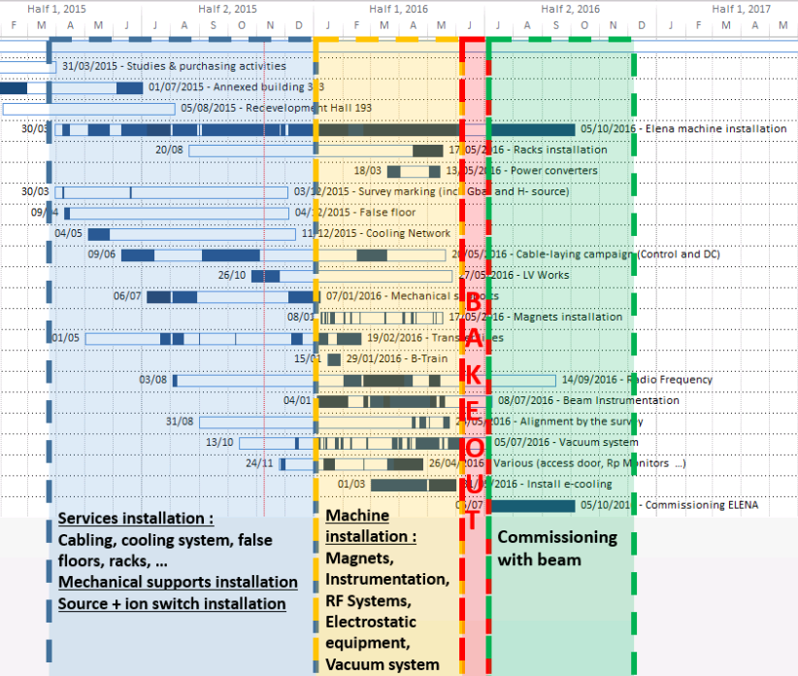
Planning ELENA Electrons-COOLER
Today
2015
2016
2017
GUN & COLLECTOR :
Ready
E-COOLING Assembling in the midle of ring ELENA
Connecting E-COOLER to ELENA ring
I hope it will live
Happily !!!!
BI Day March 10th 2016

Slide 20
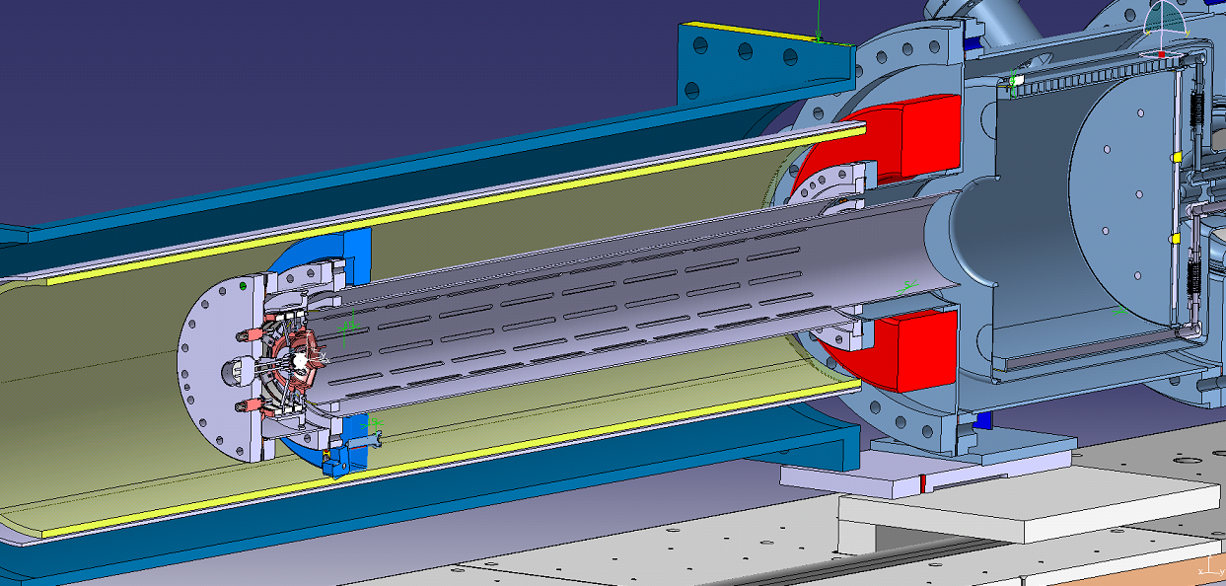
ELENA E-cooler Gun configuration on a lovely Test bench for validation.

Slide 21
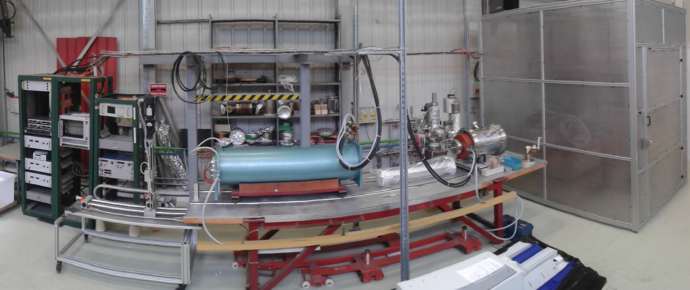
Soon ELENA E-COOLER Gun Beam tests
(Test bench bat 236: Started by R.Sautier)

Slide 22
Thanking to Electron Cooler team :
Gerard Tranquille
Alexandre Frassier
Lars Soby
Lars Varming J.
Marc Timmins
Antti Juhani K.
Alejandro Carlon Z.
Benjamin Moles
BE BI
BE OP
EN MME

Slide 23
That’s All For Now
Next step for E-COOL Team :
A new E-COOLER for AD-RING for LS2
BI Day March 10th 2016

Slide 25
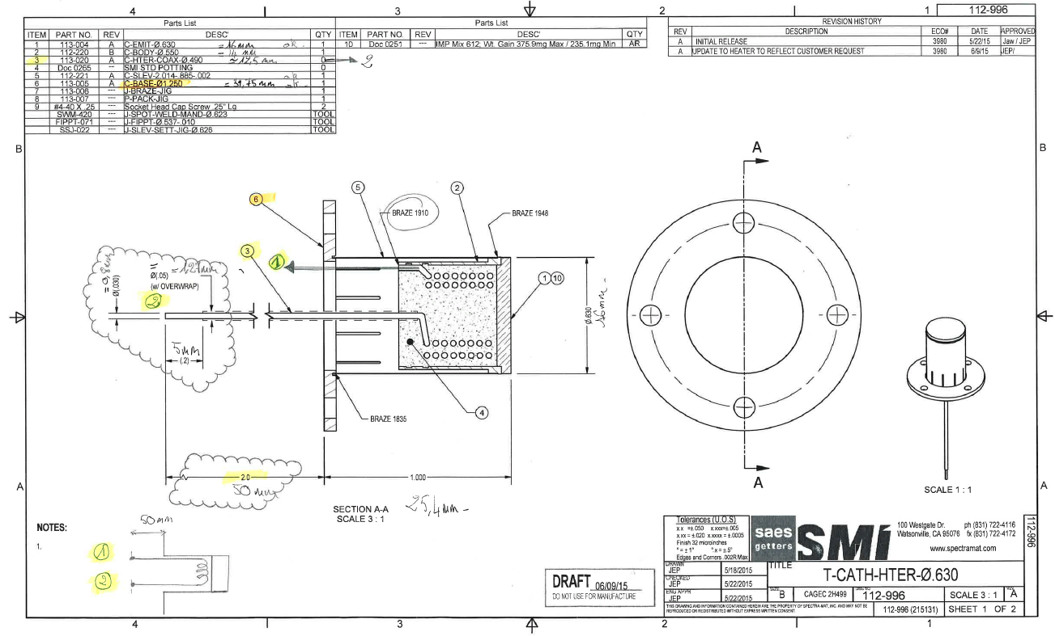

Slide 26

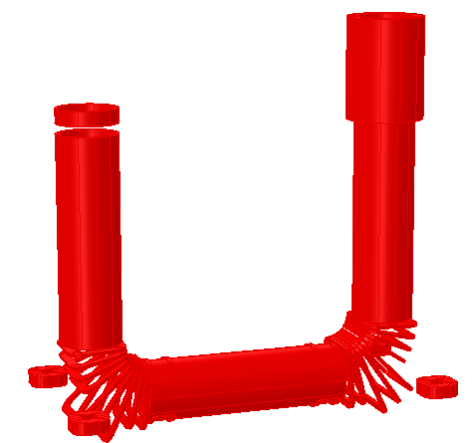
The magnet system
Magnetic system components
Main cooler solenoid
Gun solenoid
Collector solenoid
Expansion solenoid
Squeeze coil at collector
2 x Toroid section consisting of
9 racetrack coils each
Various corrector coils to
ensure good field quality
Orbit correctors
Solenoid compensators

Slide 27
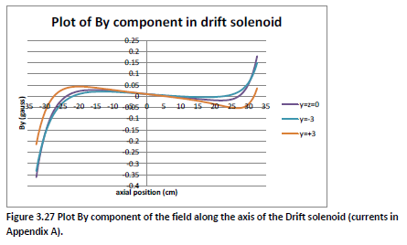
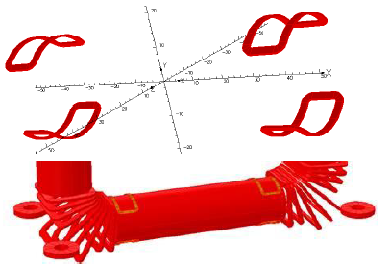
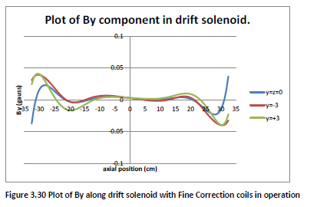
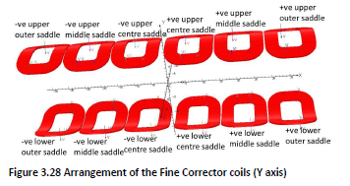
Fine tuning the field

Slide 28
Beam Ionisation Profile Monitors
Readout
MCP
e-
Top Electrode
Ion +
e-
Bottom Electrode
Residual Gas
Vaccum Chamber

