Slide 1
WP9 MagNet
Marta Bajko
X EUCARD2 Annual Meeting Malta 2016

Slide 2
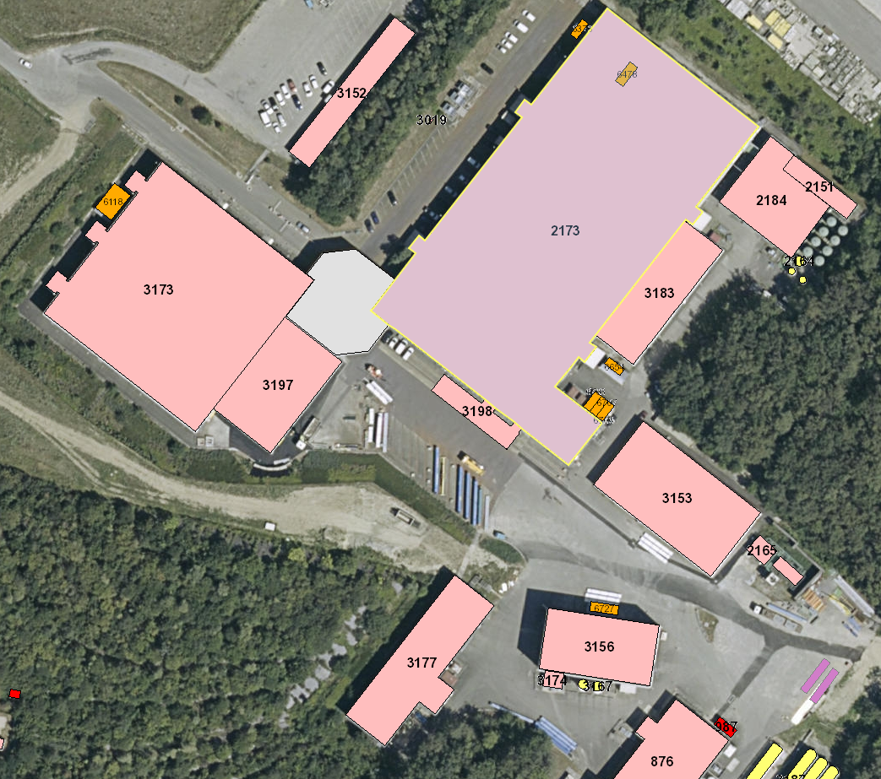
MagNet @ CERN IN SM18
MagNet is hosted at
CERN in b. 2173, known as SM18
Is a test stand for superconducting magnet test

Slide 3
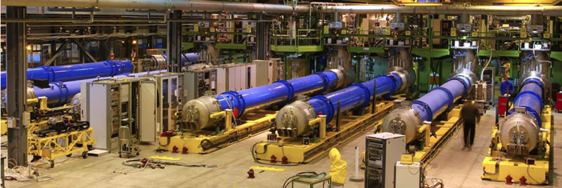
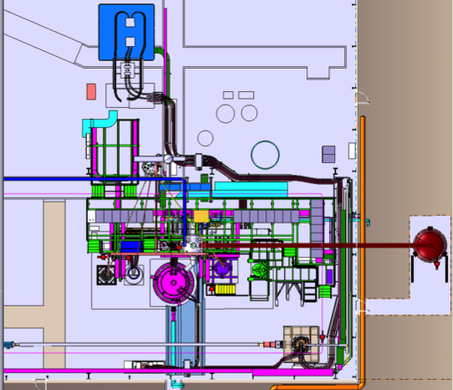
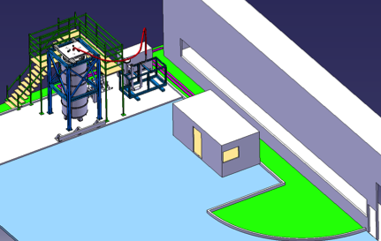
INSTALLATIONS for testing @ MagNet
10 operational horizontal benches
To test magnets with their own cryostats allowing the feeding with current up to 17 kA and coolant up down to 1.9 K LHe. Very much optimized for a series test for 2000 magnets in 5 years.
4 vertical cryostats for 20 kA and 300 - 1. 9 K with possibility of variable temperature He gas feeding and a CRYO COOLER FOR 4.2 K
  Long cryostat with 1 insert+ 1 in preparation
  Diode and HTs lead cryostat with 3 inserts
  FRESCA2 magnet test station to be installed
  Large cryostat to be installed
20 kA power converter
20 kA water cooled cables
Valve box
Control Room
Pumping line
Cryogenic rack
Cryogenic Control
Magnet Flushing Station recuperated from LHC Main Magnet series tests activity
DAQ
HFM cryostat
Cold buffer
Transfer lines recuperated from CRG
10 kA power converter
LN₂ tank
Cryostat borrowed from RF
1 Supercritical He feed Box with 20 kA powering capacity
1 LN2 test station without powering capacity
Control Room
Temporary placed in the parking area

Slide 4
Approved MagNet projects
1. FOSxCRYO (Fiber Optic Sensors FOR CRYogenic ApplicatiOns and Superconducting Magnets)
Project leader: Dr. Andrea Cusano UNIversity of Sanio (IT)
7 members ( It + Hu)
ongoing
2. ThMo_Nb₃Sn (Numerical modelling of Nb₃Sn magnets for particle accelerators )
Project leader: Dr. Fabrizzio Bellina UNIversity of Udine (IT)
5 members ( IT+ USA)
finished
3. AMIT_Mag HeBP (AMIT Magnet Helium Bath Performance)
Project leader: Dr. Fernando Toral CIEMAT (SP)
5 members (all SP)
Finished
see talke of F. Toral
4. ContSysTempSens (Control System for Temperature Sensors )
Project leader: Dr. Vardaine Szarka Angela University of Debrecen (HU)
4 members (all HU)
ongoing
5. AHTDRMC (Analysis of the Heater Tests Data from the Nb₃Sn-model magnet)
Project leader: Dr. Tiina Mary Salmi (FI)
4 members (all FI)
ongoing
6. Electromagnetic and Thermal Analysis of Nb₃Sn Cables and Magnets for Particle Accelerators ( MagTin2016)
Project leader: Dr. Dr. Fabrizzio Bellina UNIversity of Udine (IT)
4 members (all IT)
New
Proposal arrived

Slide 5
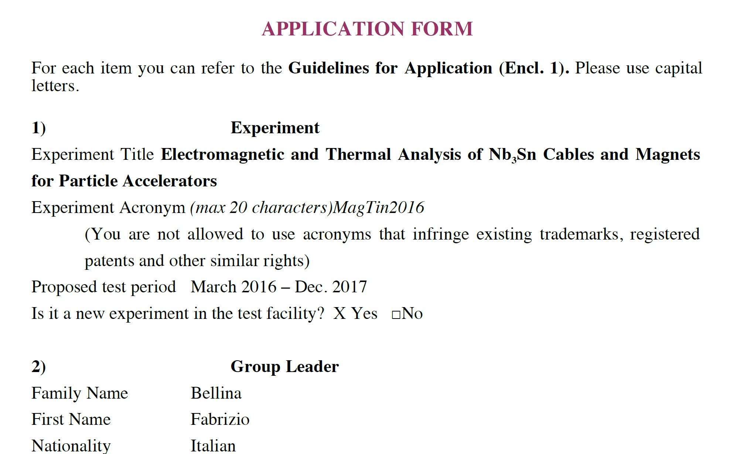
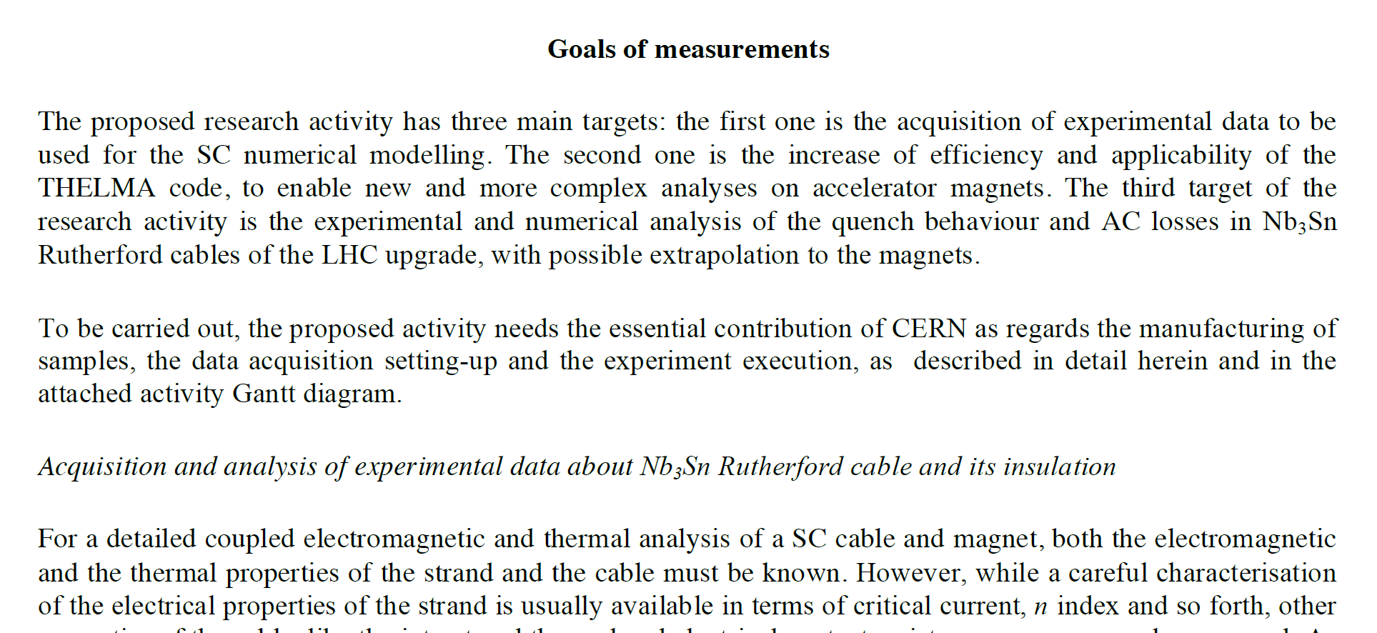
Project proposals
Just approved….

Slide 6
Status of the TNA MagNet 2016
1540 (over 1920) accesses given
6 ( over 8) projects
10 universities and institutes
5 countries ( IT, SP, HU, USA, FI)
22 ( over 60) users
38 travels to CERN
STATUS in 2016

Slide 7
Access distribution in MagNet

Slide 8
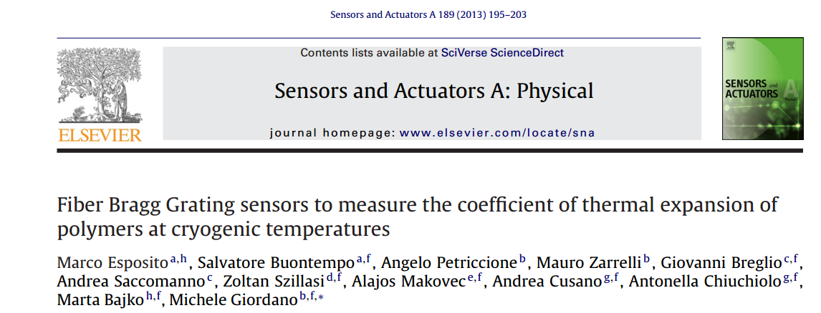
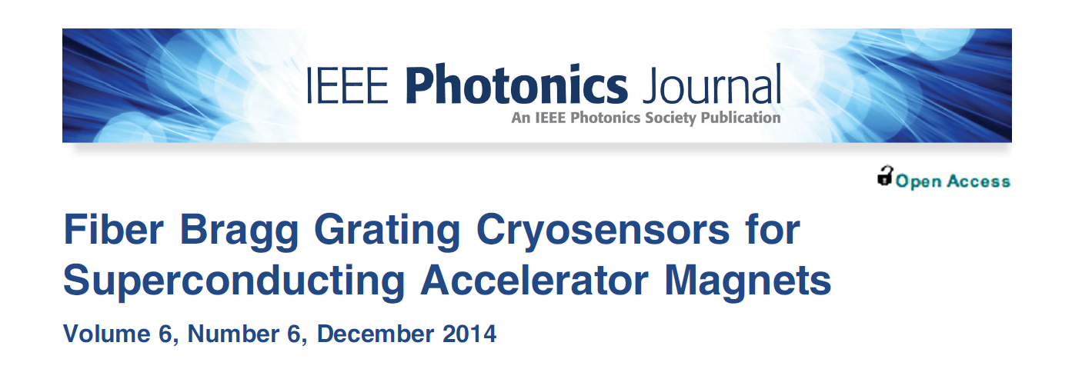
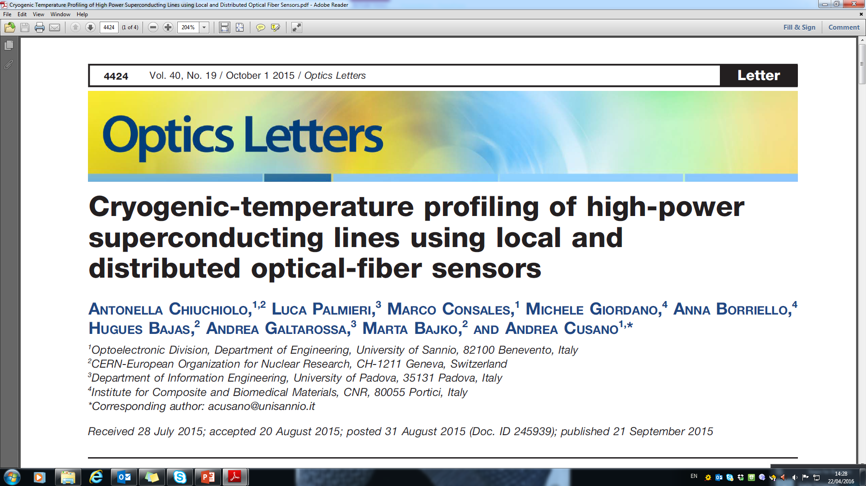
JOURNAL publications
Impact factor:
1.769
Example:FOS x CRYO team
Impact factor:
2.32
Impact factor:
3.292

Slide 9
CONFERENCE publications
“Fiber Bragg Grating Sensors Based Monitoring System for Superconducting Accelerator Magnets”
A. Chiuchiolo, M. Bajko, J. C. Perez, H. Bajas, M. Consales, M. Giordano, G. Breglio, A. Cusano ; Photonics Conference, 2014 Third Mediterranean , vol., no., pp.1,3, 7-9 May 2014
“Fiber Bragg Grating Sensor as Valuable Technological Platform for New Generation of Superconducting Magnets”
  A. Chiuchiolo, M. Bajko, J. C. Perez, H. Bajas, P. Viret, M. Consales, M. Giordano, G. Breglio, A. Cusano; Proc. SPIE 9157, 23rd International Conference on Optical Fibre Sensors, 91579I (June 2, 2014)
“Fiber Optic Cryogenic Sensors for Superconducting Magnets and Superconducting Power Transmission lines at CERN”
  Chiuchiolo, M. Bajko, J. C. Perez, H. Bajas, M. Consales, M. Giordano, G. Breglio, L. Palmieri, A. Cusano, Proc. SPIE 9286, Second International Conference on Applications of Optics and Photonics, 92864B (August 22, 2014)
“Structural Health Monitoring of Superconducting Magnets using Fiber Bragg Grating Sensors”
A. Chiuchiolo, M. Bajko, J. C. Perez, H. Bajas, M. Guinchard, M. Giordano, G. Breglio, M. Consales, A. Cusano,
Proc. of EWSHM - 7th European Workshop on Structural Health Monitoring, Jul 2014, Nantes, France. (2014).
“Cryogenic temperature monitoring in superconducting power transmission line at CERN with hybrid multi-point and distributed fiber optic sensors”
  A. Chiuchiolo, L. Palmieric, M. Consales, M. Giordano, H. Bajas, A. Galtarossa, M. Bajko, A. Cusano
  Proc SPIE, 24° International Conference on Optical Fibre Sensors, Brazil (September 2015)
“Advances in Fiber Optic Sensors Technology Development for temperature and strain measurements in Superconducting magnets and devices”
A. Chiuchiolo, H. Bajas, M. Bajko , L. Bottura, M. Consales, A. Cusano, M. Giordano, J. C. Perez
24th International Conference on Magnet Technology, Seoul, Korea (October 2015), in press on IEEE Transactions on Applied Superconductivity
Example:FOS x CRYO team

Slide 10
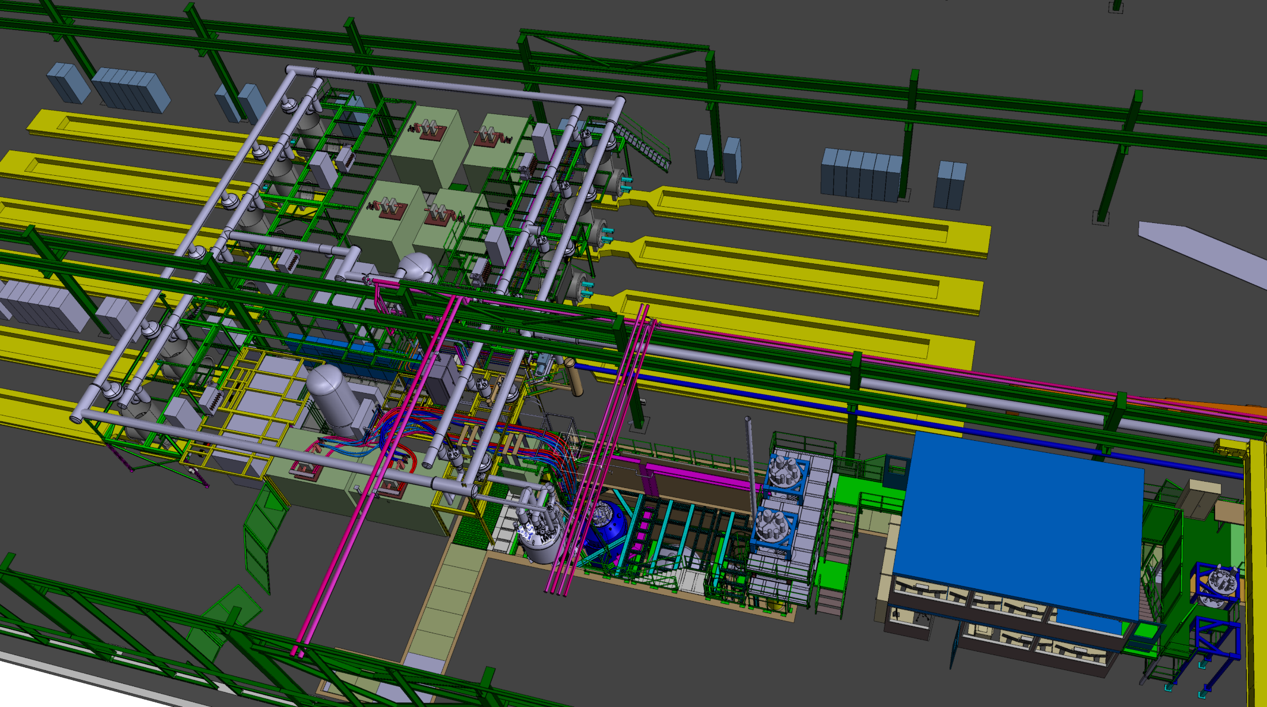
What is ongoing today @ MagNet
We are upgrading the test facility . Altougth the motivation of the upgrade is the HL LHC project, the community can profit of the new installations.

Slide 11
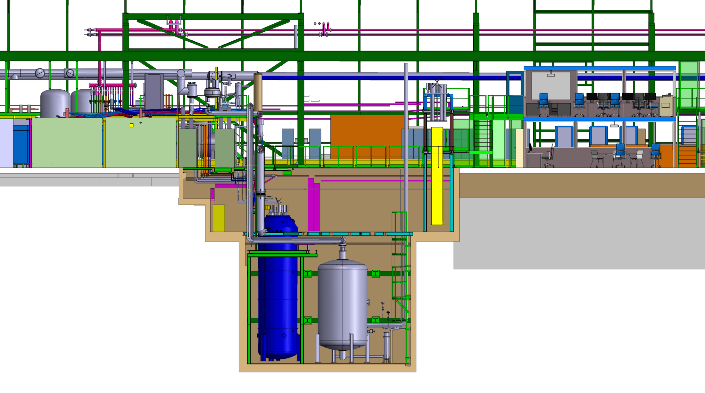
The upgrade of MagNet
Installation of an additional VERTICAL cryostat for 1.9 K and 4.2 K operational temperature and up to 30 kA powering capacity for magnets up to 5 m long and 800 mm outer diameter operation end of 2016.
Horizontal benches will also be updated to 20 kA powering capacity… only for ARIES.
The SERVICES are also upgraded:
increase of LHe production with 35 g/s …. Only for ARIES
increase of demineralized water production with 100 m³/h already for EUCARD2
Increase of powering with 2 MVA Only for ARIES
A new control room for vertical and horizontal test stands already for EUCARD2

Slide 12







Next projects… not yet submitted
on optical fibers
Fiber Optic Fischer connectors qualification at 4.2 and 1.9 K for cryogenic test facilities instrumentation
Novel Fiber Bragg Grating sensors for Nb3Sn coils heat treatment monitoring
Radiation hardness study of FBG based sensors for cryogenic temperature
University of Padova
University of Sannio
National Research Council (CNR)
University of Debrecen
National Institute of Nuclear Physics

Slide 13
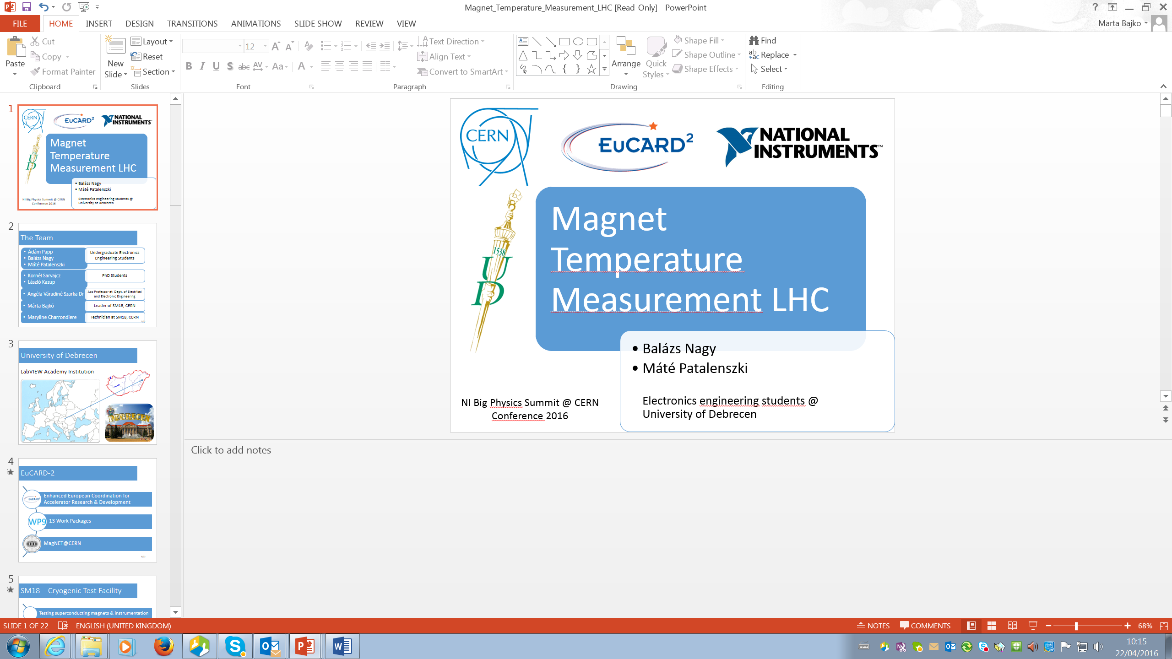
Next projects… not yet submitted
Development for an instrument for high voltage test
Testing of a new hardware with a dedicated software handling High Voltage test in cryogenic environment to levels up to 3 kV and with ultiplexing capacity for different channels.
University of Debrecen
The work done within EUCARD2 was presented by the same team in the “NI Big Physics Summit @ CERN 2016.

Slide 14
Thanks for your attention

