Slide 1


Laser Scanning for the replacement of EVB2 in the
ISIS Synchrotron
Tony Millington
ISIS Accelerator Division
Rutherford Appleton Laboratory

Slide 2
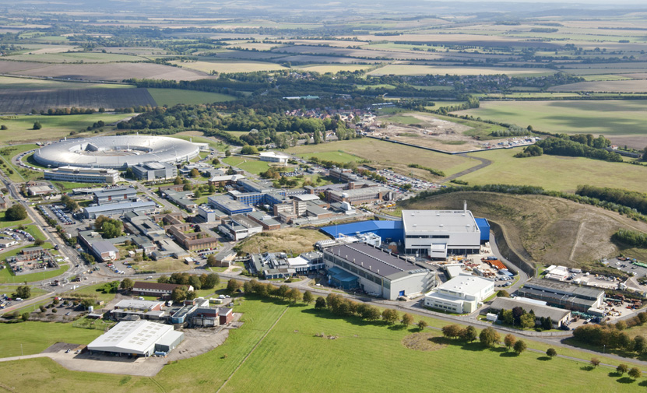
The ISIS pulsed neutron and muon source at the Rutherford Appleton Laboratory in Oxfordshire is a world-leading centre for research in the physical and life sciences.
It is owned and operated
    by the Science and
    Technology Facilities
    Council

Slide 3
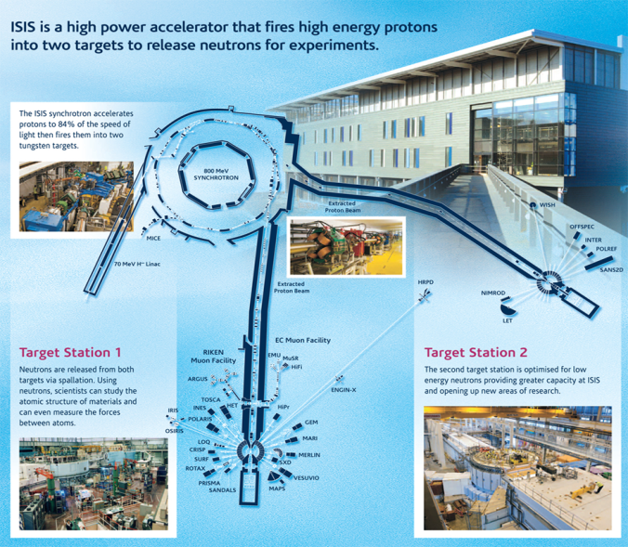
Comprises a 70MeV LINAC, Synchrotron 2 Extracted Proton Beamlines (EPBs) and 41 Instruments
ISIS has been operating since 1984
The second EPB and Target Station (TS2) was added in 2009

Slide 4
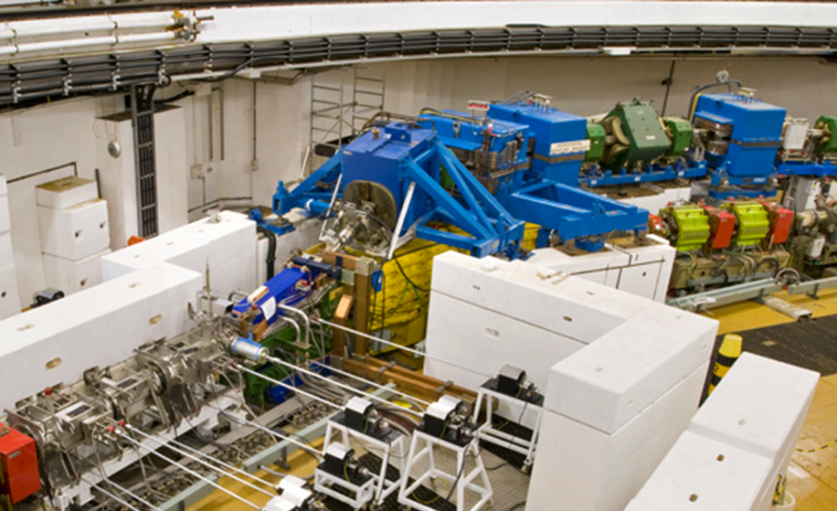
EVB2 Replacement Project
EVB2 is a large vertical bending dipole magnet located in the EPB1 extraction line of the synchrotron
The magnet is over 30 years old and has become increasingly unreliable
Water leaking from
  EVB2 was found to
  have caused
  significant damage
  to the large dipole
  magnet beneath it

Slide 5
Therefore, in late 2013, a project was put in place to replace the existing EVB2 magnet
The scope of the project included procuring a new EVB2 magnet and frame which would replace the existing magnet
The existing magnet could then be assessed and refurbished or replaced to act as a ‘drop-in’ spare
From a survey and alignment point of view, this is where the headaches started

Slide 6
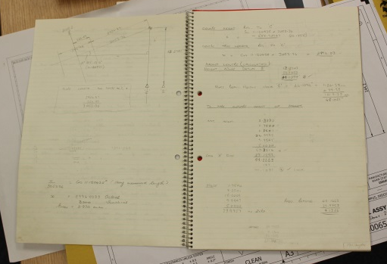
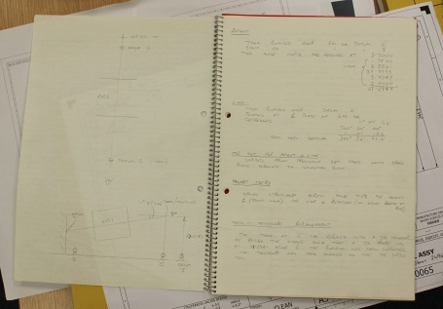
The existing magnet was installed during the original construction of the synchrotron and EPB1 and was aligned using optical instrumentation on a direct line of sight along the beamline
There are no discernible fiducial marks on the magnet, and very limited data or records have been found relating to the initial installation

Slide 7
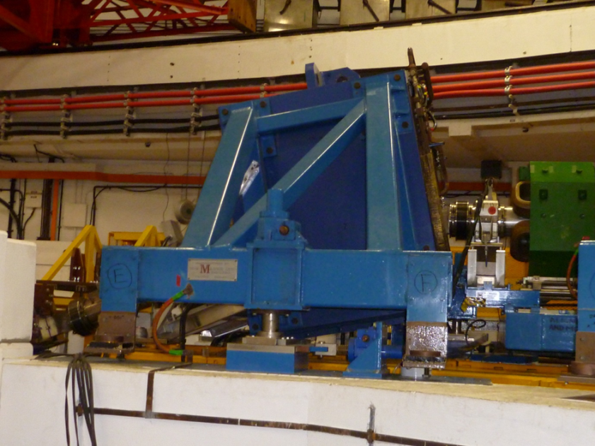
There are two sockets for Taylor Hobson spheres mounted on the ‘inside’ side of the frame, but again no information was found detailing how the sockets related to the magnets position or the beam

Slide 8
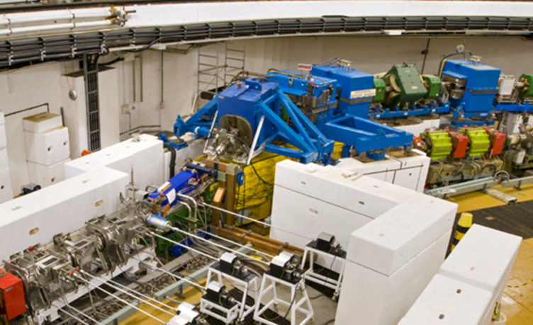
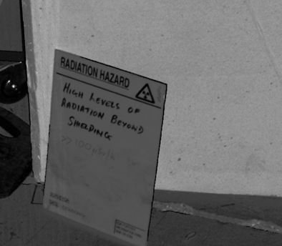
Access problems to EVB2
  High radiation area immediately upstream, ‘dose rate’ in order of 100µSv/hr
  Magnet at ‘high level’ mounted above Synchrotron dipole

Slide 9
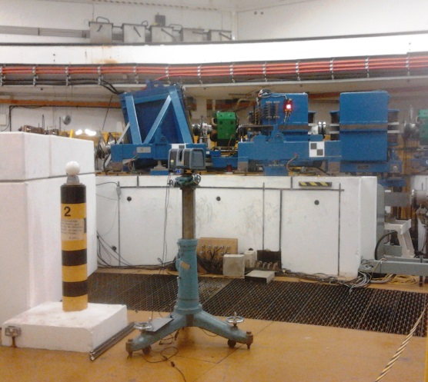
Survey solution
Fundamentally, replacement EVB2 magnet must match to fit the existing flight tubes up- and downstream
Solution was to set-up and pre-align the replacement EVB2 by ‘reverse engineering’ the existing alignment
Difficulties of access to existing EVB2 (high dose rates and elevated position) ruled out using AT401 Laser Tracker
In-situ EVB2 surveyed using Trimble FX Laser Scanner

Slide 10
Trimble FX is a phase shift laser scanner, which when we bought it (Feb 2014) offered significantly better accuracy and scan data quality than most, if not all, terrestrial laser scanners on the market.
At ISIS we also have access to both a GOM and a CreaForm white light scanning systems, as well as a FARO Edge ScanArm.
These systems offer better accuracy than the FX scanner, but share the disadvantage of the Laser Tracker in requiring greater access, and longer times, on and around the scanned item.

Slide 11
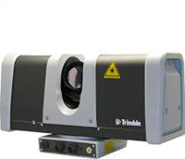
Manufacturer quoted accuracies for the FX are:
  Range uncertainty . . . . . . . . . . . . . . . . . . . . . . . 1 mm @ 15 m single pass (on 90% reflectivity)
  Distance accuracy (std dev.) . . . . . . . . . . . . . . . 0.6 mm @ 11 m (on 90% reflectivity) 0.8 mm @ 21 m 2.4 mm @ 50 m
  Position accuracy . . . . . . . . . . . . . . . . . . . . . . . . 0.4 mm @ 11m 0.8 mm @ 21m 2.0 mm @ 50 m
  Angle uncertainty . . . . . . . . . . . . . . . . . . . . . <30 arc second
  (1.6 mm @ 11 m; 3 mm @21 m; 8 mm @ 50 m)
  Angular resolution . . . . . . . . . . . . . . . . . . . . . . . . . . . . . 8 sec

Slide 12
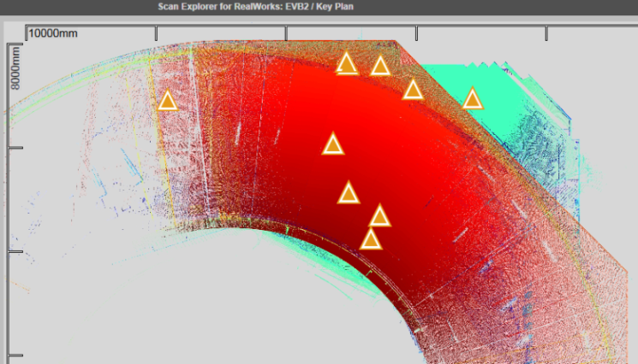
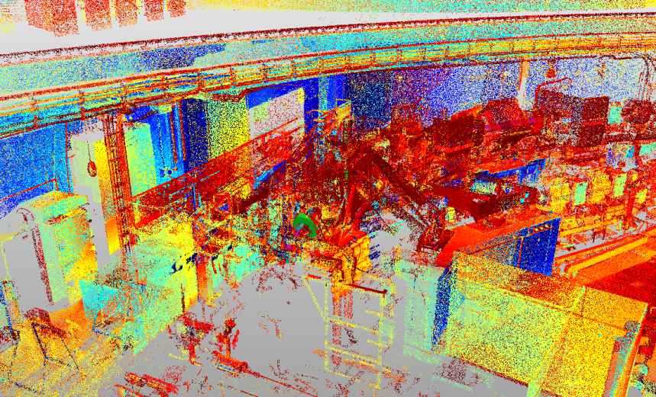
The scanning process on site, within the Synchrotron, required 10 scans – each taking about 45 minutes.
Because we weren’t under significant time pressure we probably over-scanned the area, but even with this number of scans (c 400M points) we still found blackspots where we had no or very little data

Slide 13
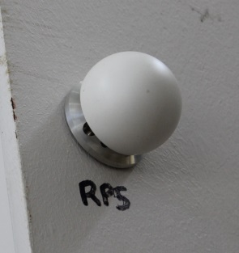
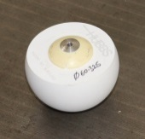
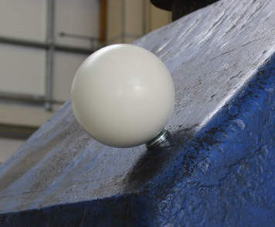
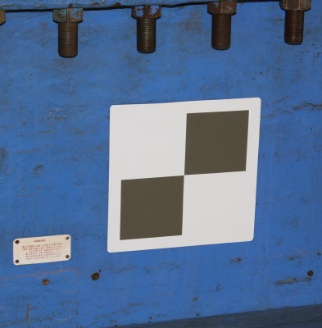
The separate scans were registered using visible targets common to several scans, including
  Hubbs Precision Scan Sphere (PSS)
  Reference spheres
  Chequerboards

Slide 14
All the scan data was processed using Trimble RealWorks®
  The software can automatically identify and abstract the control targets, spheres of a known diameter and black and white chequerboards
  Pairs of targets common to two or more scans are then identified and a least-squares adjustment is performed using the corresponding targets
  The adjustment results in a set of scans which are ‘bundled’ together as a registered point cloud

Slide 15
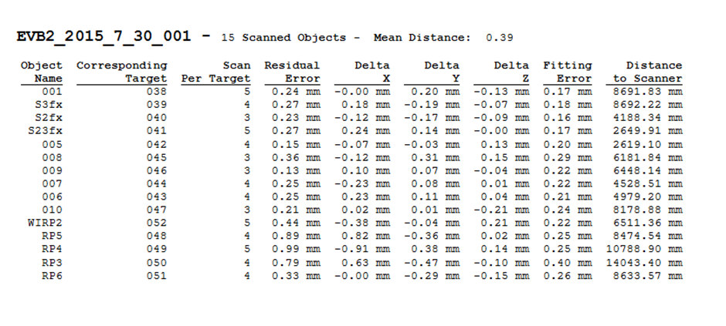

The overall results for the scan registration were
  10 STATION(S) - Mean Distance: 0.32 Max Distance: 0.61
  28 TARGET(S) - Mean Distance: 0.32 Max Distance: 1.10
  Example scan results for individual scan registration (Scan 1)

Slide 16
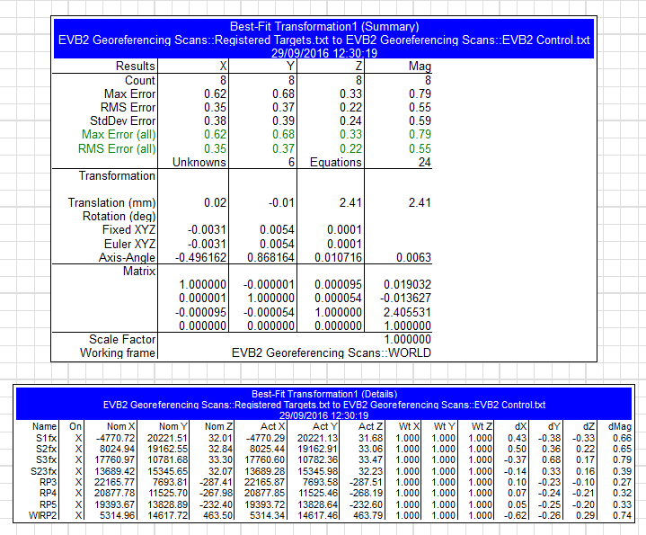

Using a number of scanned PSS targets which were placed on known laser tracker control points, the registered pointcloud was then transformed to the existing Synchrotron Survey Control network

Slide 17


Having completed the registration process, the pointcloud, trimmed to include just the EVB2 and frame (c. 40.5M points), was exported as an .e57 format file
The .e57 file was imported into CloudCompare for ‘cleaning’ and reduction of extraneous ‘noise’
The ‘clean’ cloud (c.26.5M points) was then imported back into RealWorks

Slide 18
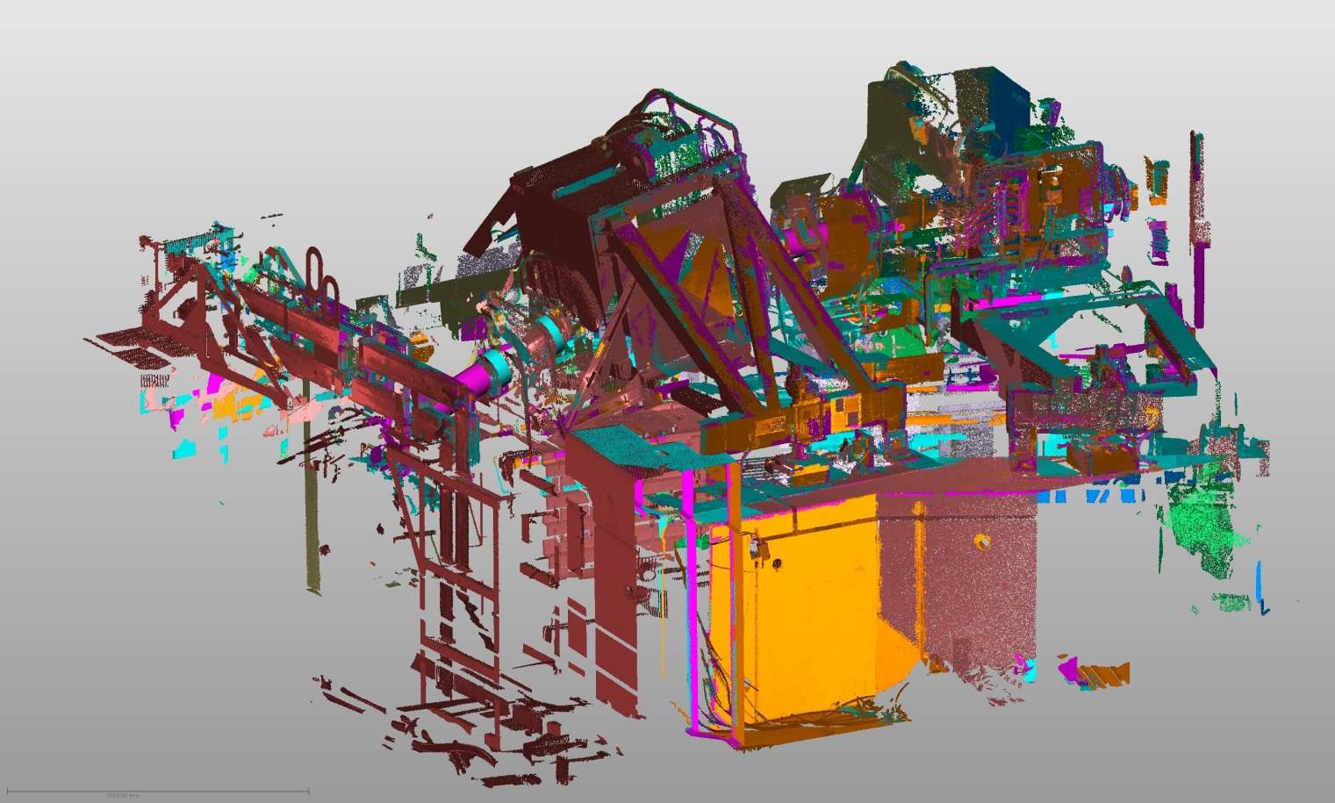

Slide 19
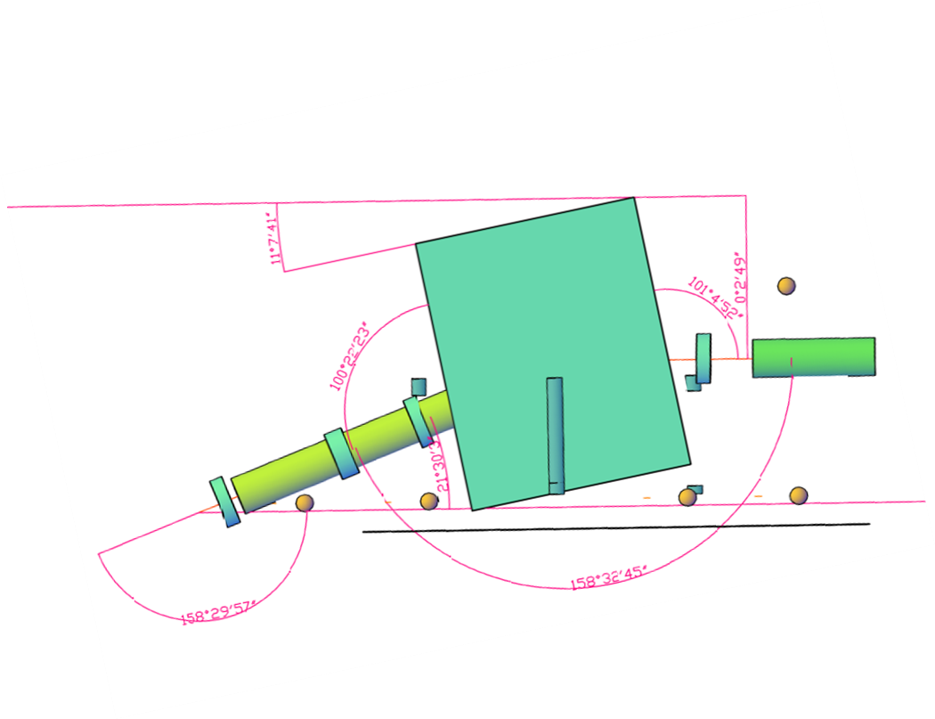
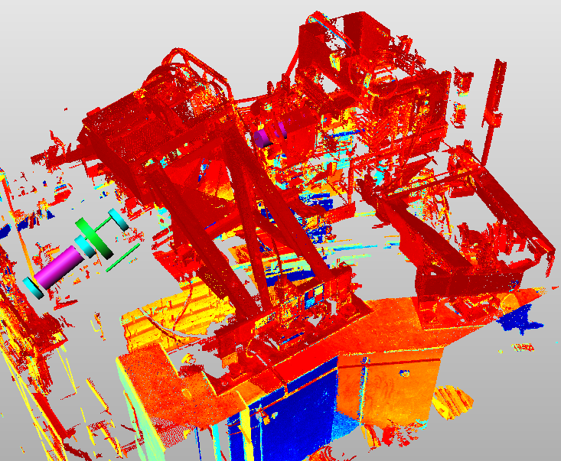
Using the pointcloud modelling functions within RealWorks we were then able to abstract key dimensions and positions for the existing, in-situ, EVB2 magnet which could be used to pre-align the replacement magnet.

Slide 20
We were also able to abstract some information to compare against known measurements, in order to give some confidence in the accuracy of dimensions taken from the pointcloud
  From the original (incomplete) 1984 alignment notes, the magnet was set to a tilt of 11°07’34.5” from horizontal. When we abstracted a ‘best-fit’ plane (5,500points, 0.29mm RMS Deviation) from the scan data we had a tilt of 11°07’41.3”

Slide 21
  We also had the original measured distance between the two TH sockets on the magnet frame.
    The measurement recorded in original notes was 1395.41mm,
    The dimension when taken from the scan data was 1395.36mm.
    When measured using the AT401, the dimension was 1395.47mm

Slide 22
Having obtained the alignment details of the in-situ magnet, we have been able to pre-align the replacement EVB2 to match
However, with no information available to conclusively determine the existing EVB2 relationship to its kinematic mounts, we still anticipate needing some additional, last minute or ‘dynamic’ adjustment when the replacement is installed

Slide 23
At present, the original EVB2 remains operational and a decision has been taken to delay installation of the replacement until absolutely necessary
Final results and assessment of the success (or otherwise) of using the scan data to pre-align the replacement magnet are therefore not yet available

Slide 24

Thank you
  For further information about ISIS please see
    http://www.isis.stfc.ac.uk/about/aboutisis.html
  Also worth a look is the series of YouTube films “Accelerators for humanity” produced by the Royal Institution
    http://richannel.org/collections/2016/particle-accelerators-for-humanity

