Slide 1

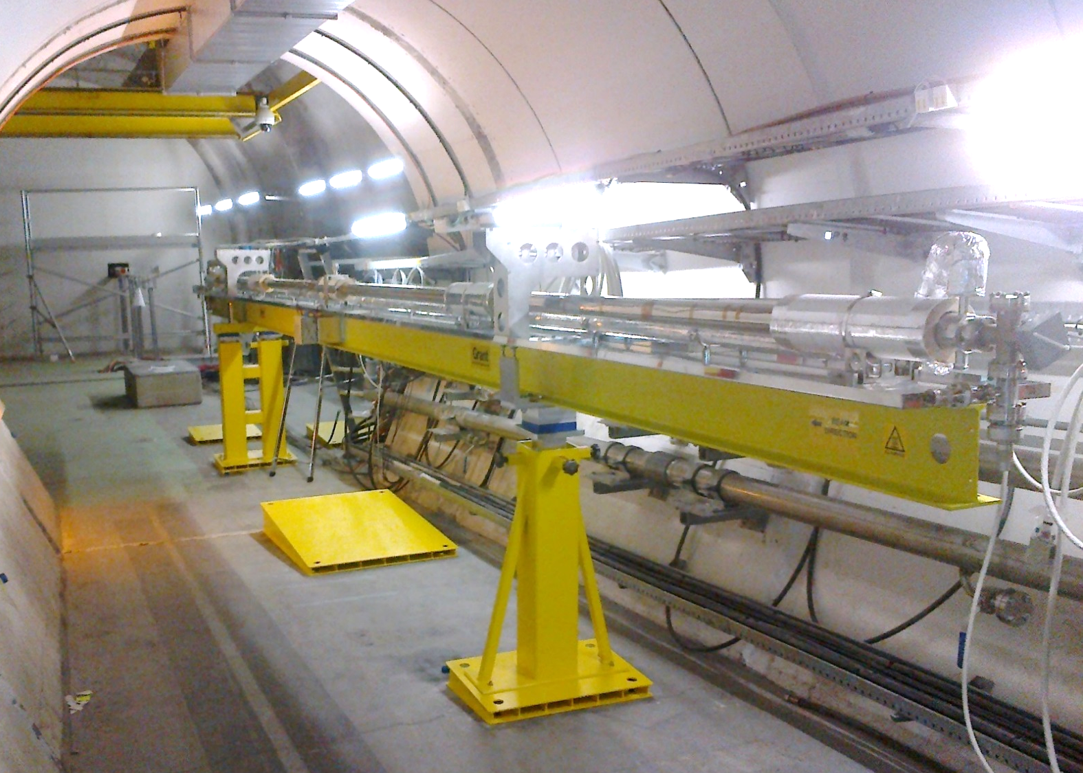
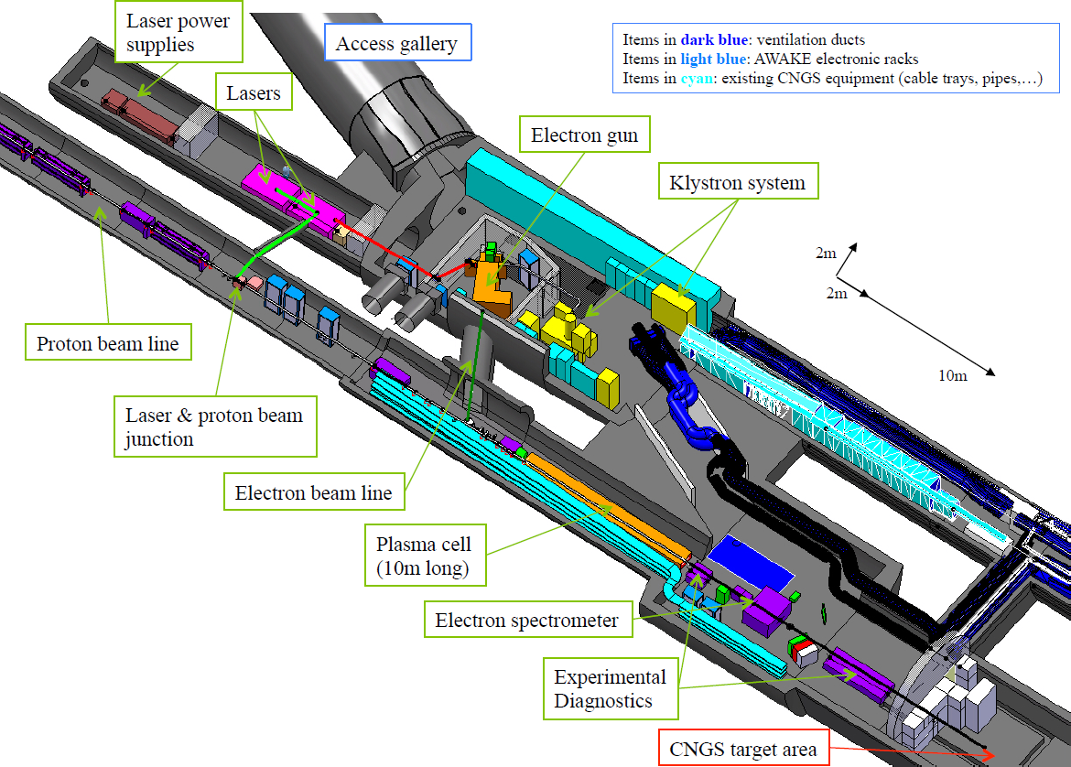
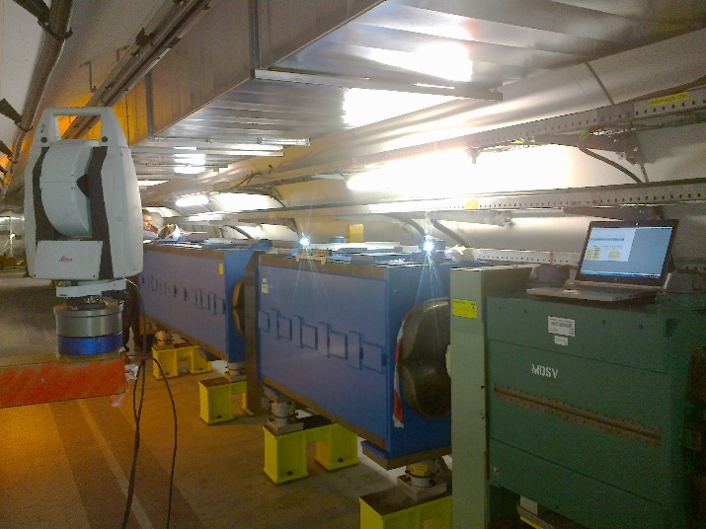
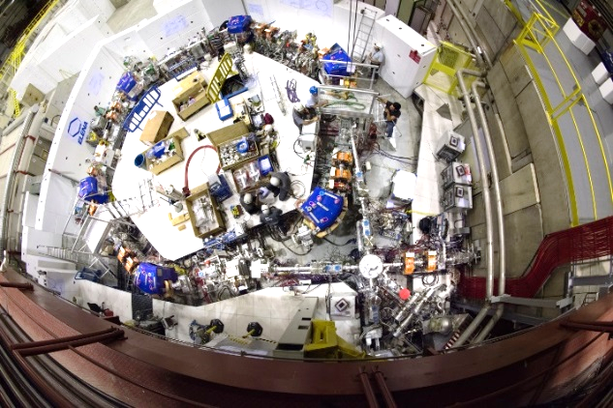
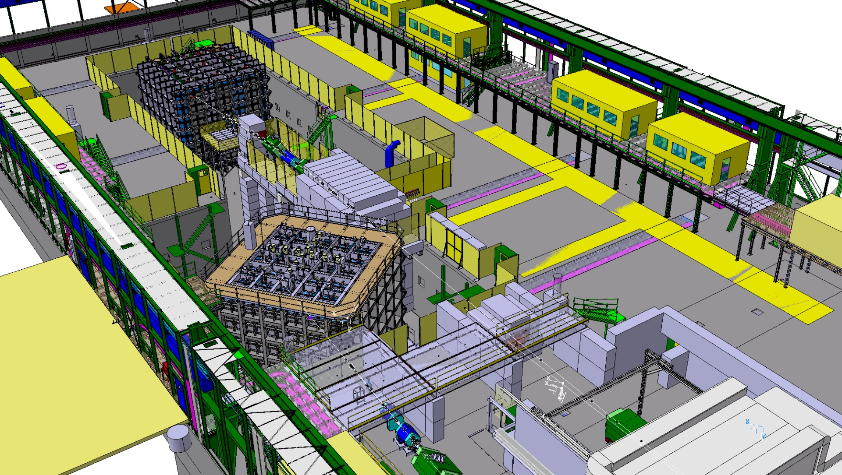
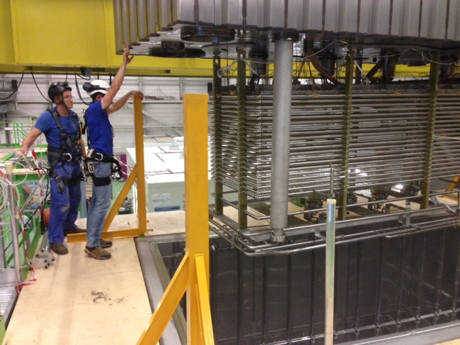
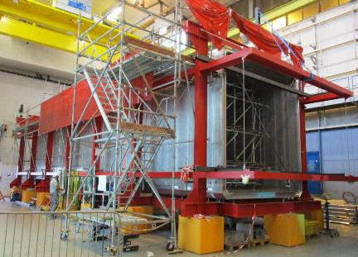
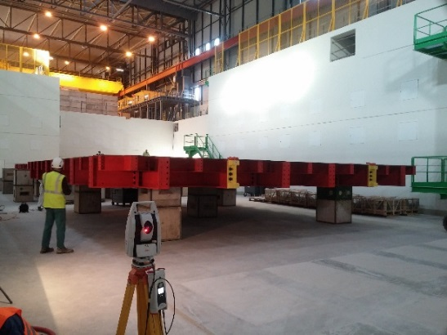
Status Report of Survey Activities
Philippe Dewitte, Tobias Dobers, Jean-Christophe Gayde, CERN, Geneva, Switzerland
Introduction:
Besides the main survey activities, which are presented in dedicated talks or poster, some projects are also progressing at CERN.
AWAKE, a project to verify the approach of using protons to drive a strong wakefield in a plasma which can then be harnessed to accelerate a witness bunch of electrons, will be using the proton beam of the CERN Neutrino to Gran Sasso, plus an electron and a laser beam. The proton beam line and laser beam line are ready to send protons inside the 10m long plasma cell in October. The electron beam line will be installed next year.
ELENA, a small compact ring for cooling and further deceleration of 5.3 MeV antiprotons delivered by the CERN Antiproton Decelerator, is being installed and aligned, for commissioning later this year.
The CERN Neutrino Platform is CERN's undertaking to foster and contribute to fundamental research in neutrino physics at particle accelerators worldwide. Two secondary beamlines are extended in 2016-18 for the experiments WA105 and ProtoDUNE. In parallel the detectors for WA104 are refurbished and the cryostats assembled.
This paper gives an overview of the survey activities realised in the frame of the above mentioned projects and the challenges to be addressed.
AWAKE - Advance WAKefield Experiment
AWAKE will use a protons beam from the Super Proton Synchrotron (SPS) in the CERN Neutrinos to Gran Sasso facility (CNGS). CNGS has been stopped at the end of 2012. A high power laser pulse coming from the laser room will be injected within the proton bunches to create the plasma by ionizing the (initially) neutral gas inside the plasma cell. The protons bunches will initiate the wakefields plasma. A second beam – the “witness” low energy electron beam – would then be accelerated by the wakefields, gaining up to several gigavolts of energy in only 10 meter.
The installation work done mainly consisted to align the magnets and beam instrumentation installed along the 85m new proton beam line and to align the laser beam line. The 10m plasma cell, main part of the experiment was fiducialized on surface and installed in the tunnel. The supports for the laser diagnostic line (OTR/CTR line) after the plasma cell were also aligned. All beam components along the 750m transfer line TT41 were smoothed during the injectors Year End Technical Stop (YETS) in 2016.
AWAKE : the plasma cell
In June 2016, a major milestone were successfully passed : the first proton beam was extracted from the SPS and hit at first shot the last beam profile monitor at the end of the line.
The next steps are to align the plasma cell with its 2 rubidium sources and to install the new electron beam line.
AWAKE : Alignment of magnet with Leica AT 401
Design of AWAKE experiment
ELENA - Extra Low ENergy Antiproton Ring
ELENA, the Extra Low ENergy Antiproton ring – an upgrade of the existing Antiproton Decelerator (AD) - is a small magnetic decelerator ring of 30 m in circumference that fits inside the present AD Hall . It will slow down the 5.3 MeV antiprotons from the AD to an energy of just 100 keV, thus being able to increase the number of trapped antiprotons by a factor of 10 to 100. In addition, ELENA will allow parallel operation of up to four experiments and opens the possibility to accommodate an extra experimental area, which will be built as an extension of the current AD Hall.
The survey activities consisted first of all in transferring the geometry from the AD machine into the hall housing ELENA, establishing a network for the first alignment of the ELENA Ring and the transfer lines. Later, the beamline and dedicated points for the installations of girders and stand alone elements were marked on the floor. This was followed by the first alignment in 3D (with an AT 40X) of around 50 elements with respect to the network.
Last but not least, a smoothing will determine the high precision neighbouring accuracy of all main elements of ELENA, before the commissioning of the machine will start later this year.
ELENA in the AD Hall
ELENA – fish eye view
CENF - CERN Neutrino Platform Project
The Neutrino Platform will provide facilities at CERN in order to allow the development and prototyping of the next generation of neutrino detectors. An extension of EHN1 experimental area is being built in which charged particle beam lines will be installed and will host the neutrino detectors WA104, WA105, ProtoDUNE and BabyMIND. The CERN survey section is deeply involved in the alignment of the two new beam lines, in the geometrical follow-up during construction of the large cryostats as well as in the survey during assembly and installation of the detectors.
Survey work for extension of H2 and H4 beamlines to experiments
Survey of the EHN1 extension hall at delivery
Installation of the reference networks
Marking of the beam lines
Metrology and fiducialisation of a part of the beamline elements
Alignment of the components
Smoothing of the lines
WA105 prototype - Top Cap insertion in the Cryostat
3D view of the CENF experimental area
Survey work for the Neutrino experiments
Geometrical validations and alignment works for the assembly of the two large WA104 cryostats (4 m x 4 m x 20 m each)
  Geometrical controls at major steps
  Control and alignments for the insertion of the detectors in the cryostats before transport to the US
Geometrical follow-up of the WA105 and ProtoDUNE cryostats construction
  Survey measurements on detector prototypes
  Measurements for the preassemblies
  Control of the cryostat bases
  Alignment taking in account the as-built cryostats
Geometrical checks for assembly of WA105 and ProtoDUNE detectors following the demands of the Physics Collaborations
Alignment of the detectors inside the cryostats with respect to the corresponding beam lines
First WA104 cryostat under construction
ProtoDUNE base supporting structure during shape control

