Slide 1





14. International Workshop on Accelerator Alignment · 3 - 7 October 2016 · ESRF – Grenoble - France
HYDROSTATIC LEVELLING SENSORS
BASED ON EXTRINSIC FIBRE
FABRY-PEROT INTERFEROMETER
TECHNOLOGY

Slide 2
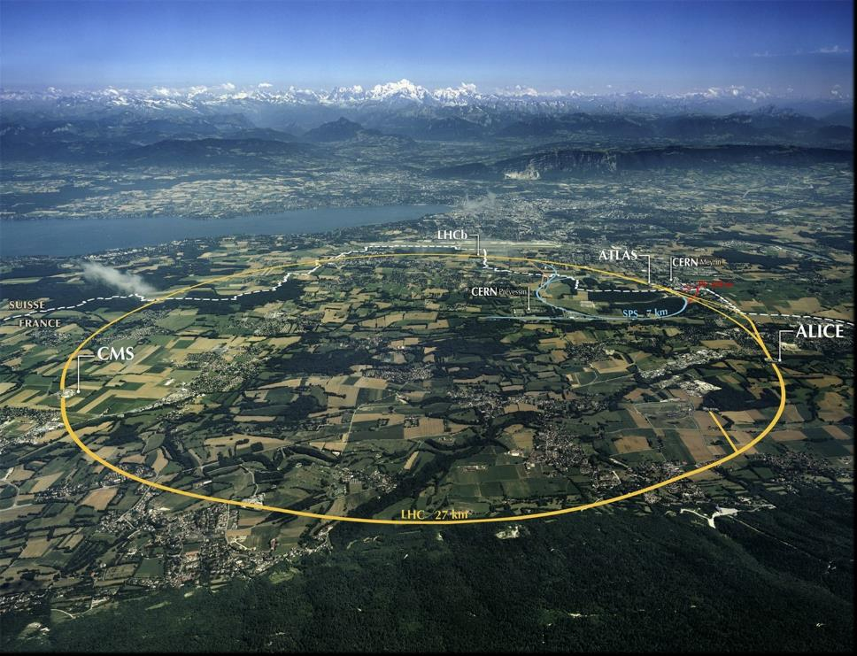
PROJECT OVERVIEW
HL-LHC
AIM
upgrade luminosity of LHC
increase collisions by factor 10
lifetime of inner triplets reached by 2023 @ 300 fb⁻¹
Alignment consequences
maintain alignment concept
with hydrostatic levelling for vertical and roll
larger zone to be covered by monitoring systems

Slide 3
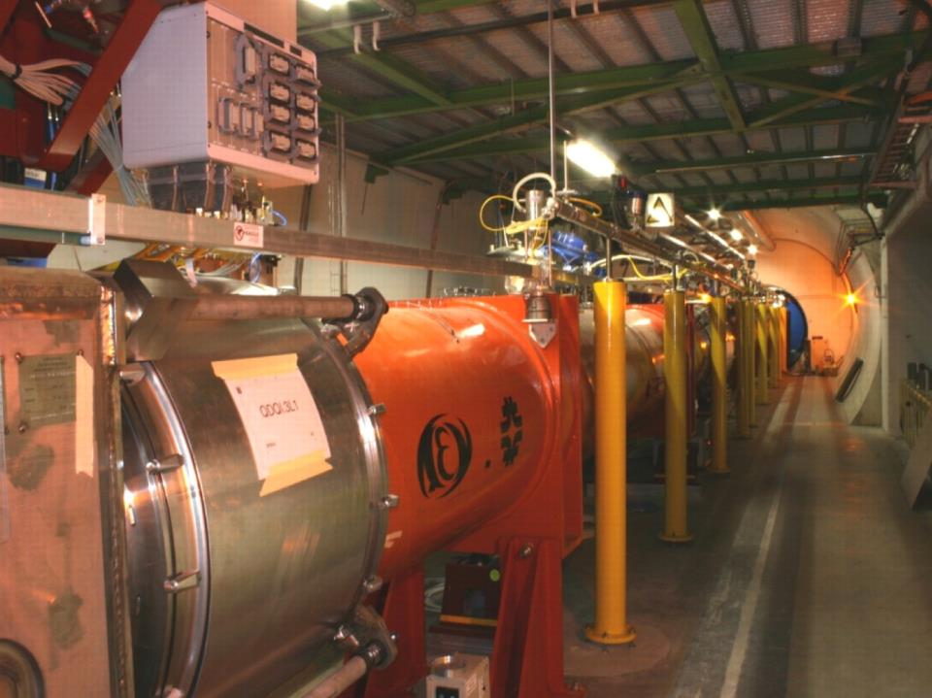
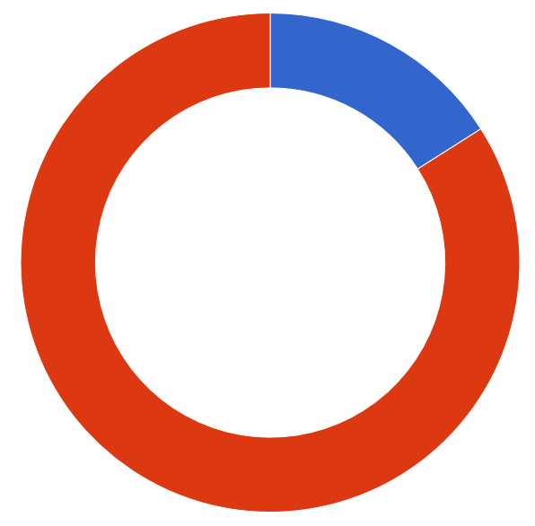
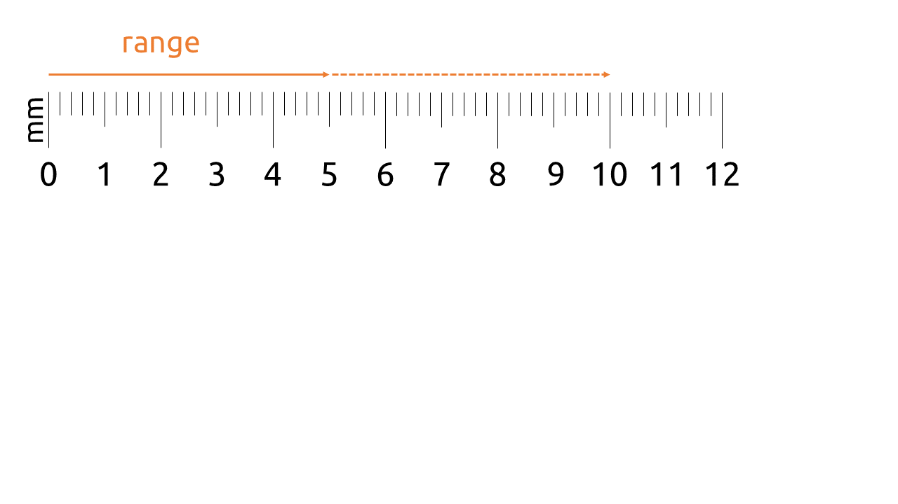
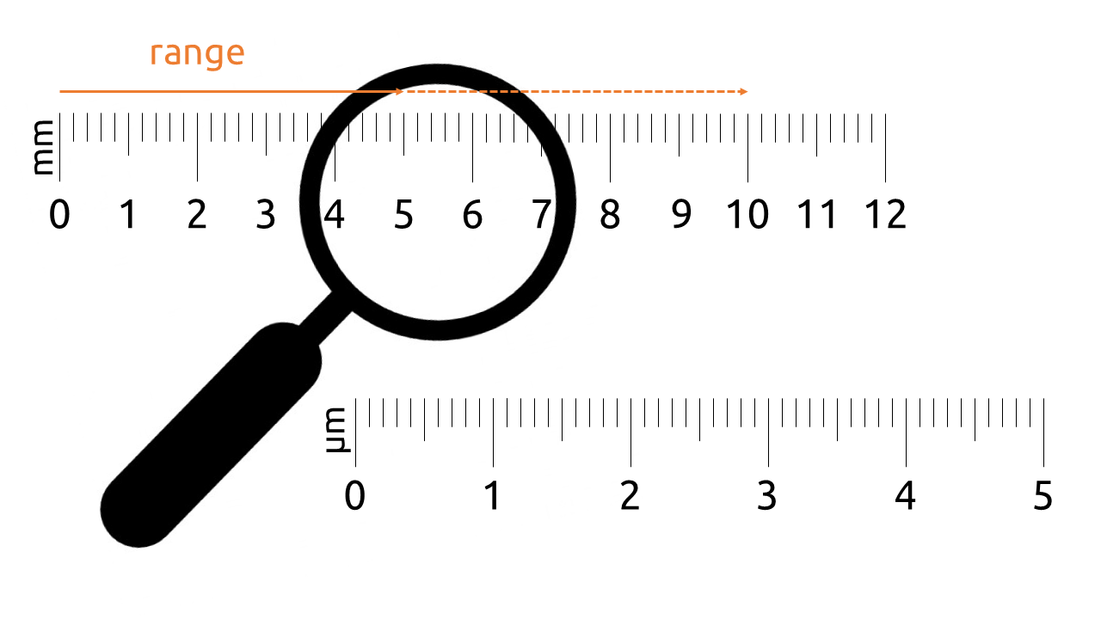
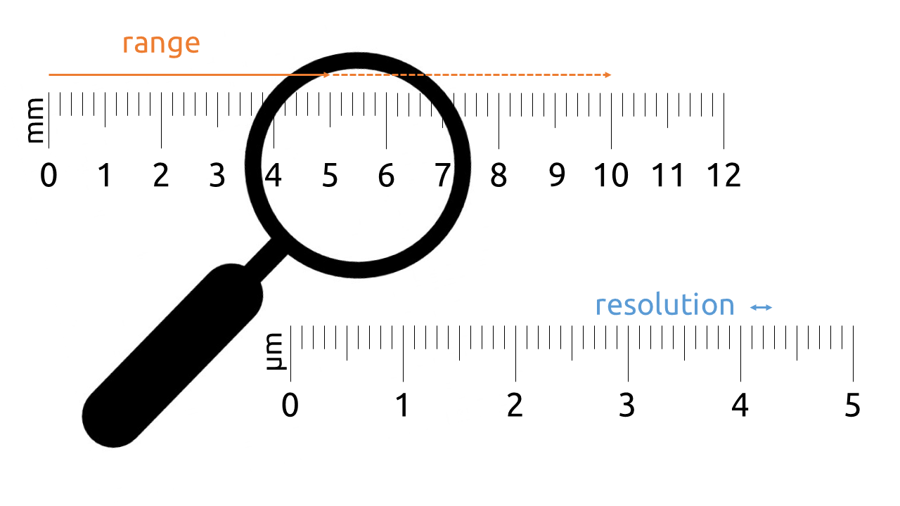
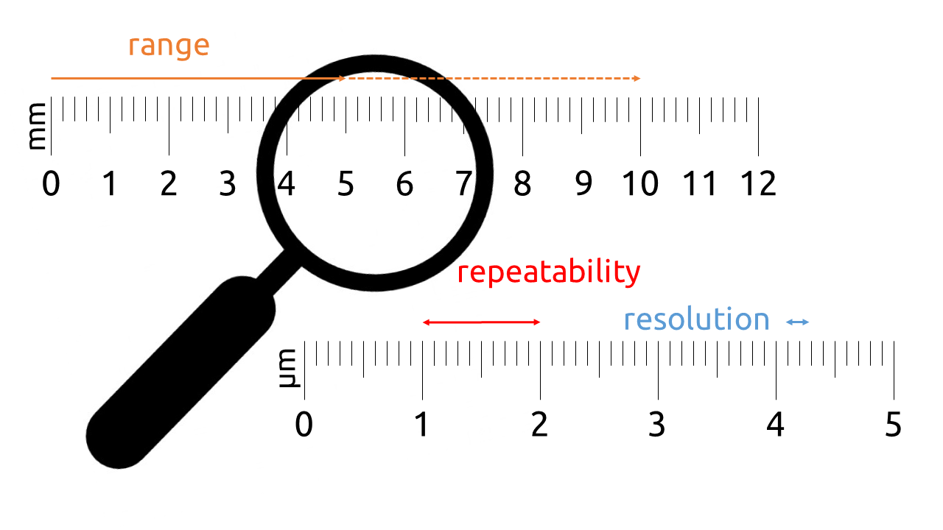
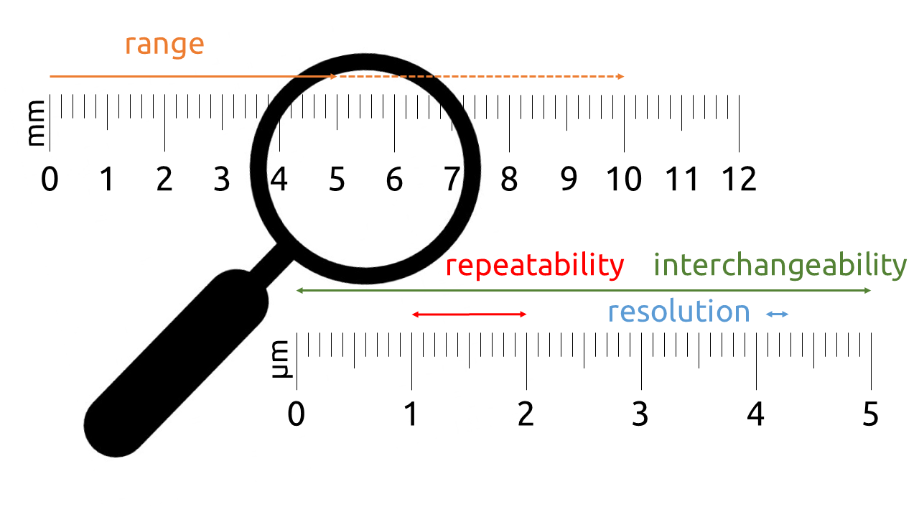
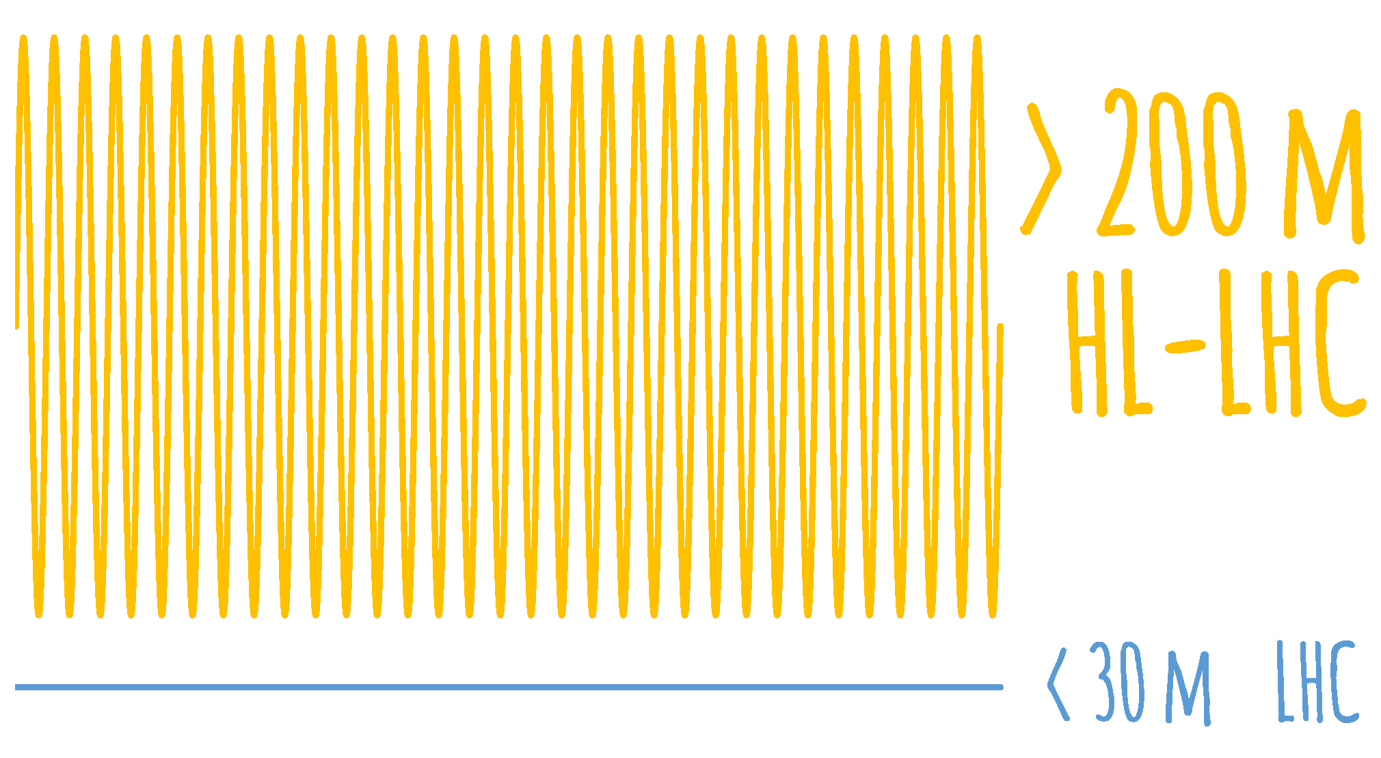
sensor
annual radiation dose
16 kGy
LHC
100 kGy
HL-LHC
MAIN HLS
REQUIREMENTS
remote DAQ
SENSOR
SENSOR
REQUIREMENTS

Slide 4
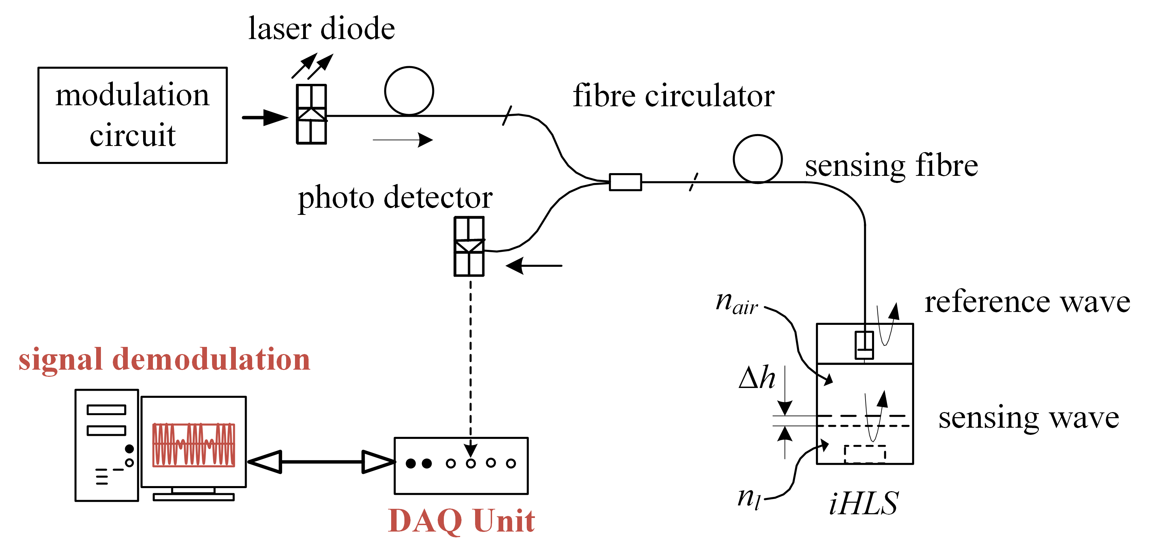
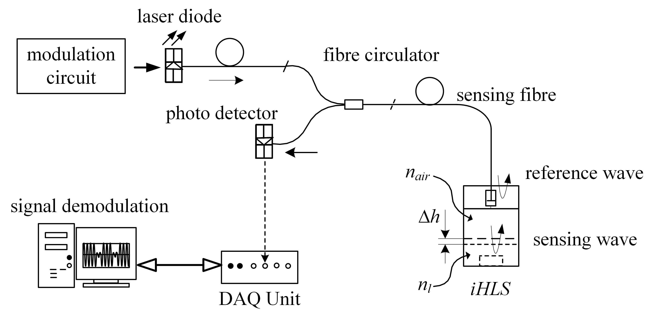
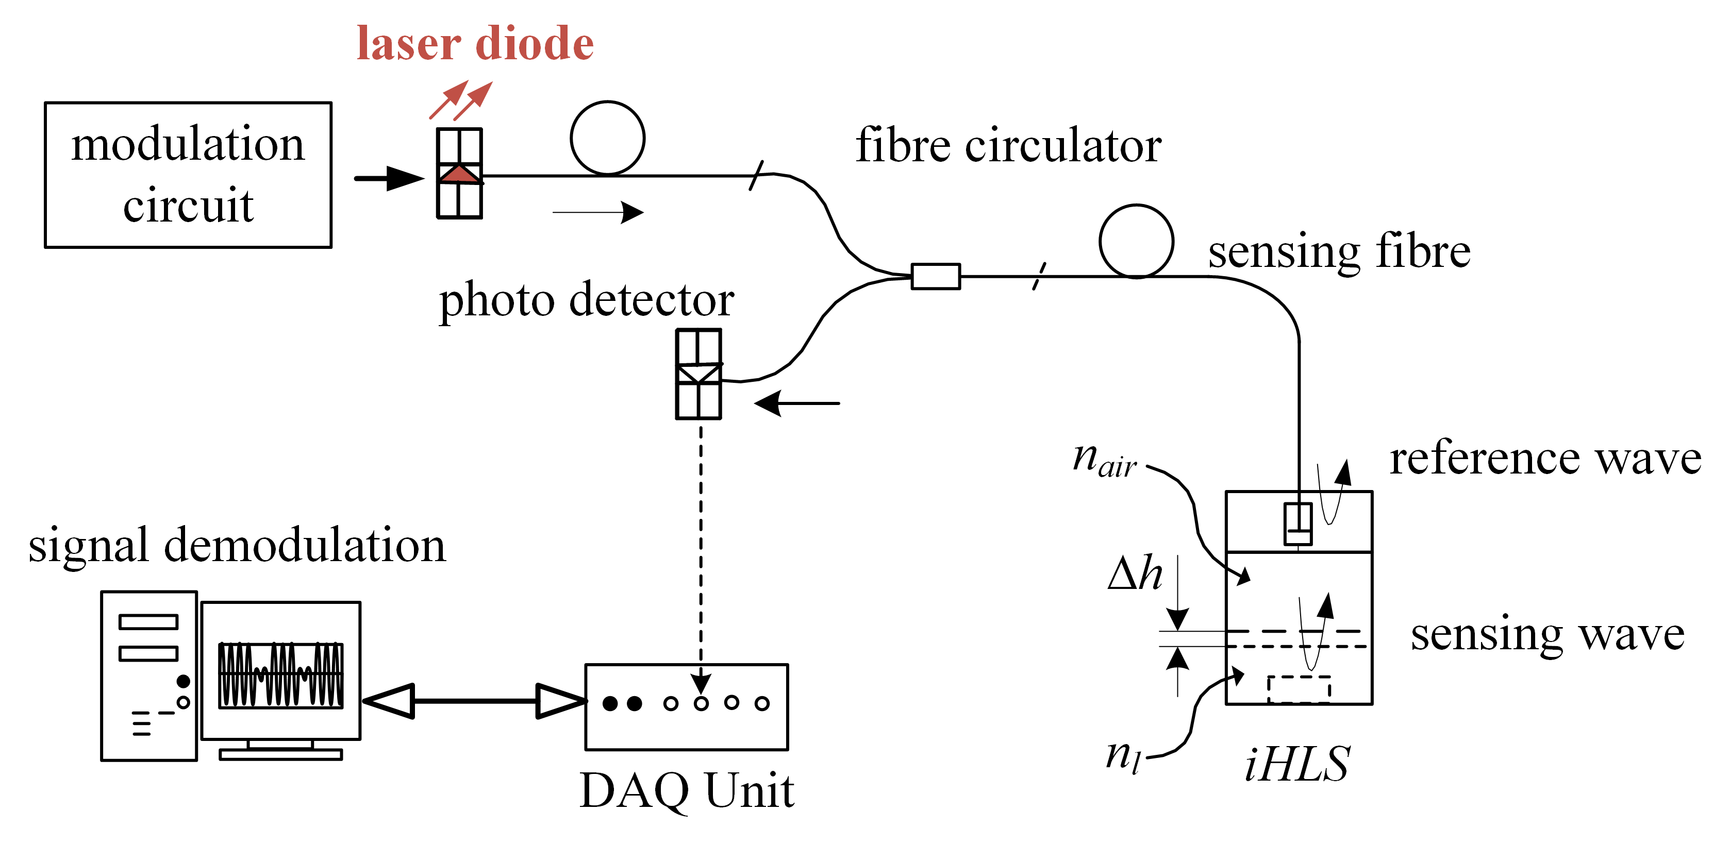
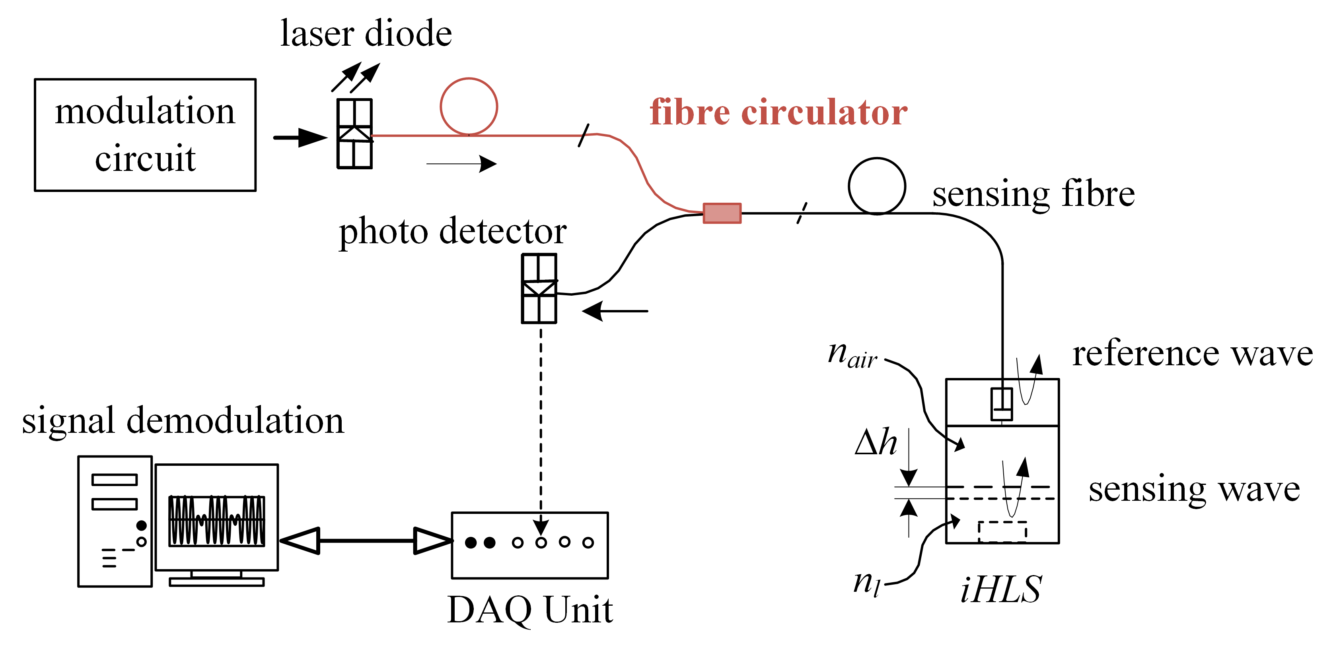
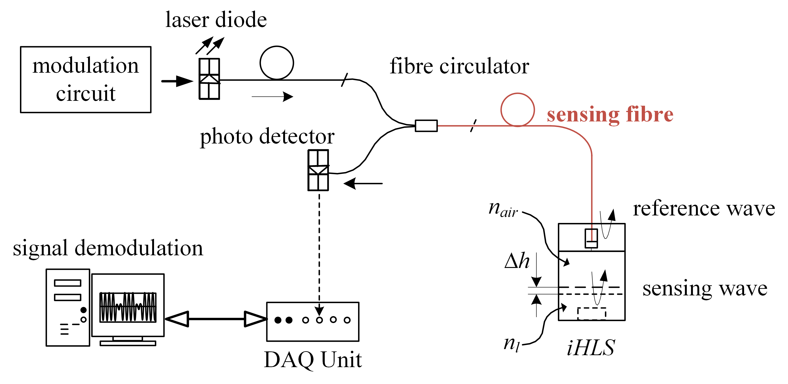
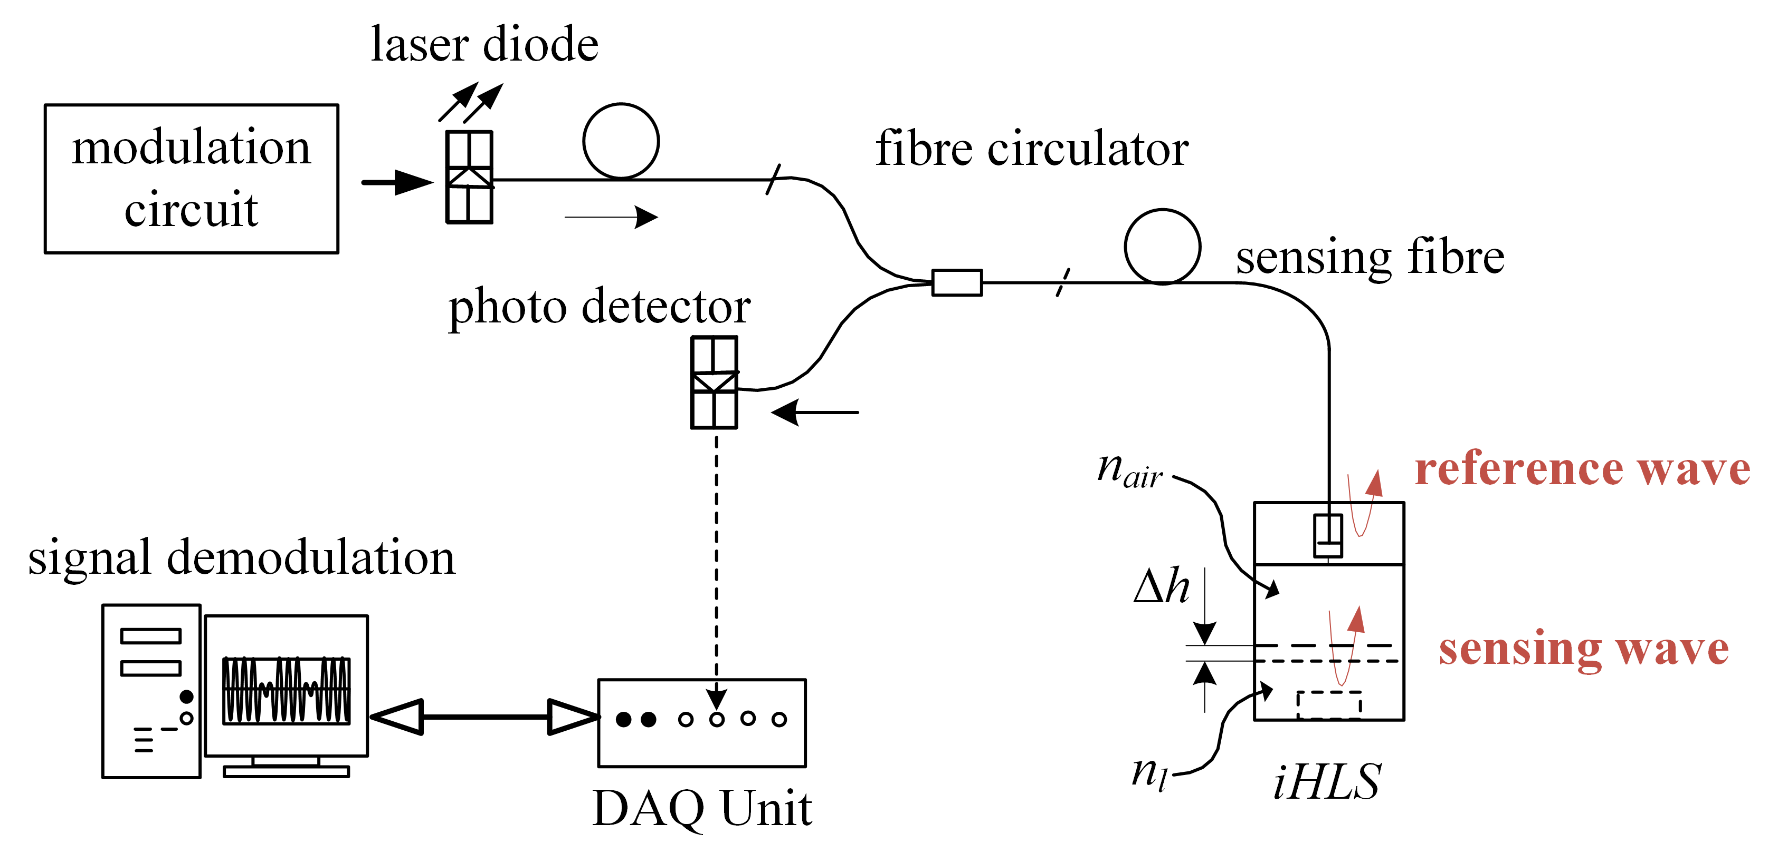
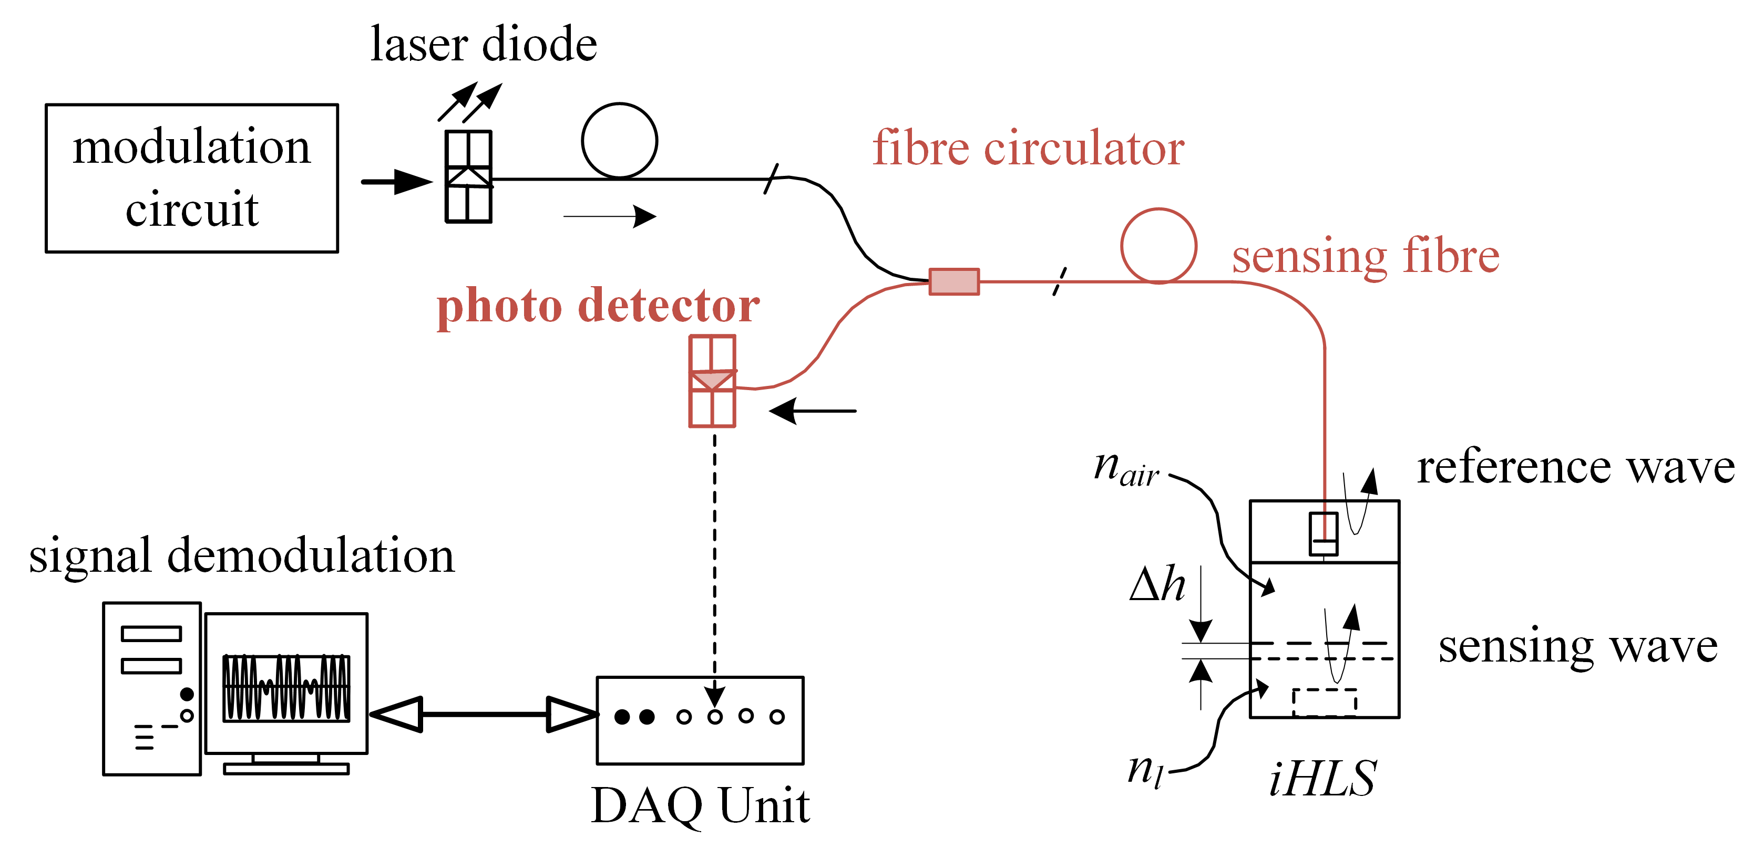
INTERFEROMETRIC
HLS SENSOR

Slide 5
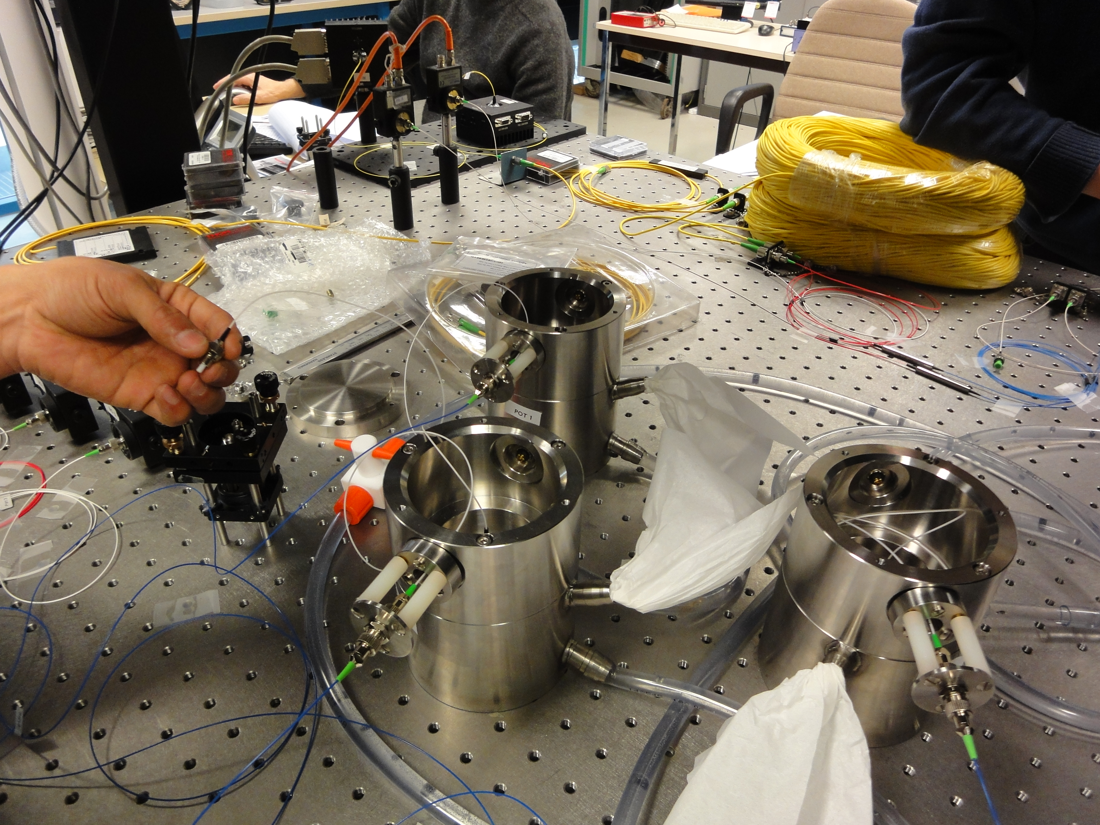
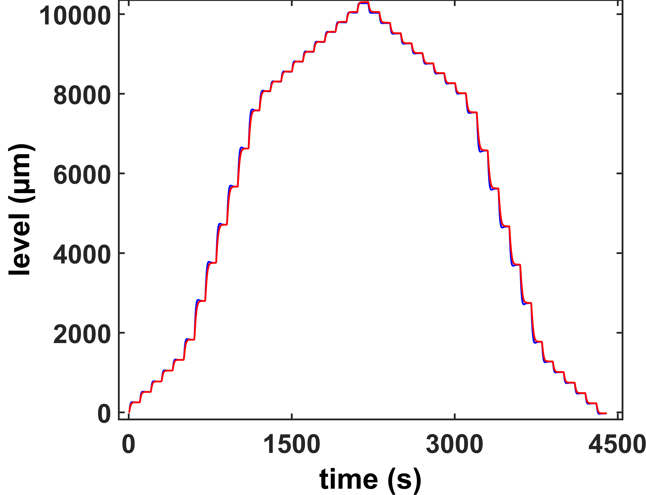
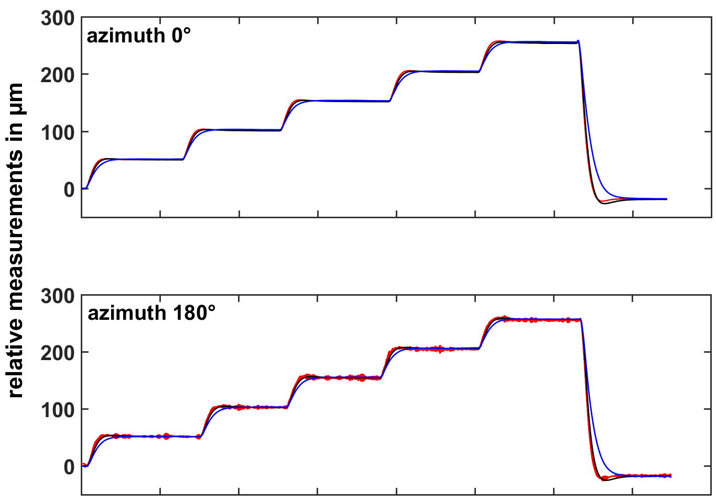
RANGE AND LINEARITY
INCLINATION TOLERANCE
range of 10 mm
5 ml = 249 µm
repeat & multiples
within ± 1 µm
5 ml
10 ml
20 ml
3 sensor network: 2 horizontal, 1 inclined
tested at four azimuths, max 1.3°
injection and extraction of liquid
TESTS IN THE
LABORATORY

Slide 6
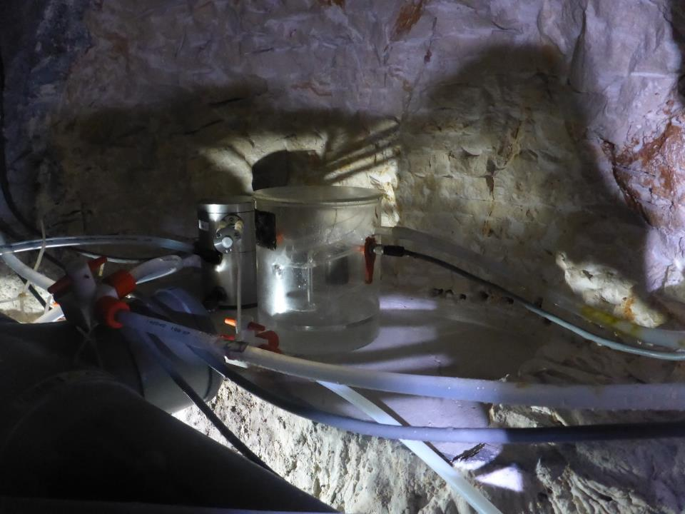
Laboratoire Souterrain
à Bas Bruit
LSBB
interferometric HLS
(iHLS)
HLS-LINES
separated water /air system

Slide 7
Laboratoire Souterrain
à Bas Bruit
STABILITY
LSBB
both sensors see same variation
differences of ~5 µm – coupling to rock
different measurement principle
none of them can be classified to be better

Slide 8
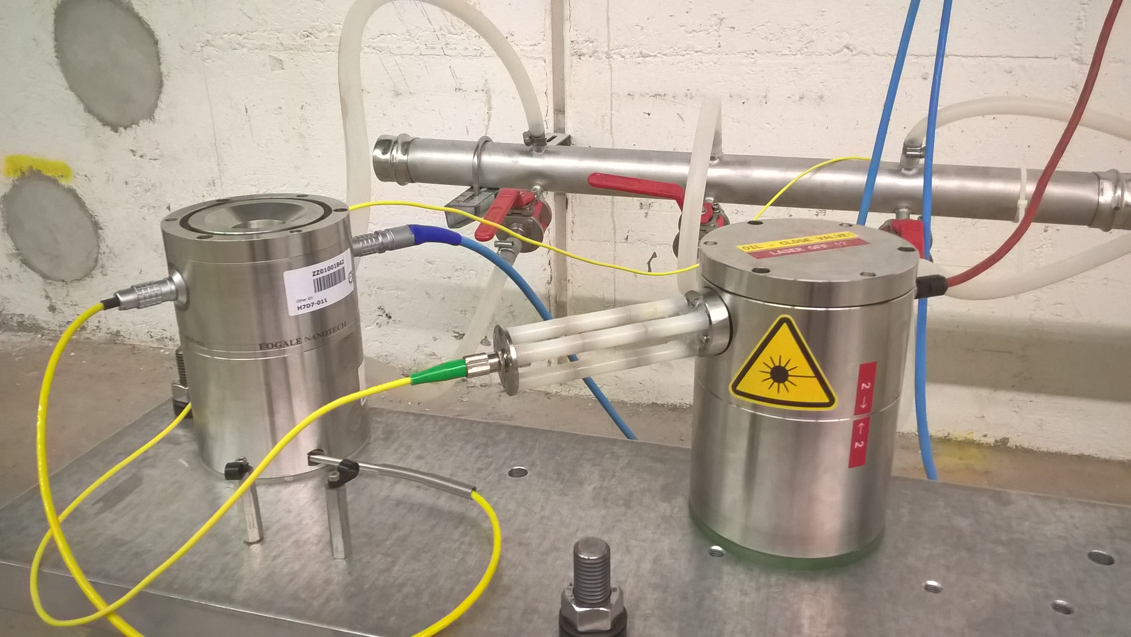
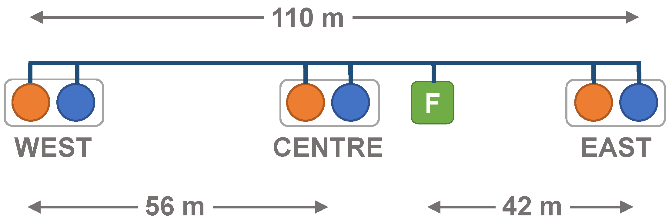
main hydraulic network
capacitive HLS
(cHLS)
interferometric HLS
(iHLS)
Transfer Tunnel 1 (TT1)
CERN

Slide 9
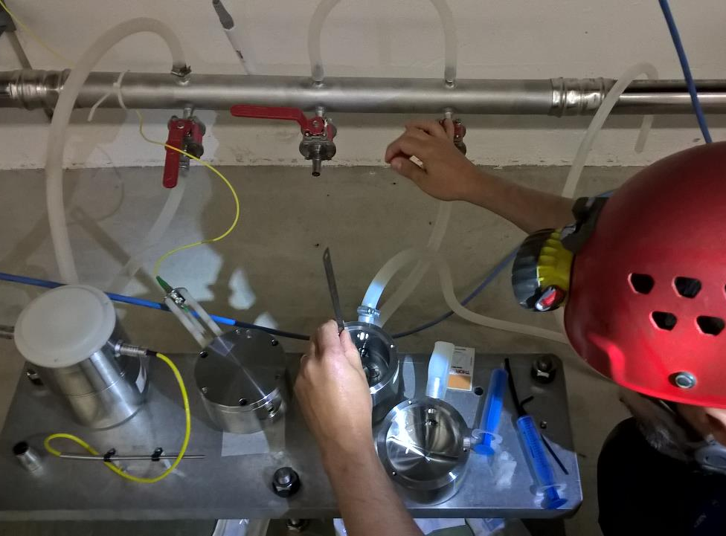
SENSITIVITY LINEARITY
Δh ~8%
injection of 20 ml water
both sensor types see 3 µm
shift in wavefront corresponds to position
extraction and injection of water to main network
difference between cHLS and iHLS ~8%
hypothesis: protective oil layer on iHLS causes shift
Transfer Tunnel 1 (TT1)
CERN

Slide 10
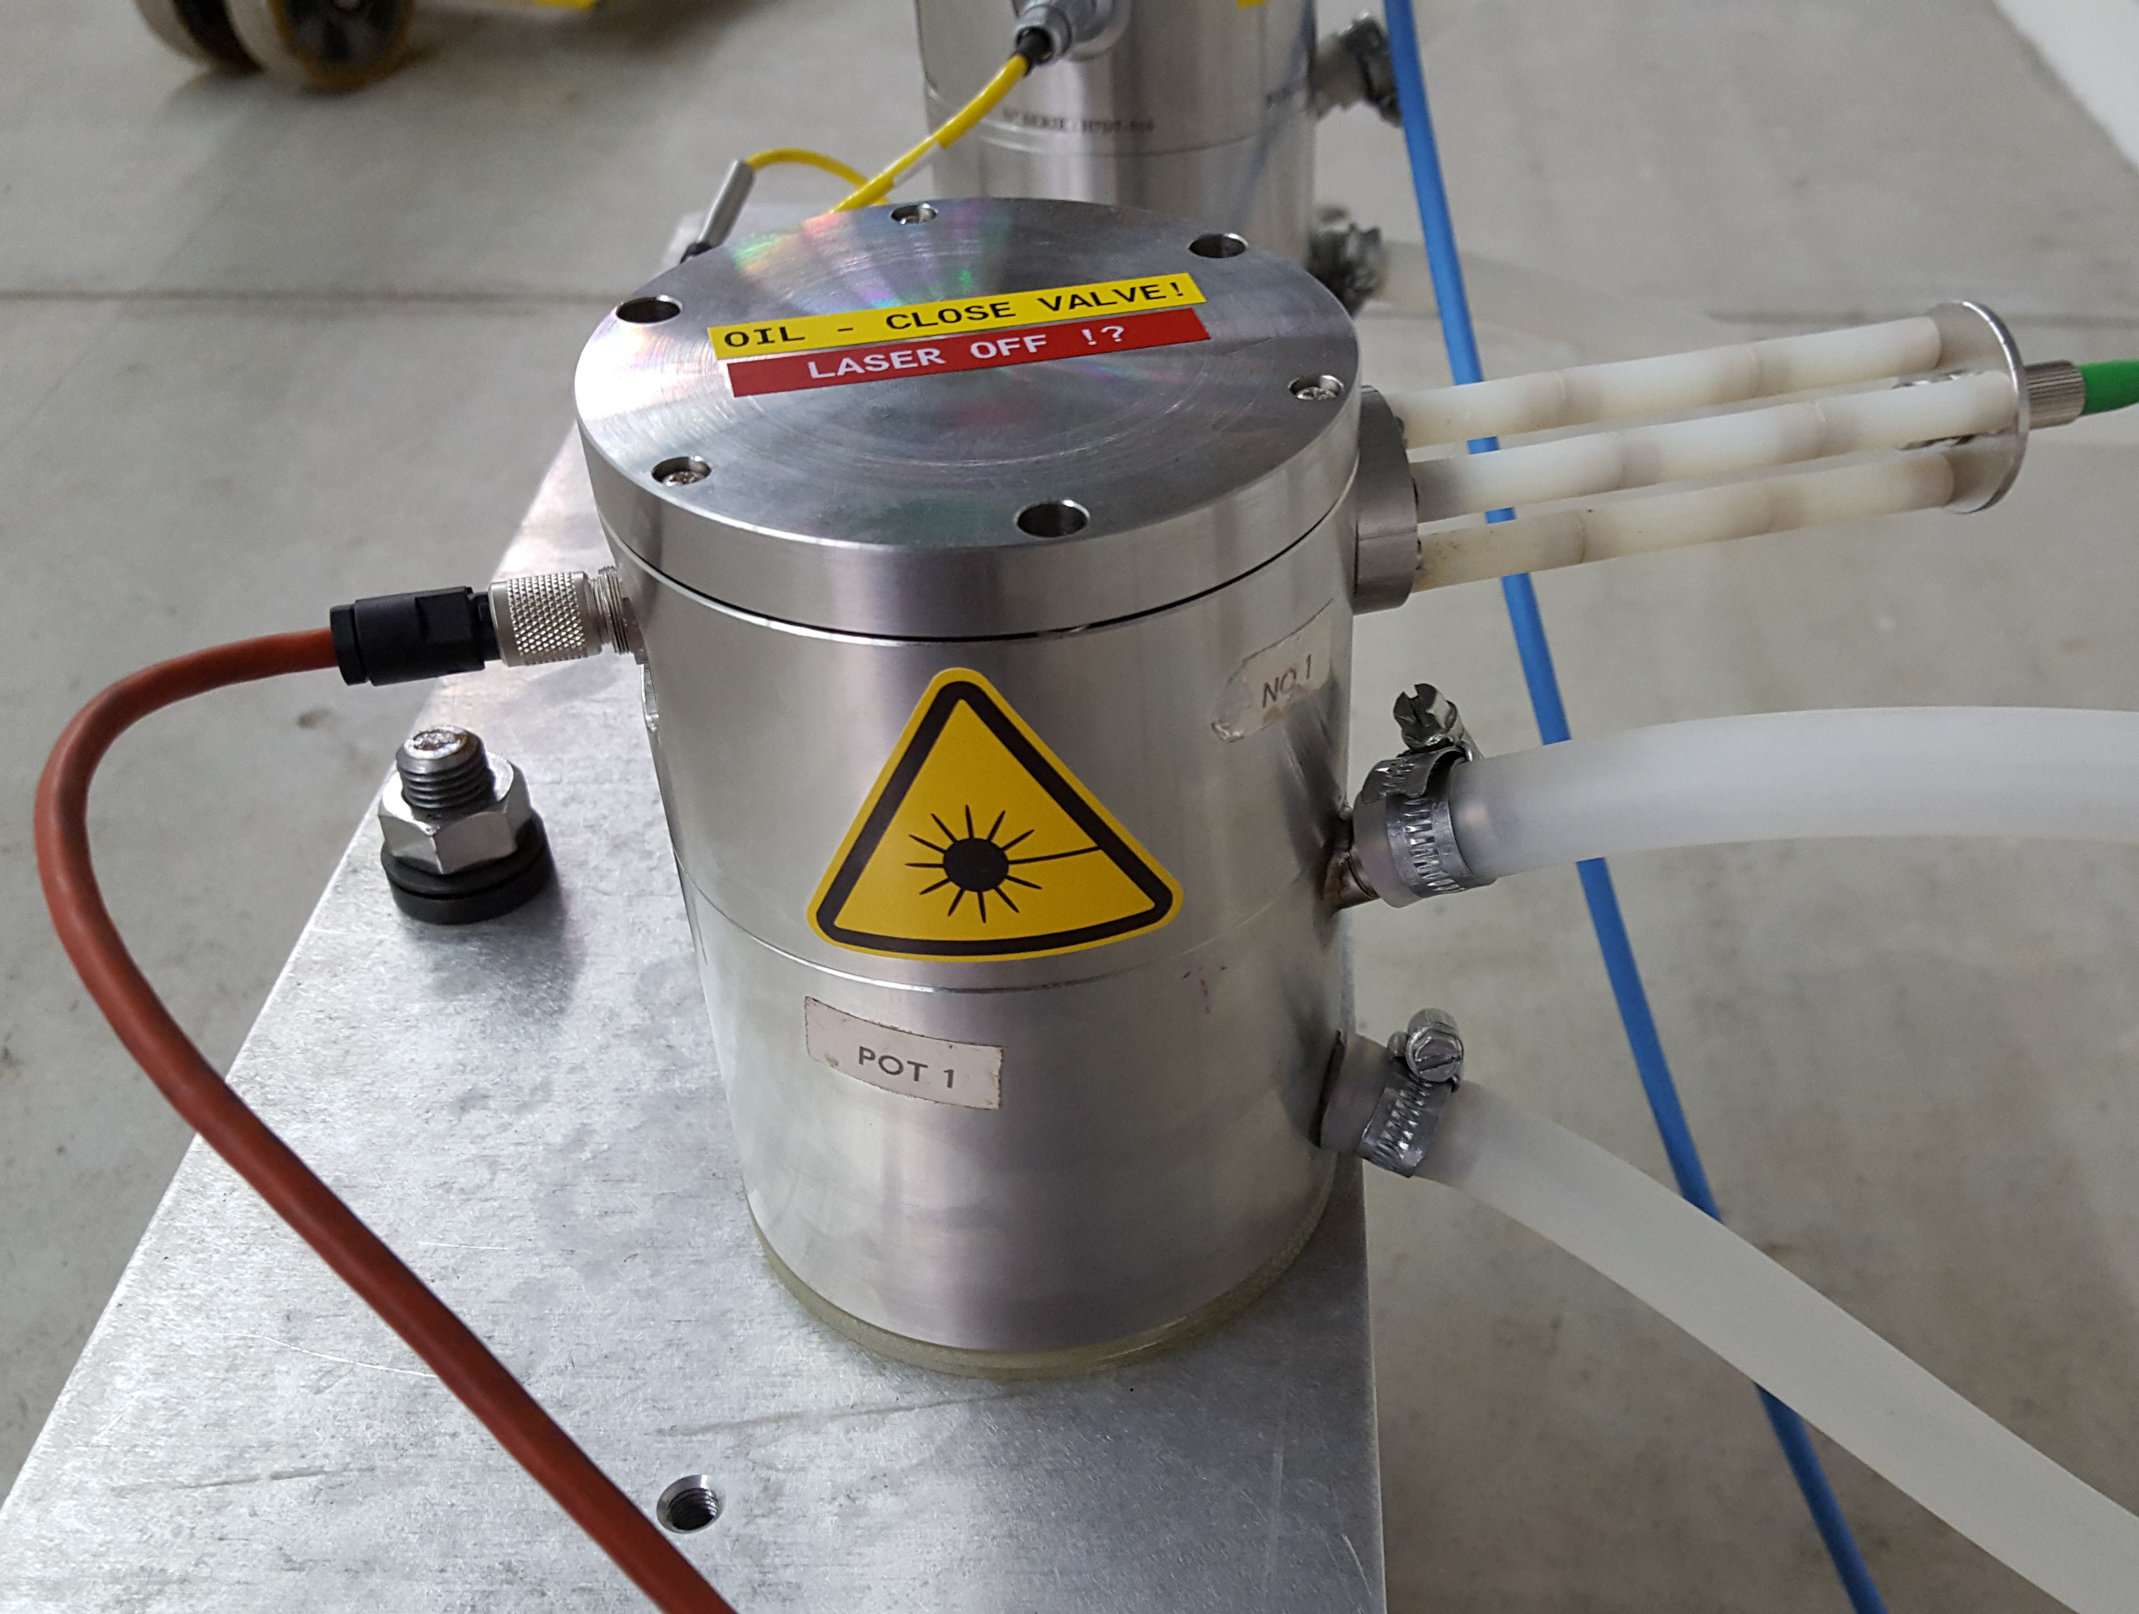
Transfer Tunnel 1 (TT1)
CERN
STABILITY
instability on central iHLS sensor
stability fixed after cleaning of sensor
  dust on optics ?
  mechanical problem ?
  tilt of support ?
earth tides on all sensors – coherent with theory
linearity difference on measurement data confirmed
EAST support is subject to true movements

Slide 11
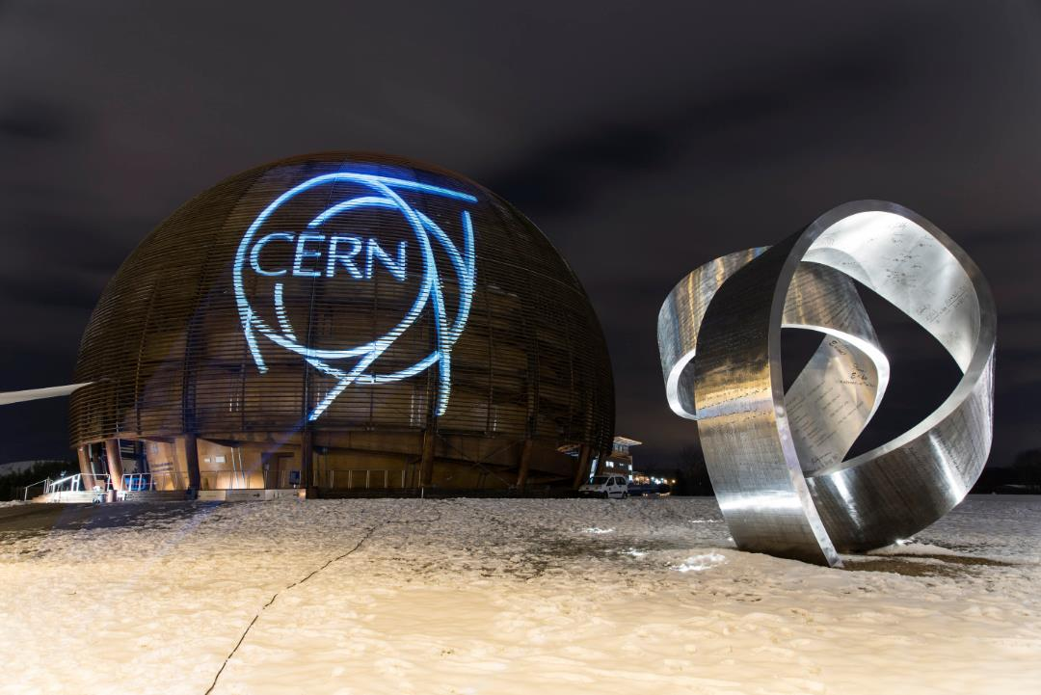
SUMMARY
3 years: idea, design and development
laboratory:
range, linearity calibration
inclination tolerance
two test installations:
stability
comparison to other sensors
linearity scale factor
complies to most specification requests
PERSPECTIVES
Relative use already possible for tilt
monitoring applications in geopyhsics
CERN: HL-LHC
absolute sensor (external, geodetic reference)
suppress protective oil layer, cancel scale factor
configuration with more sensors
radiation tests on system components

Slide 12

to all persons involved in the project
Thank you for your helping hands, brilliant ideas and your understanding!

