Slide 1
Alignment of SuperKEKB
Main Ring Magnet System
Mika Masuzawa (KEK)

Slide 2
Contents
Introduction
  SuperKEKB
Challenges
  Tight schedule, everyone wants to do lots of things at the same time.
  Tunnel keeps moving.
  KEKB alignment network was destroyed by the earthquake in 2011.
Strategy
  Smoothing
Results
  Well done!
Summary

Slide 3
Introduction
  SuperKEKB

Slide 4
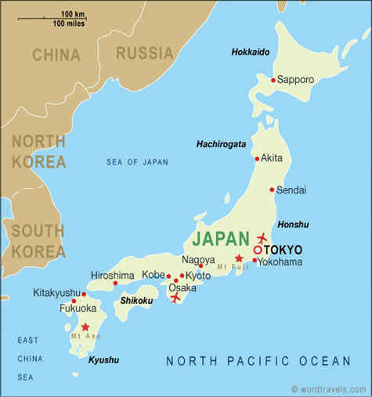
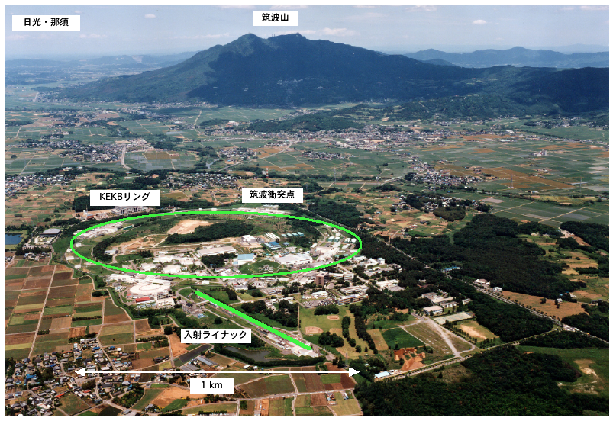
~50kn
North of Tokyo
3 km in circumference, 11m below the ground level
3rd largest circular machine alive in the world

Slide 5
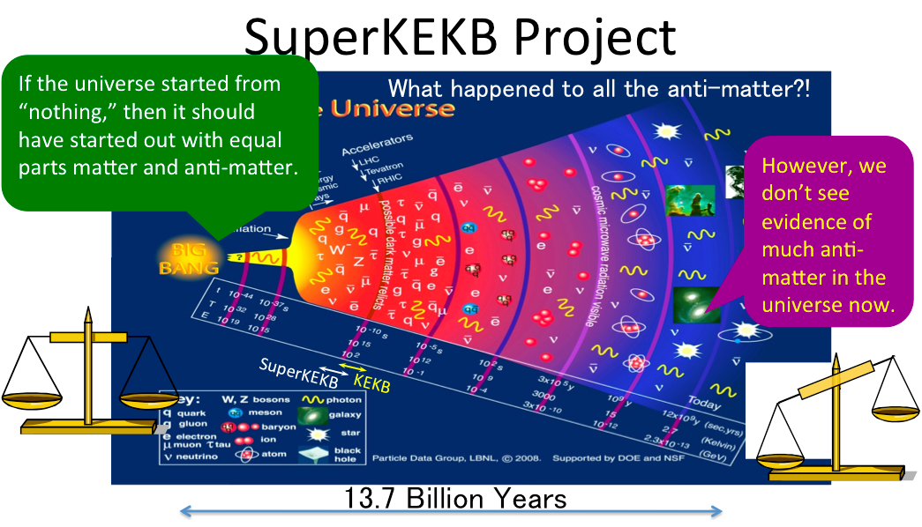
To discover new physics, we need a high-luminosity collider, and a detector capable of taking large amounts of data.

Slide 6
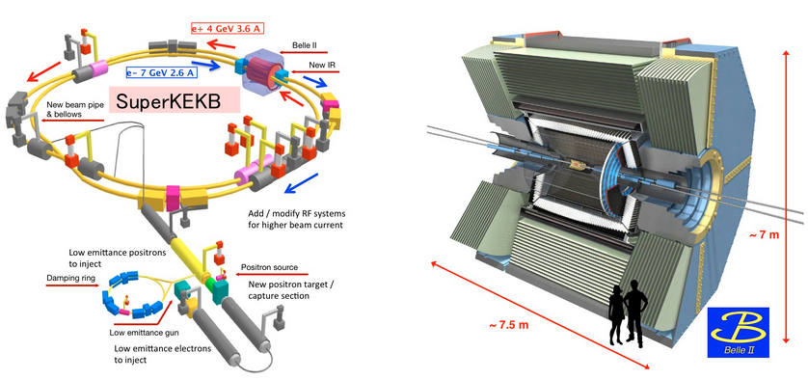
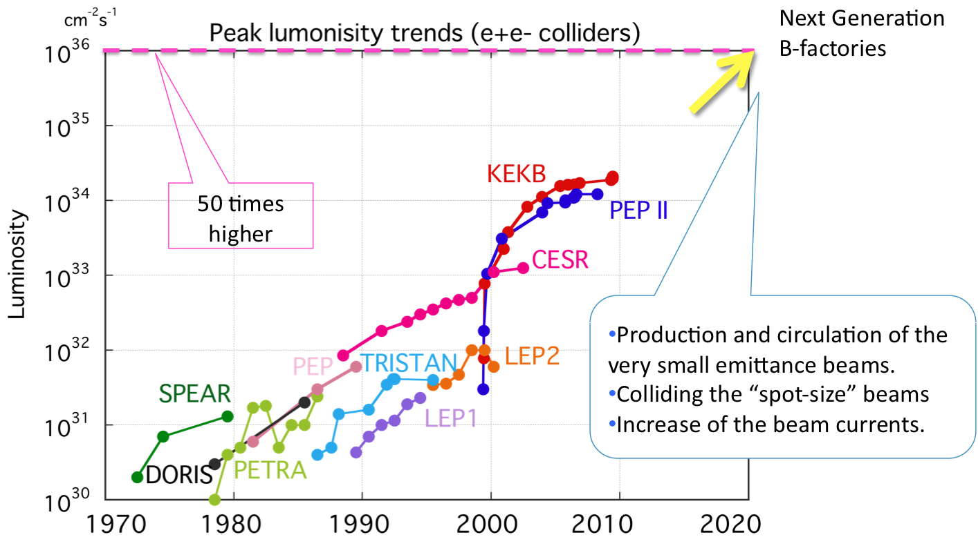
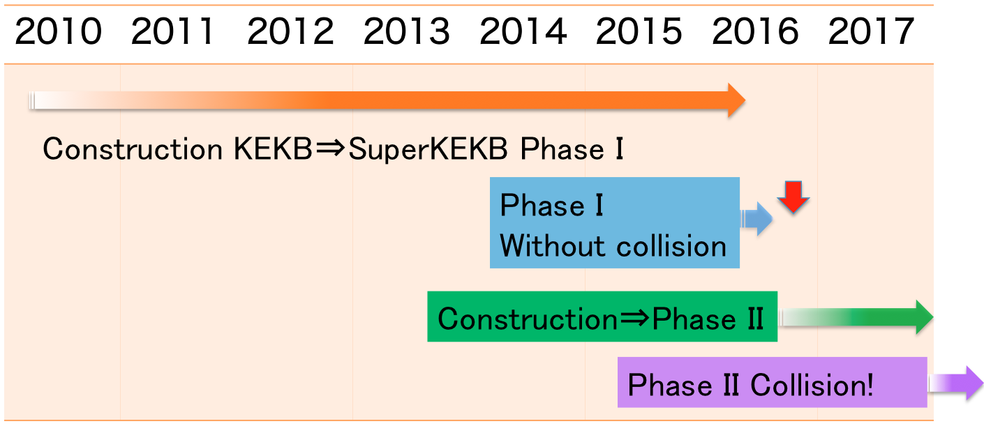
Today
Luminosity frontier machine
Collision of nano-beams!

Slide 7
Challenges
  Tight schedule, everyone wants to do lots of things at the same time.
  Tunnel keeps moving.
  KEKB alignment network was destroyed by the earthquake in 2011.

Slide 8
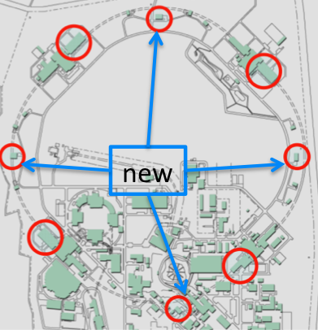
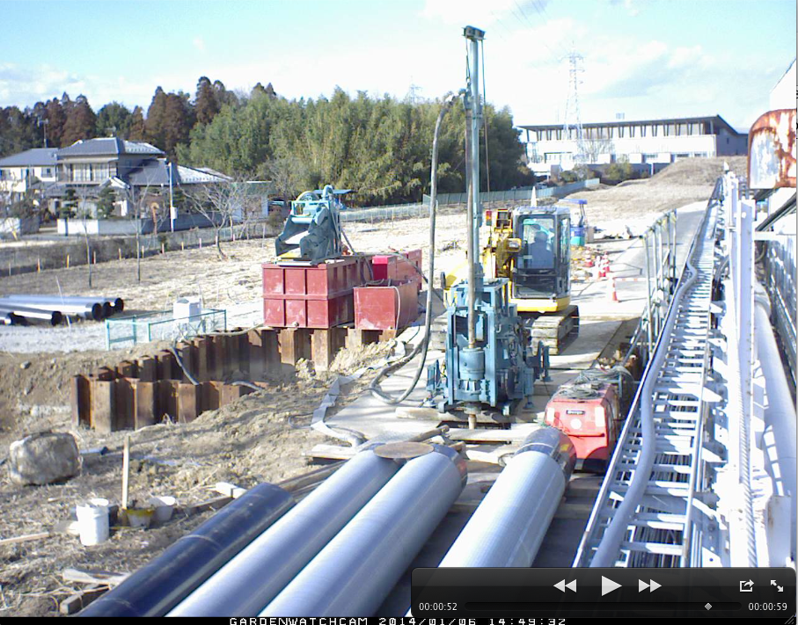
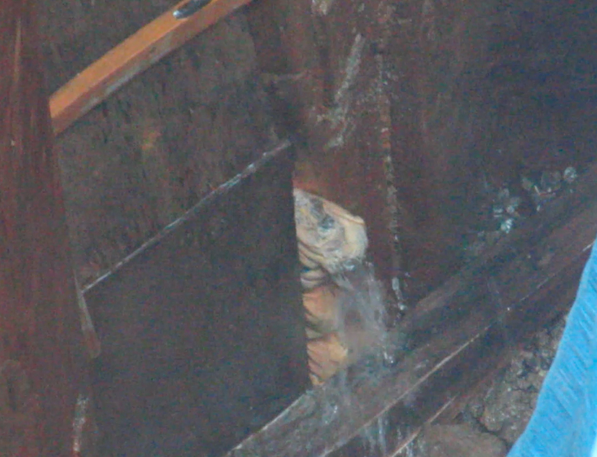
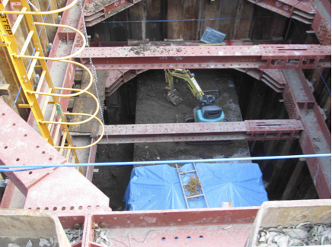
Tight schedule, everyone wants to do lots of things at the same time
KEKB➔SuperKEKB
More magnets & power supplies
New utility buildings were built.
Excavation of the vertical shafts, right above the
tunnel.
Rich in ground water…

Slide 9
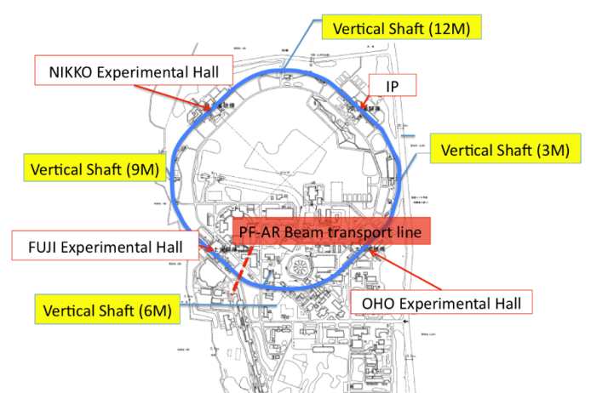
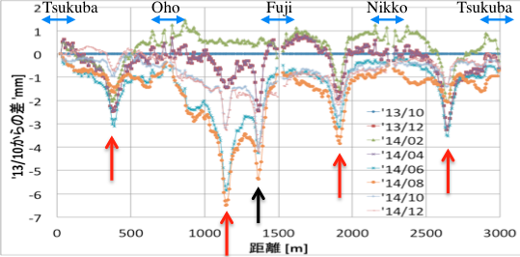
Tunnel keeps moving (excavation)
We had to wait until the last minute(~ half a year before the startup) before carrying out 2nd round of alignment because
  Effect of the construction of new facility buildings along the tunnel was large.
  Tunnel temperature was not stable at all (varied more than 10 degrees)
Tunnel monument height variation since October 2013 surveyed with Digital level.
Tunnel level variation (mm)
Distance (m) from the IP, measured clock-wise

Slide 10
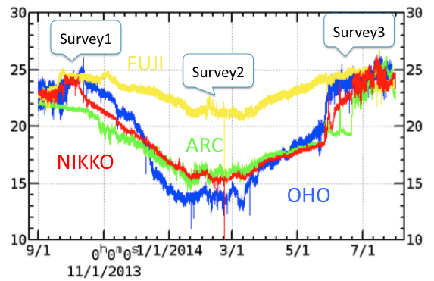
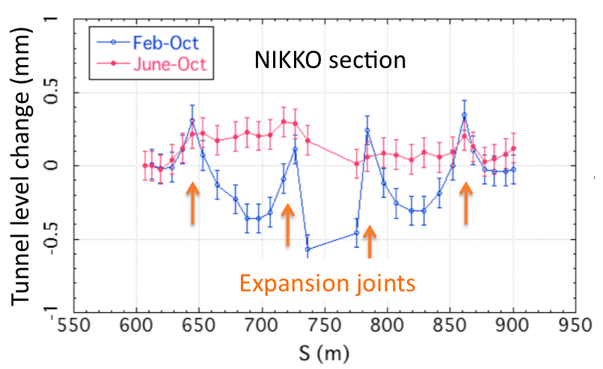
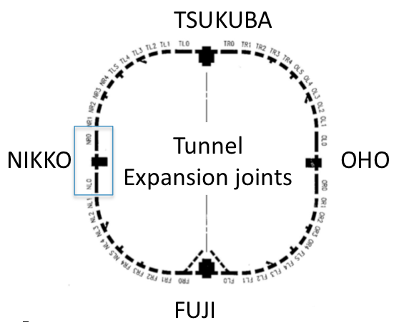
Tunnel keeps moving (temperature)
No AC in the tunnel
(to save electricity)
Level changes of up to 0.5 mm are seen at the expansion joints between summer and winter.

Slide 11
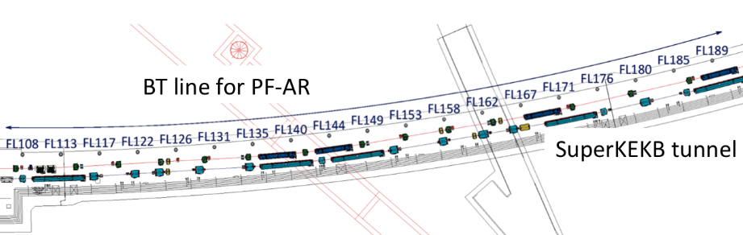
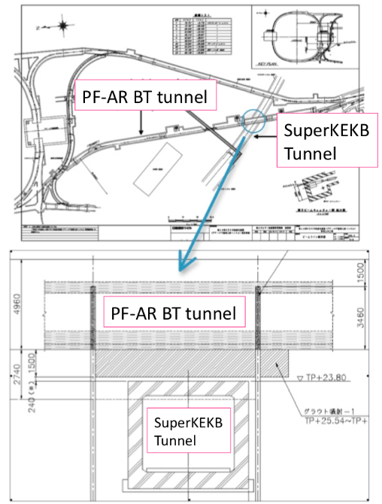
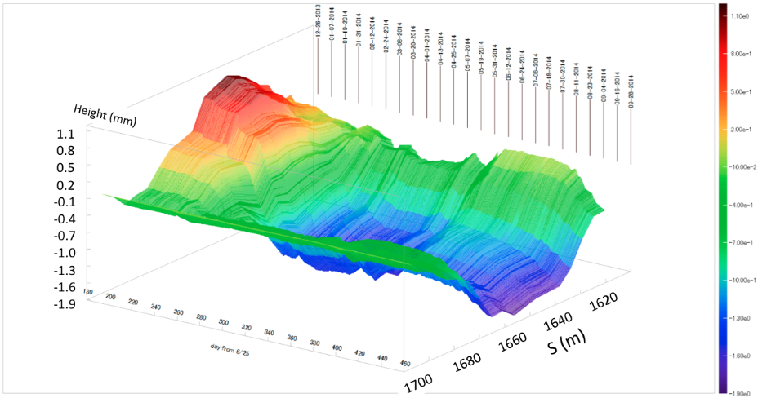
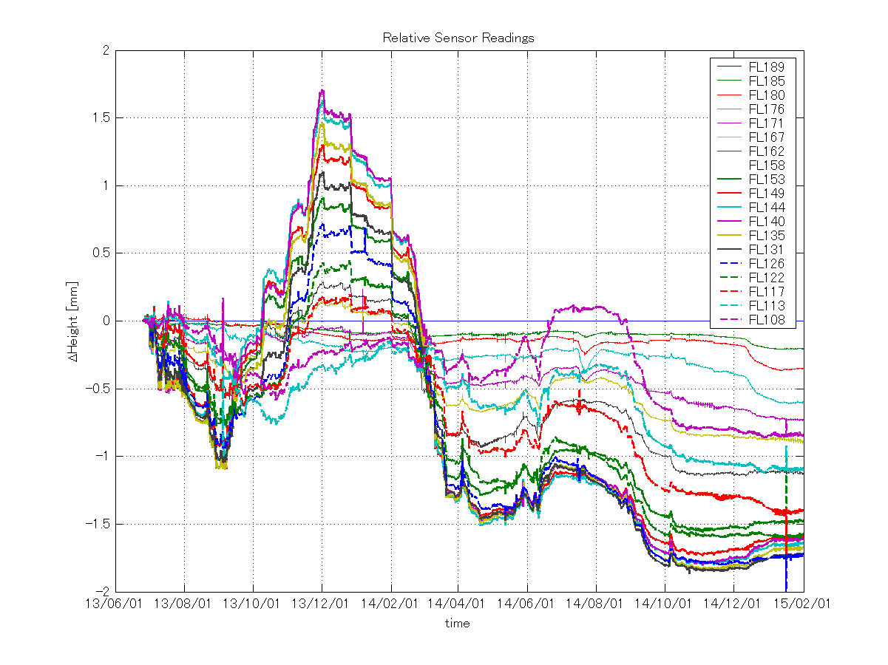
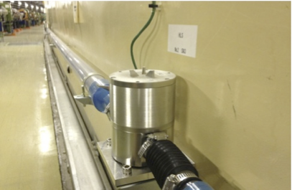
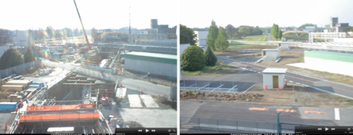
Tunnel keeps moving (new BT to PF-AR)
Effect of construction of new PF-AR BT line as monitored by HLS
Excavation finished
Refilling of the soil
completed
The tunnel level does not seem to go back to
where it was before the construction.

Slide 12
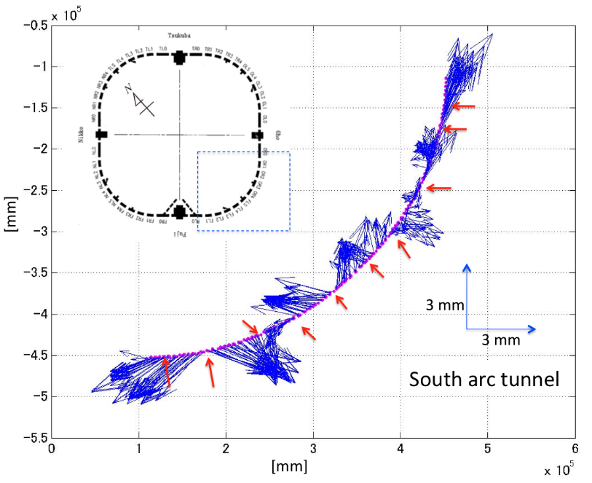
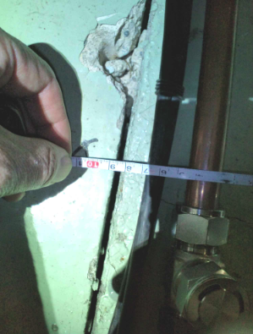
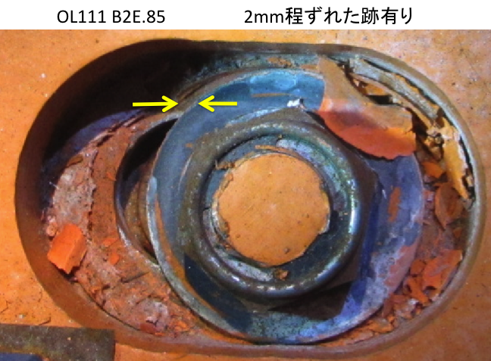
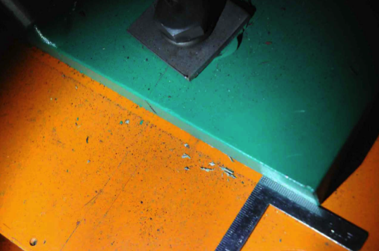
  KEKB alignment network was destroyed by the earthquake in 2011

Slide 13
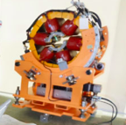
Goals of Phase I commissioning
to achieve smooth beam circulation
to confirm that the circumferences of the LER and HER match within a few mili-meters
to do debugging of various hardware and software systems
to understand the basic features of the machine and to learn about low-emittance tuning methods.
Strategy
  To wait until the summer 2015 for the 2nd round of surveying, which left us with little time for aligning the magnets for Phase I.
  Smoothing, based on the network analysis
Sextupole magnets with variable tilt angles for superkekb
By R. Ueki (R. Sugahara) at the Thursday poster session

Slide 14
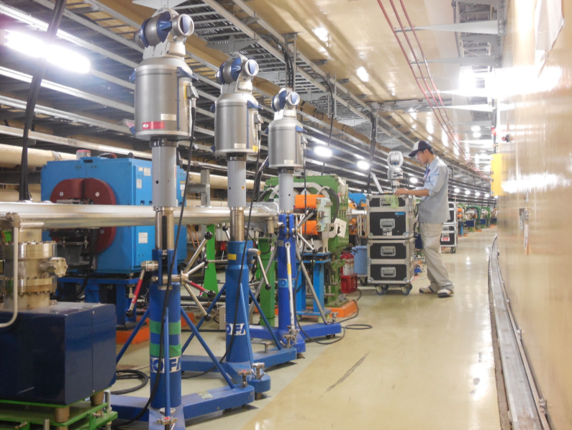
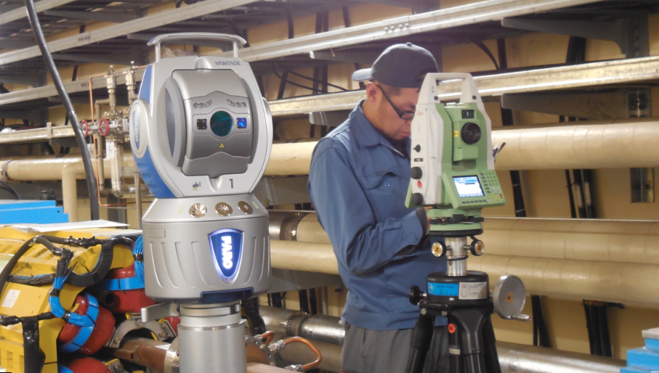
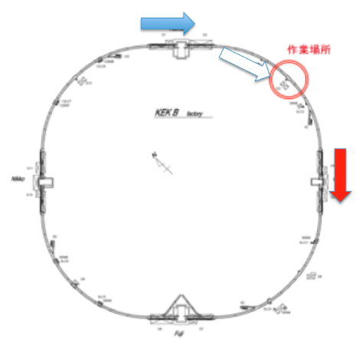
2nd round survey campaign in the summer
June and July 2015
Survey was carried out by 3 teams.
Calibration of the laser trackers was done carefully.
Special attention was paid to systematic errors, as even very small systematic errors can result in a large error at the end over hundreds of measurement sets.

Slide 15
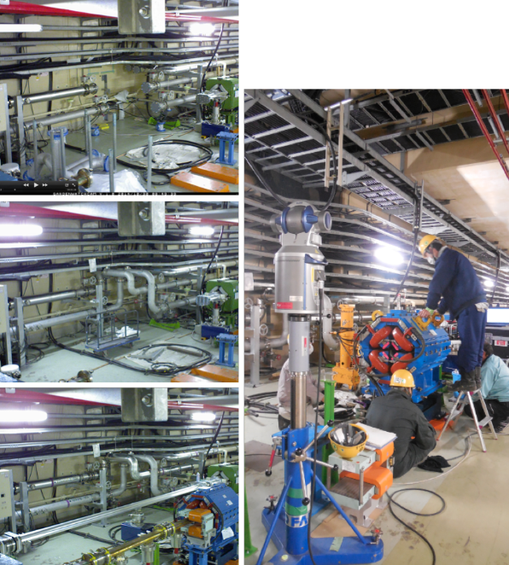
Magnet alignment
Magnets newly installed in the tunnel were aligned to nearby magnets using a laser tracker.
Aligned new magnets:
HER quadrupoles
  In mid-arc section
IR magnets
  In Tsukuba straight section and part of the north and east tunnel.

Slide 16
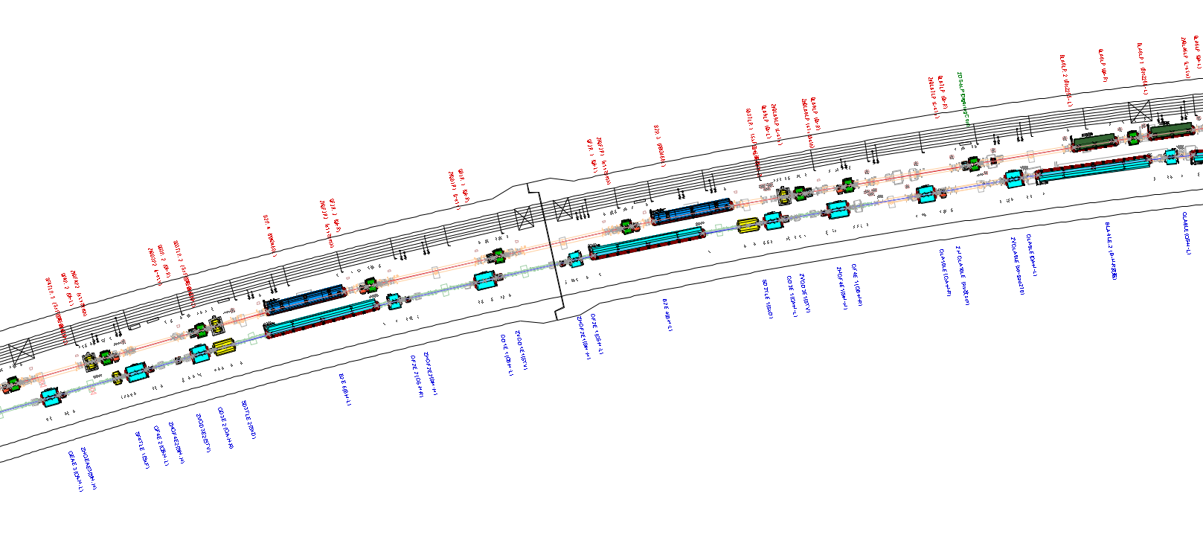
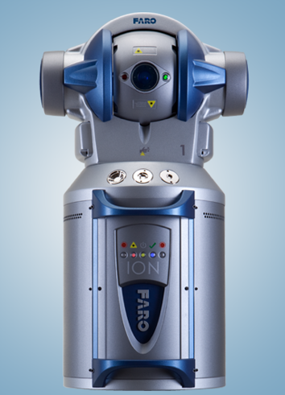
2nd round survey campaign in the summer
June and July 2015
Constraints on the working area/time
Alignment can not coexist with PS test, PS test can not coexist with water flow check, none can coexist with RF high power test (if in the same area)…,civil engineering can not coexist with survey/alignment…
More than 1200 network control points in the tunnel
More than 4000 reference points for the magnets
More than 5000 points to be surveyed and analyzed. More than 400 LT settings, with overlaps

Slide 17
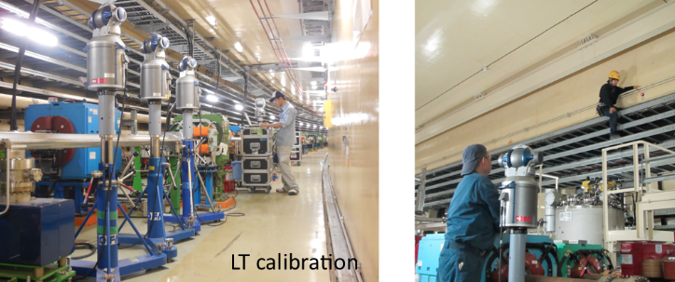
  Smoothing, based on the network average calculation
Survey results ➔ Adjustments of the misaligned magnets
We got hundreds of data points each day from 3 teams,
which were analyzed and cross-checked by us independently everyday. If we found something funny, we requested the survey team to go back before they moved a long distance down the tunnel.

Slide 18
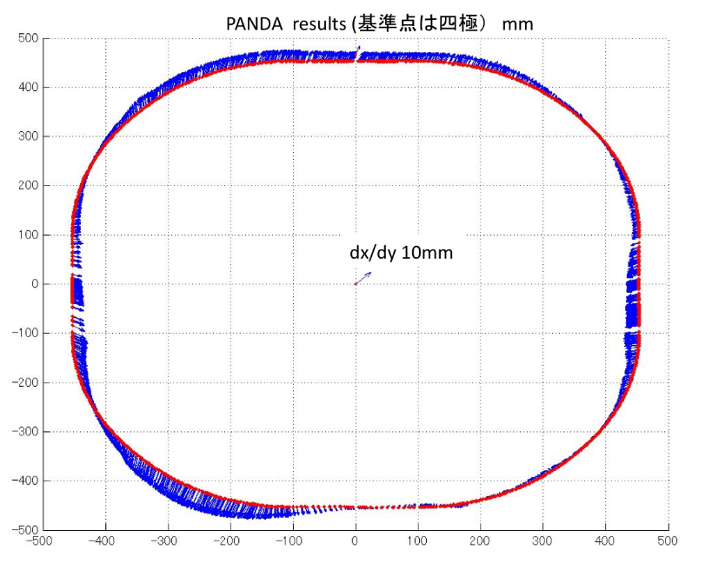
Survey Data and analysis results
The north and west parts expand outward more than 10 mm. This probably happened when the TRISTAN monuments were first built.
Does this matter?
➔No. Deformation of low order does not matter.
Constraints:
The rings have to close.
➔Smooth periodic curves will do.
Our choice was a Fourier series (n=60). We tried FS with n=30, but the # of magnets to be adjusted increased, and the amount of adjustment became larger…
(of course we can do it but it would have affected
other accelerator components such as vacuum chamber and rf…)
IP

Slide 19
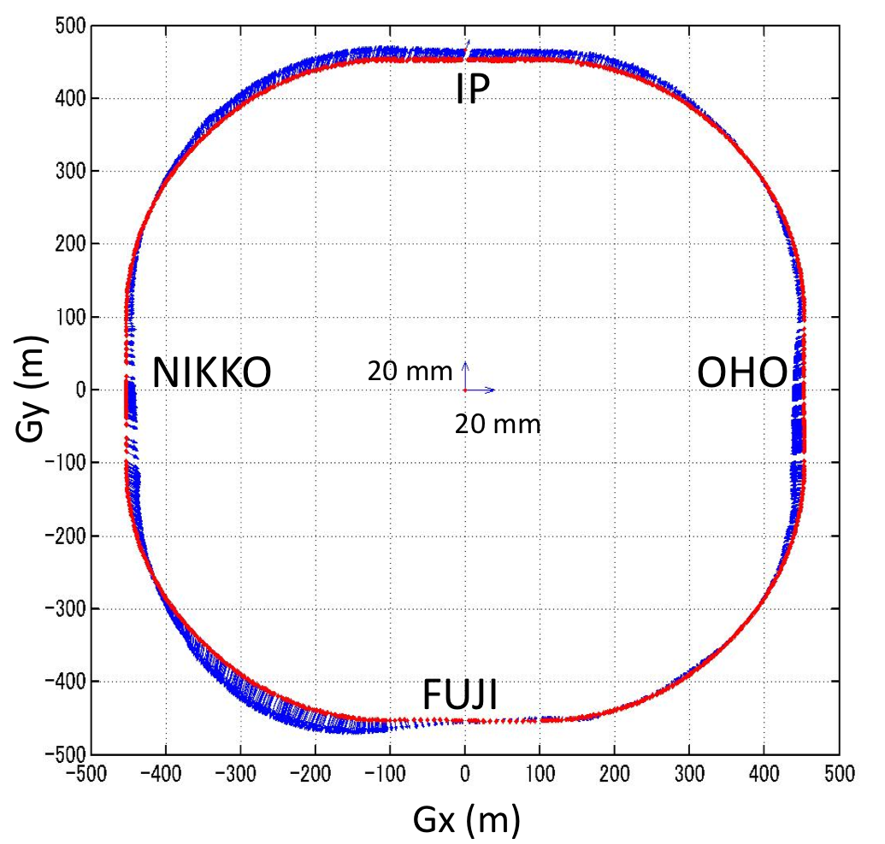
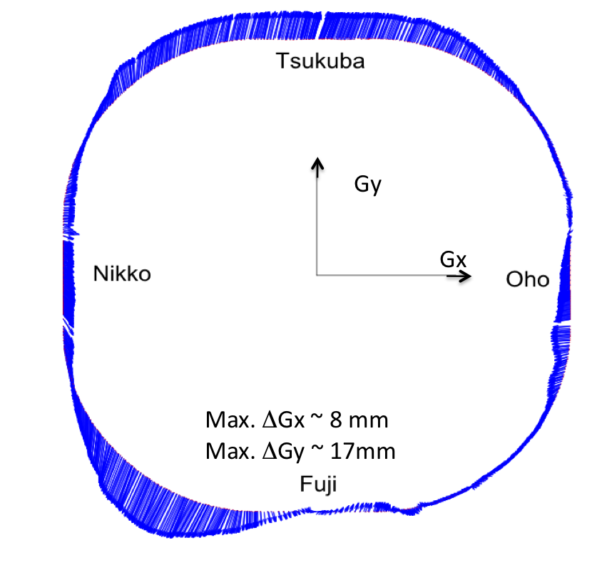
Analysis results, comparison
PANDA & PAG-U gave similar results
We are developing our own code from scratch, which also gives
similar results but needs some more work.

Slide 20
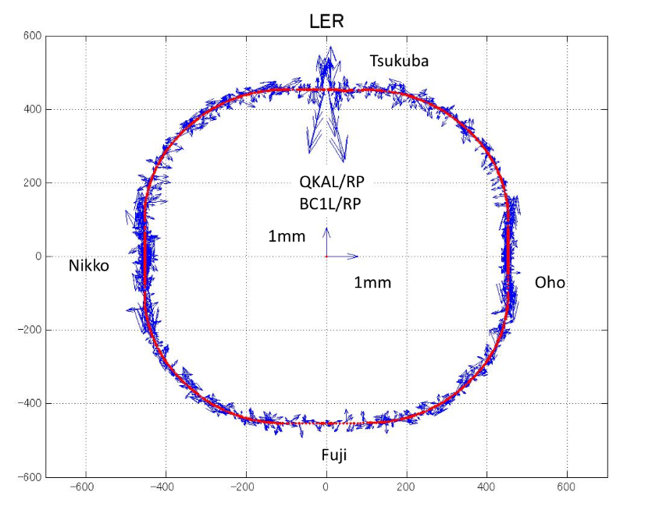
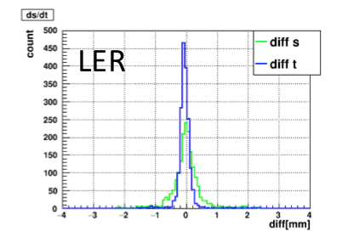
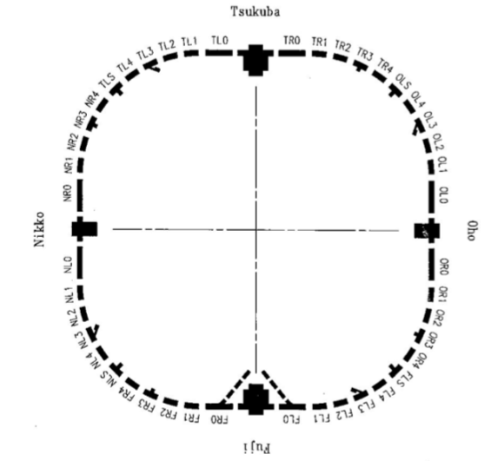
Survey Data and analysis results
Deviation from smooth curves (LER)
We used the old lattice (oops)
S: Beam direction
T: perpendicular to the beam
The spread in “s” (beam direction) is larger.
This is due to the expansion joints.
The temperature was NOT controlled during SuperKEKB construction.
The temperature was different between the 1st rough alignment and the 2nd survey.

Slide 21
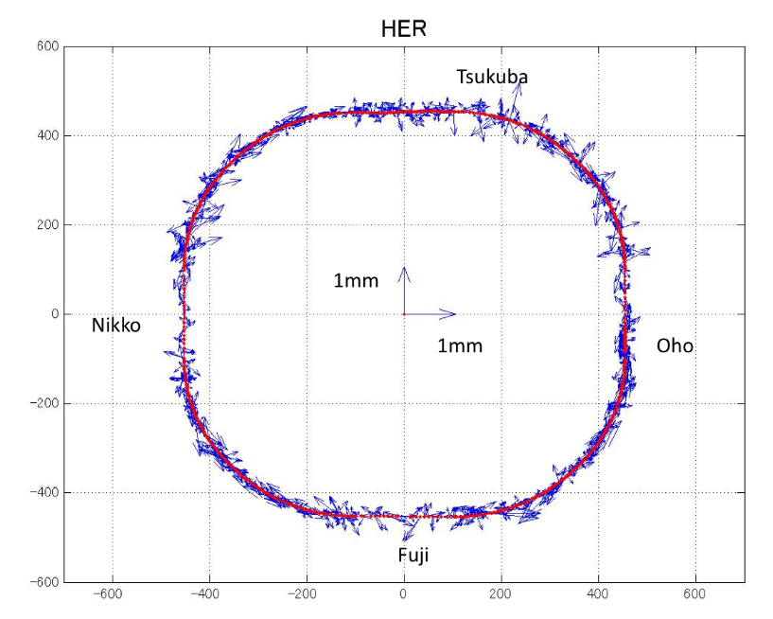
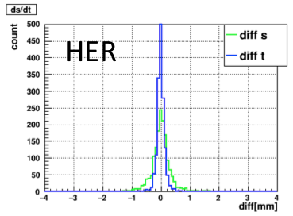
Survey Data and analysis results
Deviation from smooth curves (HER)
S: Beam direction
T: perpendicular to the beam
Expansion joints to absorb the thermal expansion & contraction.
The spread in “s” (beam direction) is larger.
This is due to the expansion joints.
The temperature was NOT controlled during the SuperKEKB construction.
The temperature was different between the 1st rough alignment and the 2nd survey.

Slide 22
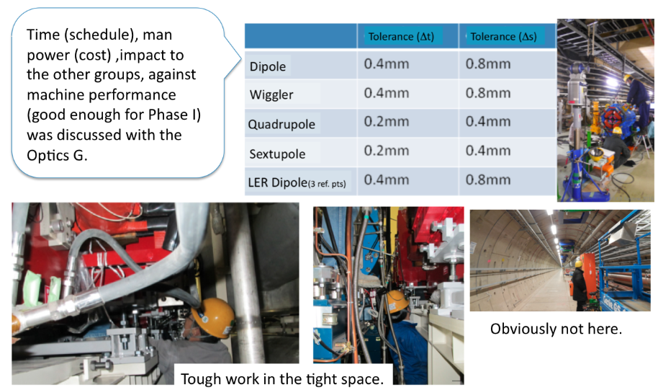
Alignment strategy
Discussion with the optics group, prioritize issues for “good-enough” for Phase I
Not our tunnel
The magnet pitch and roll angles were measured using digital inclinometer.

Slide 23
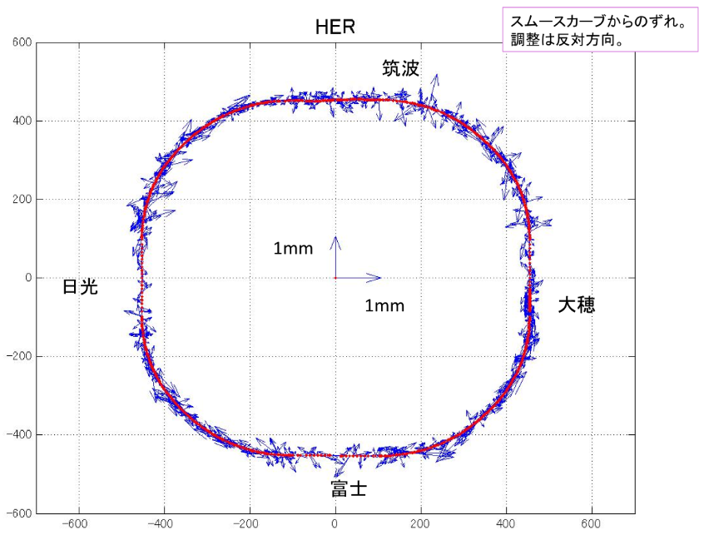
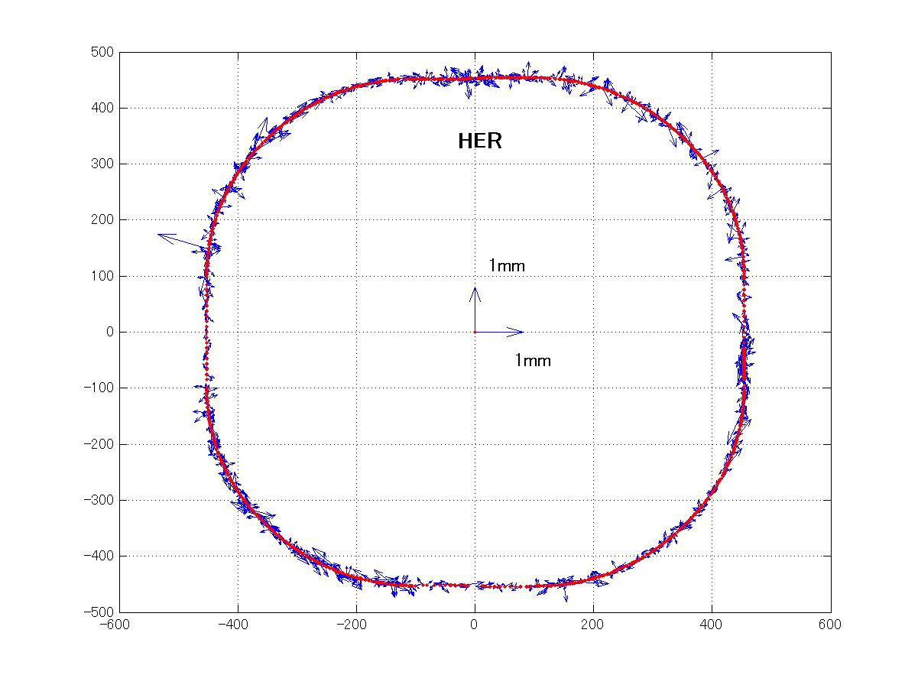
Alignment strategy
Alignment was carried out by two teams, followed by a survey team dedicated to
checking the alignment.
Before
Found a misalignment,
which was fixed right away.
B2E_26

Slide 24
Vertical (Level)
Survey Results

Slide 25
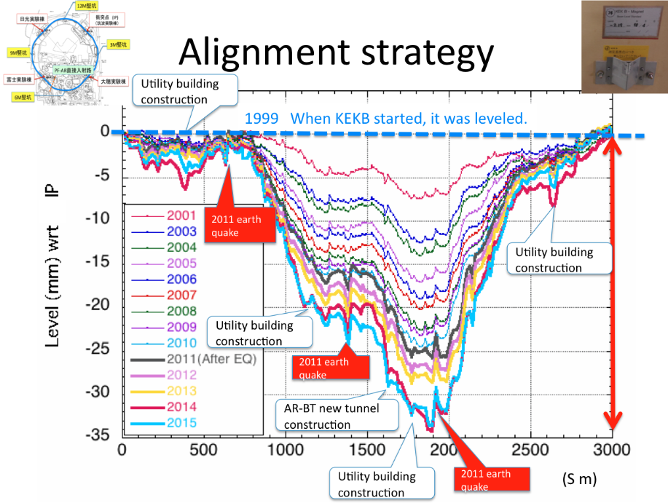
Tunnel sinking continues

Slide 26
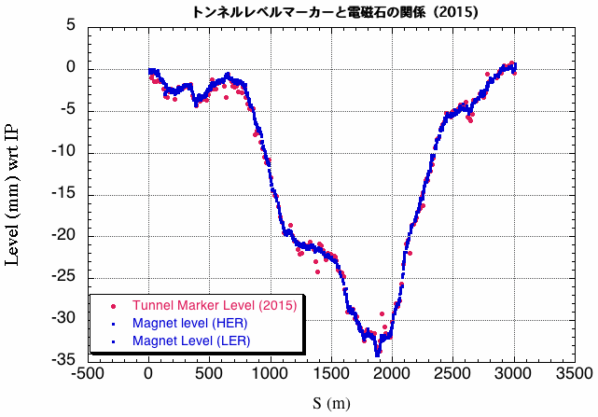
Survey Data and analysis results
We fixed the gap in the magnet level from the 2011 Earthquake
The data were used to “pre”-set the V-steering magnets when circulating the beam.

Slide 27
Results
  Well done!

Slide 28
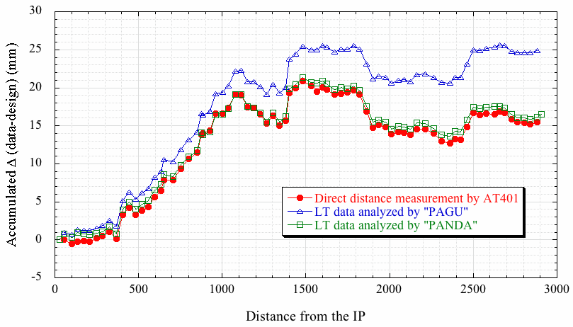
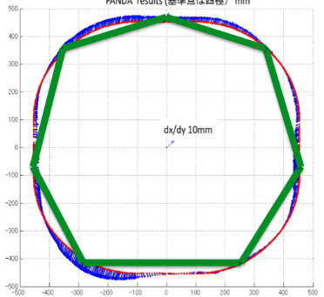
Circumference estimate
PANDA and AT401 direct distance measurement agree
Our best guess from the survey and analysis (PANDA) was that the circumference is about 16.4 mm longer than the SuperKEKB design. This information was used when injecting the LER beam to the ring on Feb.9, 2016 and the beam said Yes!

Slide 29
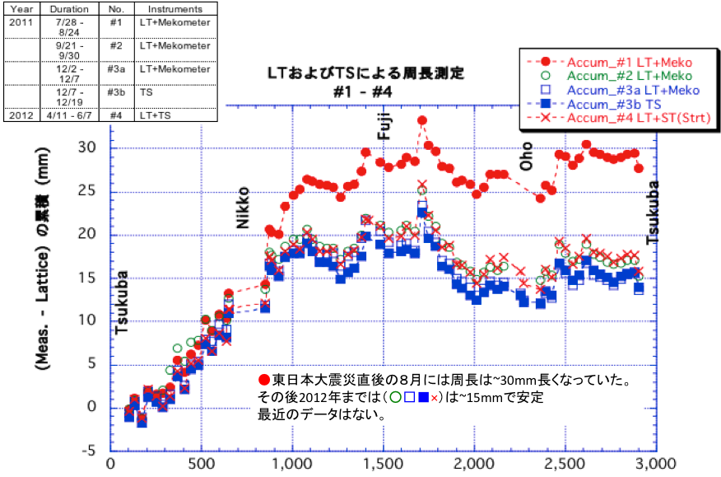
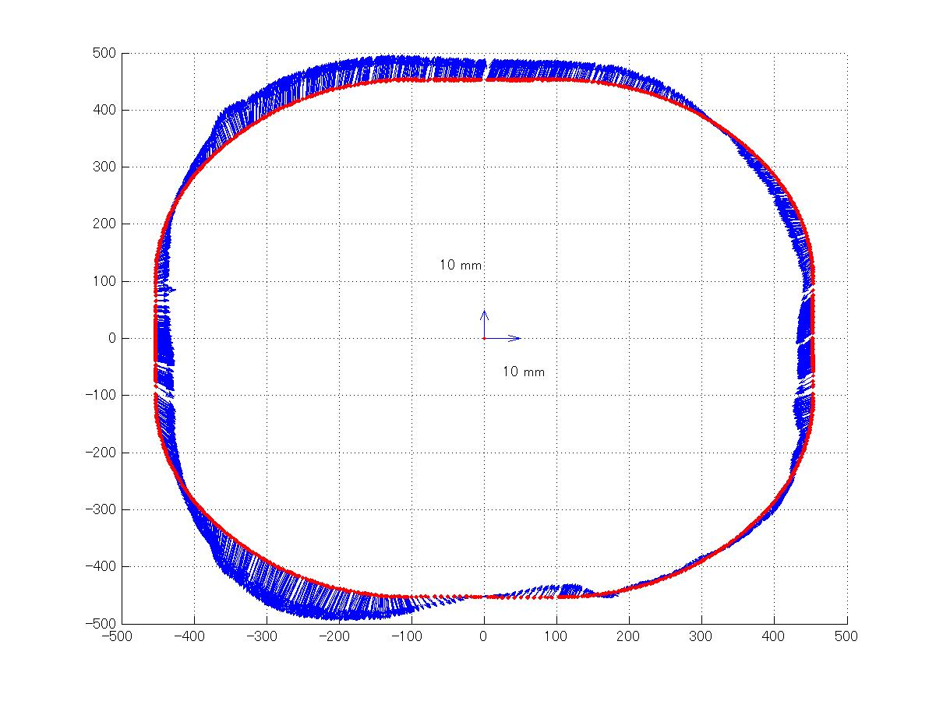

Our rings look like this
(Our rings have been always larger than the design)
Our rings were the largest right after the Great East Japan Earthquake in 2011. They started shrinking but not back to the level of KEKB.

Slide 30



First beam to the SuperKEKB MR LER…
Each spike corresponds to 1 turn.
130 turns!
Storage was achieved the next day when we turned on the RF

Slide 31

Difference between LER and HER
LER was commissioned first, then HER.
RF said that the difference between two rings in circumference is ONLY 0.2 mm!
I know, we were just lucky but.

Slide 32

We came a long way

Slide 33
Summary

Slide 34
Summary
The SuperKEKB MR magnet system was completed in time for Phase I commissioning.
The prediction for the circumference agreed with the actual circumference within 0.3 ppm accuracy and the difference in the circumference in both rings was found to be 0.2 mm (!), which contributed to the smooth start-up of the MR.
We would like to add more HLS sensors to monitor the tunnel level changes, especially at the IP & LCC sections (T. Kawamoto’s poster on Thursday).

Slide 35
No time to rest
We are preparing for Phase II, with the final focus superconducting magnet systems.
One cryostat was installed in August, 2016.
The floor was leveled nicely by “self-leveling” method.

Slide 36


Slide 37

Alignment

Slide 38


Slide 39


Slide 40
Merci

