Slide 1
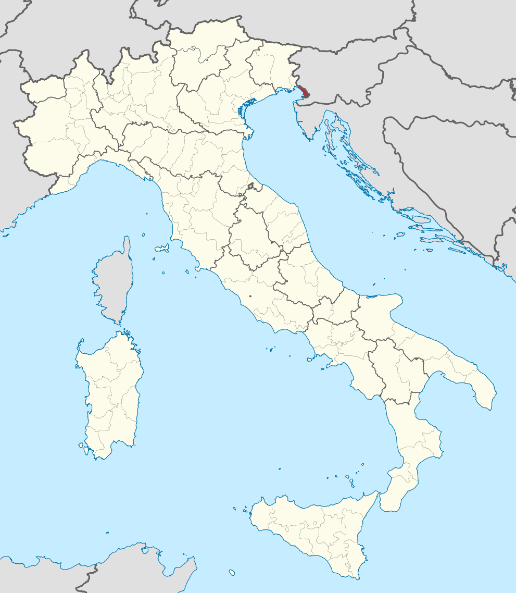
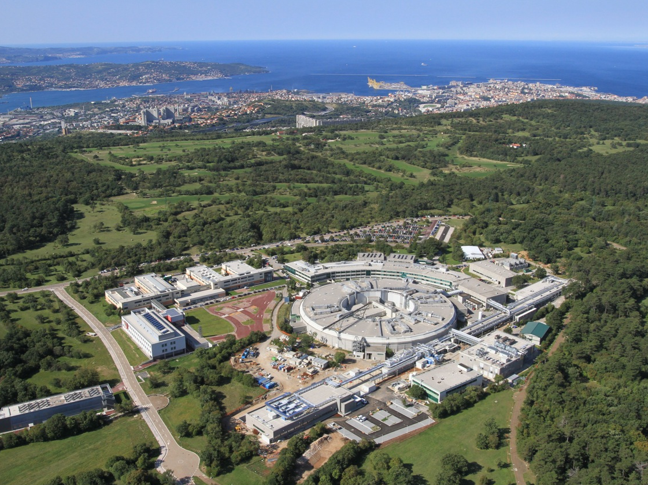
The Electron Beam Dump of the FERMI FEL
Simulation & measurement of electromagnetic and neutron radiation fields
The FERMI free-electron laser
Geometry
Scoring & results
Optional:
Magnetic fields
Map:
Wikimedia Commons
Lars Fröhlich (DESY) ● Katia Casarin, Alessandro Vascotto (Elettra—Sincrotrone Trieste)

Slide 2
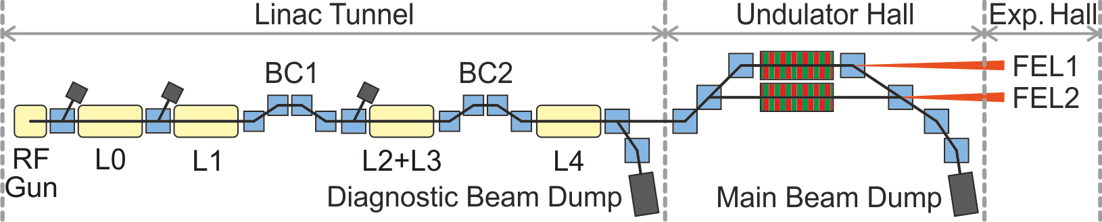
The FERMI Free-Electron Laser
FERMI is a seeded free-electron laser driven by a 1.5 GeV electron linac.

Slide 3
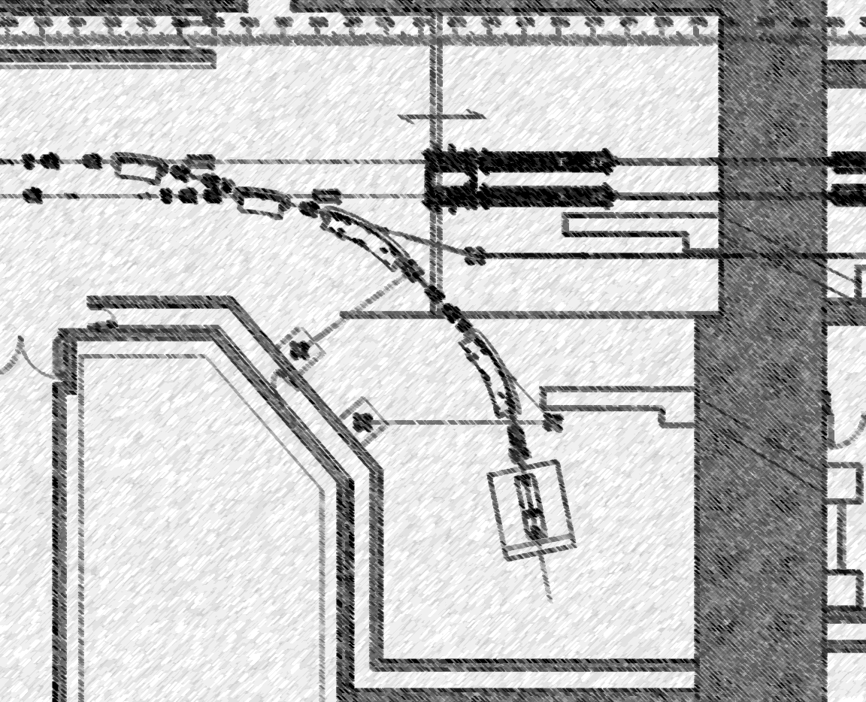
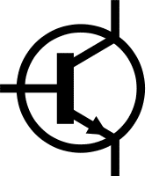
The Geometry – In Broad Strokes

Slide 4
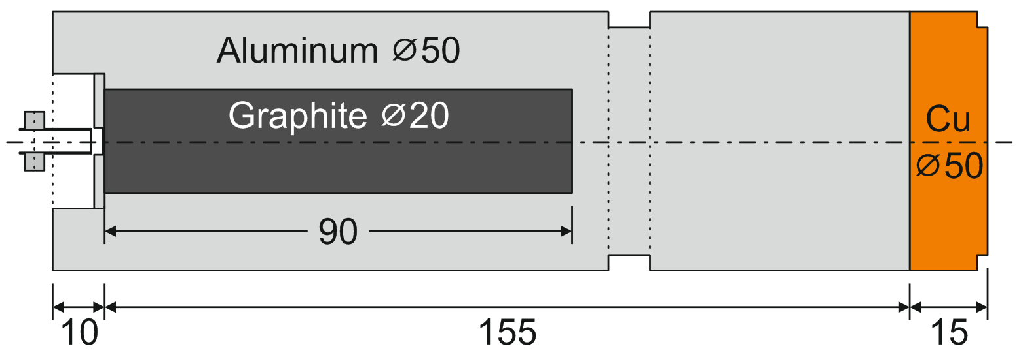
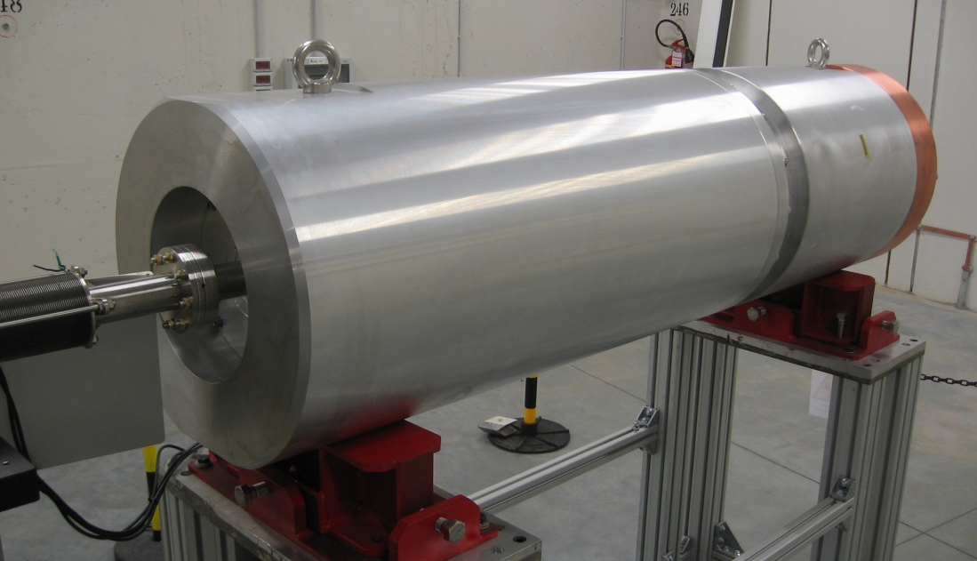
The Main Beam Dump

Slide 5
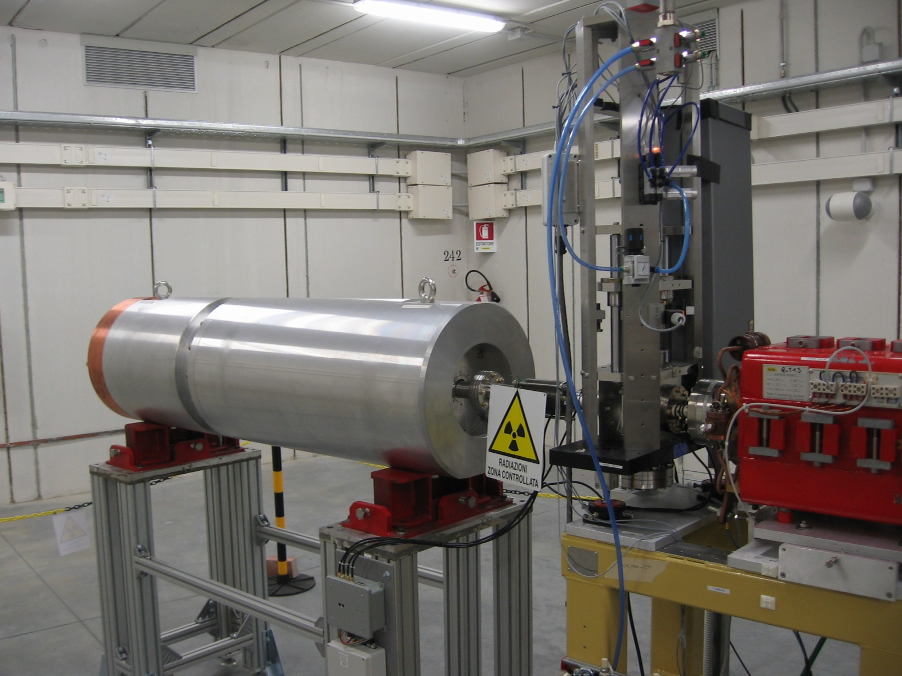
The Main Beam Dump

Slide 6
Fluka Geometry
Lattices, for no reason at all.

Slide 7
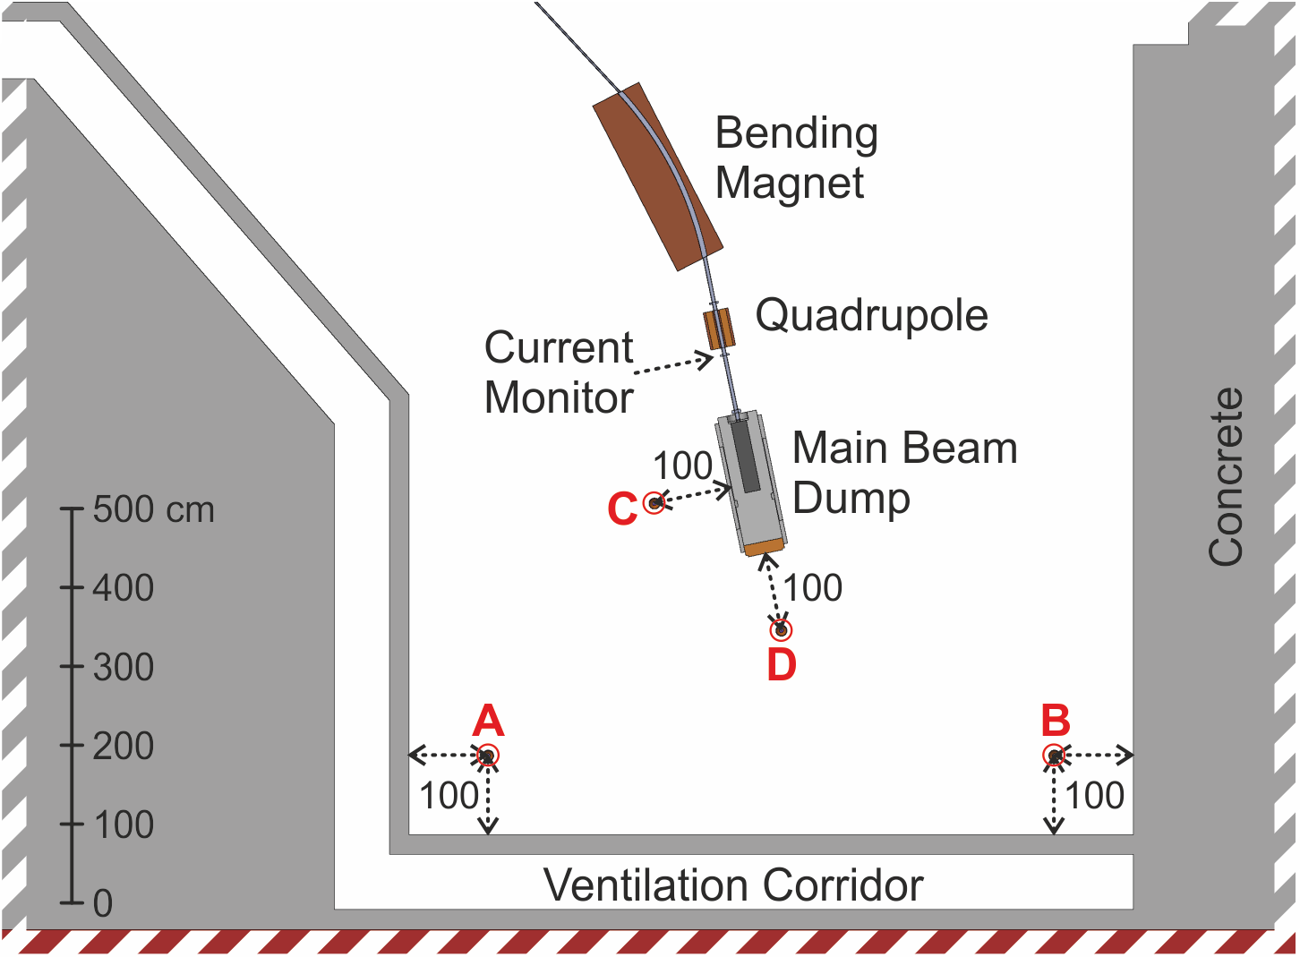
Measurement Positions
A–D Ionization chamber currents
A–D Neutron dose equivalent H*(10)

Slide 8
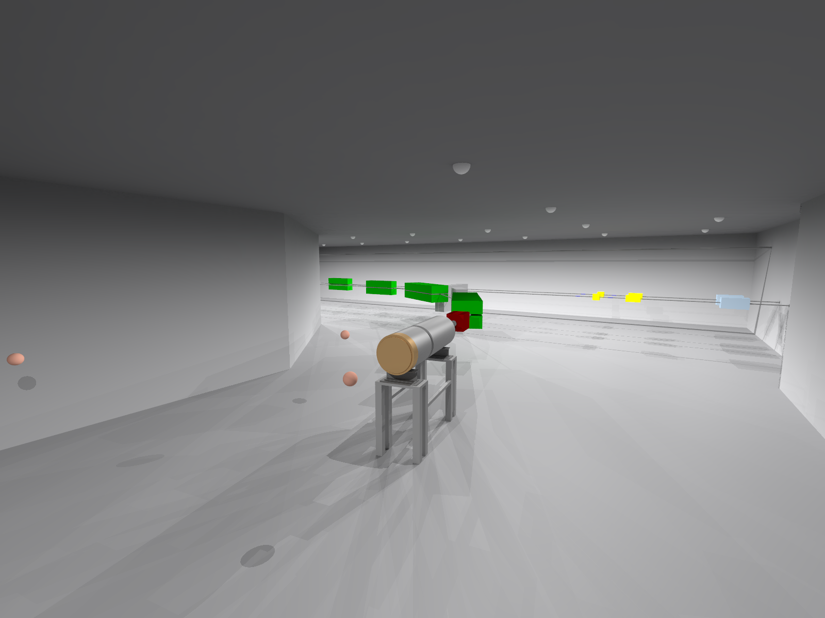

Slide 9
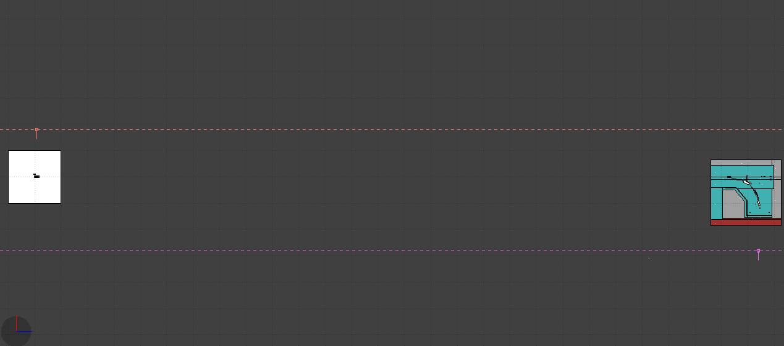
Top View
Parking
Lot
(z ≈ 0 m)
Simulation
Geometry
(z ≈ 280 m)
Black Hole

Slide 10
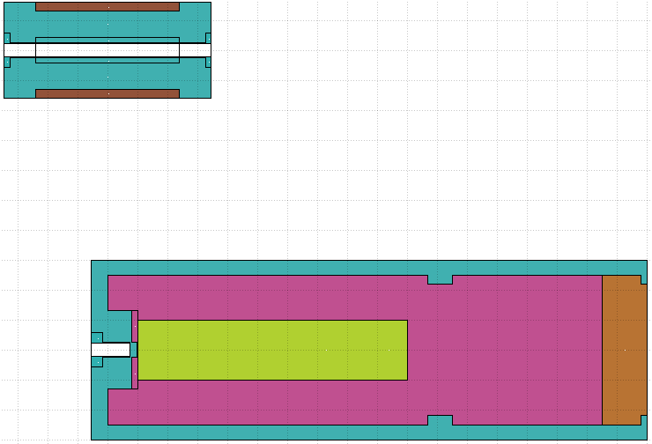
Parking Lot (Top View)
z = 0
x = 0

Slide 11
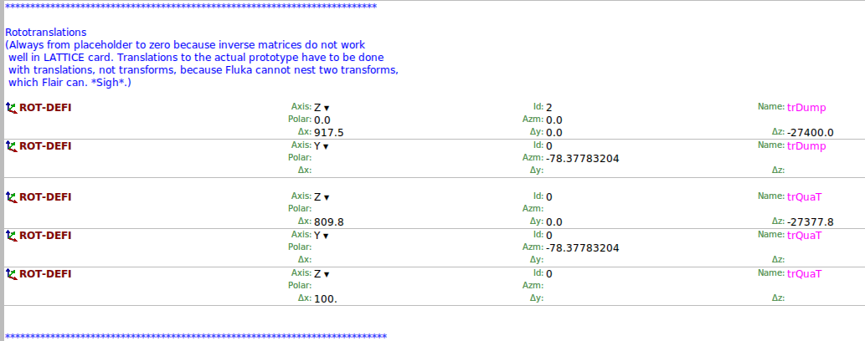
Transforms

Slide 12
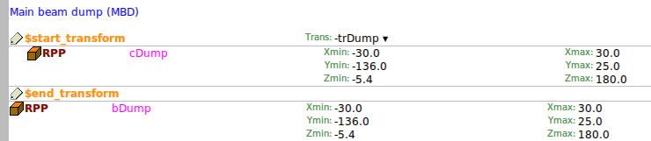
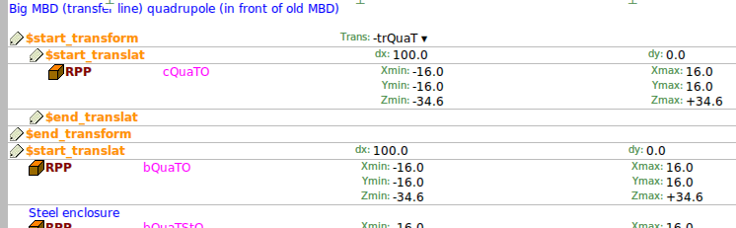
Bodies
Clone
Prototype,
around (0,0,0)
Clone
Prototype,
around (100,0,0)
Translation here cannot be transformation!

Slide 13
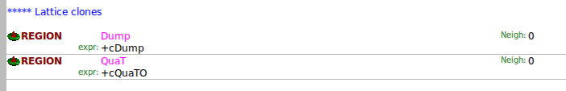
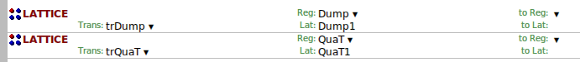
Clone Regions & Lattice Cards
No inverse (negative) transformations here!

Slide 14
Scoring & Results
Why life is easier if you don‘t measure things.

Slide 15
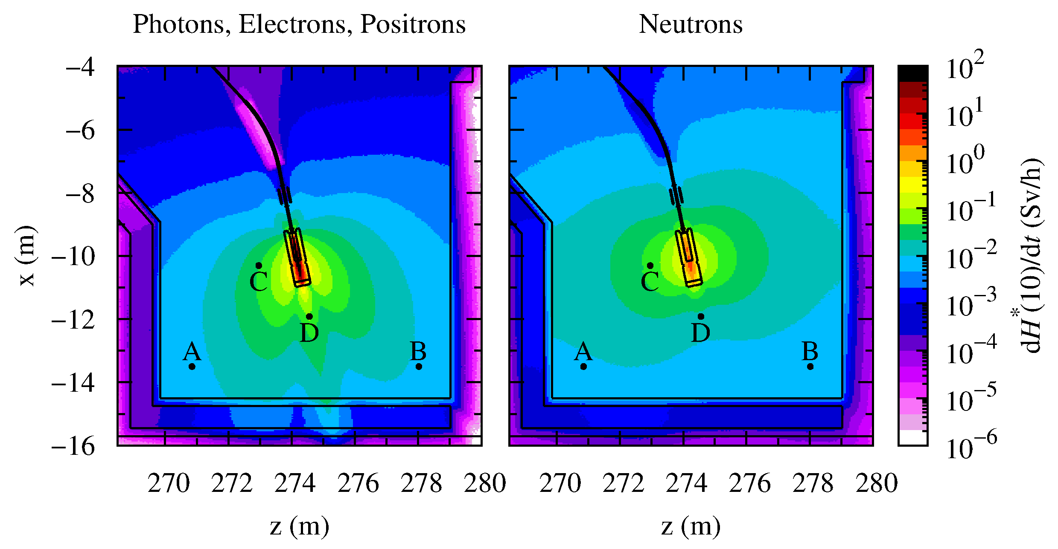
Scoring
Simulation only
3D USRBIN of ambient dose equivalent H*(10) (nice to look at)
USRBDX for photon spectra
USRBDX for neutron spectrum in position A
Simulation & measurement
Deposited energy in ion chamber gas
(to calculate current)
H*(10) from neutrons in position A
500 pC bunches
10 Hz
(5 nA)
y-avg. ± 20 cm

Slide 16
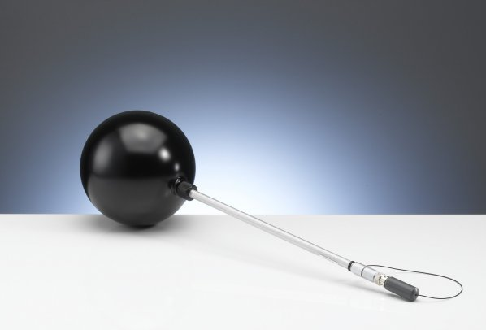
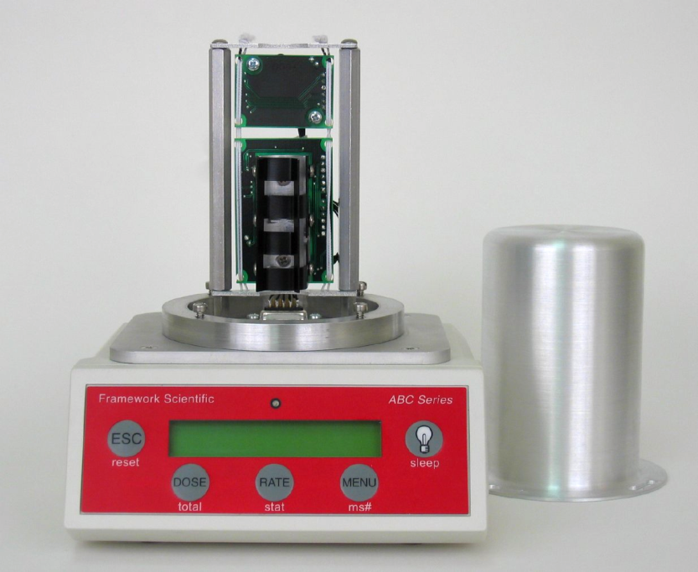
Detectors
PTW 32002
spherical ionization chamber
Active air volume: 1182.7 cm³
Outer wall: 3 mm polyoxymethylene
Inner sphere: 10 cm ∅ polystyrene
Keithley 6517 electrometer
Framework Scientific ABC1260
neutron detector
Superheated drop detector
Acoustic detection mechanism
Active volume: 10 cm³ SDD-100 vial
Calibrated vs. H*(10) with AmBe

Slide 17

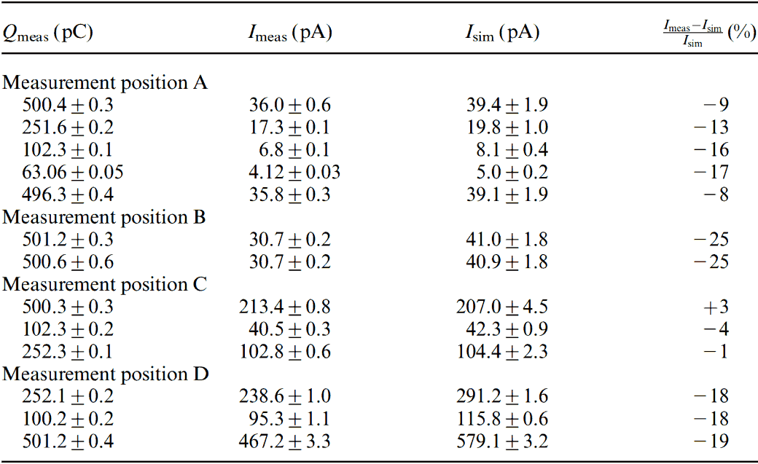
Ionization Chamber Current
Ion chamber model in simulation
Score deposited energy in “enclosed air” region
Calculate released charge per primary (34 eV for 1 e⁻-ion pair)
Scale to bunch charge/current
Hard to reach good statistics
→ LPB everywhere except target region; weak importance biasing
Outer electrode
Inner electrode
Enclosed air

Slide 18
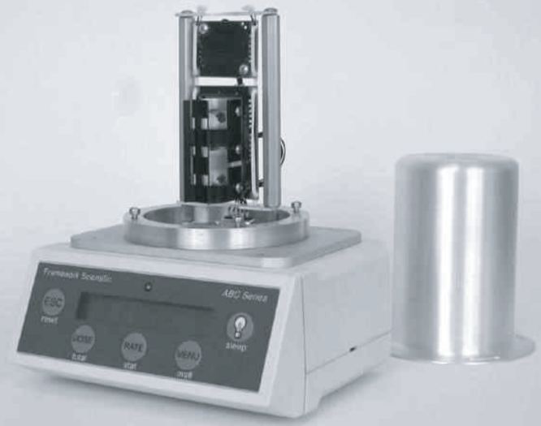
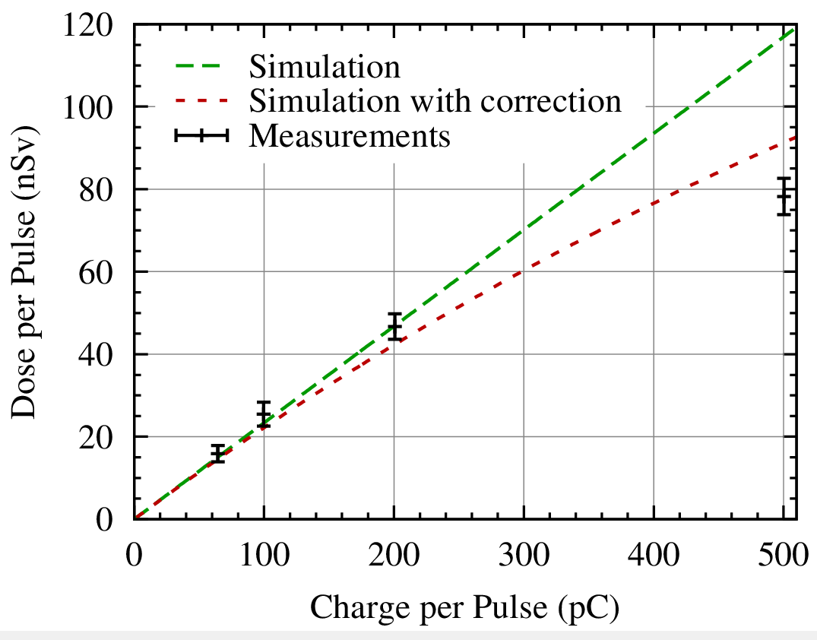
Neutron Dose Equivalent
Neutron detector in position A
Score DOSE-EQ in detector position (in air, no model present)
Scale to bunch charge
Compare to measurement

Slide 19
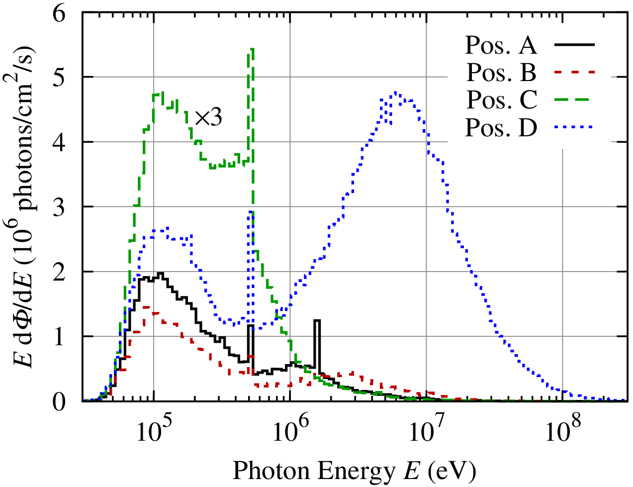
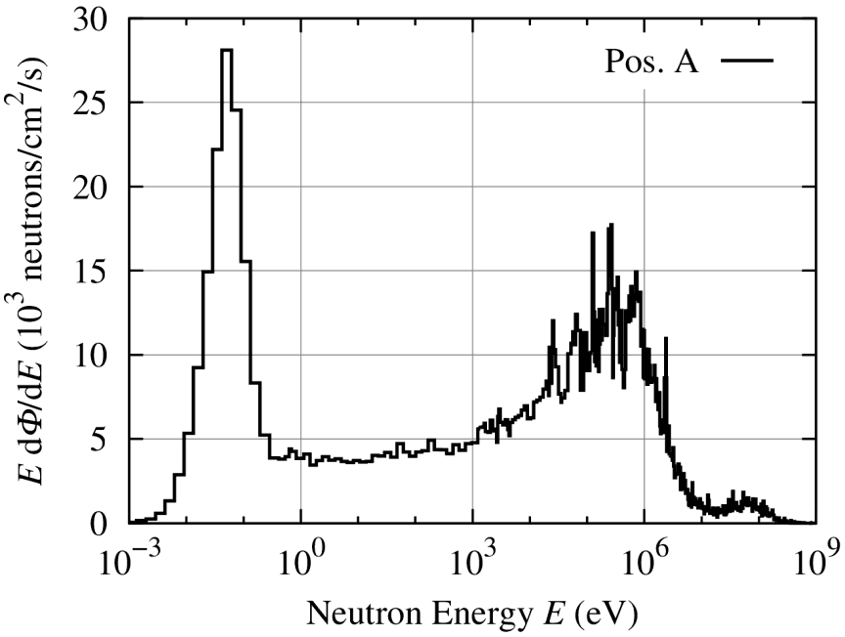
Energy Spectra
2 runs with special transport & production cutoffs
Detector model consists of air
USRBDX at outer detector sphere
Fluence scoring
Isolethargic plots: Area proportional to number of particles
Photons
Neutrons

Slide 20
Conclusions
Simplified geometry
Some estimated material properties (concrete composition, graphite density)
For practical purposes: Good agreement with measurements
Nice tool to understand
radiation fields around the accelerator
Extremely helpful for “what if”
scenarios
L. Fröhlich, K. Casarin & A. Vascotto,
Simulation and measurement of the radiation field of the
1.4-GeV electron beam dump of the FERMI free-electron laser,
Radiation Protection Dosimetry (2014)
doi:10.1093/rpd/ncu138

Slide 21
Spare Slides
… or: What did not fit in elsewhere.

Slide 22
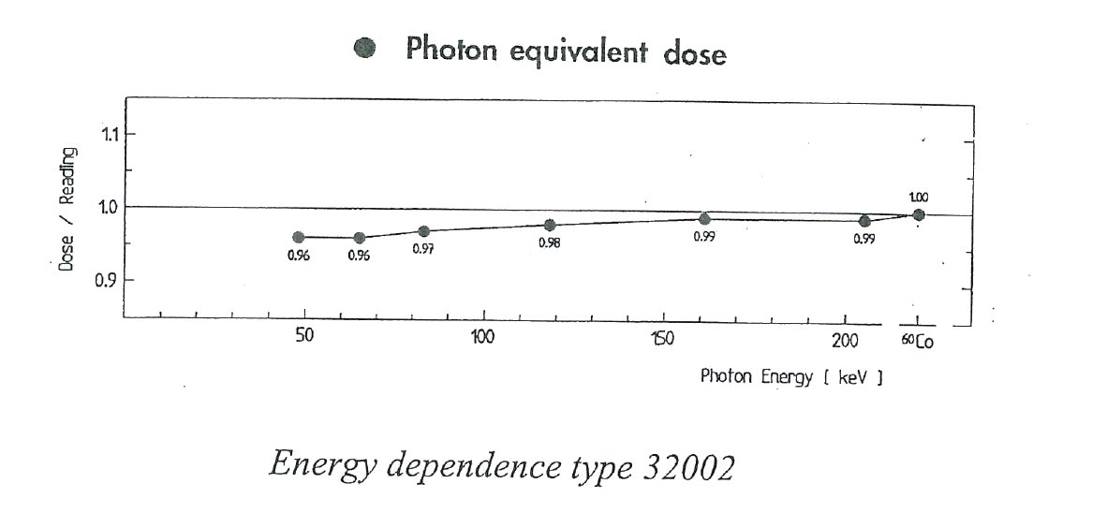
Energy Dependence PTW 32002

Slide 23
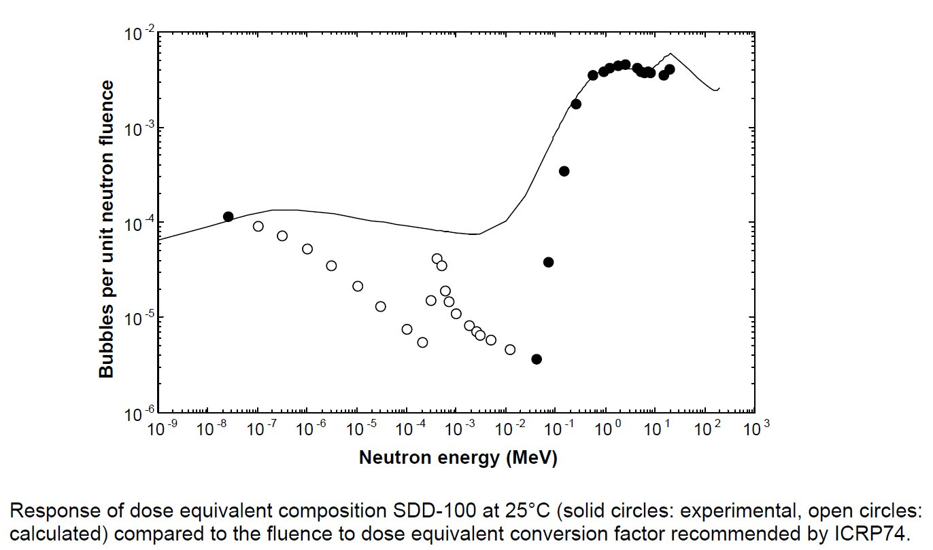
Energy Dependence SDD-100
(kinetic energy)

Slide 24
Magnetic Fields
One magfld.f to rule them all.

Slide 25
… more problems
challenges!

Slide 26
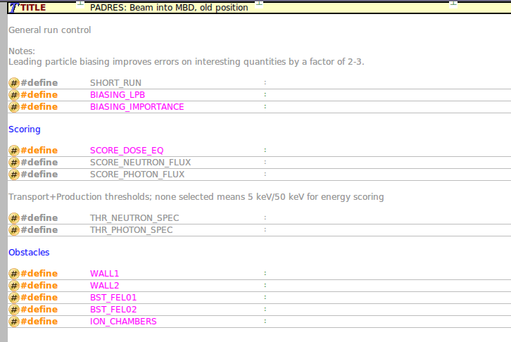
Not just a title…

Slide 27
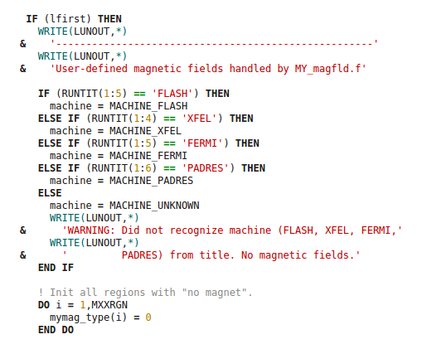
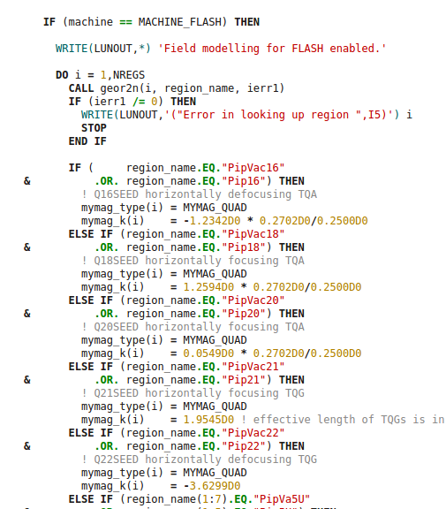
Magnet setup by machine and region name

Slide 28
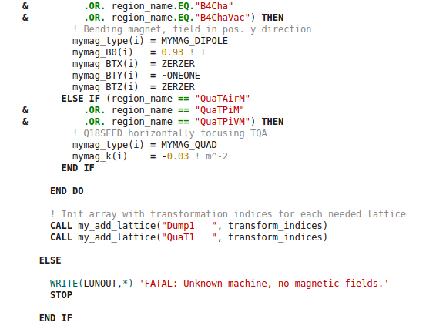
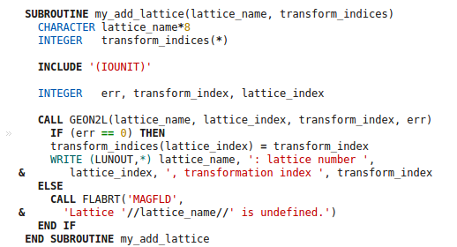
Not so nice: Lattices

Slide 29
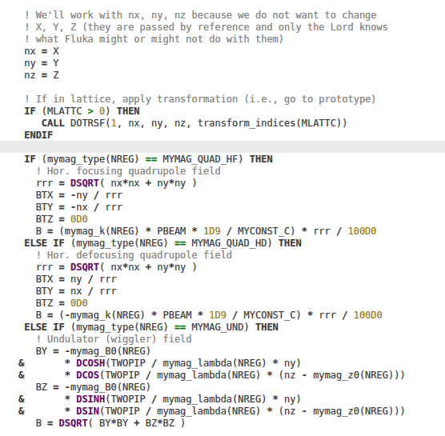
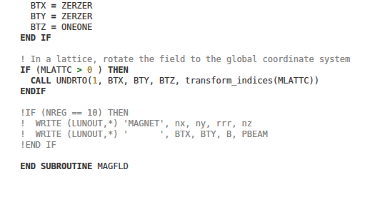
Field calculation: More fun with lattices

