Slide 1
Optical links for Upgrade
Summary of Sub-detector consultations
Base line for ‘general scheme’
Ken Wyllie - Laurent Roy - Niko Neufeld – Rainer Schwemmer
Electronics Meeting 11 Feb 2016

Slide 2


Mini-meetings summary:
Same ‘general scheme’ for all sub detectors
(except Velo: no need ‘Detector PP’)
2 single Fibres
MPO 12 Fibres
VTTx
VTRx
Detector Patch Panel
UX85
PP
Surface PP
TELL40
SOL40
TELL40 - SOL40 side:
Number of links used / MPO12
not clear for many sub detectors
depend on the:
Detector side:
VTTx/VTRx quantity well defined
Detector Patch Panel location +/- well defined
UX85 PP location well defined
Long distance cables:
2 installation types still possible (‘blowing + splice’ or ‘trunk’)
Surface PP location depend of Data Centre position
(Decision ~ next summer)
“occupancy” “Firmware optimisation” “MonteCarlos” “FPGA Bandwidth” …

Slide 3
Scenario 1: ‘‘ Full MPO ’’
-Many ‘not used’ fibres installed from detector to the surface
→ more patch cord
more MPO adaptors in the different PP (space on the detectors)
more long distance cables
-Extra single fibres with LC connectors to store detector side
-‘not used’ fibres can not be considerate as fully spare
-if need install ‘splitting cassette’ afterward
→additional break point
→space for cassette to foreseen in the rack
3 not used
1
2
3
4
5
6
7
8
9
10
11
12
13
14
15
16
17
18
…
LC
MPO-MPO Adaptors Path Panel
MPO-MPO Adaptors Path Panel
12f
MPO
MPO
MPO 1
MPO 1
12f
MPO
9 used
MPO
TELL40
3 not used
3 not used
MPO
MPO
MPO 2
MPO 2
12f
MPO
9 used
12f
MPO
MPO
MPO
MPO
MPO 3
144f
MPO 3
MPO
12f
MPO
8 used
1
2
3
4
5
6
7
8
9
10
11
12
13
14
15
16
17
18
…
LC
Trunk 1
TELL40
MPO
MPO
MPO
MPO 4
MPO 4
12f
MPO
8 used
4 not used
UX85 caverne
PM85 pit
Surface
4 not used

Slide 4
Scenario 2: ‘‘ LC on surface ’’
- Number of fibres optimized
Reduce quantity of Patch cord, patch panel, long distance cable (cost)
- Possibility to mix Control and Data fibres in the same 12 ribbon
Flexibility with patching on the surface (always accessible)
→ Possibility to change the number of fibres send to the TELL40 or SOL40 /MPO12
- More space need on the surface in patch panel room (3 times space need for MPO PP)
- Rigorous connection need for initial installation
1
2
3
4
5
6
7
8
9
10
11
12
13
14
15
16
17
18
19
20
21
22
23
24
LC
MPO-MPO Adaptors Path Panel
LC-LC Adaptors Path Panel
12f
MPO
MPO
MPO 1
3 not used
MPO
9 used
MPO
TELL40
MPO
MPO
MPO 2
MPO
9 used
12f
MPO
3 not used
MPO
MPO
MPO 3
144f
MPO
8 used
Trunk 1
4 not used
TELL40
MPO
MPO
MPO 4
MPO
8 used
…
…
UX85 caverne
PM85 pit
Surface

Slide 5
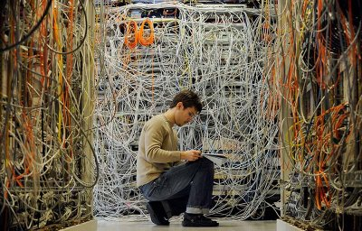
TFC + Control:
1 MPO/ type of transmission
Could be a problem if distance between the 12 VTRx long…
LC Duplex
1
2
3
1f
Detector Path Panel
12f
MPO
12f
MPO
SOL40
1f
1
2
3
12f
MPO
L
- Data and Control mixed
→ reduce the total length of single fibre part (save space)
→Avoid spaghettis inside the ‘large’ detectors
MPO
…
1
2
3
1f
SOL40
1
2
3
Data
Control
1
2
3
4
5
6
7
8
MPO
MPO
TELL40
…
…
Use the same ‘root’: separation on the surface PP

Slide 6
2 techniques for long distance installation available for LC on the surface
1) 144 fibres Trunk pre-connectorized in factory
with at the ends: 12 MPO12 and 144 LC is technically possible
Instead of having 12 MPO- 12MPO trunk + splitting cassette MPO-12LC
(more expensive + 1 more break point)
2) Blowing in pipes 144 fibres ‘micro cable’ with 12 MPO12 already pre connectorized
splice 144 pigtails LC after blowing
→ Same as prototype already installed
-> research best prices on going

Slide 7
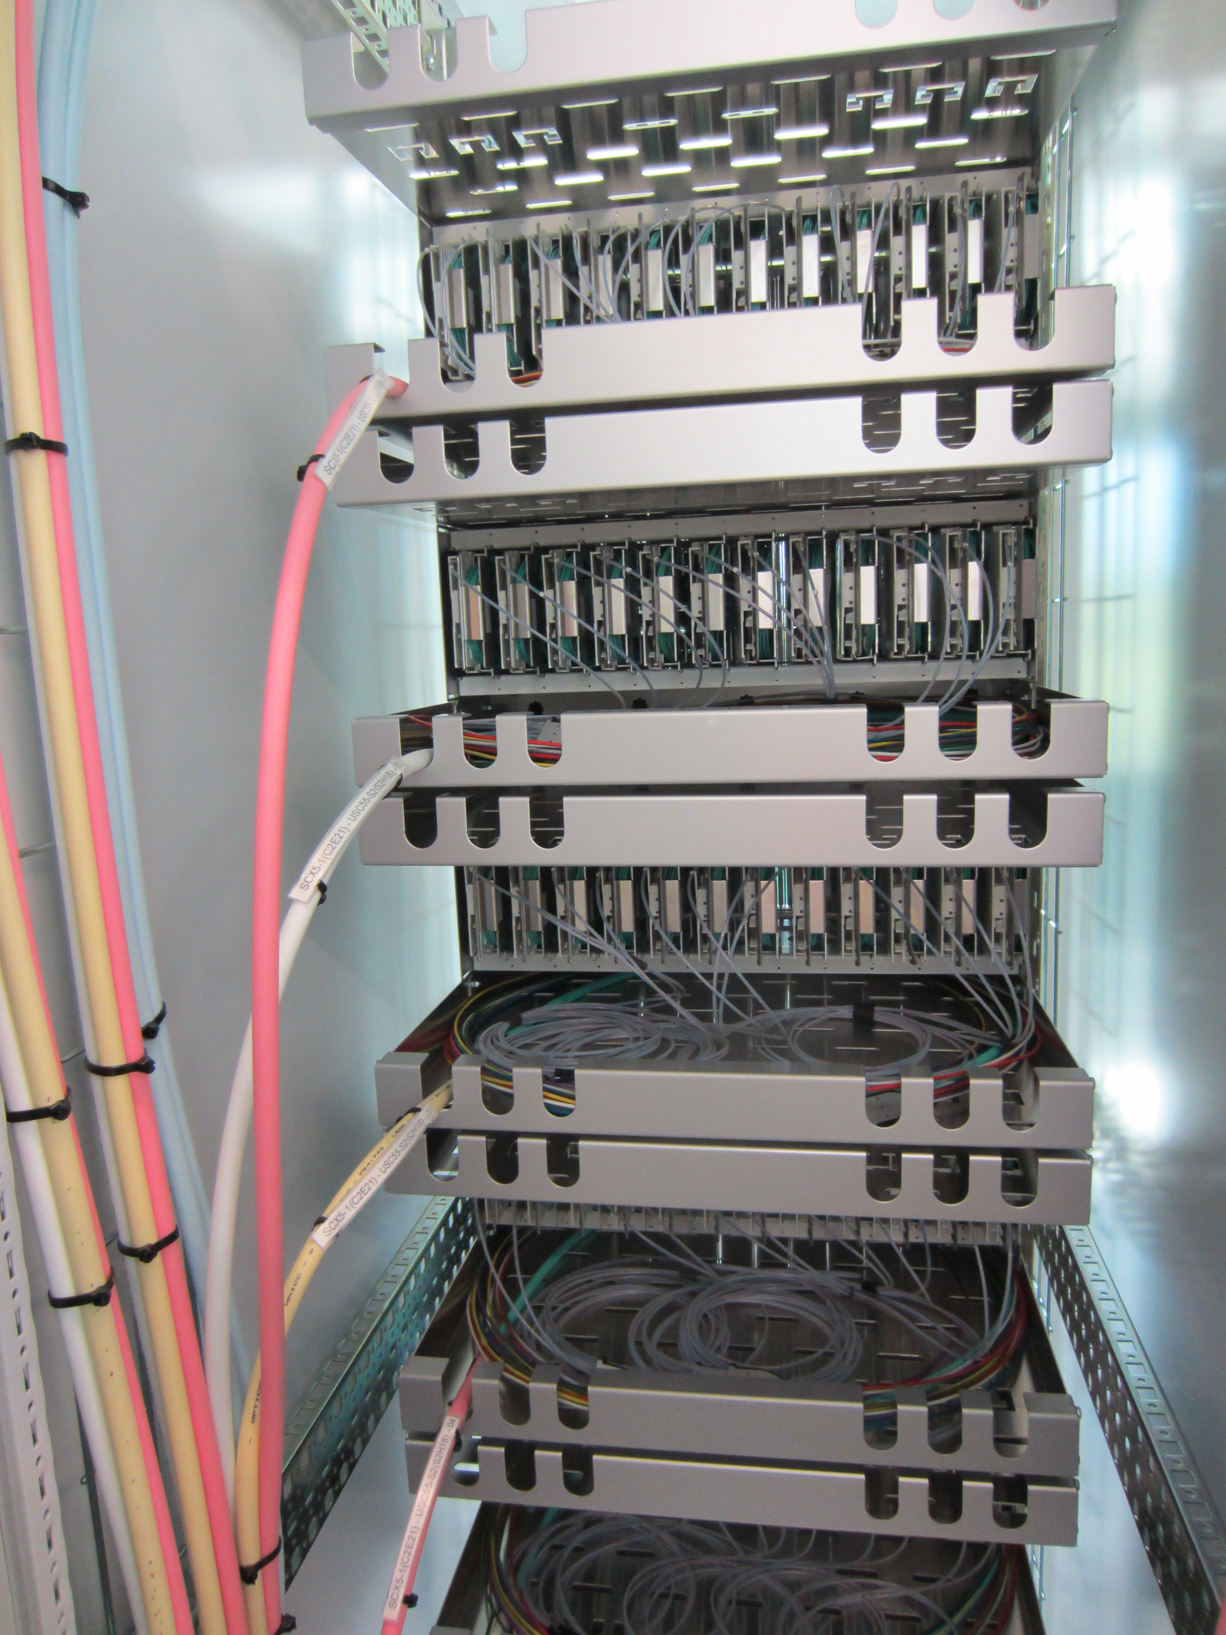
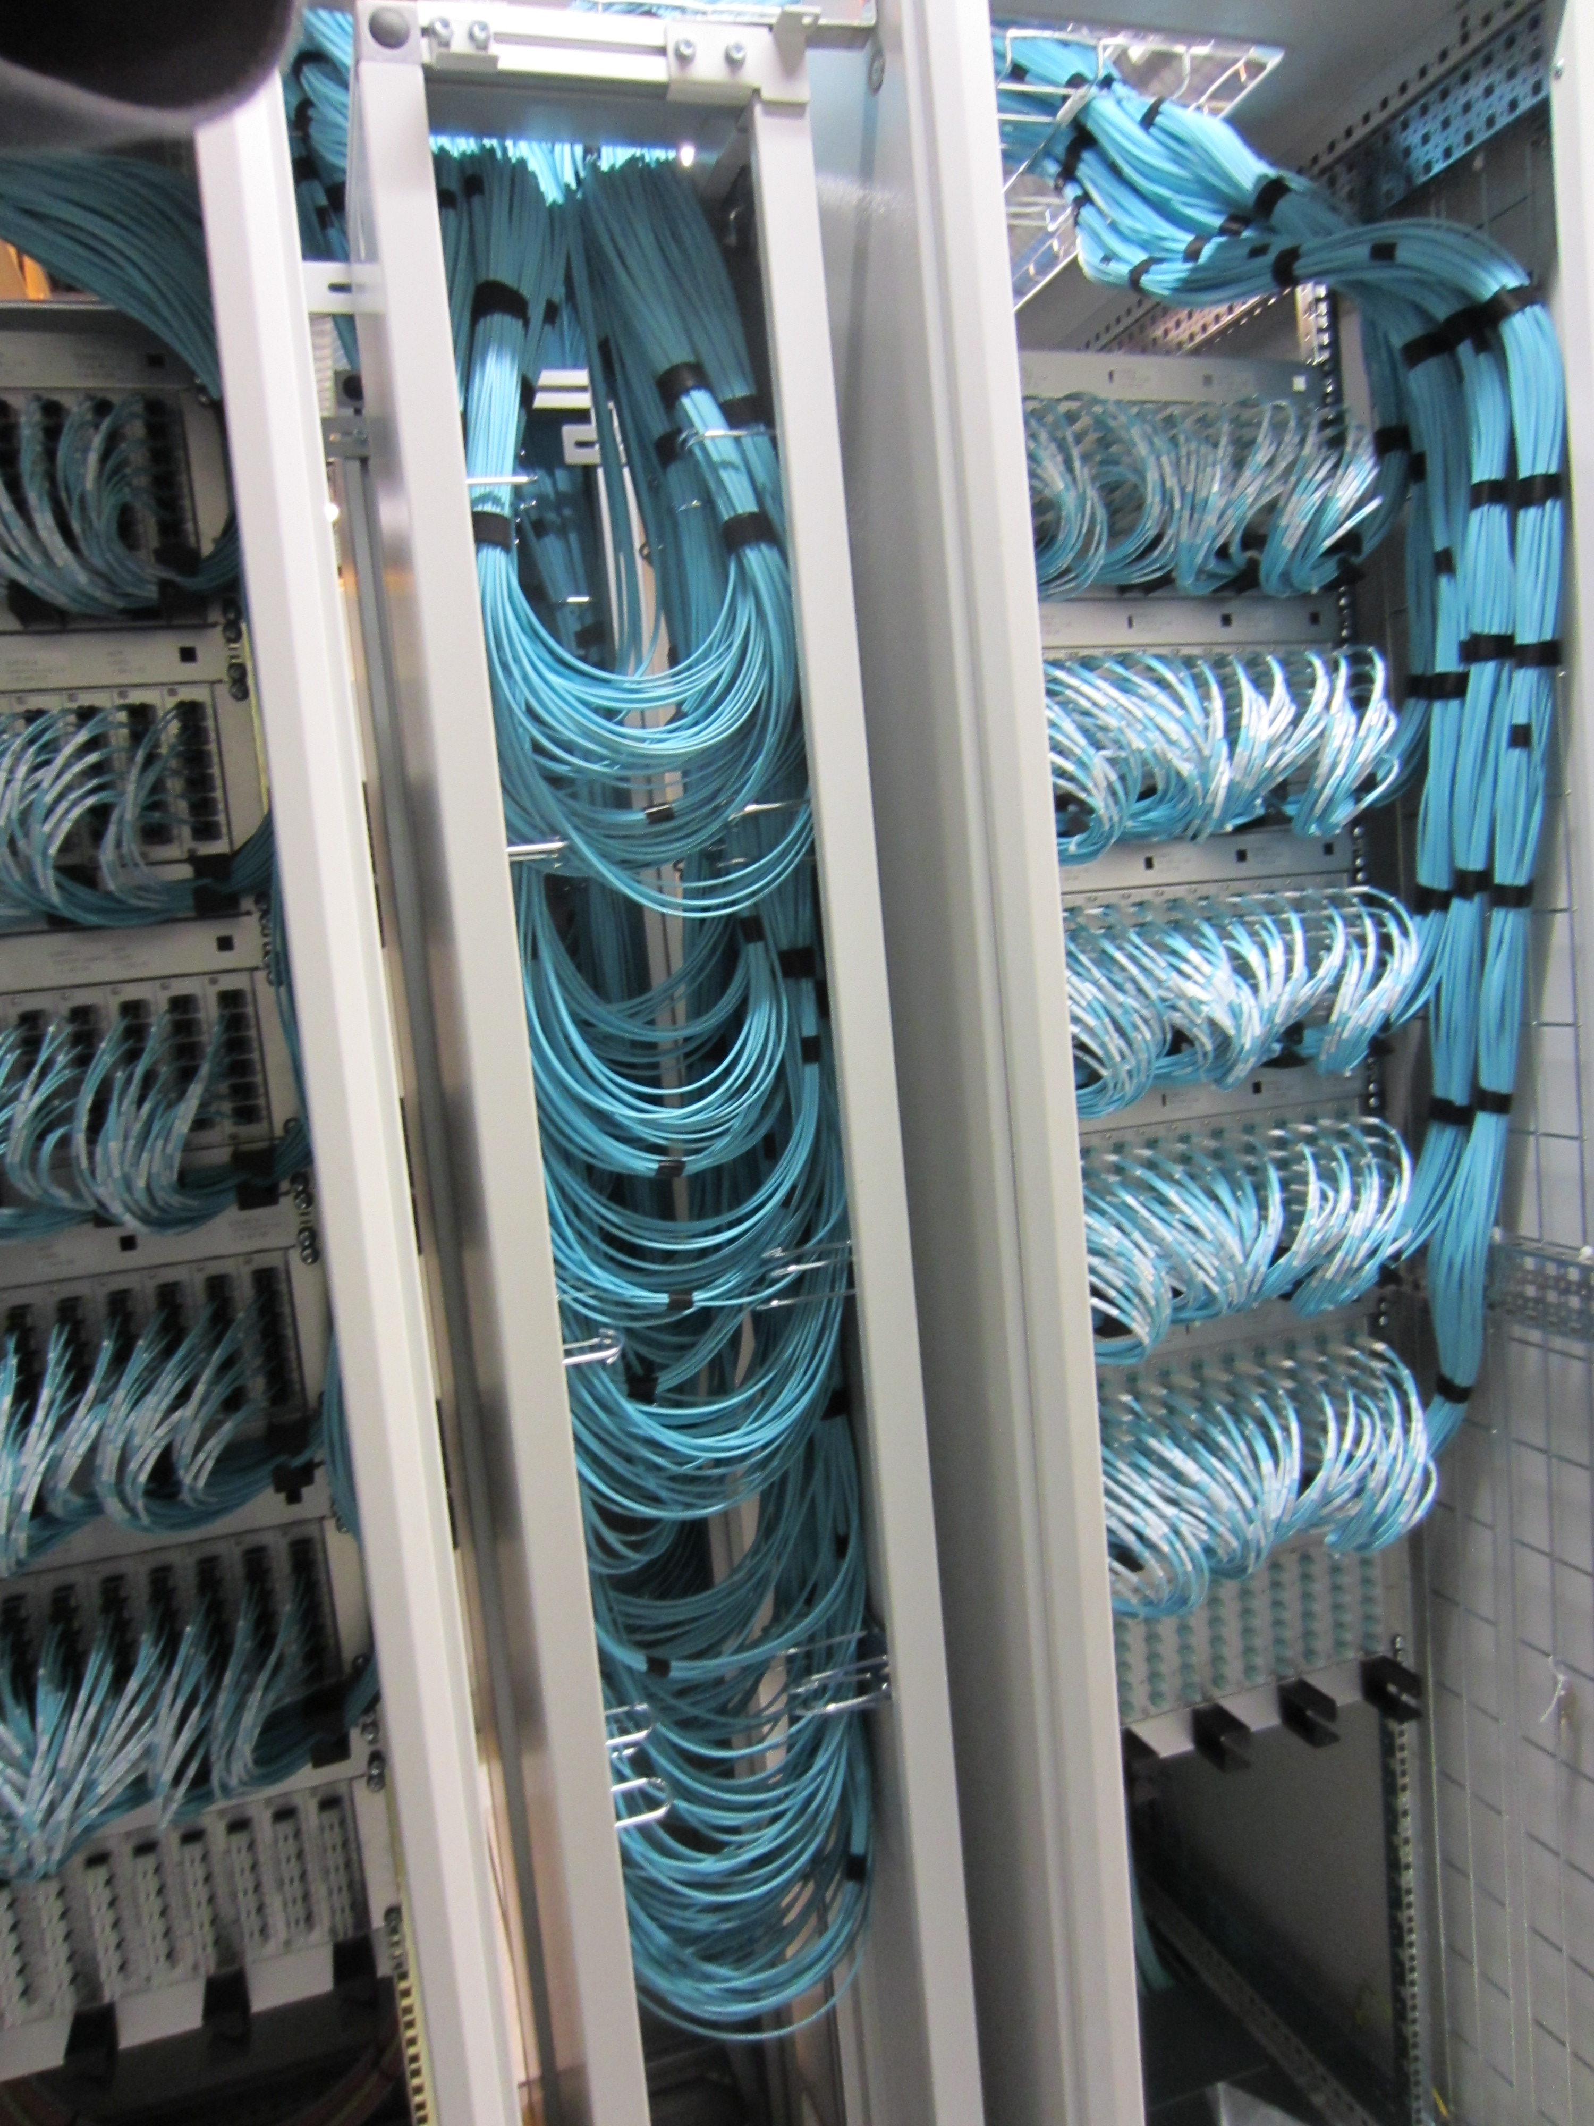
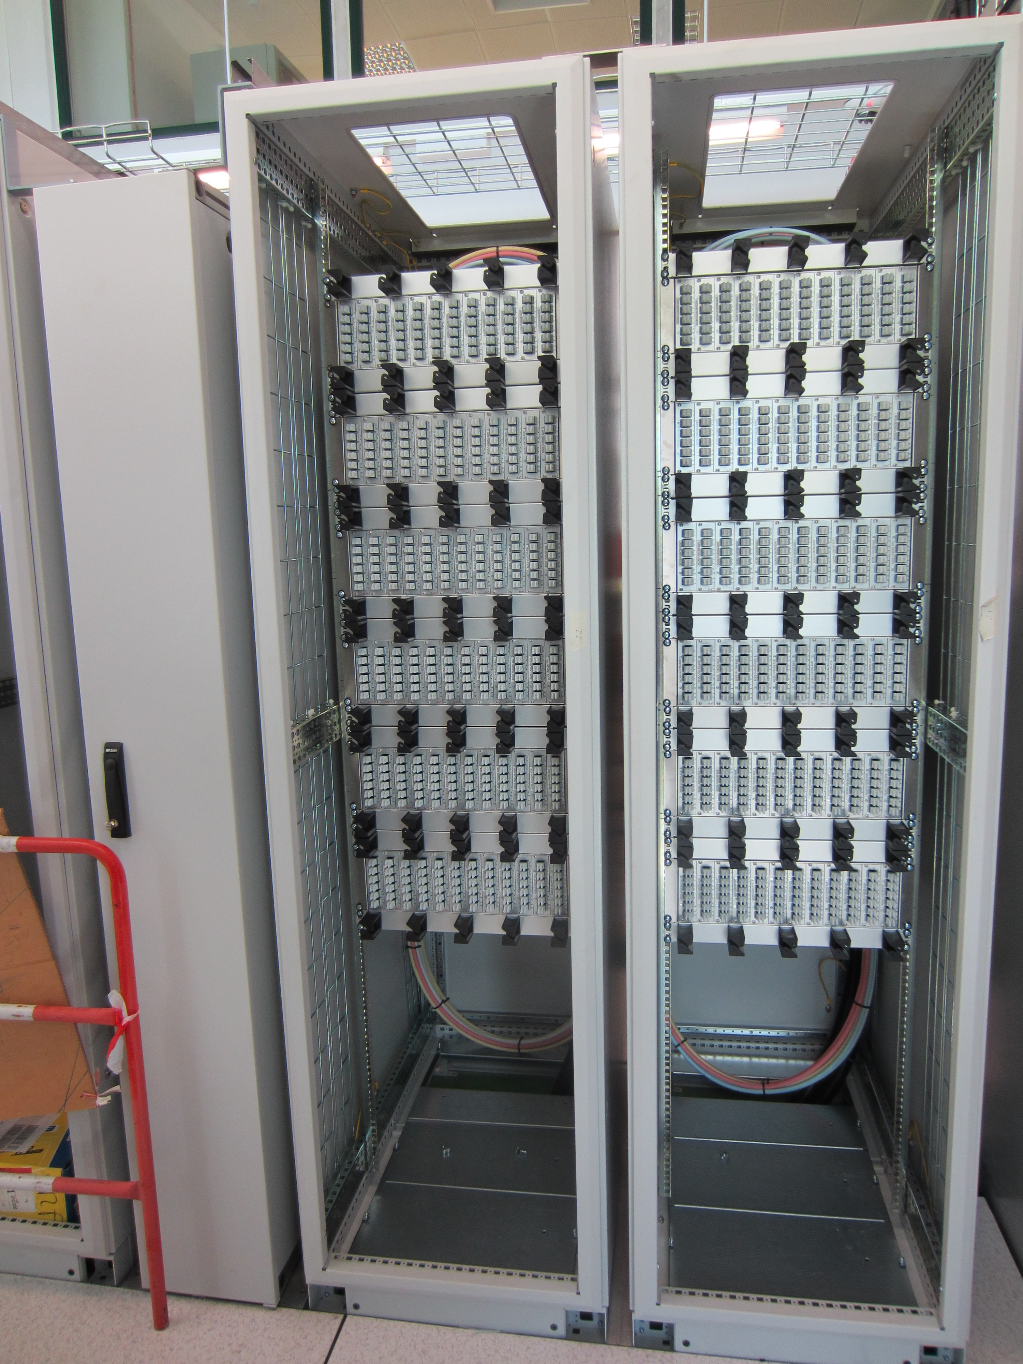
Patch Panel with single connectors example (CMS):
Possibility to have 288 single connectors in 3U
At least 2 U must be added for cable management + Space to store extra length
- A false floor for long distance cable + enough space above racks for patch cords
Patch cord
extra length storage
Long distance connection
(blowing in this case)
5U
47U racks
Patch cords not yet installed
Patch cord connected in front

Slide 8
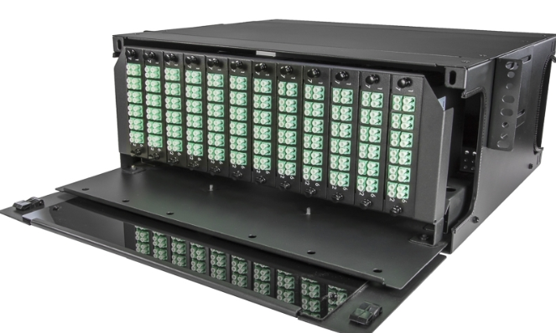
Space estimate for PP Racks on the surface with single LC connectors
PP 3U (288 fo = 2 cables)
+2U Space for cable management
-> 8 racks
MUON
CALO
RICH2
Scifi A
Scifi C
UT
RICH1
VELO
52U
Example: 288 LC Patch Panel

Slide 9
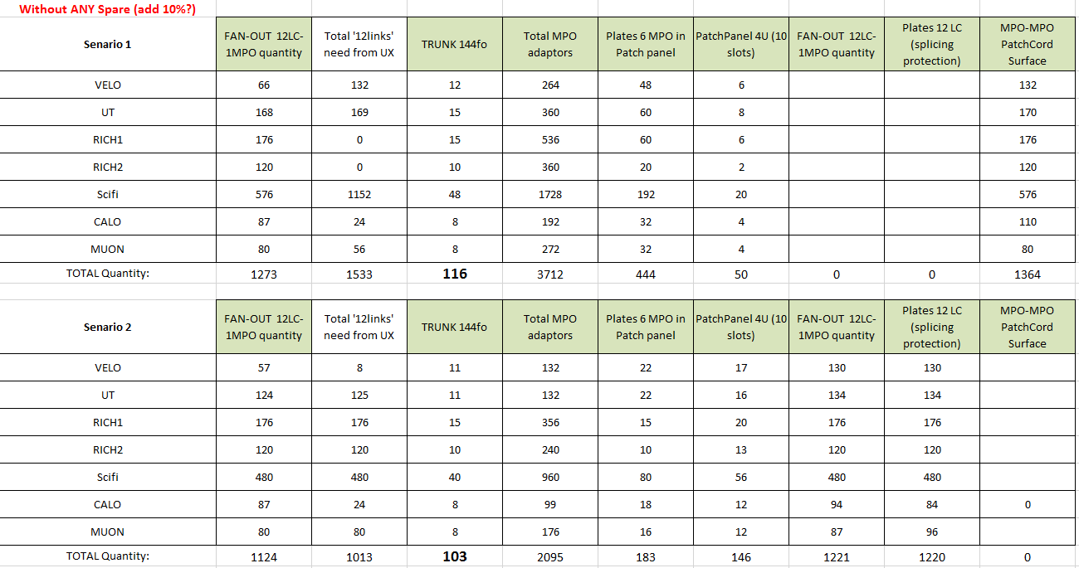
Quantities comparison / Scenario ‘Full MPO’ or ‘LC PP on the surface’
13 trunk 144fo less with scenario 2 (with LC)
Total LHCb cost:
.Fan-Out 10m both sides
.Long distance cables+Installation
.PatchPannel
~15% cheaper with scenario 2
(based on EL contract prices, without any spare in both scenario)
Rk: table 2 not optimized by regrouping TFC + Control with Data

Slide 10
CONCLUSION
Scenario with LC Patch Panel on the surface will be the Base Line for DATA and for TFC+Control
If needed TFC+Control can be mixed with DATA in the Patch Cord detector side
→ an EDMS document / sub detector will be established
-equipment quantities detailed
-connections detector side -> TELL40 +SOL40 detailed
(thanks in advance for your collaboration)

