Slide 1
MEDICIS BEAM INSTRUMENTATION

Slide 2
Contents
MEDICIS requirements
BE/BI proposal
Conclusions

Slide 3
MEDICIS requirements (EDMS no. 1578751)
FRONT END FARADAY CUP
DIAGNOSTIC BOX(SCANNER+FC+SLIT)
COLLECTION SLITS

Slide 4
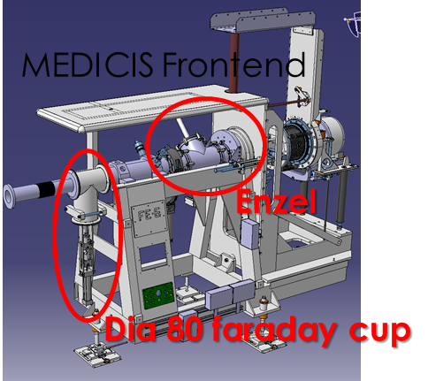
FRONT END FARADAY CUP REQUIREMENTS
80 mm aperture
~3000 cycles/year

Slide 5
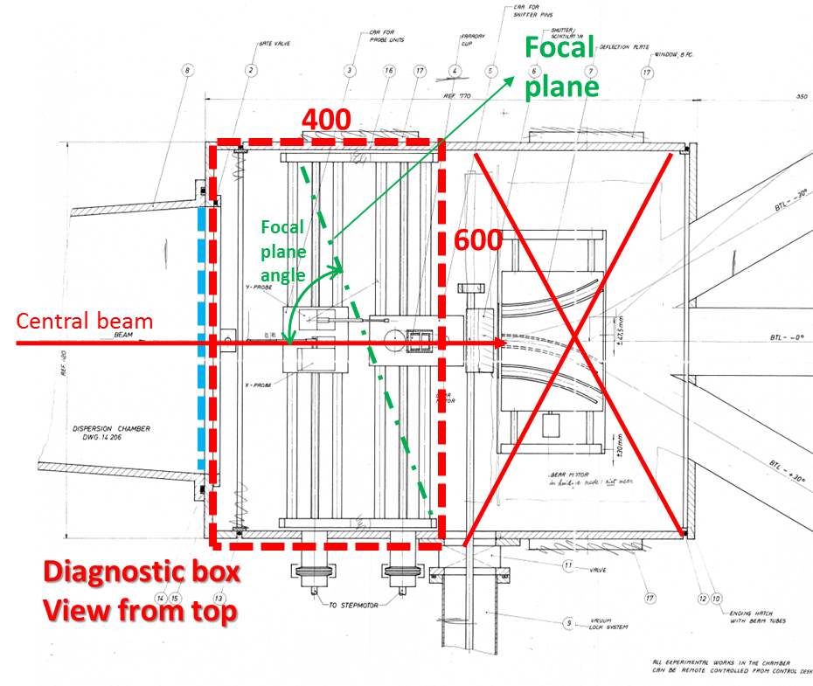
DIAGNOSTIC BOX
BEAM SCANNER REQUIREMENTS
H and V planes, 350mm X 50mm
Along the focal plane(rotated by 60° instead of 90° with respect to beam direction)
~35000 scans/year for the H plane, ~10000 scans/years for the V plane

Slide 6
DIAGNOSTIC BOX
FARADAY CUP+SLITS REQUIREMENTS
maximum stroke of the slit and the Faraday cup 400 mm
min/max aperture of the slit 0-50mm
40 mm aperture for the FC
min/max current on the measurement zone 0.1 pA – 10μA
~10000 cycles/year

Slide 7
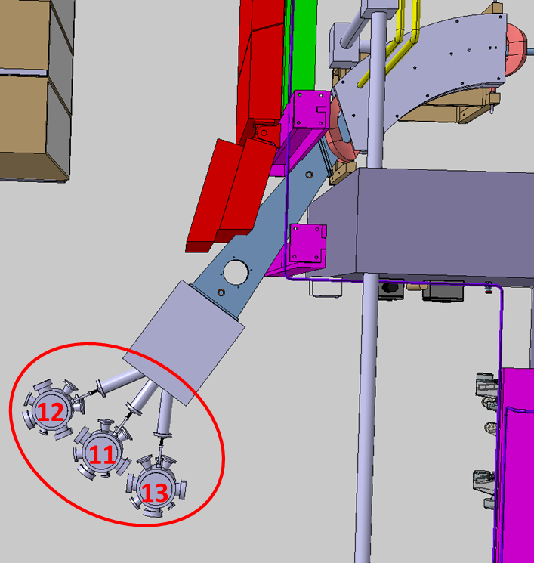
COLLECTION SLITS REQUIREMENTS
maximum stroke of the four-sector slits150mm
min/max aperture of the slit 0-50mm
Dimensions of the plates 50 mm x 30 mm
min/max current on the measurement zone 0.1 pA – 10μA

Slide 8
BE/BI PROPOSAL
FRONT END FARADAY CUP
Can use standard ISOLDE front-end 80mm faraday cup
  Spare parts for 2 units available(for ISOLDE, will need to be replaced)
  Standard electronics already exist – needs 1 additional PLC
EN-STI to provide actuator and vacuum chamber
  Proven reliability, rad-hard and works very well
Resources required to be ready for end 2016
  Material budget of 10kCHF
  1MM of FSU support (~7kCHF)
  Staff manpower of 1MM (can be made available)

Slide 9
DIAGNOSTIC BOX
New design required
  Would need to be done by EN/MME(or EN/STI) with input from BE/BI
  Not clear if the design can be completed by summer 2016
4-6 months required for production(based on similar ongoing projects)
Unlikely to be ready by the end of 2016

Slide 10
Diagnostic box: proposed split of responsibility
EN/STI
Design of the slits
Design of the movement system for both slits & FC
Integration of the scanners (design by BI)
Production of the tank, slits, FC(input from BI) & movement system
BE/BI
Design and production of the scanners+spares
  Requires resources from EN/MME
Electronics for the control & readout of the scanners
Design & electronics of the FC
BE-BI Resources required:
  Staff manpower 2MM (not identified)
  Material budget of 65kCHF
  1MM FSU support (~7kCHF)

Slide 11
COLLECTION SLITS
Should be designed & produced by EN-STI
BI provides instrumentation
  However electronics yet to be developed
    Under development for ISOLDE
    Unlikely to be ready for end 2016
BE-BI Resources required
  Staff manpower covered by ISOLDE development
  Material budget of 10kCHF

Slide 12
CONCLUSIONS
For any design and integration to start the beam instrumentation engineering specifications need to be finalised as soon as possible
Resources, budget and timeline
  Very early stage but BE-BI contributions unlikely to be ready by end 2016 even if all resources can be made available
    Missing 2MM staff manpower for diagnostic box scanner design & production follow-up and assembly
    Earliest conceivable installation date Spring 2017
    Budget required estimated at 100 kCHF

