Slide 1
https://indico.cern.ch/event/490526/
Thursday 3rd March
CV Presentation
UPDATE MEDICIS
Cooling
A.BROCHE – EN/CV

Slide 2
OUTLINE
  Users requirements
  Technical proposal
  Budget
  Planning

Slide 3
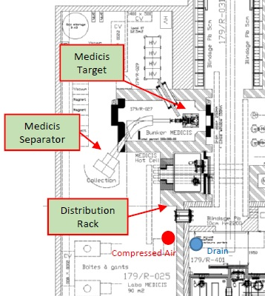
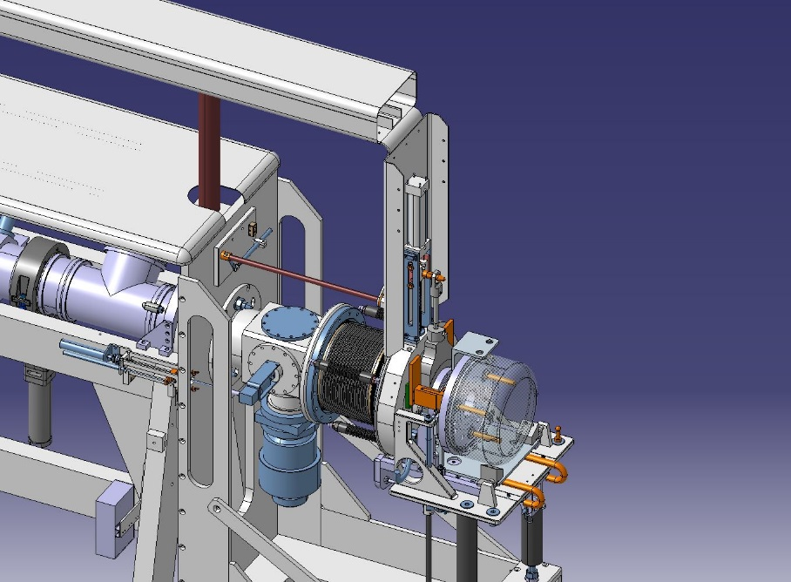
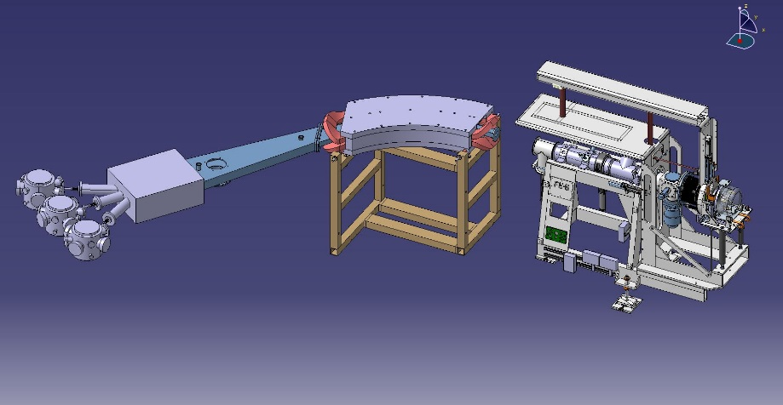
USERS REQUIREMENTS
The Front End Target and Separator require DW cooling;
To include compressed air purge to drain potentially
radioactive water contained in the Front End Target;
To include an emergency mode in case of power failure;
To design a system independent of ISOLDE’s activity;
EDMS 1352214 is Obsolete;
URs are detailed in the Work Package EDMS 1353803.
Item | Heat load (kW) | ∆T (°C) | ∆P (Bar)
Front End Target | 4 | 16 | 1.5
Separator | 3 | 10 | 3

Slide 4
TECHNICAL PROPOSAL: First Floor
To Ground Floor’s manifold

Slide 5
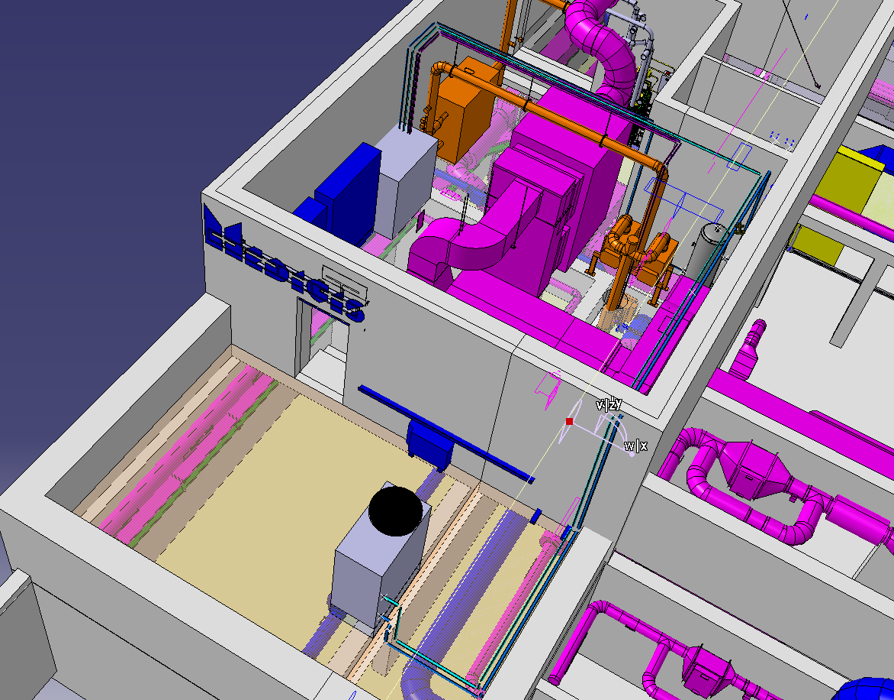
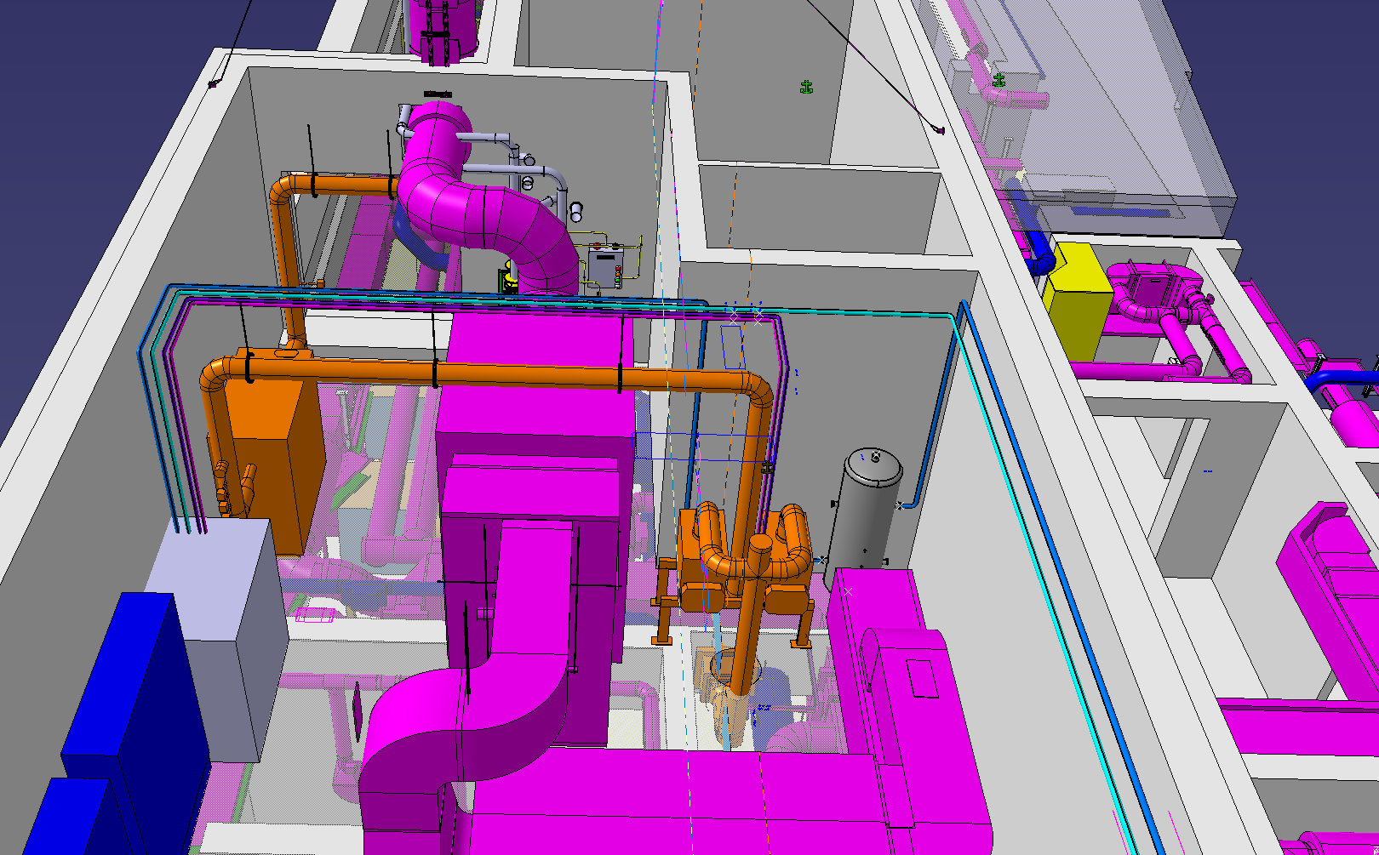
TECHNICAL PROPOSAL: First Floor

Slide 6
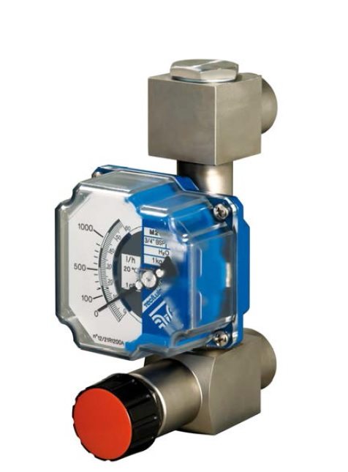
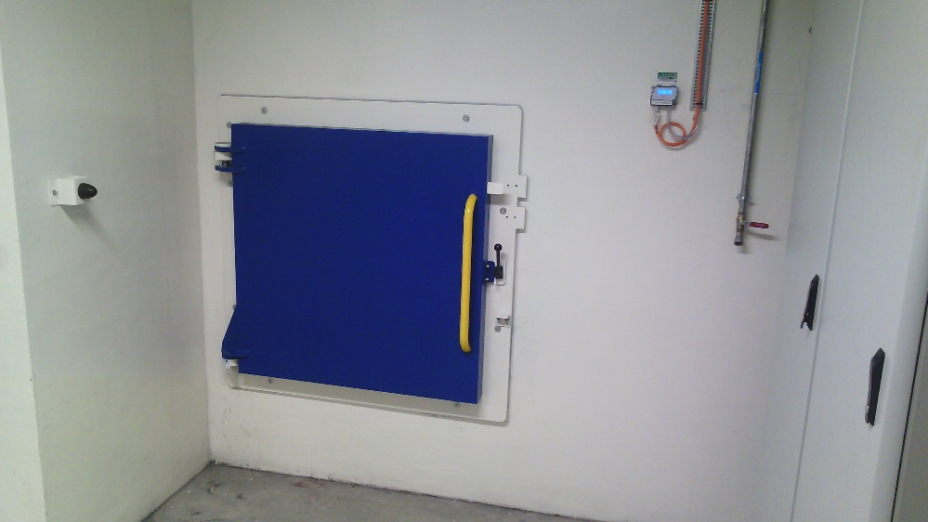
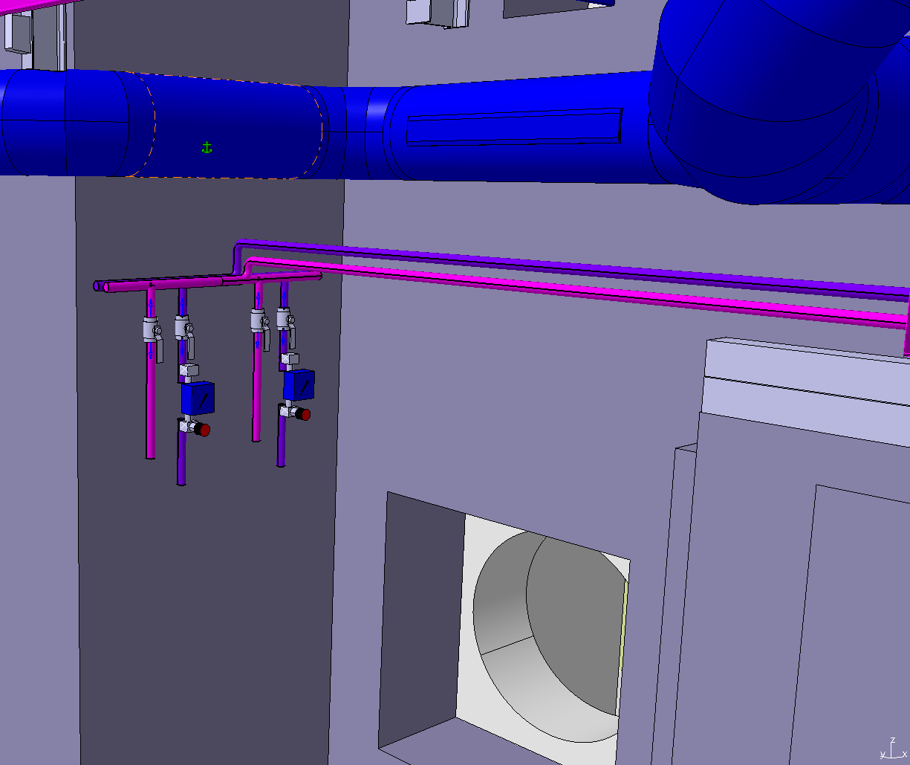
TECHNICAL PROPOSAL: Ground Floor
From First Floor’s cooling station
+ dry contacts
Compressed air and Purge

Slide 7
BUDGET
Total is 221 kCHF + 10% contingencies;
See detailed Work Package EDMS 1353803.

Slide 8
PLANNING
Work package approval: March 2016
Price inquiry: April to May 2016
Construction work: September 2016
Commissioning: October 2016

Slide 9
THANK YOU FOR YOUR ATTENTION
QUESTIONS ?

