Slide 1
PLD coatings

Slide 2
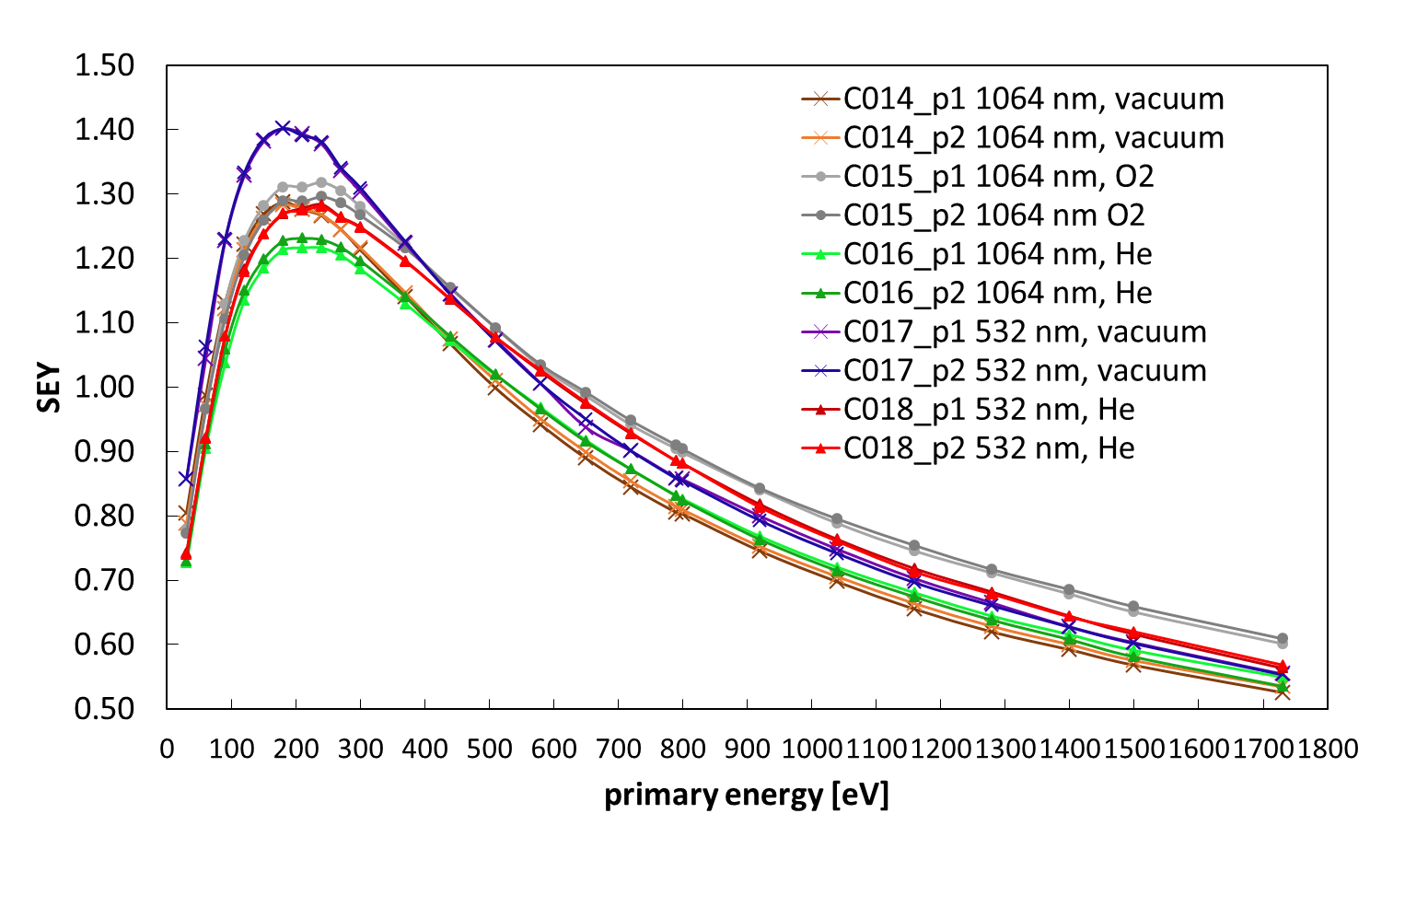
SEY of first carbon PLD coatings on Cu (Poli Milano, V.Russo)
Plot in Plot file
He 20Pa (0.2 mbar); O₂ 5Pa (0.05mbar); Vacuum = 1e-5 mbar
2 points on each sample have identical SEY, seems homogeneous
Assuming the differences are significant (reproducibility of coatings) we have the following ranking: 532 vac > 1064 O2> 532 He> 1064 vac >1064 He
Next: XPS, SEM (surface and thickness in EDX if possible)

Slide 3
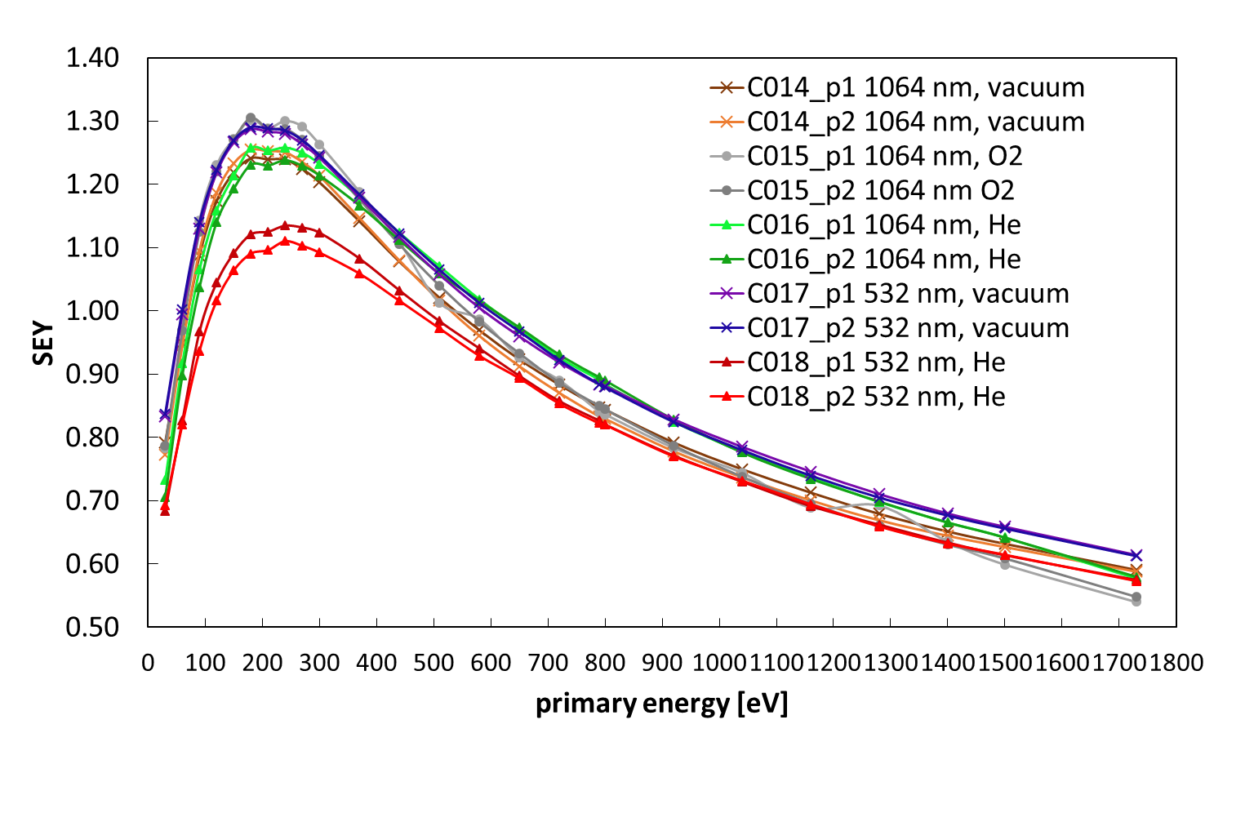
SEY of first carbon PLD coatings on StSt (Poli Milano, V.Russo)
Plot in Plot file
He 20Pa (0.2 mbar); O₂ 5Pa (0.05mbar); Vacuum = 1e-5 mbar
2 points on each sample have identical SEY, seems homogeneous
The ranking is different from copper….: 1064 O2 > 532 vac >1064 He> 1064 vac >1064 vac > 532 He (on Cu: 532 vac > 1064 O2> 532 He> 1064 vac >1064 He)
Next: XPS, SEM (surface and thickness in EDX if possible)

Slide 4
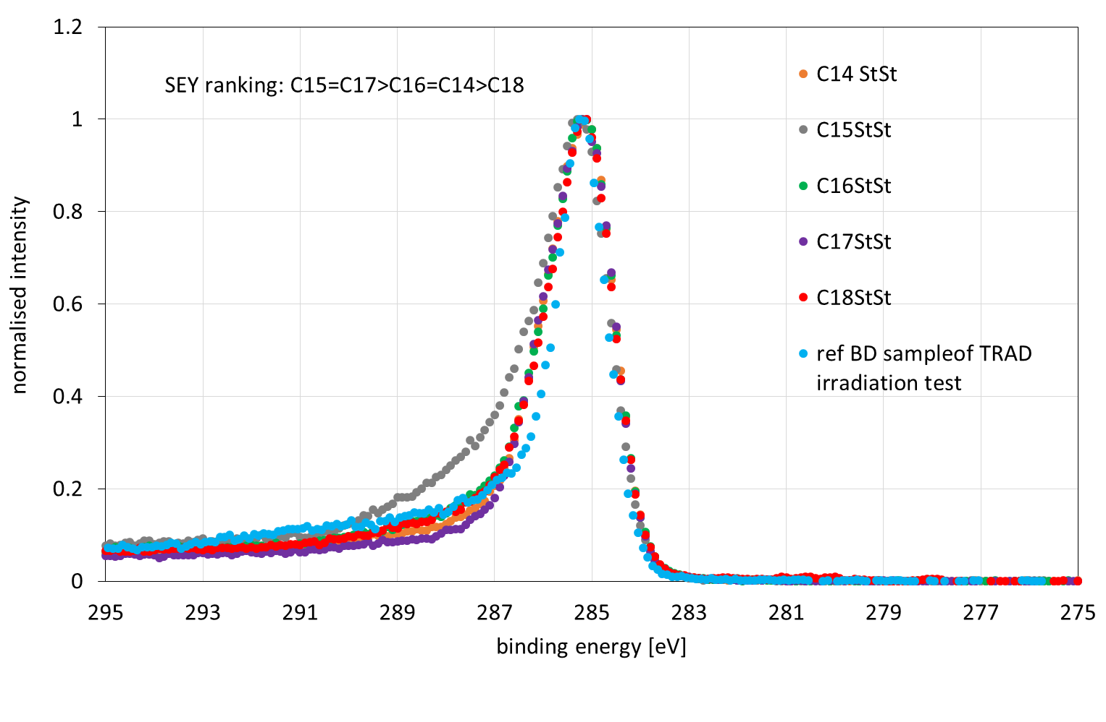
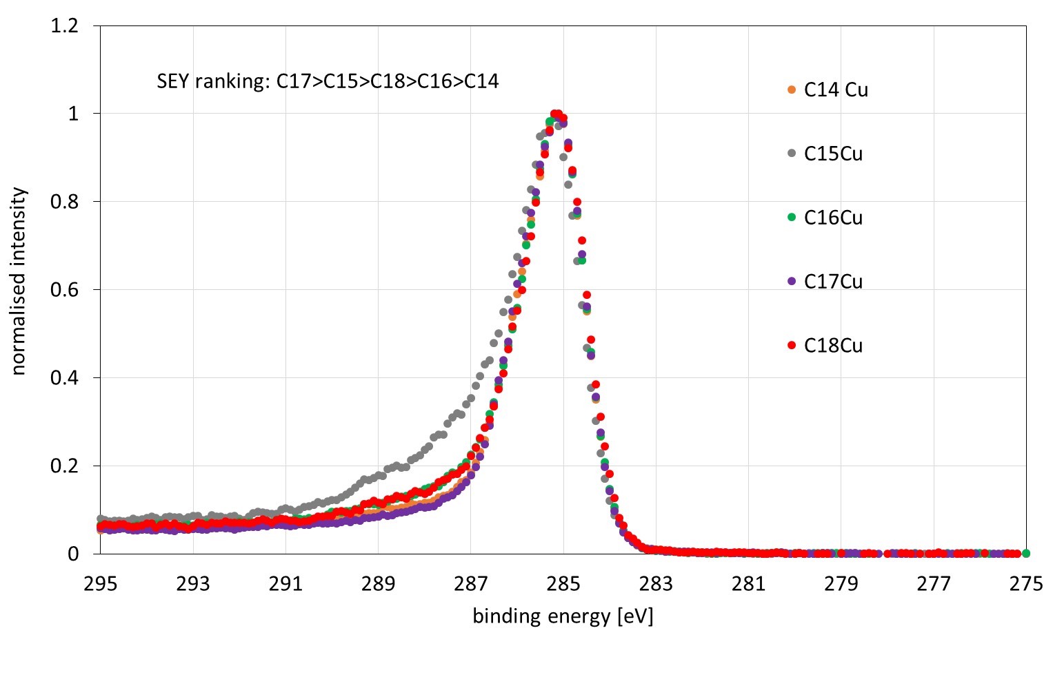
XPS (preliminary)
XPS of Cu PLD
C16 is thinner or scratched ( Cu is much more visible)
C15 has much more O/C (made in O₂), followed by C18/C16 He and finally those in vac C17/C14
XPS of StSt PLD
C15 has much more O/C (made in O₂) and C17/C14 (vac) is the lowest
The lineshape does not have the usual correlation with SEY, especially for the sample in O_{2…….}

Slide 5
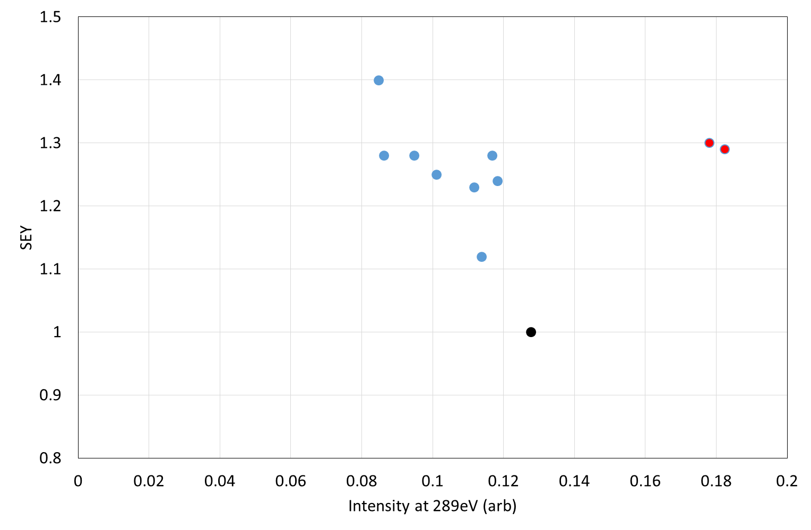
SEY of first carbon PLD coatings: correlation with XPS
samples in O₂
ref

Slide 6
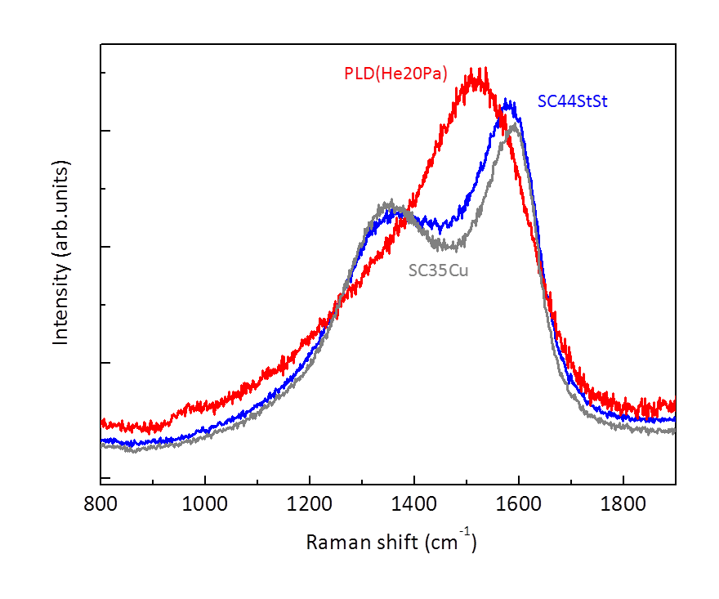
More disordered structure (wide , non resolved peaks…)

