Slide 2
SEY meeting:
SPS-aC activities
By M. Van Gompel

Slide 3
Overview
Introduction
  Magnets to coat in situ
Cathodes
  MBB
  QF
Quality assurance
  Before coating
  During coating
  After coating -> SEY
Future activities

Slide 4

Overview
Introduction
  Magnets to coat in situ
Cathodes
  MBB
  QF
Quality assurance
  Before coating
  During coating
  After coating -> SEY team
Future activities

Slide 5
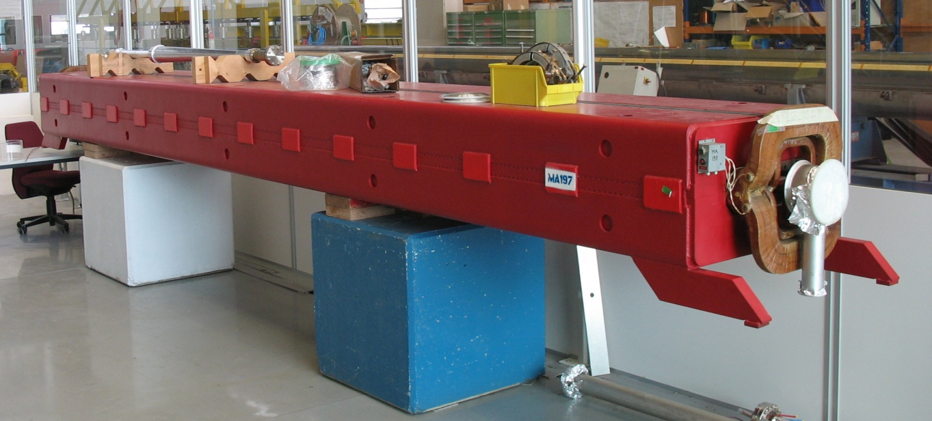
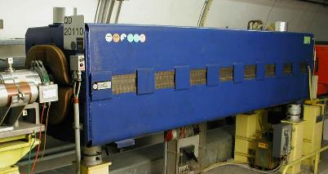
Introduction: Magnets to coat in situ
Low SEY:
Secondary
Electron
Yield

Slide 6
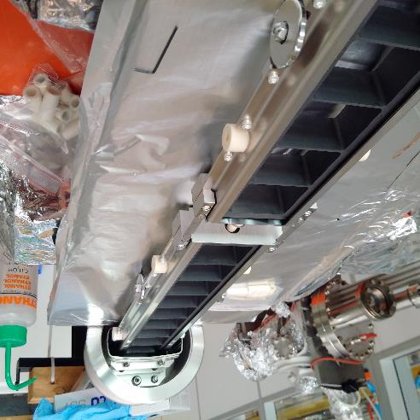
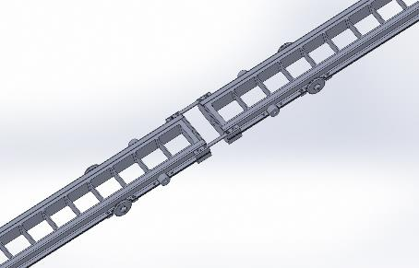
Cathodes: MBB cathode
Main train is 2 m
Robust and easy to repair/assemble
Coat 2 MBB dipoles in series (13.28 m): Total cathode length of 13.43

Slide 7
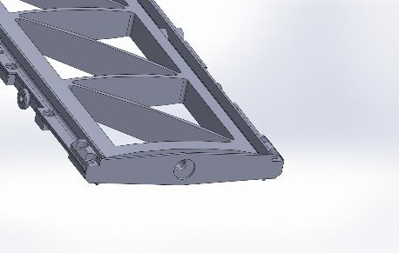
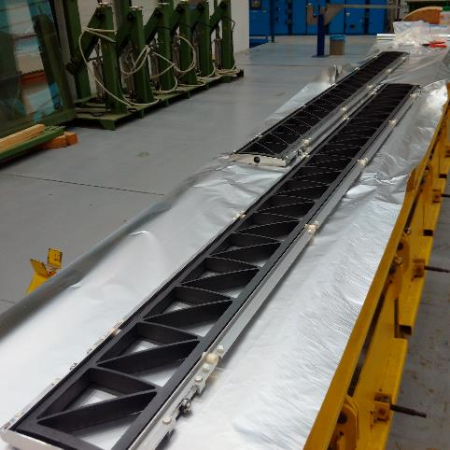
QF cathode
Follows contour of QF tube surface
Wider cathode since larger surface needs coating
Triangular cells
1.7 meter cathode (2 trains)

Slide 8
Introduction: Magnets to coat in situ

Slide 9
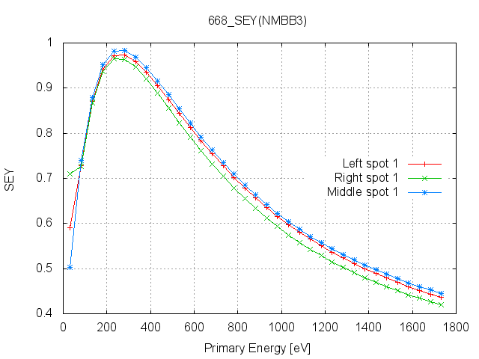
QA: SEY examples
Left (13.2 m)
Middle (6.6 m)
Right (0 m): injection
and pumping
First test of 2 MBB tubes in series with pumping group on right side
4.5 hour coating

Slide 10
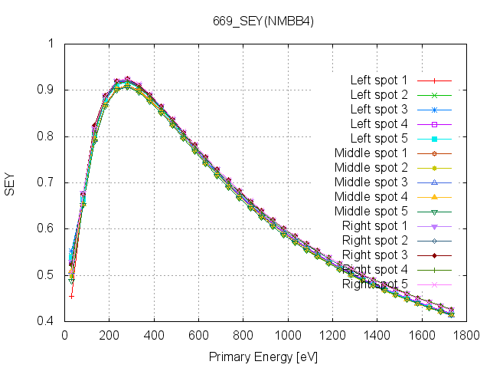
QA: SEY examples
Left (13.2 m)
Middle (6.6 m)
Right (0 m): injection
and pumping
First test of 2 MBB tubes in series with pumping group on right side
24 hour coating

Slide 11
Introduction: Magnets to coat in situ

Slide 12
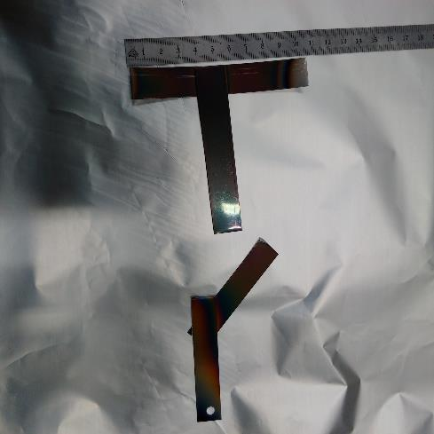
QA: SEY examples
First test of coating a QF tube
24h coating

Slide 13
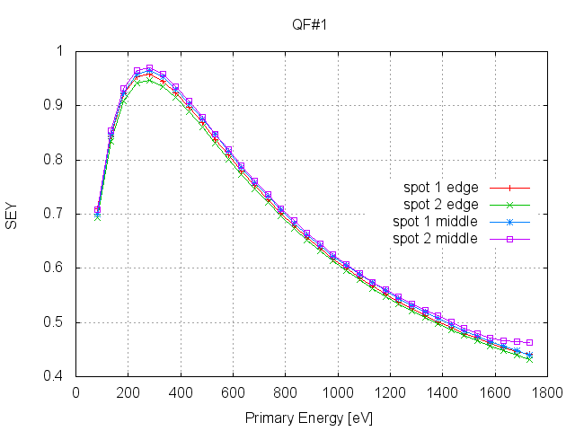
QA: SEY examples
Middle (SEM: 415±8 nm)
Edge (SEM: 205±65 nm)
First test of coating a QF tube
24h coating

Slide 14
Future activities with support from you
Coat 2 MBB dipoles in series
Coat a QF quadrupole
Optimise deposition time of MBB and QF
Coat MBB by hollow cathode sputtering with triangular cells
Help with EYETS!
XPS analysis on Ozone etched samples

Slide 15
Risk assessment
After coating ( endoscope + IR)
  Sooth
  Peel off
  SEY_{MBB} < 1.10 and SEY_{QF}< 1.05
  Inhomogeneous coating (Discoloration, transverse thickness variations, uncoated regions)

Slide 16
Future activities with support from you
Coat 2 MBB dipoles in series
Coat a QF quadrupole
Optimise deposition time of MBB and QF
Coat MBB by hollow cathode sputtering with triangular cells
Help with EYETS!
XPS analysis on Ozone etched samples

