Slide 1
The modified pyECLOUD code and main results

Slide 2
The story of space charge in LHC IPM.
Ionization Double Differential Cross Section investigation.
Correction procedure investigation.
Summary.

Slide 3
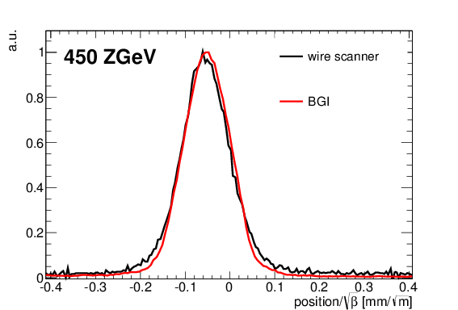
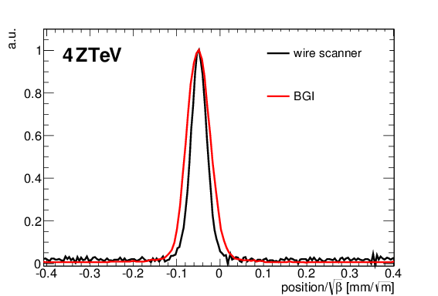
The story - data
In 2011 I’ve spend a lot of time trying to calibrate – with beam - LHC IPM. Results were confusing (from The First Experience with LHC Beam Gas Ionization Monitor, proceedings of IBIC12 TUBP61, CERN-ATS-2012-286):
The profile at high energy was always broader than expected.

Slide 4
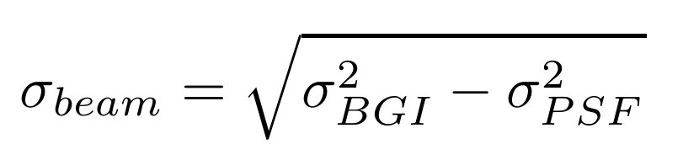
The story – chasing the broadening
Various possible reasons for broadening were investigated
  Detector tilt – excluded
  MCP/phosphor nonuniformity – excluded
  PSF of the imaging system
  Large electron gyroradius
  Beam space charge
Ad 3: the PSF could be corrected in quadrature:
but σ_{PSF} was obviously not constant during the ramp
Ad 4: I have tried to simulate electron trajectories using Geant4 (which suppose to give DDCS).

Slide 5
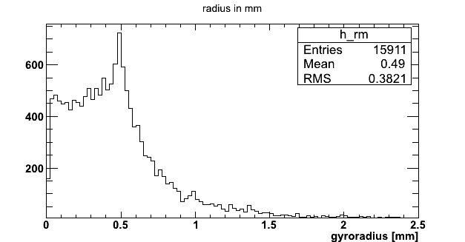
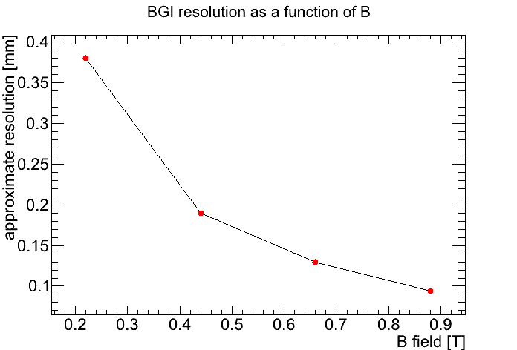
The story – Geant 4
Geant4 simulations of electron trajectories in BGI, EDMS 1182412
Main results:
  large gyroradius due to
  cross-section “cutoff” at 100 eV
  this turned out to be false – Geant4
  cannot simulate low energy
  electrons
  Increase of electric field
  did not help to reduce observed
  beam profile distortion, only
  increase of magnetic field helped.
  Geant4 cannot simulate beam
  space charge

Slide 6
The story - pyECLOUD
In early 2012 we were looking with Marcin Patecki how to simulate beam space charge.
After ‘CCC discussion’ with Giovanni Iadarola we decided to try with pyECLOUD. Giovanni modified his code to include uniform electric and magnetic fields.
Results are published in Marcin’s thesis: Analysis of LHC Beam Gas Ionization monitor data and simulation of the electron transport in the detector, Politechnika Warszawska/CERN-THESIS-2013-155
At that time we still used incorrect DDCS from Geant4 (trying to modify physics list), but having serious doubts about it, we repeated all simulations with zero initial velocities.
Thesis publishes also an interesting attempt to estimate theoretically the effect of the bunch field on electron movement by Giuliano Franchetti (something to be followed up).

Slide 7
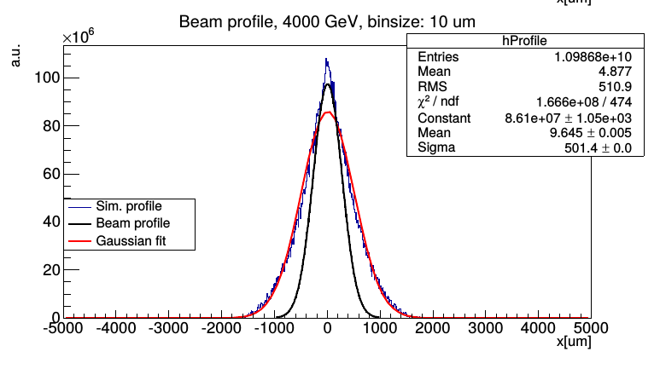
The story – pyECLOUD results
Profile distortion is clearly due to beam space charge
  Initial velocities play secondary
  role.
  For lead beam the distortion
  should be much smaller
  (2011 observations not explained).
  Increase magnetic field to 1T
  would suppress the effect
  from beam space charge.
  No simple correction procedure found (despite considerable effort)

Slide 8
Dominik and DDCS
Dominik Vilsmaier continued Marcin’s study focusing on:
  Proper Double-Differential ionization cross section (DDCS).
  Beam profile correction procedure.
Dominik’s work is documented in his thesis:
Profile distortion by beam space charge in Ionization Profile Monitors, CERN-THESIS-2015-035 and HB2014 proceedings: Investigation of the effect of beam space-charge on electrons in ionization profile monitors, HB2014, MOPAB42

Slide 9
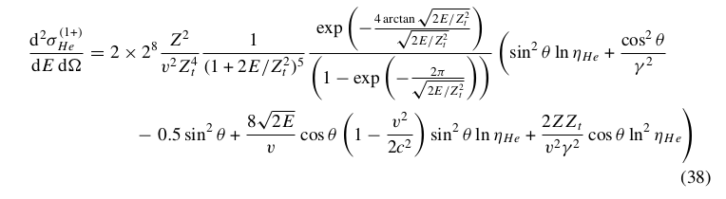
DDCS
In general it is not an easy to calculate DDCS for low energy (1 eV) electrons. Also a very few measurements exist!
Lot of work, especially for fast projectiles, were done in last years by A. Voitkiv (MPI Heidelberg).
One of his papers he gives DDCS for He⁺ ionization by relativistic projectiles:

Slide 10
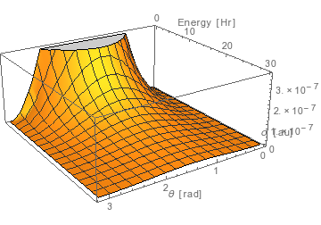
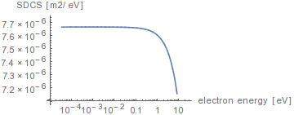
DDCS

Slide 11
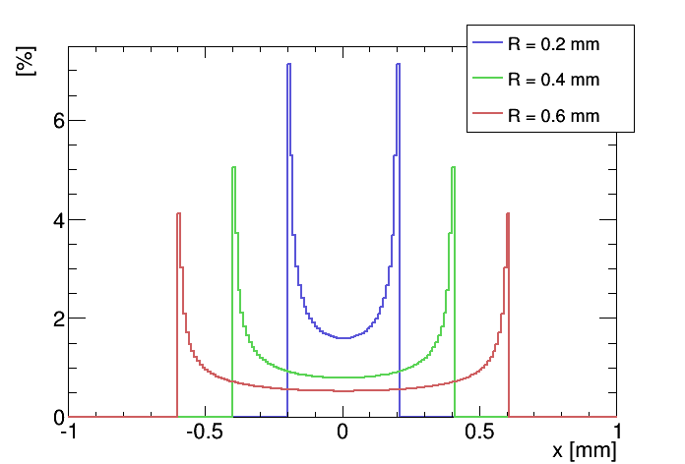
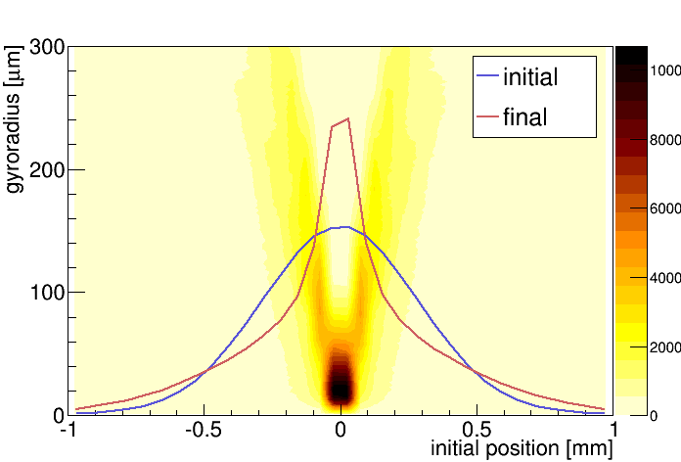
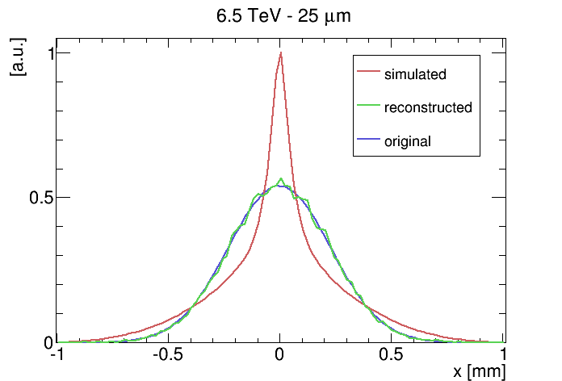
Correction procedure
For a given electron gyroradius – the PSF is known and could be deconvoluted
“Electron sieve” (or a slit) is needed
Dominik shows that using sieve able to reconstruct electron gyroradius with 25 um resolution, a very good correction is possible

Slide 12
Summary
pyECLOUD is a good tool, but has 2 main limitations:
  Assumes relativistic beams by neglecting longitudinal component of the fields
  External fields are uniform (no field map)
Precise knowledge of Double Differential Cross Section maybe not often required (when beam space charge dominates), but when required is quite tricky.
Stronger magnetic field is an obvious but expensive solution to space charge problem.
Correction procedure based on “electron sieve” theoretically works, technical implementation needs still a lot of work.

