Slide 1
Python based particle tracking code for monitor design
20160303
Kenichirou Satou
J-PARC/KEK

Slide 2

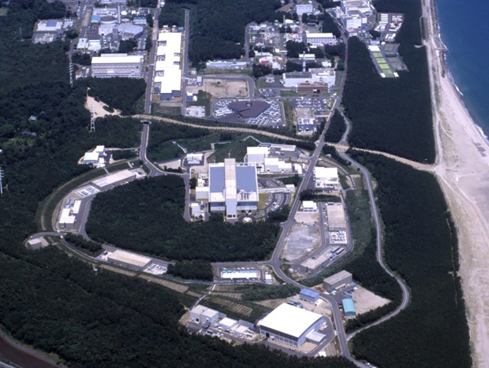
J-PARC
Japan Proton Accelerator Research Complex
LINAC
30 mA (operational)
(50 mA (goal))
3 GeV RCS
600 kW
(1 MW)
Tokai, Ibaraki
ν detector
MLF
30 GeV MR
340 kW
(750 kW)
Hadron hall
Notes:
First, I will introduce J-PARC.
J-PARC is located at Tokai village in Ibaraki prefecture.
This is the photograph of J-PARC.
As you can see, the campus is very near the Pacific Ocean.
One of the aim of J-PARC is providing high intensity proton beam with 750 kW to research facility.
Here, the intensity now realized at the facility and goal values are written.

Slide 3
Accelerators in J-PARC
Main ring (MR)
Hadron
Rapid Cycling Synchrotron (RCS)
LINAC
MLF
Ion Source
Neutrino
http://j-parc.jp/Acc/ja/about.html
Notes:
This is the schematic of J-PARC.
Proton beam provided from the ion source is accelerated by LINAC up to 400 MeV.
And accelerated again by the rapid cycling synchrotron RCS.
Finally, the proton beam is transported to Main Ring MR and accelerated up to 30 GeV.
Our goal is providing the high power beam with 750 kW from MR.
In this talk, I focus on the IPM installed at MR.

Slide 4
Main ring (MR)
Total length (m) | 1568
Energy (GeV) | 3 | 30
β | 0.9712 | 0.9995
Lorentz γ | 4.20 | 32.97
Harmonic number | 9
No. of bunches | 8
Circulating period (μsec) | 5.38 | 5.23
RF frequency (MHz) | 1.67 | 1.72
Bunch length (time) (nsec) | 200 | 70
Bunch length (space) (m) | 60 | 20
Tune | FX: ν_{x}=22.40, ν_{y}=20.75 SX: ν_{x}=22.30, ν_{y}=20.78
Fast extraction (FX)
IPM (H)
Neutrino
RF cavity
Hadron
Injection
Slow extraction
(SX)
High intensity⇒reduction of beam loss
IPM (H/V)
Beam orbit tuning with
accurate beam profile information
500 m
Notes:
Then, I’ll introduce a little more detail for MR.
The operational parameters of MR are listed here.
I’ll emphasize our aim is realization of high intensity beam from MR.
Of course, the amount of residual radiation would be much more as intensity increased.
So, we have to reduce beam loss during operation and optimum beam orbit tuning is essential to prevent emittance blow up due to injection mismatch, strong space charge effect, beam instabilities and so on. beam from hitting the wall and so on. And it goes without saying that non-destructive measurement is preferable to prevent beam loss and profile blow up during measurements.
For that, accurate beam profile information is very important.
IPM is used to measure the beam profile, and (場所を指しながら) here, there are a couple of IPMs to measure the horizontal and vertical profile, where the dispersion is zero.
Another IPM for measuring horizontal profile is installed here where the dispersion is 2.1 m. This IPM has been firstly used to check momentum shift driven by longitudinal impedances which will be took place when the RF is turned off to de-bunch the beam for Slow Extraction operation. This time, let me show you the status of them, and how to use for beam tuning simply.

Slide 5

Injection
Hadron
540 m downstream from injection point
Dispersion = 0
Neutrino
IPM (H/V)
IPM (Vertical)
$\sim$540 m
IPM (Horizontal)
Beam
Notes:
This is the photograph of the IPMs.
The proton beam comes from RCS and injected at this point.
These IPMs are installed about 540 m downstream from the injection point and placed where dispersion equals zero.
This is the photograph of the IPMs.

Slide 6
contents
Position displacement?
  Main Source?
  Equation of motion of electron in IPM
New python based simulation code
Demonstration of the code
No summary

Slide 7
Tracking Error Sources
The error sources which induce position x displacement are,,,,
Error E field: Space charge of the beam and guide E field
  Ex=Esx+Egx
  Ez=Esz(negligible small when relativistic beam)+Egz
  Alignment error of the chamber
Error B field: Magnet
  Bx and Bz
  Alignment error of the magnet
Initial velocity of the detached electron (or ion)
Electron-gas molecule collision -> Outside of this presentation
Which one is the most important???
How much we should reduce the error source???
A simulation code will answer but it is worth while to check analytically

Slide 8


Eq. of motions (preliminary)
And using
Using the imaginary variables and parameters,,,,
$$\frac{\tilde{E}}{B}$$
$$\frac{E_{y}}{B}$$

Slide 9


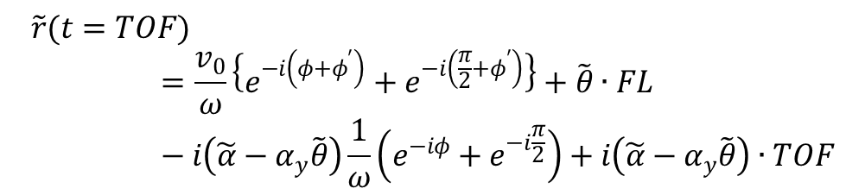
Eq. of motions (preliminary)
Initial velocity
If α and θ is constant value
Initial position is (0,0)
On the detector plane
Flight length
$$\tilde{r}(t=TOF)=\frac{v_{0}}{ω}\left\{e^{−i\left(φ+φ^{′}\right)}+e^{−i\left(\frac{π}{2}+φ^{′}\right)}\right\}+\tilde{θ}∙FL−i\left(\tilde{α}−α_{y}\tilde{θ}\right)\frac{1}{ω}\left(e^{−iφ}+e^{−i\frac{π}{2}}\right)+i\left(\tilde{α}−α_{y}\tilde{θ}\right)∙TOF$$
Here,
$$ie^{−iω∙TOF}=e^{−iφ}$$
$$\tilde{v_{0}}=v_{0}e^{−iφ^{′}}$$

Slide 10
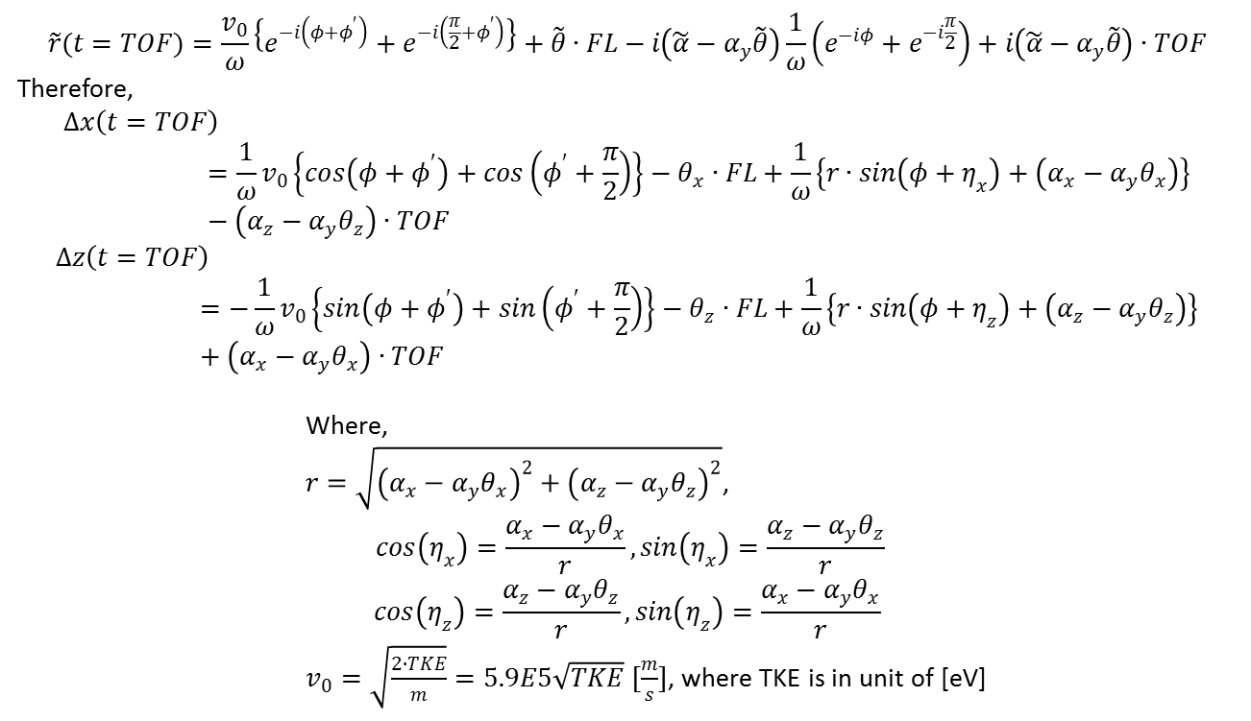
Eq. of motions (preliminary)
The position displacement due to initial TKE and error fields can be expressed as,
$$\tilde{r}(t=TOF)=\frac{v_{0}}{ω}\left\{e^{−i\left(φ+φ^{′}\right)}+e^{−i\left(\frac{π}{2}+φ^{′}\right)}\right\}+\tilde{θ}∙FL−i\left(\tilde{α}−α_{y}\tilde{θ}\right)\frac{1}{ω}\left(e^{−iφ}+e^{−i\frac{π}{2}}\right)+i\left(\tilde{α}−α_{y}\tilde{θ}\right)∙TOF$$
Therefore,
$$∆x\left(t=TOF\right)=\frac{1}{ω}v_{0}\left\{cos\left(φ+φ^{′}\right)+cos\left(φ^{′}+\frac{π}{2}\right)\right\}−θ_{x}∙FL+\frac{1}{ω}\left\{r∙sin\left(φ+η_{x}\right)+\left(α_{x}−α_{y}θ_{x}\right)\right\}−\left(α_{z}−α_{y}θ_{z}\right)∙TOF$$
$$∆z\left(t=TOF\right)=−\frac{1}{ω}v_{0}\left\{sin\left(φ+φ^{′}\right)+sin\left(φ^{′}+\frac{π}{2}\right)\right\}−θ_{z}∙FL+\frac{1}{ω}\left\{r∙sin\left(φ+η_{z}\right)+\left(α_{z}−α_{y}θ_{z}\right)\right\}+\left(α_{x}−α_{y}θ_{x}\right)∙TOF$$
Where,
$r=\sqrt{{\left(α_{x}−α_{y}θ_{x}\right)}^{2}+{\left(α_{z}−α_{y}θ_{z}\right)}^{2}}$,
$$cos\left(η_{x}\right)=\frac{α_{x}−α_{y}θ_{x}}{r}, sin\left(η_{x}\right)=\frac{α_{z}−α_{y}θ_{z}}{r}$$
$$cos\left(η_{z}\right)=\frac{α_{z}−α_{y}θ_{z}}{r}, sin\left(η_{z}\right)=\frac{α_{x}−α_{y}θ_{x}}{r}$$
$v_{0}=\sqrt{\frac{2∙TKE}{m}}=5.9E5\sqrt{TKE} [\frac{m}{s}]$, where TKE is in unit of [eV]

Slide 11
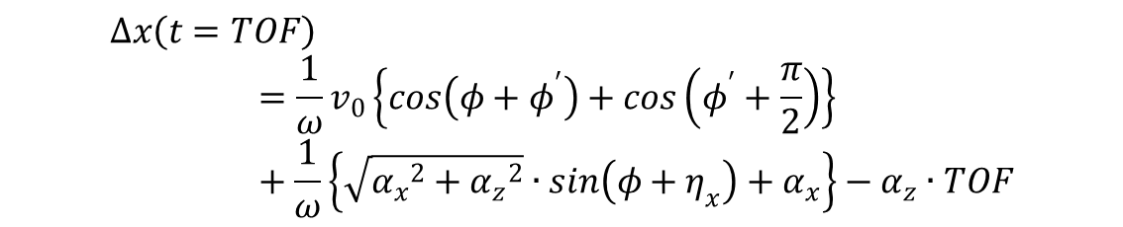
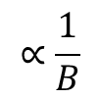

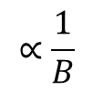
X position displacement due to error E field (preliminary)
In case the magnetic field error is negligible small, the position x displacement can be expressed as,
$$∆x\left(t=TOF\right)=\frac{1}{ω}v_{0}\left\{cos\left(φ+φ^{′}\right)+cos\left(φ^{′}+\frac{π}{2}\right)\right\}+\frac{1}{ω}\left\{\sqrt{{α_{x}}^{2}+{α_{z}}^{2}}∙sin\left(φ+η_{x}\right)+α_{x}\right\}−α_{z}∙TOF$$
In a real IPM chamber,
Gyro motion
Initial TKE
Gyro motion
Field error: Ex, Ez
E×B drfift (Ez×By)
Field error: Ez
$$∆x\left(t=TOF\right)<\frac{2}{ω}v_{0}+\frac{1}{ω}\left\{\sqrt{{α_{max, x}}^{2}+{α_{max, z}}^{2}}+α_{max, x}\right\}+α_{max, z}∙TOF$$
$$∝\frac{1}{B}$$
$$∝\frac{1}{B^{2}}$$
$$∝\frac{1}{B}$$

Slide 12
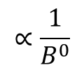

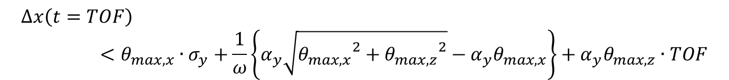

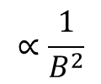
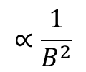
X position displacement due to error B field (preliminary)
Geometrical shift
Bx/B
Gyro motion
Field error: Bx/B, Bz/B
E×B drfift (Ey×Bz)
Field error: Bz
$$∆x\left(t=TOF\right)<θ_{max, x}∙σ_{y}+\frac{1}{ω}\left\{α_{y}\sqrt{{θ_{max,x}}^{2}+{θ_{max, z}}^{2}}−α_{y}θ_{max,x}\right\}+α_{y}θ_{max,z}∙TOF$$
$$∝\frac{1}{B^{0}}$$
$$∝\frac{1}{B^{2}}$$
$$∝\frac{1}{B^{2}}$$
E
$$σ_{y}$$
B
$${θ_{x}σ}_{y}$$

Slide 13
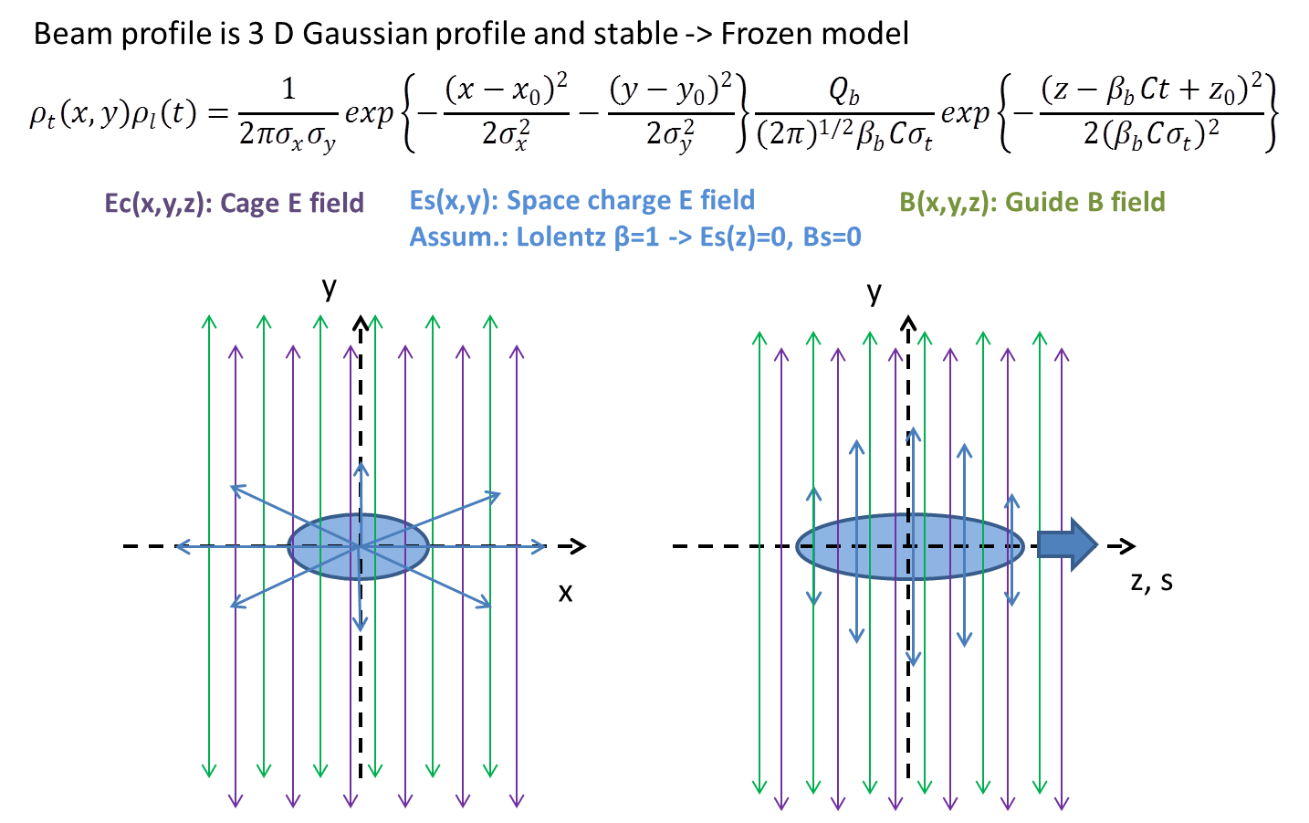
Python based particle tracking code
Python based particle tracking code to design beam monitors which utilizes charged particles like IPM (detached electron and ions), Laser wire scanner (detached electron), Faraday cup based CT (secondary electron escape), etc.
The fields in which the particles are moving,
  Beam space charge effect
    Only 2D electric field: Relativistic beam condition
  3D electric and magnetic fields from another code which will be used to control the particle motion
  Space charge effect of the tracked particles ensemble are not included -> single particle motion
Was used to check CPS IPM (under development) performance

Slide 14
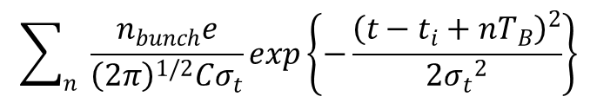
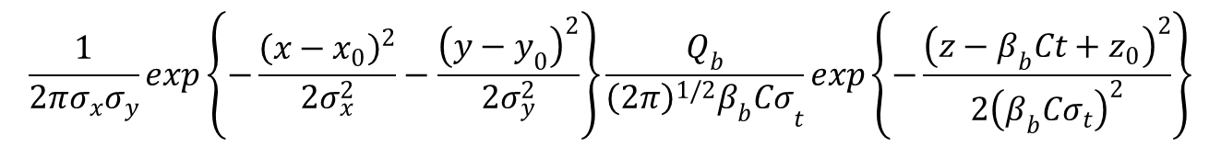
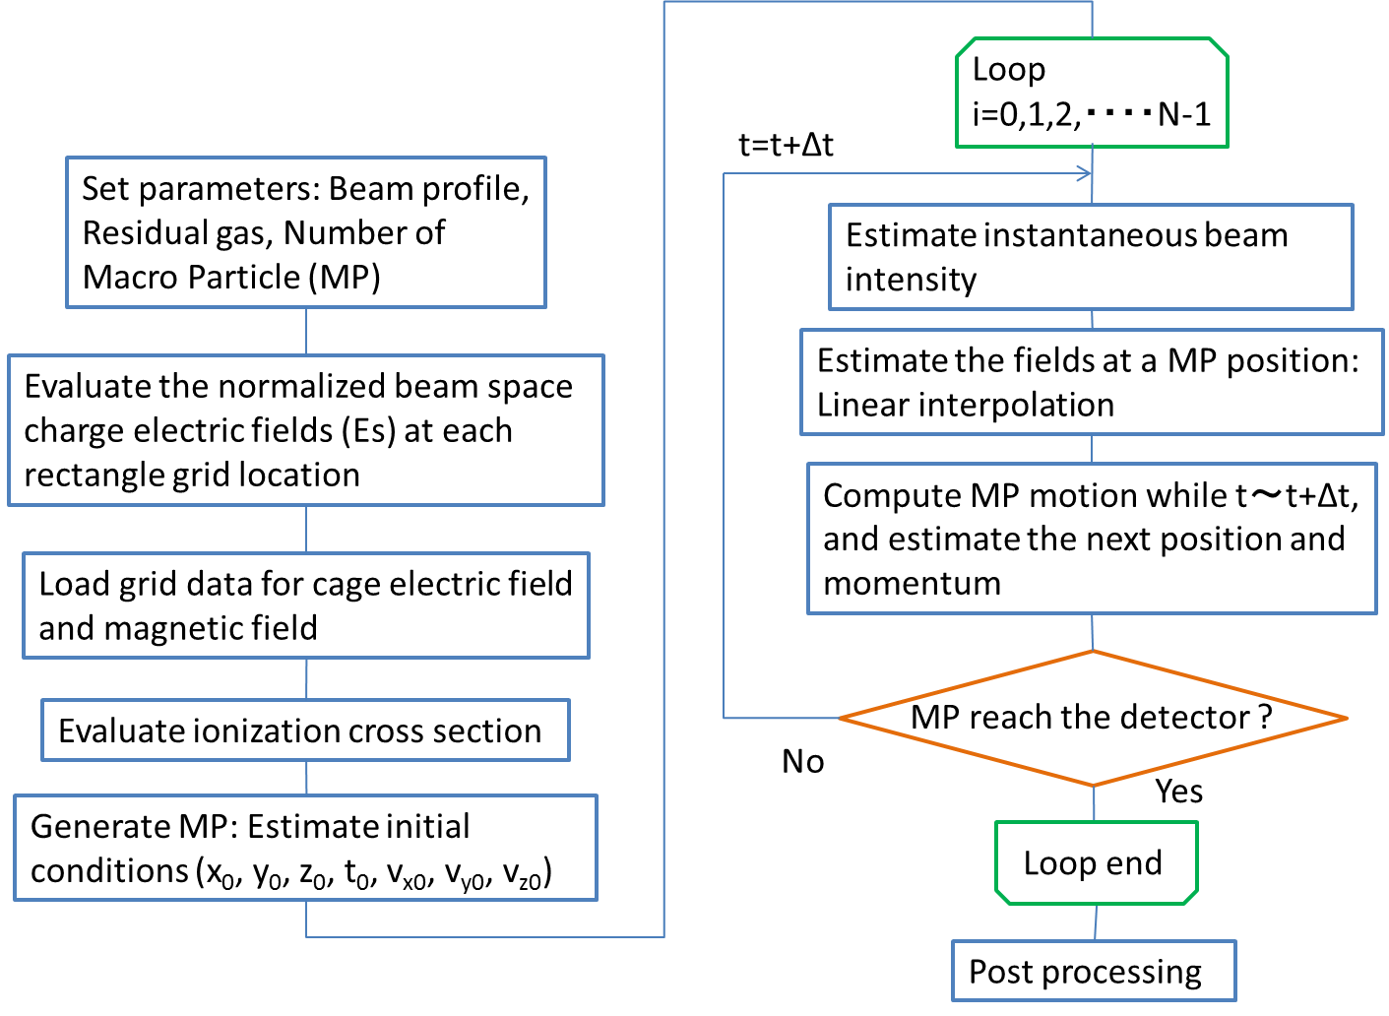
Python based 3D particle tracking code Profile simulator for IPM design
Beam intensity of bunch train
Gaussian profile
Successive Over Relaxation (SOR)
to estimate Poisson eq.
・Assumed to be 2D: Relativistic
・Rectangular grid
Grid data from
POISSON/Superfish (2D)
CST STUDIO SUITE (3D)
・Rectangular or Cubic grid
3D particle tracking
4th order Runge-Kutta method
Ionization cross section
Single differential cross section
for H, He, H₂, CH₄, NH₃, and H₂O
Double differential cross section
for H, and He
Flow chart of the simulator

Slide 15
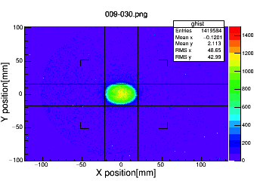
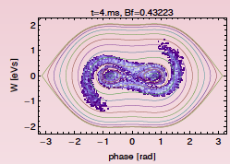
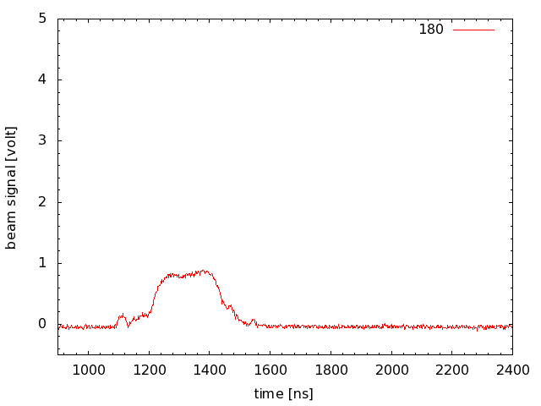
But in a real case, the profile could be far from the Gaussian-shape: J-PARC MR
Transversal profile
Longitudinal profile
OTR@350BT
Space charge dilution by the 2nd RF harmonics
Simulation
(100 kV, 70 kV)
WCM

Slide 16
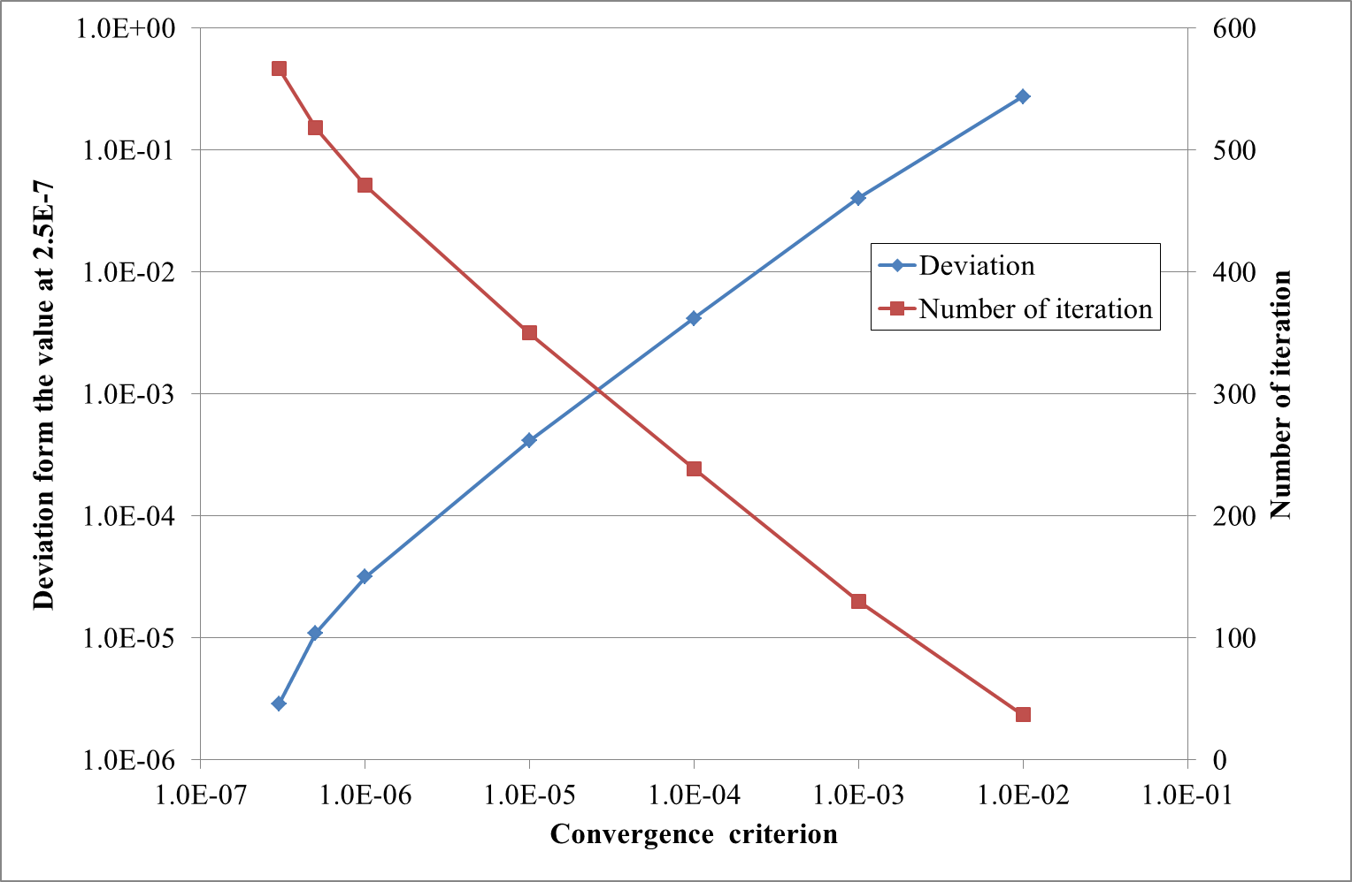
SOR method
Beam Potential Convergence at the Grids
Default value
About 470 iterations are needed to obtain a potential value at each grid point
Notes:
This graph shows how many iteration are needed to obtain converged grid potential value.

Slide 17
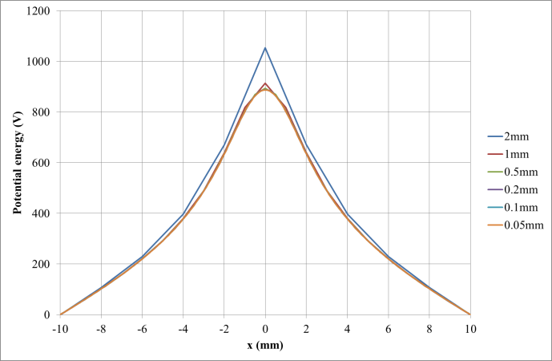
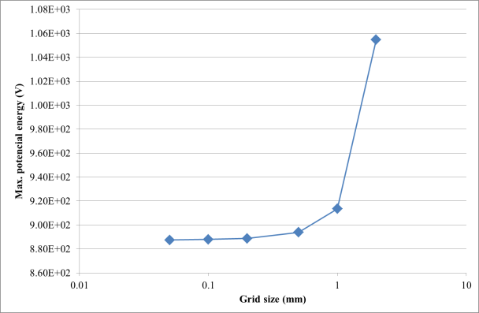
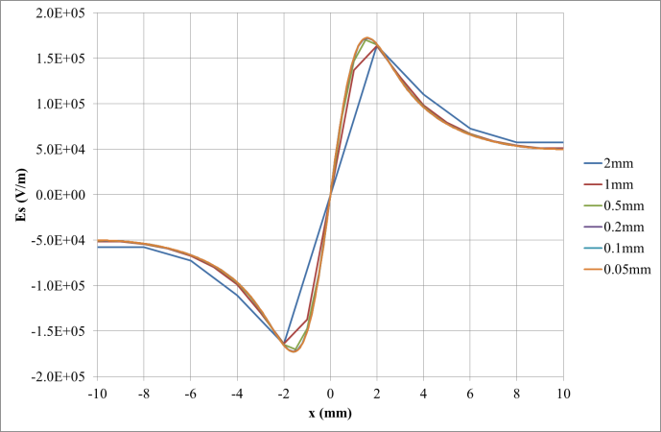
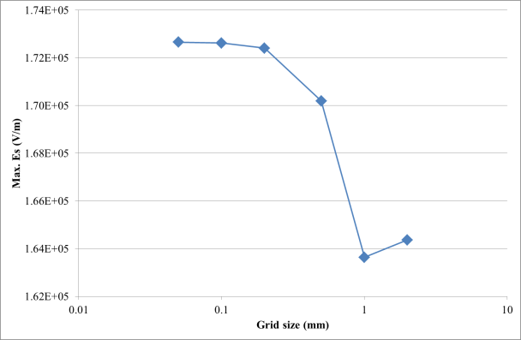
Es calc.: Grid size selection
Beam size: σx=σy=1mm

Slide 18
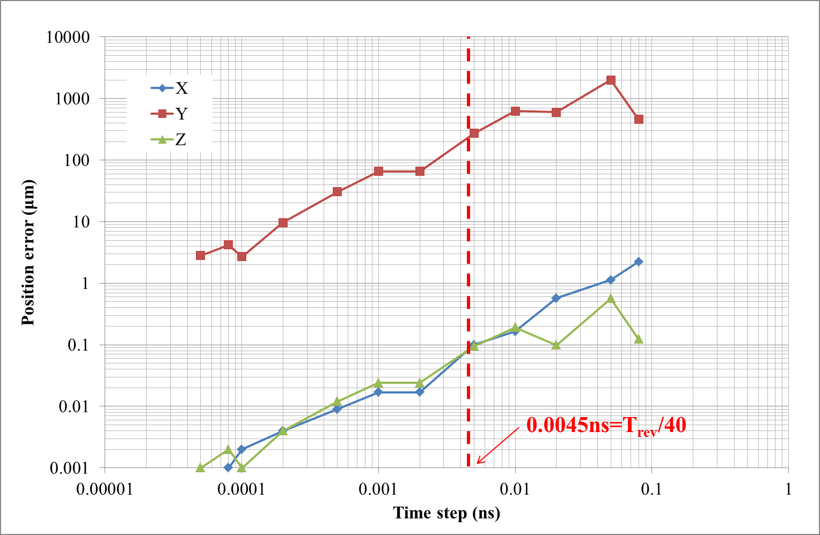
Tracking error vs. time step
4th dorder Runge-Kutta

Slide 19
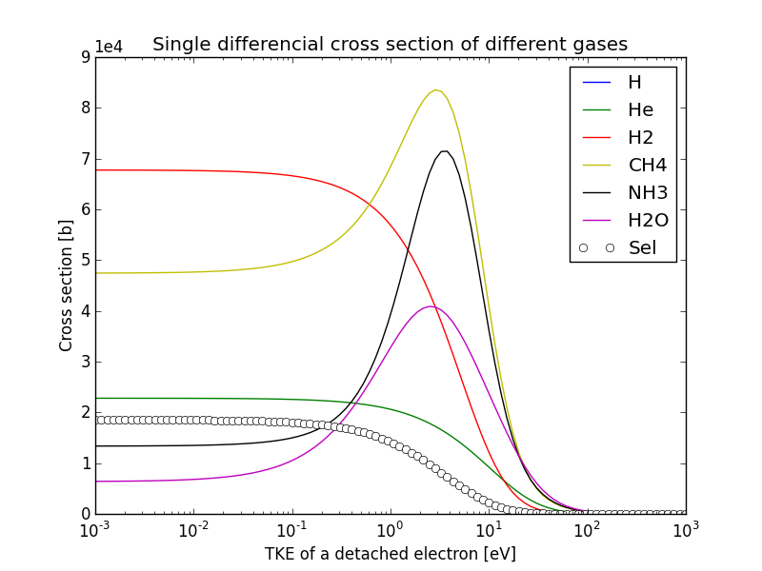
Initial conditions of a detached electron
Single differential cross section (H, He, H2, CH4, NH3, H2O)
Or
Double differential cross section (H, He)
are used for initial TKE of detached electron
Ref.
  "Differential cross section for ionization of helium,neon,and argon by high-velocity ions"
    J.H.Miller et. al., Phys. rev. A, 27 (1337), 1983.
  "Analytic representation of secondary-electron spectra"
    J. Chem. Phys. 87 (12), 15 Dec. 1987
  "Electron production in proton collisions with atoms and molecules: energy distribution"
    M.E. Rudd et. al., Rev. Mod. Phys., 64, No2, 441 (1992)

Slide 20
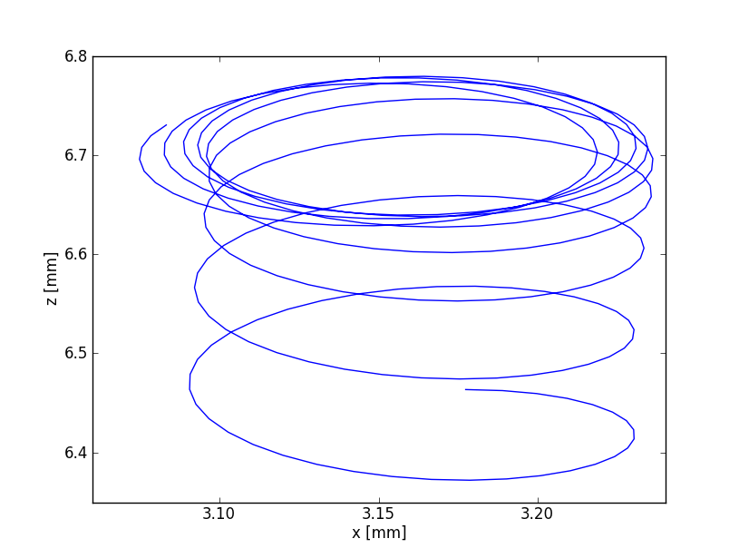
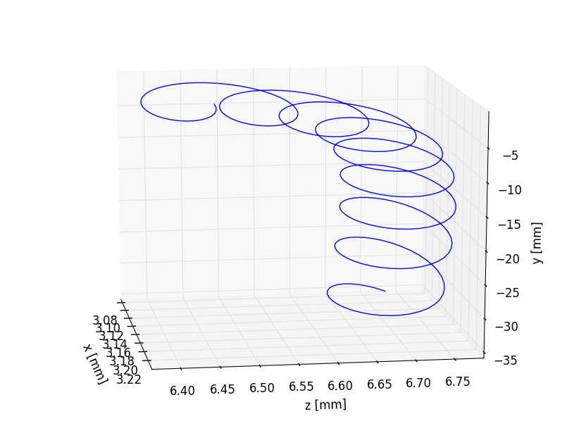
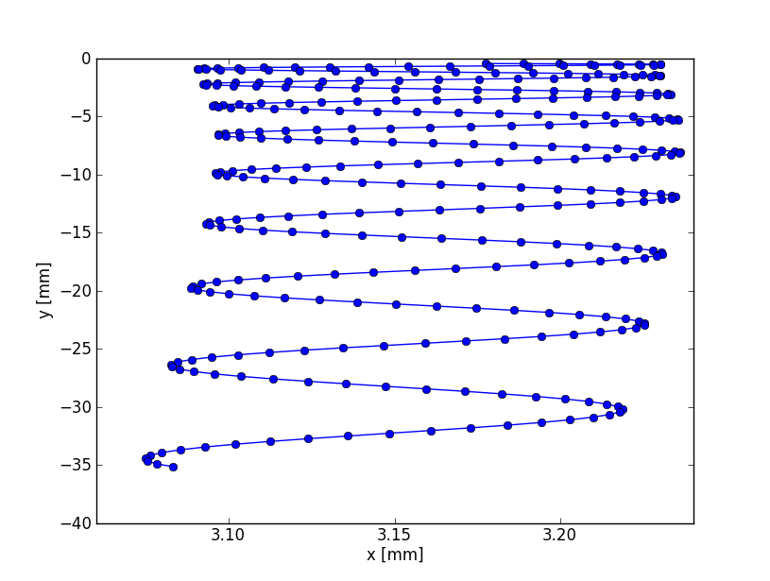
An example of tracking
Final position
Esx×By drift
Initial position
Gyro-motion
・Initial momentum
・Esx

Slide 21
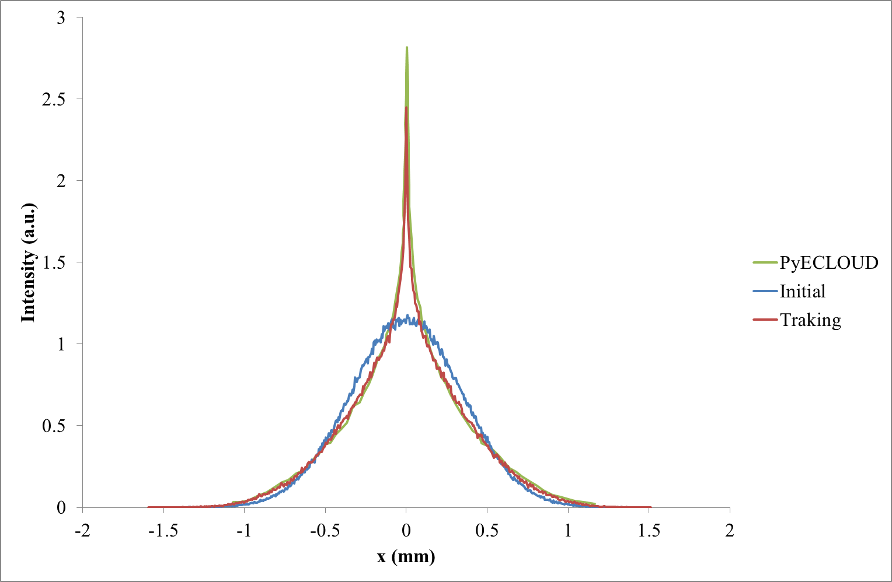
Cross check with PyECLOUD
(Cross check with ESS code are now on going)
Only includes
Esx,Esy
Ecy
By
TKE=0 eV

Slide 22
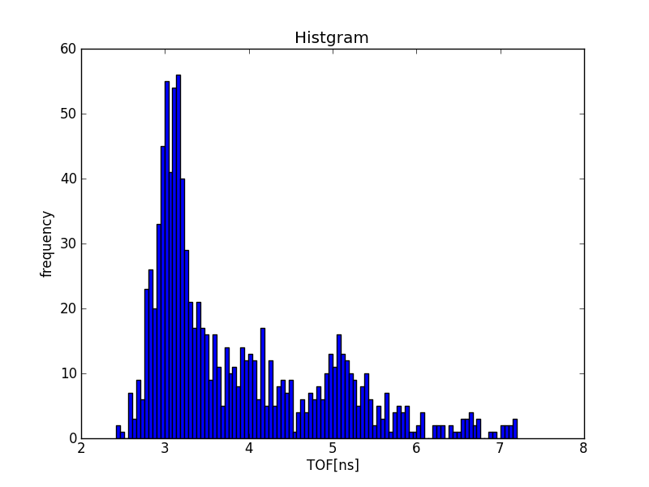
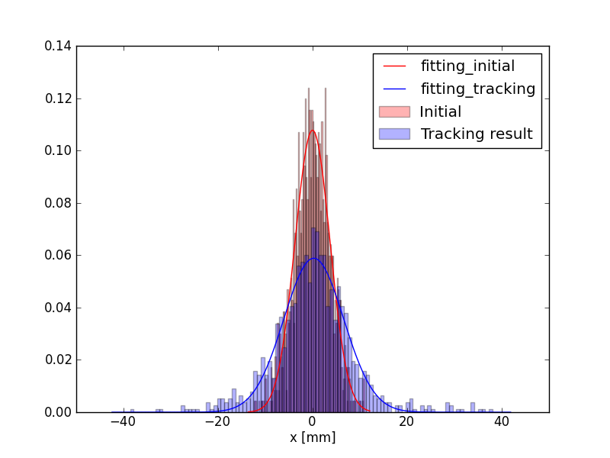
Calculation time using my 5 years old laptop PC
・Intel Core i5 2.5GHz(4 CPUs): 64bit
・8.2GB memory
SOR: Space charge E field -> 1079 s (18min)
  Grid size: 70×70
  Conversion criteria: 1E-6
Tracking -> 124s (2min) / 1000 macroparticles
  Time step: 0.005 ns
  600step/3ns
TOF
Profile

Slide 23
Demonstration
How to use the code

Slide 24
In the near future upgrade
Es calcu.
  Non-Gaussian beam profile: SOR method
  Analytical solution for Gaussian beam (Same as ESS code)
  Non relativistic 3D Gaussian beam: Taking into account, Esz, Bs(x,y,z) fields

