Slide 1
IPM Simulations at Fermilab
3-4 March 2016
Randy Thurman-Keup

Slide 2
Nova Era Main Injector / Recycler
Recycler accumulates protons from Booster synchrotron
  8 GeV
  ~5 x 10¹³ protons
Main Injector receives beam from Recycler
  8 GeV incoming
  Up to 120 GeV outgoing
    Nova neutrino experiment
  588 53-MHz rf buckets
    each bucket ~18 ns
    1 x 10¹¹ protons per bucket
    Bunch length typically ~1-3 ns
  Few millimeters transverse sigma

Slide 3
MATLAB Simulation
Simulation tracks particles through arbitrary E and B fields
Uses interpolation to obtain the fields at any point from previously calculated field distributions
Propagates using a relativistic formula
Invert

Slide 4
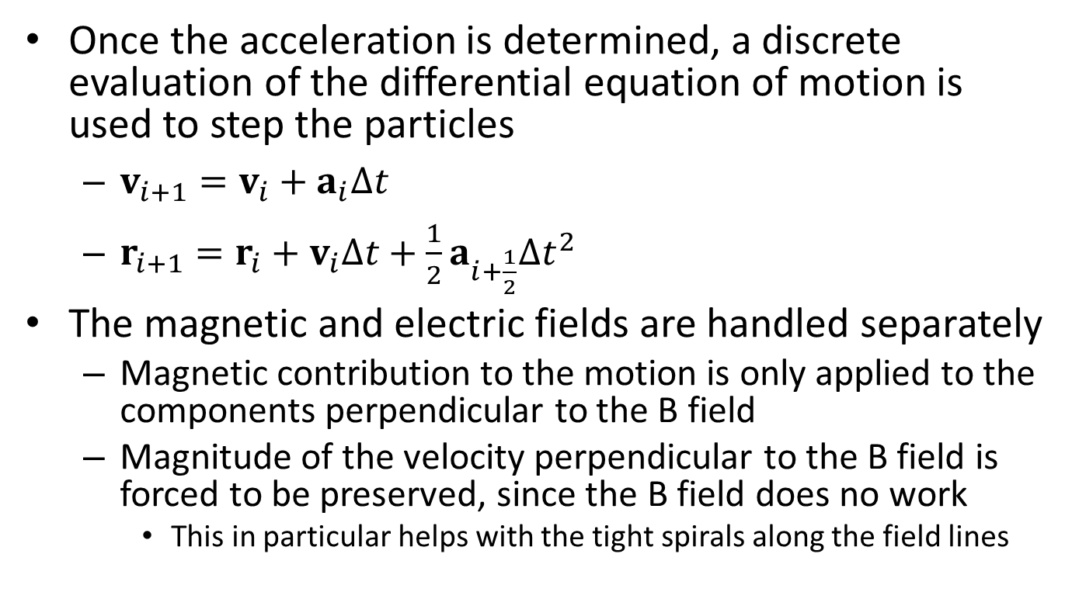
Matlab Simulation
Once the acceleration is determined, a discrete evaluation of the differential equation of motion is used to step the particles
  $v_{i+1}=v_{i}+a_{i}∆t$
  $r_{i+1}=r_{i}+v_{i}∆t+\frac{1}{2}a_{i+\frac{1}{2}}{∆t}^{2}$
The magnetic and electric fields are handled separately
  Magnetic contribution to the motion is only applied to the components perpendicular to the B field
  Magnitude of the velocity perpendicular to the B field is forced to be preserved, since the B field does no work
    This in particular helps with the tight spirals along the field lines

Slide 5
Source Fields
The electric and magnetic fields of the bunch are calculated before hand for various bunch parameters
  Evaluated with proper time delay to represent the moving beam
Electric field of Fermilab IPM determined from a 2-D Poisson calculation
  Would like to create a more detailed 3-D electric field distribution using CST
  Try to explain discoloration on beam chamber out from ends of IPM active region
Magnetic field of Fermilab IPM from 3-D magnet model

Slide 6
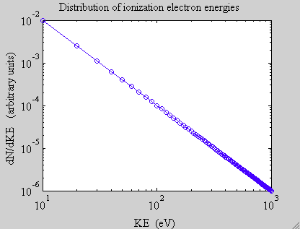
Ionization Particle Distributions
Ionized particle distributions are random in emission angle with 1/E² energy distribution
  Don’t think random emission is correct
Not sure how to deal
with low KE regime
  Dominated by quantum
  effects?
  Does it matter?

Slide 7
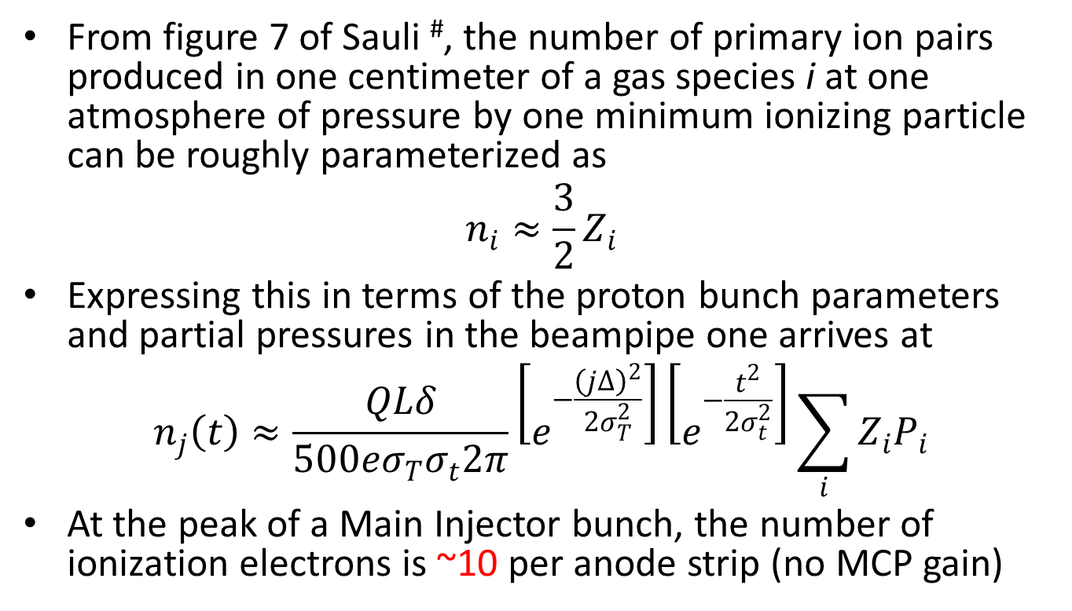
Gated-on Expected Signal
From figure 7 of Sauli #, the number of primary ion pairs produced in one centimeter of a gas species i at one atmosphere of pressure by one minimum ionizing particle can be roughly parameterized as
$$n_{i}≈\frac{3}{2}Z_{i}$$
Expressing this in terms of the proton bunch parameters and partial pressures in the beampipe one arrives at
$$n_{j}\left(t\right)≈\frac{QLδ}{500eσ_{T}σ_{t}2π}\left[e^{−\frac{{\left(j∆\right)}^{2}}{2σ_{T}^{2}}}\right]\left[e^{−\frac{t^{2}}{2σ_{t}^{2}}}\right]\sum_{i}{Z_{i}P_{i}}$$
At the peak of a Main Injector bunch, the number of ionization electrons is ~10 per anode strip (no MCP gain)
#F. Sauli, “Principles of Operation of Multiwire Proportional and Drift Chambers”, CERN 77-09, 3/5/77.

Slide 8
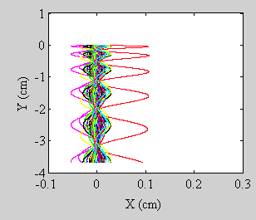
Gated-on IPM
Anode Strip
Particles originating from single point
(resolution contribution)
Elapsed time ~ 1.7 ns

Slide 9
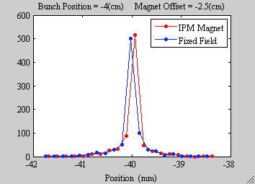
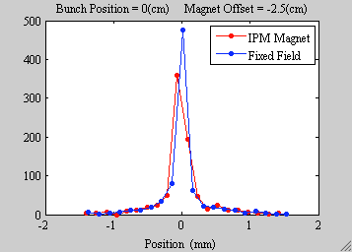
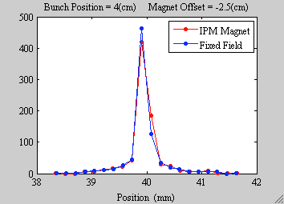
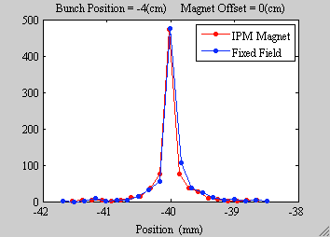
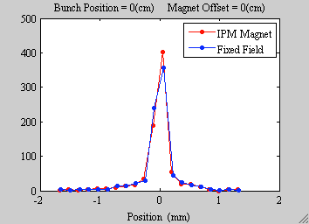
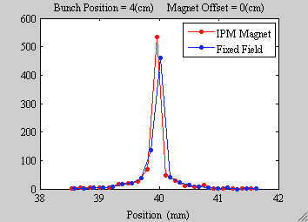
Gated-on IPM
Particles originating from single point
(resolution contribution)
Bunch offset refers to x

Slide 10
Gated-off IPM
Magnet with vertical B field
OFF
Cathode
E Field ~ 0 kV/m
Electron Suppression Grid
B Field ~ 1 kg
Field shaping electrodes
Wire mesh gate
Microchannel Plate (MCP)
Electrons
propagate into
or out of the page
Anode strips

Slide 11
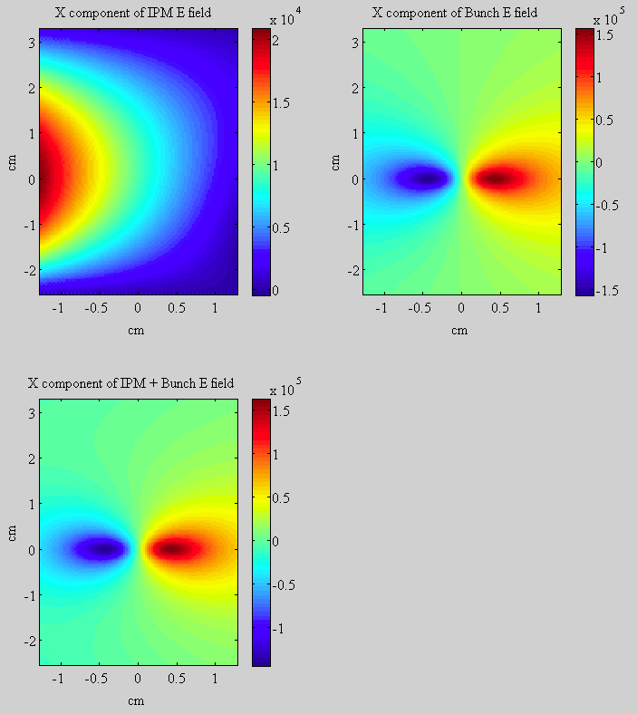
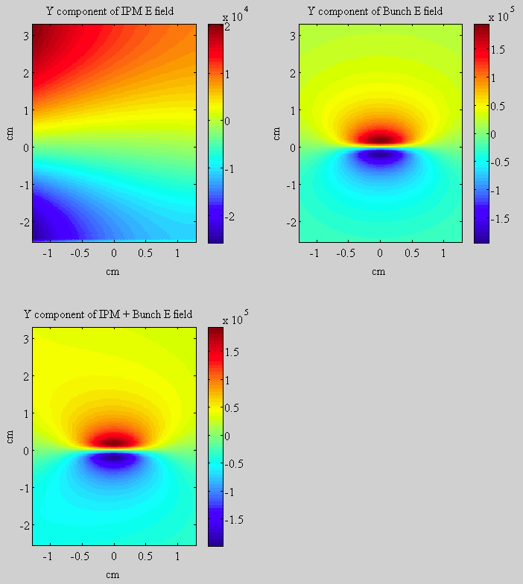
Gated-off Fields
X Component of E field
Y Component of E field

Slide 12
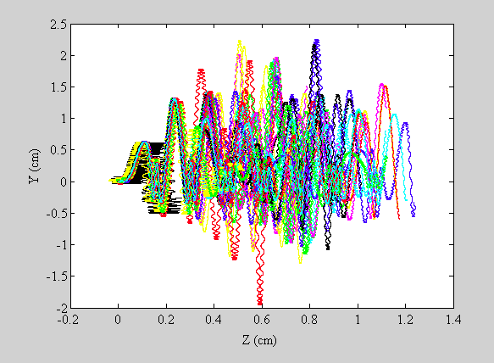
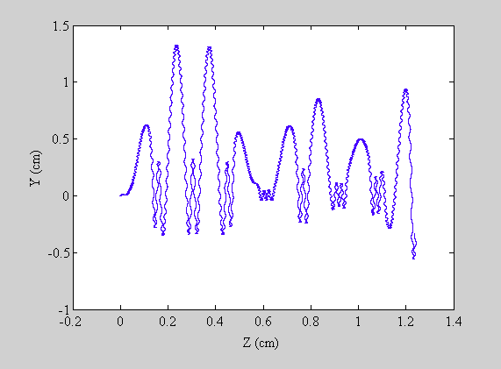
Gated-off Motion
Electron drift along beam direction
Single particle
Particle origination point

Slide 13
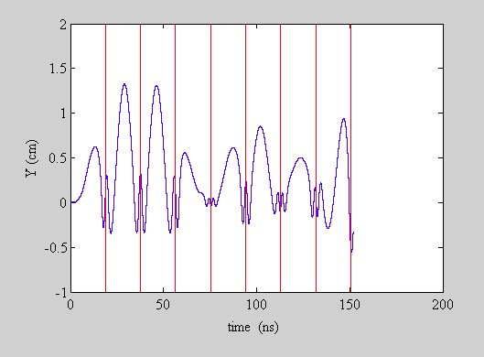
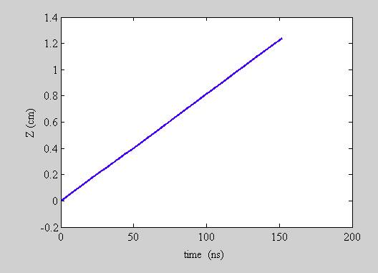
Gated-off Behavior
Y motion vs time
Drift Velocity
1.2 cm / 150 ns = 8 cm/μs
Compared to
10 cm/μs analytically estimated
Bunch Centers

Slide 14
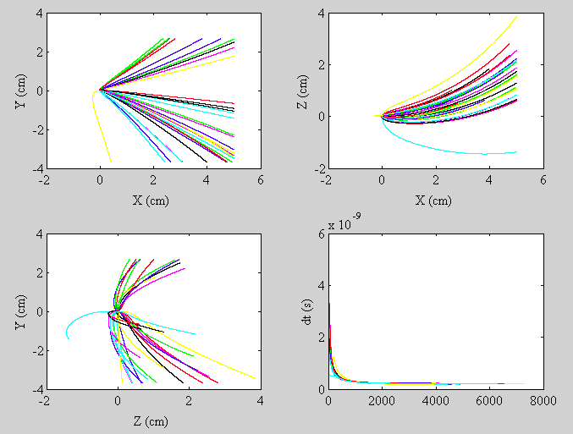
Gated-off Ion Paths
Elapsed time is ~1.5 μs
Ok, since ions do not
go past the gating grid

Slide 15
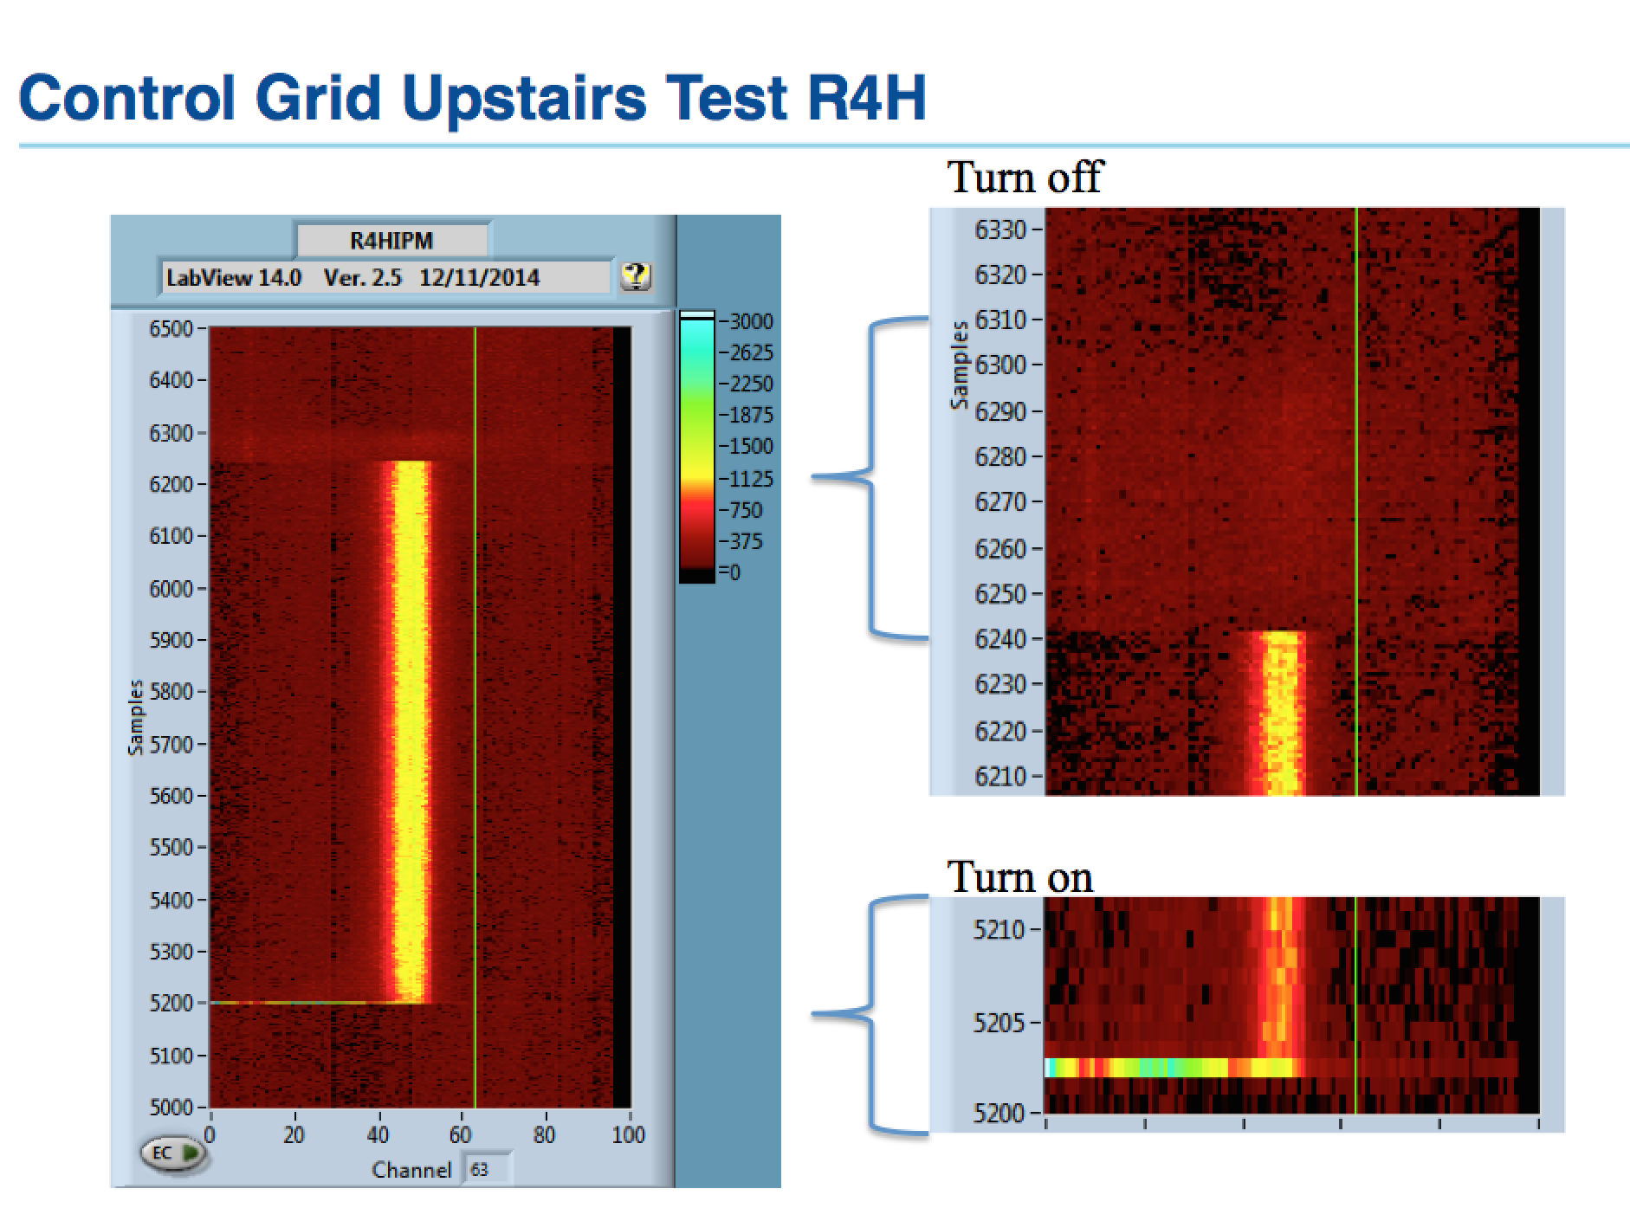
Gated Grid Test

Slide 16
Conclusions
Use of Matlab simulation with fields generated from other sources allowed an evaluation of the gating grid behavior for the new IPMs at Fermilab
Matlab historically not the best choice for tracking since it is/was an interpreted language
  Works well if problem can be formulated in matrix form
Details of initial momenta of ionization products very crude
  Decided that details were probably only relevant for low momentum transfers
  Low momentum transfers quickly overcome by clearing and magnetic fields

Slide 17
Extras

Slide 18
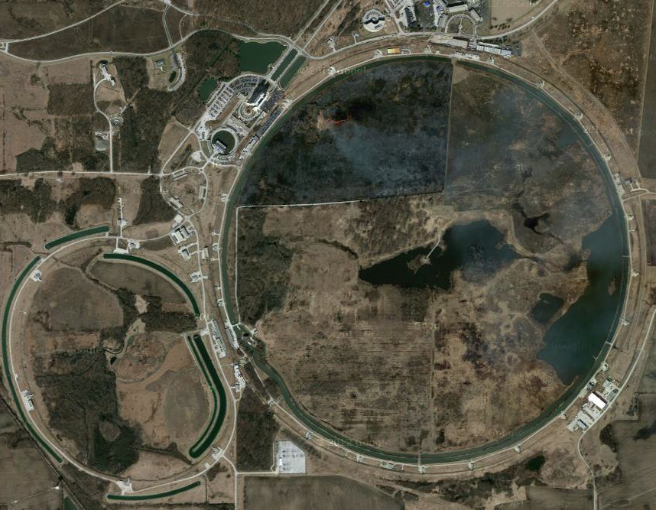
Fermilab
ν to Nova
Source and Linac
Booster Synchrotron
Tevatron
Antiproton
Accumulator and
Debuncher
Recycler and
Main Injector

Slide 19
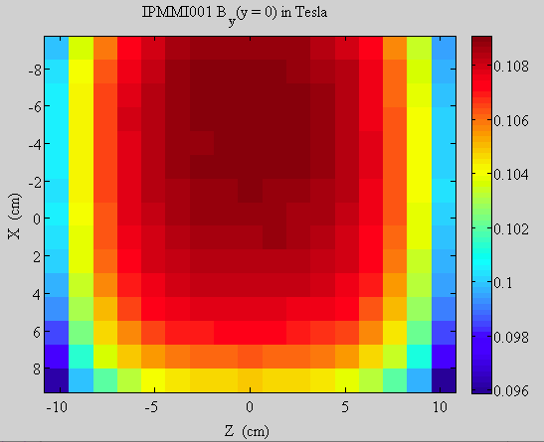
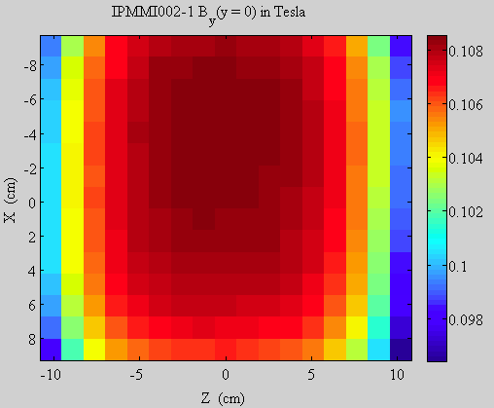
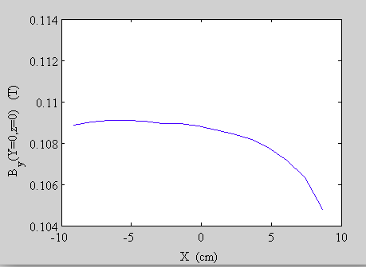
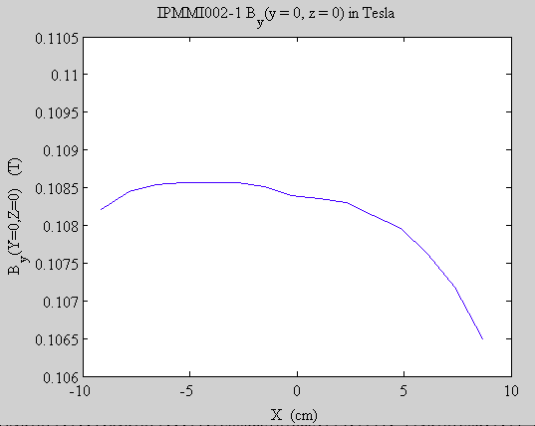
Magnet Measurements
IPM Active Region
Old Shunt
New Shunt
0.004 T
0.002 T

Slide 20
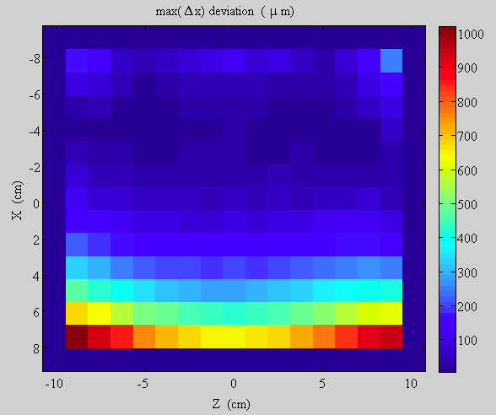
Magnet Measurements
B Field Line
Maximum
Deviation

Slide 21
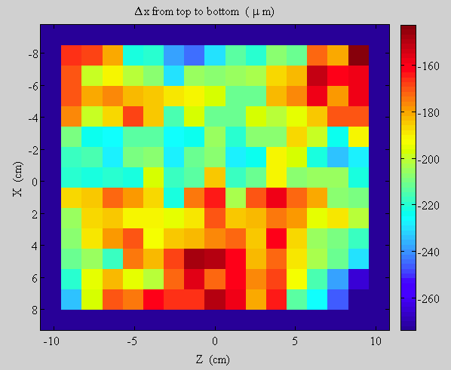
Magnet Measurements
B Field Line
Deviation from top to bottom
Average value of 200 μm could be hall probe rotation; corresponds to ~0.1 degrees

Slide 22
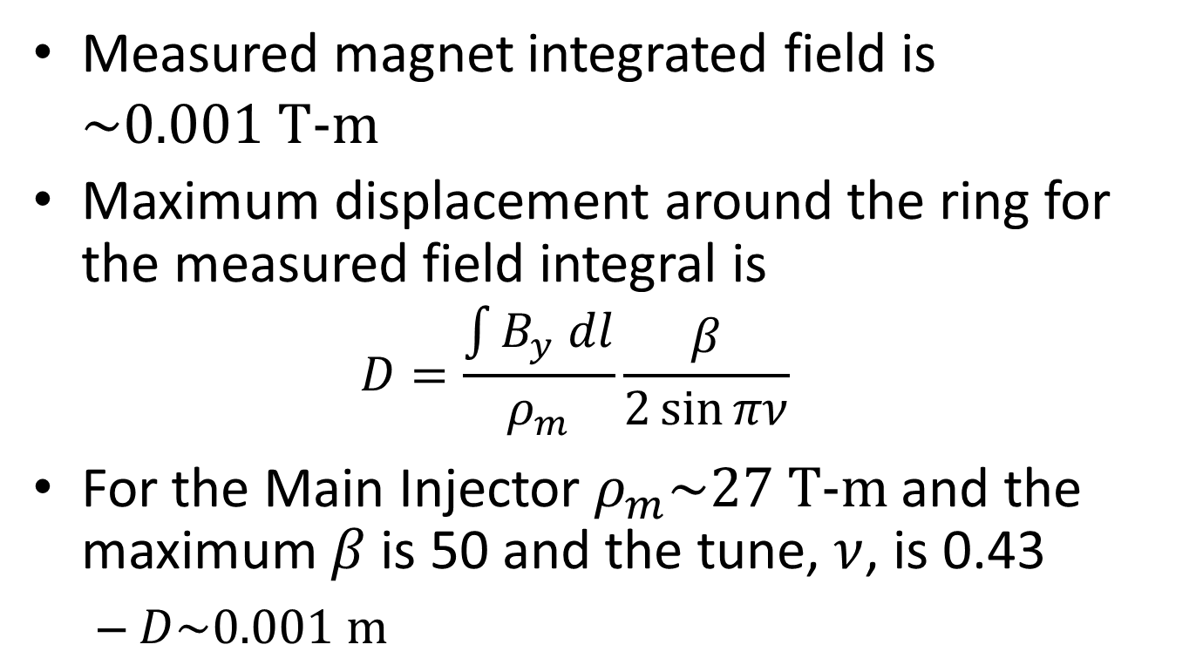
MI Orbit Perturbation
Measured magnet integrated field is $\sim 0.001 \text{T}\text{−}\text{m}$
Maximum displacement around the ring for the measured field integral is
  $$D=\frac{\int{B_{y} dl}}{ρ_{m}}\frac{β}{2\sin{πν}}$$
For the Main Injector $ρ_{m}\sim 27 \text{T}\text{−}\text{m}$ and the maximum $β$ is 50 and the tune, $ν$, is 0.43
  $D\sim 0.001 \text{m}$

Slide 23
IPM Concept
Magnet with vertical B field
Cathode
Electron Suppression Grid
Ions
Field shaping electrodes
Beam
(into page)
Ionization Happens
Electrons
Wire mesh gate
Microchannel Plate (MCP)
Anode strips
500 μm spacing

Slide 24
Gated IPM Concept
Problem with MCP is short lifetime
  Plate is using up lifetime whenever beam is in the machine and the IPM voltage is on
  Voltage takes a while to raise and lower
Would like to be able to gate the charge to preserve the MCP
  Stop the electrons and ions from reaching the MCP
  Allow the electrons and ions an escape path from the IPM active region
    i.e. no Penning traps

Slide 25
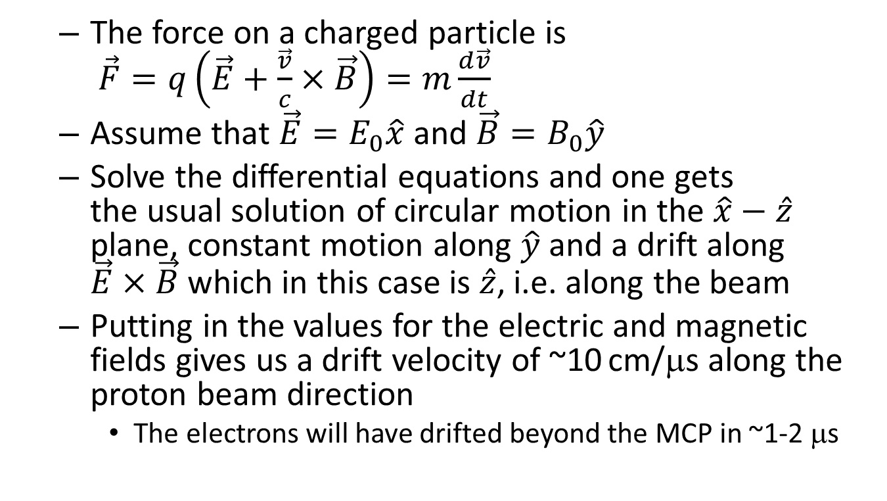
Gated IPM Concept
  The force on a charged particle is
  $\vec{F}=q\left(\vec{E}+\frac{\vec{v}}{c}×\vec{B}\right)=m\frac{d\vec{v}}{dt}$
  Assume that $\vec{E}=E_{0}\hat{x}$ and $\vec{B}=B_{0}\hat{y}$
  Solve the differential equations and one gets
  the usual solution of circular motion in the $\hat{x}−\hat{z}$ plane, constant motion along $\hat{y}$ and a drift along $\vec{E}×\vec{B}$ which in this case is $\hat{z}$, i.e. along the beam
  Putting in the values for the electric and magnetic fields gives us a drift velocity of ~10 cm/μs along the proton beam direction
    The electrons will have drifted beyond the MCP in ~1-2 μs

Slide 26
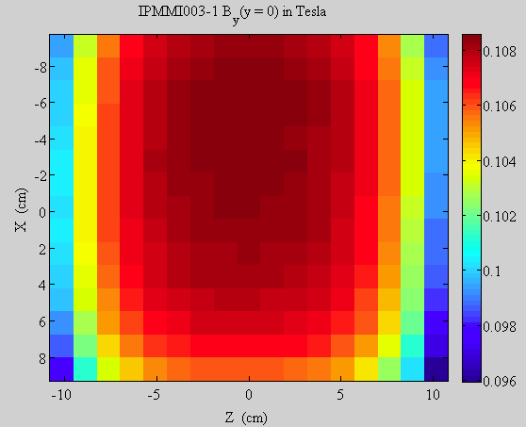
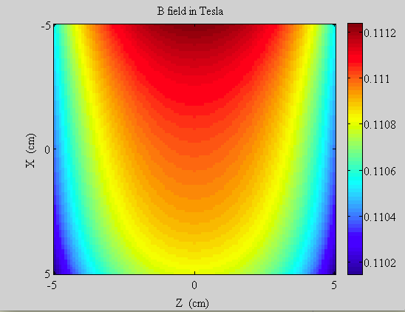
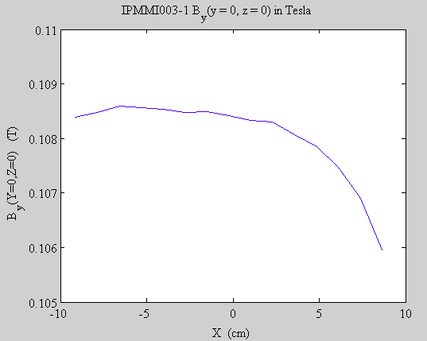
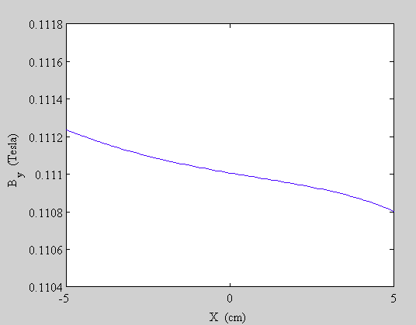
Magnetic Field in Simulation
Measured
Model
0.0005 T
0.0004 T

Slide 27
Gated-on IPM
Magnet with vertical B field
ON
Cathode
E Field ~ 1 kV/m
Electron Suppression Grid
B Field ~ 1 kg
Field shaping electrodes
Wire mesh gate
Microchannel Plate (MCP)
Electrons spiral
down helically
Anode strips

