Slide 1

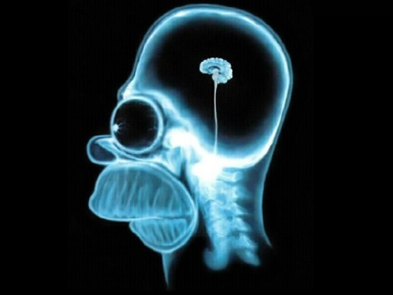
Ahead of the Hunt:
Small field models and GW – leading candidates
Ben-Gurion University
of the Negev
Ira Wolfson

Slide 2
Motivation
The hunt for Primordial Gravitational Waves
Alternatives to large field models.
Fundamental Physics?
Ben-Dayan, Brustein JCAP 1009, 007 (2010)
Hotchkiss, Mazumdar, Nadathur JCAP 1202, 008 (2012)

Slide 3
Outline
Recent Results
  The model
  Covering the plane of interest
  Finding the most probable member
Discrepancy between analytics and numerics
Summary and outlook
Wolfson, Brustein (2016) arXiv:1607.03740
And ongoing work

Slide 4
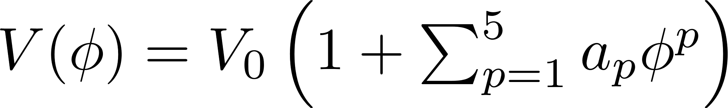
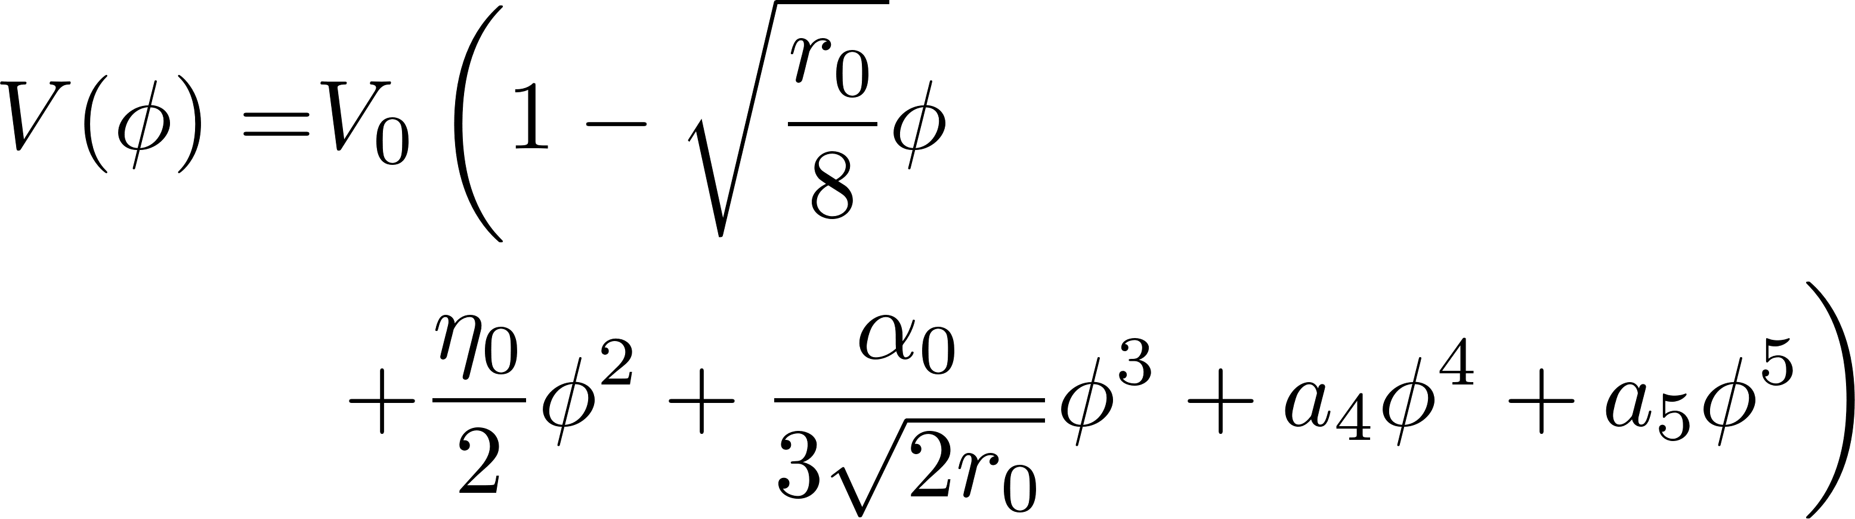

Results
5 Degree polynomial model
Recent Results
  The model
  Covering the plane of interest
  Finding the most probable member
Discrepancy between analytics and numerics
Summary and outlook
as
a
$$⇓$$
Ben-Dayan & Brustein JCAP 1009, 007 (2010)

Slide 5
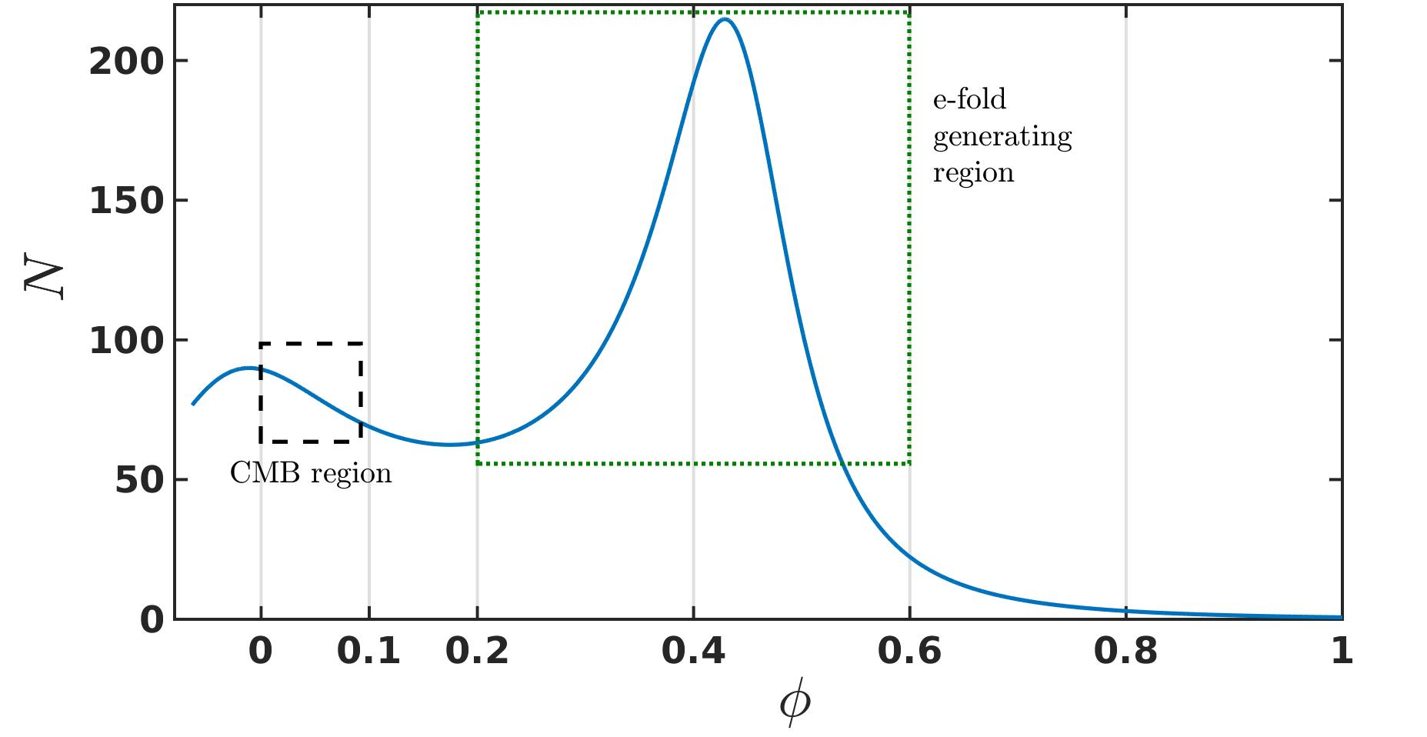
Results
Why look at these models?
Recent Results
  The model
  Covering the plane of interest
  Finding the most probable member
Discrepancy between analytics and numerics
Summary and outlook
as
a

Slide 6
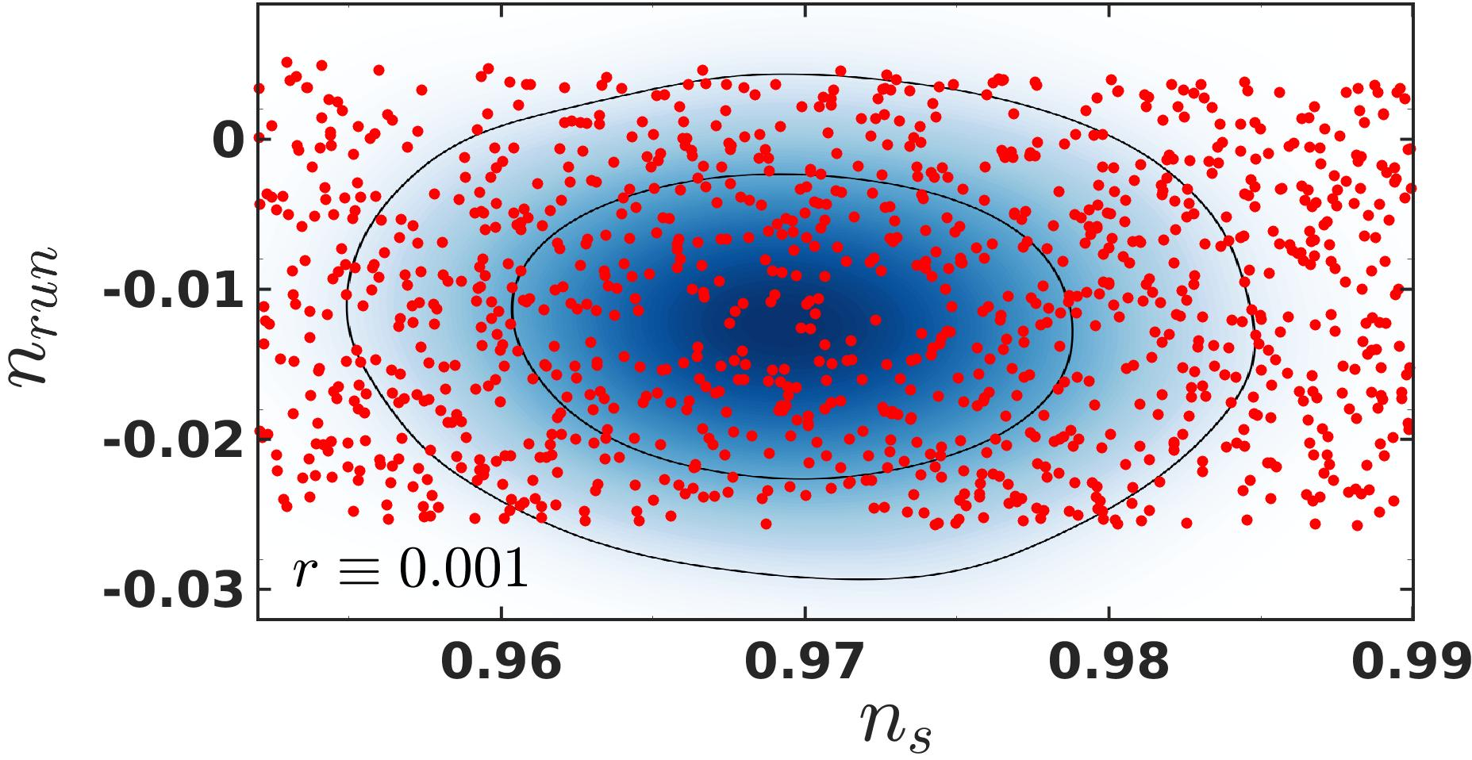
Results
5 Degree polynomial model
Recent Results
  The model
  Covering the plane of interest
  Finding the most probable member
Discrepancy between analytics and numerics
Summary and outlook
as
a

Slide 7
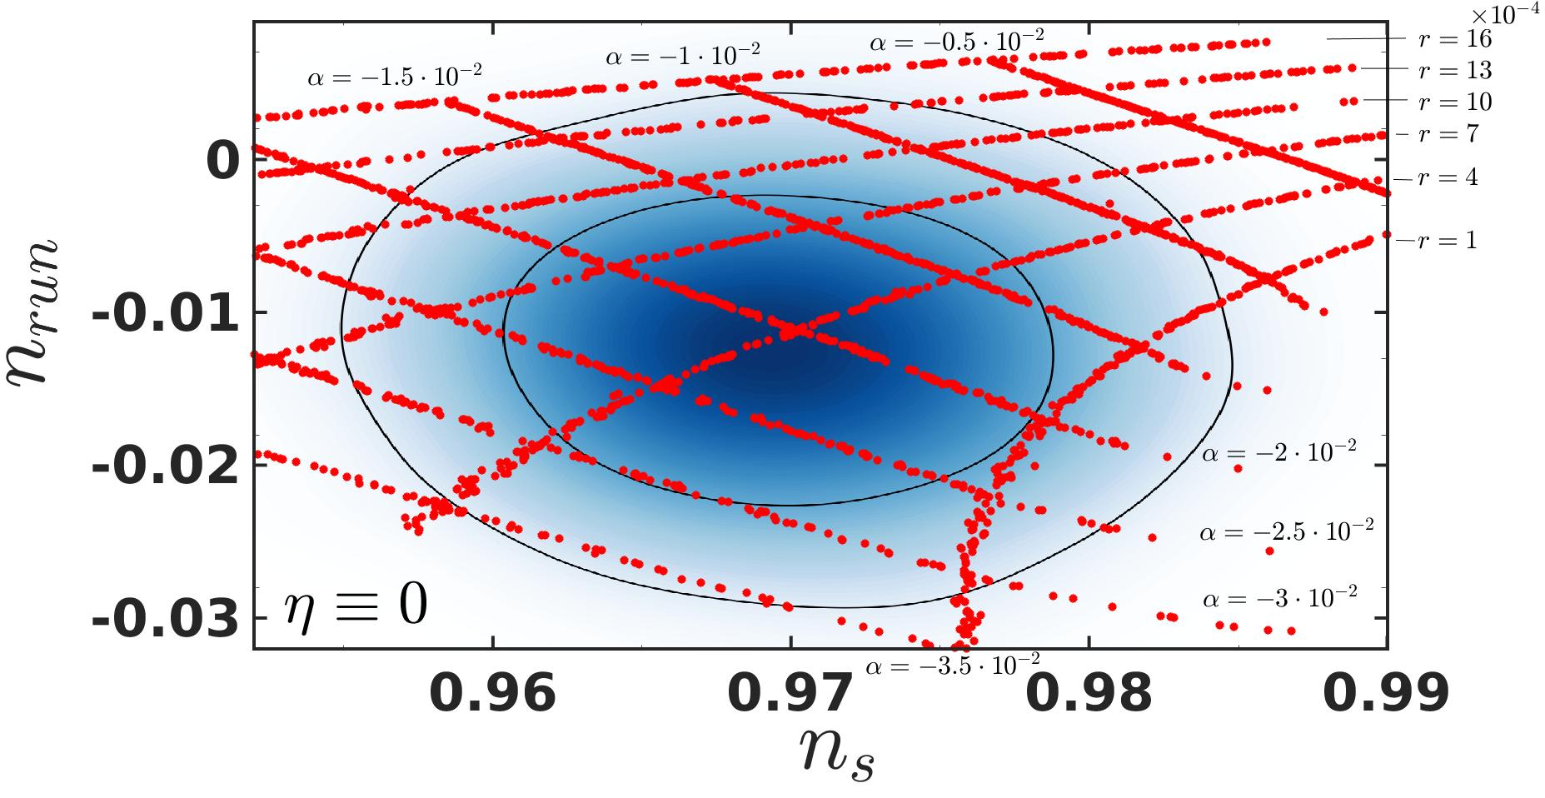
Results
5 Degree polynomial model
Recent Results
  The model
  Covering the plane of interest
  Finding the most probable member
Discrepancy between analytics and numerics
Summary and outlook
as
a

Slide 8
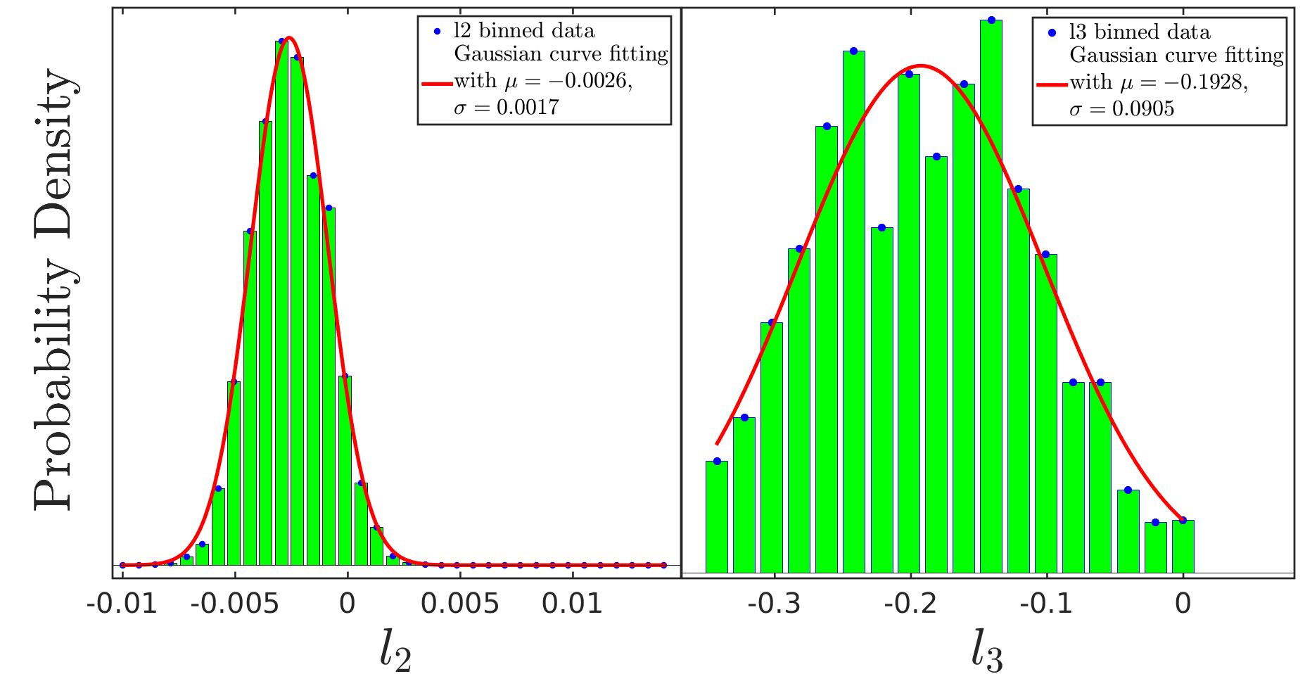
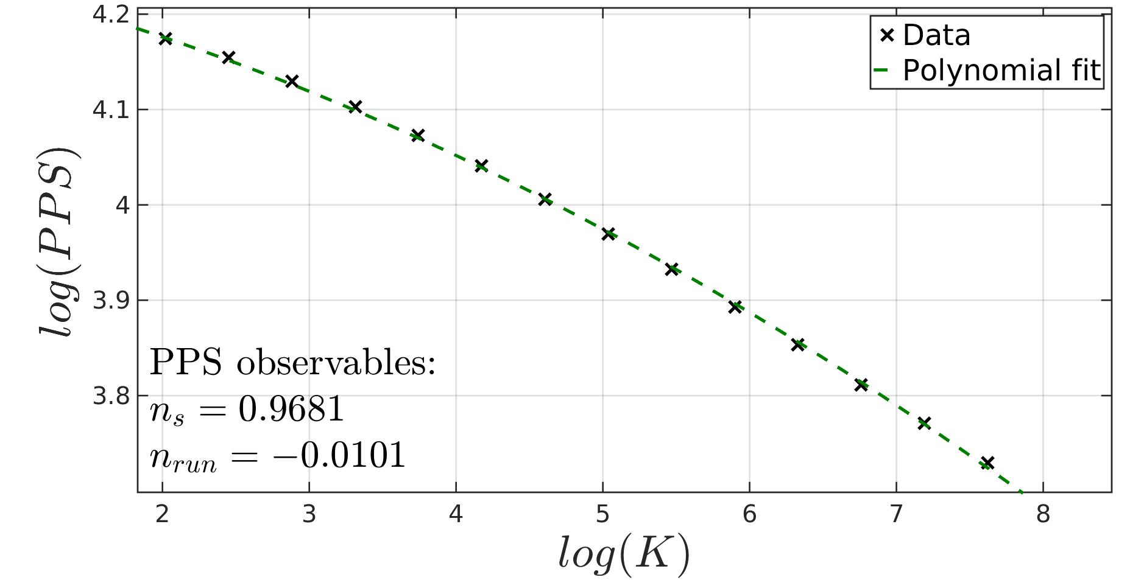
Results
5 Degree polynomial model
Recent Results
  The model
  Covering the plane of interest
  Finding the most probable member
Discrepancy between analytics and numerics
Summary and outlook
as
a

Slide 9
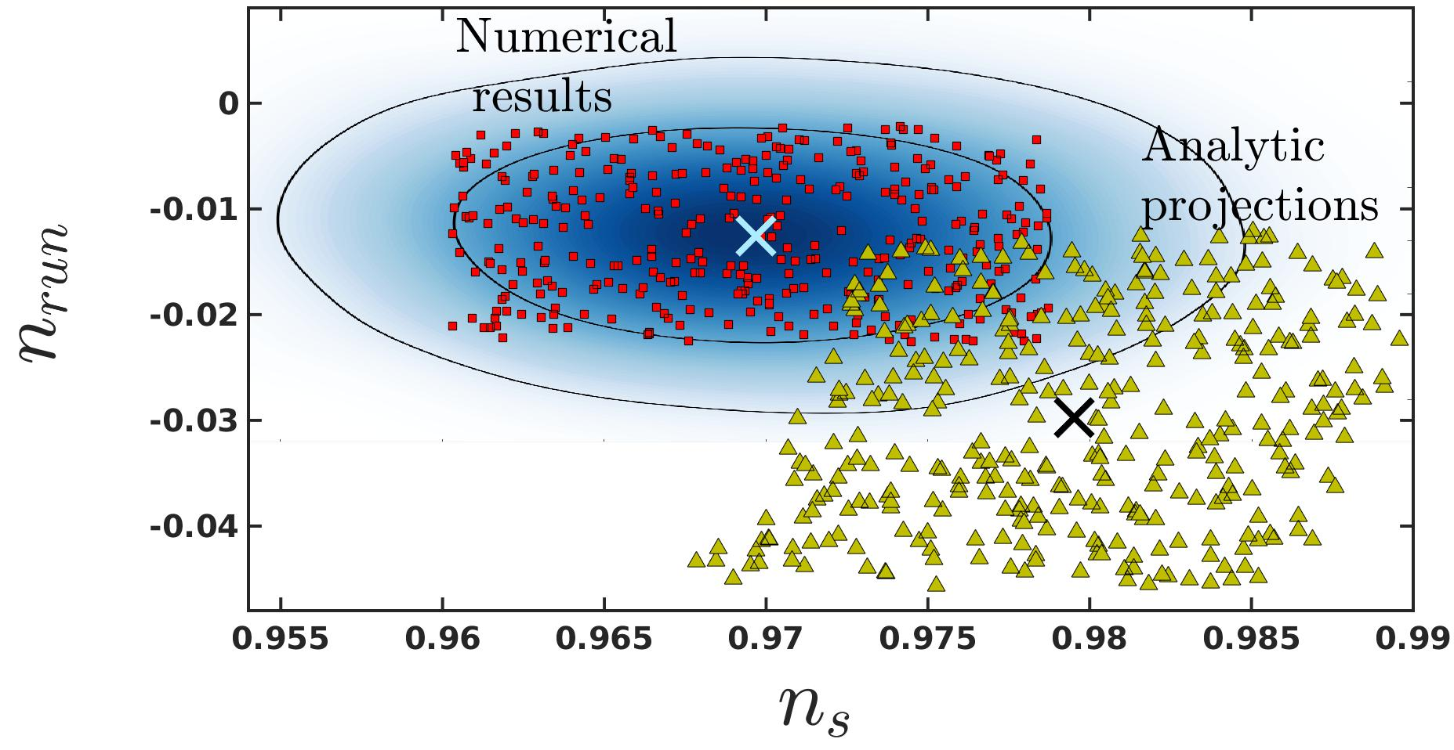

OOPS!... Something’s wrong
Discrepancy between analytics & numerics
Recent Results
  The model
  Covering the plane of interest
  Finding the most probable member
Discrepancy between analytics and numerics
Summary and outlook
as
a
$$r_{0}=0.001$$

Slide 10
OOPS!... Something’s wrong
Discrepancy between analytics & numerics
Recent Results
  The model
  Covering the plane of interest
  Finding the most probable member
Discrepancy between analytics and numerics
Summary and outlook
as
a
$$r_{0}=0.001$$
        Inflationary perturbations from a potential with a step
        Adams et.al. PRD 64, 123514 (2001)

Slide 11
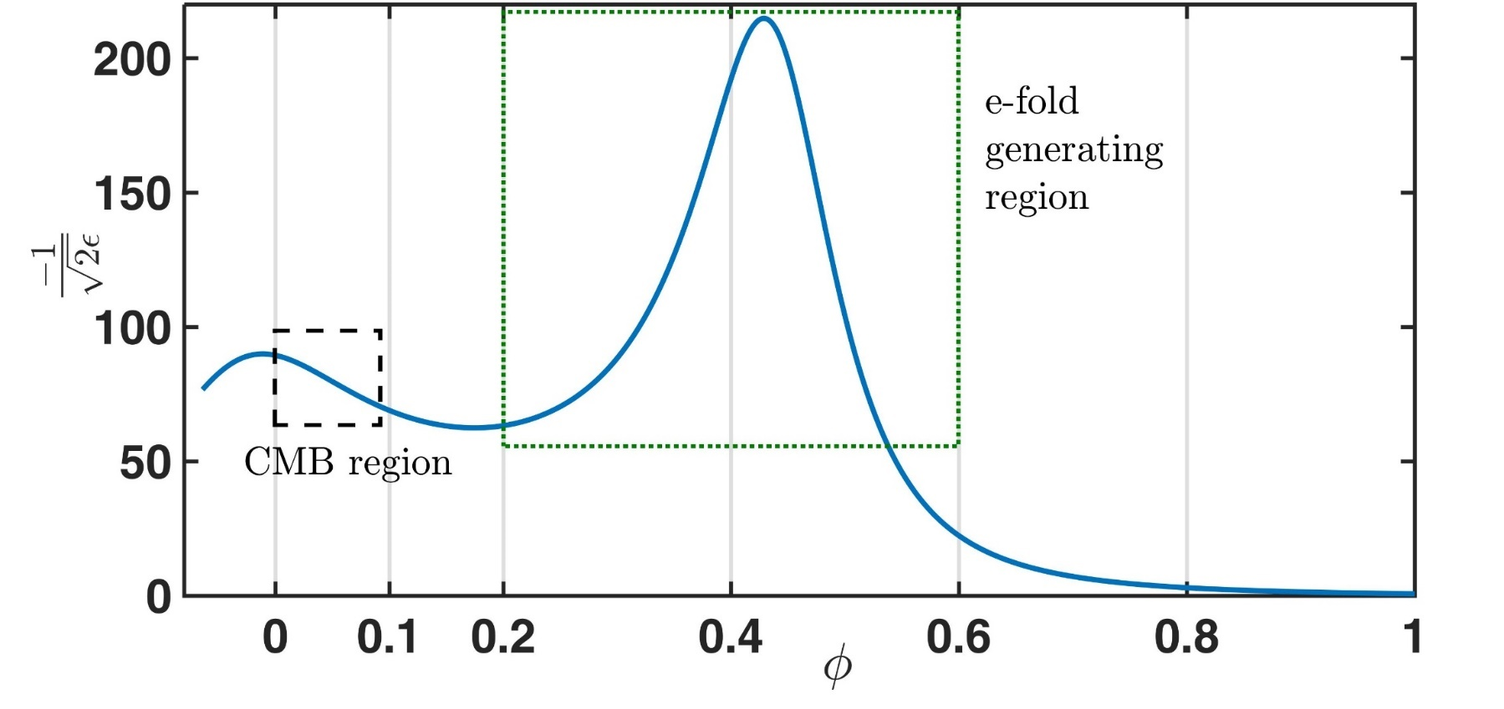
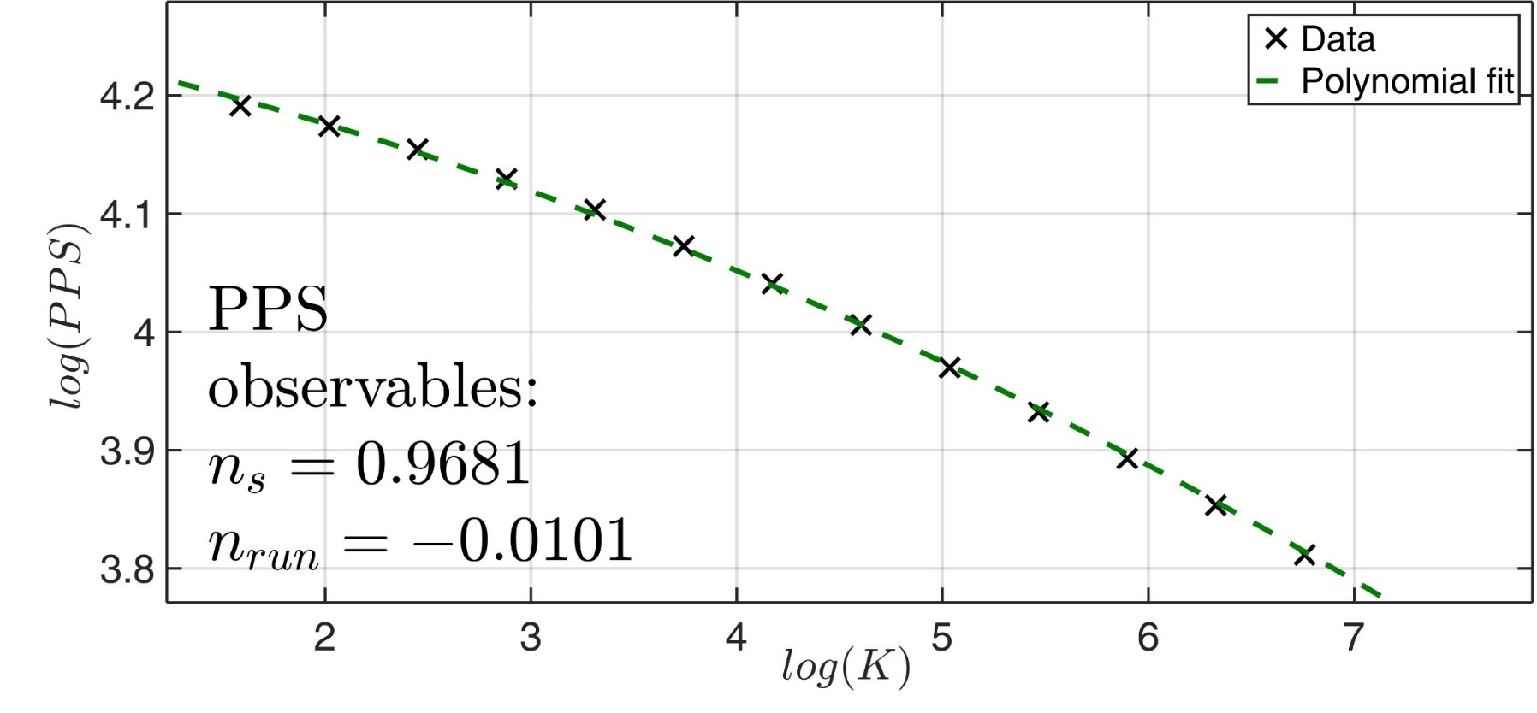
Summary and outlook
Summary
Recent Results
  The model
  Covering the plane of interest
  Finding the most probable member
Discrepancy between analytics and numerics
Summary and outlook
as
a
Small field models can produce GW.
There is much more in a potential than the first derivative.
Numerical analysis is indispensable.

Slide 12
Summary and outlook
where do we go from here?
Recent Results
  The model
  Covering the plane of interest
  Finding the most probable member
Discrepancy between analytics and numerics
Summary and outlook
as
a
Go to higher tensor-to-scalar ratios.
See what BICEP3 yields, and adjust.
Find a better analytic expression from first principles?
Quantify perturbations – give better analytic tools.

Slide 13
Questions?

Slide 14

Thank you!

