Slide 1
Blue Tensor Spectra
(with slightly parity-violated) from axion-gauge couplings
Ippei Obata (Kyoto University, PhD)
(in preparation)
29_Nov_CosPA2016

Slide 2
Primordial GWs from the inflation
Tensor power spectrum (vacuum fluctuations):
info
Energy scale of early Universe
Red-tilted.
Parity-symmetric.
Tiny amplitude.
BICEP2/Keck Array (2016)

Slide 3
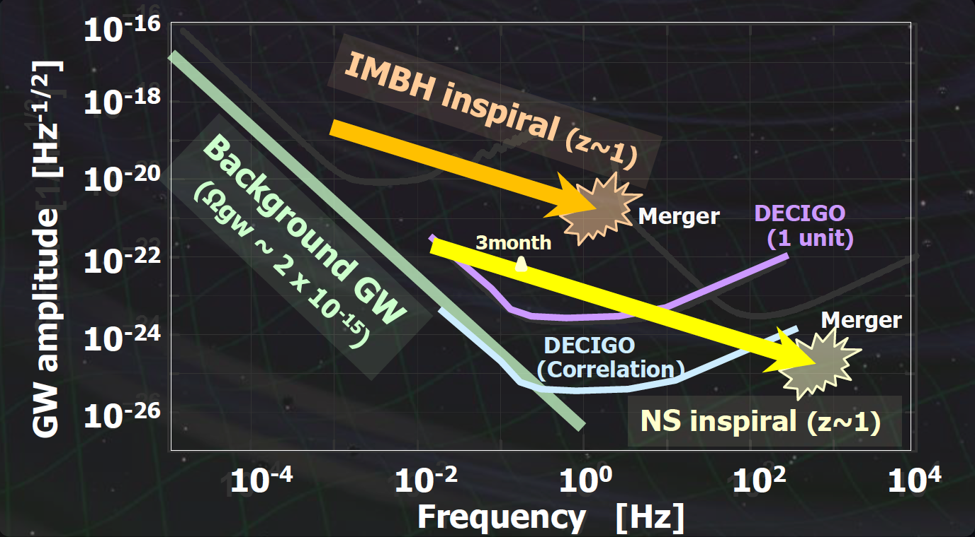
Is it detectable directly?
Sensitivity curves of DECIGO:
Ando (2013, DECIGO workshop)
( r = O(1) )
if the source of GWs is vacuum fluctuations

Slide 4
Additional sources of GWs
Sorbo (2011), Barnaby et al. (2011), …
(inflationary axion-gauge coupling)
EOM for gauge field:
(One helicity mode enhancement!)
→Additional sources for scalar and tensor perturbations!

Slide 5
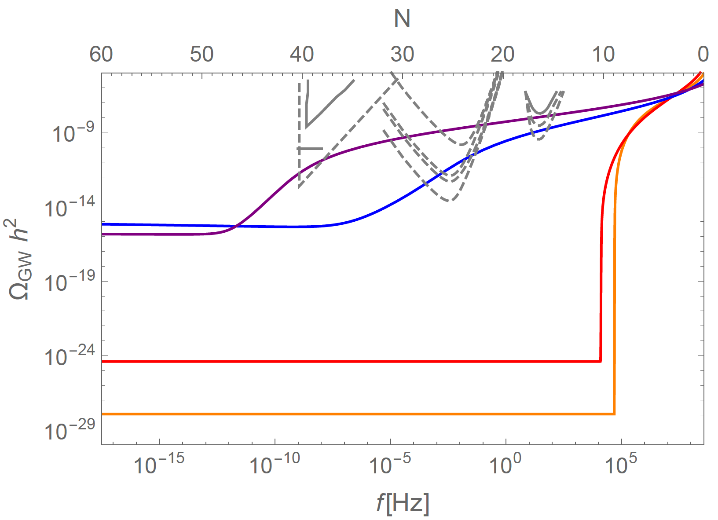
Testable chiral blue tensor spectrum
Valerie et al. 2016
Tensor spectrum:
CMB
( r = O(0.01) )
: Starobinsky type
: Chaotic type
: Hilltop type
Preferable parameter region

Slide 6
Testable chiral blue tensor spectrum
Valerie et al. 2016
Tensor spectrum:
CMB
( r = O(0.01) )
: Starobinsky type
: Chaotic type
: Hilltop type
Preferable parameter region
Natural scale predicted by the heterotic superstring!
Svrcek & Witten (2005)

Slide 7
Our question and study
Question…
? :
Testable blue tensor spectrum ↔︎ EFT of the heterotic string theory
In this work…
We explore the concrete model building based on the heterotic string theory and reconsider the form of axion-gauge couplings.
We found that rich varieties of blue tensor spectra could be provided sourced by gauge fields coupled to two types of axions.

Slide 8
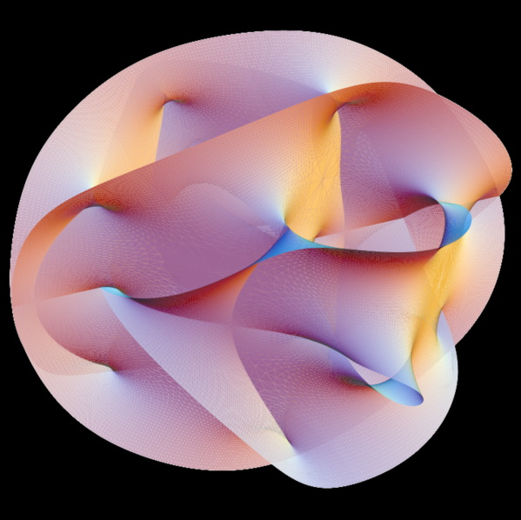
Axions from the heterotic superstring
Choi &Kim (1985), …
Axions arise from the B field:
: its field strength
Two types of axion
“Model-independent” type
“Model-dependent” type
compactification

Slide 9
Axions from the heterotic superstring
Choi &Kim (1985), …
Origin of axion-gauge couplings:
Bianchi identity:
Anomaly cancellation term:
4-dim. reduced axion-gauge coupling
Model-independent axion:
Model-dependent axion:
(omitting Lorentz indices)

Slide 10
Source of GWs from superstring
Model example (1):
→ parity-symmetric blue tensor spectra!

Slide 11
Source of GWs from superstring
Model example (2):
diagonalising
→ slightly parity-violated blue tensor spectra!

Slide 12
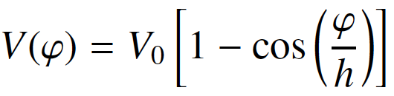
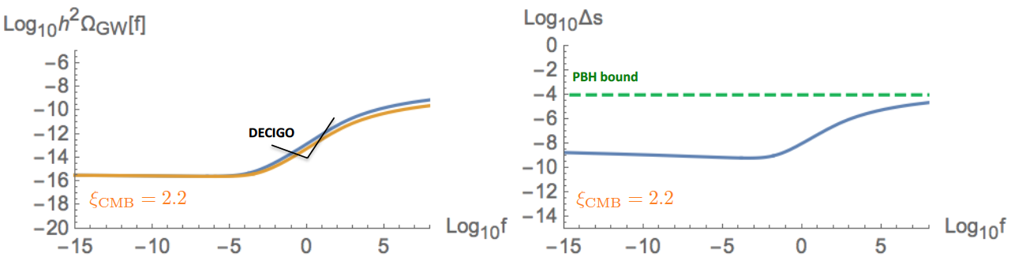
Main Results
ex:
BBO
Bule-tilted and slightly parity violated spectra.
Testable by future gravitational wave interferometers (DECIGO, BBO).
Avoiding the overproduction of scalar modes.

Slide 13
Summary & Outlook
We explore the concrete model building based on the heterotic string theory and reconsider the form of axion-gauge couplings.
We found that rich varieties of blue tensor spectra sourced by gauge fields coupled to the model-(in)dependent axion could be provided.
? Possible potential forms of axion, the non-Abelian gauge interaction, …
Working in progress!

