Slide 1
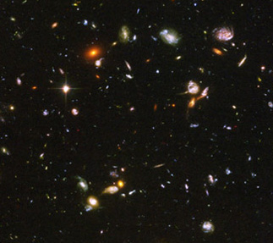

Unveiling the Signatures of an Evolving and Interacting Dark Sector
Eromanga Adermann
Supervisors: Geraint Lewis, Pascal Elahi & Chris Power
Sydney Institute for Astronomy
The University of Sydney

Slide 2
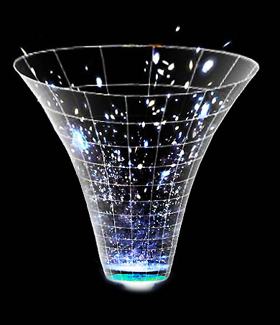
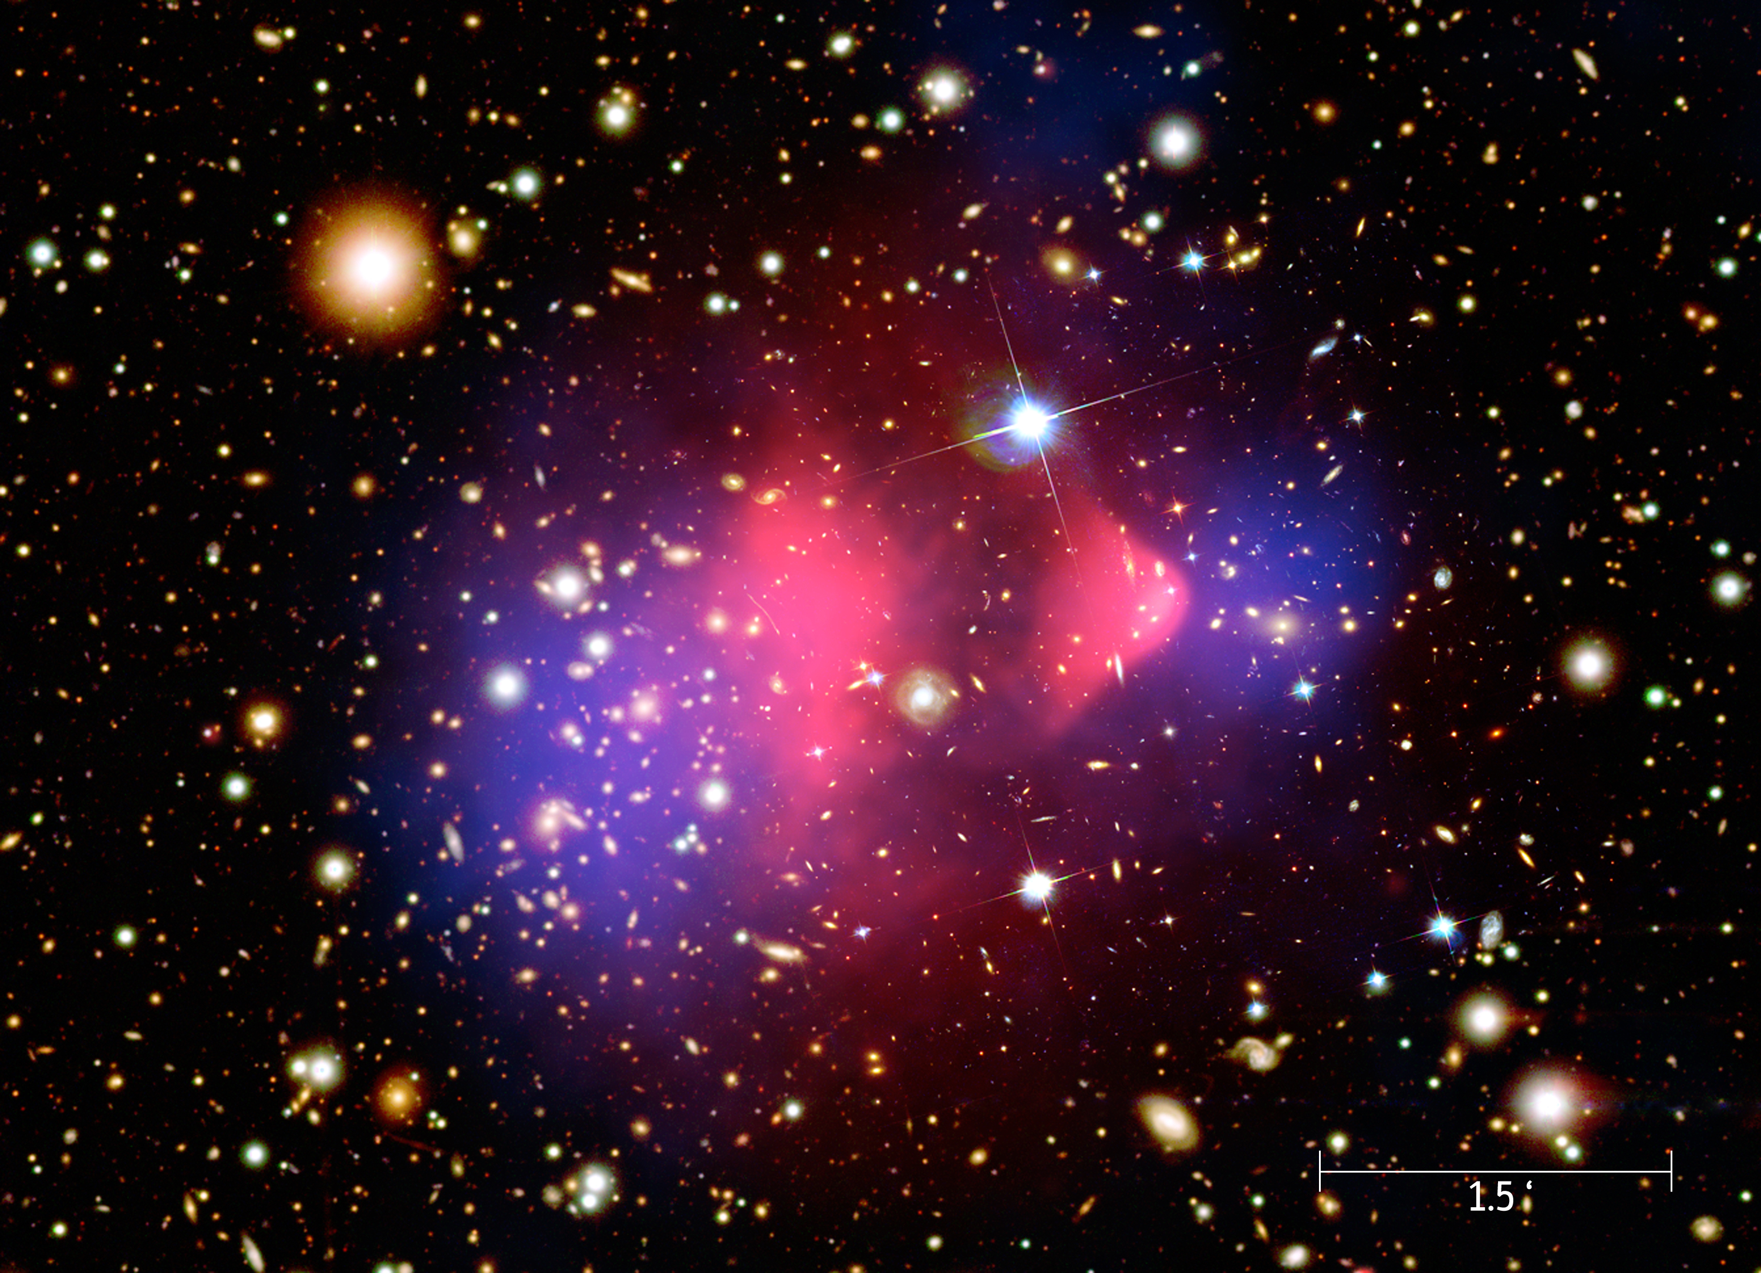
Λ Cold Dark Matter (ΛCDM)
Non-relativistic, non-baryonic matter
Λ drives accelerated universal expansion

Slide 3
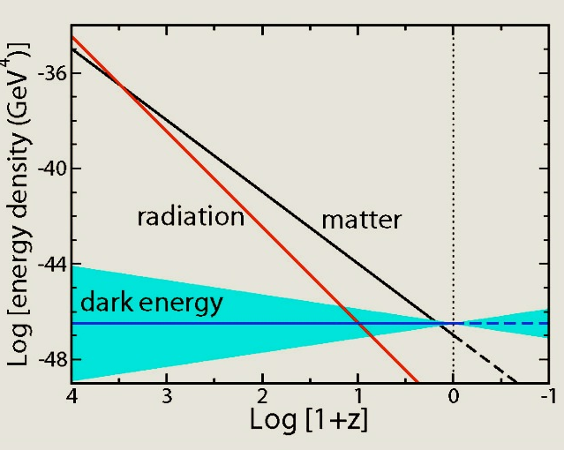
Beyond Λ Cold Dark Matter
Matter and dark energy densities unexpectedly similar today (Coincidence Problem)
Image Credit: NASA/IPAC Extragalactic Database Knowledgebase

Slide 4
Beyond Λ Cold Dark Matter
?
The nature of the dark sector is unknown

Slide 5
Alternative Cosmological Models
Quintessence (φCDM)
Dark energy arises from a dynamic scalar field, ϕ:
where V(ϕ) = V₀ ϕ^{-α}
Dark energy density can track the matter density, alleviating the Cosmic Coincidence problem
Expansion history altered compared to ΛCDM
(Ratra & Peebles 1988)

Slide 6
Alternative Cosmological Models
Coupled Dark Energy (CDE)
where V(ϕ) = V₀ ϕ^{-α} and m(ϕ) = m₀e^{-βϕ}
Coupling –> dark matter decays into ϕ
Additional drag force acting on DM particles only
Altered expansion history and growth of density perturbations compared to ΛCDM

Slide 7
Alternative Cosmological Models
ΛCDM
Λ
φ
φCDM
φ – DM coupling
CDE

Slide 8
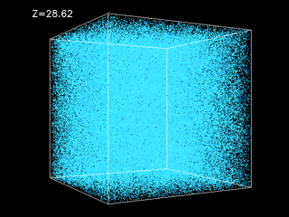
Simulations: Creating a Model Universe
Expansion History
+
Power Spectra
2 x 512³ particles
500 h⁻¹ Mpc
Image Credit: The National Centre for Supercomputer Simulations

Slide 9
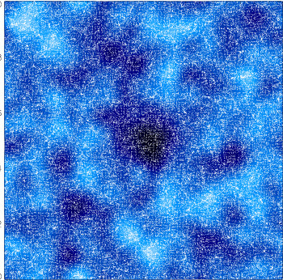
Signatures in Voids
Voids are regions of low density in the large-scale structure
Why voids?
  Growth depends more simply on underlying cosmology than halo growth
Image Credit: : Erwin Platen, University of Groningen

Slide 10
Void Finding
The Hessian Matrix
Voids
e₁ > 0, e₂ > 0, e₃ > 0
ρ
x_{i}

Slide 11
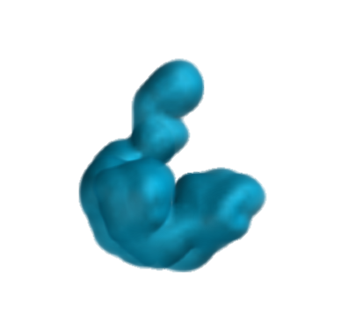
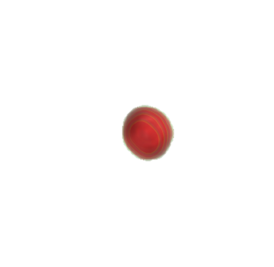
Examples of Voids
330
400
h⁻¹Mpc
h⁻¹Mpc
280
350
10
h⁻¹Mpc
60
240
h⁻¹Mpc
290

Slide 12
Average Void Density
Calculate average density of each void
Characterise the distribution by fitting a probability density function (PDF) to the distribution
Compare the PDF predicted by ΛCDM to the PDFs predicted by φCDM and CDE
Best fit was a skewed Gaussian distribution:
x = log₁₀(ρ/ρ_{crit})

Slide 13
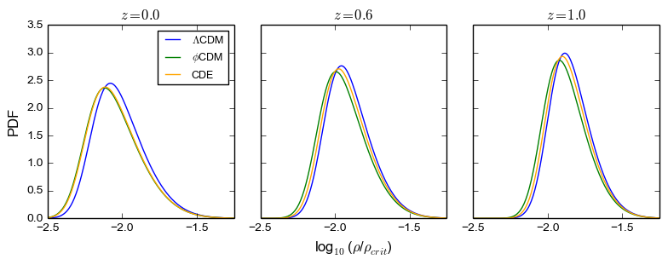
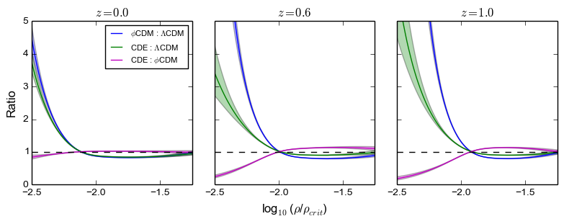
Average Void Density PDFs

Slide 14
What does this mean?
Any difference in the PDFs is due to difference in underlying cosmology
Scalar field reduces average void density
Coupling acts to increase the average void density
Potential probe of dark sector/cosmology!

Slide 15
Summary and Future Work
Studied voids in ΛCDM, Quintessence, CDE
Differences in average void density distribution
More detail on how void densities depend on dark sector physics
Feasibility of average void density as observational probe
Potential observational probe of dark sector!

Slide 16
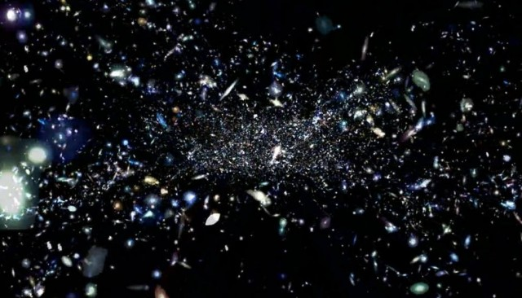
Thank you for Listening!

Slide 17
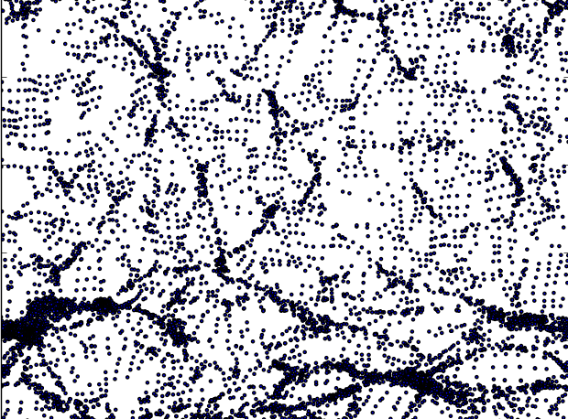
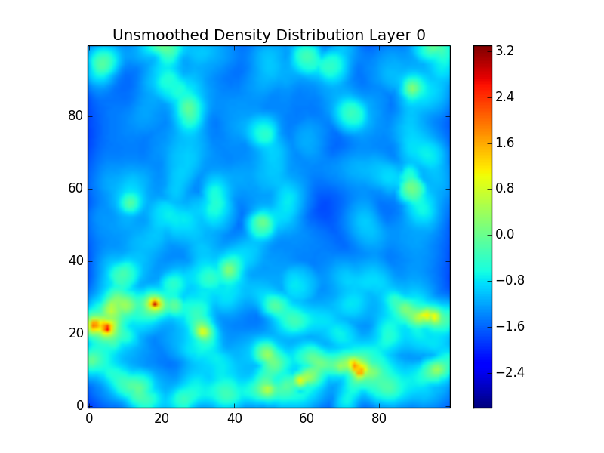
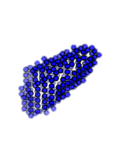
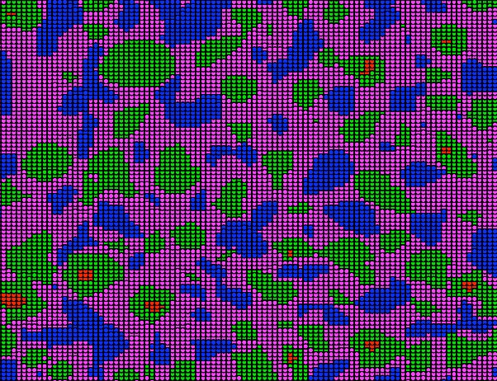
Void Finding Pipeline
Simulation Output
Density Plot
Smoothing + Density Calculation
Calculate Hessian
Friends of Friends Grouping
Void
Classified Output

Slide 18
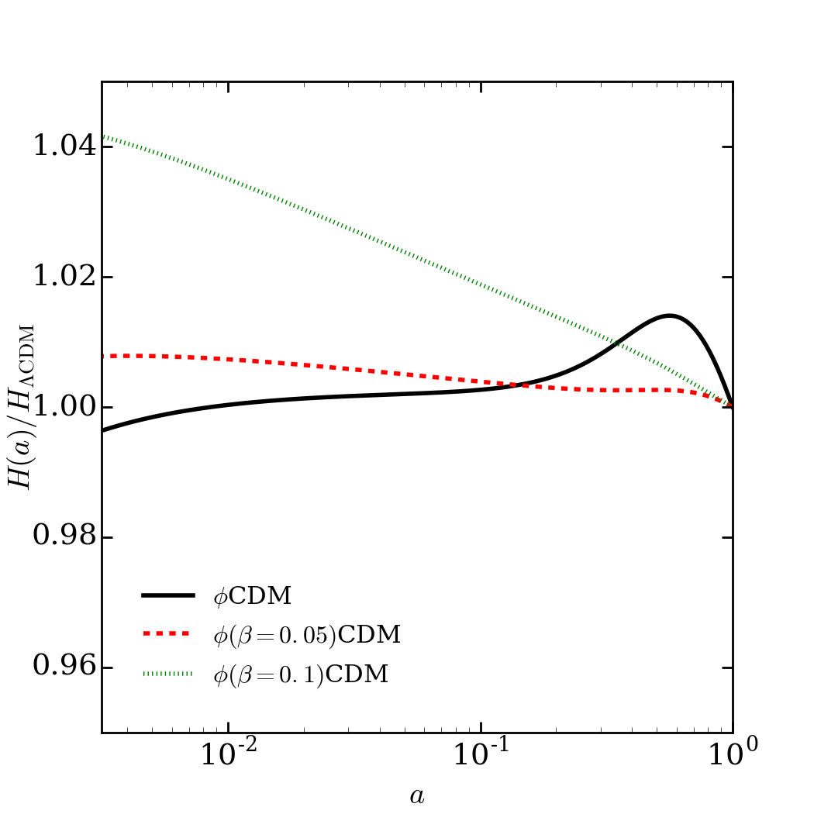
Contents (for the moment)
The significance of exploring alternative cosmologies (in particular evolving and interacting dark sector models – what problem do they solve (coincidence problem))
How have I explored these cosmologies? (voids, why voids, N-Body simulations, why these specific parameters)
What have I found? (results)
Significance of results (what I have found is amazing because…)
Next steps (observations (where the audience can get involved), more exploring)

Slide 19
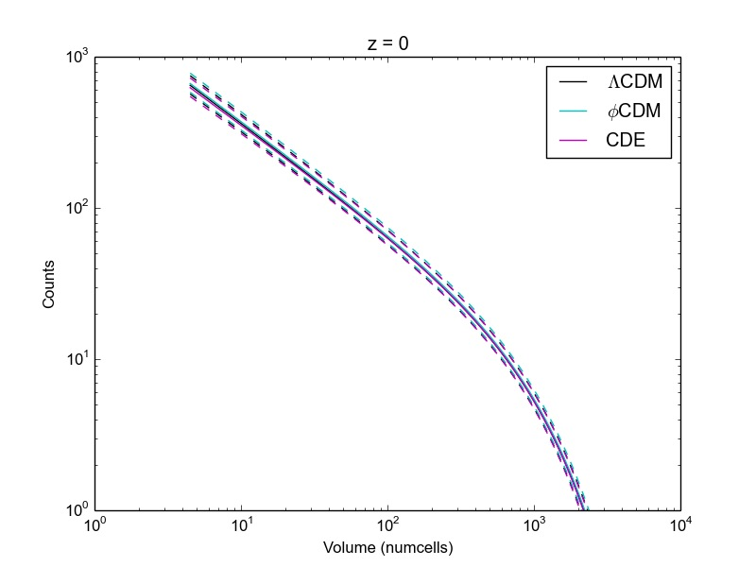
Volume (Mpc³)

Slide 20
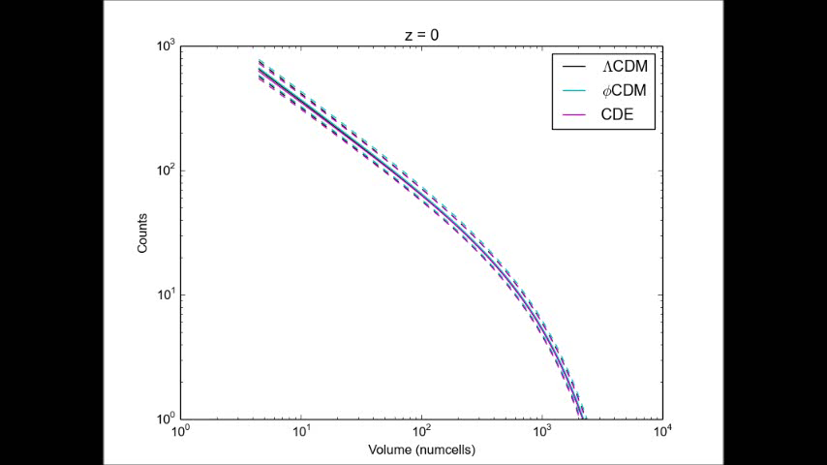
Evolution through Redshift
Volume (Mpc³)

