Slide 1
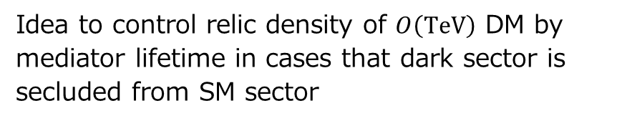
Relic Abundance in Secluded Dark
Matter Scenario with Massive Mediator
Masato Yamanaka (Maskawa Institute)
Collaborator: S. Okawa, M. Tanabashi
arXiv:1607.08520 [hep-ph]
Idea to control relic density of $O\left(TeV\right)$ DM by mediator lifetime in cases that dark sector is secluded from SM sector

Slide 2

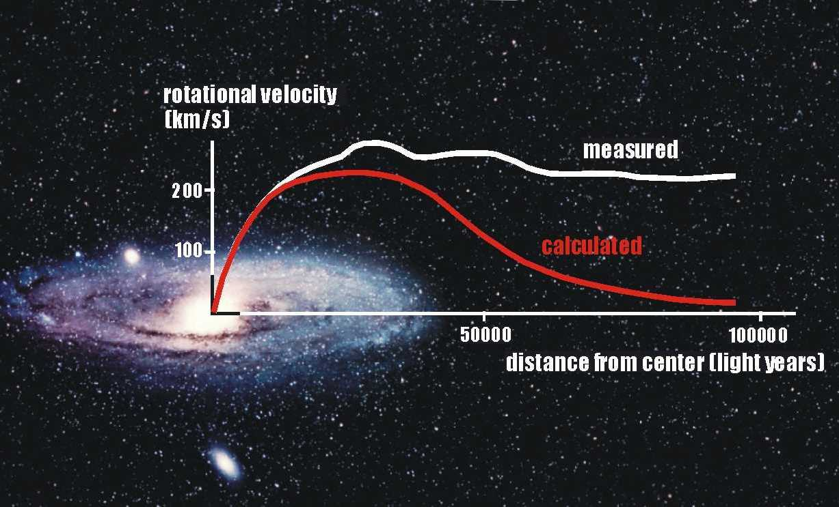
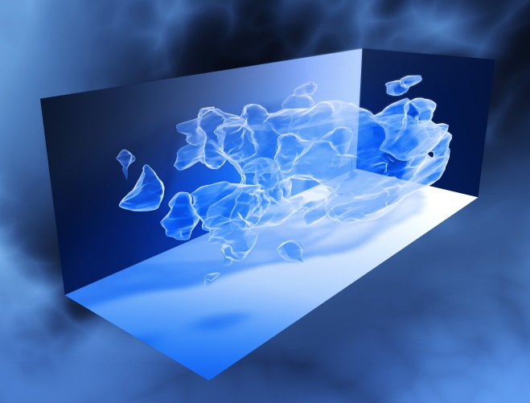
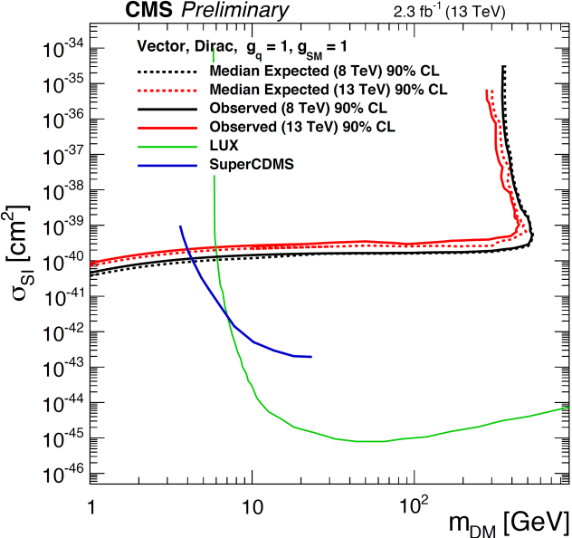
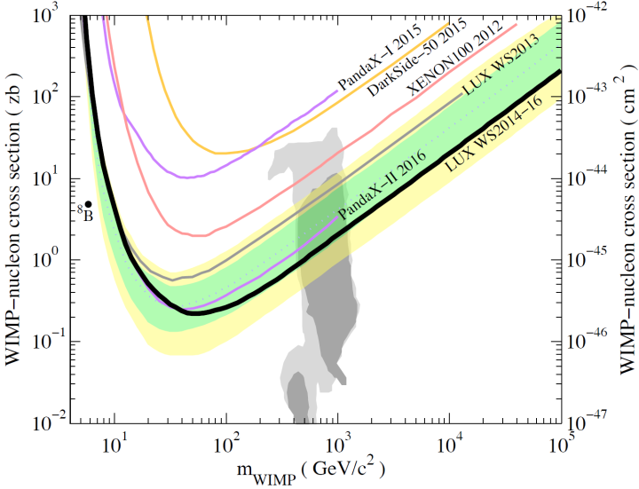
Dark matter
Various gravitational evidences, but no direct evidences …
LUX collaboration (2016)
CMS collaboration (2016)

Slide 3
New scenarios secluded from SM
No interaction between DM and SM?
DM
mediator
Various scenarios in light of theoretical and observational motivations
Secluded WIMP dark matter
M. Pospelov, A. Ritz, M. B. Voloshin, PLB (2007)
N. Arkani-Hamed, D. P. Finkbeiner, T. R. Slatyer, N. Weiner, PRD (2009)
SM
SIMP dark matter
Y. Hochberg, E. Kuflik, T. Volansky, J. G. Wacker, PRL (2014)
Y. Hochberg, E. Kuflik, H. Murayama, T. Volansky, J. G. Wacker, PRL (2015)
Cannibal dark matter
E. D. Carlson, M. E. Machacek, L. J. Hall, APJ (1992)
D. Pappadopulo, J. T. Ruderman, G. Trevisan, PRD (2016)
Impeded dark matter
J. Kopp, J. Liu, T. Slatyer, X. Wang, W. Kue, arXiv1609.02174 (2016)
etc.

Slide 4
New scenarios secluded from SM
No interaction between DM and SM?
DM
mediator
Various scenarios in light of theoretical and observational motivations
Secluded WIMP dark matter
M. Pospelov, A. Ritz, M. B. Voloshin, PLB (2007)
N. Arkani-Hamed, D. P. Finkbeiner, T. R. Slatyer, N. Weiner, PRD (2009)
Mediator lifetime plays an important role to determine the DM relic density, particularly
in DM-mediator degenerated scenario
SM
SIMP dark matter
Y. Hochberg, E. Kuflik, T. Volansky, J. G. Wacker, PRL (2014)
Y. Hochberg, E. Kuflik, H. Murayama, T. Volansky, J. G. Wacker, PRL (2015)
Cannibal dark matter
E. D. Carlson, M. E. Machacek, L. J. Hall, APJ (1992)
D. Pappadopulo, J. T. Ruderman, G. Trevisan, PRD (2016)
Impeded dark matter
J. Kopp, J. Liu, T. Slatyer, X. Wang, W. Kue, arXiv1609.02174 (2016)
etc.

Slide 5
Aim and outline
Aim of work
Analysis of mediator lifetime dependence on
the relic density in secluded dark matter scenario
Toy model and analytic calculation
Outline
Numerical analysis
Summary

Slide 6
Toy model and formulation
Toy model to illustrate new thermal relic scenario
Boltzmann Eq. in the new scenario
Parameter space wherein the mediator lifetime controls the relic density

Slide 7
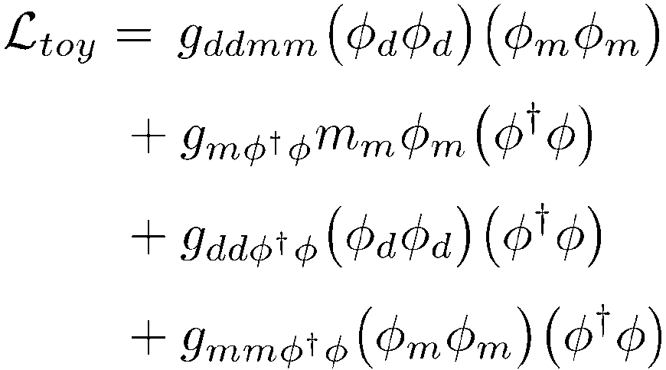
Toy model
SM＋ dark matter $φ_{d}$ ＋ mediator $φ_{m}$
Dark sector with degenerated in mass: $m_{d}≃m_{m}$
Communicator between dark sector and SM: SM Higgs $φ$
Our idea holds for other scenarios in which communicator is not SM Higgs

Slide 8
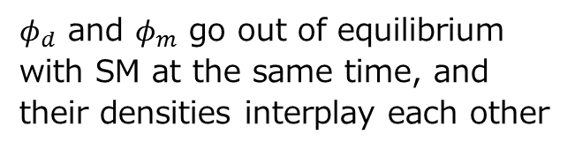

Toy model (important point)
SM＋ dark matter $φ_{d}$ ＋ mediator $φ_{m}$
Dark sector with degenerated in mass: $m_{d}≃m_{m}$
Communicator between dark sector and SM: SM Higgs $φ$
Important: strong interaction between $φ_{d}$ and $φ_{m}$
$φ_{d}$ and $φ_{m}$ go out of equilibrium
with SM at the same time, and their densities interplay each other
Necessary to solve a system of evolution equations

Slide 9
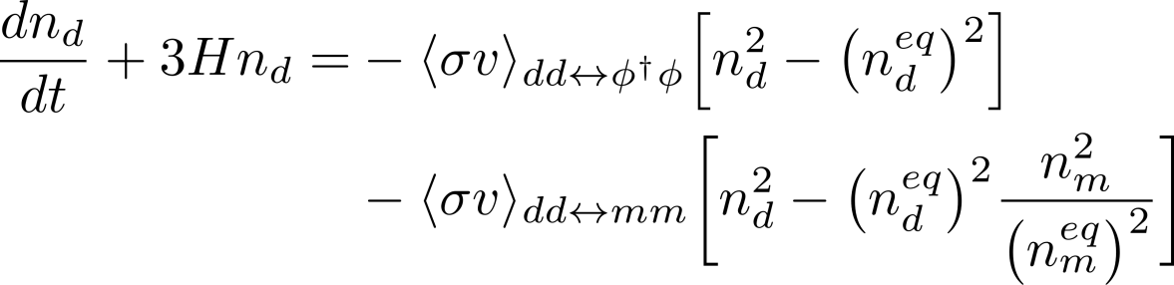
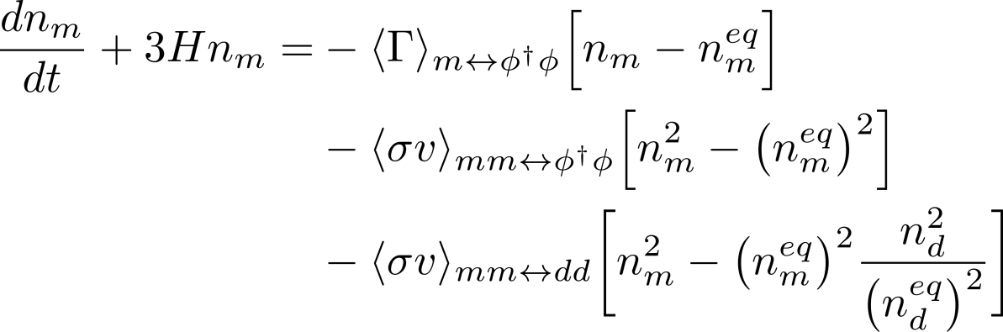




Evolution Eq. (Boltzmann Eq.)
Boltzmann Eqs. for $n_{d}$ and $n_{m}$
$H:$Hubble parameter
$〈σv〉:$thermal averaged cross section
$〈Γ〉:$thermal averaged decay rate

Slide 10
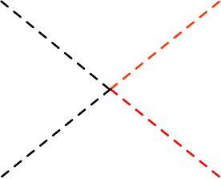
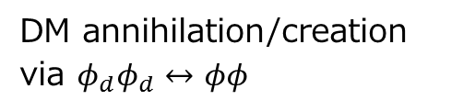




Evolution Eq. (Boltzmann Eq.)
DM annihilation/creation via $φ_{d}φ_{d}↔φφ$
Boltzmann Eqs. for $n_{d}$ and $n_{m}$
Our scenario holds even
in the absence of the term
Our relic scenario works
also in scenarios wherein
DM is secluded from SM
$$d$$
$$φ$$
$$d$$
$$φ$$

Slide 11
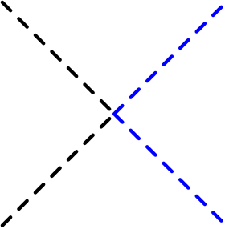
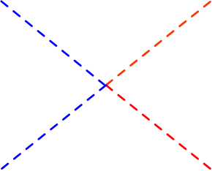





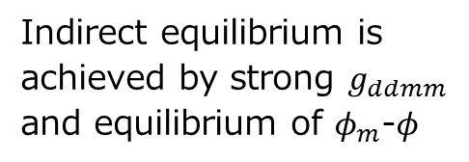



Evolution Eq. (Boltzmann Eq.)
Boltzmann Eqs. for $n_{d}$ and $n_{m}$
Our scenario holds even
in the absence of the term
why???
Indirect equilibrium is achieved by strong $g_{ddmm}$ and equilibrium of $φ_{m}$-$φ$
$$d$$
$$m$$
$$m$$
$$φ$$
$$d$$
$$φ$$
+
indirectly
$$d$$
$$m$$
$$m$$
$$φ$$
$$d$$
$$φ$$

Slide 12


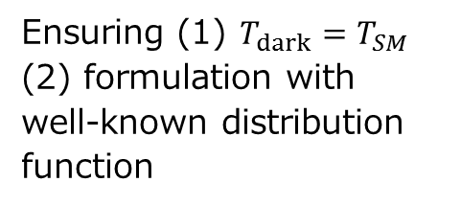



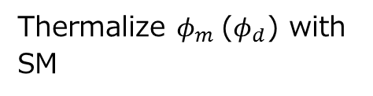



Evolution Eq. (Boltzmann Eq.)
$$m$$
$$φ$$
Boltzmann Eqs. for $n_{d}$ and $n_{m}$
$$m$$
$$φ$$
Thermalize $φ_{m}$ ($φ_{d}$) with SM
Ensuring (1) $T_{dark}=T_{SM}$ (2) formulation with well-known distribution function
$$d$$
$$m$$
DM density can vary through only this process
DM density is fixed when this process is frozen
$$d$$
$$m$$

Slide 13
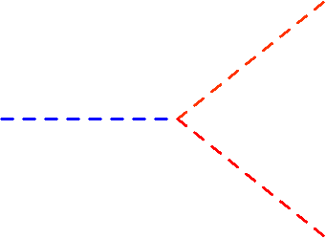


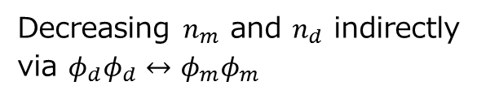

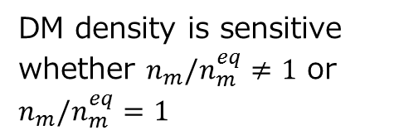
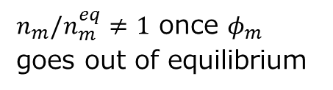

Evolution Eq. (Boltzmann Eq.)
Boltzmann Eqs. for $n_{d}$ and $n_{m}$
$n_{m}/n_{m}^{eq}≠1$ once $φ_{m}$ goes out of equilibrium
DM density is sensitive whether $n_{m}/n_{m}^{eq}≠1$ or $n_{m}/n_{m}^{eq}=1$
Important: $φ_{m}$ can go out of equilibrium or not
$$φ$$
$$m$$
Decreasing $n_{m}$ and $n_{d}$ indirectly
via $φ_{d}φ_{d}↔φ_{m}φ_{m}$
$$φ$$

Slide 14
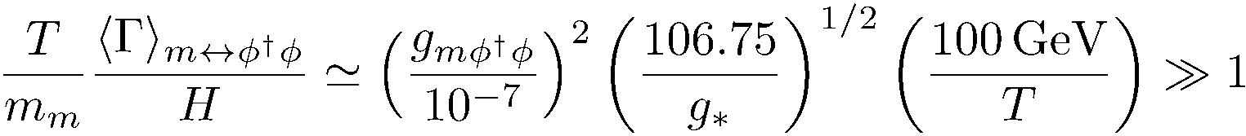
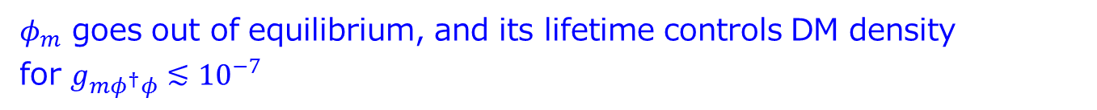
Parameter space where lifetime controls DM density
Condition to maintain the equilibrium of $φ_{m}$ and SM
derived in our paper
$φ_{m}$ cannot go out of equilibrium for $g_{mφ^{†}φ}≳{10}^{−7}$
$n_{m(d)}=n_{m(d)}^{eq}∼e^{−m_{m(d)}/T}$, and are fixed when $φ_{d}φ_{d}↔φ_{m}φ_{m}$ freezes out
Well-known thermal relic scenario (but, annihilation to $φ_{m}$, not SM particles)
$φ_{m}$ goes out of equilibrium, and its lifetime controls DM density
for $g_{mφ^{†}φ}≲{10}^{−7}$

Slide 15
Numerical analysis
Evolution of DM density
Relation of DM relic density and mediator lifetime

Slide 16
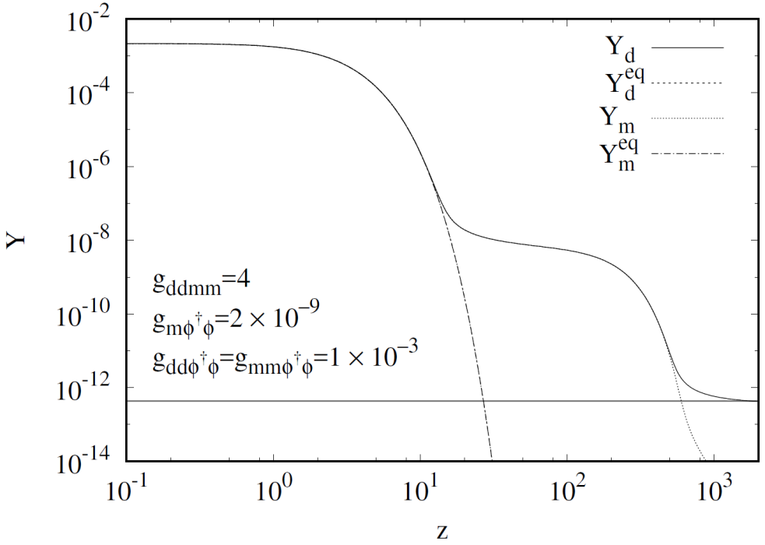
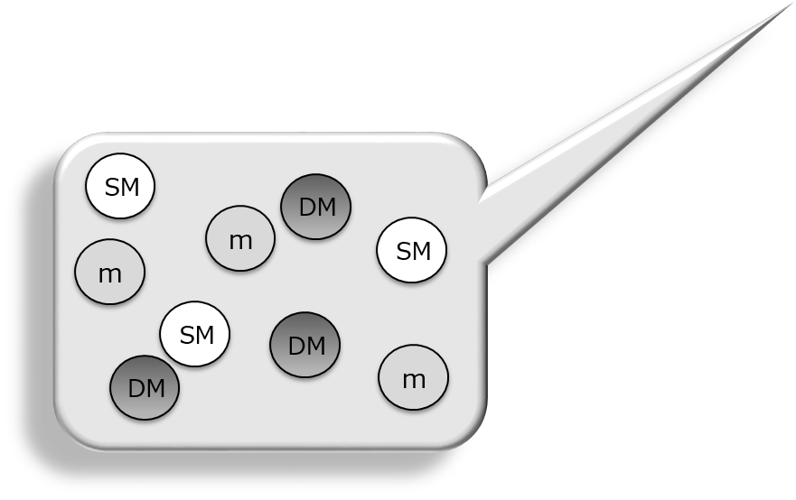
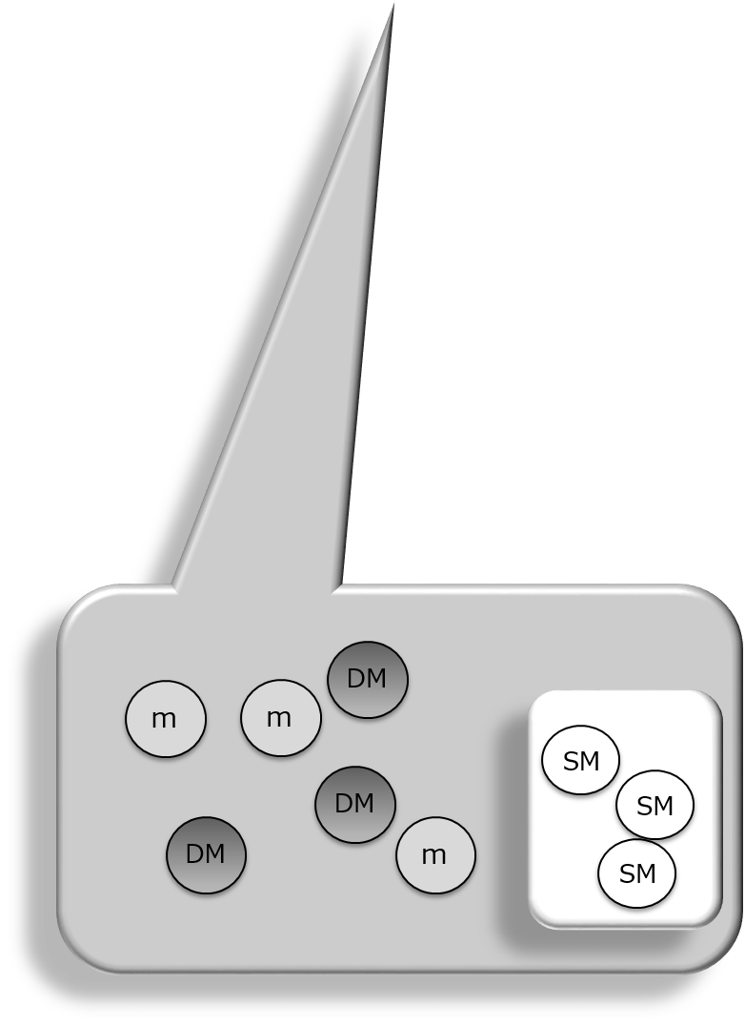
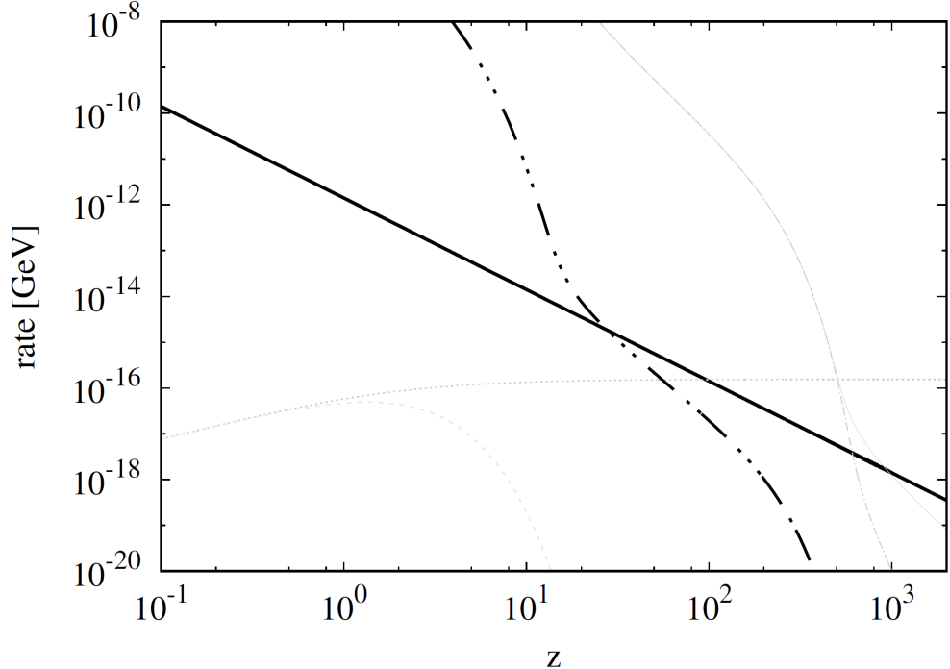







Evolution : stage 1
$$H$$
$${〈σv〉}_{mmφφ}n_{m}$$
$${〈Γ〉}_{D}$$
$${〈σv〉}_{ddmm}n_{d}$$
$${〈Γ〉}_{ID}$$
$${〈σv〉}_{mmdd}n_{m}$$

Slide 17

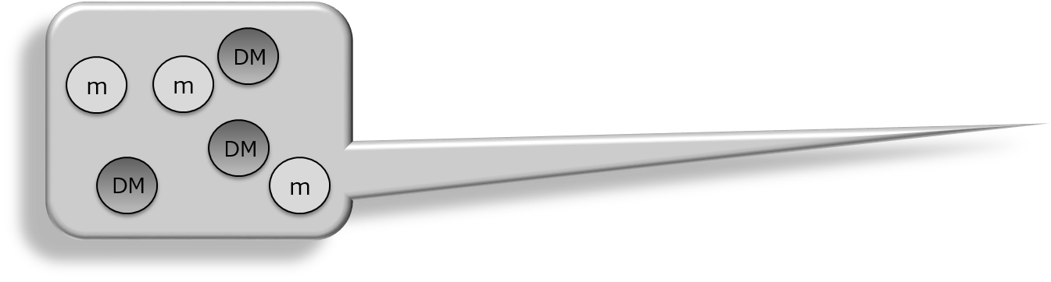
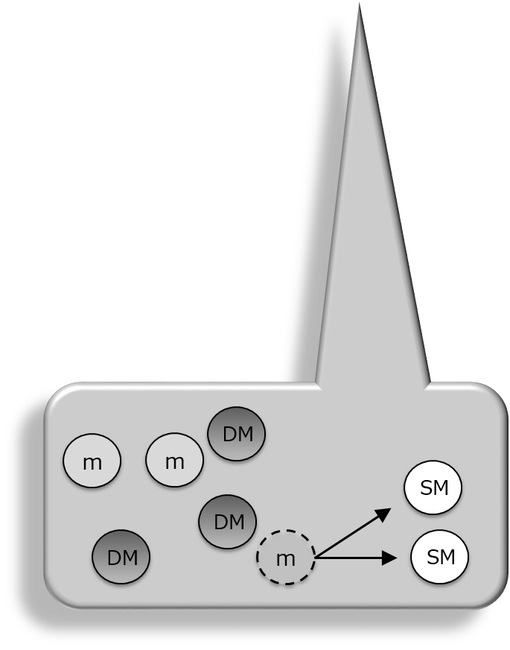
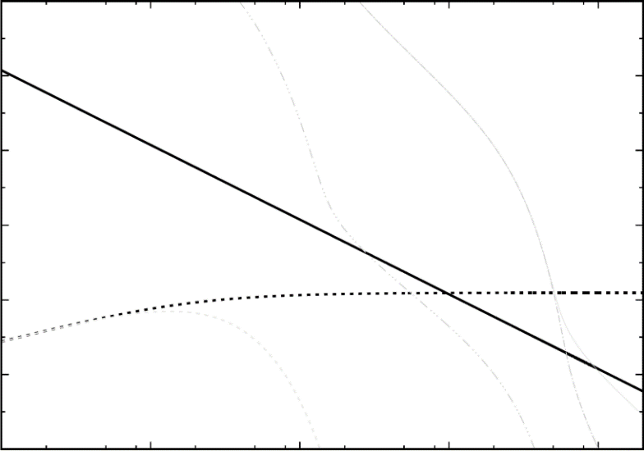



Evolution : stage 2
Fake freeze out
$$H$$
$${〈σv〉}_{mmφφ}n_{m}$$
$${〈Γ〉}_{D}$$
$${〈σv〉}_{ddmm}n_{d}$$
$${〈Γ〉}_{ID}$$
$${〈σv〉}_{mmdd}n_{m}$$

Slide 18
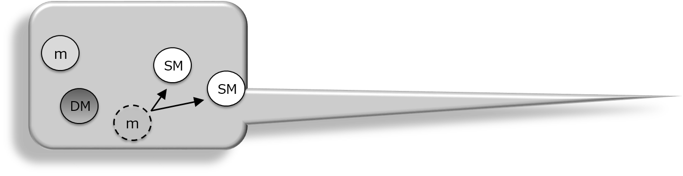

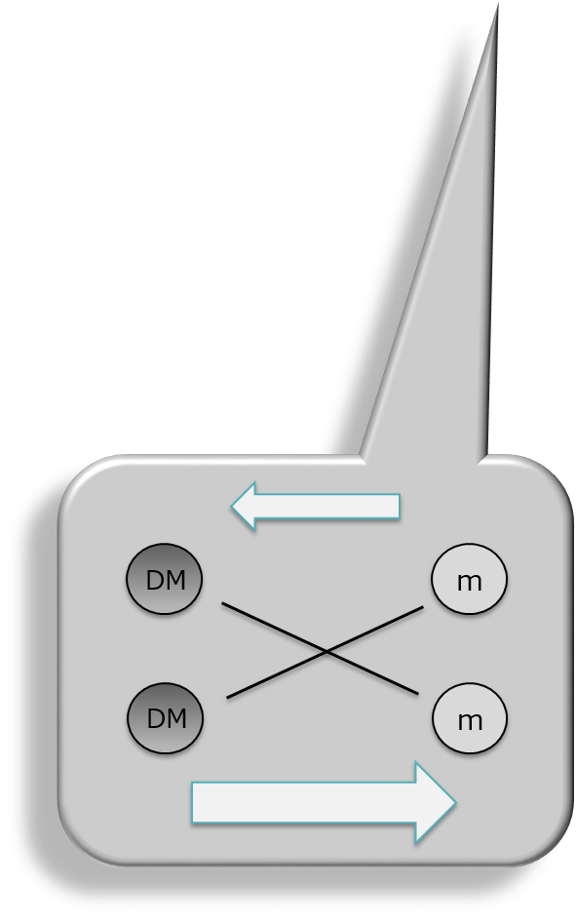
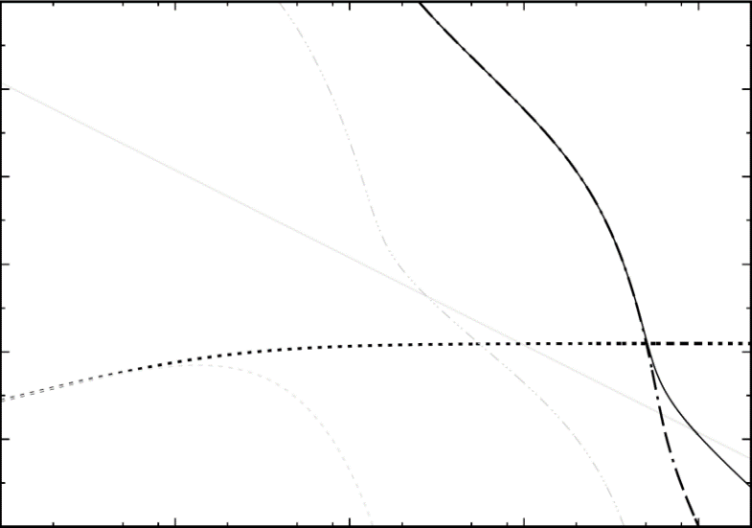





Evolution : stage 3
$n_{d}$ traces $n_{m}$ and decreases
∴
$$H$$
$${〈σv〉}_{mmφφ}n_{m}$$
Violation of detailed valance due to
$${〈Γ〉}_{D}$$
$${〈σv〉}_{ddmm}n_{d}$$
$${〈Γ〉}_{ID}$$
$${〈σv〉}_{mmdd}n_{m}$$

Slide 19

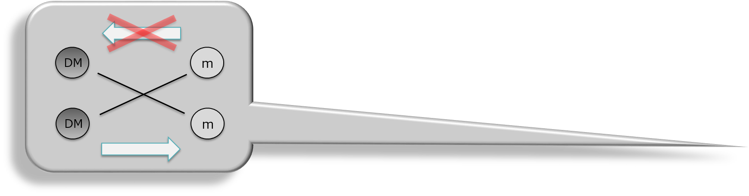
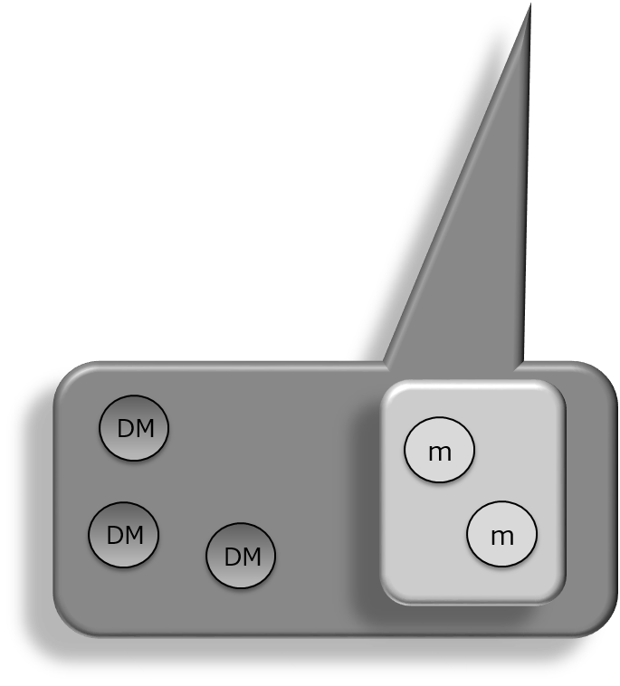
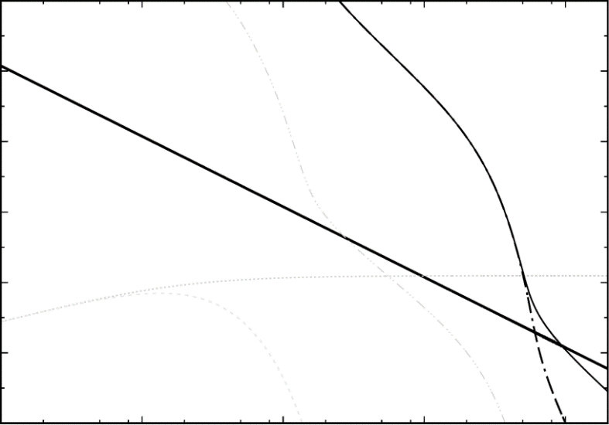
Evolution : stage 4
$$H$$
$${〈σv〉}_{mmφφ}n_{m}$$
True freeze out
$${〈Γ〉}_{D}$$
$${〈σv〉}_{ddmm}n_{d}$$
$${〈Γ〉}_{ID}$$
$${〈σv〉}_{mmdd}n_{m}$$

Slide 20
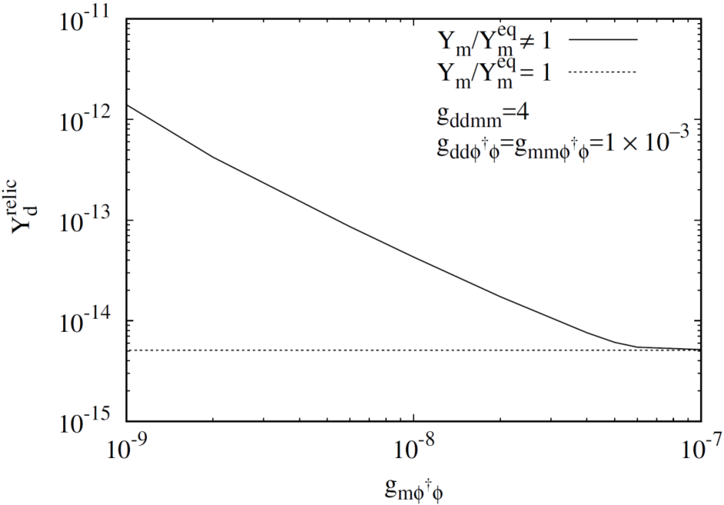
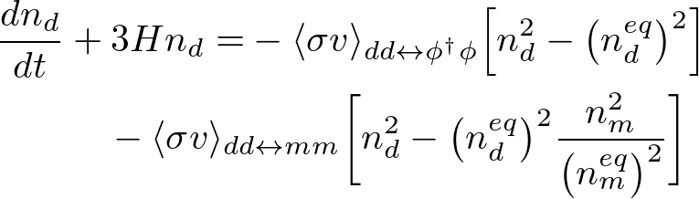
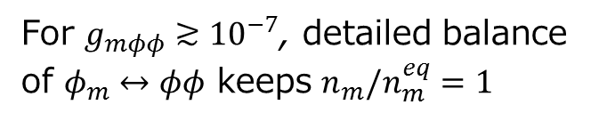
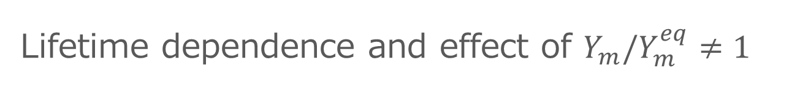
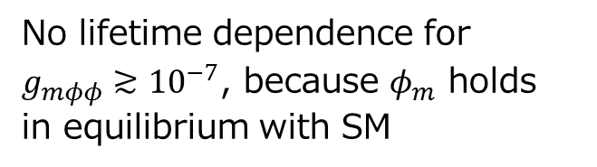

Lifetime dependence and effect of $Y_{m}/Y_{m}^{eq}≠1$
No lifetime dependence for
$g_{mφφ}≳{10}^{−7}$, because $φ_{m}$ holds
in equilibrium with SM
Lifetime dependence on DM relic density
consistent with the condition analytically derived
For $g_{mφφ}≳{10}^{−7}$, detailed balance of $φ_{m}↔φφ$ keeps $n_{m}/n_{m}^{eq}=1$
DM evolves regardless of mediator
短寿命
Long-lived
Short-lived
$$=1$$

Slide 21
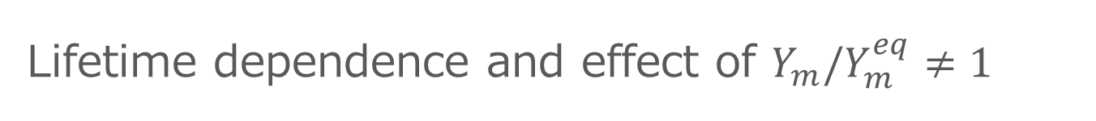
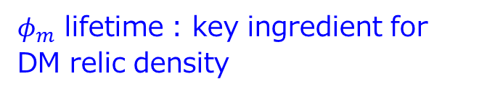
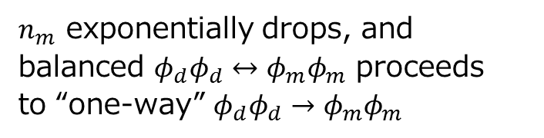
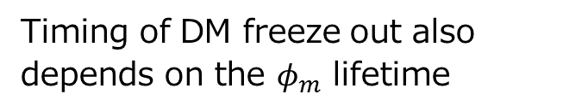
Lifetime dependence and effect of $Y_{m}/Y_{m}^{eq}≠1$
Timing of DM freeze out also depends on the $φ_{m}$ lifetime
Lifetime dependence on DM relic density
$n_{m}$ exponentially drops, and
balanced $φ_{d}φ_{d}↔φ_{m}φ_{m}$ proceeds
to “one-way” $φ_{d}φ_{d}→φ_{m}φ_{m}$
$φ_{m}$ lifetime : key ingredient for
DM relic density
短寿命
Long-lived
Short-lived

Slide 22
Summary

Slide 23
Summary
DM scenarios secluded from SM are activated from the viewpoint
of observational motivations/constraints
Theoretical viewpoint suggests $O(TeV)$ DM with degenerated mediator
Over-abundant DM in previous scenarios with long-lived mediator
due to too small DM annihilation rate
New relic scenario wherein mediator decouples from SM with DM, and the lifetime controls DM density via decaying before freeze out of DM
Toy model with Higgs communicator accounts for the observed density
Our idea holds for other scenarios in which communicator is not Higgs

Slide 24
Thank you very much!

Slide 25
Backup slides

Slide 26
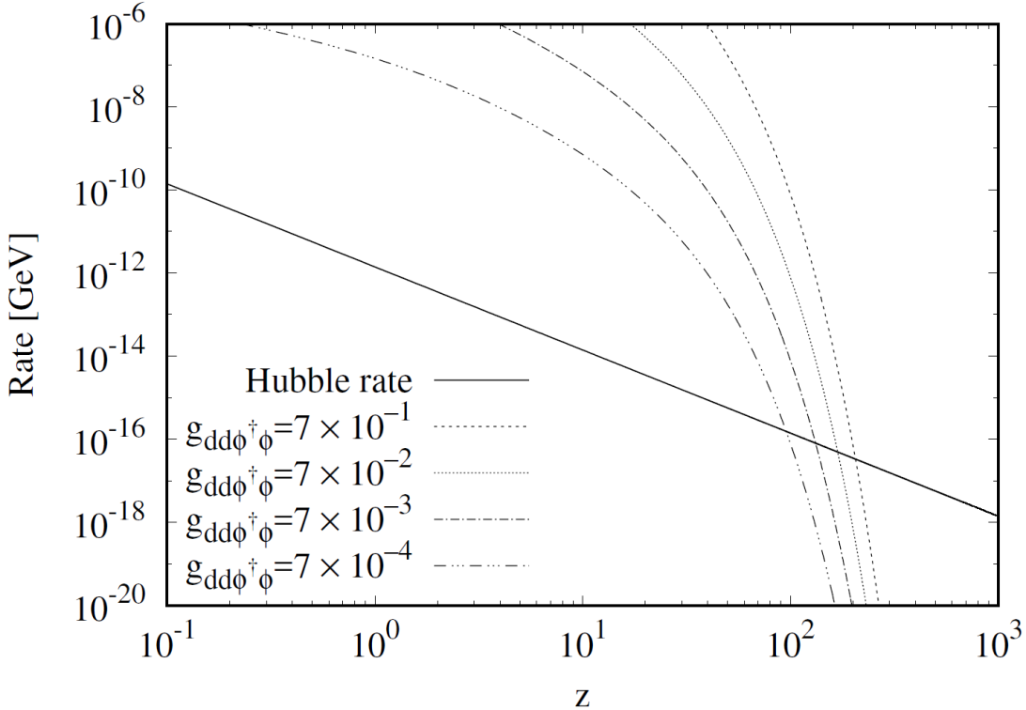

ダークセクター温度は標準模型セクターと同じ？

Slide 27
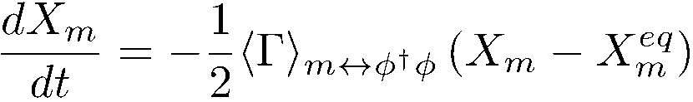

Condition that lifetime controls DM density (derivation)
Only $φ_{m}↔φ^{†}φ$ for the process of $φ_{m}$ and SM$@ T<m_{m}$
Rewriting Boltzmann Eq. in terms of ${X_{m}=n}_{m}R^{3} (R$: scale factor$)$
$φ_{m}$ goes out of equilibrium at $t_{0}$, then $X_{m}=X_{m}^{eq}+Ce^{−〈Γ〉Δt/2}$ at $t_{0}+Δt$
$φ_{m}$ immediately goes back to equilibrium as long as

Slide 28
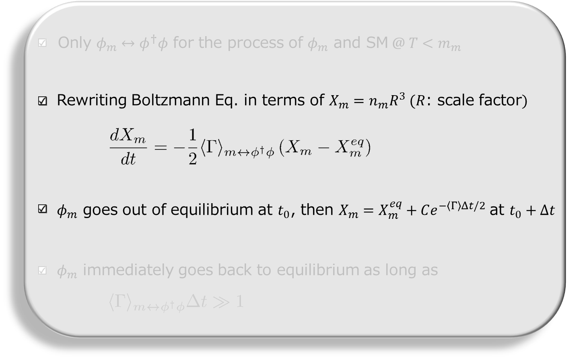
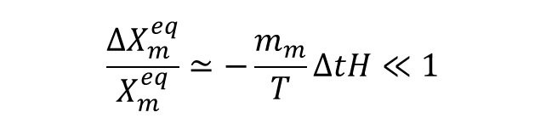
Condition that lifetime controls DM density (derivation)
Assumption in this step “constant $X_{m}^{eq}$ in $Δt$”
Requirement for justification: $ΔX_{m}^{eq}/X_{m}^{eq}≪1$ in $Δt$
$$\frac{ΔX_{m}^{eq}}{X_{m}^{eq}}≃−\frac{m_{m}}{T}ΔtH≪1$$

Slide 29
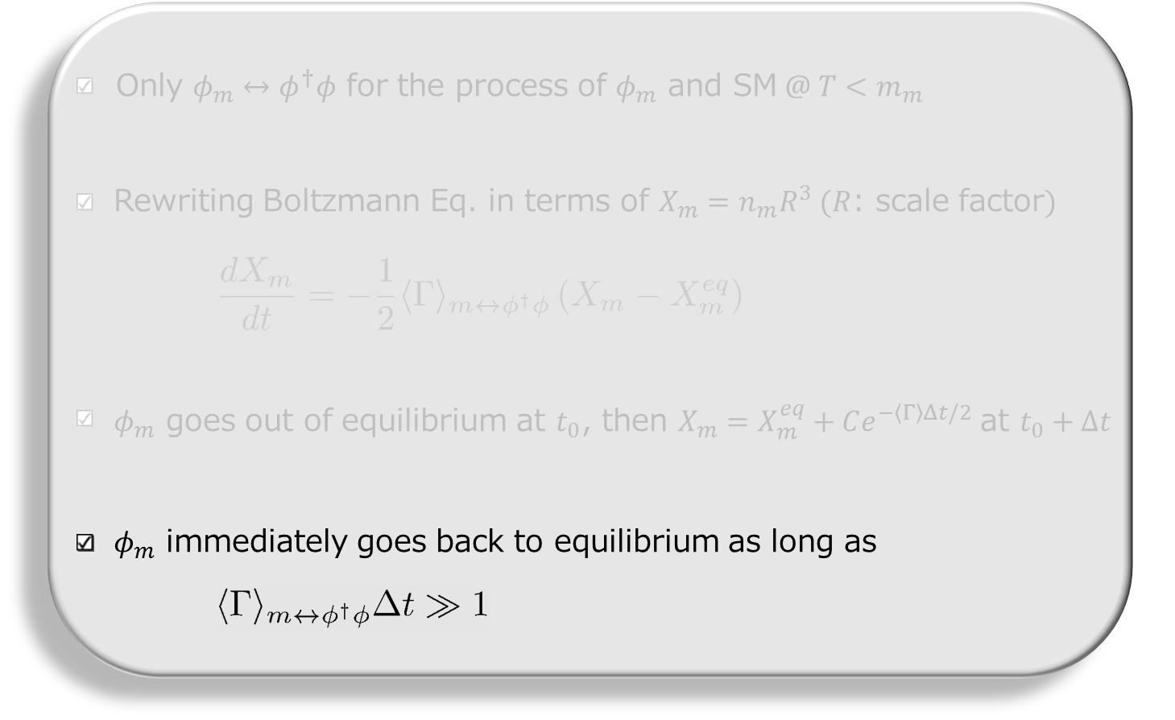
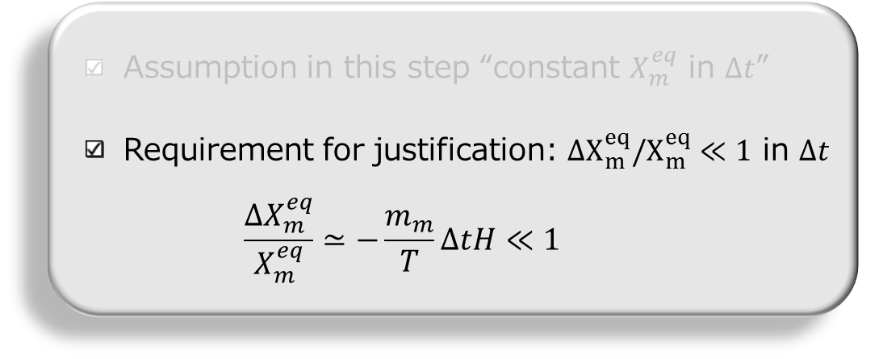

Condition that lifetime controls DM density (derivation)
Condition to maintain the equilibrium of $φ_{m}$ by combining inequalities

Slide 30



In other parameter cases
Lifetime can control DM density even for different interaction strength of $φ_{d}$-$φ_{m}$ and/or $φ_{d(m)}$-$φ$
Holds for various models and scenarios

Slide 31






Relic density in degenerated DM-mediator system
Previous scenarios can not account for the observed density
in degenerated system (solid)
Contour of observed DM density
X: mass ratio of DM and mediator
Y: coupling of $φ_{d}φ_{d}φ_{m}φ_{m}$
Our scenario successfully yields the observed DM density even in DM-Med. degenerated system
Novel possibility of DM model buildings is introduced wherein
$φ_{d}$ and $φ_{m}$ are unified in a dark symmetry multiplet

Slide 32

Ex. 1: Secluded DM scenario
Framework : SM + DM + mediator
DM annihilates into only mediator
Mediator decays into SM particles after freeze out of DM density
Requirement to account for observed DM density: $m_{DM}≫m_{m}$
DM density $∝{\left(σv_{DM→M}\right)}^{−1}∝{\left(s−{4m}_{m}^{2}\right)}^{−1}≃{\left(4m_{DM}^{2}−{4m}_{m}^{2}\right)}^{−1}$
Feature: Cosmic ray anomaly can be reproduced by selecting
daughter particles with tuned $m_{m}$

Slide 33


Ex. 2: SIMP DM scenario
Framework : SM + DM + mediator
Decreasing DM density through
$DM+DM+DM→DM+DM$
Getting cold daughter DM by
transporting DM energy to SM
Requirement to account for observed DM density: $m_{DM}∼O(100MeV)$
Reaction rate: $n_{DM}^{2}{〈σv^{2}〉}_{3→2}≃{(m}_{DM}{T)}^{3}{\left(e_{}^{−m_{DM}/T}\right)}^{2}⋅(α_{eff}^{3}/m_{DM}^{5})$
Feature: shortcoming of small scale structure can be explained by strong self-interaction of DM

Slide 34

Scenario: Heavy DM with degenerated mediator
Can DM density be observed one in such a scenario?
Seems to be impossible due to small phase space and unitarity bound on the coupling
Key ingredient:
Mediator lifetime, which can make the impossible possible

Slide 35





Evolution : stage 1
$1$
Thermalization of dark sector via scatterings with SM particles
Reaction rate ${〈σv〉}_{mmφφ}n_{m}$
becomes smaller than $H$
$10$
$$H$$
$${〈σv〉}_{mmφφ}n_{m}$$
$φ_{d}$ and $φ_{m}$ decouple from equilibrium with SM
$${〈Γ〉}_{D}$$
$${〈σv〉}_{ddmm}n_{d}$$
$${〈Γ〉}_{ID}$$
$${〈σv〉}_{mmdd}n_{m}$$
$$z=m_{d}/T$$

Slide 36






Evolution : stage 2
$10$
Mediator decay rate ${〈Γ〉}_{D}$
is smaller than $H$
$φ_{d}$ and $φ_{m}$ densities are temporarily frozen
(“terrace” structure)
${10}^{2}$
$$H$$
$${〈σv〉}_{mmφφ}n_{m}$$
Mediator decay becomes
active, because ${〈Γ〉}_{D}>H$
$${〈Γ〉}_{D}$$
Mediator density starts
to decrease exponentially
$${〈σv〉}_{ddmm}n_{d}$$
$${〈Γ〉}_{ID}$$
$${〈σv〉}_{mmdd}n_{m}$$
$$z=m_{d}/T$$

Slide 37






Evolution : stage 3
${10}^{2}$
Due to large rate of $φ_{d}φ_{d}↔φ_{m}φ_{m}$,
$φ_{d}$ density tracks decreasing $φ_{m}$ density
${〈Γ〉}_{D}$ exceeds interaction rates ${〈σv〉}_{ddmm}n_{d}$ and ${〈σv〉}_{mmdd}n_{m}$
${10}^{3}$
$$H$$
$${〈σv〉}_{mmφφ}n_{m}$$
Large gap of $φ_{d}$ and $φ_{m}$ density breaks detailed balance of $φ_{d}φ_{d}↔φ_{m}φ_{m}$
$${〈Γ〉}_{D}$$
$${〈σv〉}_{ddmm}n_{d}$$
$${〈Γ〉}_{ID}$$
$${〈σv〉}_{mmdd}n_{m}$$
$$z=m_{d}/T$$
Detail will be illustrated soon

Slide 38





Evolution : stage 4
${10}^{3}$
${〈σv〉}_{mmdd}n_{m}<H$, and
$φ_{m}φ_{m}→φ_{d}φ_{d}$ is frozen
${〈σv〉}_{ddmm}n_{d}<H$, and
$φ_{d}φ_{d}→φ_{m}φ_{m}$ is also frozen
${10}^{4}$
True freeze out of DM
via the decoupling from mediator
$$H$$
$${〈σv〉}_{mmφφ}n_{m}$$
$${〈Γ〉}_{D}$$
Observed DM density is obtained in DM-mediator degenerated system
$${〈σv〉}_{ddmm}n_{d}$$
$${〈Γ〉}_{ID}$$
$${〈σv〉}_{mmdd}n_{m}$$
$$z=m_{d}/T$$

