Slide 1
Streaming Analytics with Spark
Magnoni Luca
IT-CM-MM
Notes:
Tim: A few slides to describe the various scenarios/investigations done would be usef
Mail
As mentioned before, we are hoping to learn from your experience with
large scale data processing, based on some of the issues we are
currently encountering.
These are some of the topics we were thinking of:
- Data storage
~ database vs noSQL
~ file system storage and POSIX reliance
- Data distribution
~ unified access
~ discoverability
- Messaging queues
~ Handling streams of logging/event data
~ Aggregation
TODO:
Pedro: good snapshot Kibana
Get good Zeppelin screenshot

Slide 2
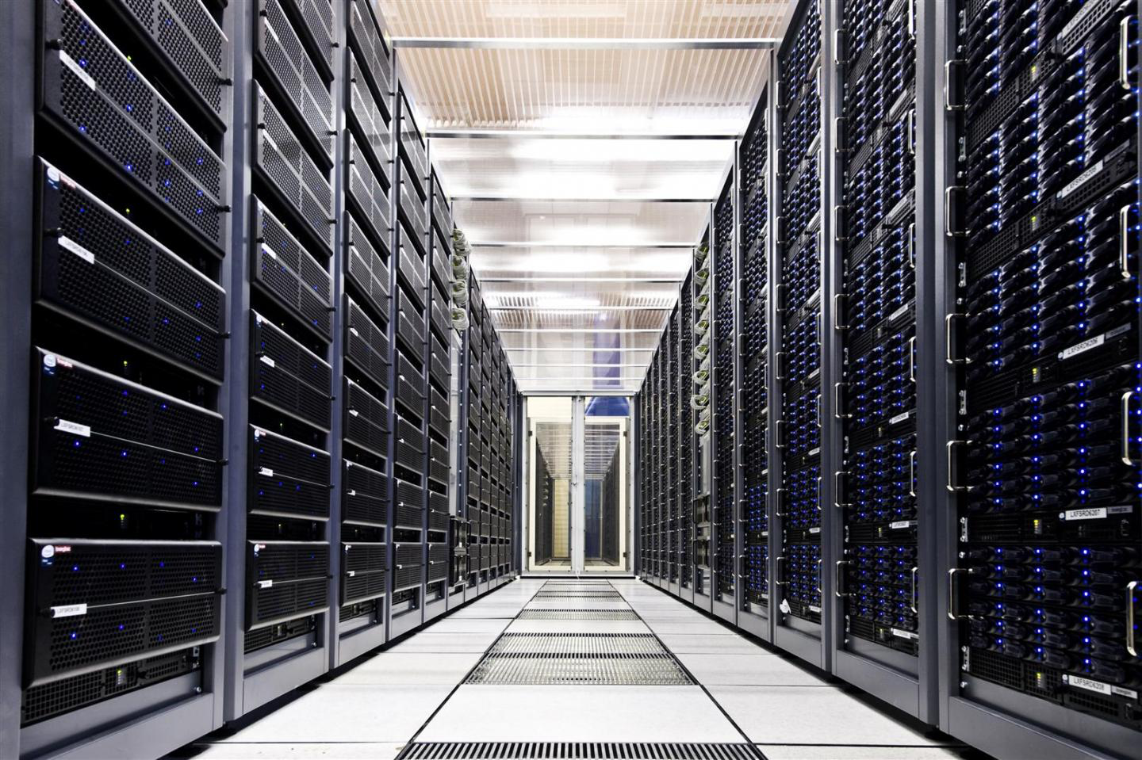
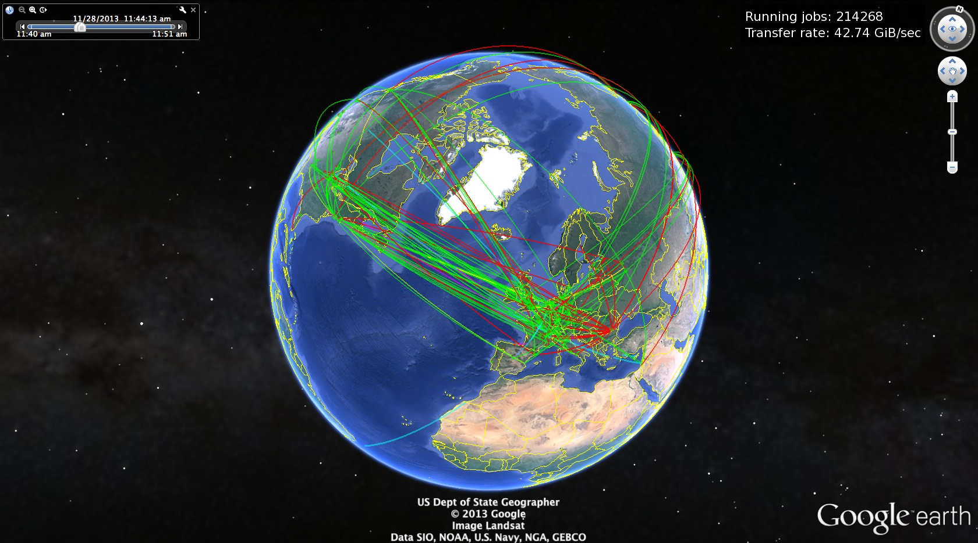
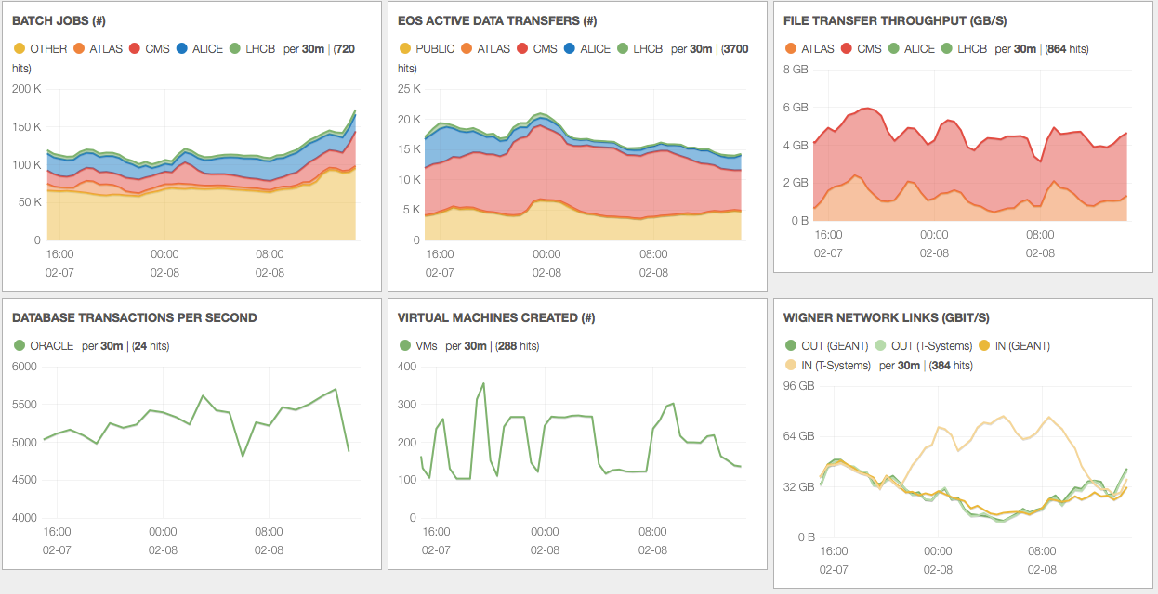
Monitoring @ CERN
Provide monitoring facilities for CERN Data Centers and WLCG Infrastructure
{\"unique_id\":\"30fbed9e-975b-11e4- 972217-5b82e4a9beef-4 ef6f2e\", \"file_lfn\":\"/store/mc/Fall-foo/QCD_Pt-80to1220_Tune4C_13TeV_pythia8/GEN-SIM-RAW/castor_tsg_40bx25_POSTLS32162_V2-v1/20000/6C4FDD71-1884-E3311-9FC2-3\":\"0\", \"read_max\":\"0\", \"read_average\":\"0.000000\", \"read_sigma\":\"0.000000\", \"read_single_bytes\":\"0\", \"read_single_operations\":\"0\", \"read_single_min\":\"0\", \"read_single_max\":\"0\", \"read_single_average\":\"0.000000\", \"read_single_sigma\":\"0.000000\", \"read_vector_bytes\":\"0\", \"read_vector_operations\":\"0\", \"read_vector_min\":\"0\", \"read_vector_max\":\"0\", \"read_vector_average\":\"0.000000\", \"read_vector_sigma\":\"0.000000\", \"read_vector_count_min\":\"0\", \"read_vector_count_max\":\"0\", \"read_vector_count_average\":\"0.000000\", \"read_vector_count_sigma\":\"0.000000\", \"write_bytes\":\"0\", \"write_operations\":\"0\", \"write_min\":\"0\", \"write_max\":\"0\", \"write_average\":\"0.000000\", \"write_sigma\":\"0.000000\", \"read_bytes_at_close\":\"0\", \"write_bytes_at_close\":\"0\", \"user_dn\":\"/DC=ch/DC=cern/OU=Organic Units/OU=Users/CN=foo/CN=11223344/CN=HomerSimpson\", \"user_vo\":\”none\", \"user_role\":\"NULL\", \"user_fqan\":\"/none\", \"client_domain\":\”springfield.us\", \"client_host\":\”\", \"server_username\":\"\", \"user_protocol\":\"xroot\", \"app_info\":\"39_https://glidein.cern.ch/39/150318:193421:capalmer:crab:QCD80:March18_039_https://glidein.cern.ch/39/1318:19342:crab:QCD80:March18_0\", \"server_domain\":\"brunel.ac.uk\", \"server_host\":\"dc-grid-pool-a4-03\", \"server_site\":\"UKI-LT2-Brunel\"}"

Slide 3









Monitoring Architecture & Tools
Data
Sources
Transport
Storage
View
Data
Centers
~ 15 K
nodes
elasticsearch
Processing
WLCG
Sites
&
Services
kafka
Notes:
Simplified workflow, mainstream technology
Identify key functionaluti Focus on few technology on each block

Slide 4
Apache Spark
Distributed large-scale data processing engine
Most active Apache project in 2014
Simpler and faster than Hadoop/MapReduce
  One framework for batch, streaming, SQL, iterative,…
Giraph
Dremel
MapReduce
Mahout
Tez
Spark
Pig
Storm
…
General Batch
Processing
General Unified
Engine
Specialized Systems
(iterative, interactive, ML, streaming…)
~ 2004
~ 2014
time

Slide 5
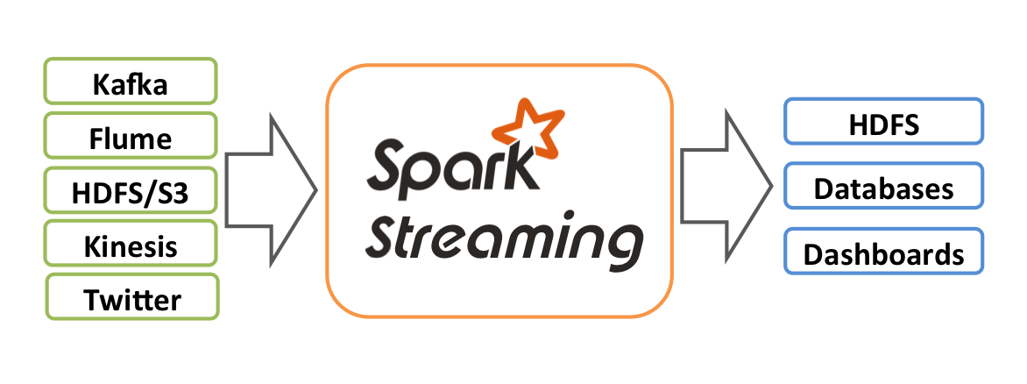
Spark Streaming
Distributed analysis of data streams
  Micro-batch computation
Scalable, High-Throughput, Fault-Tolerant
Processing latency “as low as” few seconds
Source: http://spark.apache.org/docs/latest/streaming-programming-guide.html
Notes:
P 270

Slide 6
Data Transport for Streaming
Streaming relies on transport to serve data as it is produced, at scale & speed
Tool-chain @ CERN:
  Collection/Aggregation of metrics and logs
    Flume, one agent on each data centers node
  Reliable and scalable data consumption
    Kafka, as distributed high-volume
    publish/subscribe messaging system
  External producers
    ActiveMQ (AMQ) over STOMP

Slide 7
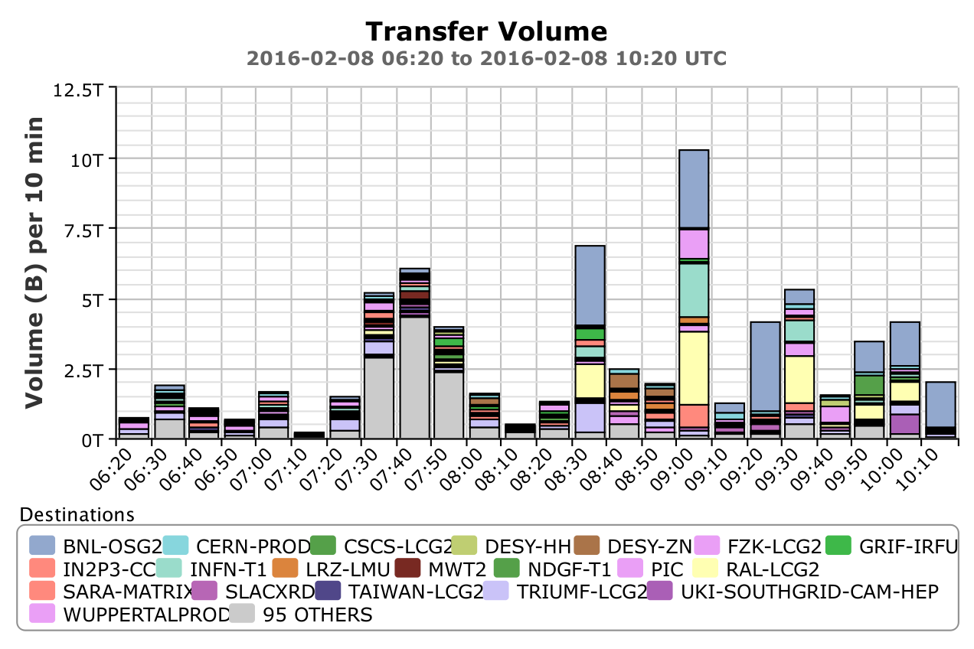
Spark examples @ CERN:
WLCG Data Transfers dashboards

Slide 8
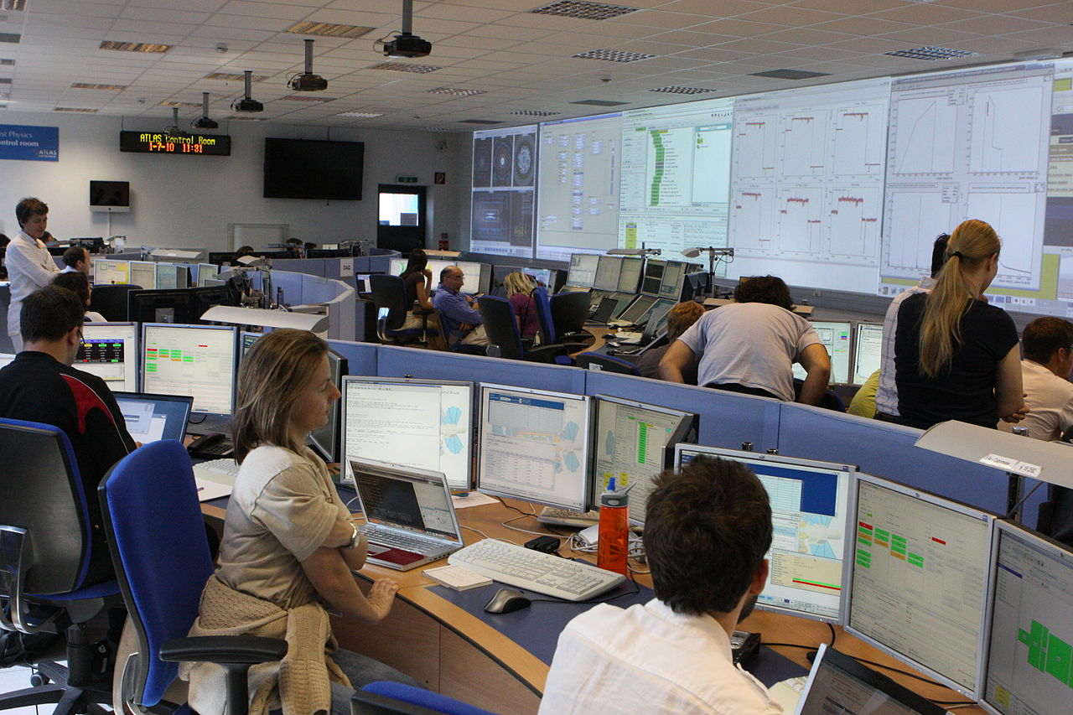
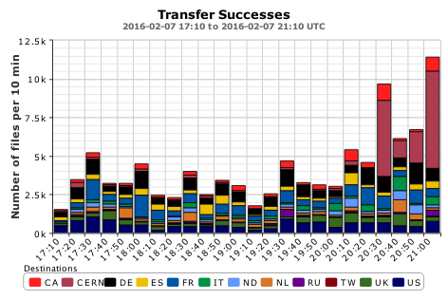
Spark examples @ CERN:
WLCG Data Transfers dashboards
~ 100 GB/day of monitoring data (data transfers and access logs) to be gathered and processed
Compute and Aggregate over time the data transfer activities across WLCG sites from raw operation logs
ATLAS DDM
CERN IT
Hadoop
FTS
Spark Batch &
Streaming Jobs
XRootD
AMQ / Flume / Kafka
Parse & Transform
Compute statistics
Merge with
previous results
HTTP
Raw JSON
http://cern.ch/wdtmon

Slide 9
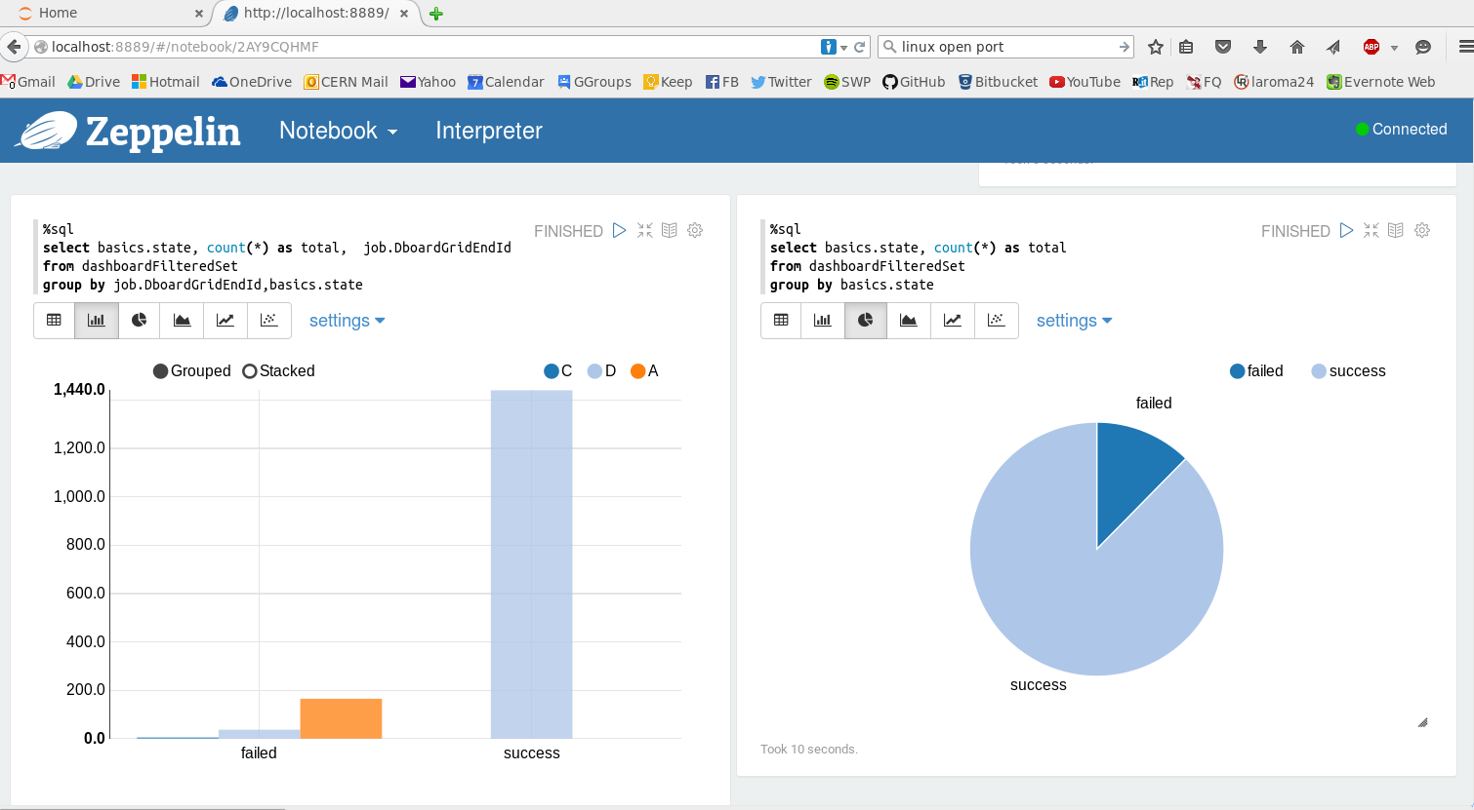
Spark examples @ CERN:
Live analytics
Explore metrics and logs from data centers as they flow
Process the raw information to correlate and make sense of the overall behavior (e.g. multi-node alarms)
Notebooks as a service
Spark Streaming
Jobs
Filter
Aggregate
Detect Patterns
Generate
Alarms
Flume / Kafka
Sensors Metrics
Zeppelin notebook:
Easy and Interactive Analytics
http://foz.cern.ch

Slide 10
More Spark @ CERN
IT Analytics Working Group
  Offline analysis and data exploration
LHC Experiments activities
  ATLAS study on data scrutiny and popularity
Thank you!

