Slide 2
Roles Storage Services
Three main roles
  Storage (store the data)
  Distribution (ensure that data is accessible)
  Preservation (ensure that data is not lost)
Size in PB + performance
Availability
Reliability

Slide 3
“Why” data management ?
Data Management solves the following problems
  Data reliability
  Access control
  Data distribution
  Data archives, history, long term preservation
  In general:
    Empower the implementation of a workflow for data processing

Slide 4

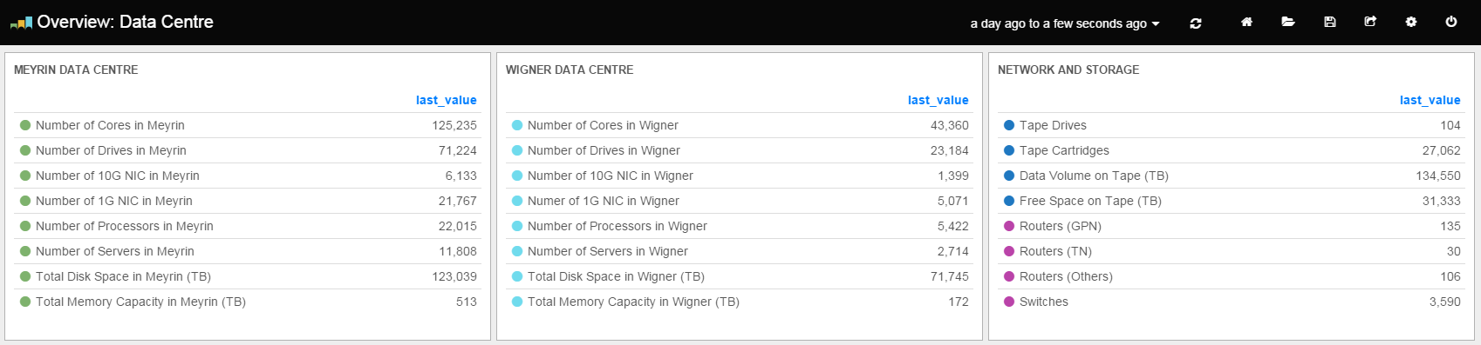





CERN Computing Infrastructure
9-FEB-2016 @ 13:05
CPUs
Network
Databases
Storage
Infrastructure

Slide 5
Storage services
Storage need to be able to adapt to the changing requirement of the experiments
  Cover the whole area of the triangle and beyond
Expensive
Slow
Unreliable

Slide 6
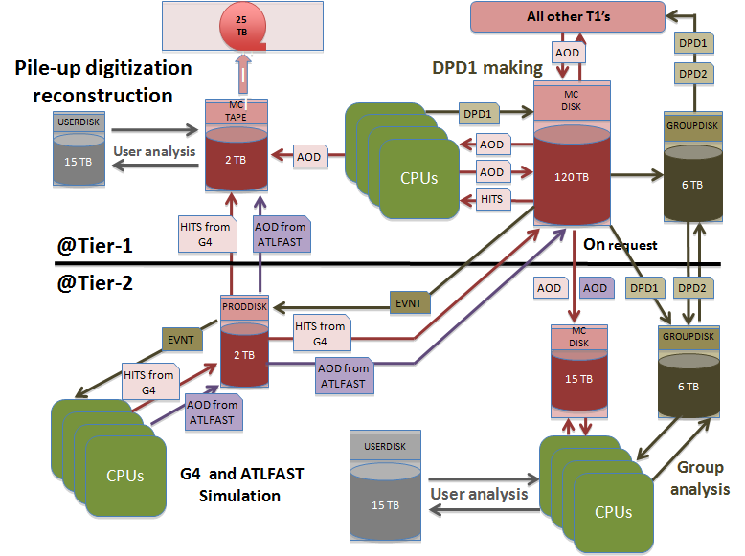
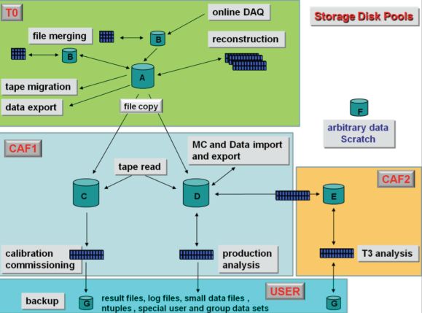
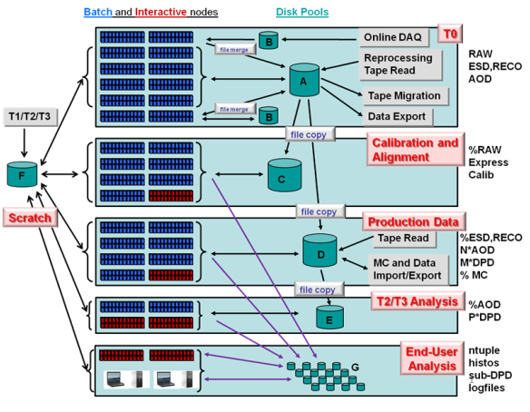
So, … what is data management ?
Examples from LHC experiment data models
Two building blocks to empower data processing
  Data pools with different quality of services
  Tools for data transfer between pools

Slide 7
Why multiple pools and quality ?
Derived data used for analysis and accessed by thousands of nodes
  Need high performance, Low cost, minimal reliability (derived data can be recalculated)
Raw data that need to be analyzed
    Need high performance, High reliability, can be expensive (small sizes)
Raw data that has been analyzed and archived
    Must be low cost (huge volumes), High reliability (must be preserved), performance not necessary

Slide 8
Data pools
Different quality of services
  Three parameters: (Performance, Reliability, Cost)
  You can have two but not three
Expensive
Flash, Solid State Disks
Mirrored disks
Tapes
Disks
Slow
Unreliable

Slide 9
Disk services and geolocalization
Meyrin
Wigner
EOS
140 PB
Ceph
Ceph
5 PB
AFS
AFS
3 PB
CASTOR
25 PB

Slide 10
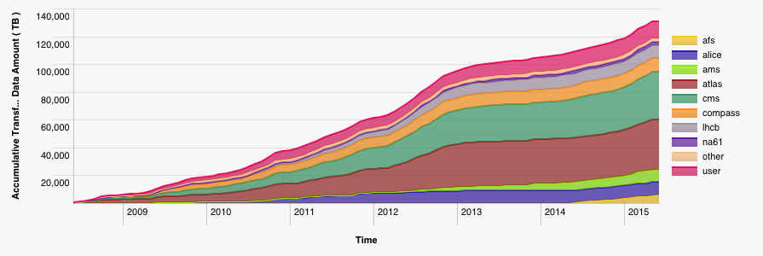
Tape Services
Data:
  ~120 PB physics data (CASTOR)
  ~10 PB backup (TSM)
Tape libraries:
  IBM TS3500 (3+2)
  Oracle SL8500 (4)
Tape drives:
  ~100 archive
Capacity:
  ~70 000 slots
  ~25 000 tapes
Data on tape (2008-2015)

Slide 11

Do we need tapes ?
Tapes have a bad reputation in some use cases
  Slow in random access mode
    high latency in mounting process and when seeking data (F-FWD, REW)
  Inefficient for small files (in some cases)
  Comparable cost per (peta)byte as hard disks

Slide 12
Do we need tapes ?
Tapes have a bad reputation in some use cases
  Slow in random access mode
    high latency in mounting process and when seeking data (F-FWD, REW)
  Inefficient for small files (in some cases)
  Comparable cost per (peta)byte as hard disks
Tapes have also some advantages
  Fast in sequential access mode
    > 2x faster than disk, with physical read after write verification (4x faster)
  Several orders of magnitude more reliable than disks
    Few hundreds GB loss per year on 80 PB raw tape repository
    Few hundreds TB loss per year on 50 PB raw disk repository
  No power required to preserve the data
  Less physical volume required per (peta)byte
  Inefficiency for small files issue resolved by recent developments
  Cannot be deleted in few minutes
Bottom line: if not used for random access, tapes have a clear role in the architecture

Slide 13
Summary
Data Management solves the following problems
  Data reliability
  Access control
  Data distribution
  Data archives, history, long term preservation
  In general:
    Empower the implementation of a workflow for data processing

