Slide 1
CERN Knowledge Transfer:
Fostering CERN start-ups
Marthe Dehli
Notes:
The Knowledge Transfer Group aims to maximise the impact of CERN technology and research in the industries and societies of our Member States. If Knowledge Transfer is a puzzle, I want to introduce you to one of the most important pieces.

Slide 2

This is Emmet
Notes:
This is Emmet. Emmet works in the IT Department at CERN, and through long night shifts and hours of coding, he’s come up with what he thinks might be a business idea. He’s looking for some advice, so he reaches out to…

Slide 3
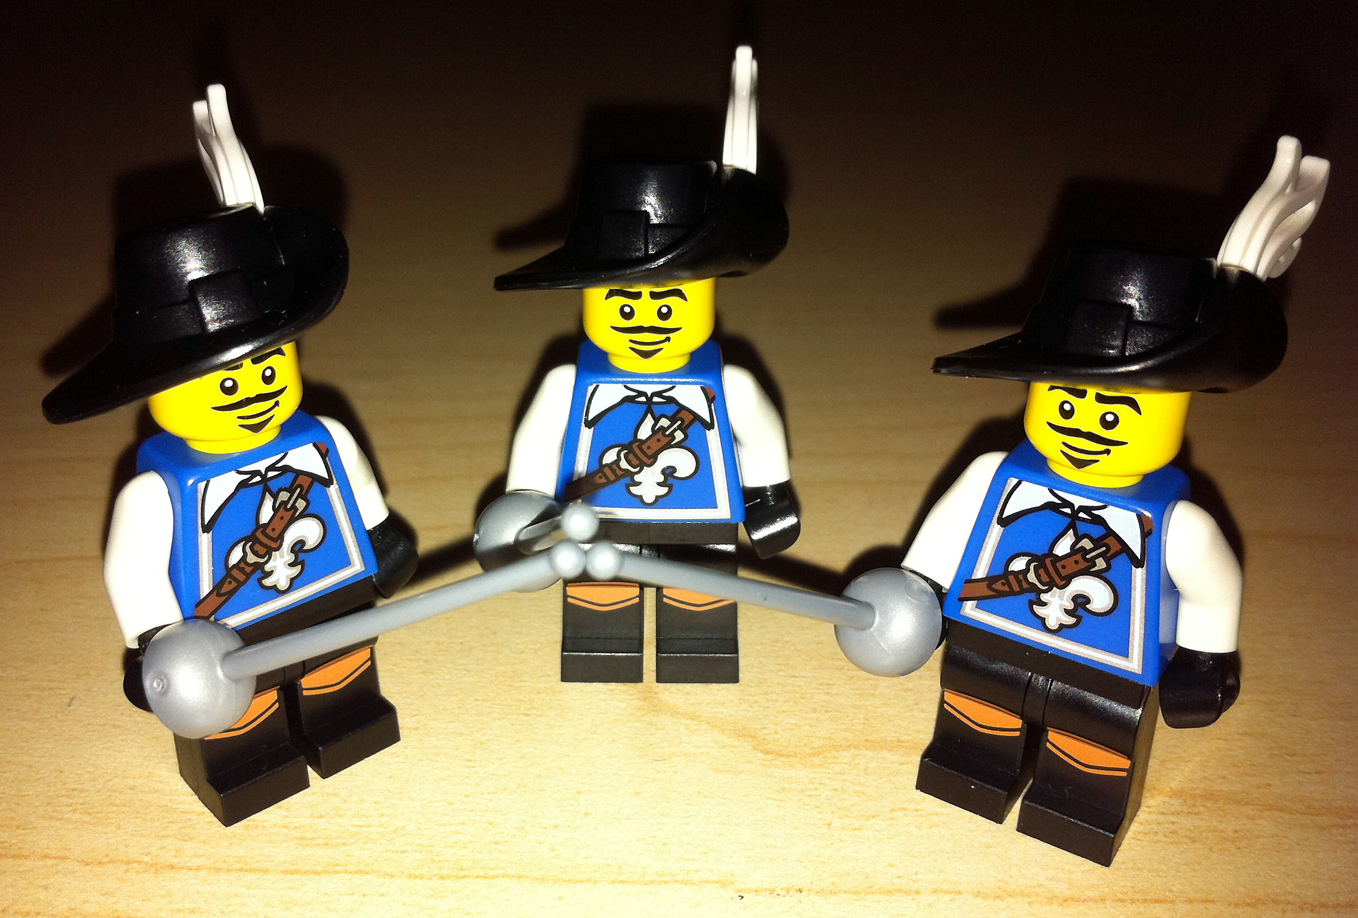
Meet-Ups
Business Plans
CERN KT
CERN labels
IP
Network
Notes:
The CERN Knowledge Transfer Group. When Emmet calls or stop by, I tell him about the Entrepreneurship Meet-Ups we do every other Wednesday.
I give him a copy of our business plan package so that he can start gathering his thoughts a bit around his upcoming venture.
I tell him to let me know if he has any questions, if I can’t answer them, I ‘ll reach out to someone who can.
Perhaps I book a meeting with one of our IP specialists, and I tell him about the different CERN labels his business can benefit from.

Slide 4
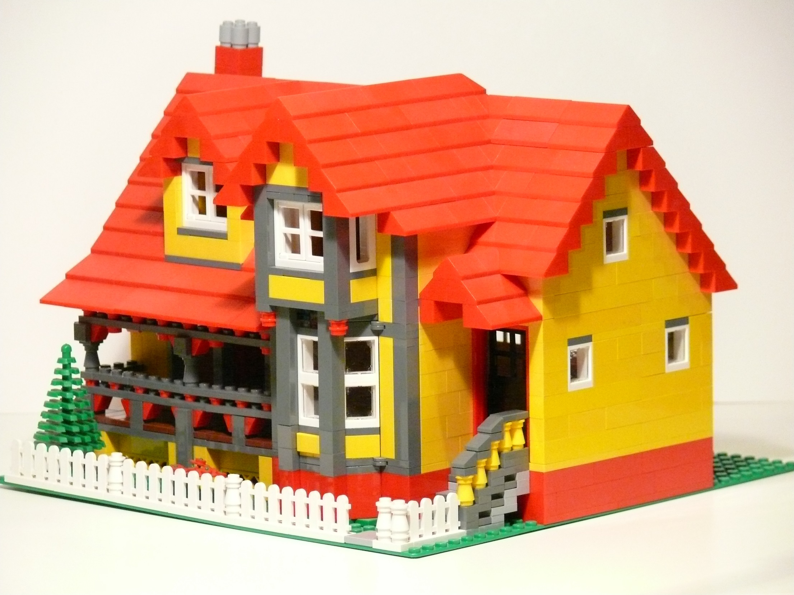
Notes:
At one point, Emmet feels like he’s done with the Geneva region. He’s ready to move away, but he also wants to keep going with his business venture.

Slide 5
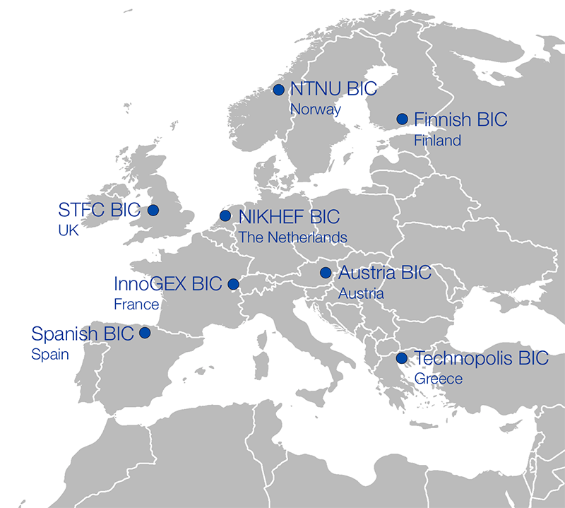
CERN Business Incubation Centre Network
Notes:
No problem, I tell him! We have eight CERN business incubators across Europe that specialise in supporting CERN start-ups. If Emmet founds his company in one of these countries, we will put him in touch with the BIC.
One of the best examples of such an arrangement is actually from within the very walls of the IT Department. From our Norwegian BIC, the company TIND Technologies is commercialising Invenio.

Slide 6

Notes:
After spending years selling CERN technology to the world, Emmet decides to travel it for himself.

Slide 7
Are you the next Emmet?
Let me know!
Marthe Dehli
@marthedehli
marthe.dehli@cern.ch
cern.ch/kt/meet-up
Notes:
If you think you are the next Emmet, let me know!

