Slide 1

DjangoGirls at CERN
26th-27th of February
Rocio Rama Ballesteros

Slide 2


What is DjangoGirls?
Connect with women without prior IT backgrounds
Volunteer Organization
DjangoGirls
1st time in Geneva – hosted at CERN, IdeaSquare!
Collaboration between:
+ ROSEH1PSters
+ CERN diversity group
+ IT Department
Events all around
the world:
Rio de Janeiro, Paris, Munich, Barcelona..

Slide 3
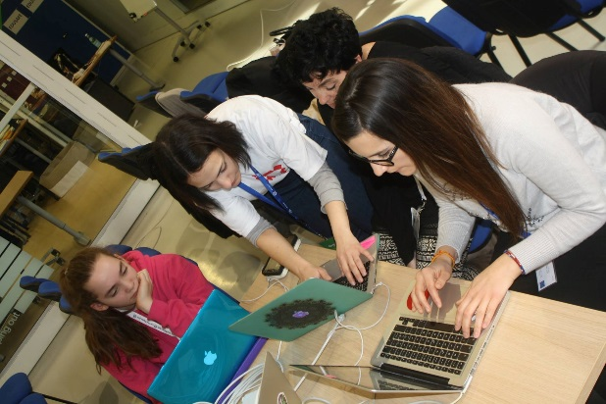
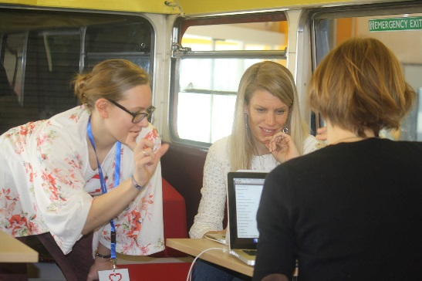
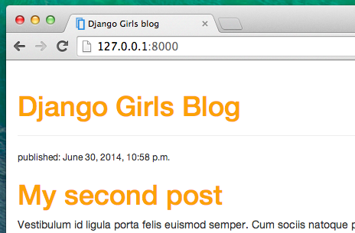
Why DjangoGirls?
Make technology more approachable
Motivate girls to code
  Take away the fear of making mistakes!
Create their own attractive websites with Django!
Change the gender gap in IT (step by step)
IT Department Annual Report

Slide 4
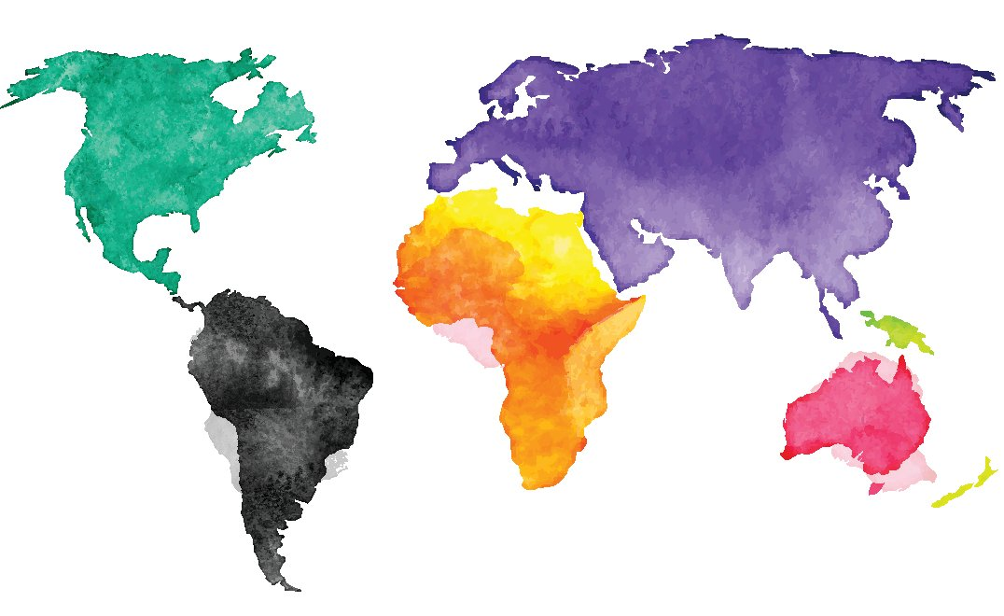







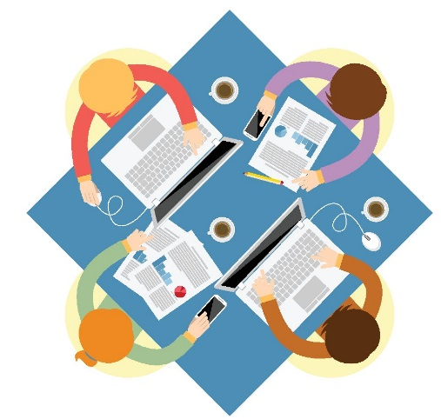
How was the event?
39 participants!
15 different countries!
24 volunteers!
~ 1 Coach & 3 girls working together with Django!

Slide 5








How was the event?
Different OSs
Many tools to learn how to use!
  Editors
  Code in Python
  Repositories
  The TERMINAL!!
Many of them did not finish the tutorial ☹
But all of them are motivated to keep coding!! ☺
Only 1 day
and 1 afternoon for everything!!

Slide 6
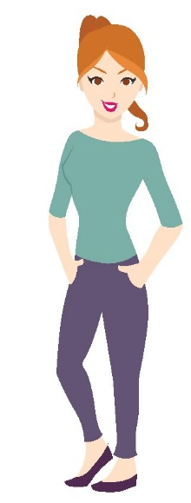
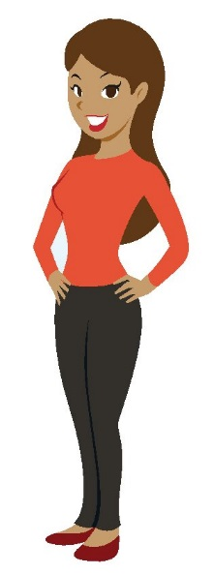
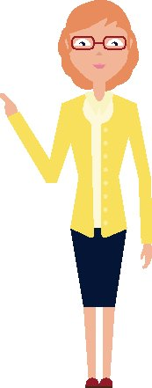
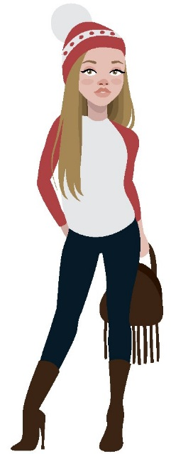
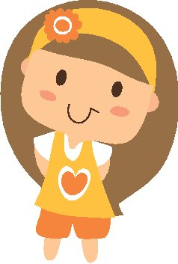
“Really great introduction to coding and thanks for all the food and tea! It would be good to be able to stay in touch with Django Girls to continue the learning if possible! ”
“After meeting all the lovely people here, […]I have to say I am in! I love this workshop. I love programming. Thank you Django Girls! ”
“It would be great to open the workshop to girls (children) with their moms”
“The workshop was too intense to handle in 1 day. I would suggest to split it over more days, shorter session! ”

Slide 7
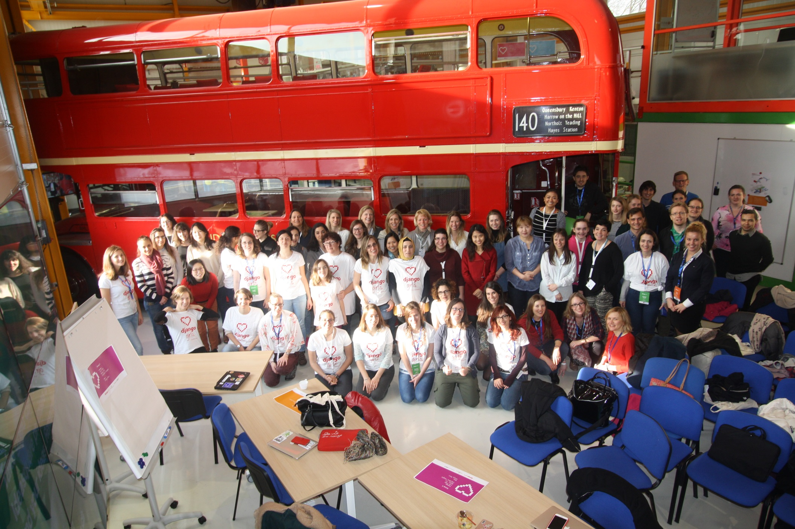
THANK YOU!!

Slide 8
More information!
https://djangogirls.org
https://twitter.com/djangogirls
https://www.facebook.com/djangogirls
http://rosehipsters.org/about/
https://cds.cern.ch/record/2137504?ln=en
https://cds.cern.ch/record/2137966?ln=en

Slide 9
References
Acknowledgements for the pictures:
“Designed by Freepik.com”
Julliard, Laure

