Slide 1


Common coil 16 T dipole: 2-D magnetic design
F. Toral, T. Martinez, J. Munilla - CIEMAT
Progress Meeting #7, Feb. 5th, 2016

Slide 2
General remarks
The main conclusion of the preliminary 2-D magnetic calculations was that the amount of superconductor necessary to provide 16 T in a common-coil dipole was too large.
All the designs are based on double-layer flat coils.
The critical current density of the cable has been improved: intrinsic properties of the superconductor and no cabling degradation.
The sensitivity of the different parameters has been analyzed for a full Nb3Sn magnet:
Intra-beam distance
Number of coils
Nominal current
Strand diameter
Iron outer diameter
2

Slide 3
Results
3

Slide 4
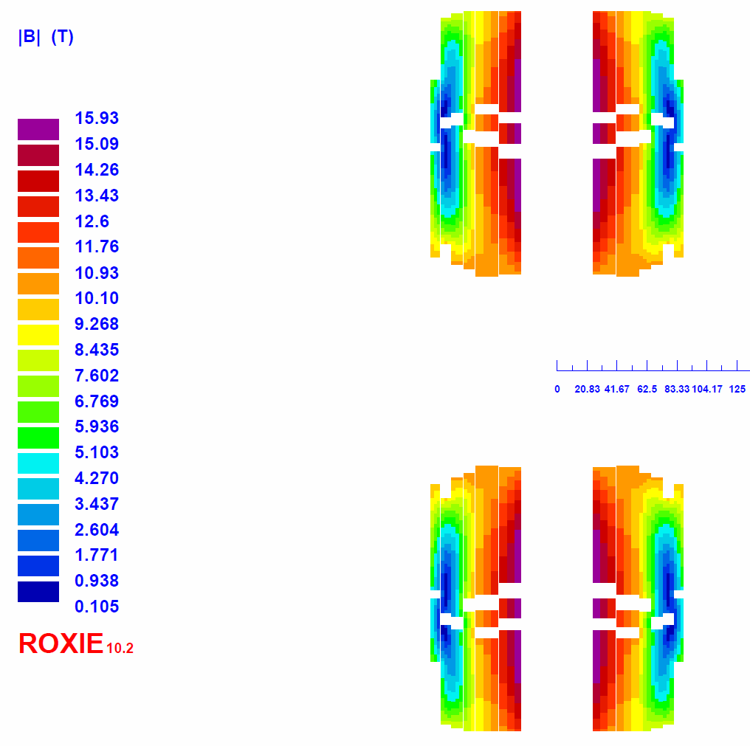
Base solution: field at coils
4

Slide 5
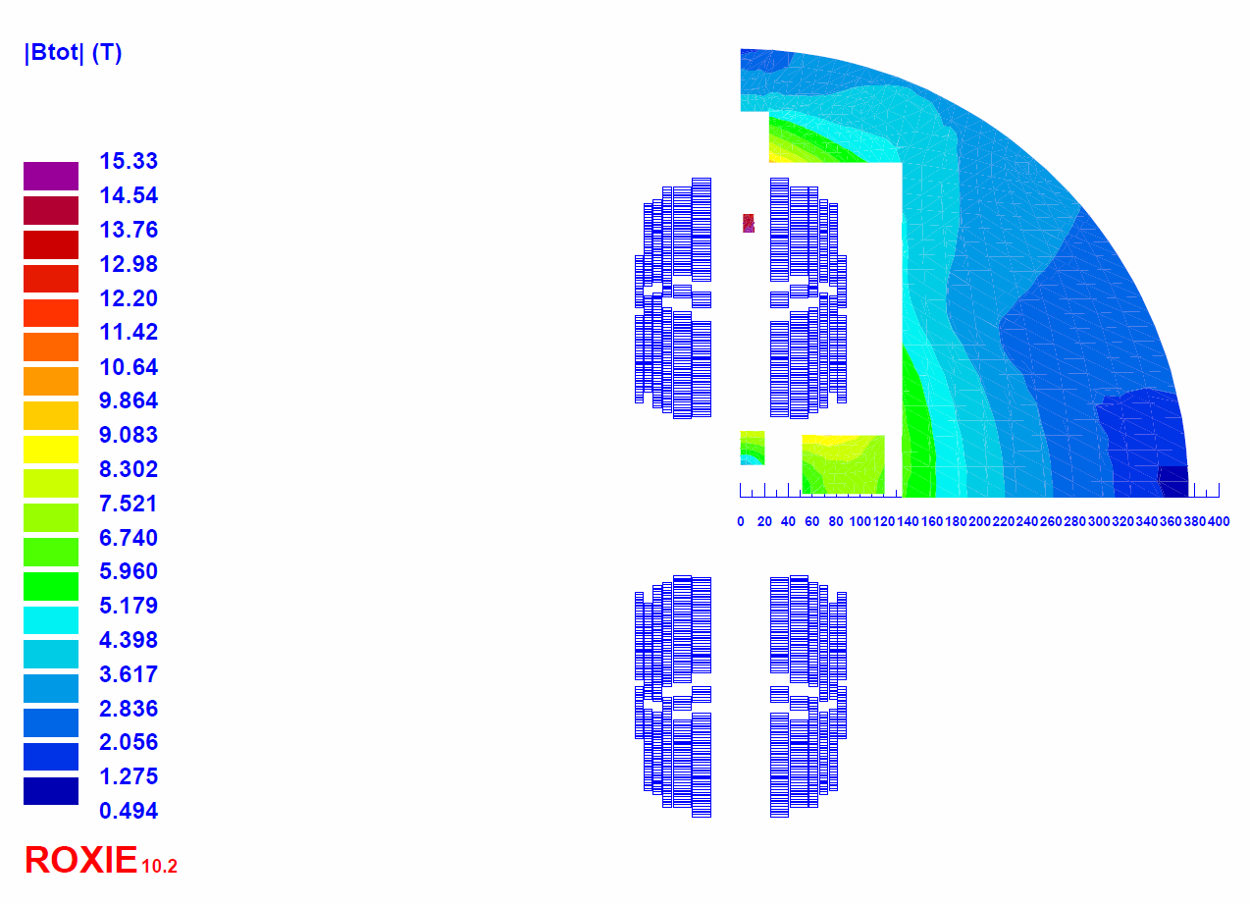
Base solution: field at iron
5

Slide 6
Conclusions
Field quality can only be achieved with a distance between beams larger than 300 mm.
For a distance between beams of 320 mm, about 15000 tons of Nb₃Sn are necessary for FCC. Optimization still ongoing, but no major improvements are expected.
No significant improvements with even larger distance between beams, larger iron diameter or higher currents.
Higher currents or a layout based on two coils are slightly worse from the point of view of superconductor efficiency but maybe necessary depending on the magnet protection studies.
Grading with NbTi is possible, very promising at 1.9 K. Which is the cost saving? To be discussed…
The dependence of superconductor volume on nominal field will be analyzed.
A mechanical 2-D analysis has been started.
6

