Slide 1

Task 5.3: Develop dipole magnet cost model: Distribution of the work and status
D. Schoerling
February 19th, 2016

Slide 2
Distribution of the work
CERN | CIEMAT | CEA
Coordination Parameter studies Extrapolating of cost from LHC magnet cost Scaling for cos-theta (see this presentation + aperture vs cost) | Analytical model of a “typical” FCC-hh high-field magnet (cost of individual components as a function of magnet size & design, cost of conductor as a function of magnet design relevant input parameters (Cu/Non-Cu, diameter, etc.)) Scaling for common-coil | Assembly cost Scaling for block design

Slide 3
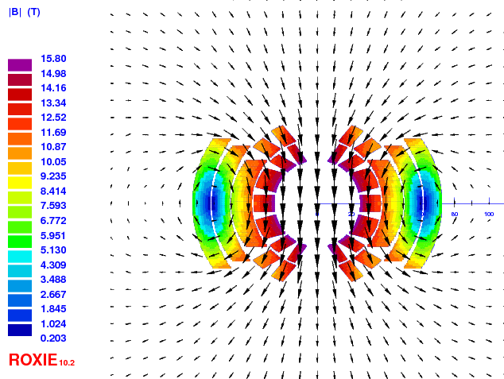
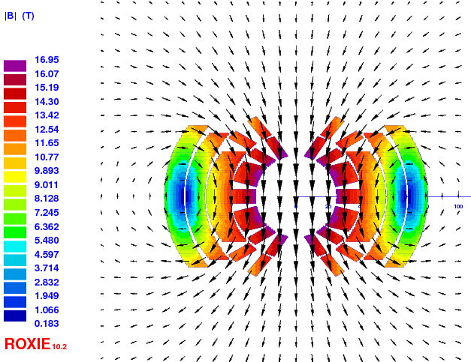
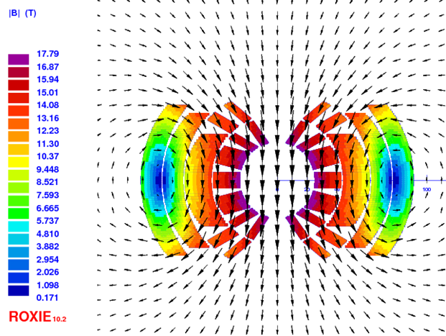
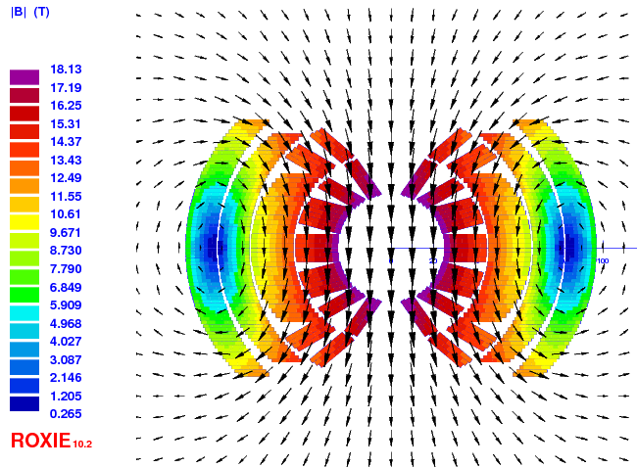
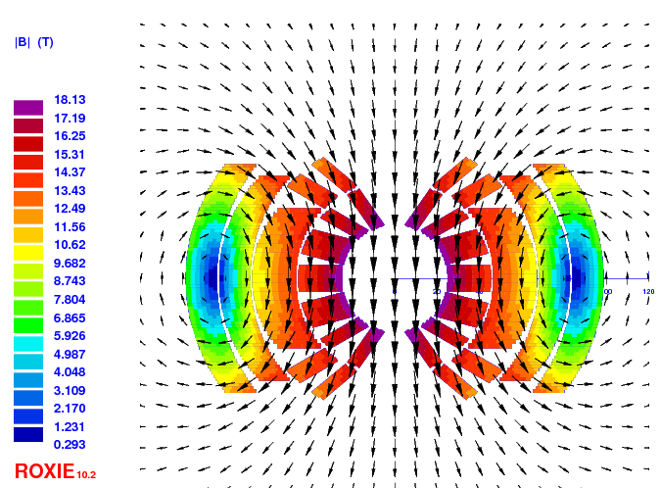
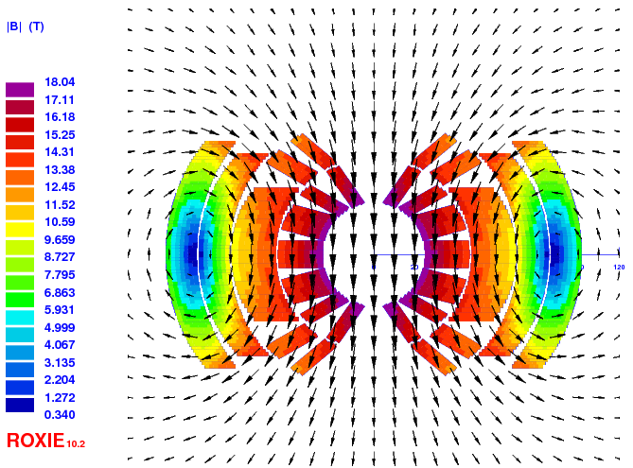
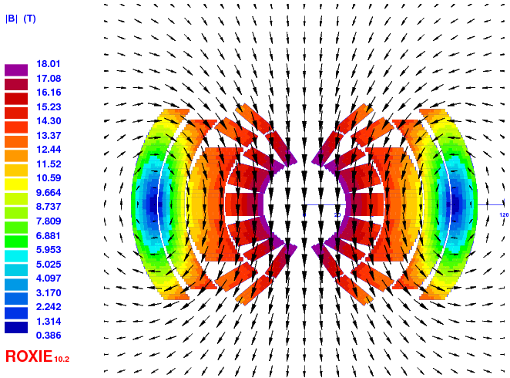
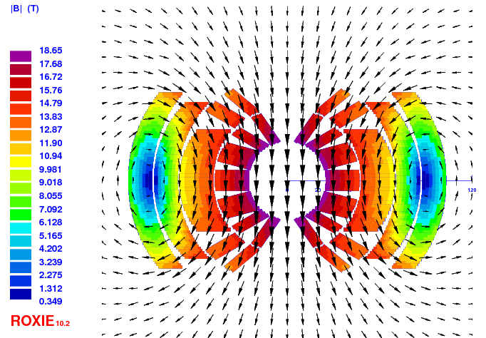
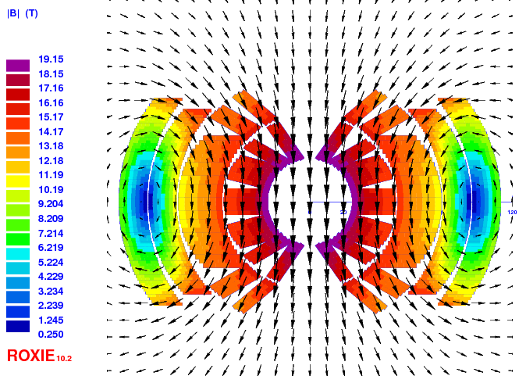
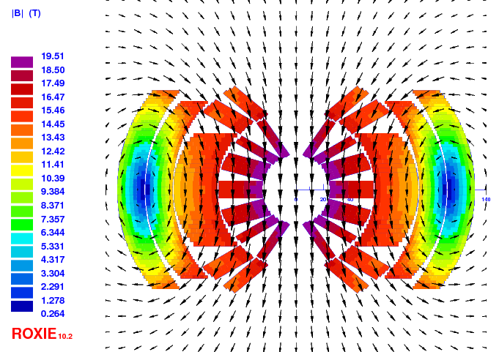
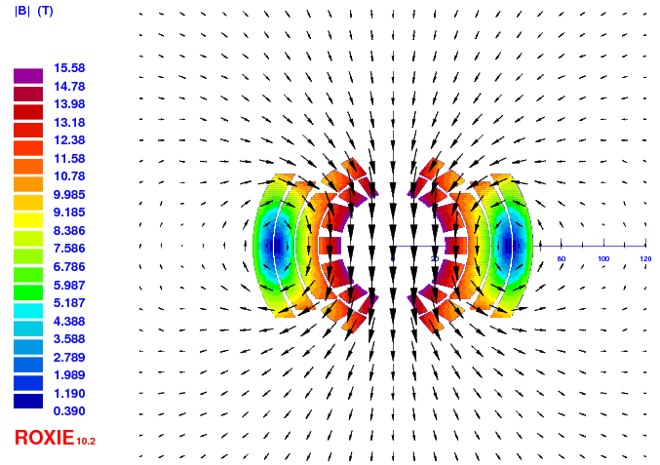
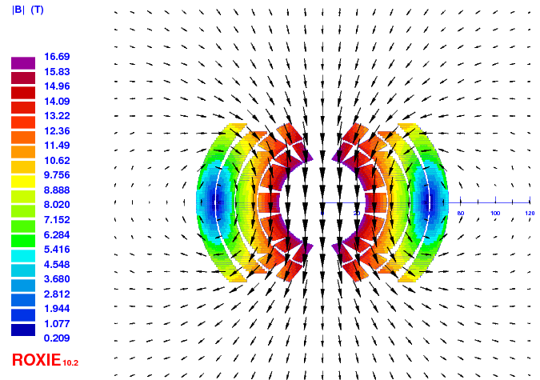
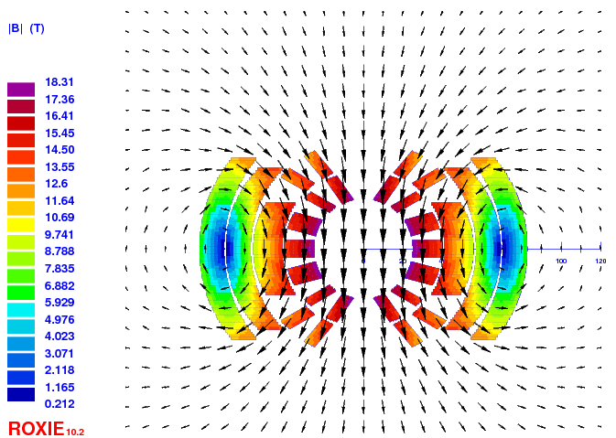
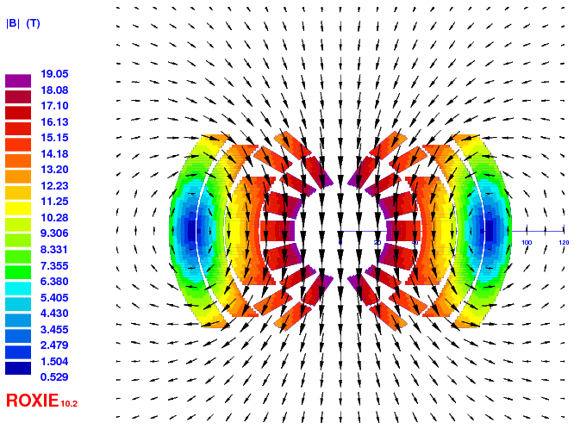
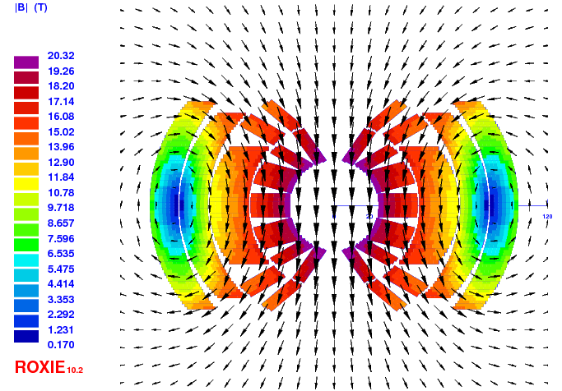
Status - Introduction
Goal: Provide preliminary estimates of the cost of the dipole magnets as a function of field and temperature based on cross-sections scaled from the EuroCirCol 16 T dipole design and from LHC magnet cost
Reference parameters: 50 mm aperture, 4578 magnets, 14.3 m long, 16 T

Slide 4
Cost of magnet
Cost of LHC dipole magnet taken as reference
LHC dipole cost was around 1 MCHF/dipole, 2000 (around 660 kEUR/dipole, 2000).
The conductor cost was around 200 kEUR/dipole, 2000
Assuming 2% inflation over 16 years for the dipoles one finds 900 kEUR/dipole, 2015
The cost of the LHC dipole without conductor is 630 kEUR/dipole, 2015
Manufacturing process involves more steps due to heat treatment, different insulation technique, etc., but number of units is larger (detailed study started with CEA & CIEMAT)

Slide 5
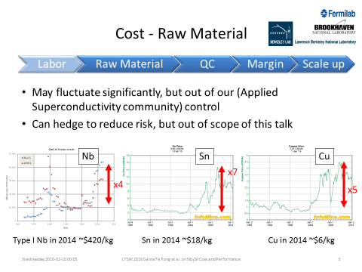
Cost of conductor
Target cost for FCC is set to 5 EUR/kA.m at 16 T and 4.2 K (CERN-ACC-2015-0021)
With J_{c}(4.2 K, 16 T) = 1500 A/mm² and Cu/Non-Cu = 1:1 => 500 EUR/kg
Remark: considering what above, the Cu placed in the conductor becomes expensive!
Source:
Ian Pong (ipong@lbl.gov), Dan Dietderich, Lance Cooley, Arup Ghosh: Cost and Performance of Nb₃Sn for the Next Big Project

Slide 6
Estimate of conductor amount
Assumptions:
Cos-theta magnet based on a schematized EuroCirCol INFN design (two double pan-cake, two-layer grading), simplified for the purpose of this study
J_{cu} ≤ 1200 A/mm² (magnet protection at short sample) and Cu/Non-Cu ≥ 1:1(optimized strand production)
Field quality (b₃ ≤ 100 units), non-optimized, no insulation, NOGRAD, LSELF
Cable without keystoning, 0% degradation
Calculation of required conductor mass for FCC-hh: 2 x Area x 140 dm/unit x 4578 unit x 8.7 kg/dm³

Slide 7
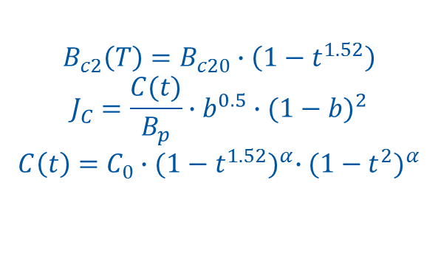
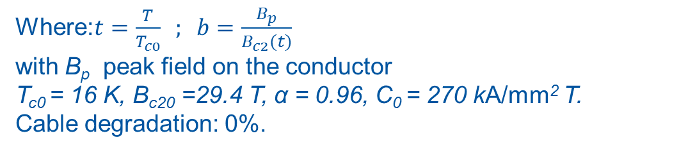
Conductor J_{c}-fit
$$B_{c2}\left(T\right)=B_{c20}∙\left(1−t^{1.52}\right)$$
$$J_{C}=\frac{C(t)}{B_{p}}∙b^{0.5}∙{(1−b)}^{2}$$
$$C\left(t\right)=C_{0}∙{(1−t^{1.52})}^{α}∙{(1−t^{2})}^{α}$$
Where:$t=\frac{T}{T_{c0}} ; b=\frac{B_{p}}{B_{c2}(t)}$
with B_{p} peak field on the conductor
T_{c0} = 16 K, B_{c20} =29.4 T, α = 0.96, C₀ = 270 kA/mm² T.
Cable degradation: 0%.

Slide 8
Conductor amount vs field @ 1.9 K
Conductor amount is sensitive to the operational field and margin!
Conductor amount in kt
 | 15 T | 16 T
10% | 6 | 7
15% | 7 | 9
20% | 9 | 12

Slide 9
Conductor amount vs field @ 4.2 K
Conductor amount is very sensitive to the operational field and margin!
Conductor amount in kt
kt | 15 T | 16 T
10% | 7 | 10
15% | 10 | 16
20% | 15 | >25

Slide 10
Conductor amount vs field
Assuming the copper in excess of 1:1 can be added for the material price of copper, savings can be achieved
Ex: For a magnet with an operating field of 16T with 15% of margin around 2000 t of conductor cost (~25%) can be saved if the Non-Cu/Cu is limited to 1:1.
Ex: For a magnet with an operating field of 16T with 10% of margin around 1500 t of conductor (~15%) can be saved if the Non-Cu/Cu is limited to 1:1.

Slide 11
Conductor amount vs operating temperature
We assume the enthalpy margin is meaningful to compare the margin to quench
In terms of enthalpy margin 10% on the load at 4.2 K corresponds to ~15% at 1.9 K
The same cross section with a margin on the loadline of 10% at 4.2 K gives a margin of 18% at 1.9 K (due to the different critical curves)
Under these assumptions we gain ~3% of margin on the loadline from 4.2 K to 1.9 K or with the same margin we can gain some conductor mass

Slide 12
Conductor amount vs operating temperature
Depending on the cooling scenario the temperature may be 4.7 K (instead of 4.2 K)
Keeping the same margin at 4.7 K would require more conductor than at 4.2 K
Going from 4.2 K to 4.7 K increases the required amount of conductor by ~1300 t (~650 MUSD).
Comparing 1.9 K to 4.7 K makes a difference in the range of 1 GUSD

Slide 13
Total cost of FCC-hh dipoles
FCC with LHC magnet cost without conductor: 630 kEUR/unit x 4578 unit= 3000 MEUR
Conductor for 16 T and baseline margin at 4.2 K or 1.9 K ~10000 t
Conductor for 15 T and baseline margin at 4.2 K or 1.9 K ~7000 t
There is a potential to save around 1 GEUR by replacing “expensive” copper in the SC strand through “cheap” pure-copper strands or a copper jack
Scenario 1 (conductor cost 500 EUR/kg):
FCC-hh 16 T: 8000 MEUR
FCC-hh 15 T: 6500 MEUR
Scenario 2 (conductor cost 800 EUR/kg):
FCC-hh 16 T: 11000 MEUR
FCC-hh 15 T: 8600 MEUR

Slide 14
Total cost of HE-LHC dipoles
Scenario 1 (conductor cost 500 EUR/kg):
16 T: 2200 MEUR
15 T: 1800 MEUR
Scenario 2 (conductor cost 1000 EUR/kg):
16 T: 3500 MEUR
15 T: 2700 MEUR

Slide 15
Conclusion
The difference in cost of operating at 1.9 K or 4.7 K is ~1 GEUR
Operating at 15 T instead of 16 T represents a cost reduction of ~1.5 GEUR
Margin is very expensive especially at 4.2 K
  5% (10%->15%) margin at 4.2 K => 40% more conductor cost (~ 3 GEUR)
  5% (15%->20%) margin at 1.9 K => 25% more conductor cost (~ 1.5 GEUR)
Replacing “expensive” copper in the SC strand through “cheap” pure-copper strands or a copper jack may save ~1 GEUR
All above if we can achieve a target cost for the conductor of 500 EUR/kg

