Slide 1

Tooling status
F. Lackner, H. Prin, M. Duret, F. Savary, D. Gerard, L. Favier, S. Triquet, D.
Smekens, S. Luzieux, R. Principe, C. Scheuerlein, C. Loeffler, J-C. Perez,
O. Housiaux, P. Revilak, T. Genestier, V. Letellier, E. Cavanna,
& all other colleagues involved in the LMF 11T activities.
Review of the11T dipoles at Collimator Section for the HL-LHC,
7 April 2016, CERN

Slide 2
Content
Coil and cold mass assembly tooling status:
  Winding and curing
  Reaction heat treatment and impregnation
  Collaring
  Cold mass assembly and shell welding
  Geometrical inspection
  Leak test
  Mechanical workshop
  Busbar preparation
  Quality and Safety aspects

Slide 3
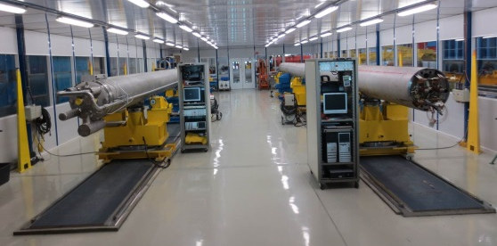
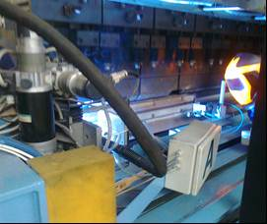
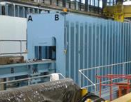
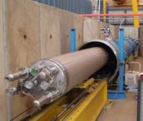
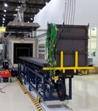
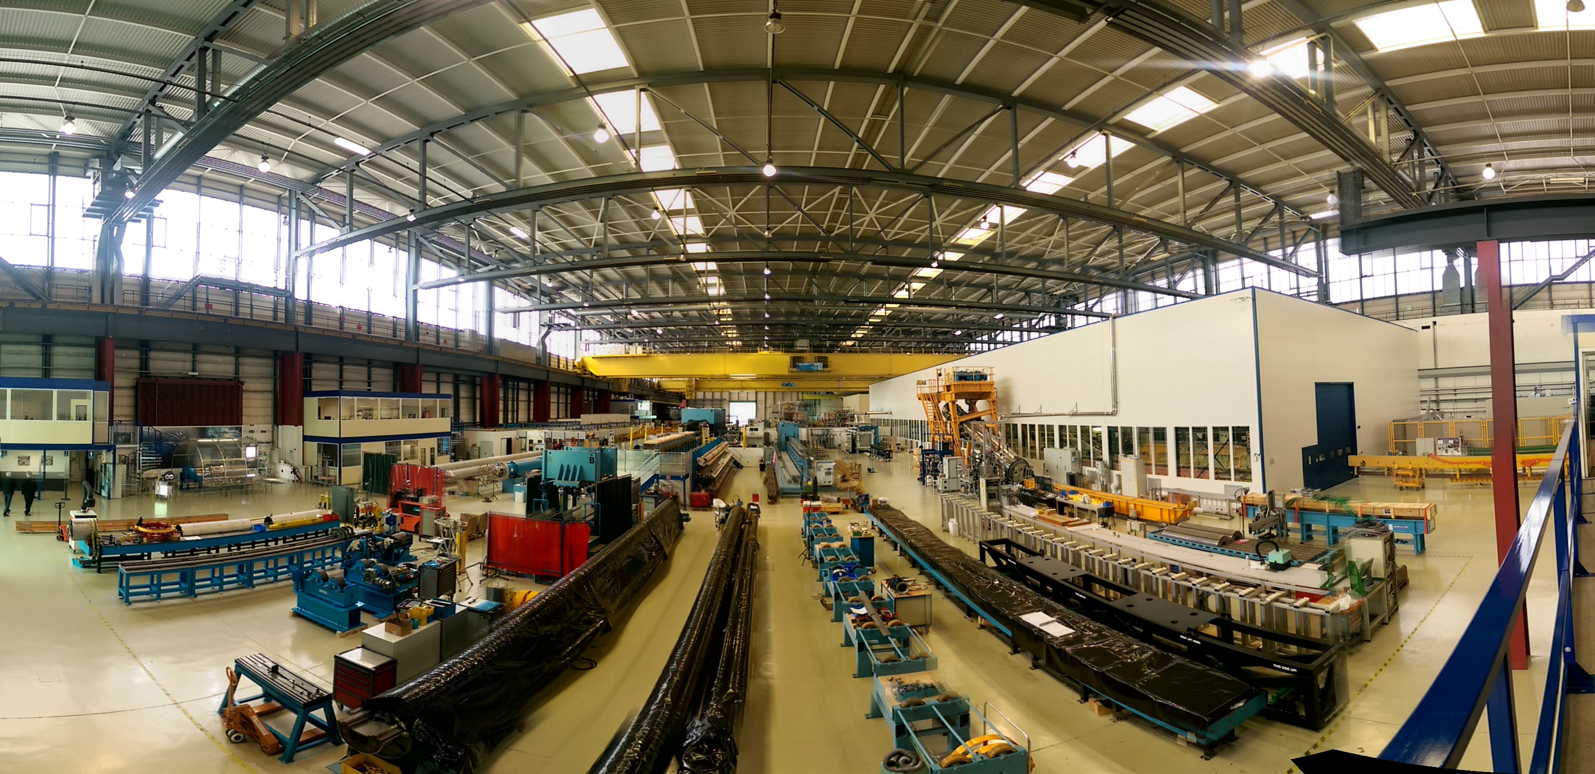
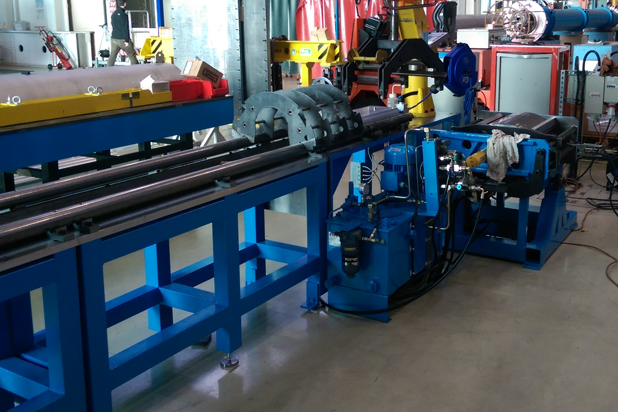
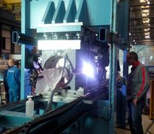
Finishing benches
Geometrical measurements
15m Welding press
15m Collaring press
Pressure/leak bench
Nb3Sn Reaction furnace
“Winding house”
Impregnation chamber
Yoke assembly bench
Cold mass magnetic measurement bench
Welding press for 2m models
Half Yoke returning bench
Cold mass assembly bench
Collared coil returning bench
Collared coil magnetic measurement bench

Slide 4
Coil winding and curing

Slide 5
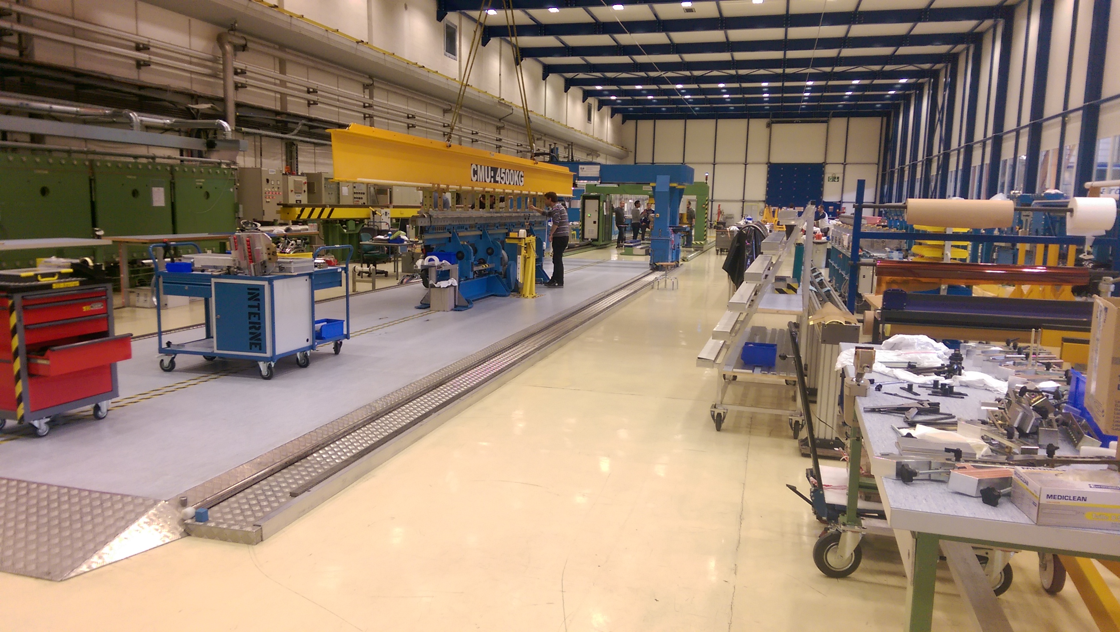
LMF - Winding house (bldg. 180)

Slide 6
Layout of the LMF - Winding House
Re-arrangement of existing winding house layout and infrastructure for simultaneous winding operations for 11T and MQXF. Subsequent adaptation of zone, finalization in June 2016.
curing press
cable insulation
curing preparation
coil storage
spooling
winding machine 1
winding machine 2
metrology
instrument.
assem. static
Gate
collaring
assem. rotat.
collaring
preparation
coil storage
11T Dipole
11T Dipole - available
MQXFB / Main dipole
11T Dipole - ongoing
Main dipole (pre-collaring)
Common zone

Slide 7
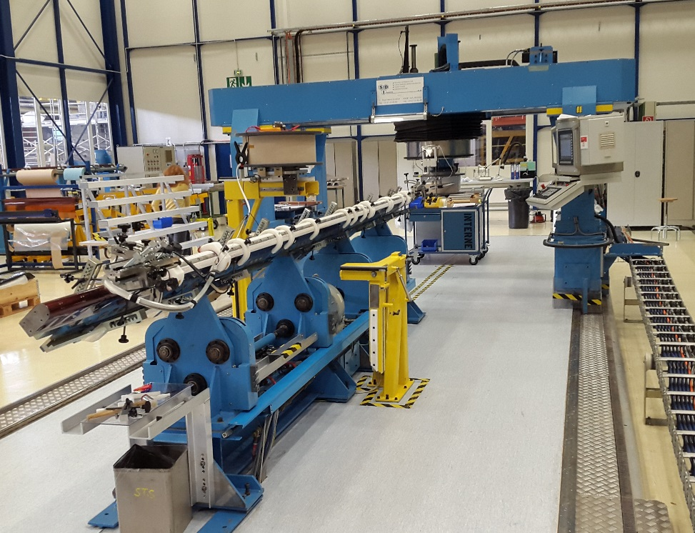
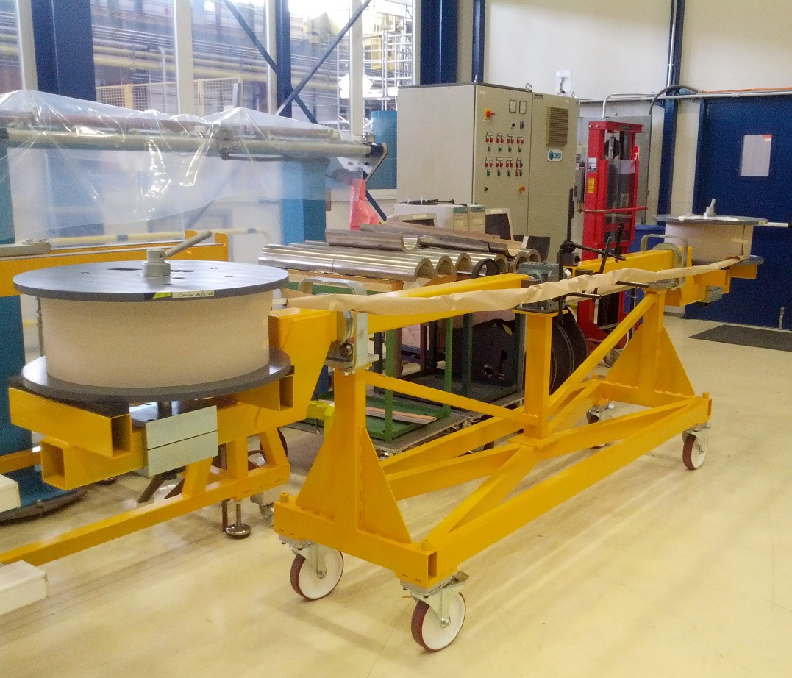
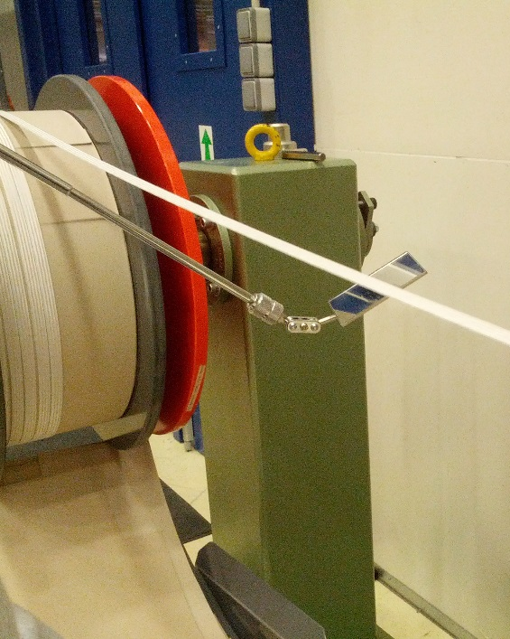
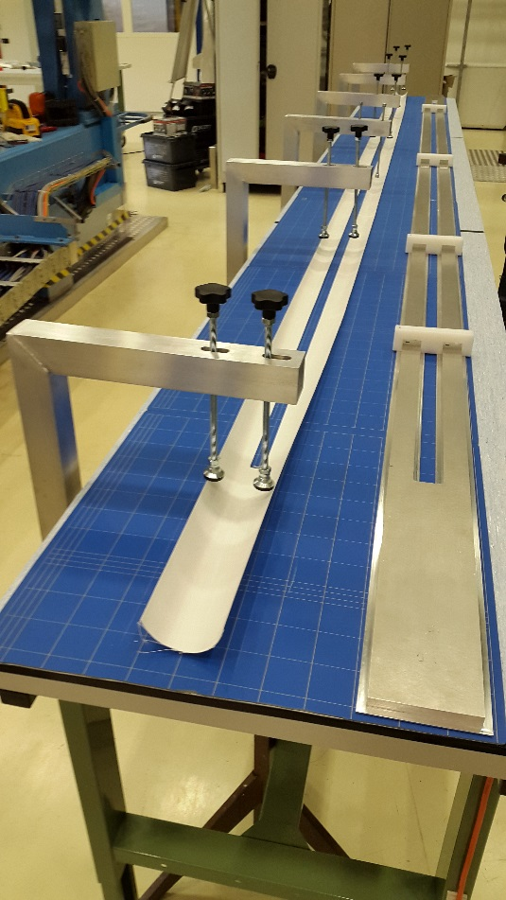
11T – 5.5 m coil winding machine
Refurbishment of previous quadrupole winding machine for LHC:
Insulated cable is separated on two reels for inner and outer layers
Fixed mandrel & mobile gantry
Integrated strain tension force measurement system
Refurbished control system
Automatic driving
Installed
Comissioned
In operation

Slide 8
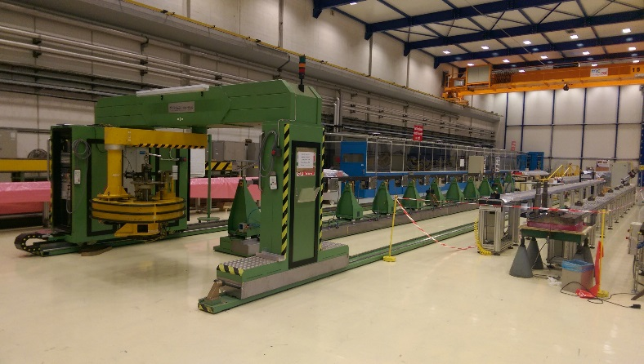
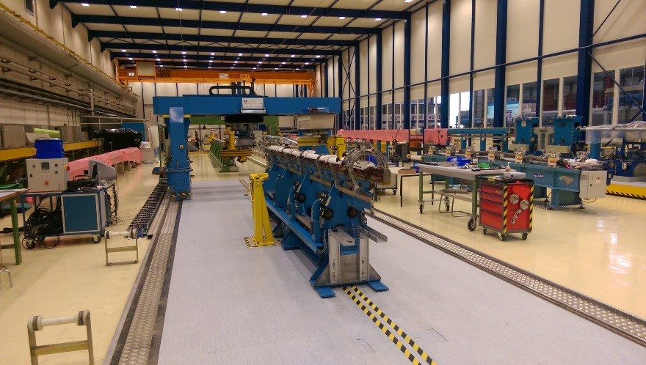
LMF - Winding machine - refurbishment
Refurbished winding machine – QXF
Refurbished winding machine – 11T
Redundancy is given by the refurbishment of 15 m LHC dipole winding machine:
Adaptation for full compatibility with the MQXFB coil design;
New winding table, increased mechanical stability (in-house production);
Replacement of control soft- and hardware including all drive systems;
Implementation of improved force tensioning system;
Installed
Comissioned
In operation

Slide 9
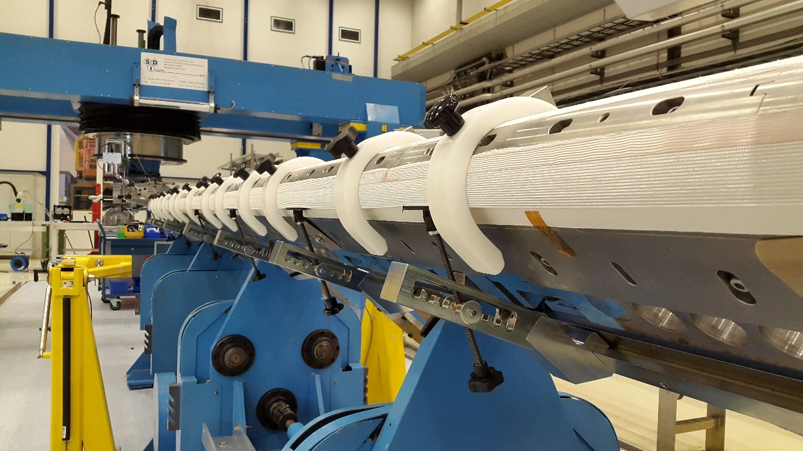
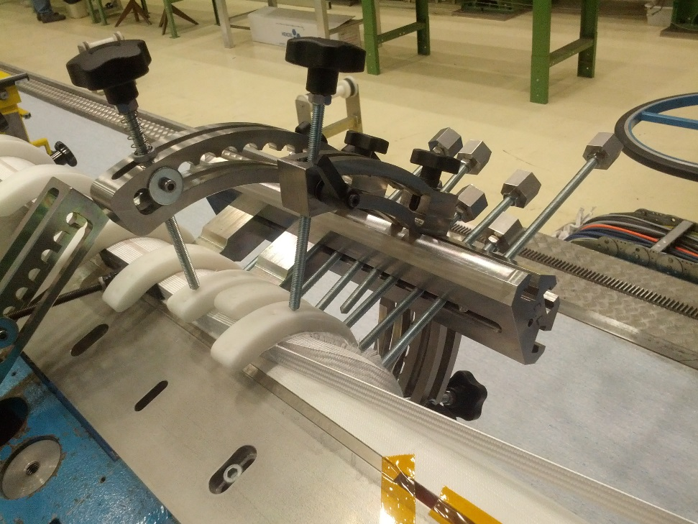
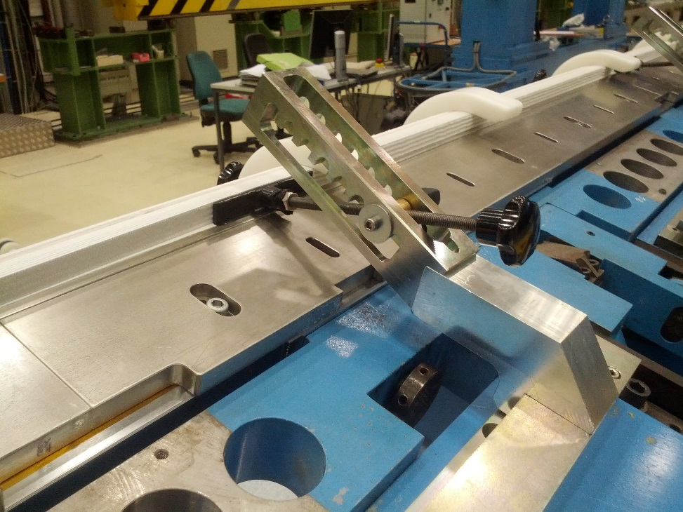
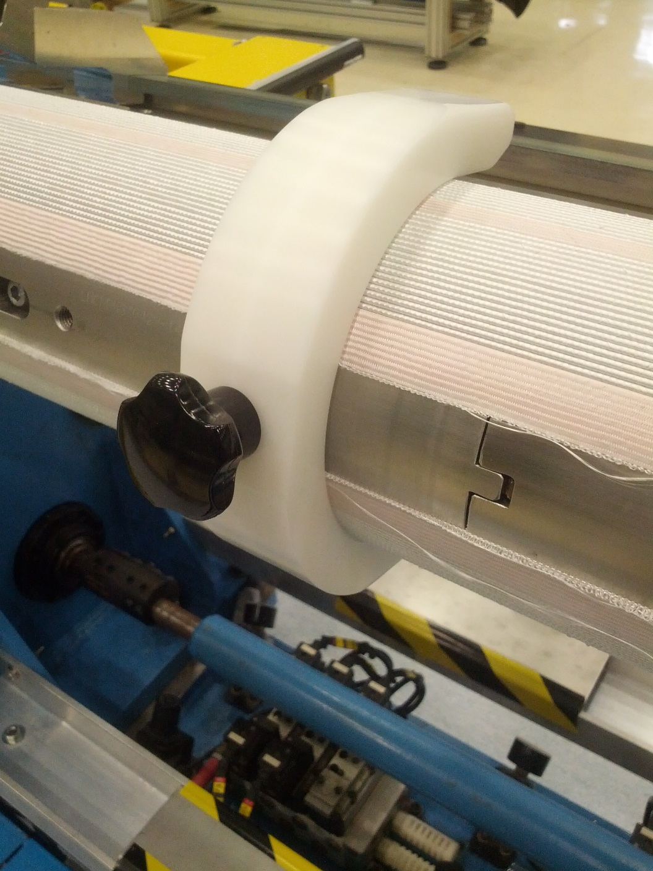
Specific tools required for coil winding
Dedicated tools coming from short models experiences, specially in the heads zones:
Heads upper pushers
Lateral pushers
Upper guides
Cable « strain gauge » to monitor the winding tension
Interlayer template
Heads upper pushers
Lateral pushers
Upper guides to keep the outer radius of the coil in a good position during winding

Slide 10
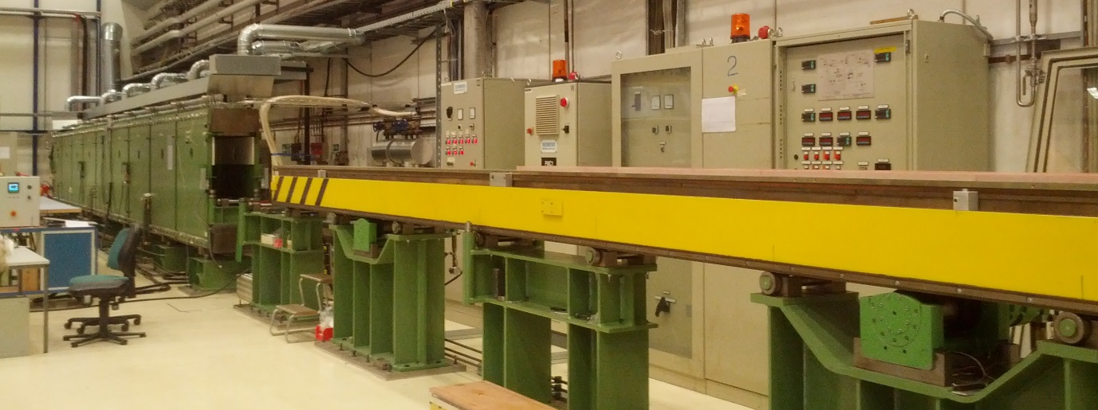
Curing press
Curing Press :
  Re-use of the 15m long press used for NbTi LHC dipole magnets
  Hydraulic sectoring was required for compatibility with the change in coil length.
Hydraulic sectoring was finalized for full compatibility with the 11T coil design.
Installed
Comissioned
In operation

Slide 11
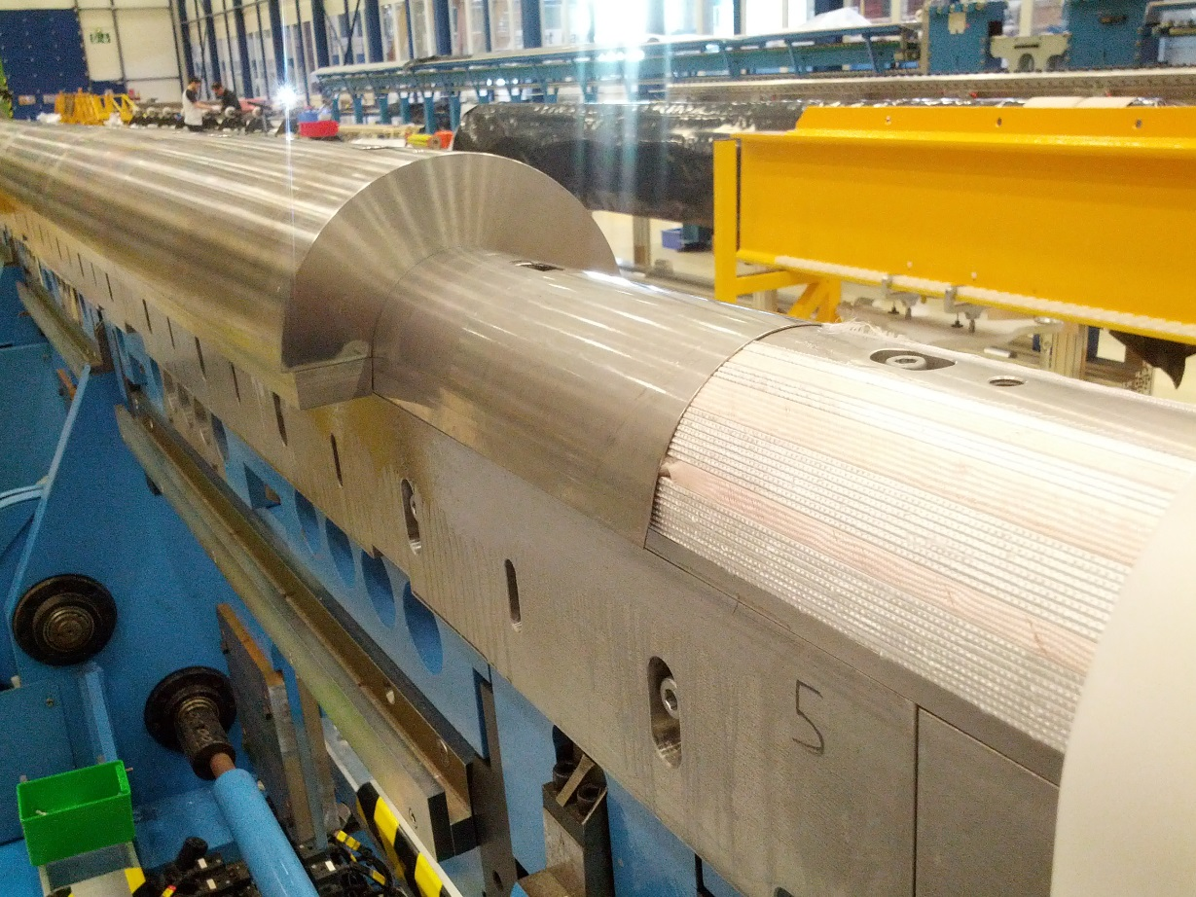
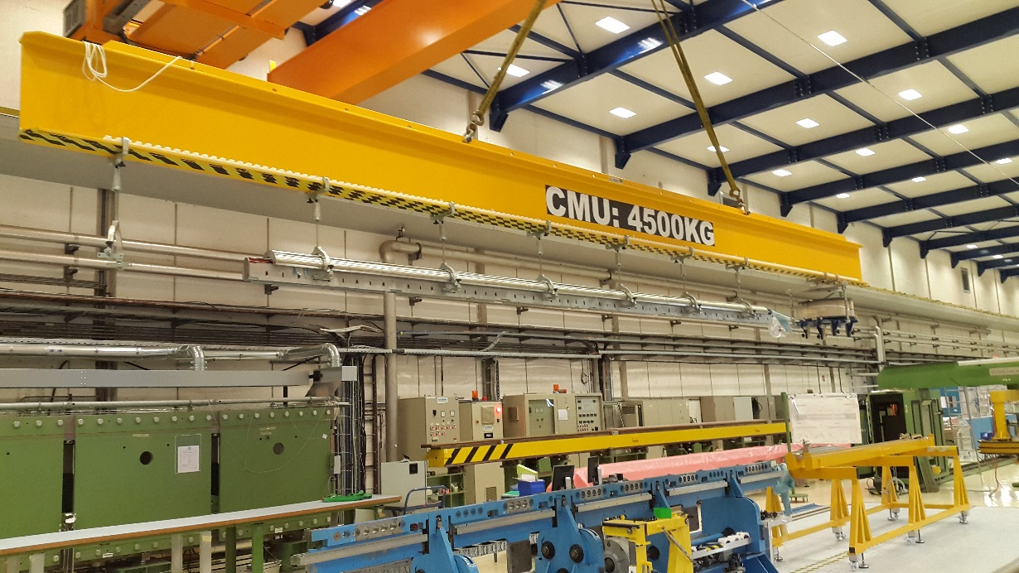
Curing tool
Lifting beam for transfer to curing press is available & compatible the MQXFB coils
Curing mould and heaters are available
Curing mould and stainless steel protection sheet
Lifting beam

Slide 12
Reaction heat treatment

Slide 13
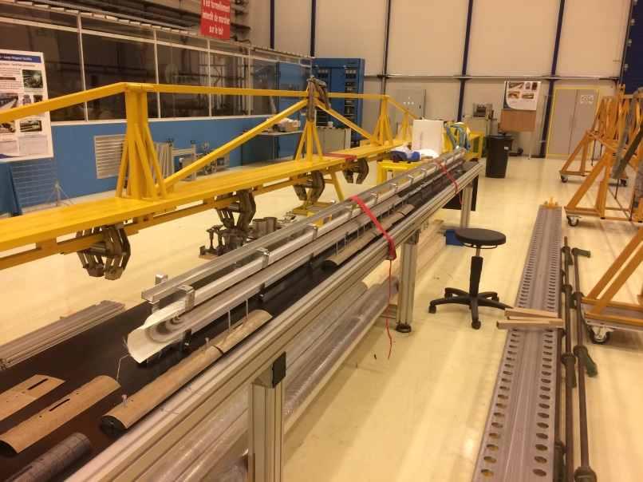
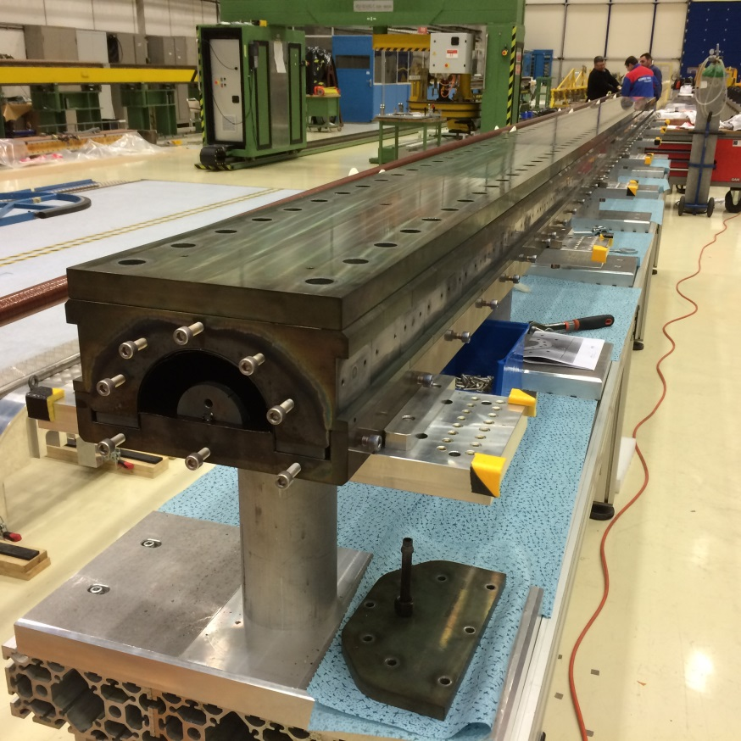
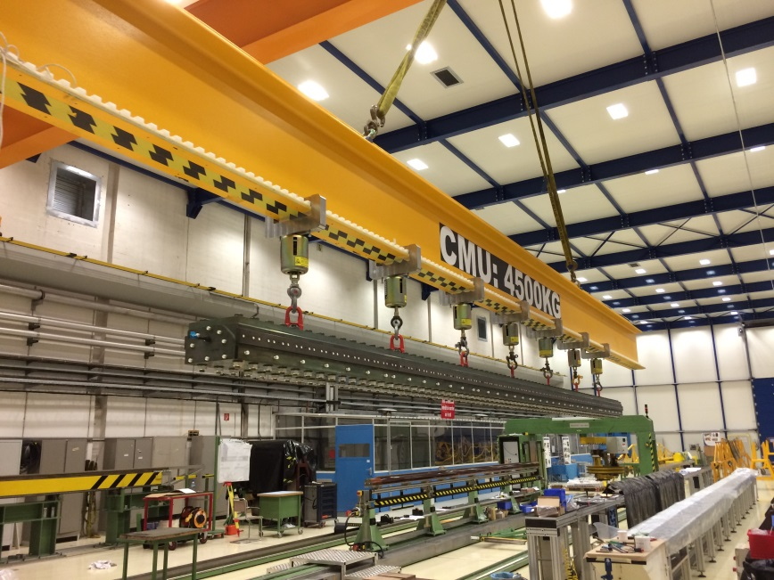
Handling of reaction fixture
Actions:
Place coil
Close fixture
Tooling:
Lifting tool - available
Reaction fixture – available
Mounting table – available
To increase the efficiency an additional RHT-baseplate and mandrel set have been procured in order to reduce downtime between RHTs.
Status: To be delivered beginning of April

Slide 14
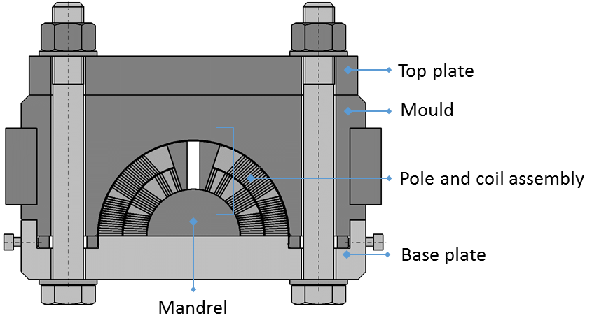
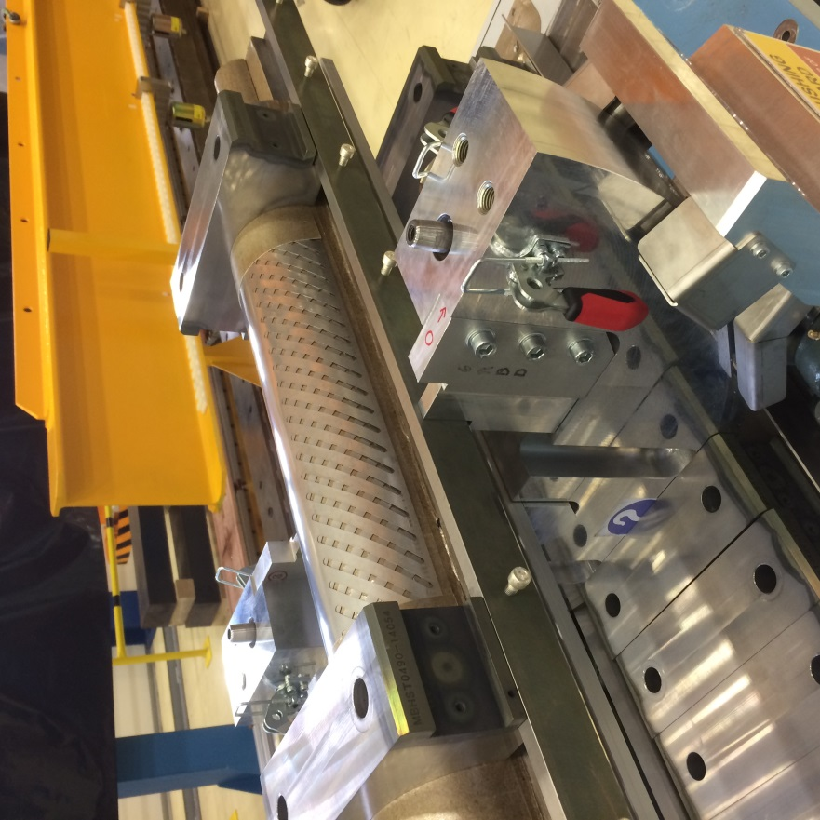
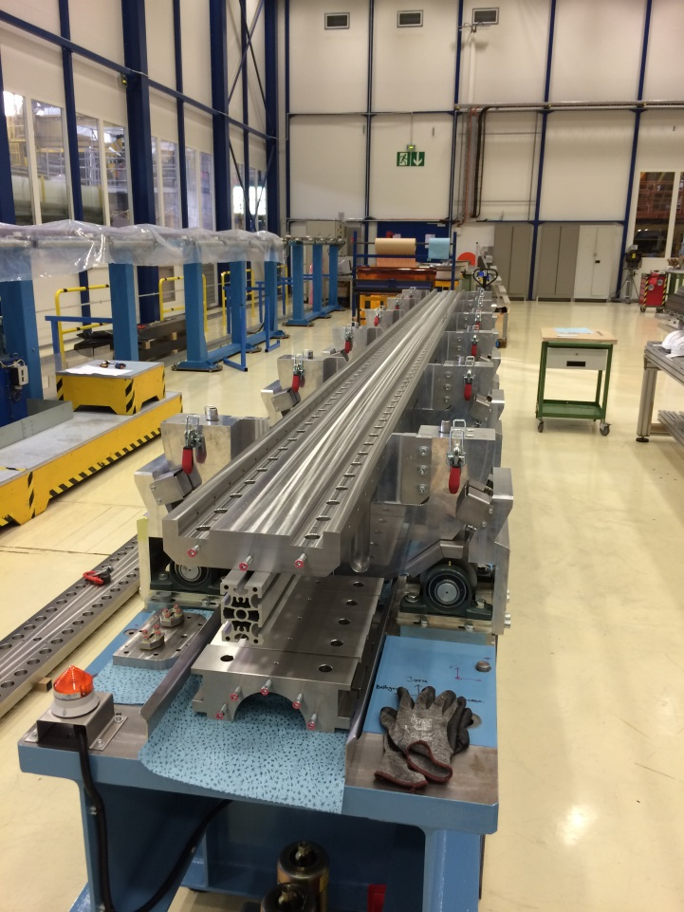
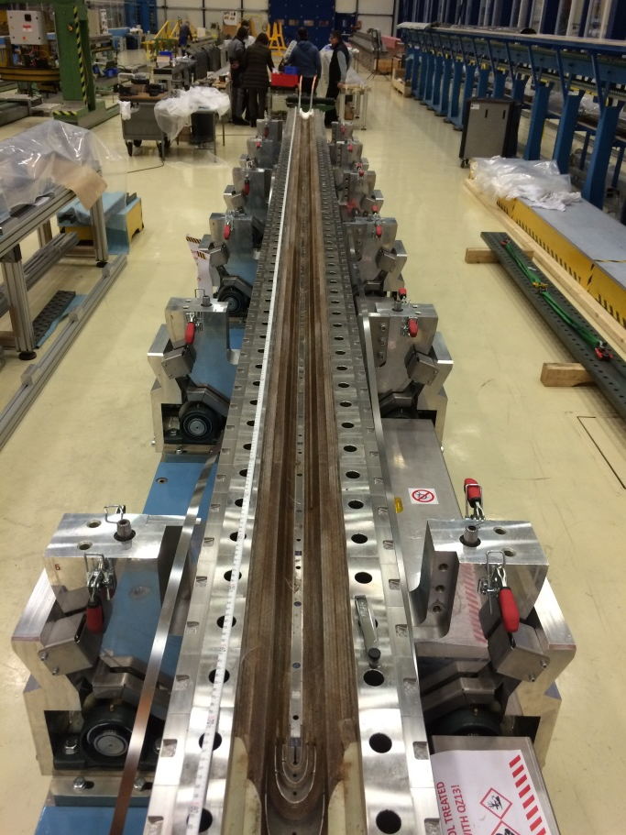
Fixture handling and assembly
Actions:
Handling and assembly of reaction and impregnation fixture
Tooling:
Handling beam - available
Handling equipment - available
Transport chariot - available

Slide 15
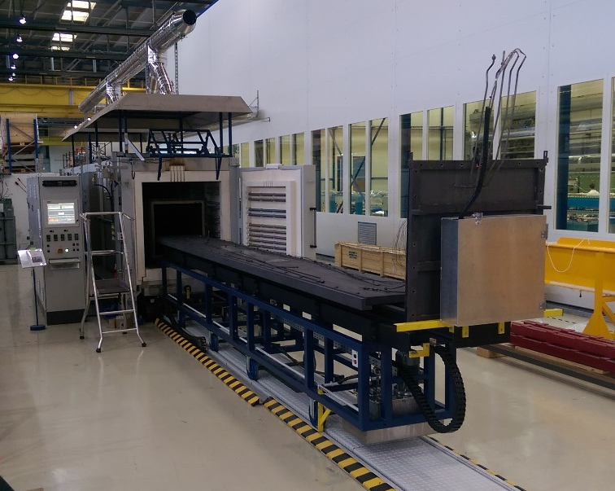
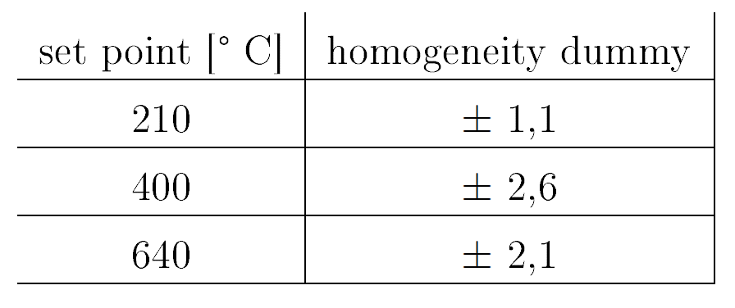
LMF - Reaction furnace I
Length: 6.5 m
Cross-section: 0.5 x 0.6 m
Inert gas: Ar
Recirculation fans: 2
Heating zones: 5
Max. heating power: 350 kW
Max. operating temperature: 900°C
Allows simultanious reaction of two coils
Installed
Comissioned
In operation
Measured temperature homogeneities during a copper coil heat treatment cycle
Specified temperature uniformity was achieved during heat treatments of the short model and full length coils.

Slide 16
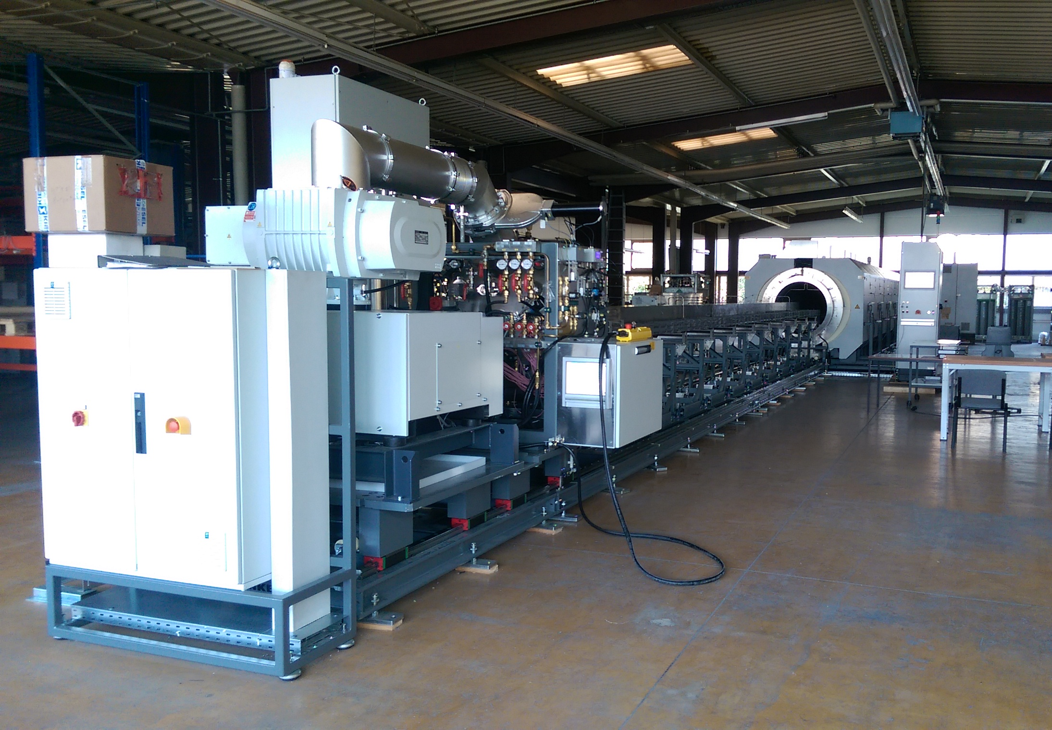
LMF - Reaction furnace II
RHT – redundancy will be given by the MQXF furnace:
Contract launched in April 2015 – reception April 13th, 2016
In-house acceptance: 20th of May
Plateaus 210°C; 400°C; 665°C; +-3°C
Heated length Ø1 m; l 10,5 m; 700 kg/m
Width < 4 m; l < 30 m; h< 4 m
40 probe TCs
Evacuation at RT to 10-2 mbar; 700 l/s
Loading and unloading automatic 20mm/s2, 0,5 mm/m
Oxygen reduction in < 10 h
Heat treatment start oxygen level < 10 ppm
52 weeks delivery
Allows simultanious reaction of two coils
Final factory acceptance in March 2016

Slide 17
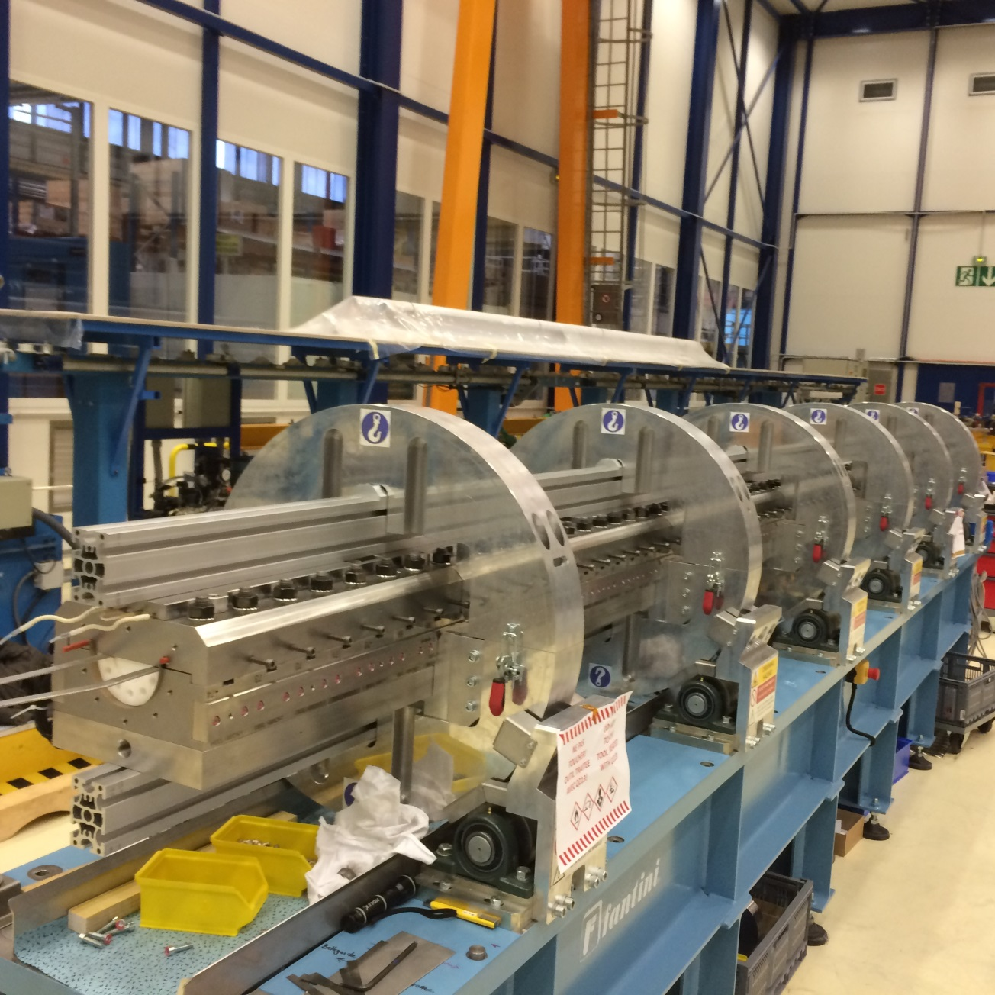
Change from reaction to impregnation fixture:
Actions:
Opening reaction fixture
Splicing of the coil
Mounting Impregnation fixture
Tooling:
Rotating table - available
Splicing tooling – available
Impregnation fixture – available
Installed
Comissioned
In operation

Slide 18
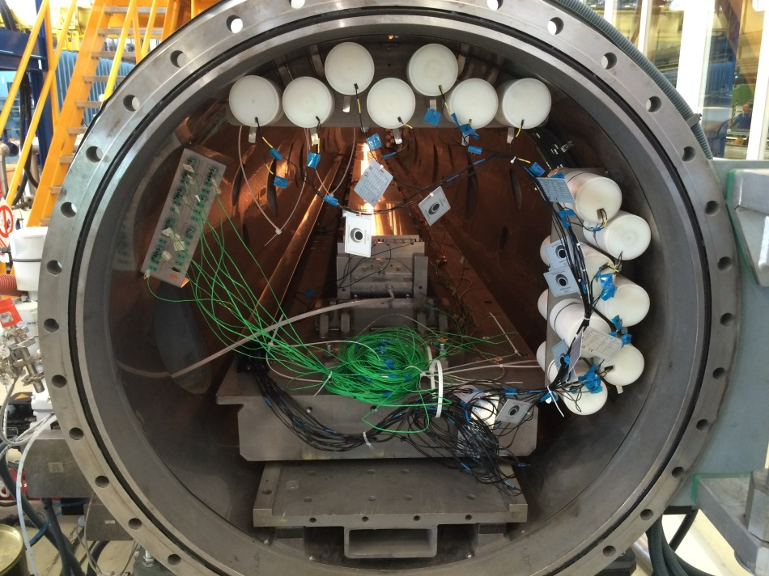
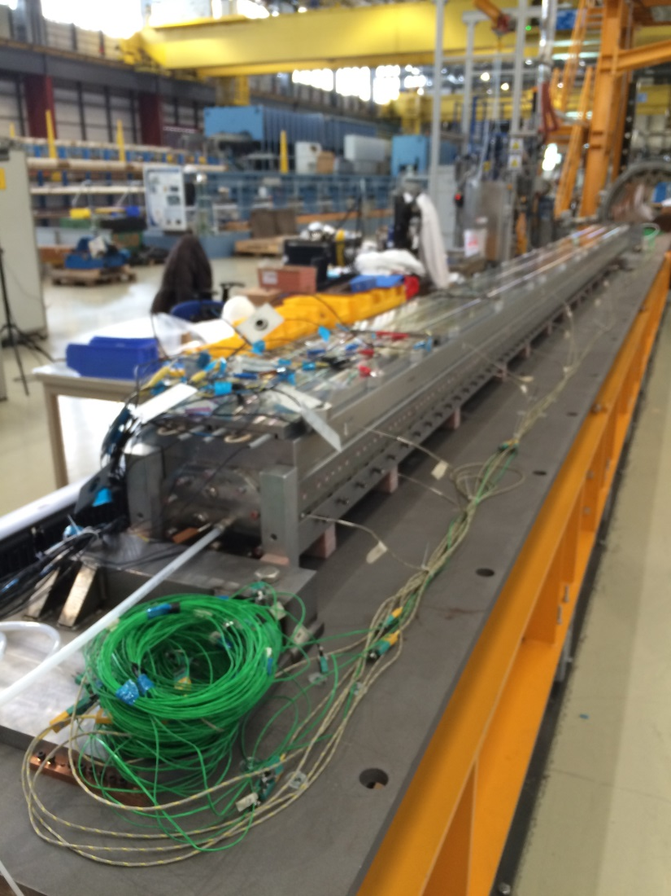
Impregnation system
Actions:
Impregnating coils
Tooling:
VPI machine, currently under commissioning
Three short model coils (sm201, sm114, sm115) already impregnated.
The first 5.5 m copper coil impregnation is currently in preparation.
Installed
Comissioned
In operation

Slide 19
Collaring

Slide 20
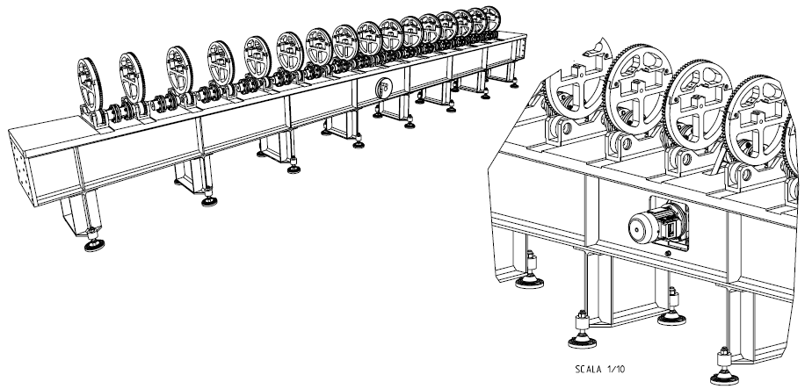
Bench for pairing and collaring
Main components for this bench are:
Support frame
Different sets of wheels properly shaped to allow the assembly of the components and its rotation, from the single coil to the fully collared assembly
Transmission of the motion: electrical motor / manual actuator
The system is designed in order to have a high stiffness, to minimize its deformation under load and keep the deformation of the coils within safe limits (i.e. 0.5 mm/m)
Courtesy Fantini Sud S.p.A.
Procurement in progress

Slide 21
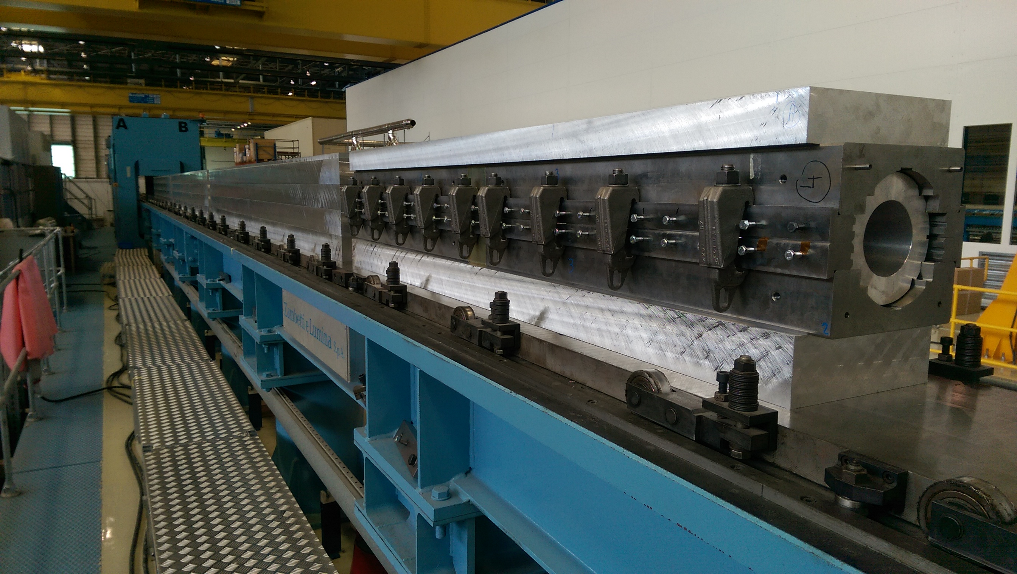
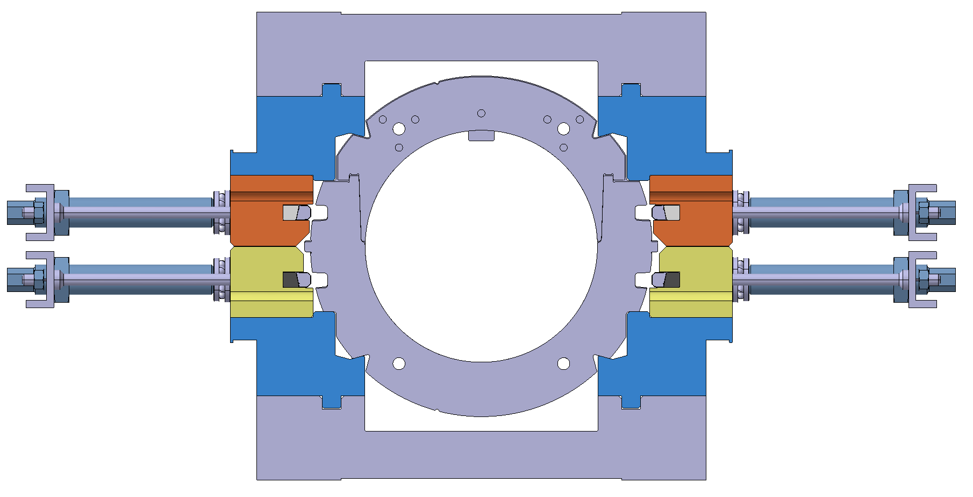
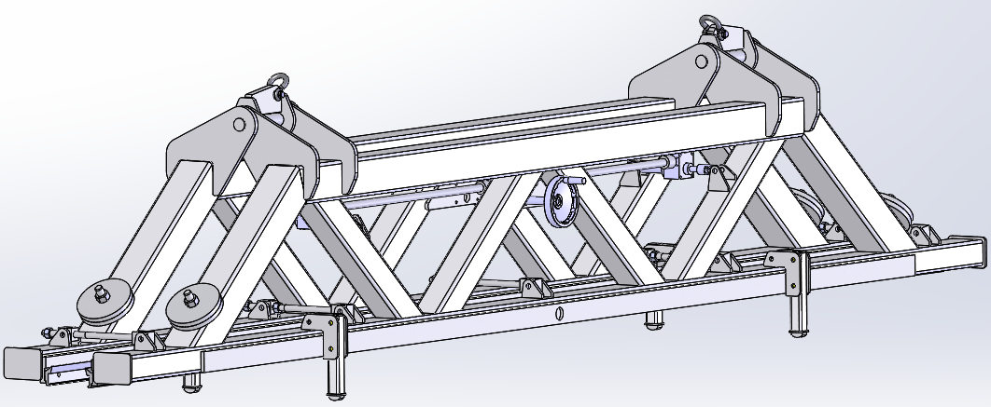
Collaring tool
The assembly of coils and collars is placed under the existing collaring press inside the collaring tool. This allows to transfer the force into the collars in order to achieve adequate pre-stress on coils.
Collaring press
Collaring test in bldg. 180 based on short model Al dummy coil
No hydraulic sectoring
Foreseen upgrade of obsolete control system
Procurement in progress | Design | Construction | Deliveries in 2016
Tool for the shaping of insulation |  | To be done | End of May
Bench for pairing and rotation |  | Ongoing | Beginning of June
Collaring tool |  | Ongoing | End of April
Lifting tool | Ongoing | To be done | End of July

Slide 22
Cold mass assembly

Slide 23
Cold mass assembly
Finishing benches
Geometry measurements
15m Welding press
Pressure/leak bench
Yoke assembly bench
Cold mass magnetic measurement bench
Welding press for 2m models
Half Yoke returning bench
Cold mass assembly bench
Collared coil returning bench
Collared coil magnetic measurement bench

Slide 24
Shell welding

Slide 25
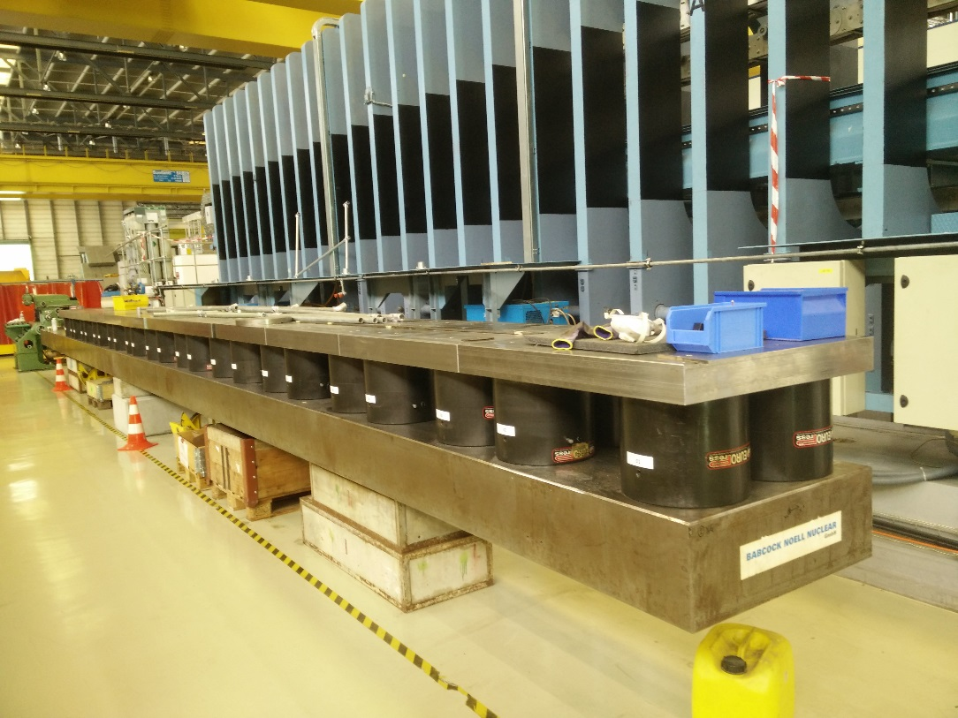
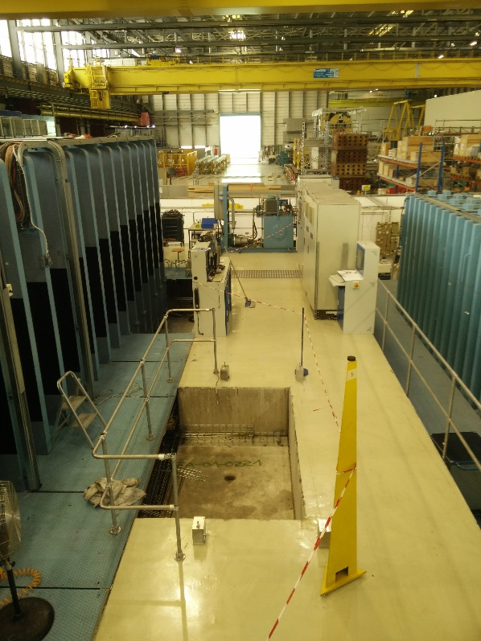
Hydraulic sectoring of Large Welding Press
Change the hydraulic system and sectoring of the press. Move the pressing cylinder from the bottom to the top (inverting pressing direction).
Allows sectoring flexibility while keeping the 15 m long pressing table
Modification implies to change the conveying system of the table in and out the press from friction wheel to cable winch
Change of the entire and obsolete control system
WEEK 17-18-19: install electrical and hydraulic
WEEK 20: test + reception at CERN
WEEK 22 (May 29th 2016): commissioning and training
Modification in progress

Slide 26
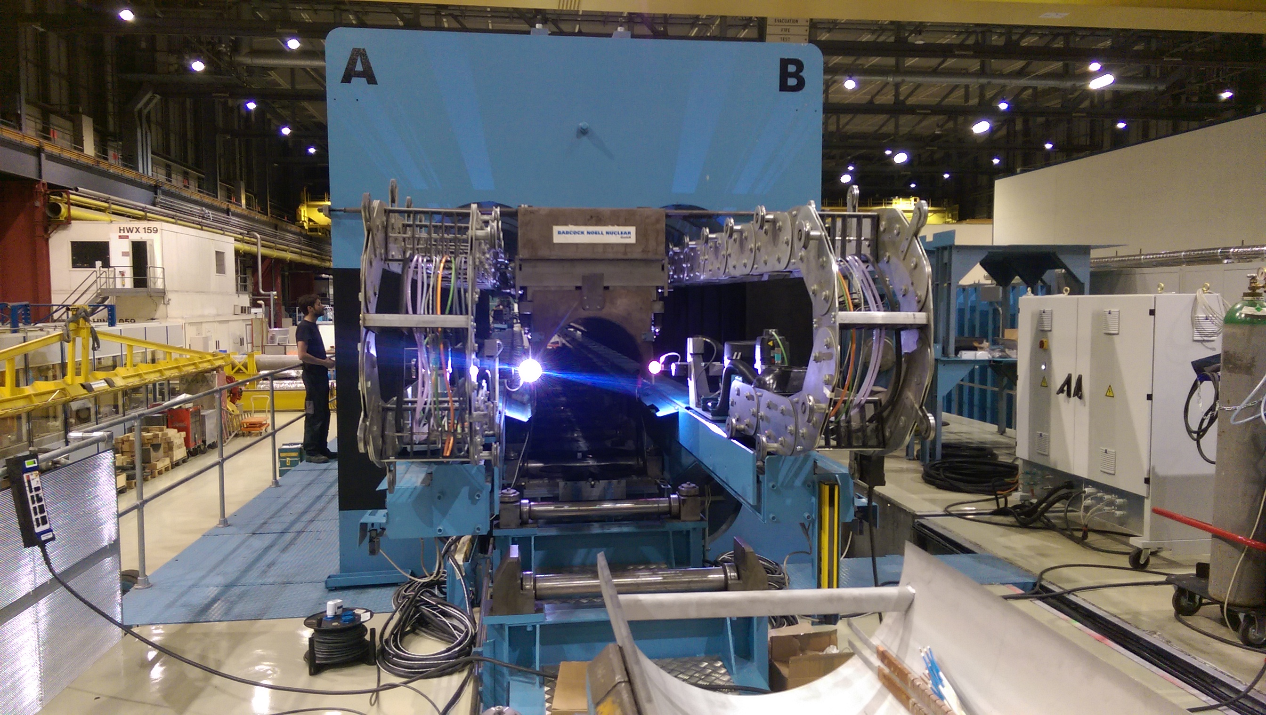
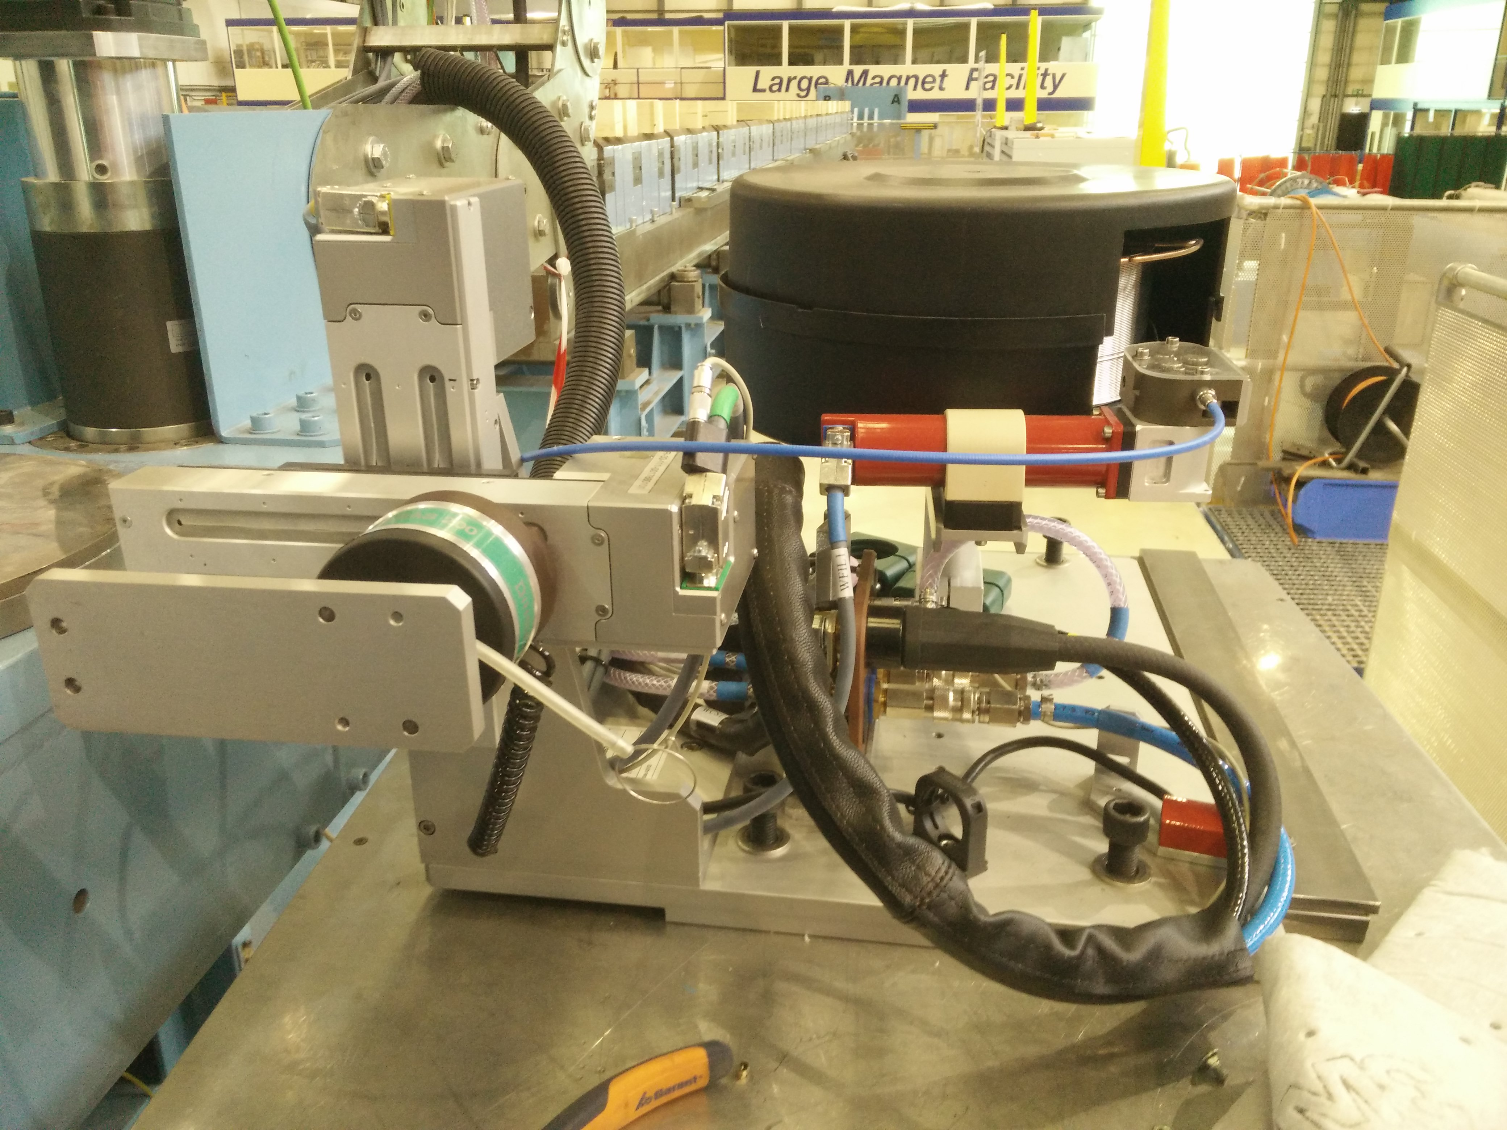
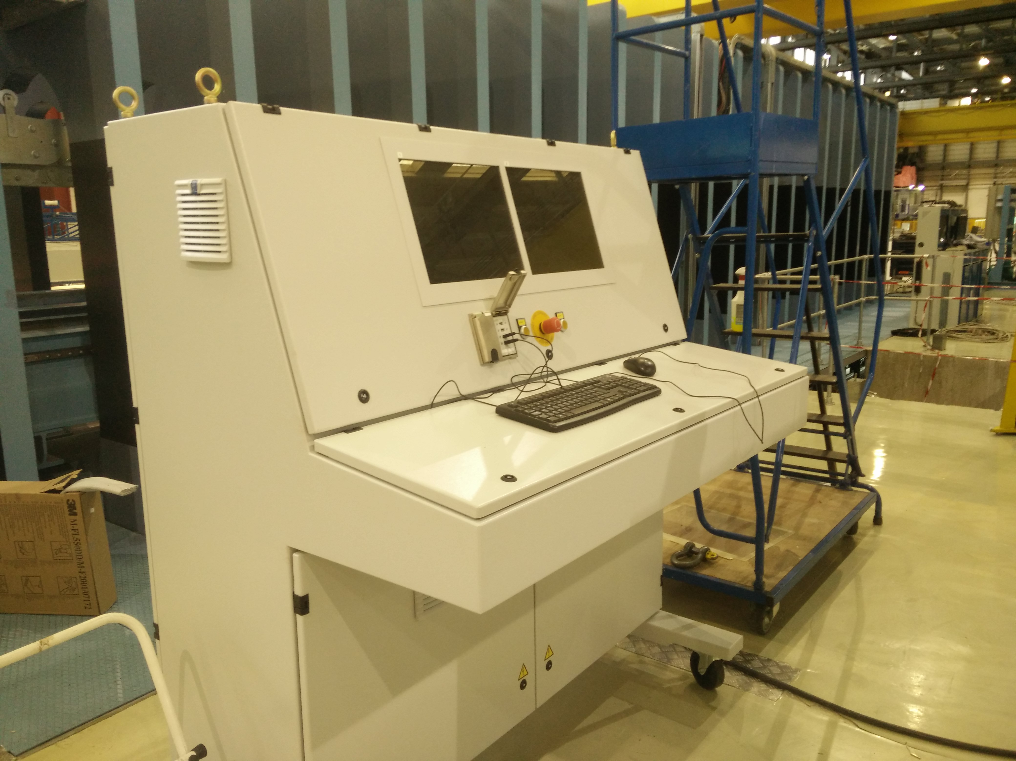
Welding equipment
New TIG welding system was fully integrated in the LWP
Welding units were successfully used during welding of short models
First trials were performed during the commissioning and final acceptance
Test welding is foreseen prior welding a 5.5 m shell
Installed
Comissioned
In operation

Slide 27
Coil metrology

Slide 28

Metrology instruments
Actions:
Geometrical assessment of coil
Tooling:
Measurement table – to be delivered
FARO-Arm (Coil metrology)
Lasertracker (Cold mass metrology)
Finishing benches and metrology
The laser tracker Leïca LTD500 will be replaced by AT-402 or AT-930.
Axyz software is being substituted by Spatial Analyser.
The Magnet Geometrical Measurement automated process (MGM-SA) is being programmed with EN-STI-ECE leaning on past developments (MGM).
Faro edge 2.7 will be used inside the winding house, delivery: already received
Granite table for winding house metrology, delivery: May 2016
Procurement and modification in progress

Slide 29
Leak testing

Slide 30
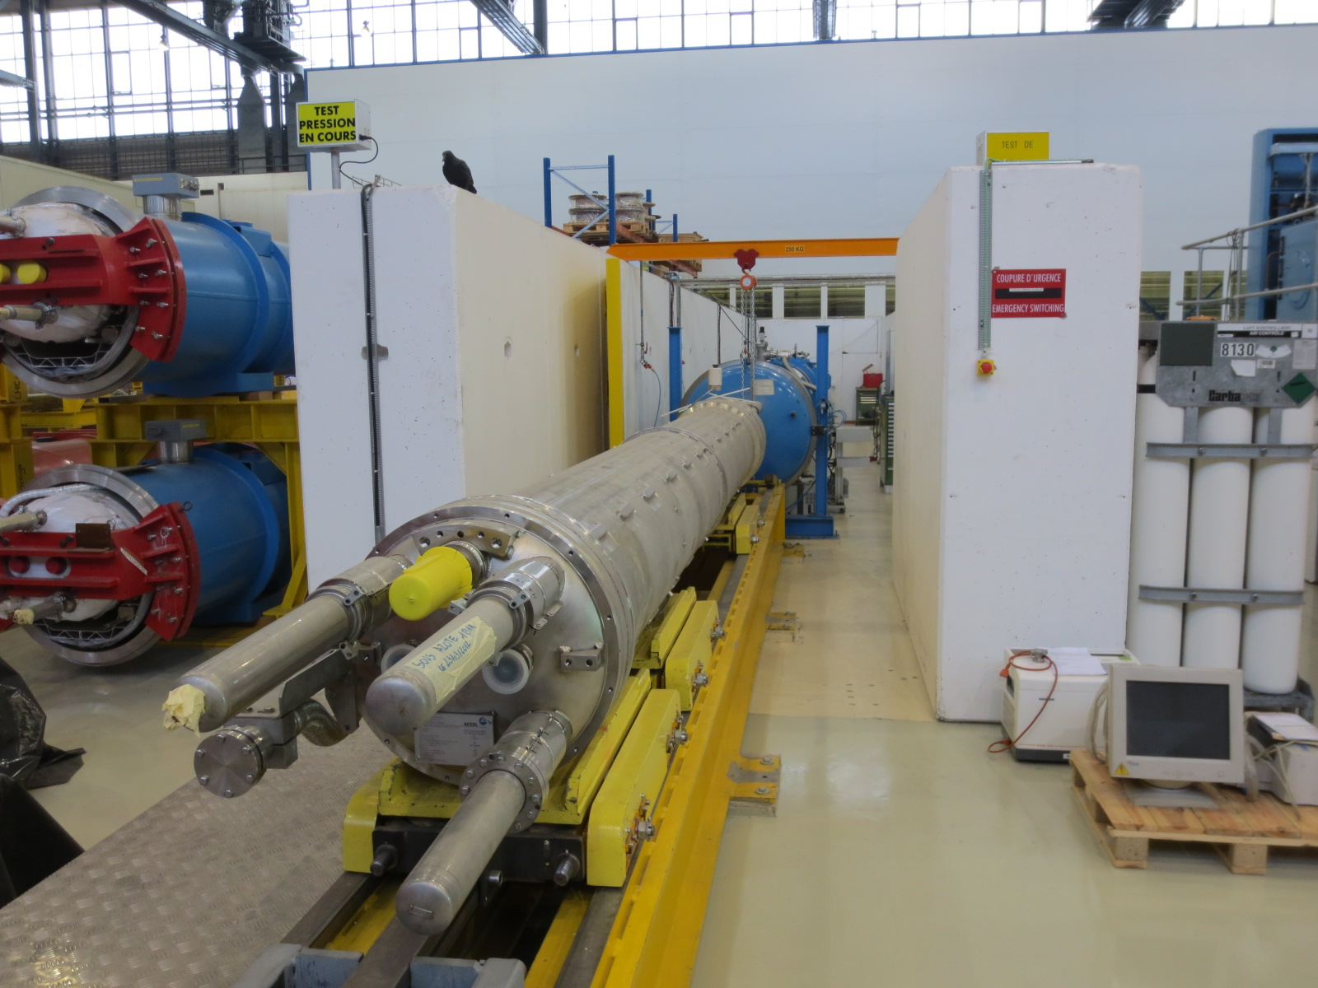
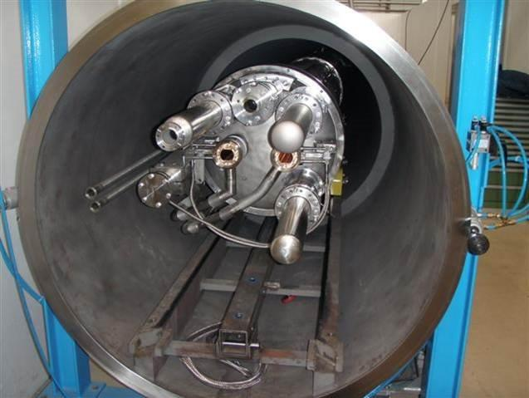
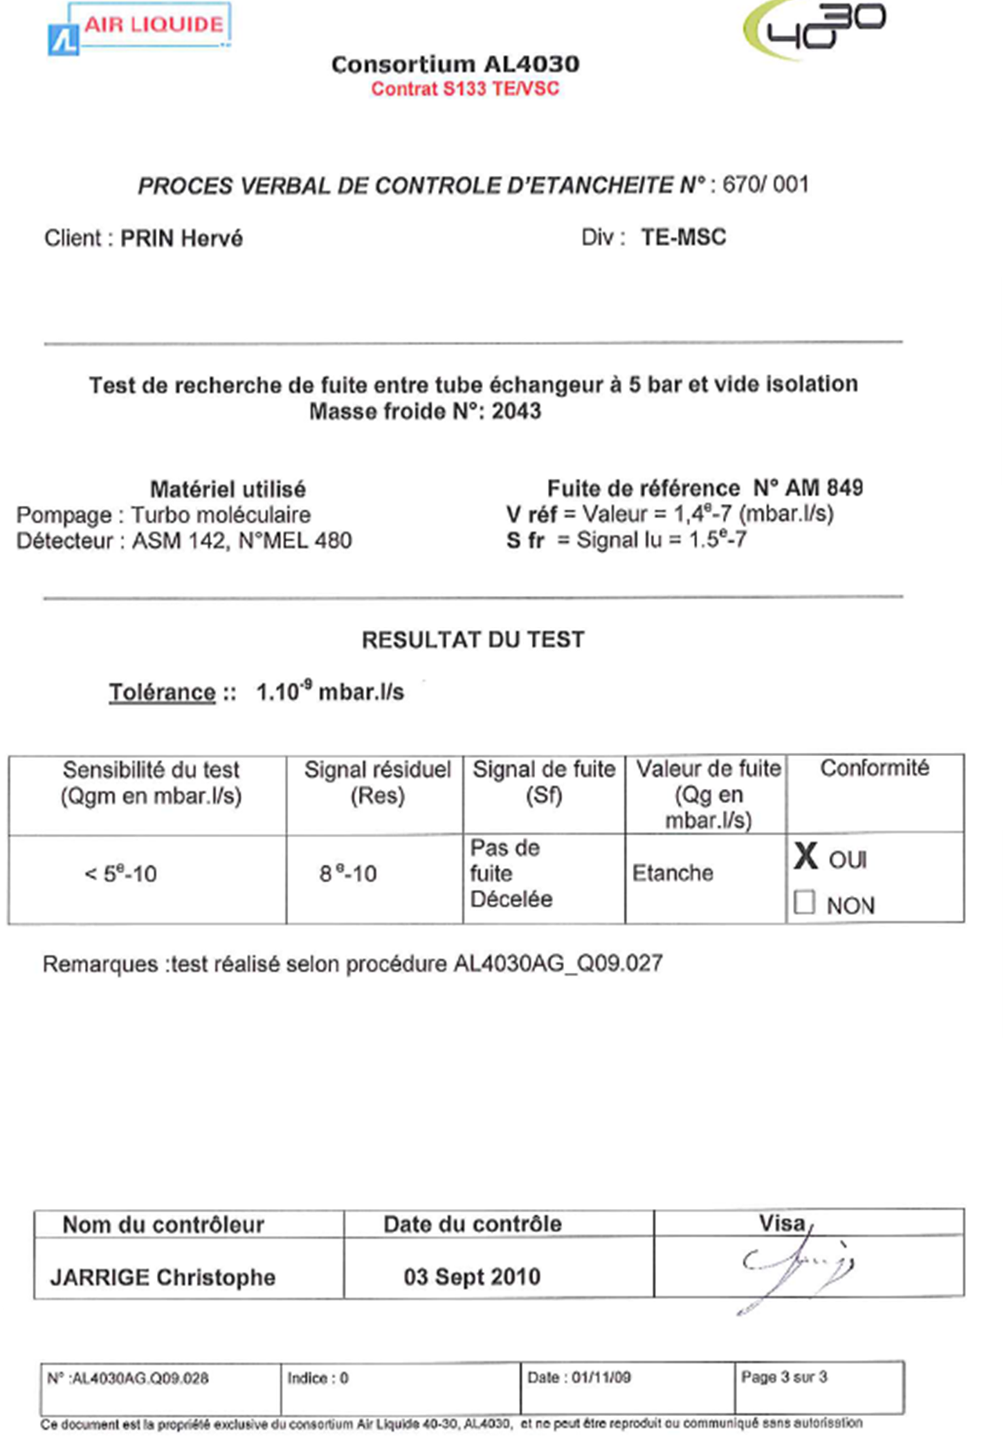
Pressure & Leak Test Station
Cold mass assembly with respect to insulation vacuum
[25 bar inside CM]
Heat exchanger with respect to cold mass assembly
[25 bar inside CM]
Heat exchanger with respect to insulation vacuum
[5 bar inside HET]
Additional test station is available in bldg. 181
Installed
Comissioned
In operation

Slide 31
Mechanical workshop & Busbar zone
Safety and quality aspects

Slide 32
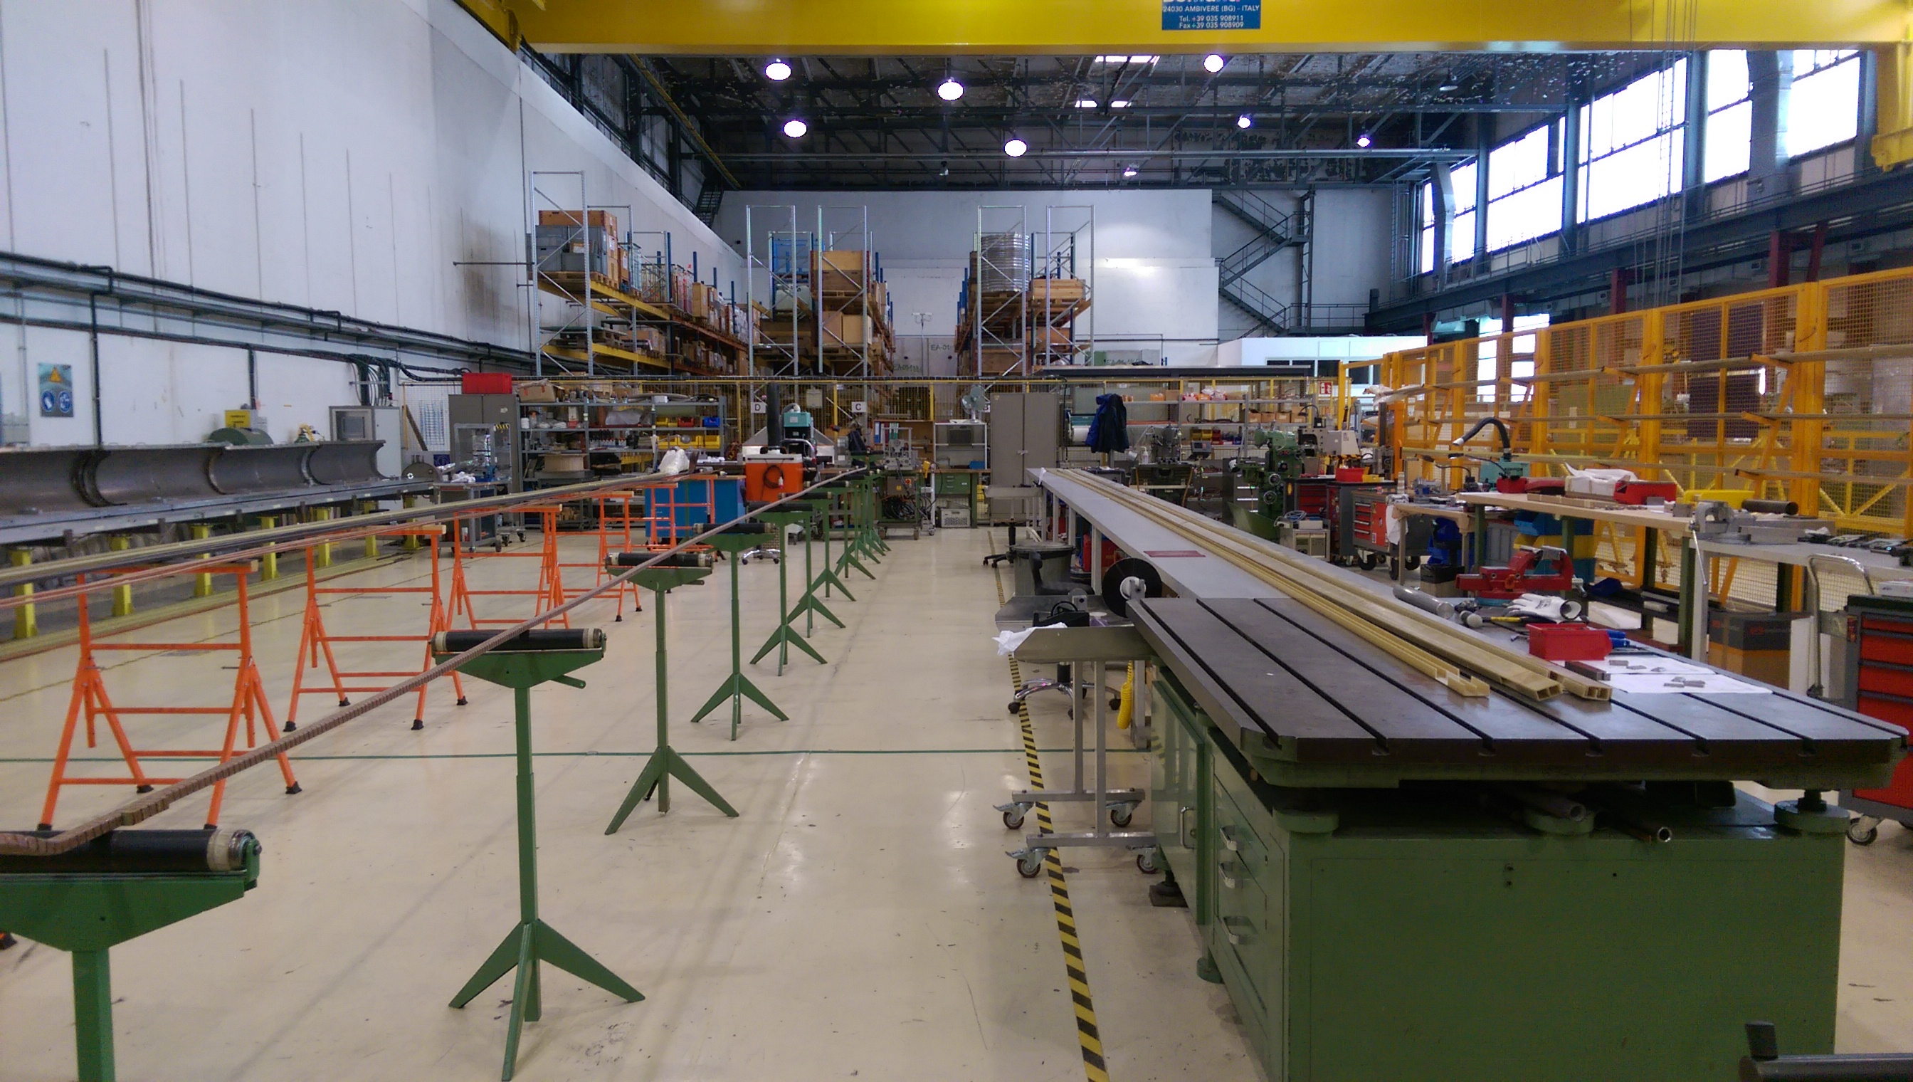
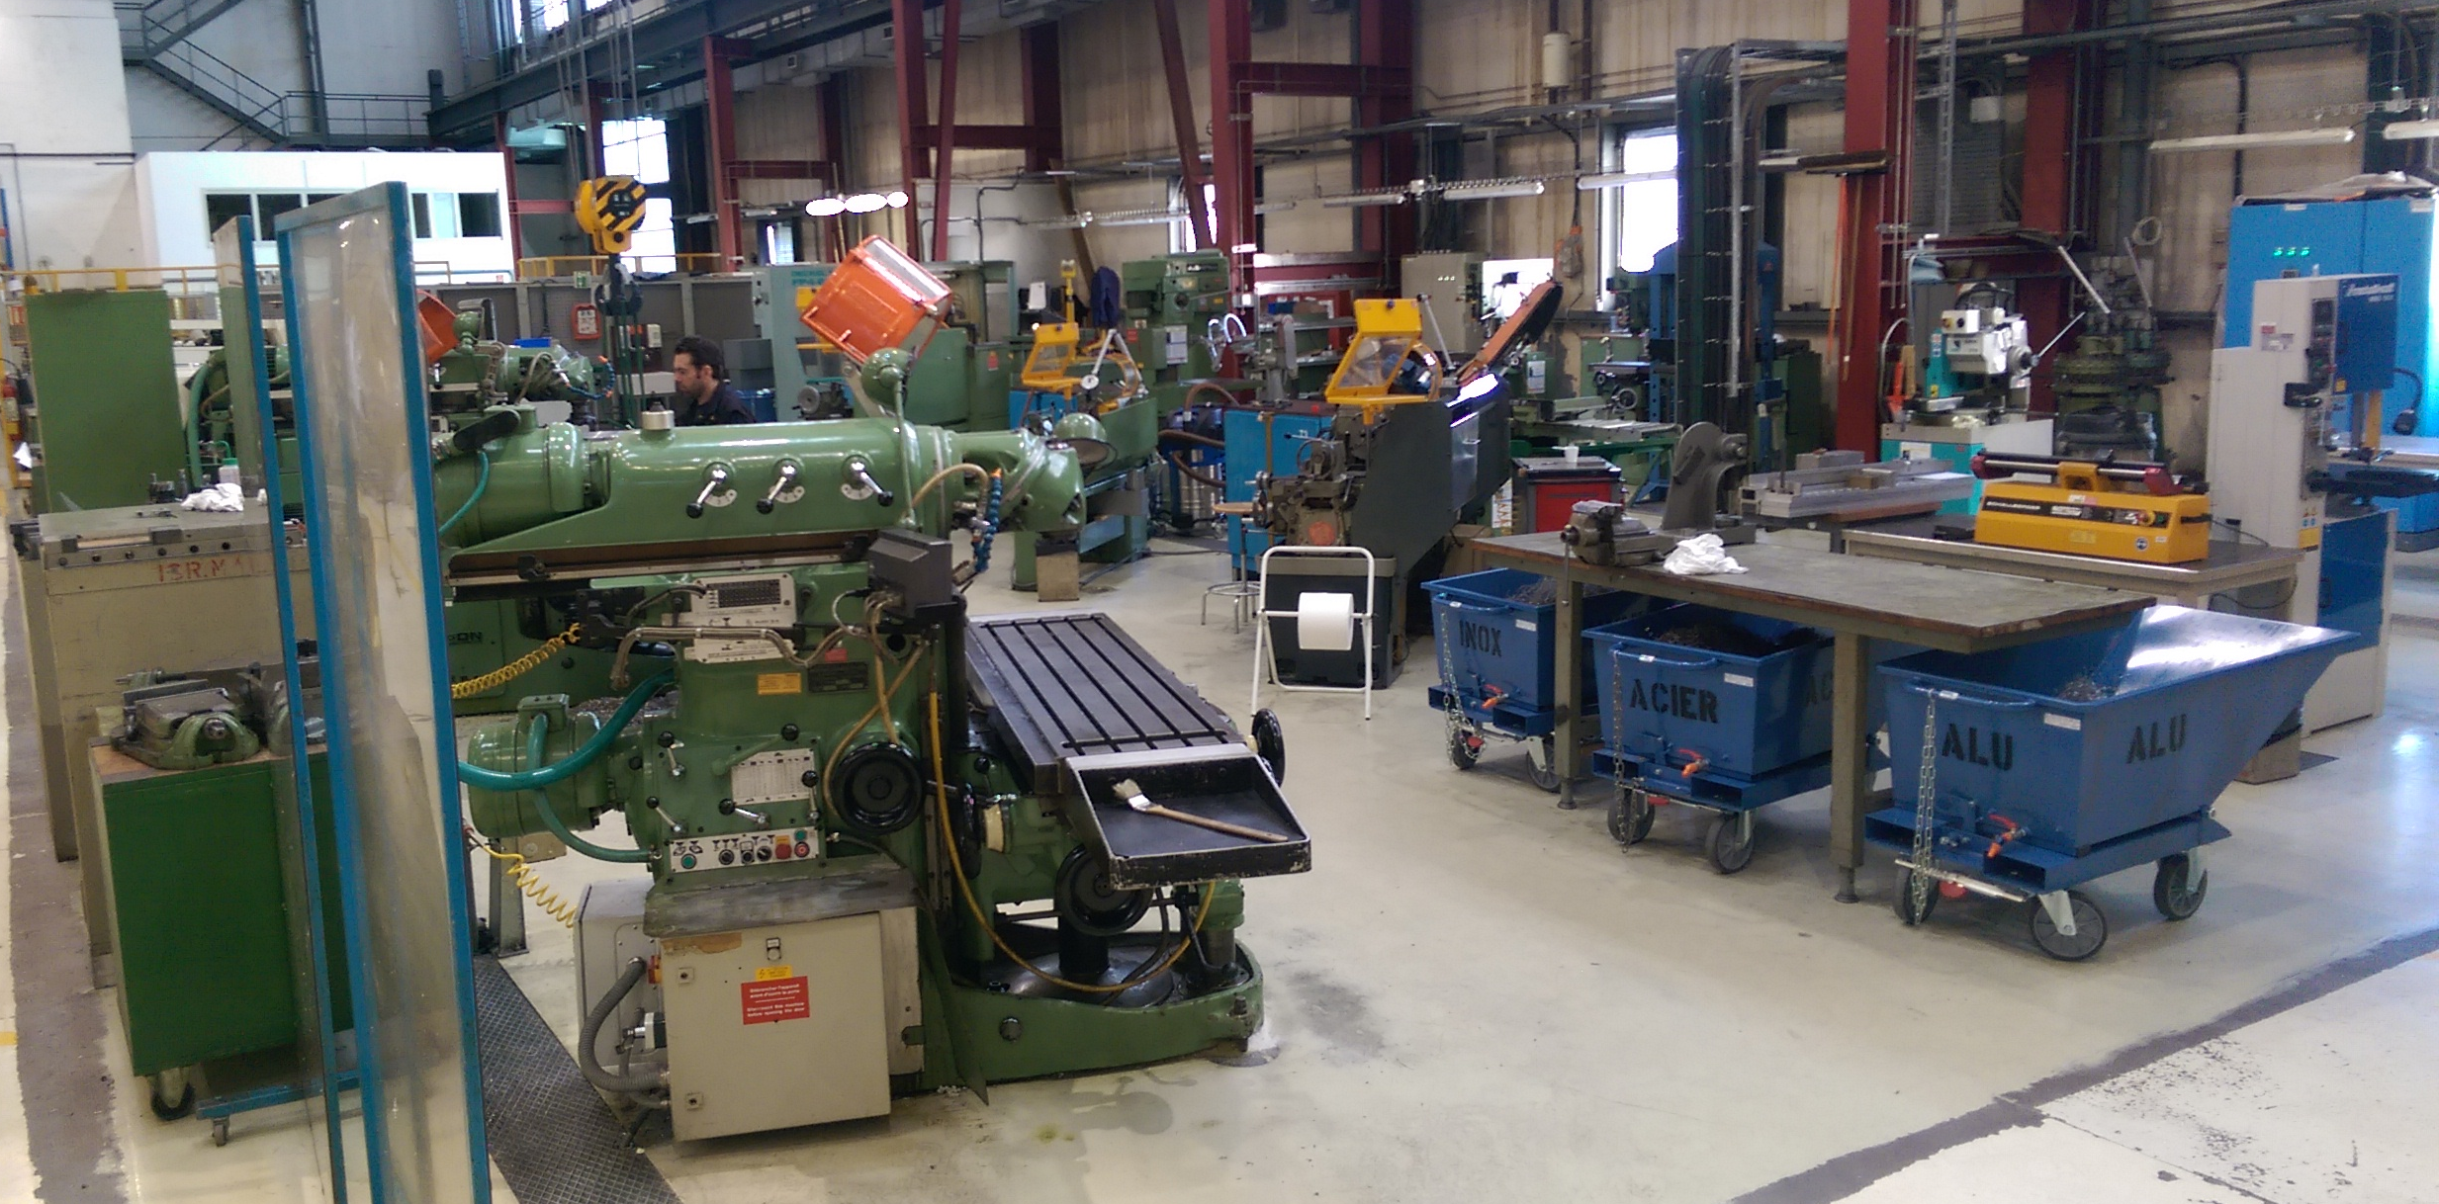
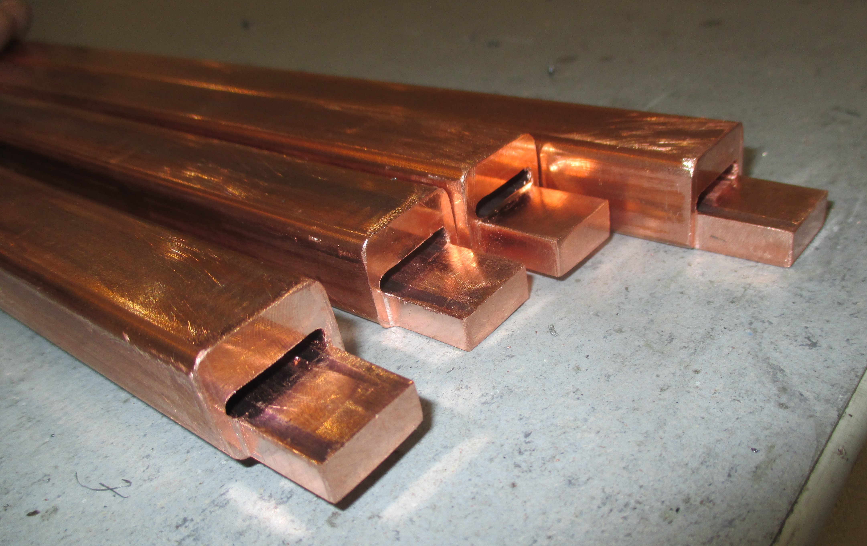






Mechanical workshop & Busbar zone
LMF - Busbar zone
LMF - Mechanical workshop

Slide 33





Safety and quality aspects
A CERN number is given for each machine.
All technical documentation relevant are archived inside EDMS:
    Certificate of conformity, User manual, Drawings…
A preliminary safety report is prepared by WP11 QA,
A safety diagnose is made by a certified company,
The working procedure written by WP11 QA includes the safety instructions,
Finally the workspace safety is analyzed by TE department.
Covered in detail by R. Principe & T. Otto (Session 3)

Slide 34
Risk mitigation and redundancy
Winding | 4 – 5 weeks | 2 winding machines are operational, MQXF machine is compatible with the 15 m LHC MB and the 5.5 m 11T design
Curing | 3 days | 1 curing tool
Reaction heat treatment | 14 days | Two furnaces will be available, each allows to heat treat two coils simultaneously.
Impregnation | 3 – 4 weeks | 1 system – bottle neck in the production flow
Collaring | 1 week | 1 system
Assembly | - | Assembly benches from LHC MB production and yoke assembly tool available
Shell welding | 1 week | 1 system, 2 welding units
Metrology | - | New laser tracker to replace the obsolete equipment FARO system for coil metrology, new measurment table
Leak test | - | 2 systems (180 & 181)

Slide 35
Impact of design change on the tooling
Production step | Change coil cross-section | Change collar outer diam. | Change of yoke diam./shape | Change of shell thickness/diam.
Winding & curing | X
RHT | X
Impregnation | X
Collaring | X | X | X
Yoking | (X) | X | X | X
Shell welding | (X) | (X) | X | X
Change of design parameters can result in a large impact on the tooling, inducing additional procurement and budget.

Slide 36
Conclusion

Slide 37
Conclusions
Production line preparation is close to finalization
Winding house – Transition to Nb₃Sn coil production is well advanced, finalization in summer 2016
Heat treatment – 2nd pair of reaction and impregnation fixtures will be ordered once the production process has saddled and no modifications are needed
Impregnation - Commissioning of impregnation system is ongoing
Continuous improvement is necessary for reducing onsite preparation time
Collaring - All tooling will be at CERN in June 2016
Test will be performed once the tooling was received
Launching update on obsolete hydraulic control system prior the series production
Assembly & shell welding - Finalizing sectoring of LWP (June 2016), performing a 5.5 m welding test with new TIG weld units.
Validate all remaining assembly process and tooling during first prototype assembly

Slide 38
Thank you
We are looking forward to your visit in the Large Magnet Facility

Slide 39
Spare slides

Slide 40


11T Dipole: Interlayer cutting template
Cutting of a 5.5m long glass fiber sheet
All tools have been improved to avoid damage of fiber glass (e.g. gentle edges and protective coating). The Insulation still remains very fragile.

Slide 41
Cable spooling operation
Around 750 m of insulated cable are splited in two reels for inner and outer layers
Insulation checks are performed on entire length prior the spooling operation
Installed
Comissioned
In operation

Slide 42

Training coils before first prototype
1st coil : Copper coil without insulation
  Winding & Reaction performed, not impregnated (copper only)
2nd coil : Copper coil with insulation
  Winding & Reaction finished, impregnation on going
3rd coil : Low Grade (CR001)
  Winding & Reaction finished
4th coil : Low Grade (CR002)
  Winding finished

Slide 43

Coil production for the prototype
5 coils
  4 for the prototype
  1 spare
1st Nb3Sn Full Performance coil (CR003) winding & curing finished
2nd Nb3Sn Full Performance coil (CR004) winding & curing finished
3rd Nb3Sn Full Performance coil (CR005) preparation for winding ongoing
4th Nb3Sn Full Performance coil (CR006) Cable not delivered yet, foreseen in June 2016
5th Nb3Sn Full Performance coil (CR007) Cable not delivered yet, foreseen in Sept. 2016

Slide 44
Bench for pairing and collaring
The preparation of the coils for the collaring will be done on bench.
The operations to be performed are:
Pairing of the coils
Installation of the beam tube between the coils
Installation of the layers of insulation around the coils
Placement of the collaring shoes
Placement of the collar packs around the coils

Slide 45
Collaring tool
4x60 collaring profiles:
they push on the collars
2x6m single piece baseplates
Automatic system for the pre-insertion and insertion of the keys.
System of pre-load given by springs.
Force applied by the press 14 MN/m:
9 MN/m absorbed by the tool
5 MN/m on the coils
Compression of the stoppers: 0.05 mm
Additional system for the insertion of the keys by means of screws manually driven.
To be used in case the automatic system is not sufficient.
Distance between the profiles:
70.05 mm
(adjustable by shims)
4x60 stoppers:
control of the stiffness

Slide 46
Lifting tool for collaring and collared coil assembly
A lifting tool is needed to lift and displace the coil:
From the bench of pairing and collaring, to the press before collaring
From the press to the bench of pairing and collaring, after collaring
From the bench of pairing and collaring to the yokes, after 90° rotation
Lifting points
Courtesy of Axzion
Frame open for visual control
Counter weights for balancing
Feet can be retracted when in use.
Rounded form, beam can be parked
when open or closed.
Built in spirit level
Bolts to secure against opening

Slide 47



Lifting tool
Rotatable clamps fixed by screws allow to change the configuration of lifting
Issue:
The current geometry will interfere with the yokes when inserting the first collared assembly inside the 2 in 1 aperture.
To be checked and solved.
Lifting from the upper groove of the collars.
From the pairing bench to the press
Lifting from the notches of the collars
From the press to the pairing bench
From the pairing bench to the yokes
The tool is designed in order to have a high stiffness,
to minimize its deformation under load and keep the deformation of the coils within safe limits (i.e. 0.5 mm/m)

Slide 48


Progress welding press
Removal of the upper press table and cradles
Invert pressing direction (bottom to top)
Dismantling of hydraulic system (hydraulic group, distribution box, tube, friction wheel with hydraulic motor,…)
Removal of obsolete electronic cabinets and obsolete control racks

