Slide 1
Cold acceptance tests and test bench readiness for the 11T cryodipoles.
G. Willering on behalf of TE-MSC-TF
With input from M. Bajko, G. D’Angelo, H. Bajas, G. Dib, O. Ditsch, C. Giloux, L. Fiscarelli, F. Savary, M. Strychalski and others
Review of the 11T dipoles at Collimator Section for the HL-LHC,
6-8 April 2016, CERN

Slide 2
Content
Test bench readiness
  SM18 test station
  Modifications of the benches
Hardware commissioning in the LHC
  Individual system tests
  Circuit tests
Acceptance tests in SM18
  Prototype testing
  Baseline for series cold powering tests.
  Documentation for acceptance tests and quality assurance

Slide 3
Introduction
The 11 T magnet
  has inductance
  has voltage taps
  has stored energy
  has quench heaters
  has one main circuit
  needs a test bench
  needs quench detection
  needs data aquisition
  needs data analysis
From a electrical point of view there is not much difference between the MBH and MB magnets,
but it falls out of our current standards and needs considerable preparation, modification, bench instrumentation, Quality Assurance and documentation.

Slide 4
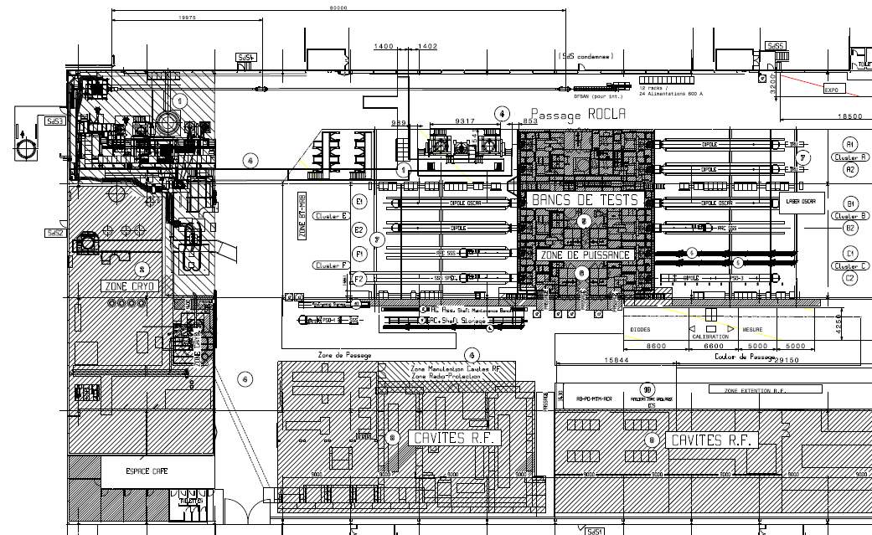
The SM18 magnet test station
zone reserved for the SC LINK TEST STATION and HL-LHC IT STRING
VERTICAL TEST CRYOSTATS
Cluster G
HORIZONTAL TEST BENCHES
Cluster A-F
CLUSTERS
C B A
CLUSTERS
F E D
CRYOGENIC ZONE
Superconducting RF CAVITY TEST ZONE
LN₂ TEST ZONE
About 50% of the total area of 7200 m² are dedicated to magnet tests and cryogenic installations

Slide 5
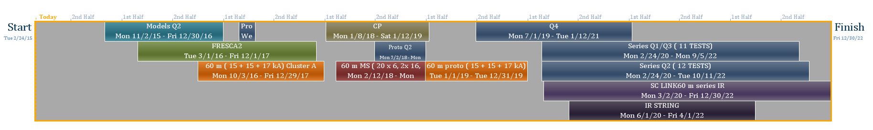
SM18 test charge
New horizontal test bench for higher current (up to 20 kA + 2 x 2 kA)
Modification of existing bench for multiple powering circuits
Additional horizontal test bench for higher current (up to 20 kA + 2 x 2 kA)
2015 2016 2017 2018 2019 2020 2021 2022
TEST OF 11 T
New vertical cryostat for larger diameter and higher current
New vertical cryostat for larger diameter
Magnets, Cryo line and SC link
New powering SC link
Serious upgrades needed for triplet and string test
Due to similarities between MB and MBH magnets easier reuse of existing benches.
IR powering schematics + New Feed box

Slide 6
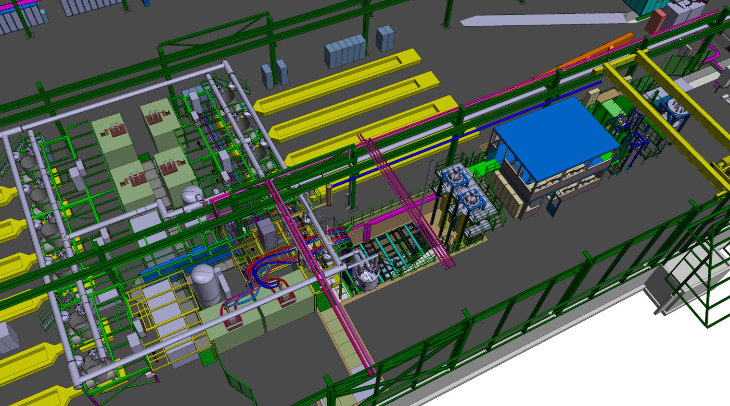
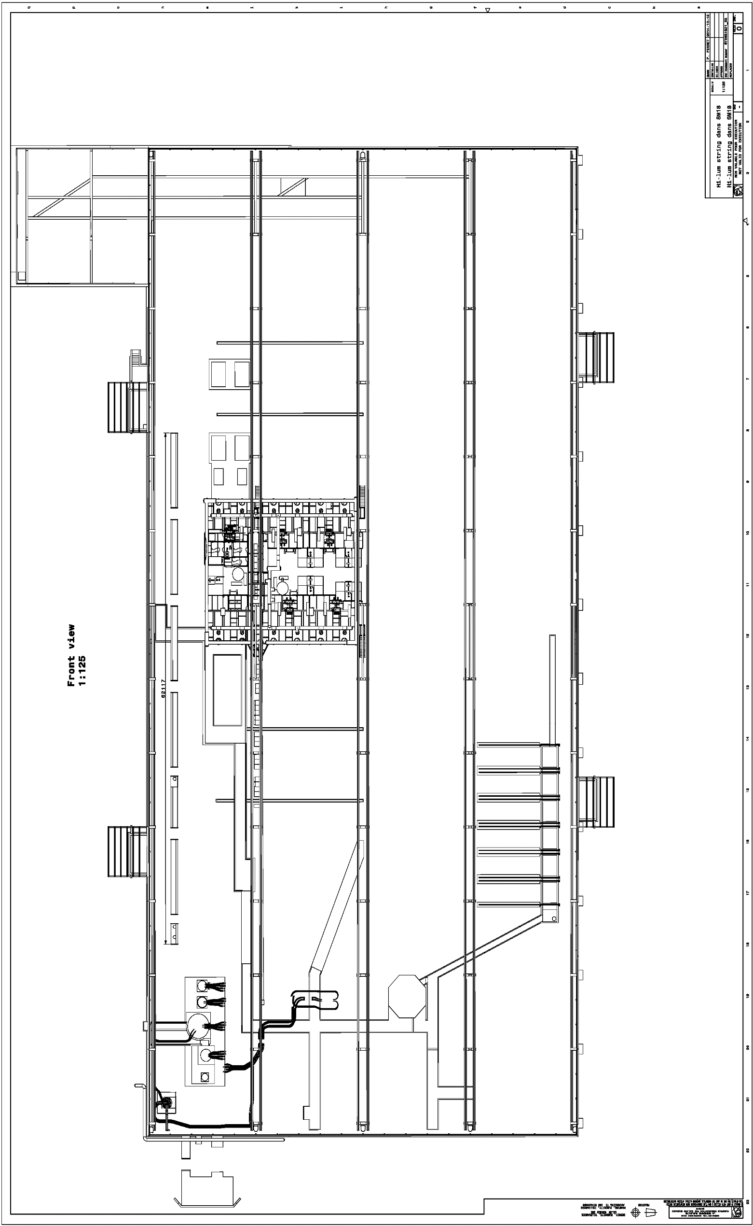
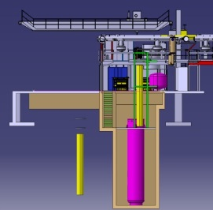
SM18 upgrades this year
New vertical test bench in cluster D:
  Max diameter = 800 mm
  Max length = 5 m
  Max current = 30 kA with EE
Horizontal cluster A for cryoassemblies upgrade
  Max current = 20 kA
  2 x 2 kA circuit for correctors
Cluster D
Cluster A
Cluster E
Cluster B
Cluster F
Cluster C

Slide 7
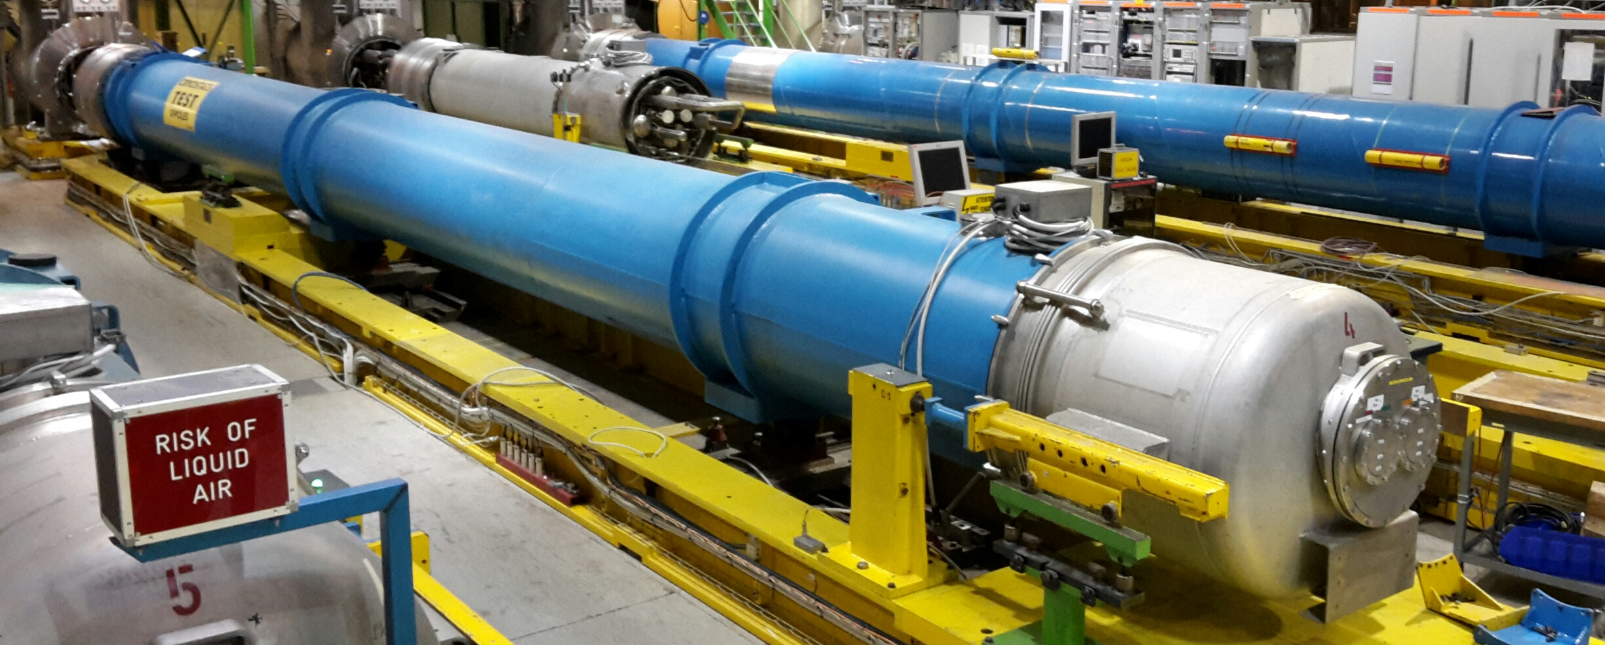
Prototypes and series tests
First prototype 2017
Test of 15 meter assembly including bypass cryostat end 2018
LBH_A
By-pass cryostat
LBH_B

Slide 8
Test bench availability
Available powering
  14 kA power converter, 20 V, may be upgraded.
  Leads qualified to voltage withstand level of 3.1 kV
Cooling steps, currently available
  Controlled cooldown to 80 K with N₂ cooled He gas.
  To 4.5 K with LHe
  With the heat exchanger cooled to 1.9 K.
Planning
  Test station available typically 10 months per year. Maintenance around Christmas break.
  Major upgrades on infrastructure foreseen in 2019, blocking the cold tests for 4-5 months.

Slide 9
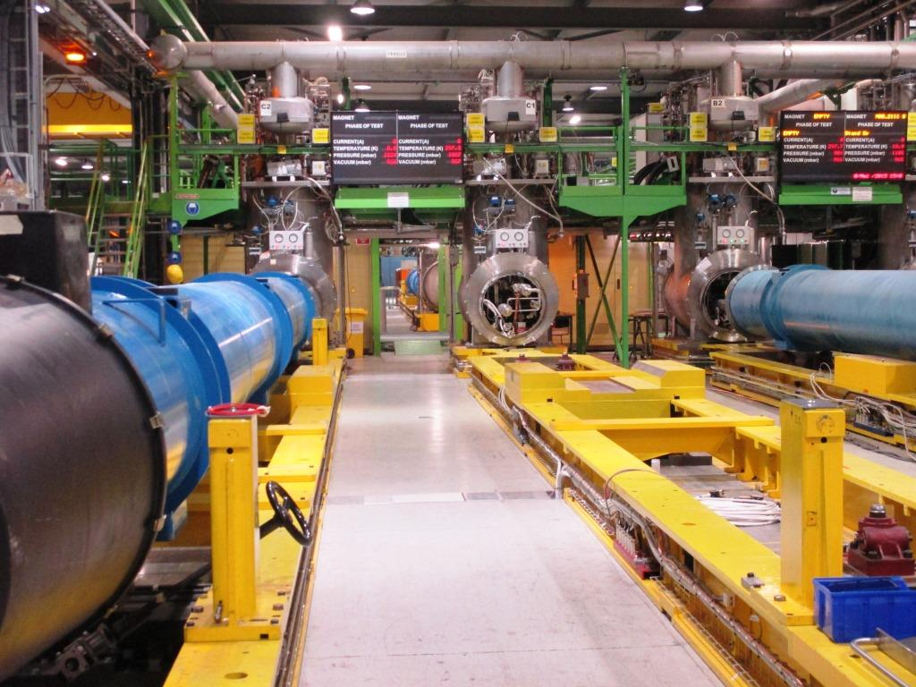
Test bench modifications
CFB
Very similar connectivity as main dipole magnet
  Work in progress between LMF, CMI and TF sections
  No modifications foreseen on CFB side
  Some modification foreseen on MRB side.
Modification of the support feet needed.
Cluster A (two benches), will be modified to handle the Nb₃Sn magnets.
Magnetic measurements (by MSC-MM)
Same bore size in MBH compared to MB
Anticryostats for magnetic measurements need to be modified (shortened).
MB magnetic measurement shaft segments will be modified to fit shorter magnet length.
MRB

Slide 10
Test bench modifications
Instrumentation
  40 – 50 vtaps wires from 2 MBH units assembly
Quench heater circuits:
  4 in MB, 8 in single unit MBH and 16 in two units MBH.
  Higher current rating
Quench detection system
  New QDS in development for the quench detection system. Prototype expected this year with variable detection thresholds (see HiLumi circuit review by J. Steckert, indico 477759)
Quench Heater Discharge units
  Need electronics upgrade to reduce QH delay from 5 to < 1 ms. (TE-MPE)
  Need to handle 150 A during discharge from ± 450 V with 7 mF of capacitance
Request (see presentation S. Yammine) to test the trim power converter in combination with main power converter. Test goal and type under discussion.

Slide 11
Content
Test bench readiness
  SM18 test station
  Modifications of the benches
Hardware commissioning in the LHC
  Individual system tests
  Circuit tests
Acceptance tests in SM18
  Prototype testing
  Baseline for series cold powering tests.
  Documentation for acceptance tests and quality assurance

Slide 12
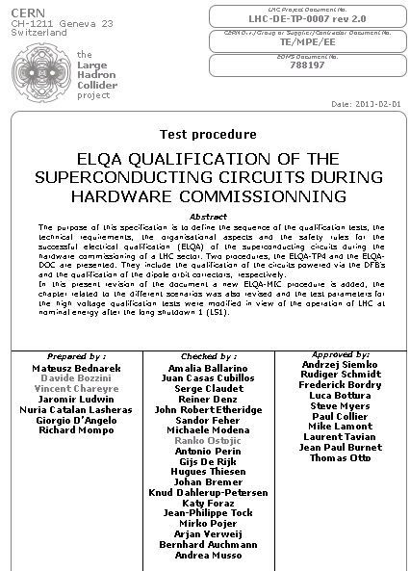
LHC: Individual System Tests
Tests and documentation by ElQA, see EDMS 788197 and QPS teams
Major updates in 2013, see also presentation in TE-TM, EDMS 1250945
Currently used in the LHC circuits
Test name
ORC | Ohmic Resistance Circuit
HVQ | High Voltage Qualification
TFM | Transfer Function Measurement
ICC | Instrumentation Continuity Check
DPC | Diode Polarity Check
MIC | Magnet Instrumentation Check

Slide 13
LHC: Individual System Tests
Instrumentation check
  Voltage tap verification, magnet resistance measured.
HV test QH vs Coil+ground
  600 V at 300 K
  2 kV at 1.9 K
Quench heater resistance tests
QPS tests
  Discharge voltage 200 V in quench heaters
Changes with 11T MBH magnets
  More QH circuits, more vtaps, but same tests
  Trim circuit to test in addition.

Slide 14
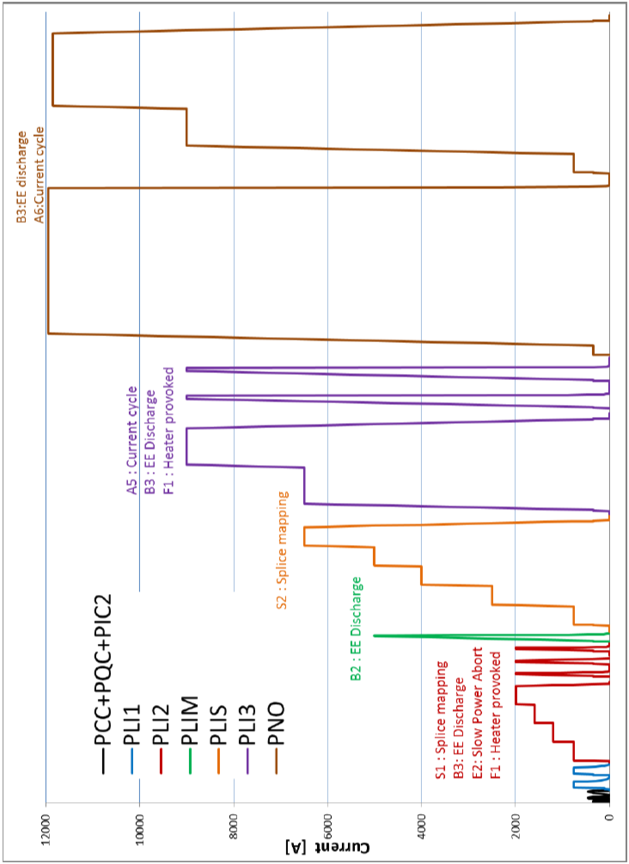
LHC: Circuit tests
HV test at 1.9 K at cold from magnet to ground at 2.1 kV.
  MP3 requests no changes to this value (see Verweij in HL-LHC circuit review, indico 477759)
Powering tests up to I_{nominal} + 100 A.
Hardware commissioning procedures by MP3: EDMS 874713.
Splice mapping at 1.9 K at high current specifically for bus bar segments.
Test of protection systems and powering interlocks.
MP3: EDMS 874713
Main change in circuit test linked to the trim, see presentation S. Yammine. Additional cycles may be added.
Using trim one could imagine ‘overtraining’ the MBH 250 A more compared to the rest of the circuit.

Slide 15
Content
Test bench readiness
  SM18 test station
  Modifications of the benches
Hardware commissioning in the LHC
  Individual system tests
  Circuit tests
Acceptance tests in SM18
  Prototype testing
  Baseline for series cold powering tests.
  Documentation for acceptance tests and quality assurance

Slide 16
Prototype testing
Feedback on magnet performance needs quench localization.
  Much less voltage taps in prototype than in model coils
  Longitudinal localization using magnetic measurement shaft as pickup coils
  Other methods of quench localization may still be discussed.
Feedback on correlation of magnetics between warm an cold measurements during the magnetic measurements.
No full research program established yet, but it can include:
  Protection studies like Minimum Quench Energy, QH redundancy tests, training up to limit, etc.

Slide 17
MB-series baseline cold acceptance tests
Warm tests in SM18 after transport
  HV test at 600 V
  Preparation and test of electrical connections to test station
  QH discharge at T_{room} + resistance measurement
  Coil resistance measurements
  HV test after connection at 300 K at 600 V.
  Leak tests
Cold tests, current situation
  HV test at 1.9 K liquid at 3.1 kV
  Re-check of all instrumentation, QH and protection cards.
  Powering to ultimate current of 12.85 kA, flattop test of 4 to 8 hours.
  Cold magnetic measurements are not part of standard qualification tests. For 11 T magnets it is planned to have cold magnetic measurements for all magnets.
  Internal resistance measurements
New tests
  Trim lead powering test

Slide 18
High Voltage Withstand Level
A short to ground is a show-stopper for a circuit: important test
Possible test at intermediate temperature of 80 K
  High Voltage Withstand Levels Working Group investigates testing at 80 K in He gas to qualify the magnet at relatively low voltage for a high voltage in liquid. There is no final recommedation yet.
  Earlier documentation:
  See F. Rodriguez, Voltage withstand levels for electrical insulation tests, EDMS 90327
  See P. Fessia et al.: Guidelines for the insulation design and electrical test of superconducting accelerator magnets during design, assembly and test phase, EDMS 1264529
Test bench (current leads and CFB) are designed for 3.1 kV in liquid and gas conditions.

Slide 19
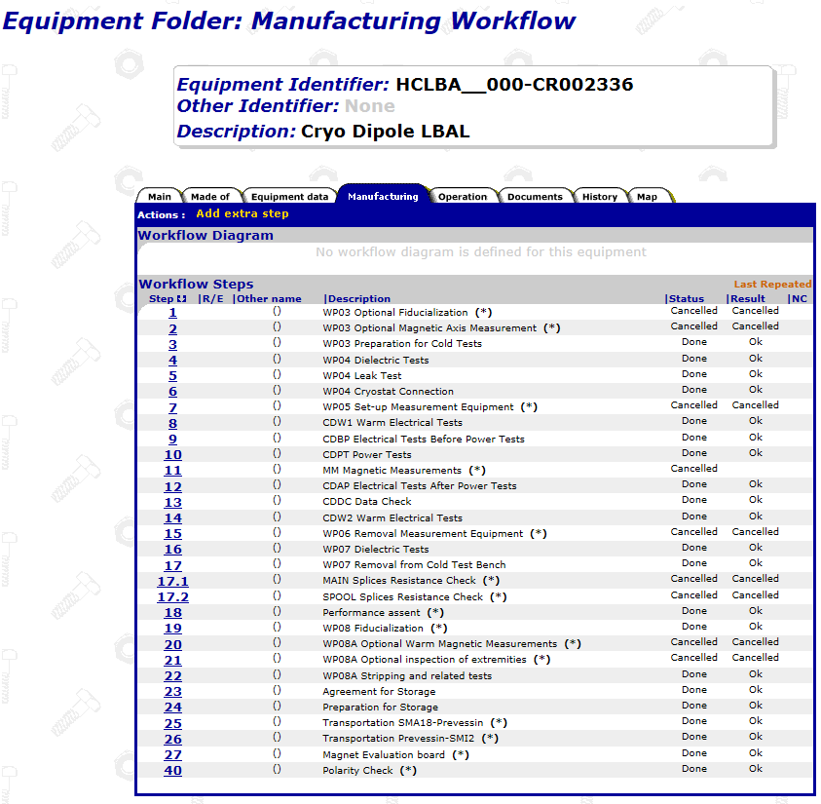
Quality assurance documentation
Direct follow-up of production QA, see presentations by R. Principe and A. Foussat
MTF is the official place for tracking manufacturing work flow up to cold powering tests
Is in already availble for all main dipoles
Possible specific steps may be added.

Slide 20
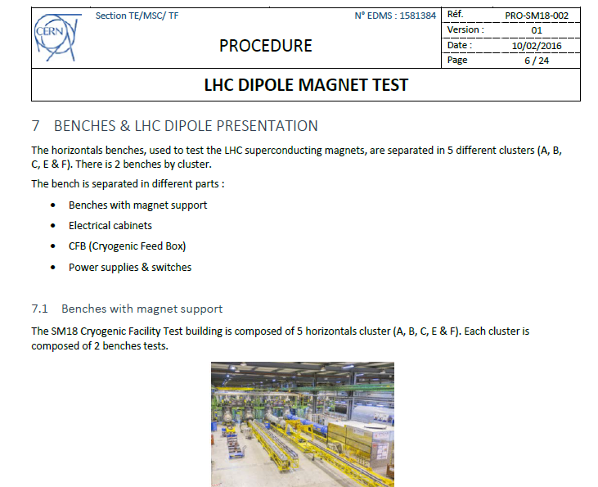
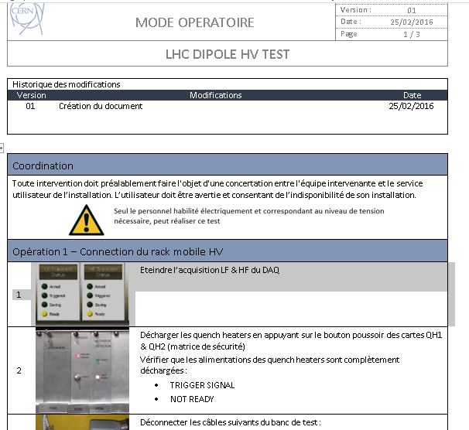
Quality assurance documentation
Test procedures are currently being updated, major work done by O.Ditsch, soon published in EDMS.
All Modus Operandi well documented and structured, made up to date, soon to be published in EDMS.
Safety documents to comply with documentation for HL-LHC work is in progress.

Slide 21
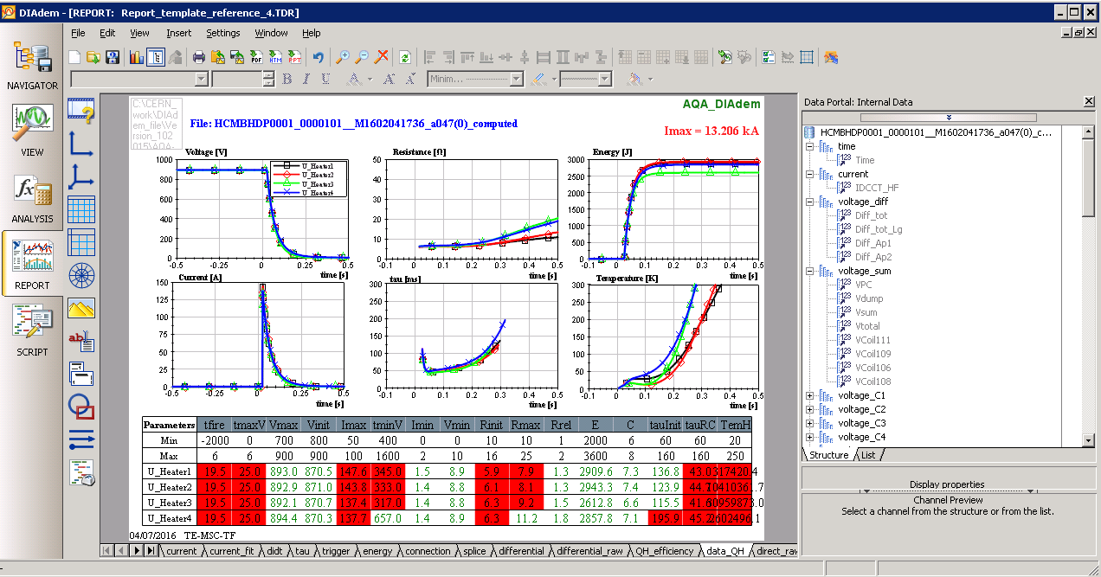
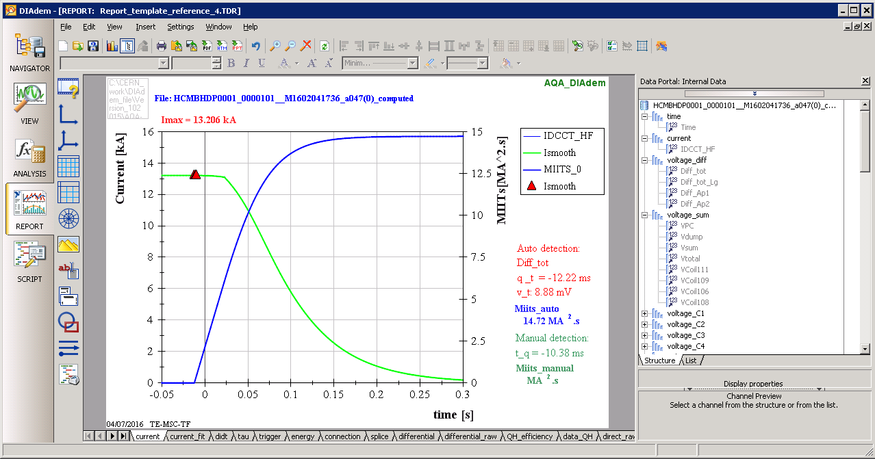
Automated Data Analysis
A renewed, more powerfull Automated Quench Analysis tool (AQA) has been implemented in DIAdem, with a main effort by H. Bajas and support from EN-STI-ECE
Shared with partner labs in US for homogeneous analysis and reporting.
Reference: H. Bajas et al., A novel Superconducting Magnet Test Results Analysis Platform for the CERN-SM18 facility test benches, ICMC-CEC 2016, to be published.

Slide 22
Conclusions
Acceptance tests
  No main deviations in principles from MB tests, but changes to standard test to be implemented.
  Prototype and series test plans to be defined
  Changes in procedures for LHC to be defined.
Test bench readiness
  Modifications to supports and MRB
  New QDS and QHD units foreseen by MPE
  Trim leads to be tested
  QA documentation updates in progress.
Everything is feasible
Nothing is for free

Slide 23
Thank you

