Slide 1

New Cross-section and its rationale
Emelie Nilsson and Susana Izquierdo Bermudez
With acknowledgement to:
C. Loeffler, F. Savary, G. de Rijk, J.C. Perez, L. Bottura, E. Todesco,
B. Bordini, J. Fleiter, M. Karppinen and D. Smekens.

Slide 2
Need for new design
Performance degradation of PIT conductor during cabling.
[Talk by B. Bordini: CERN Superconductor and cable design and performance]
For LS3: New PIT cable geometry needed to reduce critical current degradation.
Thin edge thickness critical for conductor performance.
Before heat treatment | Bare thickness in (mm) | Bare mid- thickness (mm) | Bare thickness out (mm) | Bare width (mm) | Keystone angle (deg.) | I_{c} degradation
First Gen. Design | 1.149 | 1.250 | 1.351 | 14.7 | 0.79 | 6-10%
Option 1 | 1.206 | 1.270 | 1.334 | 14.7 | 0.50 | <5%
Option 2 | 1.199 | 1.250 | 1.301 | 14.7 | 0.40 | <5%
Option 3 | 1.186 | 1.250 | 1.314 | 14.7 | 0.50 | ~5%
interpolated value
(to be confirmed)
Notes:
Include estimates on cable degradation

Slide 3
Contents
Need for new design
Coil cross section optimized with ROXIE
  Guidelines for optimization
  Proposed new cross-sections
  Fine tuning capabilities on the cross section
Magnet parameters
Iron saturation
3D effects
Summary

Slide 4
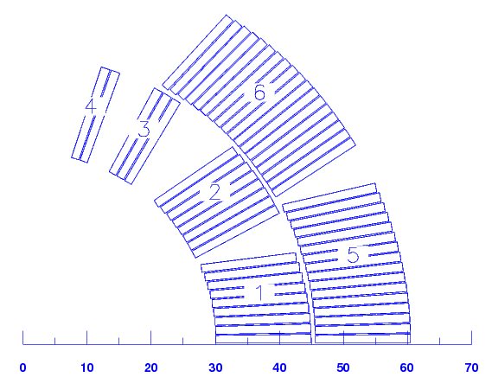
Guidelines for the optimization
    Assumptions on cable growth during heat treatment:
    1 % growth in width
    3 % growth in mid-thickness
    Keystone angle unchanged
Avoid sharp edges on wedges
Keep position of block 4 (winding condition)
Blocks as radial as possible
Minimize impact coil production and performance
Notes:
Our approach: to have a coil cross section as close as possible to the current design

Slide 5
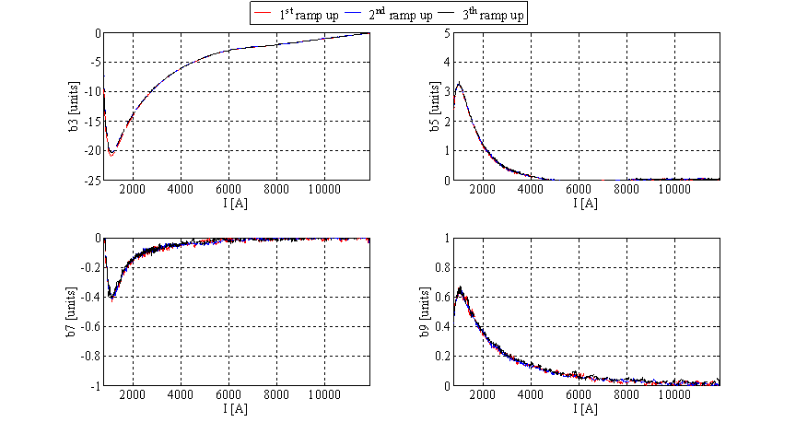
Persistent current effects in MBHDP101
Geometrically shifted to show the persistent current contribution.
Notes:
measurements

Slide 6
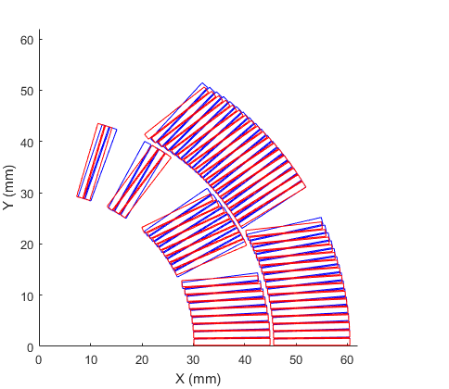
Optimized cross section, Cable Option 2
Keystone angle: 0.4°, Bare inner thickness after HT: 1.236 mm
New design
 | Systematic - First Generation |  |  |  |  | Max.Persistent at I = 1100 A
Normal | Geometric | Saturation | Persistent | Injection | High Field
B₁ (T) |  |  |  |  | 11.221
b₂ | 0.000 | -14.500 | 0.000 | 0.000 | -14.500 | 0.000
b₃ | 7.459 | -0.400 | -8.000 | -0.541 | 7.010 | -20.000
b₄ | 0.000 | -0.400 | 0.000 | 0.000 | -0.550 | 0.000
b₅ | -0.014 | 0.100 | 2.500 | 2.486 | 0.100 | 3.400
b₆ | 0.000 | -0.020 | 0.000 | 0.000 | -0.020 | 0.000
b₇ | -0.093 | 0.062 | 0.200 | 0.107 | 0.100 | -0.400
b₈ | 0.000 | 0.000 | 0.000 | 0.000 | 0.000 | 0.000
b₉ | 0.912 | 0.028 | 0.450 | 1.362 | 0.960 | 0.600
First gen. design
 | Systematic - Cable Option 2 |  |  |  |  | Max.Persistent at I = 1100 A
Normal | Geometric | Saturation | Persistent | Injection | High Field
B₁ (T) |  |  |  |  | 11.220
b₂ | 0.000 | -14.500 | 0.000 | 0.000 | -14.500 | 0.000
b₃ | 7.220 | -0.400 | -8.000 | -0.780 | 6.820 | -20.000
b₄ | 0.000 | -0.400 | 0.000 | 0.000 | -0.550 | 0.000
b₅ | -0.014 | 0.100 | 2.500 | 2.486 | 0.040 | 3.400
b₆ | 0.000 | -0.020 | 0.000 | 0.000 | -0.020 | 0.000
b₇ | -0.093 | 0.062 | 0.200 | 0.107 | 0.430 | -0.400
b₈ | 0.000 | 0.000 | 0.000 | 0.000 | 0.000 | 0.000
b₉ | 0.912 | 0.028 | 0.450 | 1.362 | 1.080 | 0.600
Notes:
around -1 unit at injection, a minimum of -13 at 1.1 kA and around 7 units at nominal
Persistent current from measurements

Slide 7
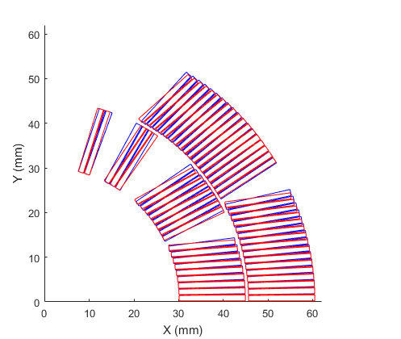
Optimized cross section, Cable Option 3
Keystone angle: 0.5°, Bare inner thickness after HT: 1.223 mm
New design
First gen. design
 | Systematic - First Generation |  |  |  |  | Max.Persistent at I = 1100 A
Normal | Geometric | Saturation | Persistent | Injection | High Field
B1 (T) |  |  |  |  | 11.221
b₂ | 0.000 | -14.500 | 0.000 | 0.000 | -14.500 | 0.000
b₃ | 7.459 | -0.400 | -8.000 | -0.541 | 7.010 | -20.000
b₄ | 0.000 | -0.400 | 0.000 | 0.000 | -0.550 | 0.000
b₅ | -0.014 | 0.100 | 2.500 | 2.486 | 0.100 | 3.400
b₆ | 0.000 | -0.020 | 0.000 | 0.000 | -0.020 | 0.000
b₇ | -0.093 | 0.062 | 0.200 | 0.107 | 0.100 | -0.400
b₈ | 0.000 | 0.000 | 0.000 | 0.000 | 0.000 | 0.000
b₉ | 0.912 | 0.028 | 0.450 | 1.362 | 0.960 | 0.600
 | Systematic - Cable Option 3 |  |  |  |  | Max.Persistent at I = 1100 A
Normal | Geometric | Saturation | Persistent | Injection | High Field
B1 (T) |  |  |  |  | 11.225
b₂ | 0.000 | -14.500 | 0.000 | 0.000 | -14.500 | 0.000
b₃ | 7.580 | -0.400 | -8.000 | -0.420 | 7.180 | -20.000
b₄ | 0.000 | -0.400 | 0.000 | 0.000 | -0.550 | 0.000
b₅ | -0.014 | 0.100 | 2.500 | 2.486 | 0.090 | 3.400
b₆ | 0.000 | -0.020 | 0.000 | 0.000 | -0.020 | 0.000
b₇ | -0.093 | 0.062 | 0.200 | 0.107 | 0.470 | -0.400
b₈ | 0.000 | 0.000 | 0.000 | 0.000 | 0.000 | 0.000
b₉ | 0.912 | 0.028 | 0.450 | 1.362 | 1.020 | 0.600

Slide 8
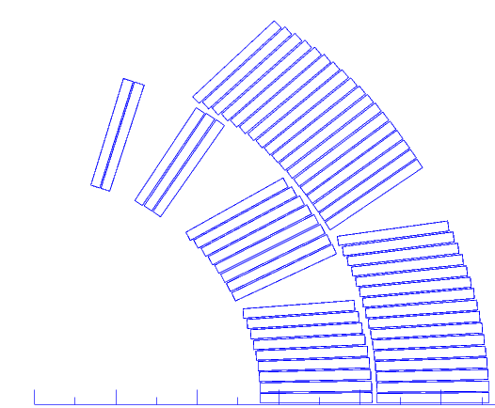
Fine tuning of field quality
Modify normal multipoles through azimuthal compression
+100 µm mid plane shim
Δb₃ = -4.8
Δb₅ = -0.9
+100 µm pole shim
Δb₃ = +3.5
Δb₅ = -0.4

Slide 9
Fine tuning of field quality
Mid plane shim 1 mm: (R_{ref} = 17 mm)
Pole shim 1 mm:
Dipole | Layer | 𝛿b₁ | 𝛿b₃ | 𝛿b₅ | 𝛿b₇ | 𝛿b₉ | 𝛿b₁₁
11 T | inner | -30.74 | -34.33 | -8.85 | -2.03 | -0.51 | -0.22
 | outer | -23.07 | -13.30 | -1.41 | -0.14 | -0.02 | 0.00
LHC | inner | -30.30 | -31.80 | -9.10 | -2.42 | -0.65 | -0.20
 | outer | -22.65 | -11.96 | -1.67 | -0.14 | -0.02 | 0.00
Dipole | Layer | 𝛿b₁ | 𝛿b₃ | 𝛿b₅ | 𝛿b₇ | 𝛿b₉ | 𝛿b₁₁
11 T | inner | 58.80 | 22.51 | -2.44 | 0.56 | -0.43 | 0.14
 | outer | 41.96 | 12.82 | -1.25 | -0.03 | 0.02 | 0.00
LHC | inner | 54.94 | 17.46 | -3.67 | 1.29 | -0.47 | 0.06
 | outer | 41.99 | 12.59 | -0.71 | -0.14 | 0.02 | 0.00
Notes:
Fine tuning capabilities similar to lhc main dipole. Strictly negative contribution from MP shim.

Slide 10
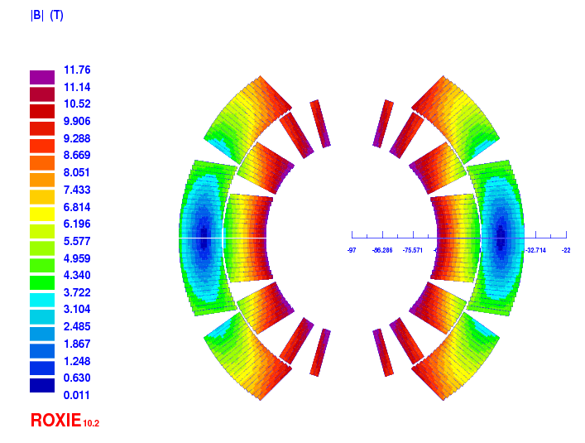
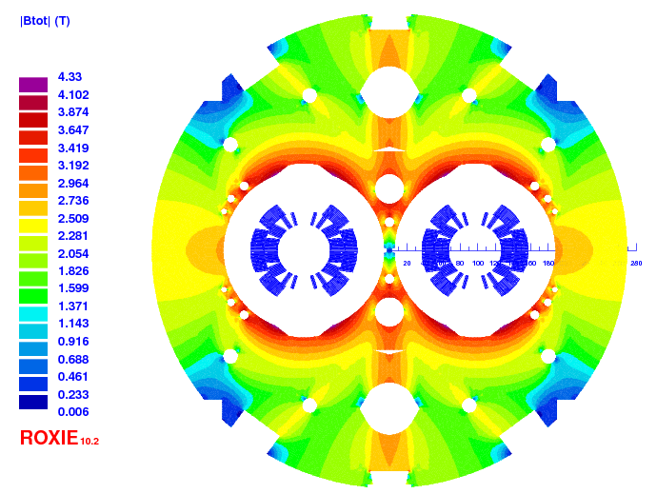
Magnet parameters
Parameters | First gen. | Op. 2 | Op. 3 | Units
Operational temperature | 1.9 |  |  | K
Clear aperture diameter | 60 |  |  | mm
Nominal B-field | 11.22 | 11.22 | 11.23 | T
Nominal current | 11.85 |  |  | kA
Nominal peak field on the coil (including strand field) | 11.75 | 11.76 | 11.76 | T
Stored energy at I_{nom} | 0.97 |  |  | MJ/m
Current sharing temperature | 6.3 |  |  | K
Differential inductance at I_{nom} | 11.97 |  |  | mH/m
Superconductor current density (j_{sc}) | 2560 |  |  | A/mm²
Engineering current density (j_{eng}) | 786 |  |  | A/mm²
Overall current density at (j_{overall}) | 5.23 |  |  | A/mm²
Horizontal EM-force F_{x} at I_{nom} | 6.23 | 6.22 | 6.22 | MN/m
Vertical EM-force F_{y} per coil at I_{nom} | 3.15 | 3.16 | 3.16 | MN/m
Notes:
Nom peak field in coil? From loadline operational point

Slide 11
Magnet parameters – load line
Operational conditions: I_{op} = 11.85 kA, B_{p} = 11.76 T (including cryostat and strand self field)
Margin on the load line assuming:
  Design value (-5%): 80.1 %
  -3 % cabling degradation: 79.6 %
  -7 % cabling degradation: 80.6 %

Slide 12
Iron Saturation – Field Quality
Transfer function:
Impact of the iron saturation effect on higher order harmonics < 0.6 units
Notes:
Plot b2,b3(current) for old and new designs
TF with cryo

Slide 13
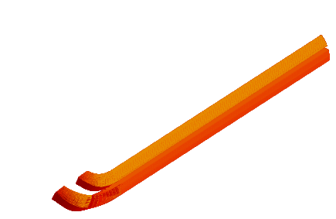
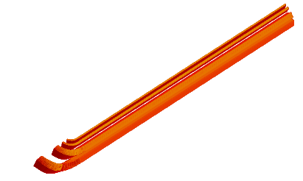
3D effects: Mechanical optimization
Preliminary results: Minor changes to current design
Curvature hard-way bend
Inner layer return end
Outer layer return end
Relative change curvature hard bend
from first gen. design:
Notes:
(New-ref)/abs(ref)

Slide 14
Conclusion
Cross section with new PIT cables is feasible.
Field quality and main field comparable to 1st generation design.
Fine tuning capabilities with azimuthal shim demonstrated.
Tests on cable degradation necessary to decide between the two cable geometries.
2D mechanical analysis have shown negligible impact of the coil geometry (option 2 or option 3) on the coil stress.
3D design on-going:
  Small differences from the mechanical optimization point of view.
  No differences are expected for the magnetic optimization.

Slide 15
Additional slides

Slide 16
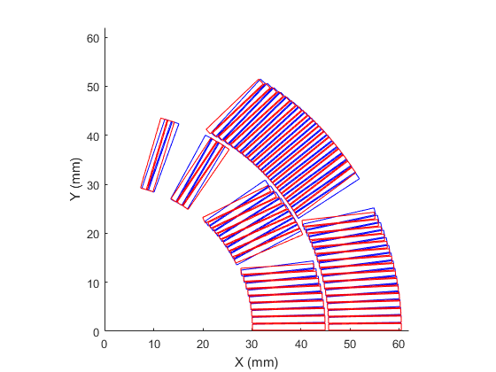
Optimized cross section, Cable Option 2 (2A):
 | Systematic - First Generation |  |  |  |  | Max.Persistent at I = 1100 A
Normal | Geometric | Saturation | Persistent | Injection | High Field
B1 (T) |  |  |  |  | 11.221
2 | 0.000 | -14.500 | 0.000 | 0.000 | -14.500 | 0.000
3 | 7.459 | -0.400 | -8.000 | -0.541 | 7.010 | -20.000
4 | 0.000 | -0.400 | 0.000 | 0.000 | -0.550 | 0.000
5 | -0.014 | 0.100 | 2.500 | 2.486 | 0.100 | 3.400
6 | 0.000 | -0.020 | 0.000 | 0.000 | -0.020 | 0.000
7 | -0.093 | 0.062 | 0.200 | 0.107 | 0.100 | -0.400
8 | 0.000 | 0.000 | 0.000 | 0.000 | 0.000 | 0.000
9 | 0.912 | 0.028 | 0.450 | 1.362 | 0.960 | 0.600
New design
First gen. design
 | Systematic - Cable option 2 |  |  |  |  | Max.Persistent at I = 1100 A
Normal | Geometric | Saturation | Persistent | Injection | High Field
B1 (T) |  |  |  |  | 11.191
2 | 0.000 | -14.500 | 0.000 | 0.000 | -14.500 | 0.000
3 | 0.610 | -0.400 | -8.000 | -7.390 | 0.210 | -20.000
4 | 0.000 | -0.400 | 0.000 | 0.000 | -0.540 | 0.000
5 | -0.014 | 0.100 | 2.500 | 2.486 | 0.200 | 3.400
6 | 0.000 | -0.020 | 0.000 | 0.000 | -0.020 | 0.000
7 | -0.093 | 0.062 | 0.200 | 0.107 | 0.840 | -0.400
8 | 0.000 | 0.000 | 0.000 | 0.000 | 0.000 | 0.000
9 | 0.912 | 0.028 | 0.450 | 1.362 | 1.070 | 0.600

Slide 17
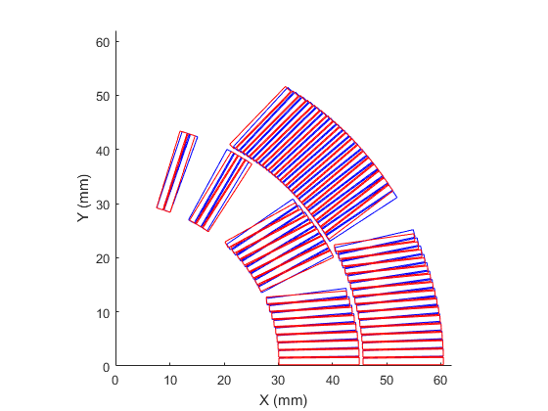
Optimized cross section, Cable Option 3 (3A):
 | Systematic - First Generation |  |  |  |  | Max.Persistent at I = 1100 A
Normal | Geometric | Saturation | Persistent | Injection | High Field
B1 (T) |  |  |  |  | 11.221
2 | 0.000 | -14.500 | 0.000 | 0.000 | -14.500 | 0.000
3 | 7.459 | -0.400 | -8.000 | -0.541 | 7.010 | -20.000
4 | 0.000 | -0.400 | 0.000 | 0.000 | -0.550 | 0.000
5 | -0.014 | 0.100 | 2.500 | 2.486 | 0.100 | 3.400
6 | 0.000 | -0.020 | 0.000 | 0.000 | -0.020 | 0.000
7 | -0.093 | 0.062 | 0.200 | 0.107 | 0.100 | -0.400
8 | 0.000 | 0.000 | 0.000 | 0.000 | 0.000 | 0.000
9 | 0.912 | 0.028 | 0.450 | 1.362 | 0.960 | 0.600
New design
First gen. design
 | Systematic - Cable option 3 |  |  |  |  | Max.Persistent at I = 1100 A
Normal | Geometric | Saturation | Persistent | Injection | High Field
B1 (T) |  |  |  |  | 11.191
2 | 0.000 | -14.500 | 0.000 | 0.000 | -14.500 | 0.000
3 | 0.750 | -0.400 | -8.000 | -7.250 | 0.350 | -20.000
4 | 0.000 | -0.400 | 0.000 | 0.000 | -0.540 | 0.000
5 | -0.014 | 0.100 | 2.500 | 2.486 | 0.220 | 3.400
6 | 0.000 | -0.020 | 0.000 | 0.000 | -0.020 | 0.000
7 | -0.093 | 0.062 | 0.200 | 0.107 | 0.900 | -0.400
8 | 0.000 | 0.000 | 0.000 | 0.000 | 0.000 | 0.000
9 | 0.912 | 0.028 | 0.450 | 1.362 | 1.010 | 0.600

Slide 18
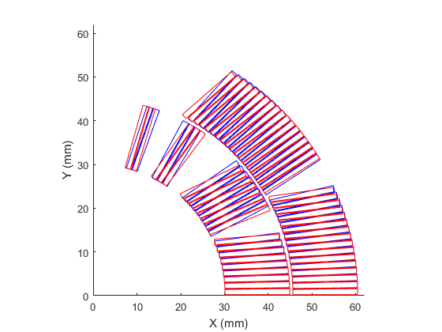
Cable Option 1, b3 optimized to 0
New design
First gen. design

Slide 19
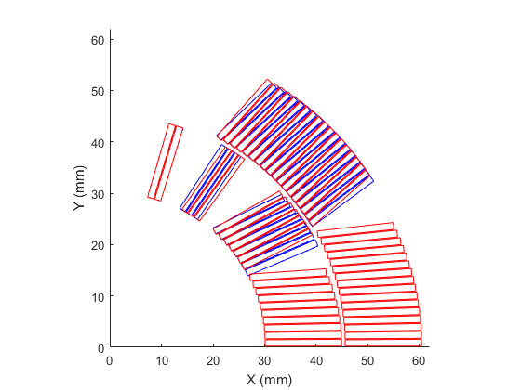
Move turn from block 2 →1
Option 2
Improved geometry – but b7 is 3 units off (and b5 2 units off for Op 2)
Notes:
Change to v8 b and blocks r only

Slide 20
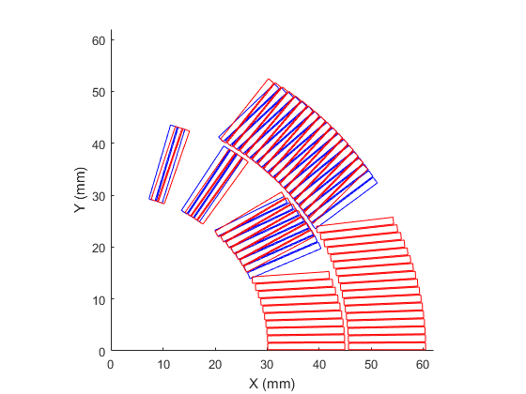
Move turn from block 2 →1 and from 6 → 5
Option 2
Improved geometry – but b7 is 3 units off
Notes:
Change to v8 b and ILOL r only

Slide 21
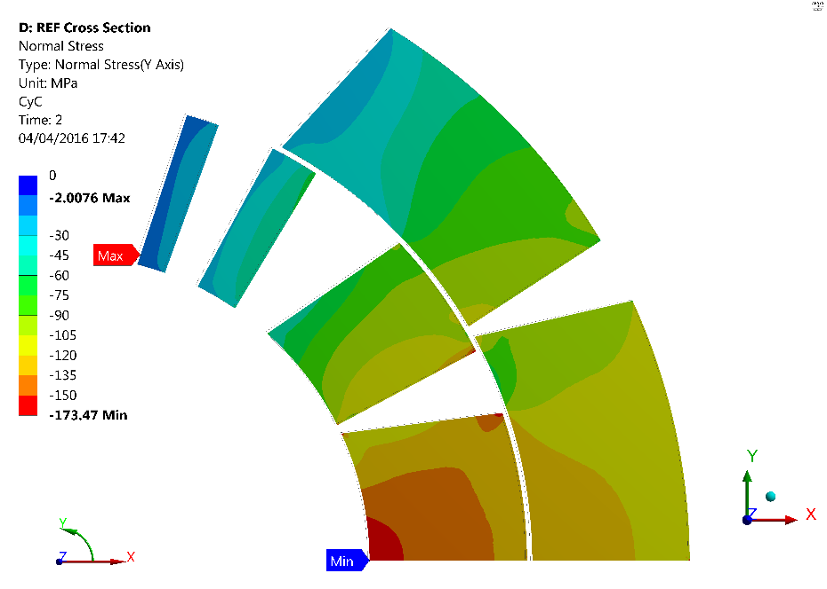
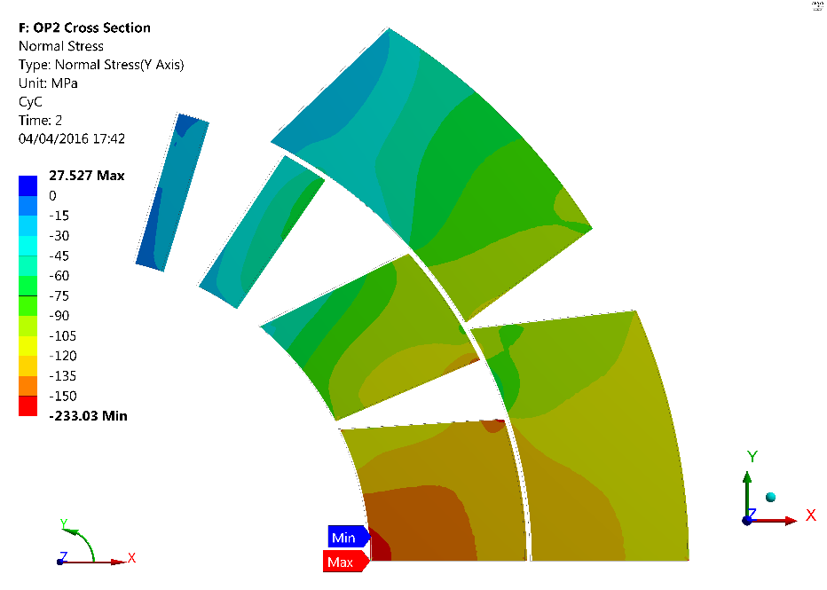
Azimuthal stress
Ref. – Azimuthal Stress 12T
OP2 – Azimuthal Stress 12T
-20.5
-21.1
-7.4
-13.0
Average - Azimuthal Stress
-142.7
-123.1
-141.2
-122.4

Slide 22
Assumptions on cable growth during HT
After heat treatment | Bare thickness in (mm) | Bare mid-thickness (mm) | Bare thickness out (mm) | Bare width (mm)
First Gen. Design | 1.185 | 1.288 | 1.390 | 14.847
Option 1 | 1.243 | 1.308 | 1.373 | 14.847
Option 2 | 1.236 | 1.288 | 1.339 | 14.847
Option 3 | 1.223 | 1.288 | 1.352 | 14.847
Notes:
Mid thickness + width
Not after reaction

Slide 23
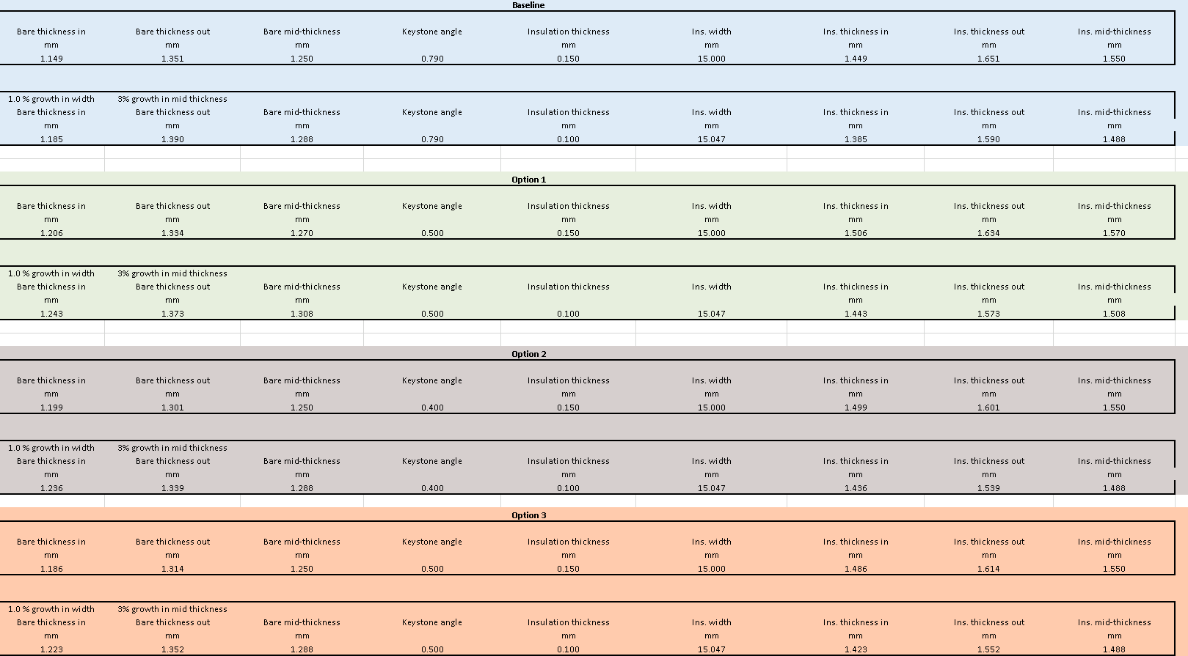
Updated cable geometry

Slide 24
Cable Geometry Before Reaction

Slide 25
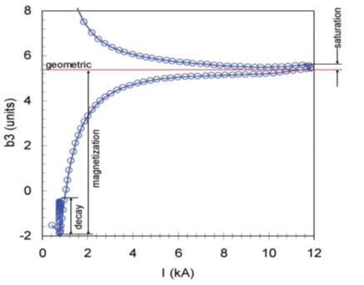
b₃ LHC main dipole
Notes:
In the main dipoles we have -2 at injection and about 6 at nominal,

Slide 26
Iron saturation – field quality

Slide 27
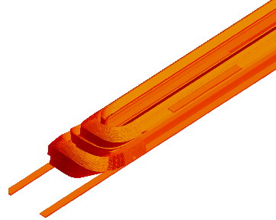
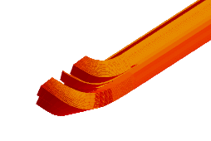
3D effects
Lead end

