Slide 1

Powering and other systems procurement: status and plan, QA/QC
H. Thiesen ( CERN, TE-EPC)
2016-04-07

Slide 2
Contents
01 Powering System
02 Power Converters and Planning
03 DC Cables & Infrastructure
04 QA/QC
05 Summary

Slide 3
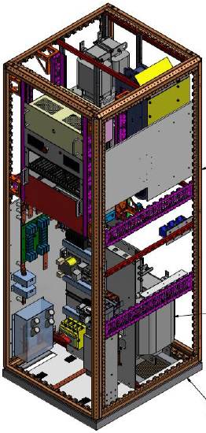
01 Powering System
Included :
Trim power converters (4 + 1 spare)
DC cables
Infrastructure
  AC distribution
  Air cooling system
  Remote control and PIC
Excluded :
Trim Current leads
11 T magnets
By-pass cryostats

Slide 4
02 Power converters and Planning
Trim power converters
4 (+ 1 spare) power converters [±250A/±10V]
Based on existing power converters (COMET – [±250A/±120V])
Actual planning
2016 | 2017 | 2018 | LS2
Specification & Integration | Converter Design | Production & Tests | Installation & Commission.

Slide 5
03 DC Cables & Infrastructure
DC Cables & Infrastructure
DC Cables
  Standard cables (no Water Cooled Cables)
  Main issue : Junction with LHC tunnel
AC distribution
  Needs :
    4 (+1) x 400V/10A on ERD1/76
    4 (+1) x 400V/2A on EOD1/76
  Reuse existing installation – to be verified with EN/EL

Slide 6
03 DC Cables & Infrastructure
DC Cables & Infrastructure
Air cooling system
  Additional heat load :
    4 x 3 kW
  Reuse existing installation – to be verified with EN/CV
Control & PIC
  Additional equipment : 4
  Reuse existing installation - to be verified with BE/CO & TE/MPE

Slide 7
04 QA/QC
Quality Assurance & Quality Control
Based on LHC QAP
Power converters
  Technical Specification: to be defined
  Reception Test Procedure: to be defined
  Individual reception tests
DC Cables & Infrastructure
  Short Circuit Tests: to be defined

Slide 8
05 Summary
Summary
Specification & design phase
  Specification & Integration
  Power converter design
No major issue
  Power converter based on existing design
  Reuse existing infrastructure
QA/QC
  Based on LHC QAP

