Slide 1
Coil winding and collaring
D. Smekens
TE-MSC-LMF
Acknowledgements
B. Auchmann
E. Cavanna
M. Daly
Th. Genestier
M. Karppinen
Ch. Löffler
Ph. Revilak
A. Temporal
and all members of the HL-LHC WP11
Review of the 11 T Dipoles at Collimator Section for the HL-LHC – CERN - 6-8 April 2016

Slide 2
Outline
Objectives for Prototype
Main Parameters of the Coils
  Adopted Features, Changes for the long coils
  Cross-Section, Coil Ends, Wedge Segmentation
Collared Coils
  Main Parameters
  Shimming Approach, New FE Models
Long Coil Production Status
Conclusions

Slide 3
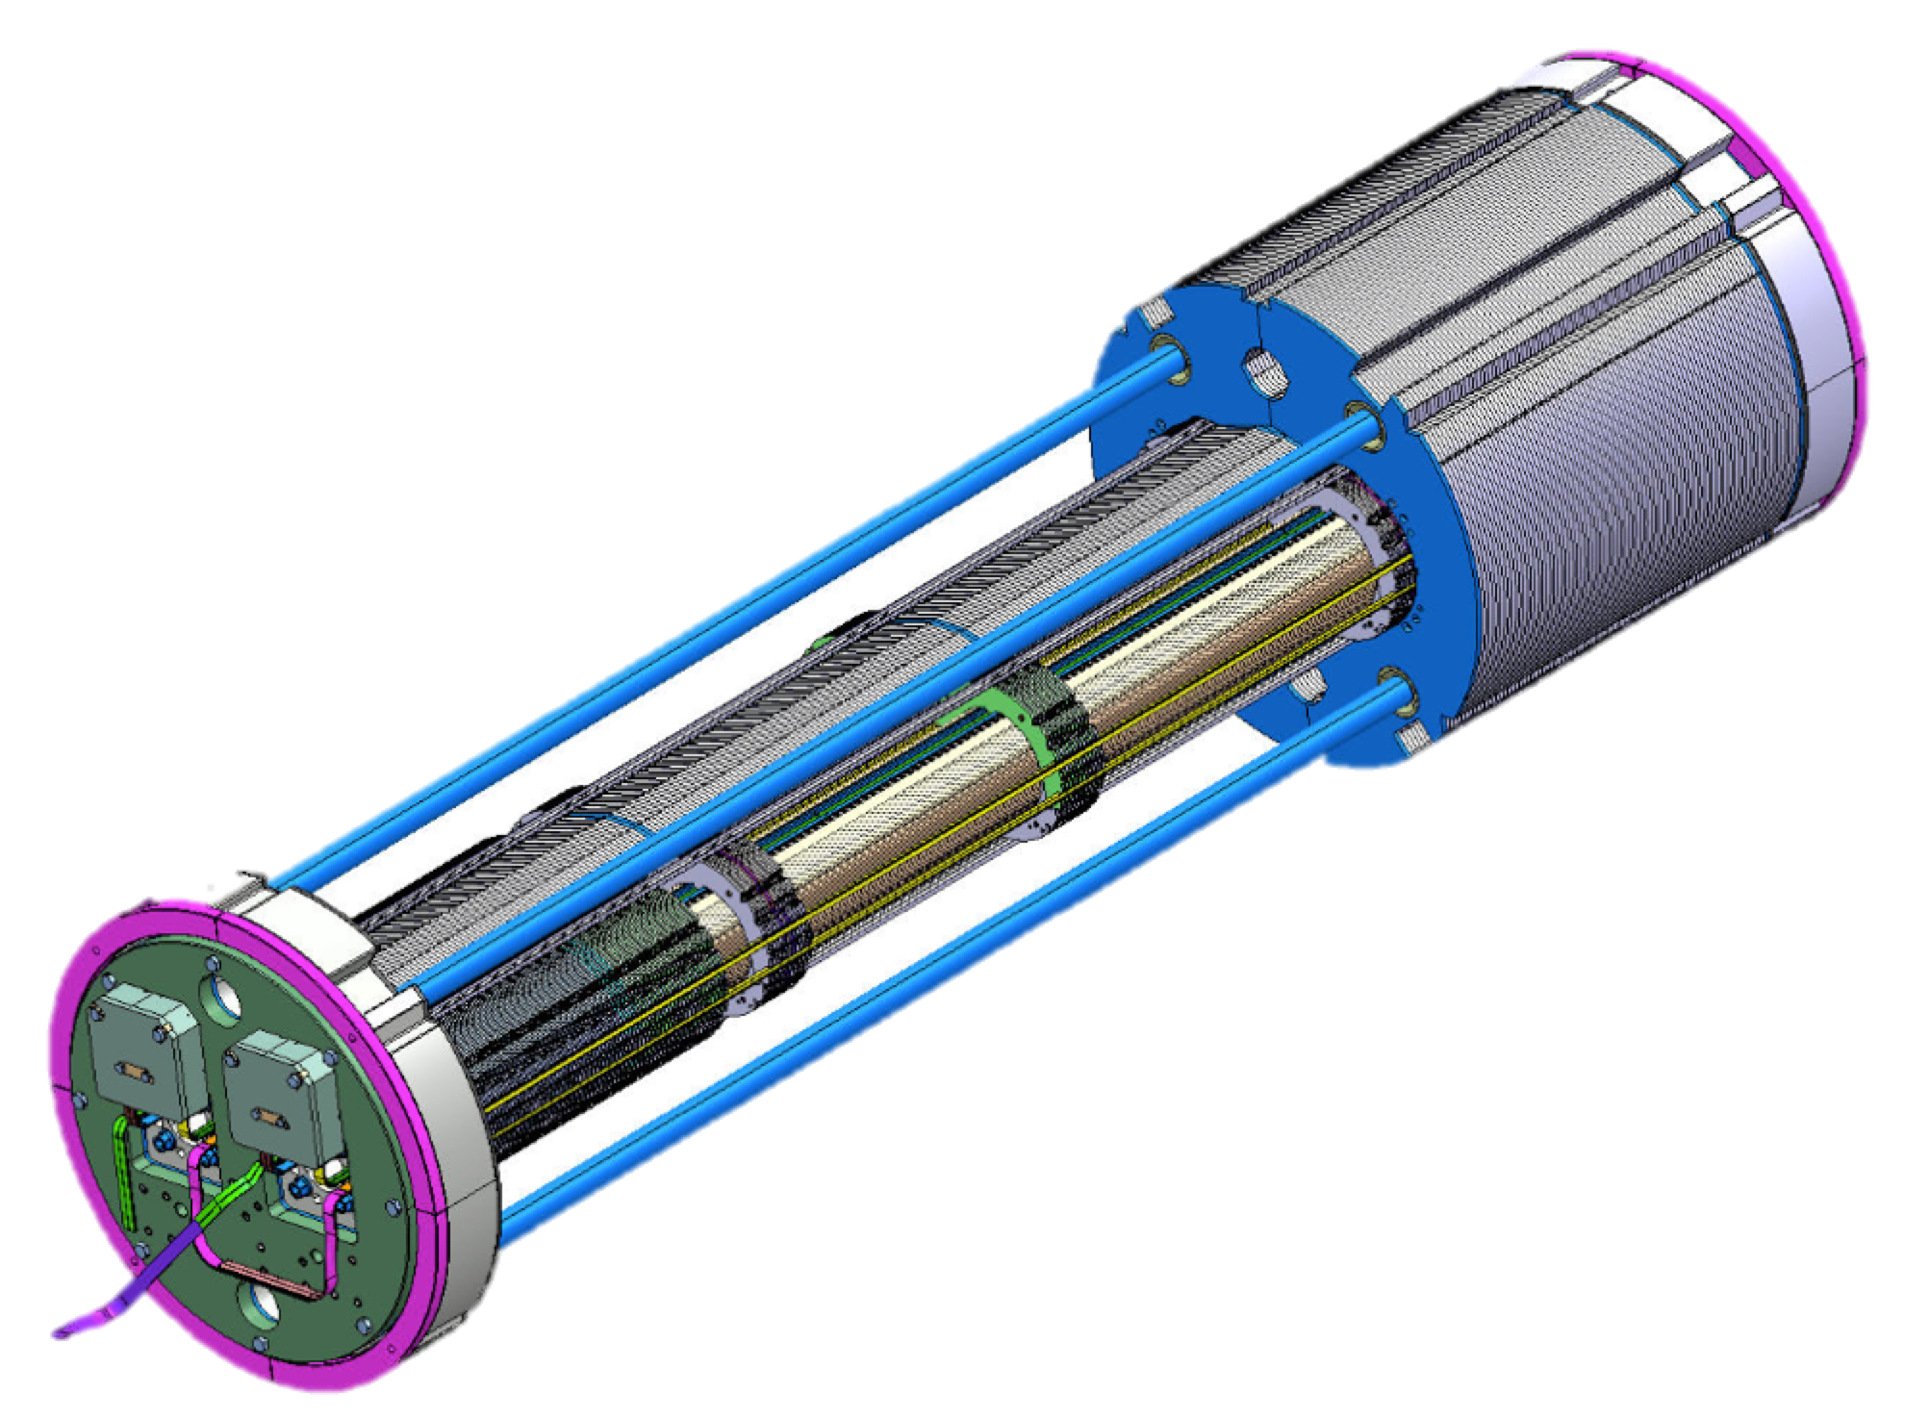
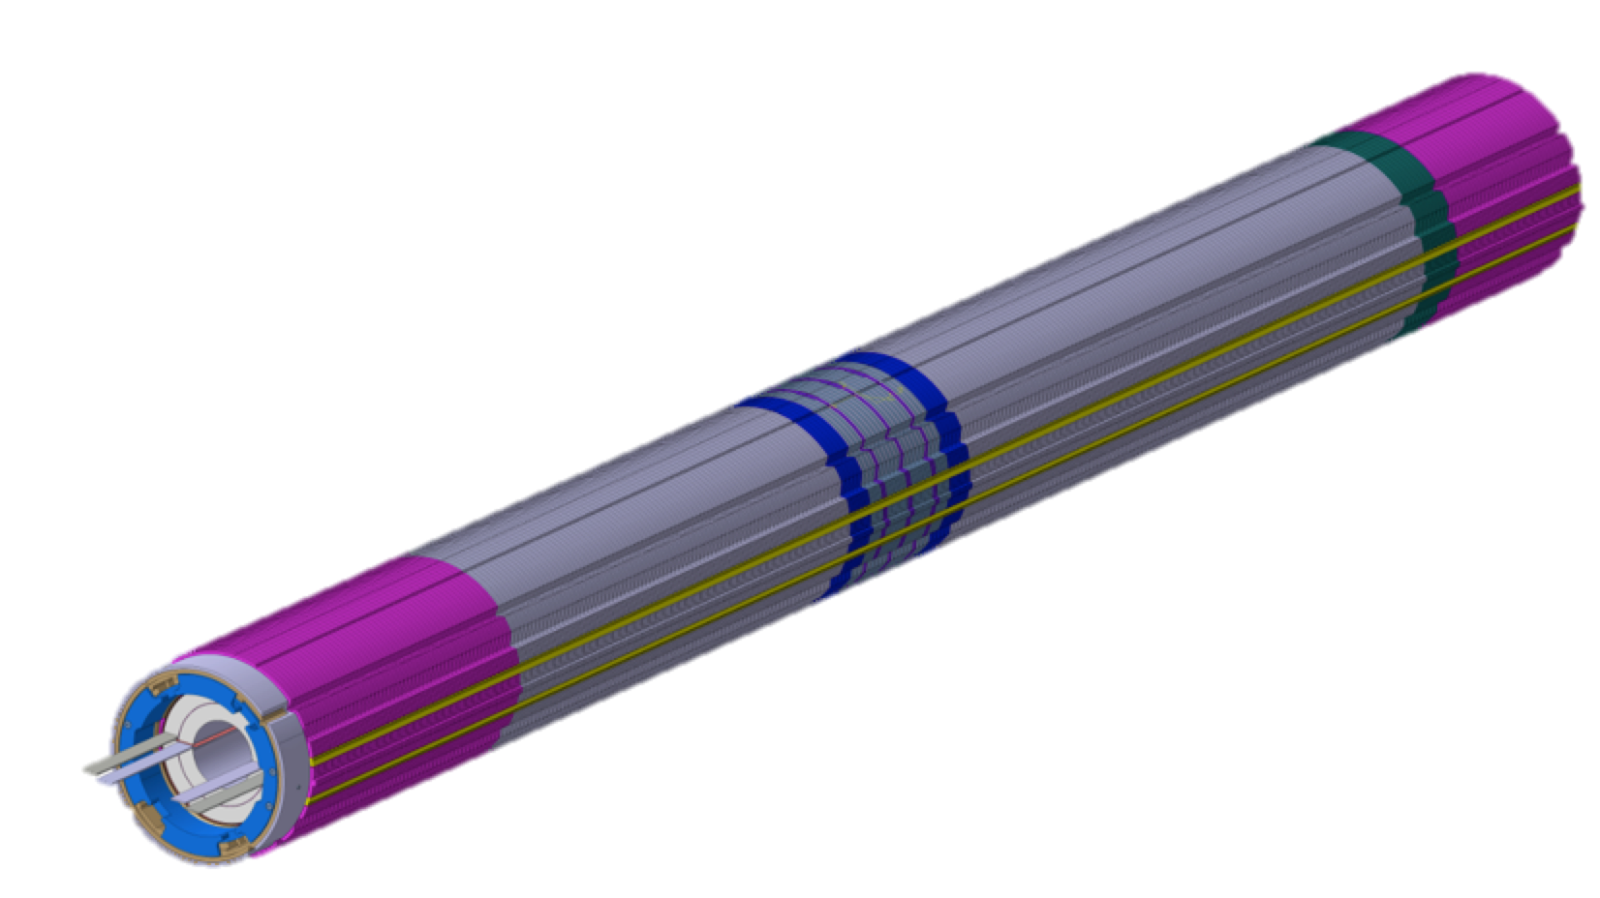
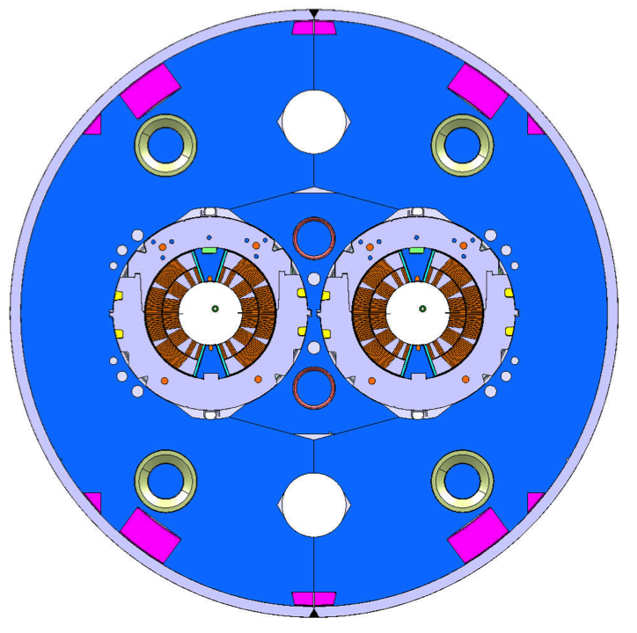
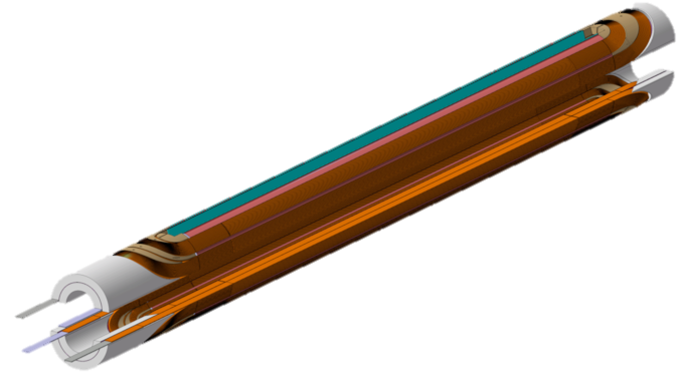
From Short Model to Prototype Assembly
2-in-1 Prototype 5.5m long is based on 2m long short models developed since 2011
Prototype: 2 collared coils, not tested as single aperture configuration: direct assembly of 4 virgin coils
Prototype: will make use of quench heaters impregnated with the coils on the outer surface (embedded)

Slide 4
Objectives for the prototype MBH_P001
Low Performance
Nb₃Sn Coil CR001
Full Performance
Coil CR003
Full Performance
Coil CR005
Low Performance
Nb₃Sn Coil CR002
Full Performance
Coil CR004
Full Performance
Coil CR006
MBH_C001 September 2016 |  | MBH_C002 November 2016 |  | MBH_C003 January 2017
CR001 | CR002 | CR003 | CR004 | CR005 | CR006
Practice collared coil |  | Prototype magnet MBH_P001
Note: this presentation is using the following simplified naming
CR00x for a coil, full MTF asset identifier: HCMBH_C005_CR00000x
MBH_C00x for a collared coil (HCMBH_C001_CR00000x)
MBH_P001 for the prototype magnet, cold mass only
Notes:
Objectives (latest revision): 3 collared coils still this year (if possible), at the latest for January 2017, ready for assembly inside the prototype yokes

Slide 5
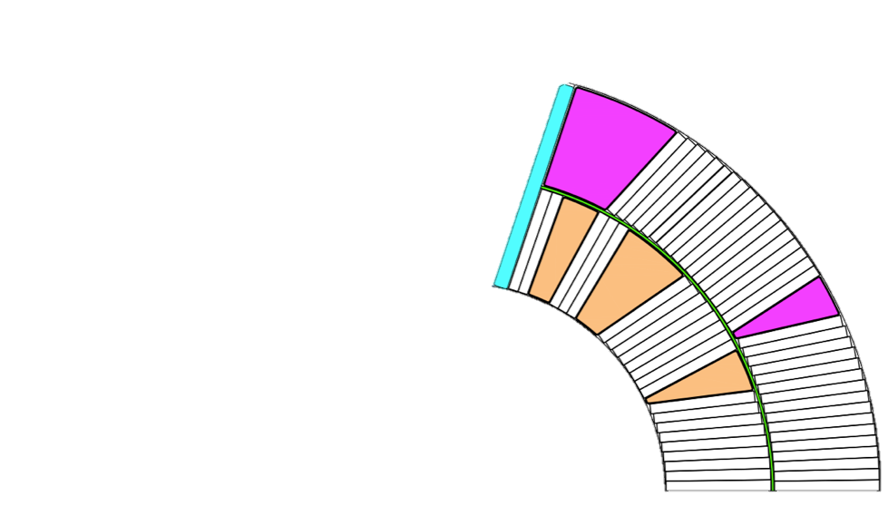
Main Parameters of the Coil
Coil: 56 turns, 2 layers, 6 blocks design, no internal splice
Coil ID / OD | 59.8 / 121.6 | mm
Coil overall length | 5559 | mm
Straight section length | 5108 | mm
Turns Inner Layer (IL) / Outer Layer (OL) | 22 (IL) / 34 (OL)
Impregnation System | Epoxy DGEBA (CTD 101-K)
Cable : RRP 0.7 mm dia. , 40 strands, cored, glass-mica insulated
Cable Length (IL / OL / on spool) | 235 (IL) / 364 (OL) / 680 | m
Cable bare width before / after reaction | 14.7 / 14.85 (+1%) | mm
Cable bare mid-thickness before / after reaction | 1.25 / 1.306 (+4.5%) | mm
Keystone angle before / after reaction | 0.79 / 0.806 | deg.
Number of strands per cable (x strand diameter) | 40 (x 0.7d [mm]) | -
Cable insulation wall thickness (design value) | 0.1 | mm
Insulation Material | Phlogopite + Glass
Notes:
A brief recall: 56 turn 2 layers coil, no internal splice (680 meters of cable on the winding spools), designed for the collaring using the ”pole loading” concept
The slide mostly to recap the terms used.

Slide 6
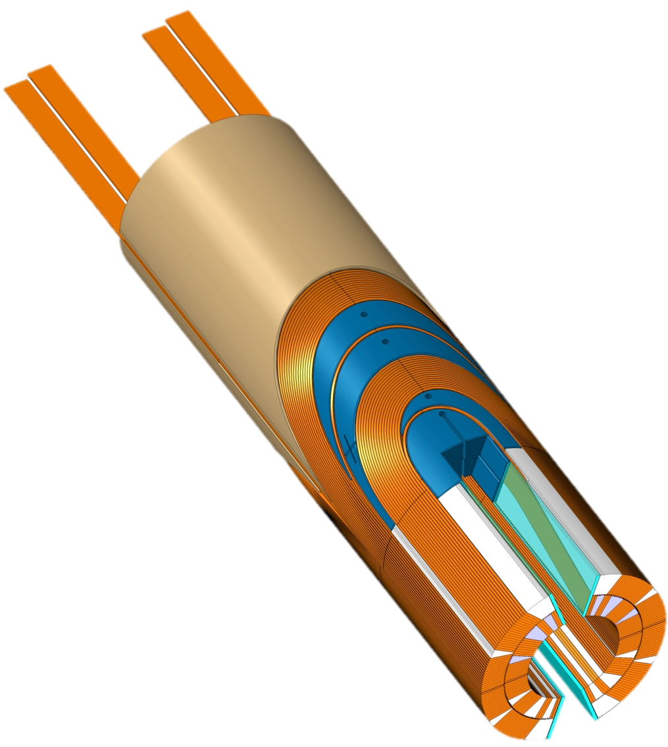
Features for prototype and LS2 magnets
Stays in
Mica-Glass Insulation S-glass sleeve overbraiding Oxide Dispersion Strength. Cu Wedges Laser Sintered 316L flex-spacers Ceramic Binder G-11 Splice Block-Saddle DGEBA (CTD-101K) Epoxy System
May Change (…currently changing)
Include inter-layer Quench Heaters Coil wedges: minimize gaps and segmentation of the wedges along the coil to allow for coil shrinkage Impregnation: from single point to multi-point resin injection Impregnation: pressurized impregnation during polymerization (3.5bars)
Already changed
Sn-Ag splice for Nb3Sn / Nb-Ti interconnect (was Sn-Pb) Copper Stabilization over splice region (was none) Embedded Quench Heaters with new ground insulation scheme (was QH outside coil)

Slide 7
Coil Cross-Section
Short Model Coils (105 -> 115) all use similar Cross-Section as per original design
Current Cross-Section defined in 2011 insulation wall thickness is larger in reality (0.115 mm) than per design (0.1 mm) Reaction cable growth not re-assessed From short model tests, conductor locus under mechanical strain/compression did not require correction
MBH_P001 Prototype will use the same cross-section (no re-optimization)
Same Cross-Section design, no re-optimization Same wedges and spacers Same coil winding parameters as for short model
Series for LS2 may also use the same cross-section
To be confirmed

Slide 8
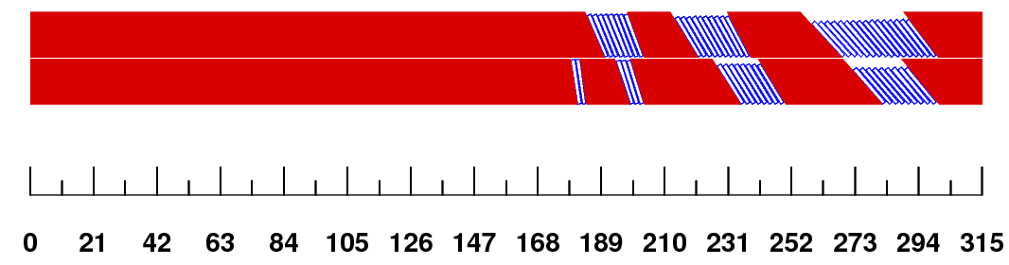
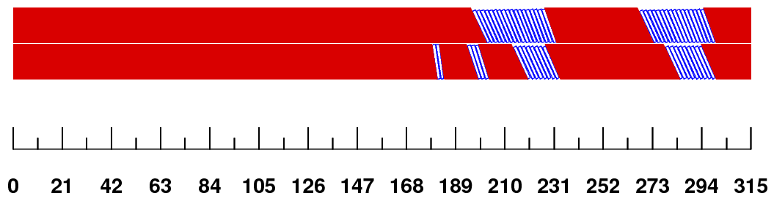
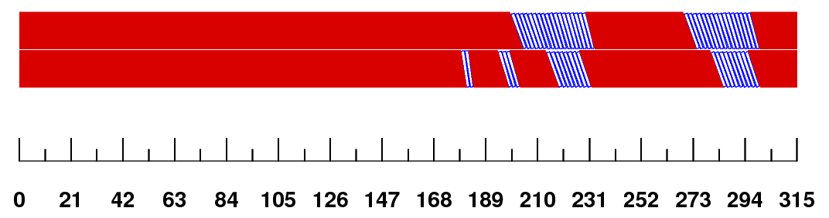
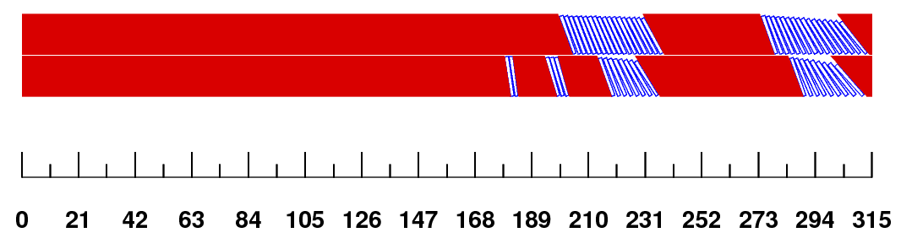
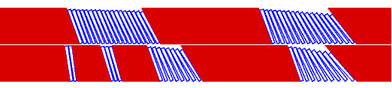
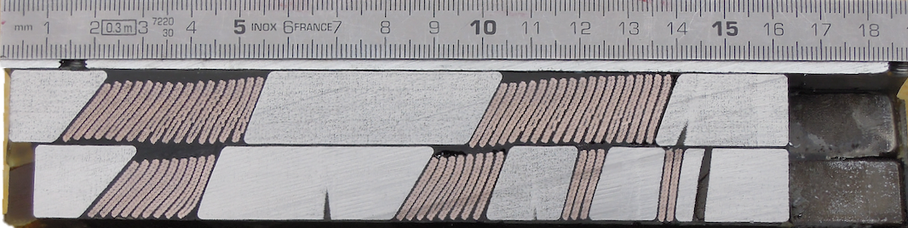
Coil Ends
Short Model Coil Ends
Several Coil Ends iterations required Spacers, saddles and splice block are different on early short model coils until coil 105 As from coil 106->114, spacer design unchanged Quality of winding as improved: coil 106-> coil 108 too long by ~ 8mm each side ; as from 109 length of coil ends is constant and as per design
Legacy versions
MBH_P001 Prototype will use identical design
Same Coil Ends as short coils Winding operations OK for long coils: generate coil ends as per design
Series for LS2
Requirements To be confirmed
Remaining Issue
Filling Quality of the Inter-Layer Cavities

Slide 9
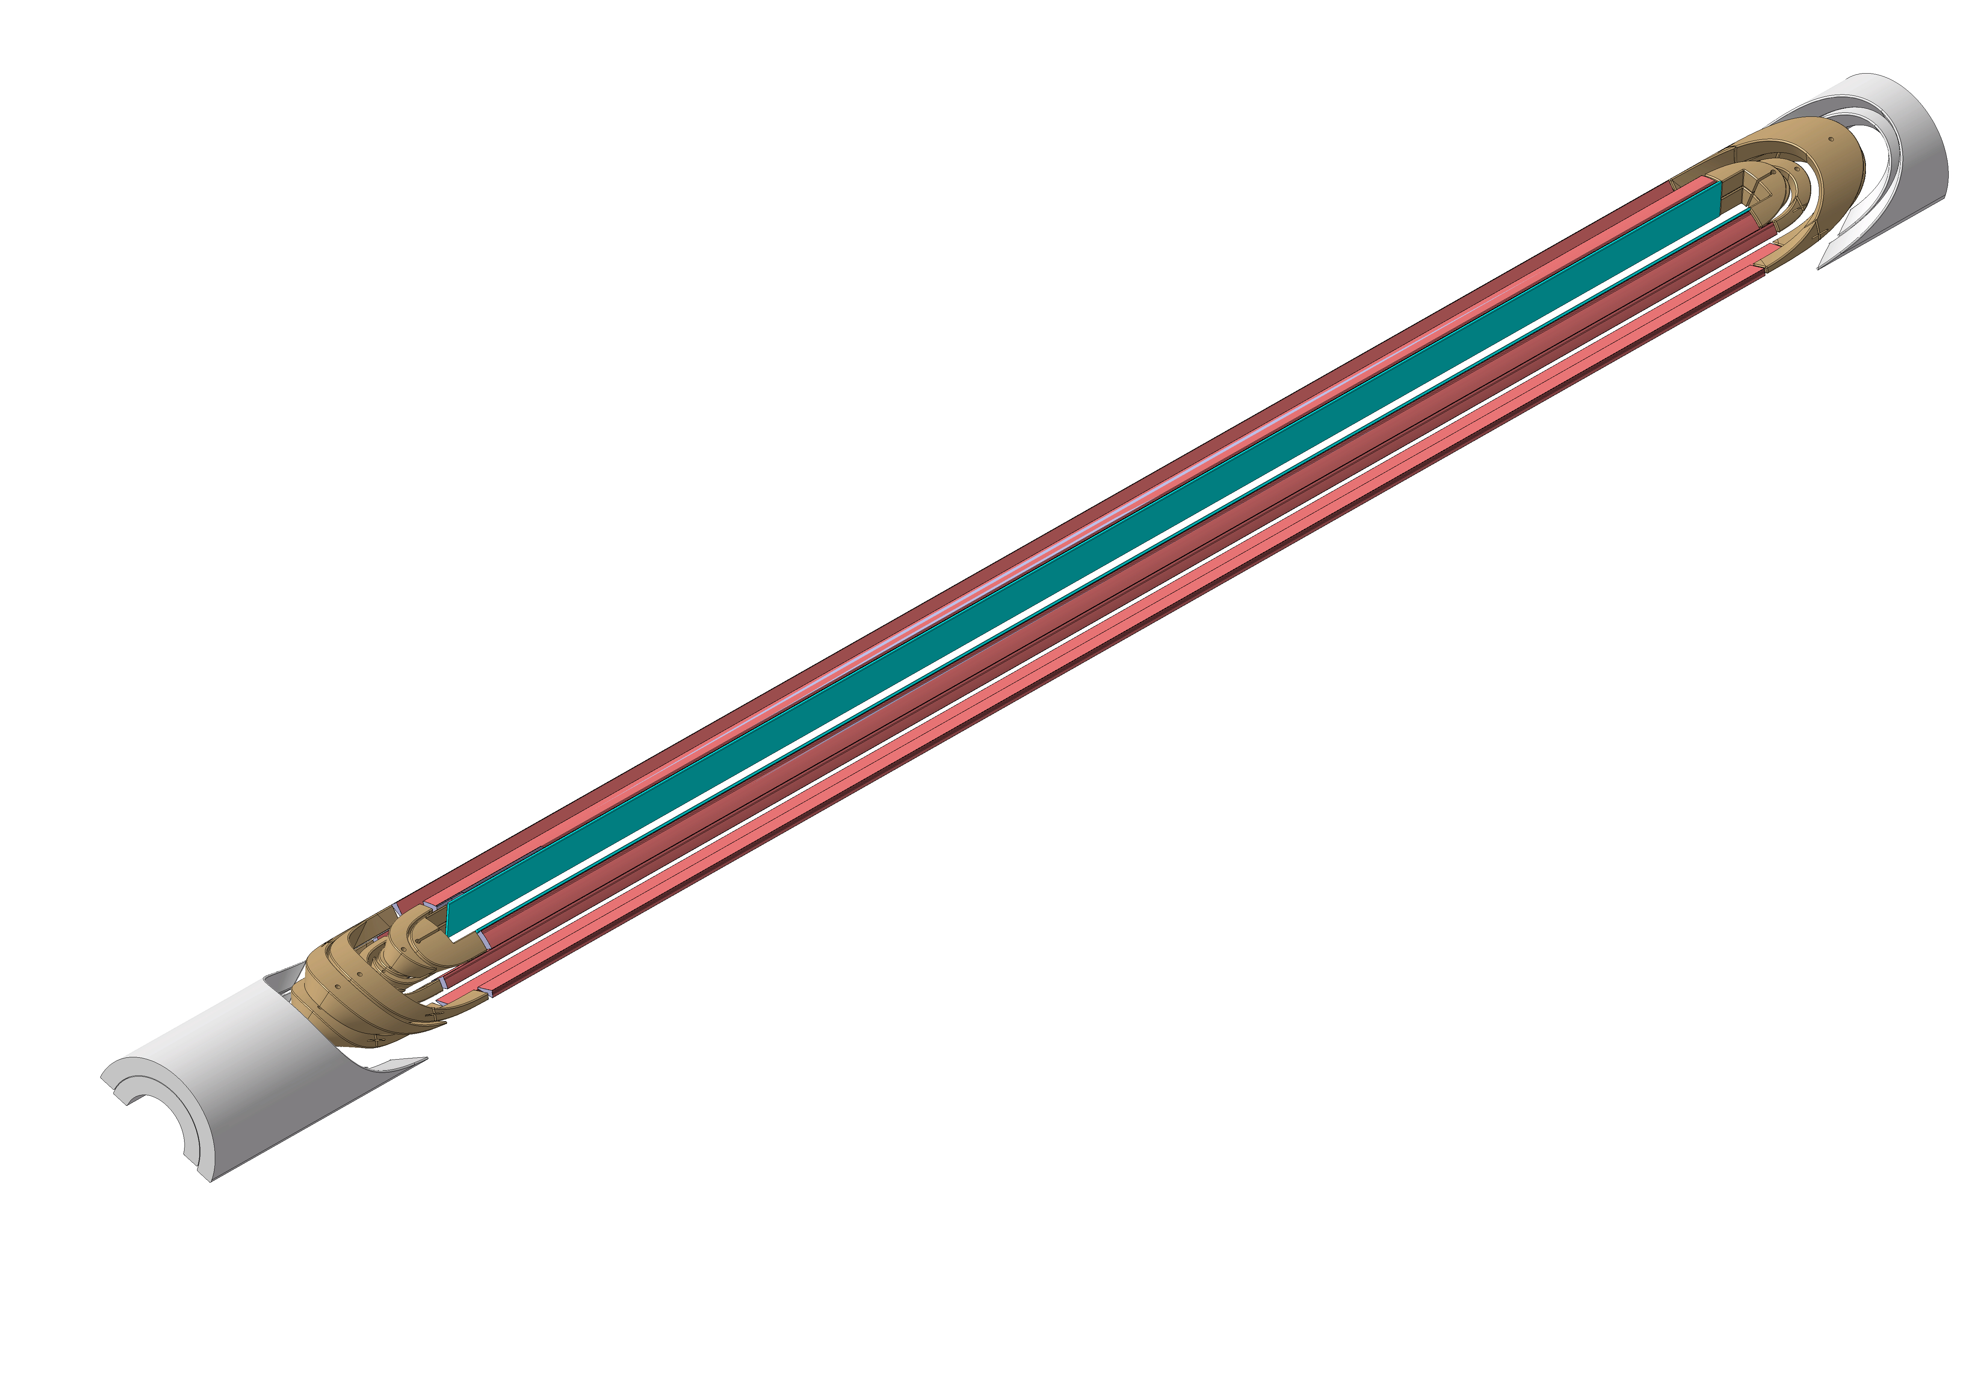
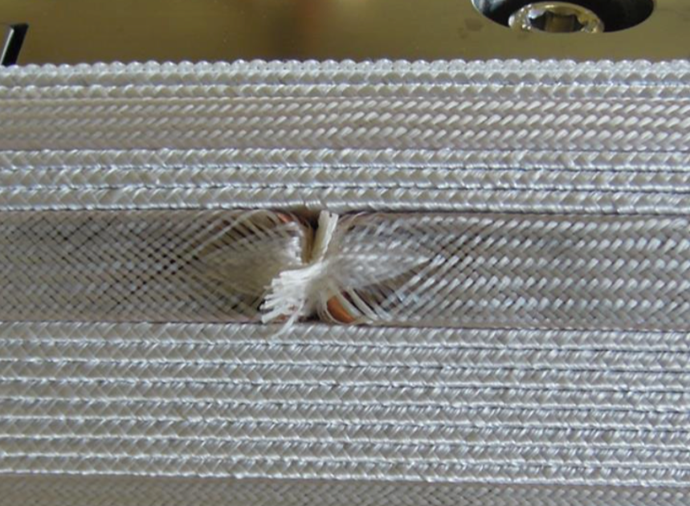
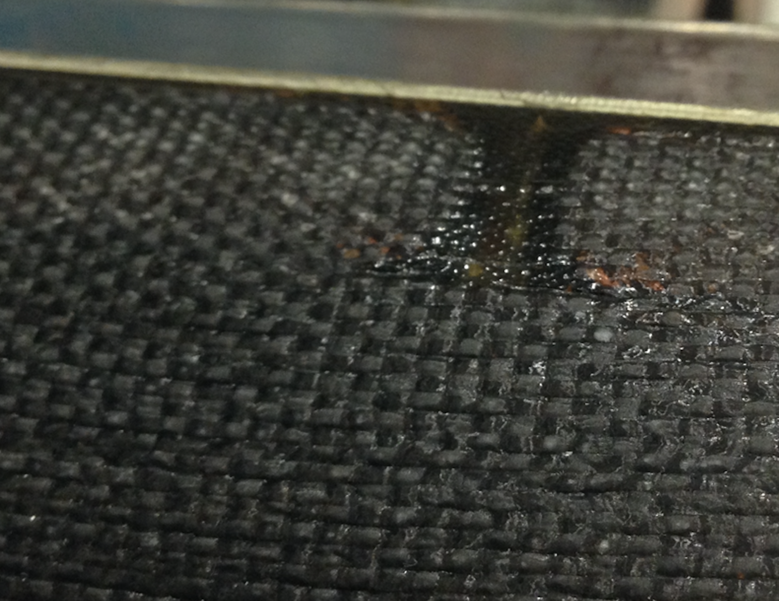
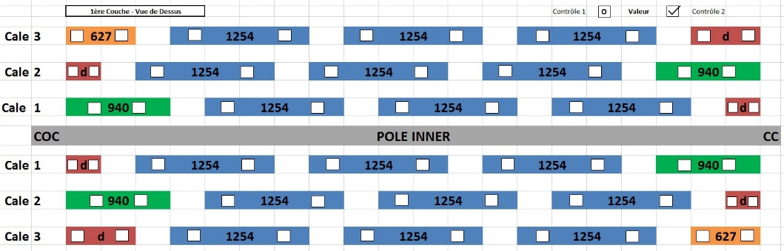
Wedge
Segmenting
Short Model Coils are progressively decreasing the gaps and segmentation of the wedges
Wedge segmentation not in 3D CAD models Gaps are (were) required for coil shrinkage (winding and reaction) Short Coil Winding & Reaction: no shrinkage
MBH_P001 Prototype has more wedge segments
Long extruded Cu-ODS wedges were unavailable until recently (now up to 3.2 meters) Long Coil Winding: important spring back (~ 5mm) Long Coil Reaction: unknown shrinkage
Series for LS2
TBC: 2 segments and one gap in straight section Gap size to be defined
Issues
Wedge Extremities not well insulated Gaps Induce Resin Rich Areas (inner layer not accessible)

Slide 10
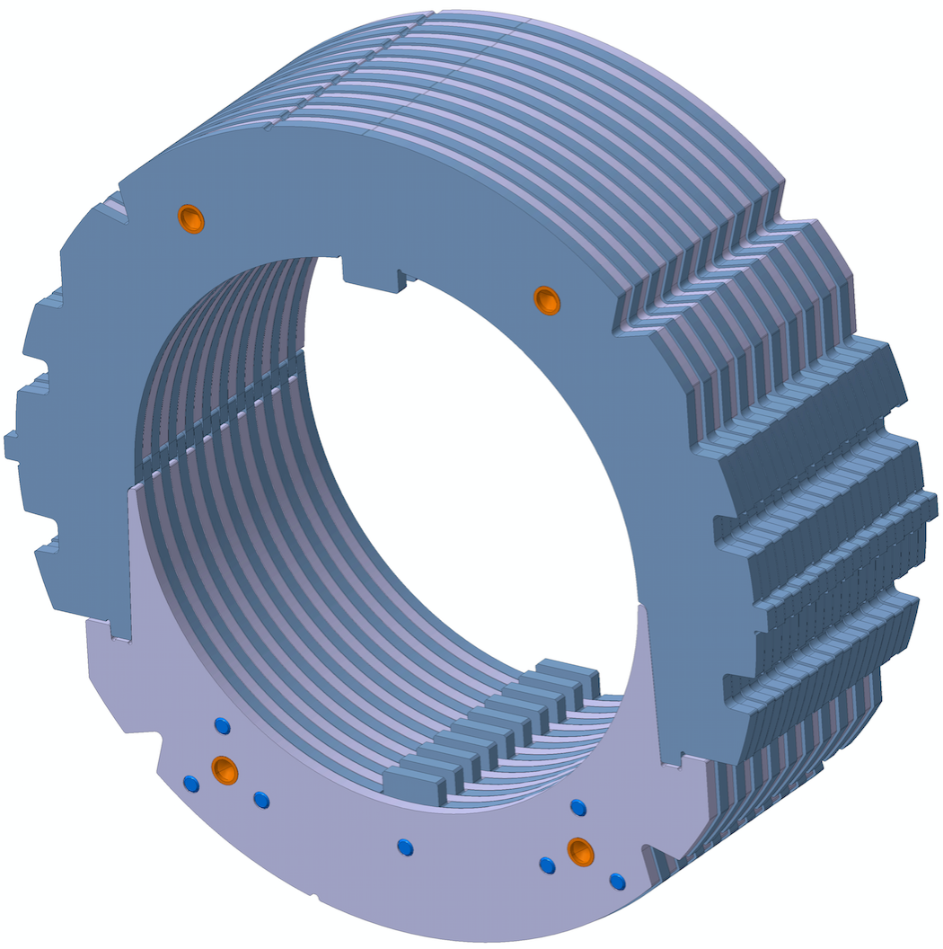
Collared Coils – Main Parameters
Coil Pre-Stress by Pole Loading, current collar design
Estimated Pre-StressTunability | +/- 15 MPa
Minimum Shim Increment Used | 0.05 mm
Maximum coil azim. pre-stress (averaged at pole turn @ RT) * | ~200 MPa
* permanent deformation of collar nose and collaring pressing surfaces
Collar Packs and Loading Poles
Collar Thickness | 3mm
Material | Austenitic Steel Nippon Steel YUS 130S
Standard Riveted Pack Length | 65 mm (20 collars)
# of Collars per long collared coils | 3418
Loading Pole Material | Titanium Ti6Al4V
Loading Pole Unit Length | 240 mm

Slide 11
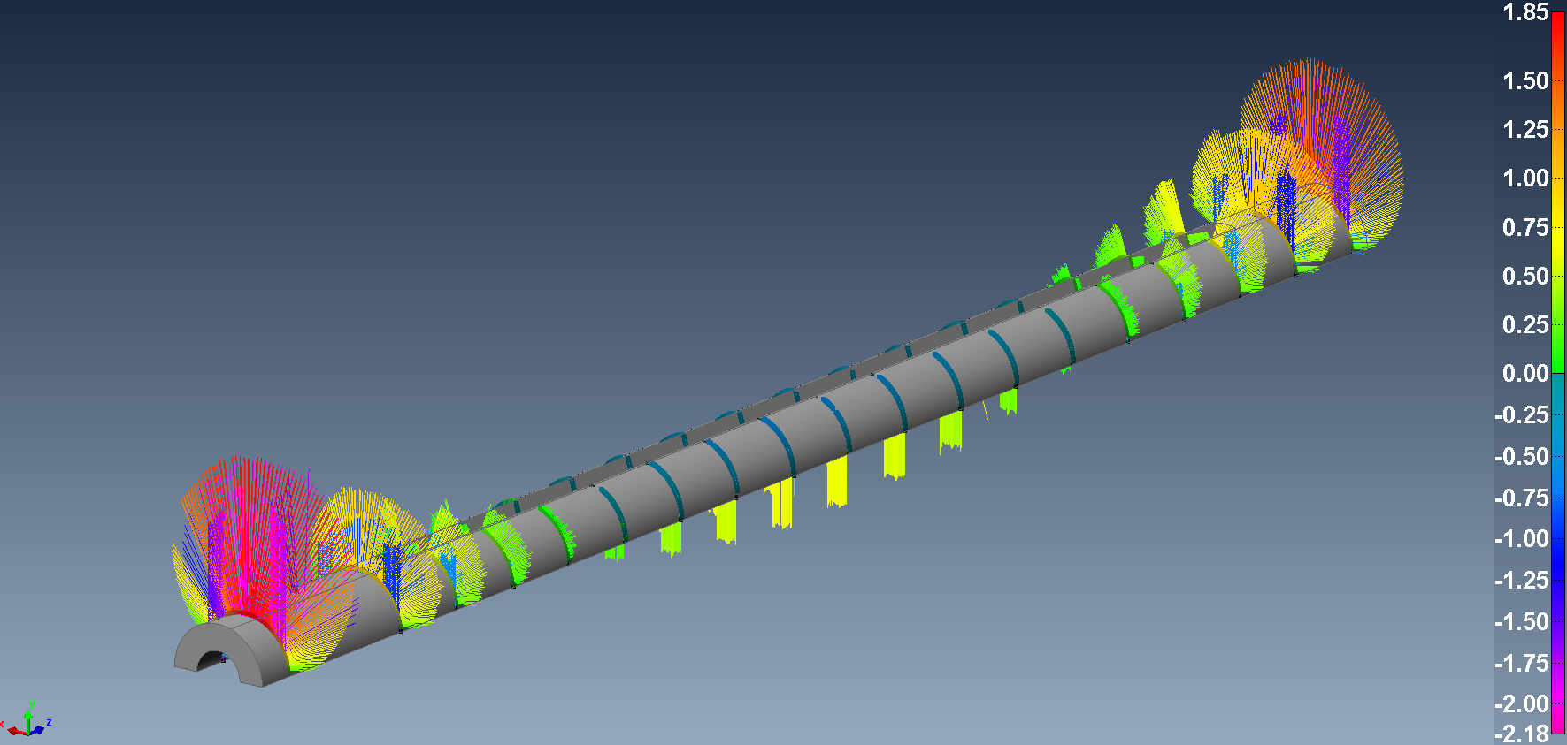
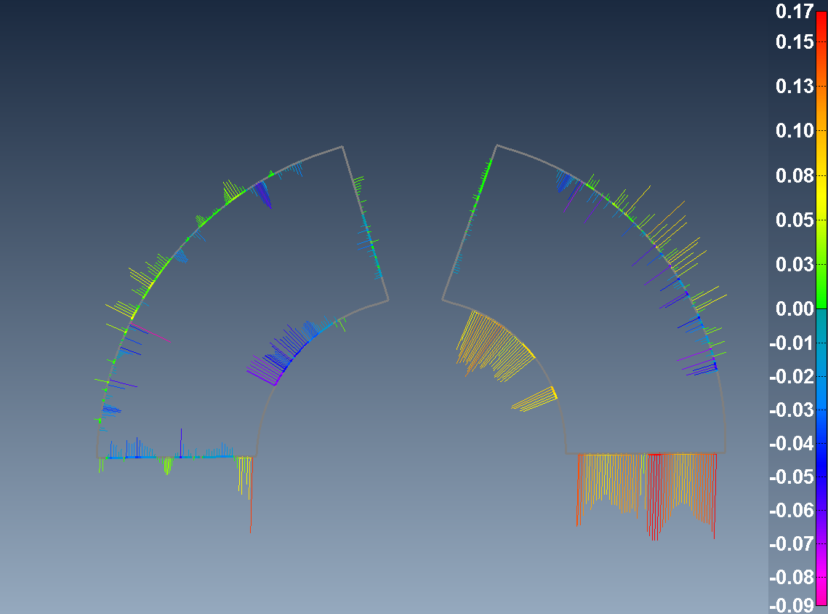
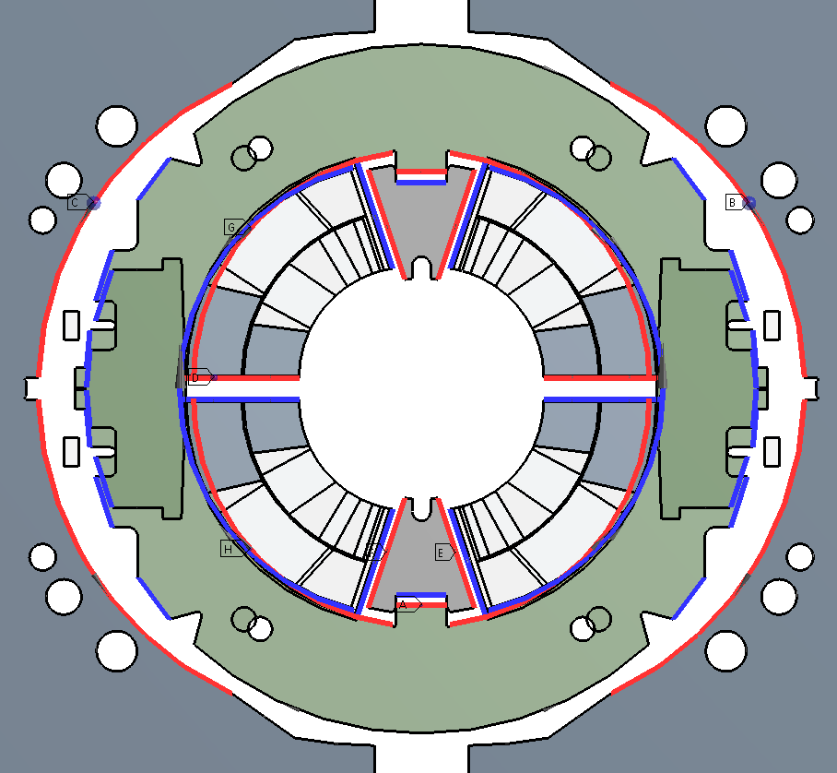
Short Model Collared Coils (SP102, SP103, DP101)
Shimming empirically increased for SP102 Low hysteretical modulus measured on 10-stacks SP103 shimmed according to non-linear properties FE Model reworked and refined since mid 2015
Prototype: MBH_C001, C002, C003 collared coils
Will use identical FE Model identical shimming procedure More studies on coil properties required
Shimming Approach
Strain-stress curves from 10-stacks RRP108/127 (coil 105)
Notes:
Shimming empirically increased for SP102 (based on known shimming of SP101 and quench behaviour)

Slide 12
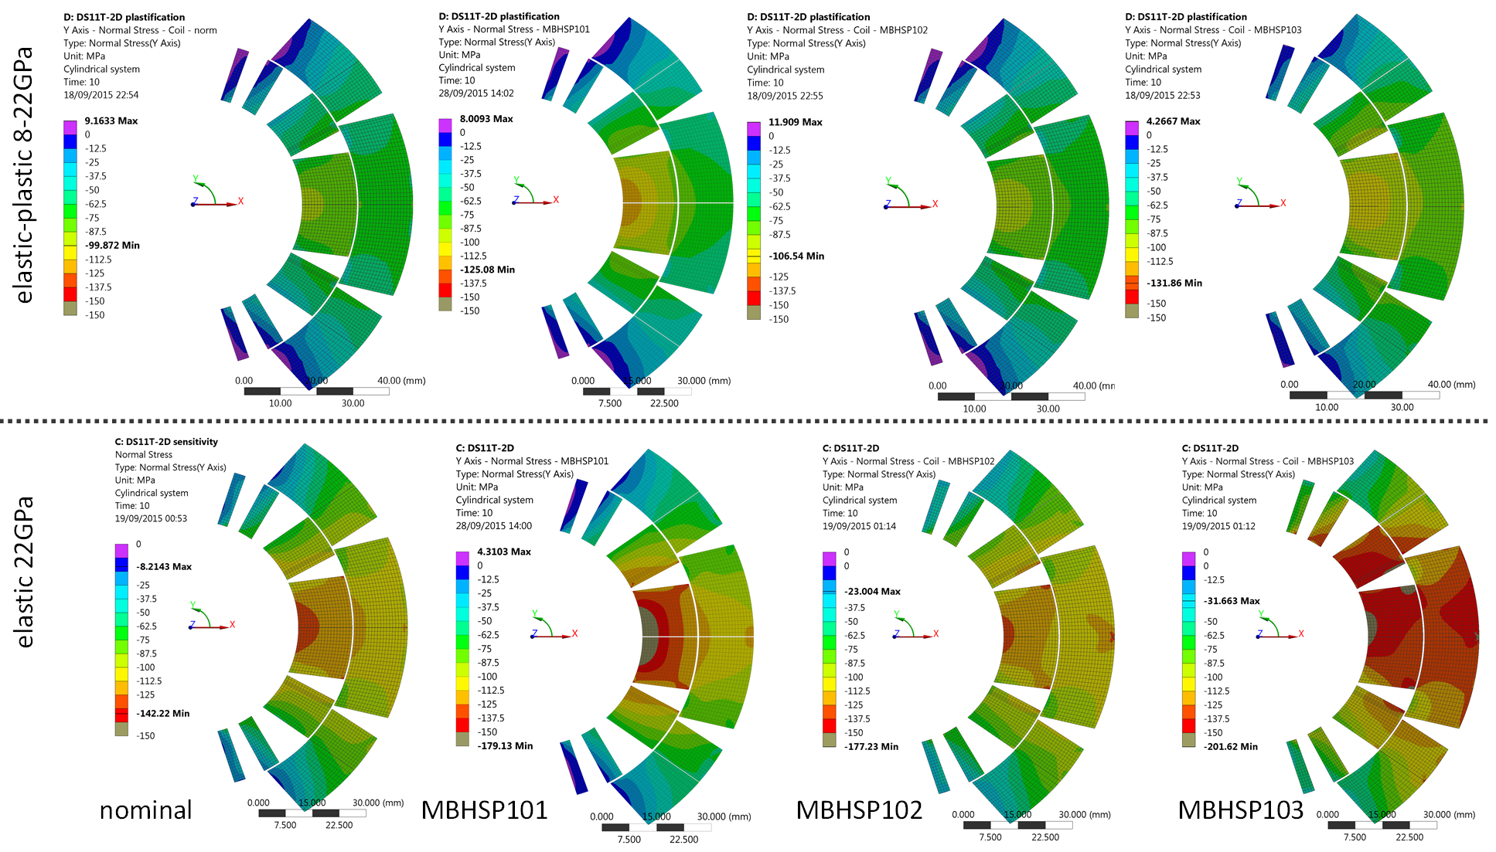
New FE Models
Initial Shimming (theoretical) | Shimming used in SP103 and DP101
Recent developments on 11T F.E. models have been presented during the
“Collaboration meeting on DS 11T Dipole grounds held at Fermilab”, September 2015:
http://indico.cern.ch/event/434223/
and during TE/MSC Technical Meetings:
“Mechanical aspects of the 11T magnet”, December 2015 https://indico.cern.ch/event/461705/
“Mechanical measurements in superconducting magnets” , January 2016:
https://indico.cern.ch/event/487129/
“Mechanical aspects of Nb3Sn magnets for HL-LHC - Session on measurement results” , February 2016:https://indico.cern.ch/event/496158/
~ 50% extra shimming elastic
18.8GPa Linear 10-18.8 GPa Non Linear
Notes:
Pre-requisite: known material properties, known geometry
Approach: quasi bi-linear stress-strain curve based on samples (10-stacks) measurments. No direct mechanical measurments on the coil itself

Slide 13
Coil Supplies & Coil Production: as of April 2016
 | Coil Parts | Winding/Curing | Reaction | Splicing | Quench Heater | Impreg. | Collaring Schedule
Copper dummy | OK | OK ¹ | OK ² | OK ³ | missing | ongoing…
CR001 practice | OK | OK ¹ | OK | on hold | missing |  | Sept 2016
CR002 practice | OK | OK ¹ | on hold |  |  |  | Sept 2016
CR003 proto_1 | OK | OK ¹ | on hold |  |  |  | Nov 2016
CR004 proto_2 | OK | OK ¹ |  |  |  |  | Nov 2016
CR005 proto_3 | OK |  |  |  |  |  | Jan 2017
CR006 proto_4 | parts missing ⁴ |  |  |  |  |  | Jan 2017
CR007 (spare) | parts missing ⁴
¹ Minor insulation damage during winding process. Coil usable.
² Important damage to insulation (dummy coil)
³ Splice not according to latest design (dummy coil)
⁴ delivery expected in May 2016

Slide 14
Conclusions
A brief overview of what is currently used to build the prototype collared coils
Prototype coils are almost identical to short model, ”just longer”.
No re-optimization, no change of cross-section
An important difference is the embedded (impregnated) quench heater system that will be discussed in talks later during this review
New FE models and better understanding of the coil properties
Good progress both in the long coil design and construction

Slide 15
Hereafter, back up slides…

Slide 16
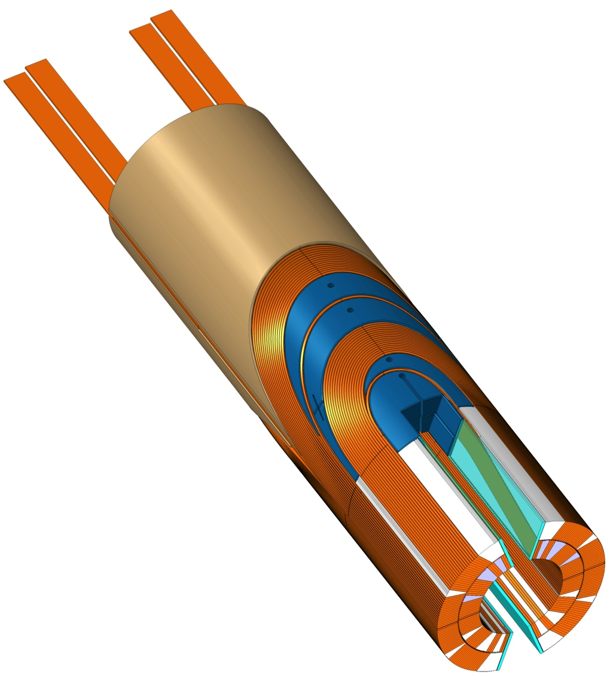
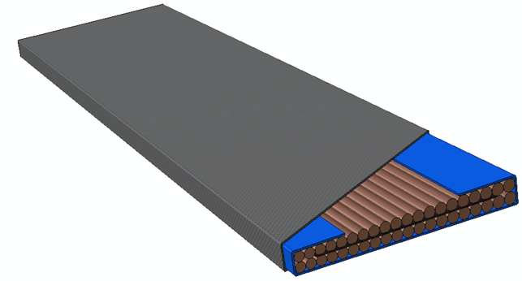
11T Dipole Coils: Naming conventions
b
Mid-Plane
Filler Wedge
Loading Plate
Key
SLS Spacer w/Flex Legs
Saddle with integrated splice block
Nb₃Sn / Nb-Ti Splice
f
c
6
5
7
4
d
3
e
2
a
Insulated cable
Filler Wedge
Loading plate
Inter-layer
Inner ground wrap
Outer ground wrap (prototype variant: including quench heaters)
Nb₃Sn Cable, mica insulation, Glass Sleeved
1
Notes:
A brief recall: 56 turn 2 layers coil, no internal splice (680 meters of cable on the winding spools), designed for the collaring using the ”pole loading” concept
The slide mostly to recap the terms used.

Slide 17
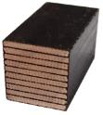



Ongoing work for FE Material Input Data and Model Validation
3
1
Experimental Test | Results | Temp
Compression | E-modulus (E), Poisson’s ratio (ν), σ, ε | RT 77 K 4.2 K
Tension | Longitudinal E-modulus (E_{11T}) | RT 77 K 4.2 K
2
1
Sample Type |  |  |  |  | Results | Temp
Material Characterisation | Epoxy | Fiber Glass |  |  | E_{ij}, ν_{ij}, σ_{ij}, ε_{ij} | RT 77 K 4.2 K
 | Epoxy | Fiber Glass | Mica
 | Reacted Cable | Epoxy
 | Reacted Cable | Fiber Glass | Epoxy
 | Reacted Cable | Fiber Glass | Mica | Epoxy
Height Effects |  | 4-stack | 18-stack
3-Point Bend Test |  |  | ASTM 198 D | Long Stack | G_{ij}
  Additional Experiments to determine the following:
    Thermal Expansion Coefficients (ij)
    MIIT’s (Tests at ≈400K)
    Dielectric property degradation during compression
Source: M. Daly

Slide 18
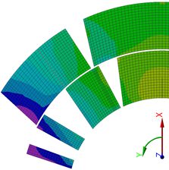
Characterisation procedure
Validate:
E-Modulus Press using strain Gauges
(Digital Imaging Correlation)
Validate with Measurements
Fiber Glass Composite (% Vf)
10-stack Measurements
E, ε
2D Model
3D Model
Coil Model 2D & 3D
Material Characterisation
σ, ν
3-Point Bend Tests
Sample Fabrication and Experimental Work
Finite Element Properties
Modelling and Calibration of Models
Source: M. Daly

