Slide 1

Magnet Powering and Operation Requirements
S. Yammine in collaboration with H. Thiesen
TE-EPC-MPC
Acknowledgements
TE-MSC-LMF F. Savary, H. Prin, L. Grand-Clement
TE-MSC-MDT S.I. Bermudez
TE-MPE-PE L.Bortot, B. Auchmann, M. Prioli
TE-MPE-EE F. Rodriguez Mateos
BE-ABP-HSS M. Giovannozzi
TE-MSC-MNC P. Fessia
EN-ACE-INT J.P. Corso
BE-OP-LHC M.S. Camillocci
WP6, WP11 members, …
06/04/2016

Slide 2
Contents
01 Overview: Integration of the 11 T Dipoles
02 RB and Trim Powering Scheme (define it, standard, special, test conditions, failure modes, ...)
03 Main Subjects for the Trim Circuit Design
04 Summary

Slide 3
01
Integration of the 11 T Dipoles

Slide 4
Integration of the 11 T Dipoles
Main Dipole Circuits (RB Circuits) :
8 main dipole circuits in the LHC
Per Circuit (Current Configuration prior to LS2) :
154 MB dipoles (77 Type A – 77 Type B)
L_{TOT} ≈ 15.7 H (102 mH / Magnet)
R_{TOT} ≈ 1 mΩ
R_{extraction} = 140 mΩ (2x70 mΩ)

Slide 5
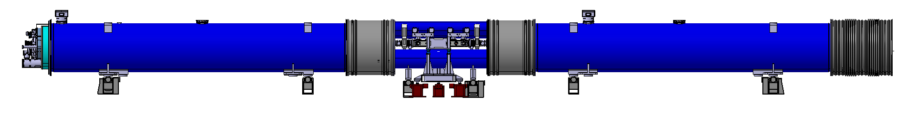
Integration of the 11 T Dipoles
Replacement of MB Dipoles :
2 11T cryo-assemblies for LS2 : MBA-B8L7 and MBB-B8R7
2 additional 11T cryo-assemblies for LS3 : MBA-B10L7 and MBB-B10R7
Only point 7 concerned
L_{11T} ≈ 130 mH
(Total Inductance of two Magnets)
Circuit RB.A67 : Magnets 151 – 153
11T Magnet
Collimator
11T Magnet
Circuit RB.A78 : Magnets 151 – 153 (Transfer to Line A)

Slide 6
02
RB and Trim Powering Scheme

Slide 7
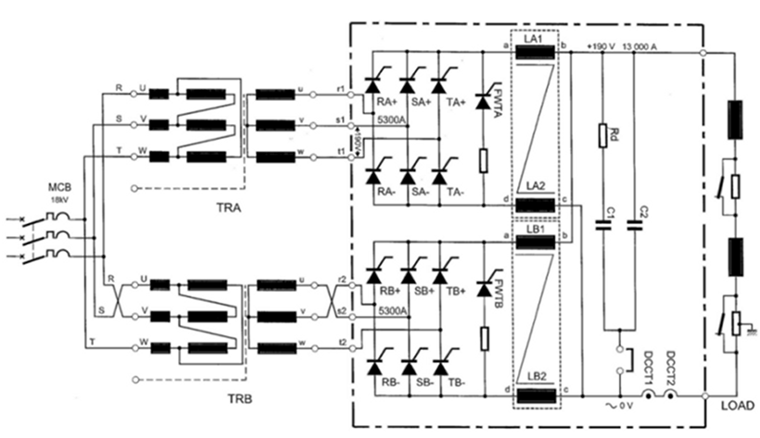
RB and Trim Powering Scheme
Powering of the RB Circuit :
RB power converter (RPTE) : 13 kA – ±190 V – 2 Quadrants
Circuit : 15.7 H - 1mΩ
18kV AC
50Hz Transformer
Output Filter
Thyristor Rectifier

Slide 8
RB and Trim Powering Scheme
Standard and Special Current Cycles of the RB Circuit :
Courtesy of M.S. Camillocci

Slide 9
RB and Trim Powering Scheme
11T Magnet - Beam Dynamics :
Field in the 11T should be the closest to the MB dipole.
Difference in the transfer functions generates a bump.
Baseline for the correction is a local correction via a trim circuit.
Courtesy of M. Giovannozzi

Slide 10
RB and Trim Powering Scheme
11 T Trim Currents for Readapted Field ^{(*)} :
Positive and Negative Currents [-250A … 100 A]
6.5 TeV
I_{RB} = 11 kA
ΔI_{11T} = -67 A
7 TeV (Nominal)
I_{RB} = 11.85 kA
ΔI_{11T} = 0 A
7.5 TeV (Ultimate)
I_{RB} = 12.84 kA
ΔI_{11T} = 91 A
(*) Preliminary curves - should be confirmed by operation

Slide 11
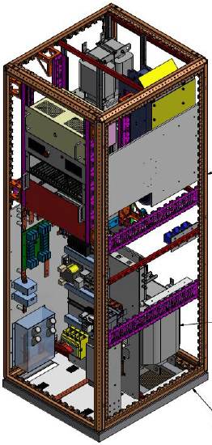
RB and Trim Powering Scheme
11T Trim Powering Schemes :
11T trim power converter : ± 250A /± 10 V – 4 quadrants
Power
Design based on existing power converter (COMET ±250A/±120V)
AC/DC Conversion
Reversibility
Output Filter
H-Bridge

Slide 12
RB and Trim Powering Scheme
Baseline Protection ^{(*)} :
Trim and RB crowbars
Bypass diodes for 11T and MB magnets
2 energy extraction systems for FPA (2x70mΩ)
QPS : Quench heaters
^{(*)} Ref : Conceptual Design Review of the Magnet Circuits for the LHC (https://indico.cern.ch/category/4887/)

Slide 13
RB and Trim Powering Scheme
Circuit Common Failure Modes :
Failure Modes | Causes | Actions | New Critical Point for the Powering
Trim PC Failure | Measurement failure Trim overcurrent Control failure Hardware failure, … | Trim crowbar closed Trim PC stopped RB PC (tbd) | Bypass diode and 11T in parallel to trim
RB PC Failure | Measurement failure RB overcurrent Control failure Hardware failure, … | Trim crowbar closed Trim PC stopped RB crowbar closed RB PC stopped | Bypass diode and 11T in parallel to trim
Quench at 11 T |  | FPA | Maximum voltage across 11T/Trim = 6 V ^{(*)}
Quench at Random Magnet |  | FPA | Maximum voltage across 11T/Trim = 12 V ^{(*)}
^{(*)} Ref : https://indico.cern.ch/event/507166/

Slide 14
RB and Trim Powering Scheme
Hardware Commissioning :
Powering tests start after individual system tests.
RB HWC test sequence :
  Number of tests with increasing current levels.
  Correct operation of various systems is checked.
Commissioning of the new RB circuit will be based on the existing one but adapted for the trim PC (tbd).
Courtesy of A. Verweij

Slide 15
03
Main Subjects for the Trim Circuit Design
(*) Ref : https://indico.cern.ch/event/507166/

Slide 16
Main Subjects for Trim Design
Summary :
Common Mode Voltage
Bandwidth Frequency of the Trim PC Control
  Decoupling the RB and the trim circuits
  Resonating frequencies
Cable and Crowbar Resistances
  Bypass diode in parallel (for quench protection)
  Maximum trim current (limited by magnet/trim connections)
  Integration and Cooling Constraints
Testing in SM18

Slide 17
Main Subjects for Trim Design
Common Mode Voltage (Voltage to Ground) :
Ramp-up, V_{CM} = 85 V
Ramp-down, V_{CM} = -85 V
FPA, V_{CM} = 450 V
FPA + Earth Fault, V_{CM} = 1000 V
Worst reported case, V_{CM} = 1200 V ^{(*)}
Design Considerations for the Common Voltage :
Isolated measurement, control and protection systems
High isolation material for the power (dielectric isolation – high isolation distance)
Already accounted for in other PCs
^{(*)} Ref : E. Ravaioli et al. “Analysis and Simulation of the event in RB.56 on the 9 February 2015” Internal Communication

Slide 18
Main Subjects for Trim Design
Bandwidth Frequency :
Coupling Trim/RB circuits :
  Trim and RB circuits are electrically coupled.
  However, the difference in inductance values (L_{RB} = 15 H , L_{11T} = 0.13) reduces significantly this coupling.
  Increasing the trim circuit bandwidth frequency reduces further this coupling.
  Trim bandwidth frequency is limited by resonating frequencies of the trim/RB circuits (30Hz).
Trim F_{BW} = 1Hz
Trim F_{BW} = 8Hz
Ref : https://indico.cern.ch/event/507166/
Current Response due to an RB Voltage Step (5V)
18

Slide 19
Main Subjects for Trim Design
Cable and Crowbar Resistances :
2 contradictory constraints :
  Bypass diode constraint :
    If R_{total} > 17mΩ, the bypass diode will be fired when crowbar is fired for |I_{TRIM}| > 60A.
    Energies up to 7 kJ could pass through the diode.
  Overcurrent constraint :
    If R_{total} < 60mΩ, a current (up to 750 A) is seen in the trim circuit in FPA.

Slide 20
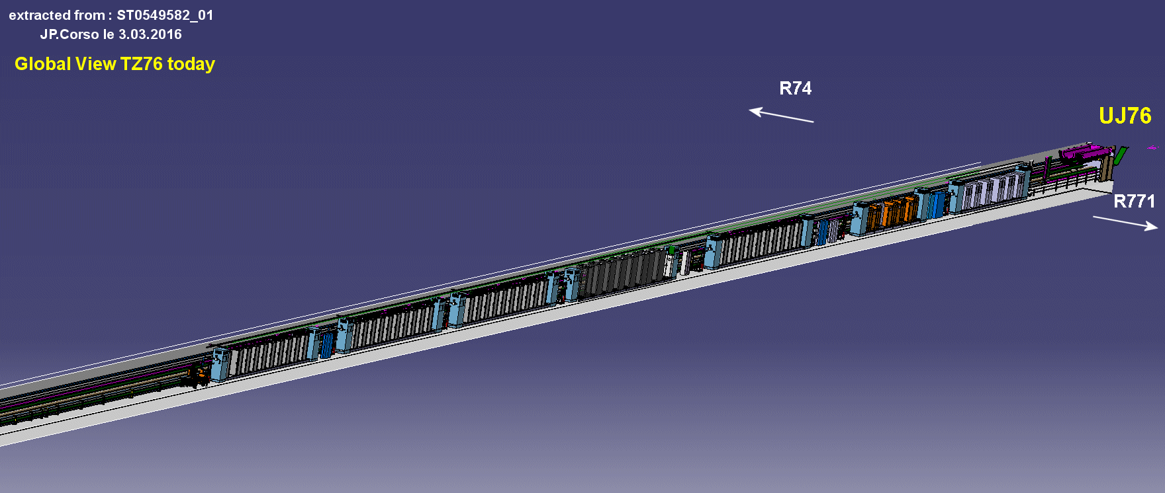
Main Subjects for Trim Design
Cable and Crowbar Resistances – Integration :
A9 option | L_{Cable} (m) | R_{cable} | Heat Losses | R_{cable} | Heat Losses
 |  | Configuration 1 |  | Configuration 2
MB.B8L7 | 440 | 13 mΩ | 0.8 kW | 39 mΩ | 2.4 kW
MB.B8R7 | 360 | 11 mΩ | 0.7 kW | 33 mΩ | 2.1 kW
Config 1 : 6x400mm^{2 (*)} Cables/PC
Config 2 : 2x400mm² Cables/PC
A20 option | L_{Cable} (m) | R_{cable} | Heat Losses | R_{cable} | Heat Losses
 |  | Configuration 1 |  | Configuration 2
MB.B8L7 | 550 | 16 mΩ | 1 kW | 48 mΩ | 3 kW
MB.B8R7 | 470 | 14 mΩ | 0.9 kW | 33 mΩ | 2.7 kW
A9
A20
Courtesy of P. Fessia – JP. Corso
^{(*)} Suggestion on the cable section – not definite

Slide 21
Main Subjects for Trim Design
Cable and Crowbar Resistances – Conclusion and Prospects :
 | Low | High
Low | Overcurrent Cable sections high Cable joules losses low Bypass diode constraint respected | No overcurrent Cable sections low Higher cable joules losses Bypass diode constraint not respected
High | No overcurrent Cable sections high Cable joules losses low Bypass diode constraint not respected | No overcurrent Cable sections low Higher cable joules losses higher Bypass diode constraint not respected
R_{cable}
R_{crowbar}
Next Step :
Find the best solution (resistance values) to respect integration, cooling, overcurrent and protection (collect more data, test bench, …) .

Slide 22
Main Subjects for Trim Design
Testing the 11T Trim in SM18 :
Tests | Configuration 1 | Configuration 2
Trim Operation Verification (without second PC) | Yes | Yes
11T TF | Yes | Yes
Trim Overcurrent Test | Yes | Yes
Partial Bypass Diode Constraint | Yes | Yes
Complete Bypass Diode Constraint | No | Yes
2 PCs Test | No | Yes
Configuration 1 -
Control of the 2 PCs together highly complex
Configuration 2 (On Two Clusters) -
Control of the 2 PCs together possible

Slide 23
04
Summary

Slide 24
Summary
Trim Circuit :
Trim circuit is in parallel to the 11T to remove or inject current is the baseline.
Trim PC characteristics : ± 250A /± 10 V – 4 quadrants (Design based on COMET (± 250A /± 120V)).
Project phase : specification and integration phase
No foreseeable major issues
Trim Circuit Design Considerations :
Trim circuit bandwidth frequency
High common mode voltage
Crowbar and cable resistances

Slide 25
Thank you for your attention
References (for circuit simulations and constraints explication)
S. Yammine and H. Thiesen, “ 11T Magnets Powering – TRIM PC Constraints”, in the Biweekly Meeting on the 11T TRIM Powering and Protection, 02 March 2016. (https://indico.cern.ch/event/507166/)
L. Bortot , “Impact of Quench-Induced Fast Power Aborts on the RB Hi-Lumi Circuit”, in the Biweekly Meeting on the 11T TRIM Powering and Protection, 02 March 2016. (https://indico.cern.ch/event/507166/)

Slide 26
Supplementary Slides

