Slide 1

Review on the 11 T Dipoles at Collimator Section for HL-LHC
Model Magnet production @ CERN
J.C. Perez on behalf of MDT team
Thanks to all contributors
6th April 2016 – http://indico.cern.ch/event/493351/

Slide 2
Outline
Coil production status & relevant fabrication information
Magnet assembly and tests status
On going R & D activities
Production plan for future models
Summary

Slide 3
Coil production status
16 coils have been produced
  2 practice coils using copper conductor (#101 & #102)
  2 practice coils with low-grade Nb₃Sn cable (#103 & #104)
  2 coils using RRP 108/127, T-Doped conductor (#105 & #106)
  1 coil with RRP 108/127 (#107)
  5 coils with 132/169 (#108, #109, #111, #112 & #113)
  1 coil with a damaged RRP 132/169 conductor (#110)
  2 coils with RRP 150/169 (#114 & #115)
  1 coil using low-performance PIT cable (#201)
2 coils using RRP 150/169 (#116 & #117) to be wound Q2-2016

Slide 4
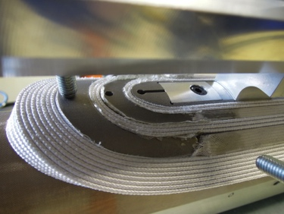
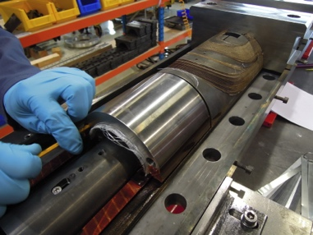
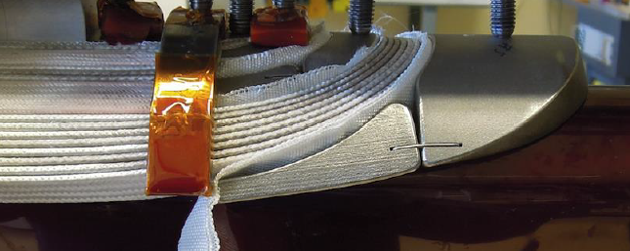
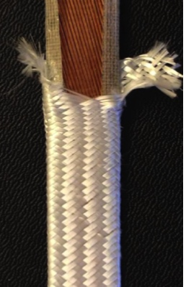
Coil configurations (#101 to #105)
Coils #101 to #104 have been used as practice coils to qualify fabrication procedure and tooling
Coils #101 to #103 have been produced using
  S2-Glass 11 Tex+ Mica cable insulation (except for coil #102 S2-33Tex)
  SS sintered solid spacers
  SS end-saddles
  316L wedges
  S-Glass inter-layer insulation
  Ceramic filler piece in the layer jump area during reaction operation
Coil #104 to #106 have been produced using
  Flexible spacers
  ODS-Cu wedges
  SS end-saddles
Coils #101and #105 used during the first single coil magnet assembly
Coils #102 to #104 sliced for inspection and measurements for process validation

Slide 5
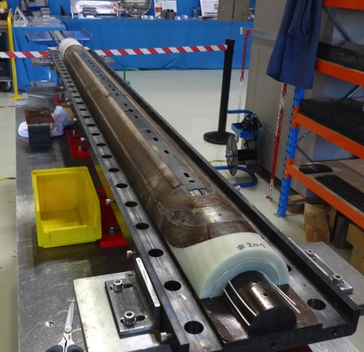
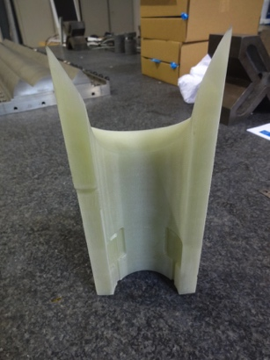
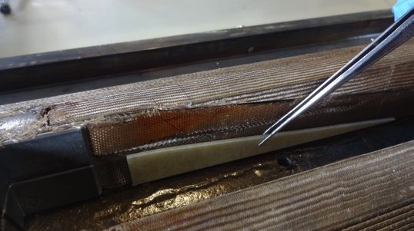
Coil configurations (#106 to #115)
Coils #106 to #108 have been produced using
  Flexible spacers
  Fiber glass end-saddles
  ODS-Cu wedges
  Ceramic filler piece in the layer jump area during reaction operation
  Non embedded Quench Heaters
  Instrumentation wires soldered after impregnation
From Coil #109
  Ceramic filler replaced by G11 filler pieces in the splice area after heat treatment
Coils #114 & #115 have been equipped with impregnated Quench Heaters on the outer layer
Coils #116 & #117 to be wound with impregnated traces and inter-layer Heaters

Slide 6
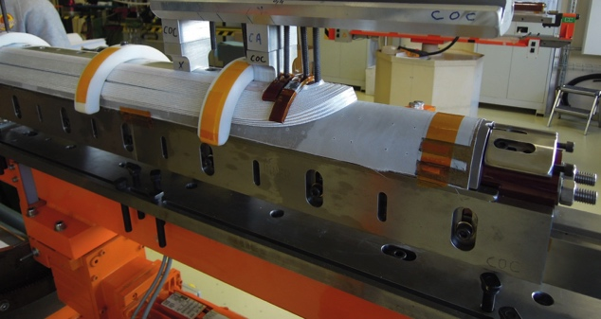
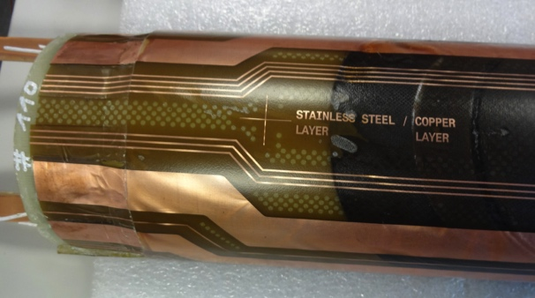
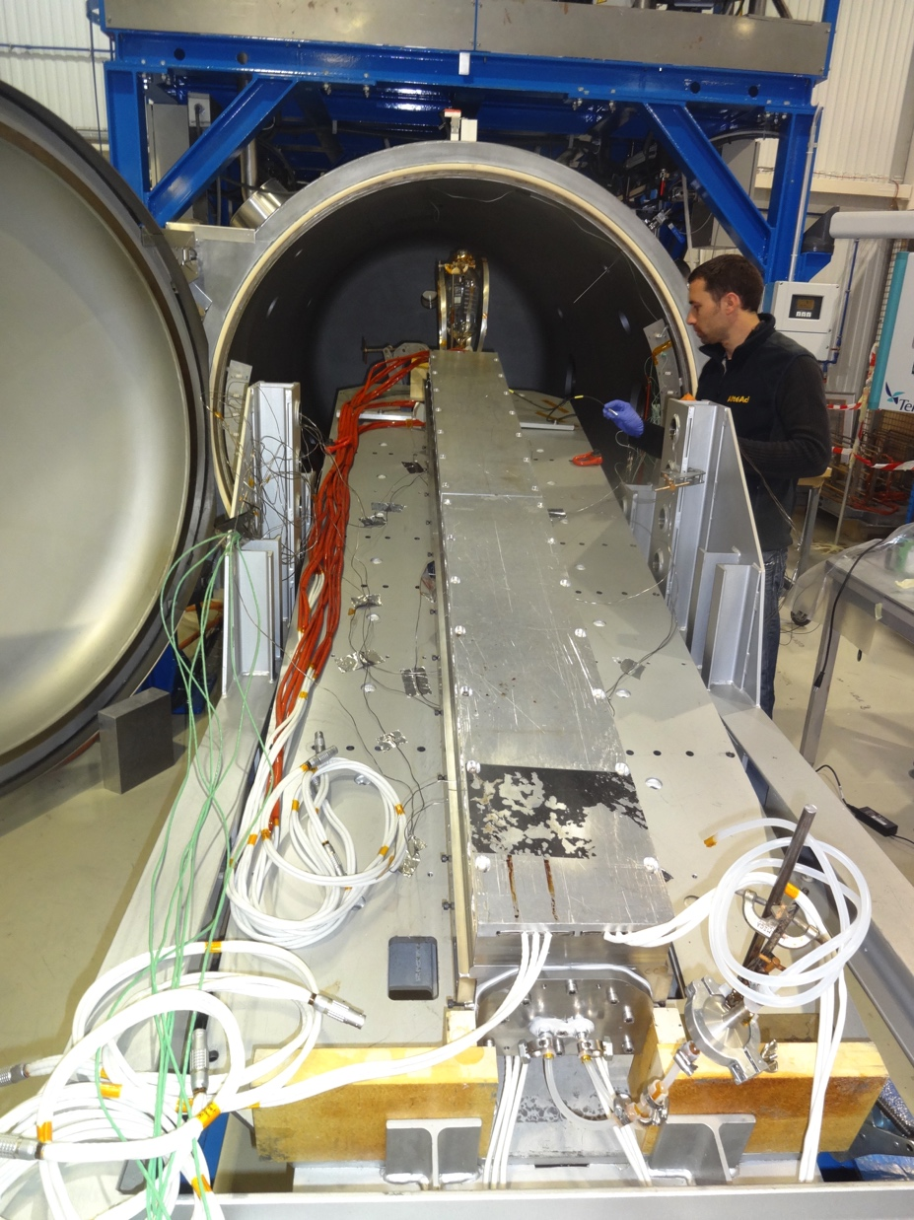
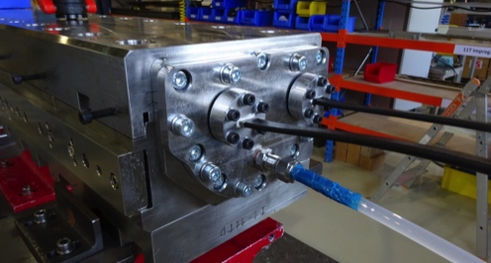
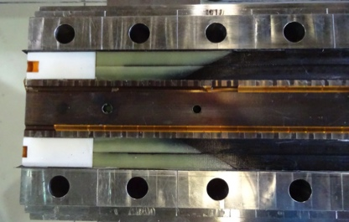
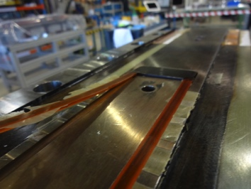
Coil #110 to #201 configurations
Coil #110 has been wound with a damaged conductor. It has been used to test the integration of an inter-layer Heater and impregnated Quench Heater on the outer layer. The coil has been impregnated with a multiple injection points mold configuration in 927.
Coil #201 produced with a low-performance PIT conductor has been used for
  Inter-layer Quench Heater integration test
  Electrical measurements up to insulation limits
  Coil impregnated using new 180 impregnation tank (multiple injection points and pressurized curing)

Slide 7
Heat treatment history and parameters
REACTION
Coil 101 to 107
FAN failure
REACTION Coil 108
Tc calibration
REACTION
Coil 109 & 111
New Tc & calibration
REACTION Coil 112 to 115
Parameter |  | MBHSP105 | MBHSP106 | MBHSP107 | FAN FAILURE Jul-2014 | MBHSP108 | THERMOCOUPLE CALIBRATION Dec-2014 | MBHSP109 | MBHSP111 | NEW THERMOCOUPLES AND CALIBRATION Jun-2015 | MBHSP112 | MBHSP113 | MBHSP114 | MBHSP115
Reaction date |  | Oct-13 | Jan-14 | Feb-14 |  | Aug-14 |  | Dec-14 | Mar-15 |  | Jun-15 | Jul-15 | Sep-15 | Sep-15
Coil destination |  | SM101 | SP101 / SP102 / DP101 | SP101 |  | SP102 / DP101 |  | SP103/ DP101 | SP103 / DP101 |  | SP104 | SP104 | SP105 | SP105
1st plateau | Nominal | 210°C / 48h | 210°C / 48h | 210°C / 48h |  | 210°C / 48h |  | 210°C / 48h | 210°C / 48h |  | 210°C / 48h | 210°C / 48h | 210°C / 72h | 210°C / 72h
 | Average | 208°C / 50h | 209°C / 45h | 207°C / 45h |  | 207°C / 37h |  | 211°C / 50h | 212°C / 46h |  | 210.5°C / 51h | 210.5°C / 49h | 210°C / 78h | 210°C / 72h
2nd plateau | Nominal | 400°C / 48h | 400°C / 48h | 400°C / 48h |  | 400°C / 48h |  | 400°C / 48h | 400°C / 48h |  | 400°C / 48h | 400°C / 48h | 400°C / 48h | 400°C / 48h
 | Average | 400°C / 50h | 399.5°C / 47h | 398.5°C / 48h |  | 398.5°C / 45h |  | 399°C / 48h | 399.5°C / 48h |  | 400.5°C / 49h | 401°C / 49h | 400°C / 50h | 400°C / 49h
3rd plateau | °C | 640°C / 50h | 640°C / 50h | 640°C / 50h |  | 640°C / 50h |  | 640°C / 50h | 640°C / 50h |  | 640°C / 50h | 640°C / 50h | 665°C / 50h | 665°C / 50h
 | hours | 642°C / 52h | 642.5°C / 53h | 642°C / 52h |  | 641°C / 51h |  | 639°C / 51h | 639°C / 50h |  | 642°C / 50h | 641°C / 50h | 662°C / 50h | 665°C / 50h
Fan in retort |  | Y | Y | Y |  | N |  | N | N |  | N | N | N | N
Argon flow | Coil | 350 l/h | 350 l/h | 350 l/h |  | 350 l/h |  | 350 l/h | 350 l/h |  | 350 l/h | 350 l/h | 350 l/h | 350 l/h
 | Retort | 1500 - 2000 l/h | 1500 - 2000 l/h | 1500 - 2000 l/h |  | 4000 l/h |  | 1500 - 2000 l/h | 1500 - 2000 l/h |  | 1500 - 2000 l/h | 1500 - 2000 l/h | 1500 - 2000 l/h | 1500 - 2000 l/h
Courtesy of N. Bourcey

Slide 8
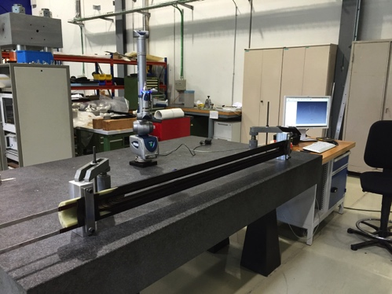
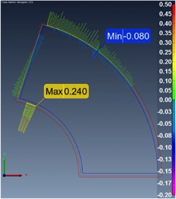
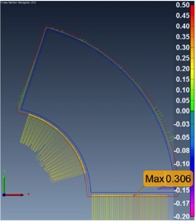
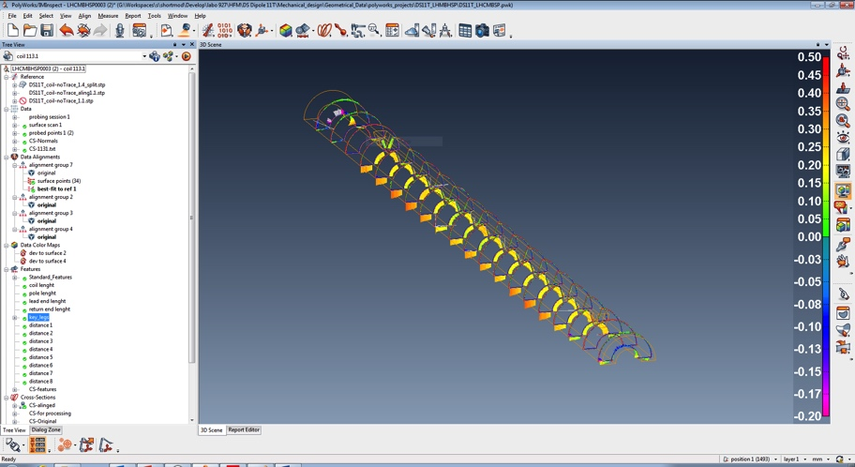
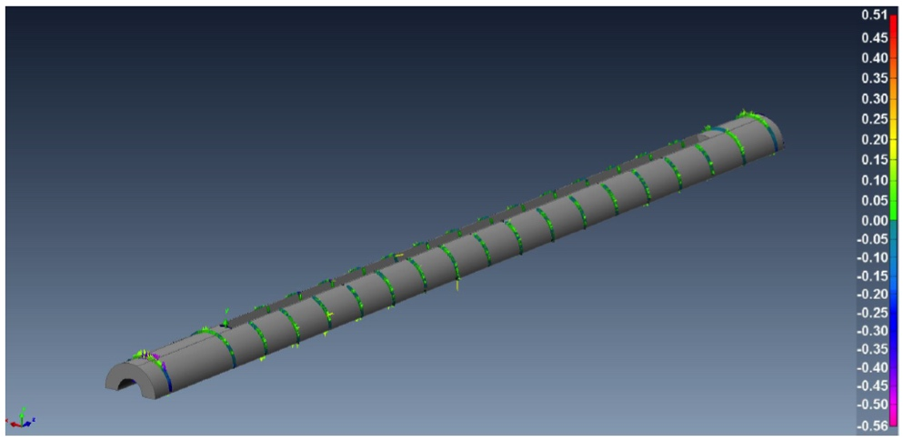
Coil measurement
3D measurements using a FARO arm and Polyworks inspection Software
Results based on Overall geometry and Cross-Section Analysis
Coils are measured after impregnation
Overall geometry analysis
  General features information
  Coil length
Cross section analysis
  Individual alignment of each cross-section in outer diameter and loading plate (banana shape deleted)
  Cross section divided in right and left side every 100 mm

Slide 9
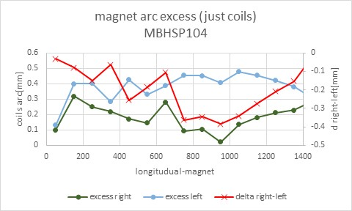
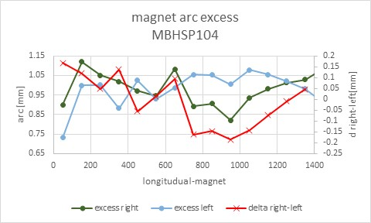
Results application
Results are used to define coil shimming plan during collared coil assembly
Geometrical measurements for correlation coil-shape vs tooling geometry in progress
How resin retracts during curing cycle? Could this geometrical variation be compensated by applying pressure during curing?
Courtesy of C. Loffler. See details on G. Willering presentation

Slide 10
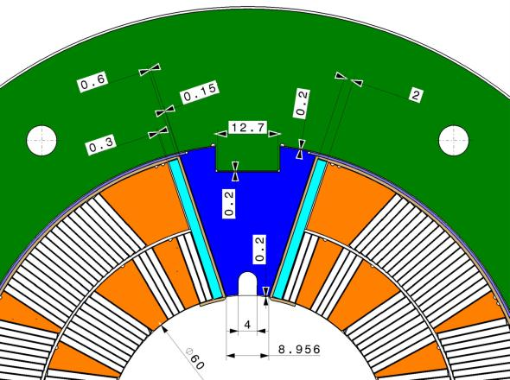
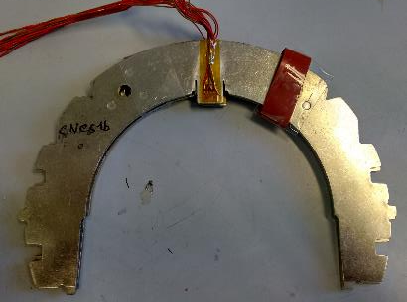

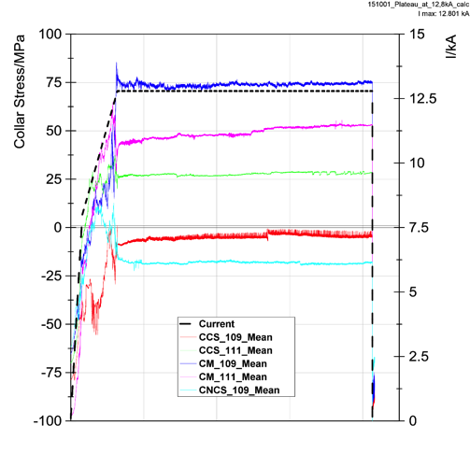
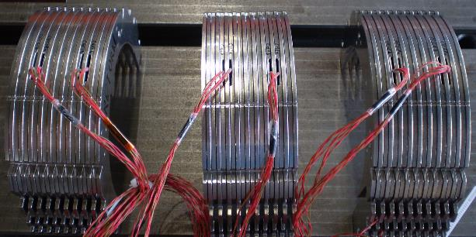
Magnet mechanical instrumentation
The model magnets are instrumented using strain-gauges
Shells on inner and outer radius
3 instrumented collar packs equipped with 8 gauges each
Magnet extremities equipped with 4 bullet gauges per side
Instrumented collars on SP103
Holding current at 12T
Courtesy of C. Loffler. See details on G. Willering presentation

Slide 11
Shell welding
Shells have been instrumented on 4 models
MBHSM101 was MIG/MAG welded
MBHSP101 to MBHSP104 & MBHDP101 were TIG welded
One of the goals of TIG welded is to increase the pre-stress in the shell
Courtesy of C. Loffler. See details on G. Willering presentation

Slide 12
Electrical tests
Electrical tests has been limited to 1 kV on model magnets
For electrical qualification of magnets to be installed in LHC worst case voltage to be considered
  950 V calculated + 500 V added for energy extraction for a magnet in series connection to the LHC dipoles
  Worst case voltage to ground is Vmaxr=(950+500) V= 1450 V (calculated by Susana Izquierdo)
  Peak turn-to-turn voltage is around 75 V
A safety factor as to be applied for electrical tests in dry air:
  VmaxrAir=(1450*4.2)V=6090 V
LHC Dipoles were tested at 5 kV in dry air
Next model magnets to be tested at least up to 5 kV to prove electrical integrity for series magnet production
Test voltage level still to be confirmed by HVWL-WG
Electrical test to high voltage level foreseen on MBHDP101 to demonstrate model electrical integrity for first prototype magnet construction
Coil #110 has already been successfully tested up to 7 kV and coil #107 up to 6.25 kV (discharge test)

Slide 13
Magnet assembly & tests

Slide 14
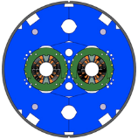
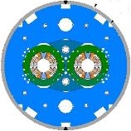
Model magnet configuration for LS2
Coil # | Single aperture | Note | Test results | Double aperture
101 | MBHSM 101 | First single coil practise model | Reached 97% Iss @ 1.9K
105
106 | MBHSP 101 | First single aperture magnet. Coil 107 of bad quality | Reached nominal current
107
106 | MBHSP 102 | Second single aperture magnet. Coil 106 from SP101 | Reached ultimate current | MBHDP101 First 2 in 1 magnet Outer shell Ø 580 mm Reached ultimate current
108
109 | MBHSP 103 | Third single aperture magnet | Reached ultimate current
111
112 | MBHSP 104 | Fourth single aperture magnet | To be tested in June 2016 | MBHDP102 Second 2 in 1 magnet Outer shell Ø 570 mm
113
114 | MBHSP 105 | Fifth single aperture magnet Impregnated QH traces, Multiple injection points & pressurized curing | To be tested Q3-2016
115
116 | MBHSP 106 | Sixth single aperture magnet Impregnated QH traces, Inter Layer QH, Multiple injection points & pressurized curing | To be assembled Q4-2016 Double aperture magnet assembly TBD
117
Reproducibility

Slide 15
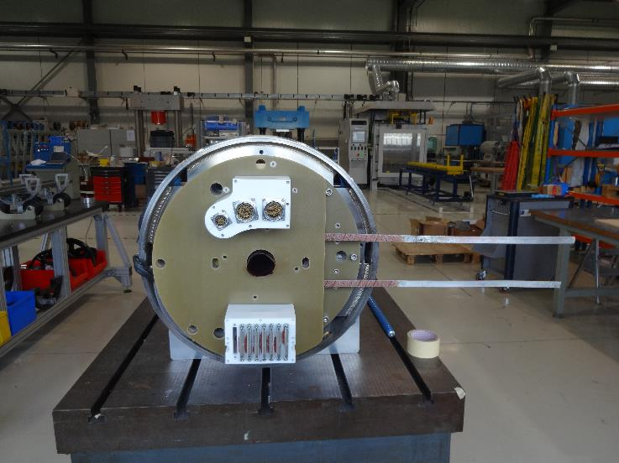
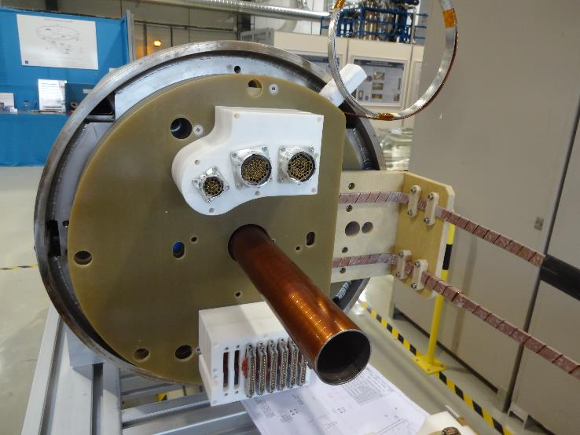
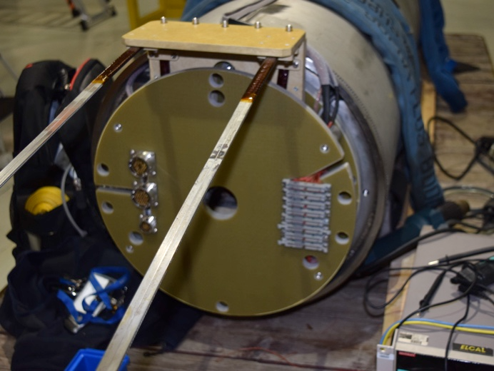
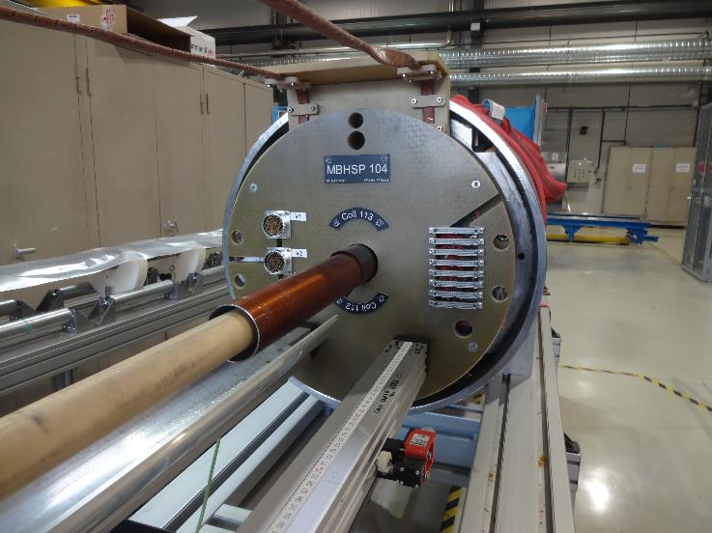
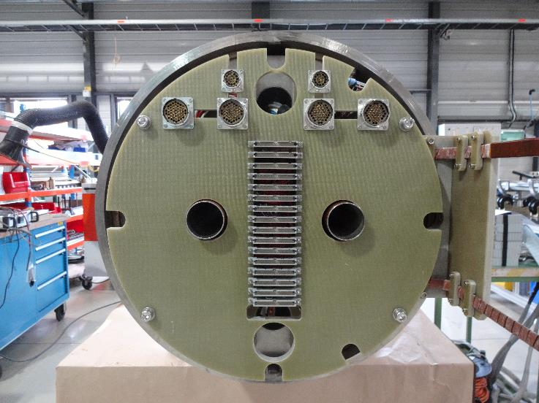
SP101
SP102
SP103
The 11T model family
SP104
DP101
Courtesy of N. Bourcey

Slide 16
On going R &D

Slide 17
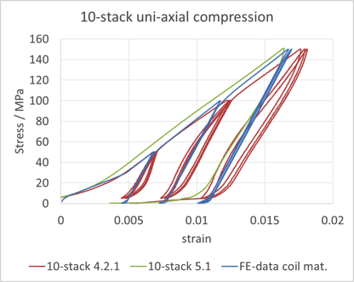
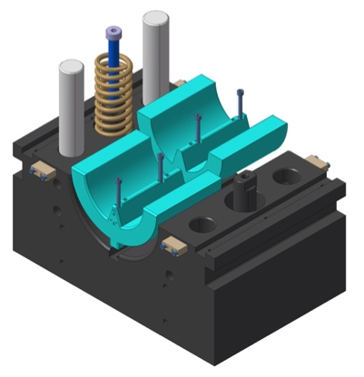
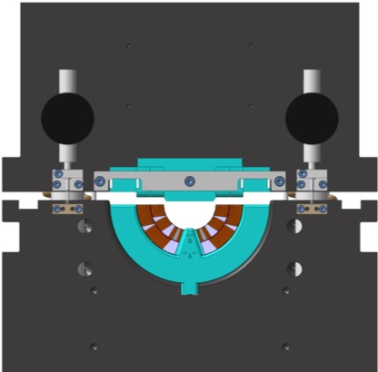
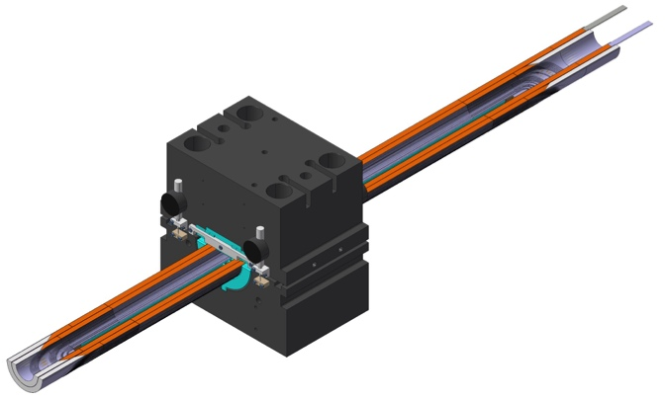
E-Modulus measurements
Modulus used in the FE model from MBHSP103
Coils have permanent deformation after cold powering tests
30 GPa has been used as input parameter on MBHSP101 model
MBHSP102 model has been built using learned information from MBHSP101 magnet to get an equivalent coil pre-stress
Test data: https://edms.cern.ch/document/1534894/1
Test performed by Oscar Sacristan de Frutos / EN-MME
MBHSP103 model has been simulated with non-linear material properties coming from measurements performed on ten-stacks (see detailed presentation from G. Willering)
It has been decided to perform E-Modulus measurements in a real coil configuration to validate FE models
An existing press used to measure MQXC, NbTi coils, is being adapted for 11T Dipole coil measurements
Measurements will be performed on coils #110 & #201 (virgin coils) and compared with coil #105 already cold tested
No Modulus measurements foreseen on virgin coils to be assembled in a magnet
The tooling will be operational by end of summer 2016

Slide 18
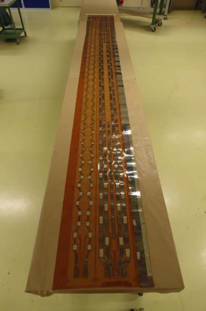

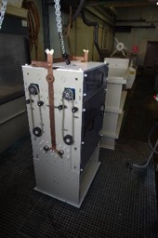
Quench heater development
A dedicated copper deposition machine has been developed, built and successfully tested to copper plate at CERN up to 10 m long quench heaters
An Italian company is being qualified for long circuits production (4.2 m MQXFA quench heater already successfully produced in February 2016 and installed at BNL)
Copper vacuum sputtering deposition technic being investigated in collaboration with a Romanian company
Internal fabrication at CERN will be kept as backup solution
First 5.5 m trace for 11T Dipole prototype fabricated in Italy will be delivered end of May 2016

Slide 19
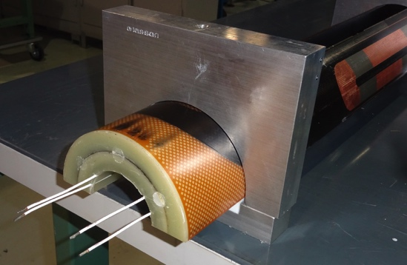
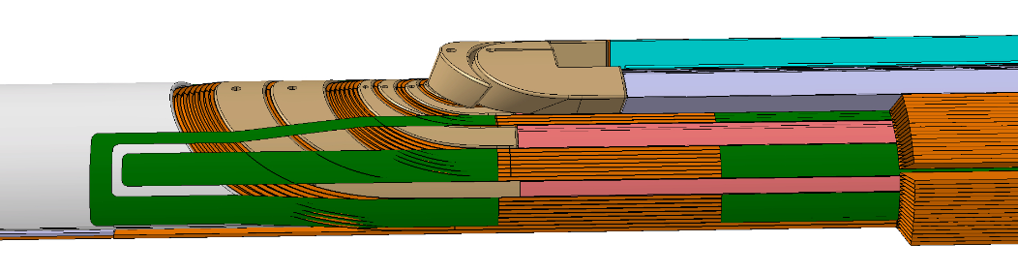
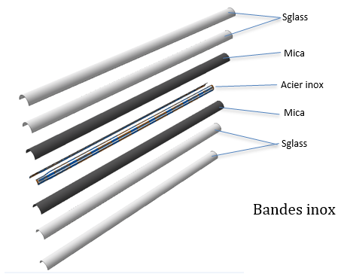
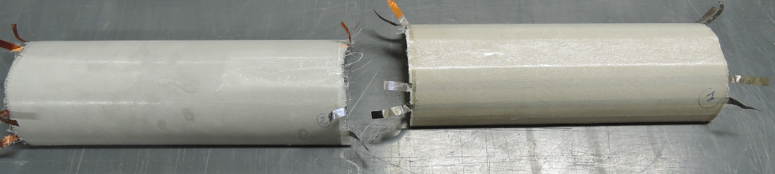
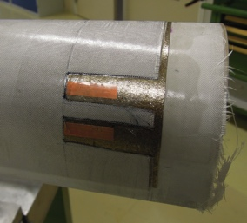
Inter-layer quench heater development
Inter layer heaters capable to withstand heat treatment temperature (already follow full manufacturing process in coil #110)
Total thickness= 0.5 mm. Component producible and to be handle up to 5.5 m
Sandwich made od SS, S2-Glass and perforated Mica
Copper plating needed to reduce overall strip resistance. Heating stations are mandatory for series magnets
Copper vacuum sputtering been considered (copper resistivity variation during reaction due to Ni diffusion)
Electrical integrity to be guaranteed (good preliminary results obtained on coils #110 & #201)
Electrical connexions to be integrated in the end-spacers being developed
First prototypes to be installed on coils #116 & #117
Trial tests in progress. First 2 meters piece scheduled Q2-2016

Slide 20
Production plan

Slide 21
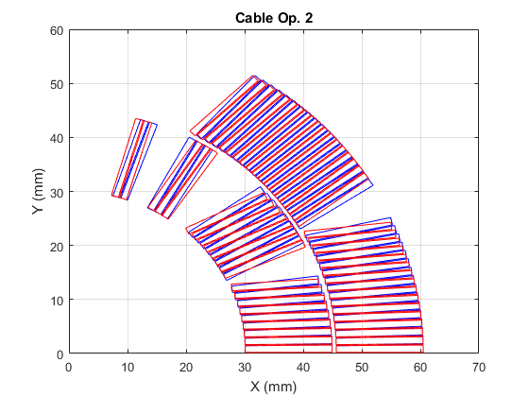
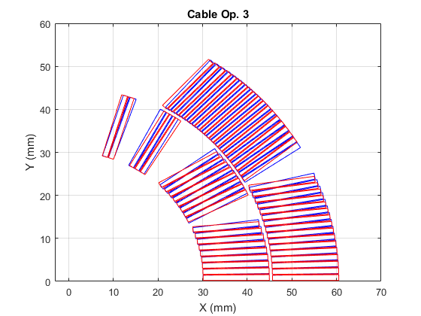
Model magnet configuration for LS3
Keystone angle 0.40 deg.
Keystone angle 0.50 deg.
A new cable geometry is required to reduce critical current and RRR degradation during PIT cable manufacturing
Two keystone angles being considered (see presentation by E. Nilsson)
Coil # | Single aperture | Note | Remarks | Double aperture
202 | MBHSP 201 | First single aperture magnet with PIT conductor & new cross-section Spot Heaters integration for high MIIts tests | Coil winding scheduled to start Q1-2017 | MBHDP201 Third 2 in 1 magnet First double aperture with PIT Outer shell Ø 570 mm
203
204 | MBHSP 202 | Second single aperture magnet with PIT conductor & new cross-section Spot Heaters integration for high MIIts tests | Coil winding scheduled to start Q2-2017
205
206 | MBHSP 203 | Third single aperture magnet with PIT conductor & new cross-section | Coil winding scheduled to start Q3-2017 | If required Double aperture magnet assembly TBD
207
118 | MBHSP 107 | First single aperture magnet with RRP conductor & new cross-section | Coil winding schedule TBD | If required Double aperture magnet assembly TBD
119
Reproducibility

Slide 22
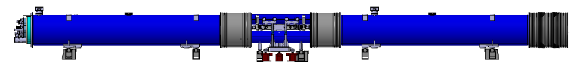

The 11T Dipole Plan in the Timeline of HL-LHC
2015 |  |  |  |  |  |  |  |  |  |  |  | 2016 |  |  |  |  |  |  |  |  |  |  |  | 2017 |  |  |  |  |  |  |  |  |  |  |  | 2018 |  |  |  |  |  |  |  |  |  |  |  | 2019 |  |  |  |  |  |  |  |  |  |  |  | 2020 |  |  |  |  |  |  |  |  |  |  |  | 2021 |  |  |  |  |  |  |  |  |  |  |  | 2022 |  |  |  |  |  |  |  |  |  |  |  | 2023 |  |  |  |  |  |  |  |  |  |  |  | 2024
J | F | M | A | M | J | J | A | S | O | N | D | J | F | M | A | M | J | J | A | S | O | N | D | J | F | M | A | M | J | J | A | S | O | N | D | J | F | M | A | M | J | J | A | S | O | N | D | J | F | M | A | M | J | J | A | S | O | N | D | J | F | M | A | M | J | J | A | S | O | N | D | J | F | M | A | M | J | J | A | S | O | N | D | J | F | M | A | M | J | J | A | S | O | N | D | J | F | M | A | M | J | J | A | S | O | N | D | J | F | M | A | M | J | J | A | S | O | N | D
 |  |  |  |  |  |  |  |  |  |  |  |  |  |  |  |  |  |  |  |  |  |  |  |  |  |  |  |  |  |  |  |  |  |  |  |  |  |  |  |  |  |  |  |  |  |  |  | LS2 |  |  |  |  |  |  |  |  |  |  |  |  |  |  |  |  |  |  |  |  |  |  |  |  |  |  |  |  |  |  |  |  |  |  |  |  |  |  |  |  |  |  |  |  |  |  |  |  |  |  |  |  |  |  |  |  |  |  |  | LS3
For LS2, Models, X-Section 1, RRP
For LS2, Prototype P1, X-Section 1, RRP
 |  |  |  |  |  |  |  |  |  |  |  |  |  |  |  |  |  |  |  |  |  |  |  |  |  |  |  |  |  |  |  |  | Series Production for LS2, X-Section 1, RRP
 |  |  |  |  |  |  |  |  |  |  |  |  |  |  |  |  |  |  |  |  | For LS3, Models, X-Section 2, PIT & RRP
 |  |  |  |  |  |  |  |  |  |  |  |  |  |  |  |  |  |  |  |  |  |  |  |  |  |  |  |  |  |  |  |  |  |  |  |  |  |  |  |  |  |  |  |  |  |  |  |  |  |  |  |  |  |  |  |  |  |  |  |  |  |  |  |  |  |  |  | Series Production for LS2-Spare and LS3, X-Section 2, PIT & RRP
For LS2, Models, X-Section1, RRP
5 Single aperture & 2 double aperture
* 2 cryo-assemblies for IP7
B8L7 & B8R7
* 1 spare cryo-assembly
* 2 cryo-assemblies for IP7 B10L7 & B10R7
* 1 spare cryo-assembly
Spare
available
in end 2021
Beginning of winding
Cold tests of LBH_P1 +
Cryo-by-pass + LBH__001
For LS3, Models, X-Section2, PIT & RRP
3 PIT Single aperture & 1 double aperture
1 RRP Single aperture
For LS3, Prototype LBH_P2,
X-Section 2, PIT
Beginning of winding
Beginning of winding

Slide 23
Summary
16 coils produced and 2 additional in progress
5 collared coils assembled using RRP conductor
4 single aperture magnet tested and 1 ready for cold powering tests
1 double aperture magnet tested with promising results
Impregnation coil deformation being investigated
Impregnation procedure using pressurize curing being qualified
Electrical model integrity to be demonstrated in view of prototype production
Inter-layer heater and long quench heaters development on going
3 single aperture & 1 double aperture PIT models to be tested for LS3
1 single aperture RRP model to be tested for LS3

Slide 24
Thank you for your attention !

Slide 25
Back-up slides

Slide 26
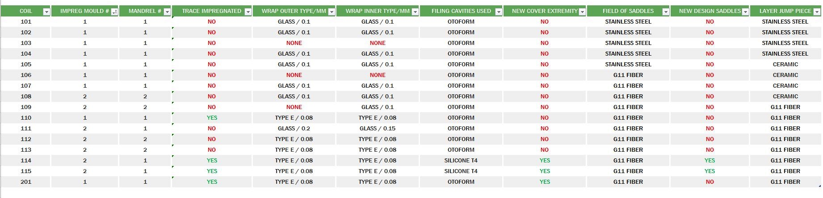
Coils configuration Summary

Slide 27
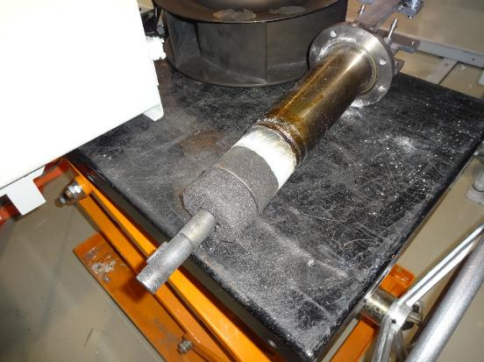
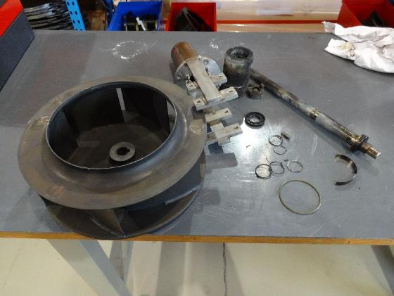
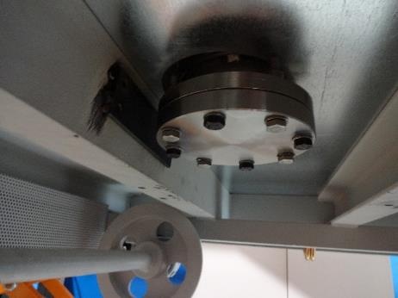
Problem with fan

Slide 28
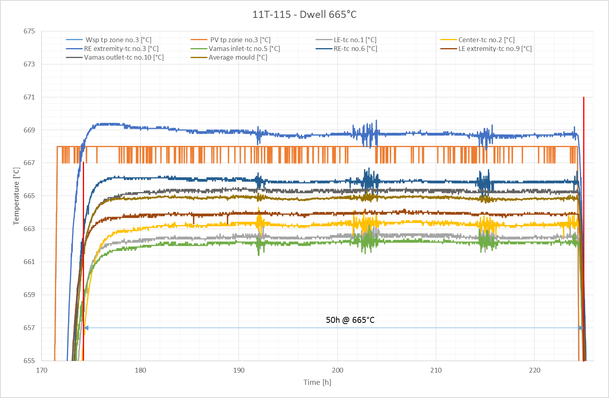
tc10
tc9
tc1
tc2
tc6
tc3
tc5

Slide 29
Coil geometrical measurements
8 coils already measured
  106 Measured after impregnation, after collaring and after training
  107 Measured after impregnation and after training
  108 Measured after impregnation
  109 Measured after impregnation and after collaring
  110 Measured after impregnation
  111 Measured after impregnation and after collaring
  112 Measured after impregnation
  113 Measured after impregnation
  114 Measured after impregnation
  115 Measured after impregnation
Measurements on collared configurations
Measurements on tooling
All results have been updated to last version of software and analysis

Slide 30
Coil geometrical measurements summary
Average deviation values (from nominal) extracted from the straight section
 | COIL
 | 106 | 107 | 108 | 109 | 110 | 111 | 112 | 113
Size Radial | -0.106 | -0.096 | -0.168 | -0.193 | -0.029 | -0.030 | 0.038 | -0.006
Angle loading plate Left | -0.132 | -0.129 | 0.040 | 0.024 | -0.121 | -0.065 | -0.116 | -0.067
Angle loading plate Right | 0.245 | 0.128 | -0.063 | -0.036 | 0.339 | 0.054 | 0.326 | 0.054
Size Azimuthal Left | -0.059 | -0.053 | -0.076 | -0.041 | -0.274 | -0.216 | -0.148 | -0.053
Size Azimuthal Right | -0.138 | -0.105 | -0.040 | -0.085 | -0.303 | -0.171 | -0.141 | -0.258
Impreg mould number | 1 | 1 | 2 | 2 | 1 | 2 | 2 | 2
IMPREG MANDREL NUMBER | 1 | 1 | 2 | 2 | 1 | 1 | 2 | 2

Slide 31
Coil geometrical measurements summary
Average deviation values (from nominal) extracted from the straight section
 | COIL
 | 114 | 115
Size Radial | 0.026 | 0.033
Angle loading plate Left | -0.054 | 0.010
Angle loading plate Right | 0.037 | -0.043
Size Azimuthal Left | -0.099 | -0.089
Size Azimuthal Right | -0.215 | -0.165
Impreg mould number | 2 | 2
IMPREG MANDREL NUMBER | 1 | 1

Slide 32

MBHSP105

Slide 34
Electrical test plan sum-up
Electrical test plan Single and Double Aperture:

Slide 35
Electrical test results sum-up

Slide 36



Exception / Additional test
Electrical test results:
Mirror aperture 101 / Single aperture 101 : 10KOhm resistors on each Vtap in the connexion box
Coil 107 push insulation and coil discharge test before cutting
Coil 110 interlayer Quench Heater – push insulation and coil discharge test
Coils 110 / 114 / 115 / 201 trace impregnated

Slide 37


Collaring
Massage
SG reset
Collaring
SM101, SP101, SP102, SP103
Collaring force 34MN (~500bars)
SP104
Collaring force 20MN (~250bars) due to stoppers thickness reduction of 0.25mm.
Introduction of the collaring keys difficult. No access to control before opening the tool.

Slide 38






Magnet assembly workflow
Collared coil assembly
FARO measurement
Collaring
Trace interface box assembly
Yoke / end- plate / shell assembly
Shell welding
Connection box assembly
Final electrical test

Slide 39





SP101
SP102
SP103
SP104
DP101
Connection box evolution
10kΩ resistance to protect vtaps removed from SP101.
Final design taken from LHC dipole design.
No need of desoldering from 1in1 configuration to 2in1.

Slide 40





MBHDP101 assembly

