Slide 1



Model magnet test results and analysis Protection and operational requirements
Susana Izquierdo Bermudez, Gerard Willering
with many contributions from WP11, WP7, FNAL collaboration.

Slide 2
Contributors
TE-MSC
Luca Bottura.
TE-MSC-SCD
Bernardo Bordini, Jerome Fleiter.
TE-MSC-TF
Gerard Willering, Hugo Bajas, Marta Bajko, Jerome Feuvier.
TE-MSC-MDT
Juan Carlos Perez, Antonios Giannopoulos, Juho Rysti.
TE-MSC-LMF
Ludovic Grand-Clement, Herve Prin, Frederic Savary, David Smekens.
TE-MPE-PE
Bernhard Auchmann, Daniel Wollmann, Jonas Blomberg Ghini, Lorenzo Bortot, Alejandro Manuel Fernandez Navarro.
TE-MPE-EE
Felix Rodriguez Mateos.
FNAL
G. Chlachidze, A. V. Zlobin.
And many other people involved in the design, construction and test of the magnet.

Slide 3
Contents
Introduction
Longitudinal quench propagation.
Quench heater design performance.
Quench propagation within the coil.
Hot spot temperature.
Analysis of failure case scenarios.
Summary.

Slide 4
Contents
Introduction
Longitudinal quench propagation.
Quench heater design performance.
Quench propagation within the coil.
Hot spot temperature.
Analysis of failure case scenarios.
Summary.

Slide 5
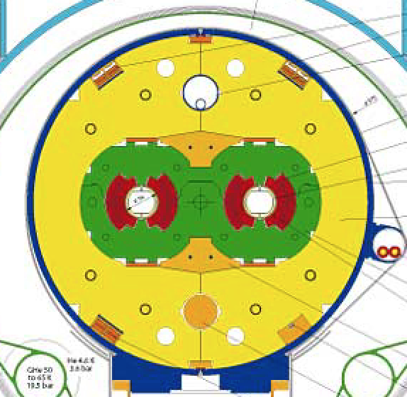
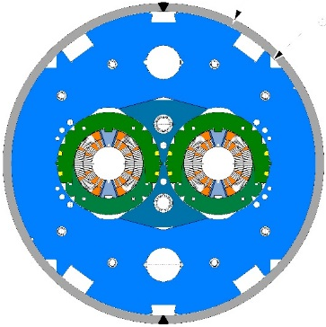
1. Introduction
Comparing to the Main Bending LHC dipoles:
High stored energy density
(compact winding for cost reduction)
Low stabilizer fraction
(to achieve the desired margins)
Magnet parameters at nominal current I_{nom} = 11.85 kA | LHC MB dipole | DS-11T dipole
Field in the aperture at I_{nom} (B₀), (T) | 8.3 | 11.2
Peak field in the conductor at I_{nom} (B_{p}), T | 8.6 | 11.6
Engineering current density at I_{nom} (J_{eng}), A/mm² | 475/583 | 790
Overall current density at I_{nom}(J_{overall}), A/mm² | 354/438 | 523
Current density it the copper at I_{nom}(J_{cu}), A/mm² | 763/882 | 1440
Stored energy in the conductor volume at I_{nom,} MJ/m³ | 60 | 130
Differential inductance at I_{nom}, mH/m | 6.9 | 11.9
Magnetic length, m | 14.3 | 2 x 5.3
Temperature margin, K | 1.8-6.5 | 4.5-14.5

Slide 6
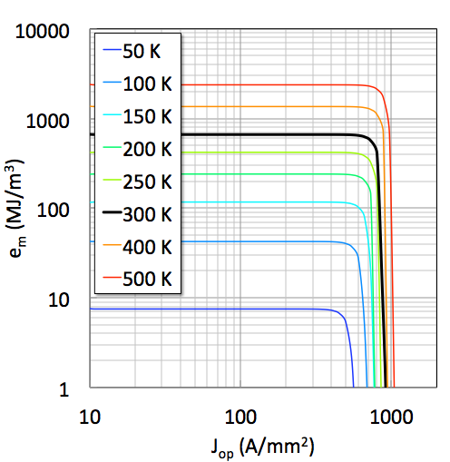
1. Introduction
One can get a relationship between the stored energy, current density and hot spot temperature under some assumptions:
The magnetic energy is completely dissipated in the internal resistance (self dump)
The whole magnet is normal at t_{discharge} (perfect heaters)
The current is constant until t_{quench} then drops to zero
Wilson’s Gamma and the power resistivity
L. Bottura
e_{m} limited
11 T/ MQXF
LHC
J_{op} limited
 | DS-11T dipole | MQXF quadrupole
J_{op}, A/mm² | 790 | 730
e_{m,} MJ/m³ | 130 | 110
* e_{m} energy density compute in the strand area (cu + sc)

Slide 7
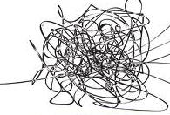
11T and MQXF are pushing the boundary of protection,
we need a good understanding of the dominating physics!
Very different space scales
  Longitudinal direction (along the cable) few hundreds of m
  Transverse direction (across the insulation) mm
Different strongly coupled physics domains
Important dependence on very non-linear material properties
Very different time scales
  Heat flow from supports and structures 1 s
  Heat flow in the coil winding 10 ms
  Heat flow along the cable 1 ms
Our approach, let’s try to understand it bit by bit…studying in detail the “key ingredients”:
Longitudinal quench propagation
  Important because it determines the time needed to detect a normal zone
Heat transfer from heater to coil
  Important because it defines the time needed to induce a distributed quench
Heat propagation within the coil
  Important because it determines the time needed to quench the whole magnet cross section

Slide 8
1. Introduction
Aim of today:
  Study the experimental data available from the short model magnets tested, validating the numerical models in order to evaluate the quench protection of the 11 T magnet under operational requirements.
 | Tested in | Strand lay out | Coil R at 300 K mΩ | Average coil RRR_{293K/4K} | S2 glass ins.OD mm
Coil 105 | MBHSM101 | RRP 108/127 | 426 | 81 | 0.1
Coil 106 | MBHSP101&MBHSP102& MBHDP101 | RRP 108/127 | 423 | 66 | 0
Coil 107 | MBHSP101 | RRP 108/127 | 426 | 97 | 0.1
Coil 108 | MBHSP102& MBHDP101 | RRP 132/169 | 407 | 185 | 0.1
Coil 109 | MBHSP102& MBHDP101 | RRP 132/169 | 400 | 131 | 0
Coil 111 | MBHSP102& MBHDP101 | RRP 132/169 | 401 | 124 | 0.1

Slide 9
Contents
Introduction
Longitudinal quench propagation.
Quench heater design performance.
Quench propagation within the coil.
Hot spot temperature.
Analysis of failure case scenarios.
Summary.

Slide 10

2. Initial quench propagation and detection
A good characterization of the initial quench propagation is important because it determines the time needed to detect a normal zone:
  Cable level: measurements on FRESCA [1]
  Magnet level:
    R&D Magnets: measurements on the Short Model Racetrack Coil (SMC) [2]
    Magnet models: measurements on FNAL and CERN 11T magnets [3]
Foreseen detection settings:
Threshold voltage = 100 mV
Validation time = 10 ms
Experimental data
[G. Chlachidze]
Experimental data
[G. Willering]
[1] J. Fleiter, et al., Quench Propagation in Nb3Sn Rutherford Cables for the Hi-Lumi Quadrupole Magnets. IEE Trans. Appl. Superconductivity
[2] S. Izquierdo Bermudez, et al., Quench modeling in high-field Nb3Sn accelerator magnets, in Proc. 25th ICEC 25 ICMC 2014
[3] G. Willering et al., Cold powering tests of 11T Nb3Sn dipole models for LHC upgrades at CERN

Slide 11
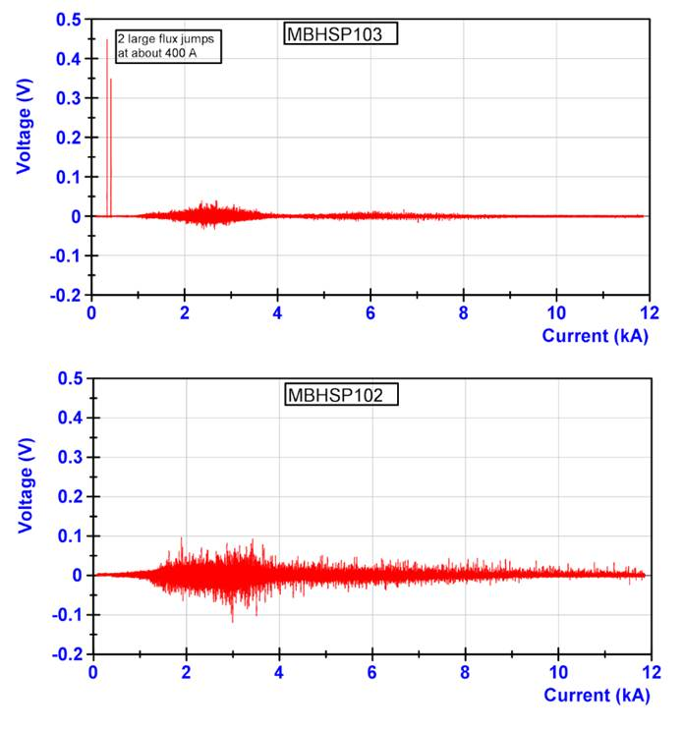
2. Initial quench propagation and detection
In Nb₃Sn, voltage spikes at low field are typically observed due to the flux jumps on the superconductor.
This requires the use of a threshold voltage/validation delay which is a function of the magnet current.
It was intensively discussed during the “Conceptual Design Review of the Magnet Circuits for the HL-LHC” https://indico.cern.ch/event/477759/session/1/contribution/30
Flux jumps characterization for all magnet current levels
Baseline protection settings
[G. Willering]

Slide 12
Contents
Introduction
Longitudinal quench propagation.
Quench heater design performance.
Quench propagation within the coil.
Hot spot temperature.
Analysis of failure case scenarios.
Summary.

Slide 13
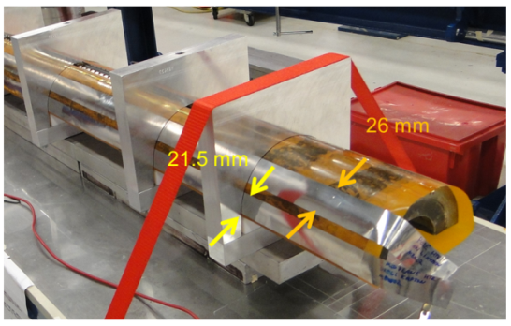
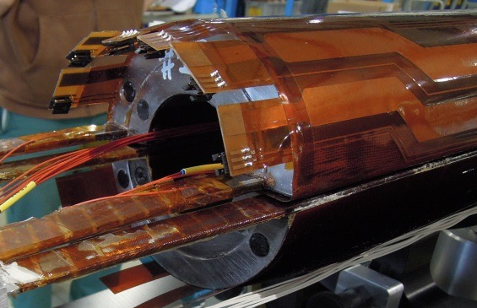
3. Quench heater design
Both for FNAL and CERN, heaters are only present in the outer layer, and they are glued on the outer coil surface after impregnation.
  New baseline for CERN: impregnate the heaters with the coil to minimize the amount of insulation between heater and coil.
The main difference between CERN and FNAL is that heaters are copper plated to reduce the overall strip resistance (max. voltage across the heaters +-450 V). CERN design can be extended to a 5.5 m magnet.
The thickness of the Kapton insulation between heater and coil is also different:
  FNAL: 1x0.114 mm or 2x0.114 mm
  CERN: 0.050 mm + ~ 0.025 mm of glue

Slide 14
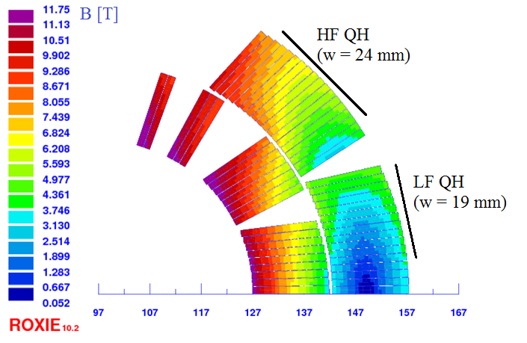
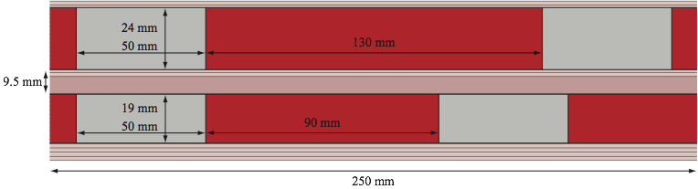
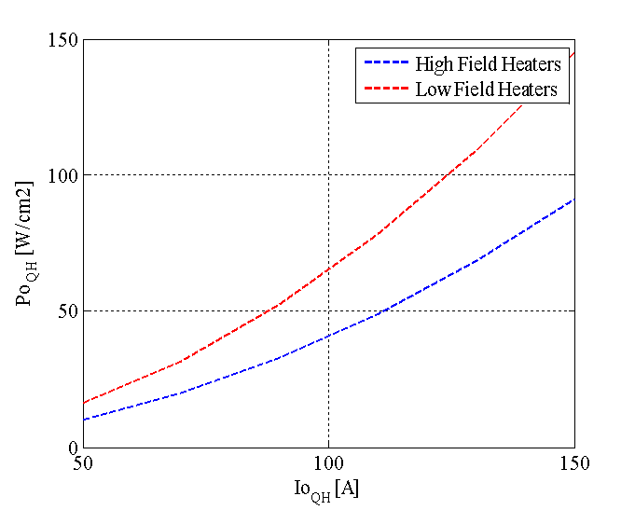
3. Quench heater design
Each aperture is protected with 4 quench heater circuits
(2 heater circuits per coil, only in the outer layer)
  Heater geometry optimized to have a uniform quench in the magnet cross section and a propagation in between stations faster than 5 ms.
  High field and low field quench heater in series (better for redundancy)
“Standard” LHC quench heater power supply:
  Charging voltage: 900 V (± 450 V)
  Maximum current through the heaters: 150 A (instead of 80 A)
  Capacitance: 7.05 mF
  Improvement of the heater firing unit expected to reduce the heater firing delay from 5 ms to 1 ms.
  Integration study needed to fit 16 heater power supplies for each cryo-assembly

Slide 15
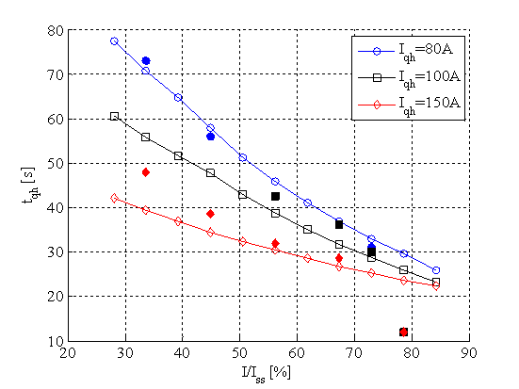
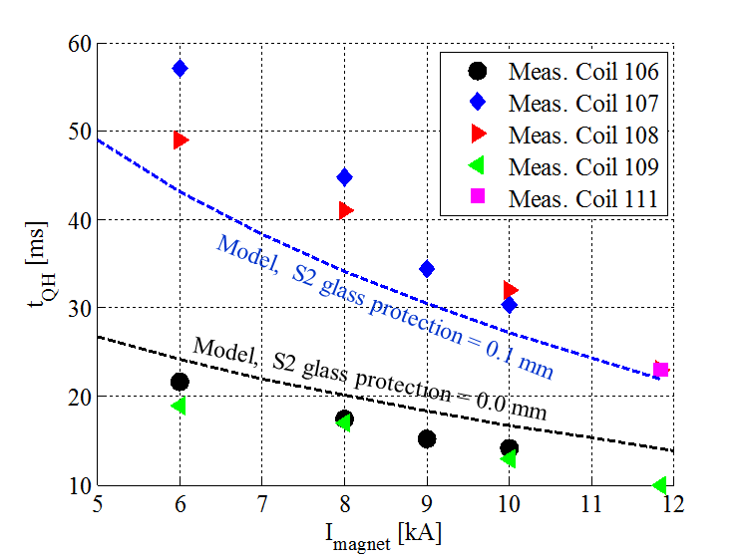
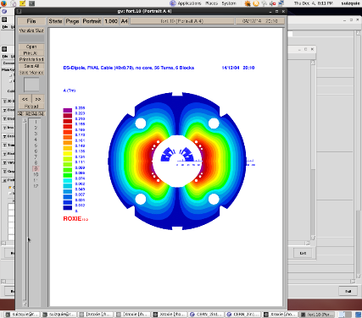
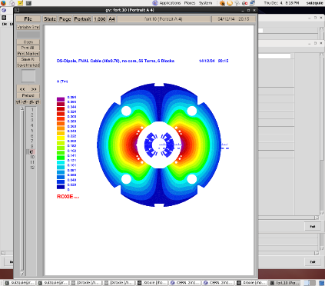
3. Quench heater delays
Key parameters for the heater delay:
Power dissipated on the heaters.
Thickness of the insulation from heater to coil.
  Baseline: heaters impregnated with the coil → S2 glass protection sheet = 0 mm
Agreement ~ 20 % between measured and expected heater delays, although discrepancy increases at low magnet current.
Iqh = 150 A
MBHSM101
MBHSP101&102&103
[experimental data from G. Willering]

Slide 16

3. Quench heater delays
Quench heater delay in FNAL magnets for the one layer of Kapton configuration are comparable to the delays measured in Coils 107, 108 and 109.
Important remarks:
  CERN uses copper cladded heater stations
  For the delays showed in this plot, heater power density is different in CERN/FNAL cases:
    CERN:
    P_{d} = 115 W/cm², τ = 45 ms
    LARP:
    P_{d} = 50 W/cm², τ = 31 ms
Model. S2 – glass protection = 0.1 mm
Model. S2 – glass protection = 0 mm

Slide 17
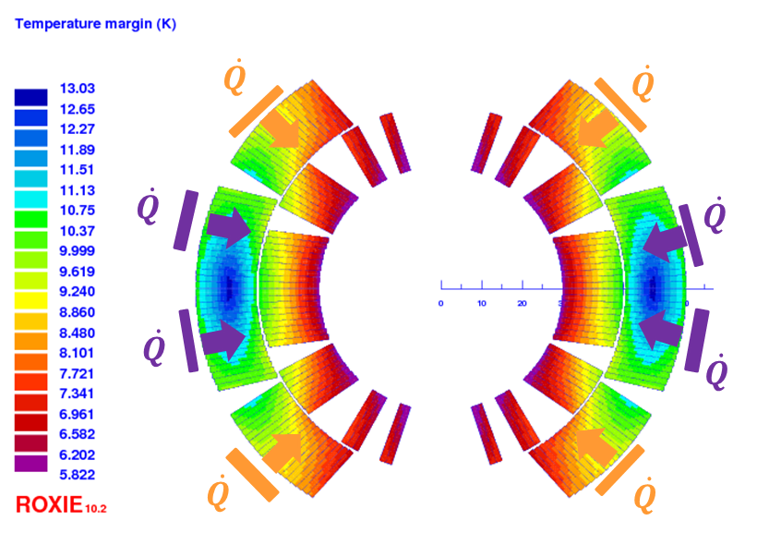
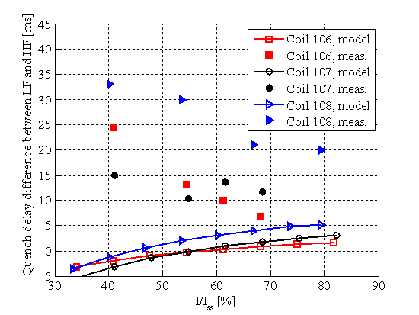
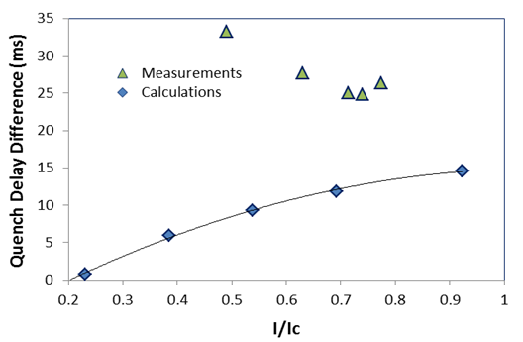
3. Quench heater delays
Quench heaters on the high field blocks
Quench heaters on the low field blocks
Even if the agreement between measurements and model is reasonable good for the heater delay in the high field area, the delay to quench the low field block is longer than expected.
It varies significantly from coil to coil to coil
  Coil manufacturing?
  Test data interpretation?
The same effect was observed in
FNAL magnets

Slide 18
3. Quench heater performance
Quench heaters are effective at all magnet current level.
  The magnet is self protected for I < 1.5 kA.
  In MBHDP101, quench heaters were able to start a quench down to a magnet current level of 500 A.
  Comparing to FNAL MBHSP02 magnet, the minimum power density required to quench is lower due to the thinner insulation between heater and coil .
  This experiment validates the selection of coverage/period for CERN heater copper cladded stations.
Nominal quench heater average power density = 115 W/cm² (Iqh =150 A, Pd_{HF}=91 W/cm², Pd_{LF}=145 W/cm²)

Slide 19
Contents
Introduction
Longitudinal quench propagation.
Quench heater design performance.
Quench propagation within the coil.
Hot spot temperature.
Analysis of failure case scenarios.
Summary.

Slide 20
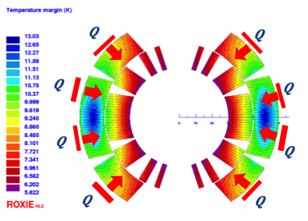
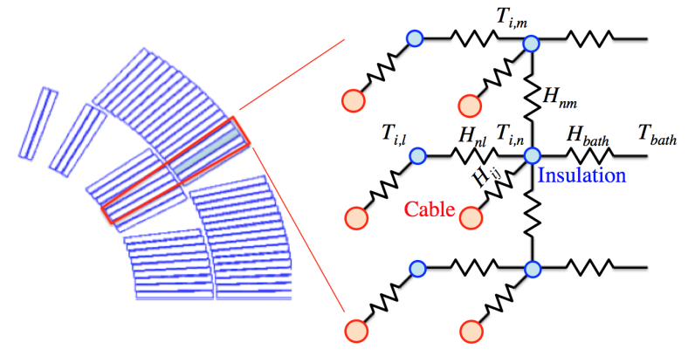
4. Quench propagation within the coil
  Once the quench heaters introduced a distributed quench in the magnet cross section, it is important to study the quench propagation within the magnet cross section:
Manual trip at different currents
Dump delay 1000 ms
Study the quench heater delay, layer to layer propagation, resistance growth and current decay.
Details on the model: S. Izquierdo Bermudez, et al., Quench modeling in high-field Nb₃Sn accelerator magnets, in Proc. 25th ICEC 25 ICMC 2014

Slide 21
4. Quench integral studies
  Significant differences in the quench integral for the different magnets tested
  The differences are explained by difference in RRR and coil resistance at room temperature.
  Agreement model-measurements within 5 %
 | Strand lay out | Coil R at 300 K mΩ | Average coil RRR_{293K/4K} | S2 glass ins.OD mm
Coil 106 | RRP 108/127 | 423 | 66 | 0
Coil 108 | RRP 132/169 | 407 | 185 | 0.1
Coil 109 | RRP 132/169 | 400 | 131 | 0
Coil 111 | RRP 132/169 | 401 | 124 | 0.1
Coil 109-111
Coil 106-108

Slide 22
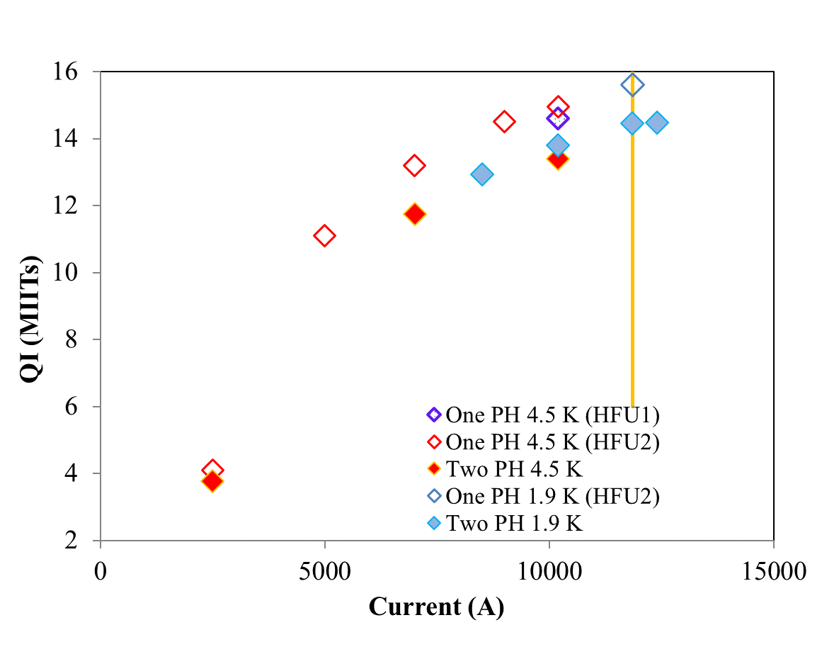
4. Quench integral studies
MBHSP02
All heaters fired
MBHSP02
T = 1.9 K
 | Magnet current | 6 kA | 8 kA | 10 kA | 11.85kA
MIITs from heaters fired to quench detected¹ | MBHSP101 | 0.65
[MA²s] | MBHSP102 | 0.8 | 1.11 | 1.41
¹ neglecting heater firing delay (4-5 ms) | MBHSP103 | 1.04 | 1.34 | 1.6
 | MBHDP101 | 0.86 |  | 1.5 | 1.47
MIITs from quench detected | MBHSP101 | 6.85
[MA²s] | MBHSP102 | 8.08 | 9.47 | 10.43
 | MBHSP103 | 9.05 | 10.87 | 12.3
 | MBHDP101 | 8.4 |  | 11.18 | 11.62
Total MIITs (from heater firing) | MBHSP101 | 7.5
[MA²s] | MBHSP102 | 8.88 | 10.58 | 11.84
 | MBHSP103 | 9.91 | 12.21 | 13.49
 | MBHDP101 | 9.56 |  | 12.68 | 13.36

Slide 23

4. Layer to layer propagation
  Layer to layer propagation delays in the different magnets tested are comparable
  Data is spread and there is a large uncertainty on the model mainly coming from:
    Thermal properties of the coil pack.
    AC loss contribution.
Outer layer to inner layer propagation delay
Experimental data
[G. Chlachidze and G. Willering]

Slide 24
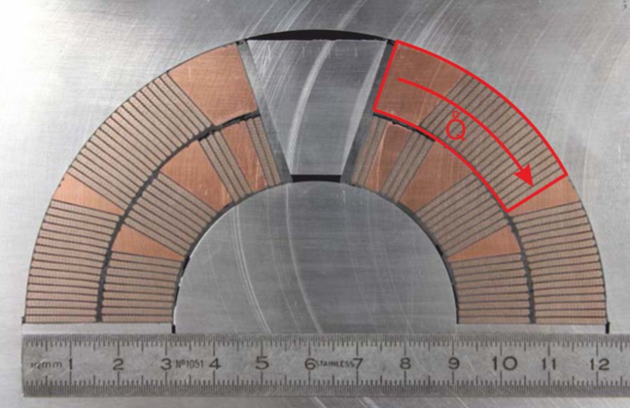
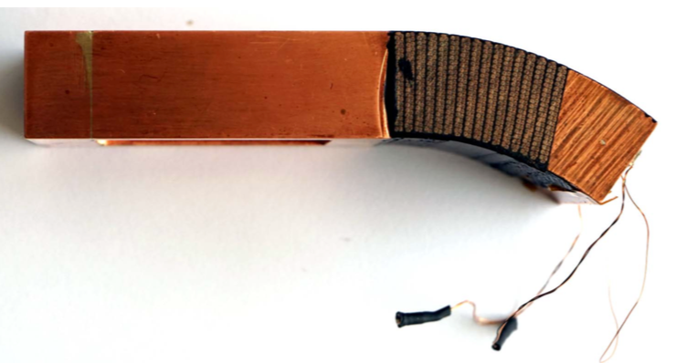
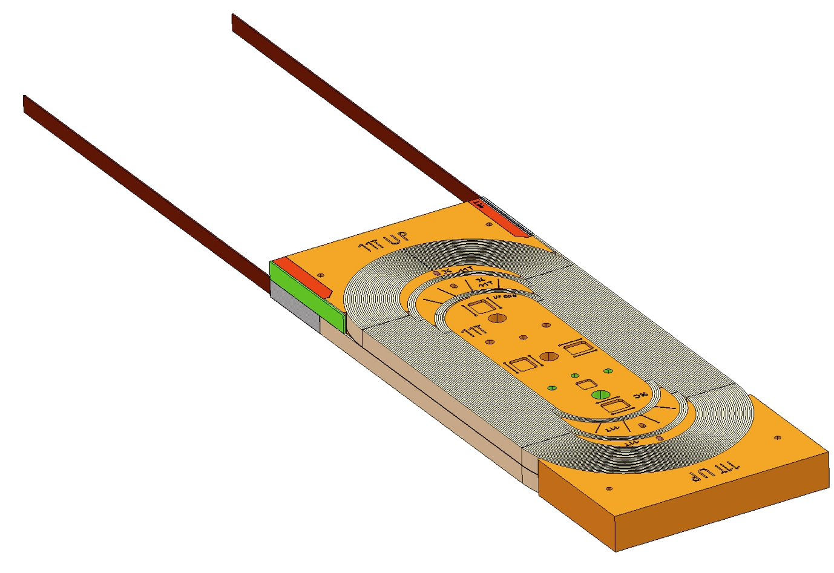
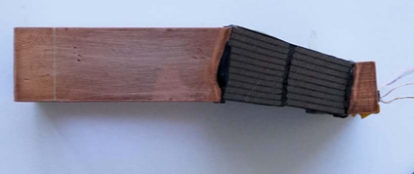
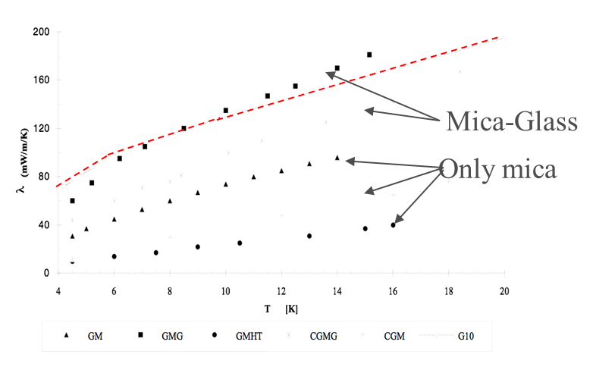
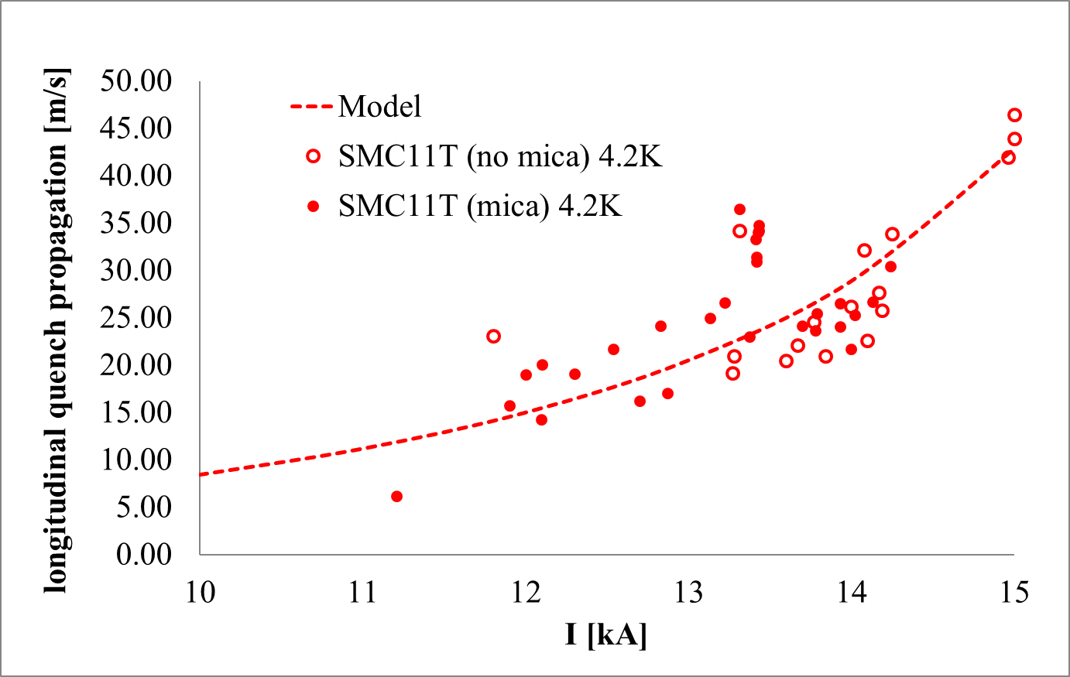
4. Thermal properties of the coil pack
Insulation scheme for CERN 11 T:
Cable insulation: 80-µm-thick C-shaped Mica film and a braided sleeve made of S2-glass fibers (total thickness after reaction = 100-µm)
Inter layer insulation: 500 µm of S2-Glass, cured using ceramic CTD-1202X
The insulation follows the same reaction treatment as the Nb3Sn (210 ºC 48h, 400 ºC 48h and 650 ºC 50 h), and then it is vacuum impregnated with the epoxy resin CTD-101K.
Measurements on-going at CERN Cryolab in order to characterize the thermal properties of the coil pack
Based on SMC-11T quench protection studies, not a significant impact on the quench propagation is expected from the Glass-Epoxy composite to the Glass-Mica-Epoxy.
Thermal Conductivity of Mica/glass Insulation for Impregnated Nb3Sn Windings in Accelerator Magnets*
Andries den Ouden and Herman H.J. ten Kate
G10
Experimental data
[H. Bajas]

Slide 25
4. AC loss contribution
AC loss measurements performed in MBHSP102 and MBHDP101
Loss dominated by the strand magnetization.
From the measurements, one can say that the contact resistance between strands is high but it is difficult to determine the value (Rc ∽ 100 µΩ?) .
Faster ramp rates are needed for a further characterization of the ISCC
  dB_{p}/dI (11T) ~ 1 T/kA
Experimental data
[G. Willering]

Slide 26
4. Fast energy extraction tests
Energy extraction tests to asses contribution of IFCC and ISCC dynamic effects:
EE discharge at different current levels at different current level and with different values of extraction resistor; manually triggering the EE, without firing QH.
Measure voltage and current to observe the presence of quench back.
Current levels and energy extraction resistance defined to assure QI < 12 MIITs and V < 1 kV
The loss, mainly coming from inter filament coupling currents, has a beneficial contribution to the magnet protection (dI/dt_{max} ∽100 kA/s for a quench provoked quench at nominal current)
Measured (continuous lines)
Expected in absence of quench back
(dotted lines)
11 kA EE test dI/dt_{max} ∽ 70 kA/s
9 kA EE test dI/dt_{max} ∽ 50 kA/s
7 kA EE test dI/dt_{max} ∽ 40 kA/s

Slide 27
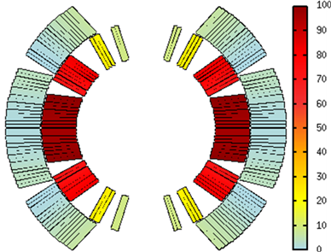
4. Fast energy extraction tests
Most of the energy is dissipated in the inner layer, as expected.
The differences in conductor resistivity for the two coils is visible in the experimental data
Normalized power dissipated
MBHSP102
[Gerard Willering]

Slide 28
Contents
Introduction
Longitudinal quench propagation.
Quench heater design performance.
Quench propagation within the coil.
Hot spot temperature.
Analysis of failure case scenarios.
Summary.

Slide 29
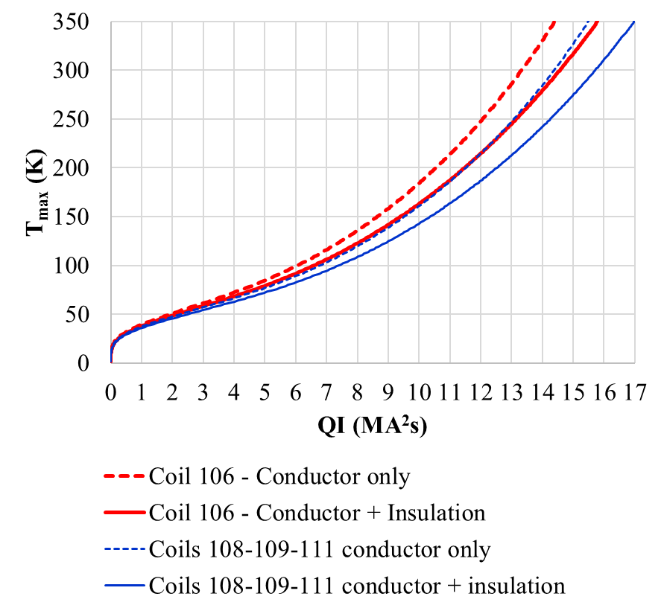
5. Hot spot temperature
An estimate of the maximum hot spot temperature for a given quench load can be computed as:
Analytical B = 12 T
As in MBHDP101 one coil has a lower RRR (coil 106, RRR = 66), large imbalance in terms of voltage and hot spot temperature are found.

Slide 30
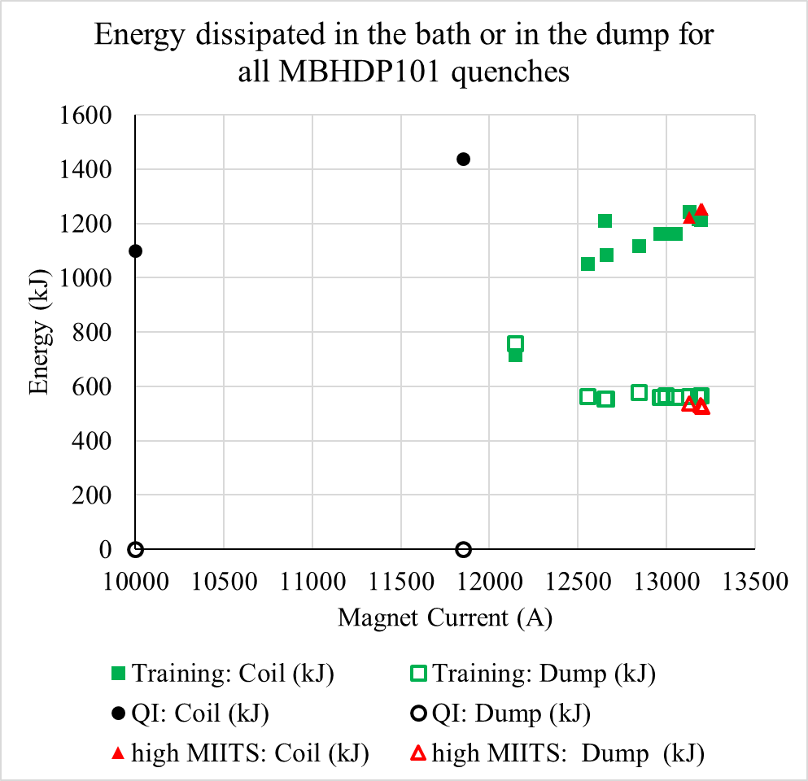
5. Hot spot temperature – MBHDP101
Three family of quenches to be studied:
  Training quenches, with standard protection settings:
    60 mΩ dump resistor + all heaters fired upon quench detection.
  Quench Integral studies (QI), quench heater provoked quench in absence of dump resistor.
  High MIITs studies, training quenches with standard protection settings delayed to achieve a given MIITs target for a quench starting in the pole turn of coil 106:
11.6 MIITs
14.8 MIITs
11.2 MIITs
11 - 12.5 MIITs
MIITs MA²s | T_{max} (K) (coil 106) | T_{max} (K) (coils 108,109, 111)
15.08 | 320 | 275
16.02 | 360 | 310
16.88 | 400 | 350
  Unfortunately, quench started in the low field region of coils 109/111 so the target temperature was not reached.

Slide 31
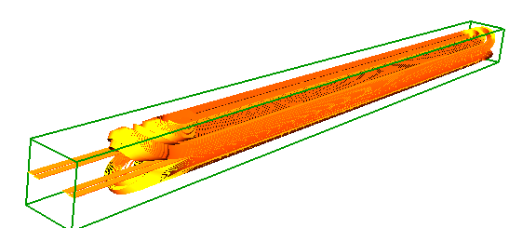
5. Hot spot temperature – QI studies
As every coil block is monitored by voltage taps, the average temperature of each coil block can be compared to the model predictions:
No dump
VTAPS
10 K
Outer layer,
High Field Block
30 K
Outer layer,
Low Field Block
MBHDP101
I_{nominal}
t = 10.5 ms: quench starts
Coil 106
t = 0 ms: quench heaters fired¹
Larger discrepancy (30 K)
(source: quench back)
 | Measured | Computed
Total MIITs (from heaters firing¹) | 13.36 | 13.29
MIITs from quench start | 11.62 | 11.55
T_{ave} below HF heaters (K) | 192 | 182
¹ Excluding heater firing delay (4-5 ms)
Inner layer,
Block 1
Inner layer,
Block 2
Outer layer,
Block 6
Outer layer,
Block 5
T_{max} Adiab. Approx. Only Cond = 210 K
T_{max} Adiab. Approx. Cond + Ins = 185 K

Slide 32
5. Hot spot temperature – Training quench
The same approach can be used for the study of the training quenches.
In order to be able to compare to the model, only quenches starting in the high field region are interesting for this analysis.
Quench #4 (12967 A)
Coil 108, outer layer connection end
Quench #9 (13180 A)
Coil 106, layer jump region
60 mΩ dump
60 mΩ dump
Quench starts t=0 ms
Quench Detected t=3.1 ms
Quench Validated t=13.1 ms
QH on t=18.1 ms
Dump on t=16.5 ms
Quench starts t=0 ms
Quench Detected t=0.6 ms
Quench Validated t=10.6 ms
QH on t=15.6 ms
Dump on t=14.6 ms

Slide 33
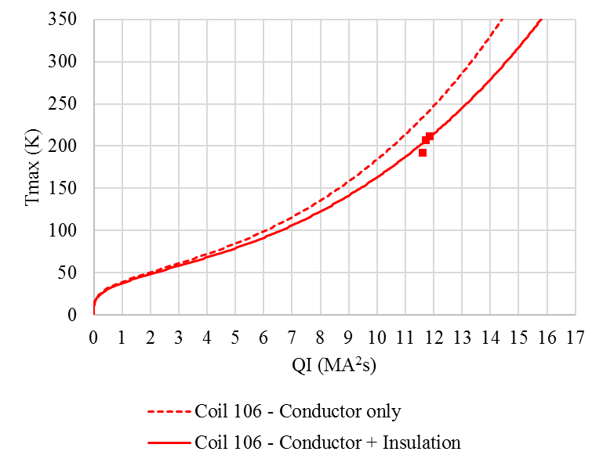
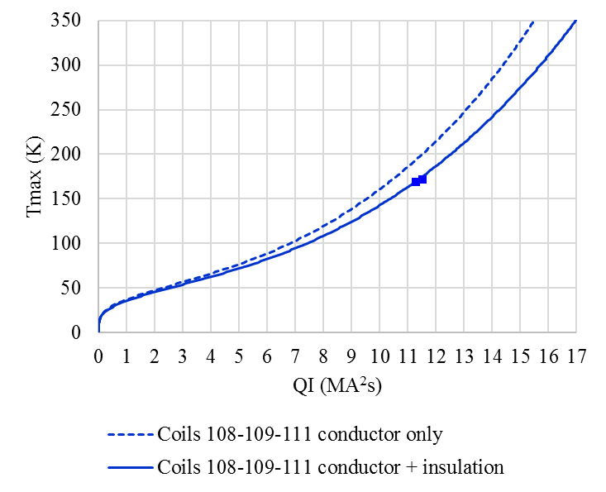
5. Hot spot temperature - Summary
Explored QI range experimentally: 11-12 MIITs.
Expected QI under operation conditions ∽ 16 MIITs.
Plan: explore 300-350 K range (spot heaters on the coil needed in order to perform these studies in a controlled way)
Preliminary data, verification of experimental data on-going
Coil 106 quenches
Coil 108 quenches
Training quench #5 #7
Training quenches # 4 #6
QI study 11.85 kA

Slide 34
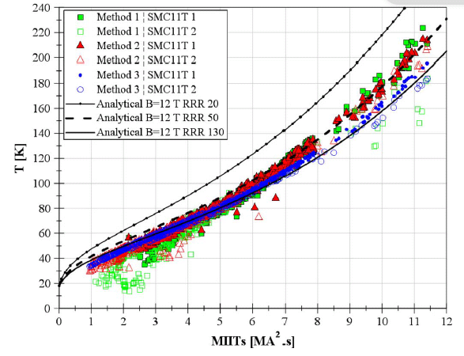
5. Hot spot temperature - Summary
A lot of data available also on SMC11T, but again…only up to the 11-12 MIITs range
(insulation included for the analytical computation of the MIIts vs T_{max})
H.Bajas et al., Quench Analyisis of High-Current-Density Nb₃Sn Conductors in Racetrack Coil Configuration, IEEE Trans. Appl. Supercond, Vol 25, No 3, June 2015

Slide 35
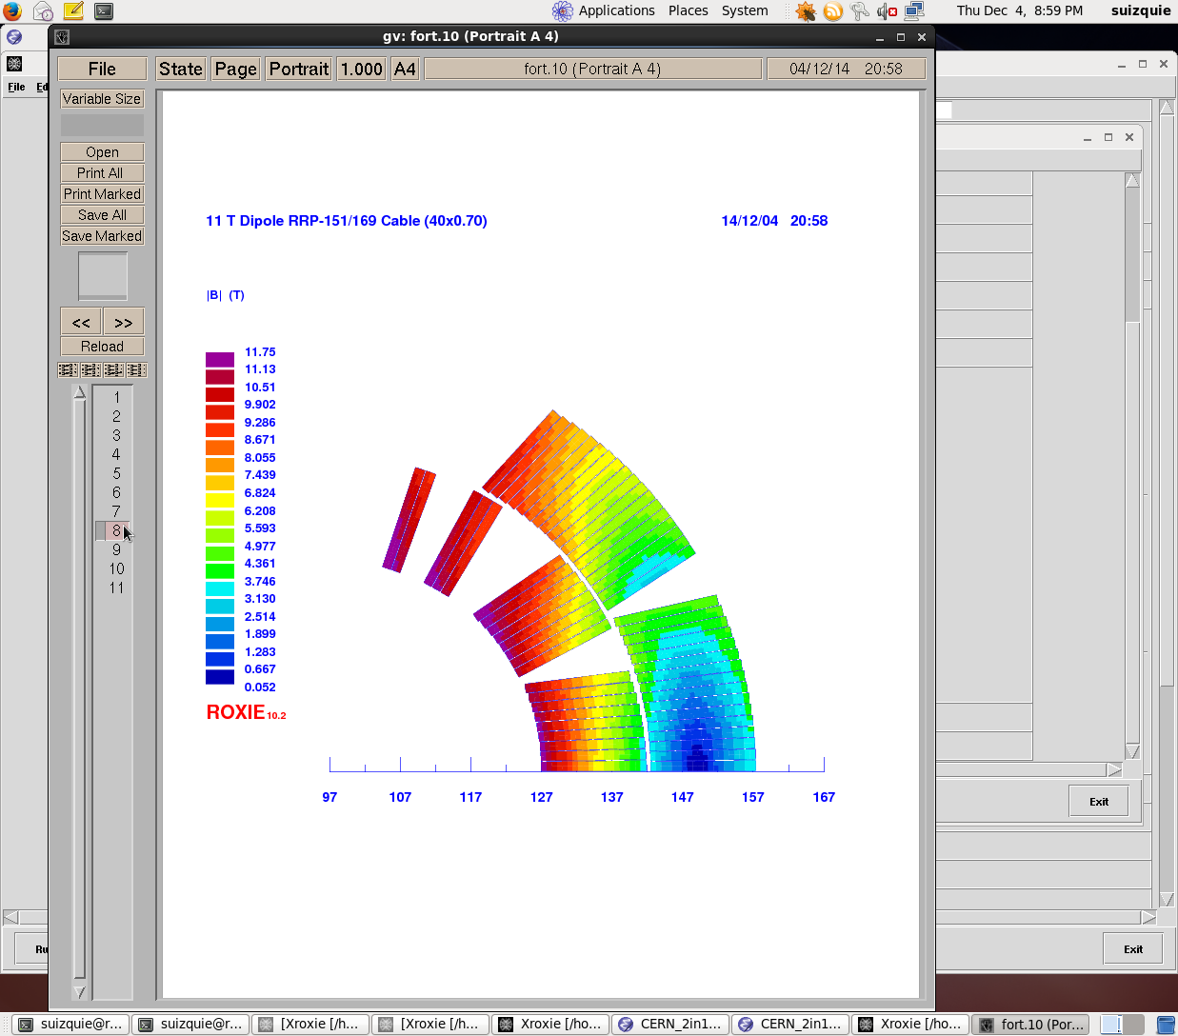
5. Expected hot spot temperature
Expected hot spot temperature under accelerator conditions:
100 mV threshold, 10 ms validation
5 ms heater firing delay
Assumed heaters impregnated with the coil. (heater delay ̴ 20 ms). Total insulation from heater to coil :
  50 µm of kapton
  100 µm conductor insulation
Nominal conductor parameters, RRR=100
All quench heaters fired
320 ± 20 K
270 ± 20 K
High field
Low field
What we expect to have:
Heater firing delay = 1 ms
Heaters delay = 14 ms
T_{max} = 280 ± 20 K

Slide 36
Contents
Introduction
Longitudinal quench propagation.
Quench heater design performance.
Quench propagation within the coil.
Hot spot temperature.
Analysis of failure case scenarios.
Summary.

Slide 37
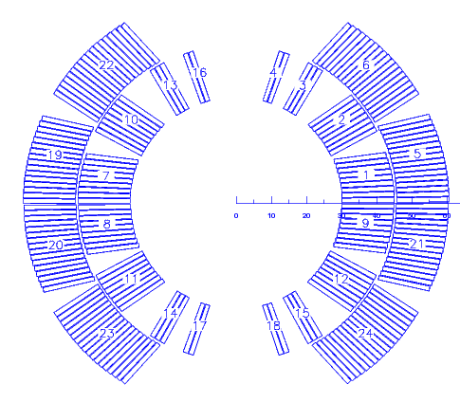
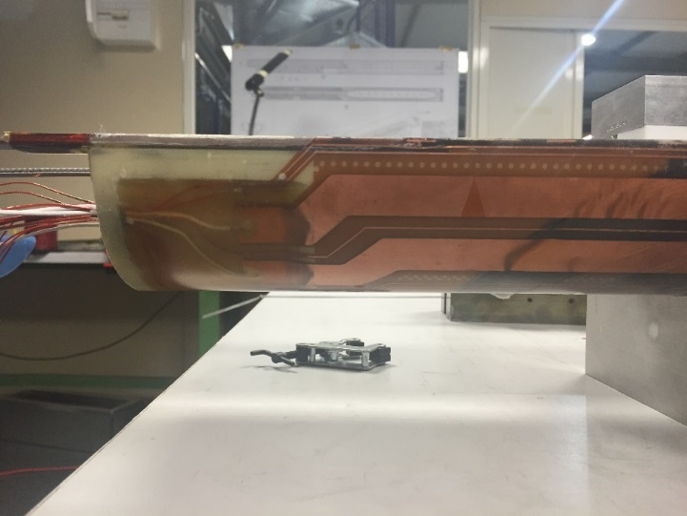
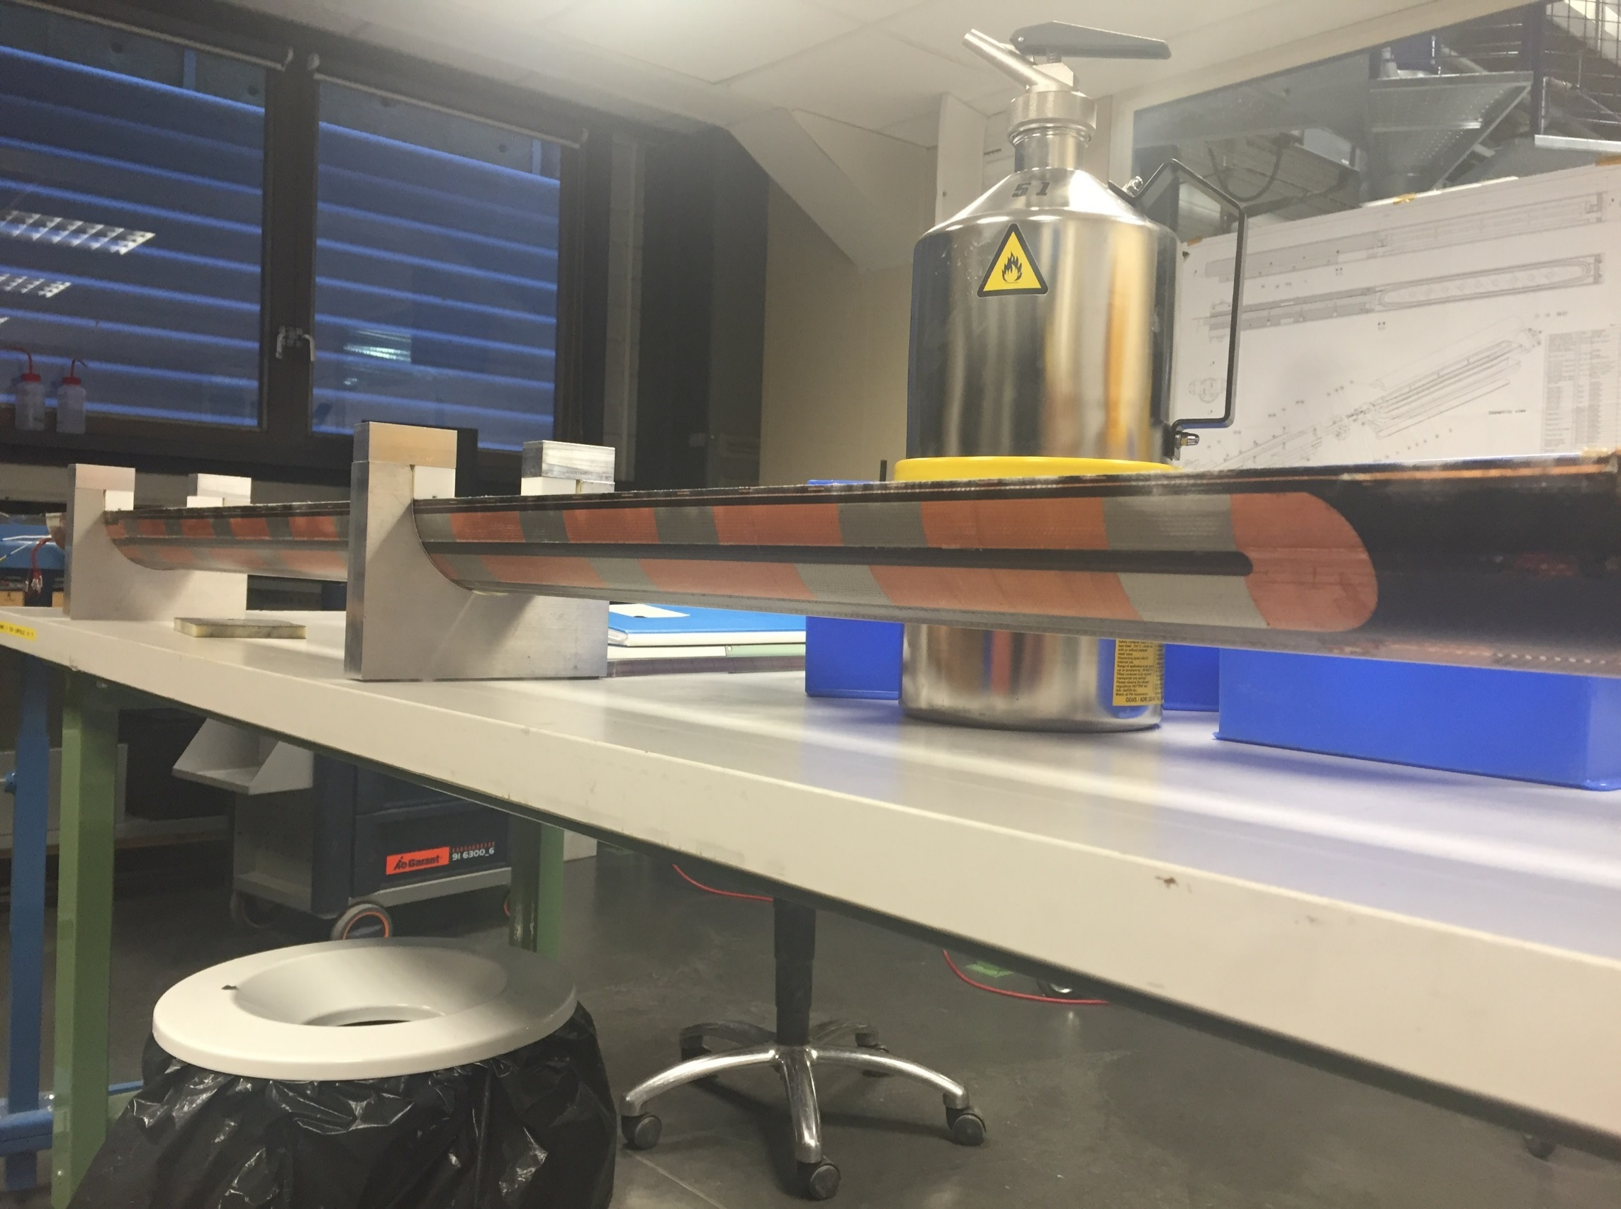
6. Baseline protection scheme
Each 11 T cryo-assembly is made out of 2 x 5.3 m magnets connected in series and protected by one standard LHC cold diode.
Unit 1, Ap. 1
Unit 2, Ap. 1
Unit 1, Ap. 2
Unit 2, Ap. 2
The baseline protection scheme considers 2 heater circuits per coil (i.e. 4 circuits per aperture, 16 circuits per cryo-assembly).
Circuit 6
Circuit 5
Circuit 2
Circuit 1
Circuit 6
Circuit 5
Circuit 2
Circuit 1
Circuit 7
Circuit 4
Circuit 3
Circuit 8
Circuit 8
Circuit 4
Circuit 3
Circuit 7
zoom

Slide 38

6. Studied heater wiring options
Option 1
(baseline)
Option 2
Circuit 3
Circuit 1
Circuit 2
Circuit 1
Circuit 4
Circuit 2
Circuit 2
Circuit 1
Circuit 1
Circuit 3
Circuit 3
Circuit 4
Circuit 4
Circuit 2
Circuit 4
Circuit 3
2 connections/heater circuit;
For one heater failure we lose only one high field heater.
Worse coil internal voltage distribution in case of failure.
4 connections/heater circuit;
For one heater failure we lose only one high field heater
Better coil internal voltage distribution in case of failure.
Option 3
Option 4
Circuit 3
Circuit 1
Circuit 3
Circuit 1
Circuit 2
Circuit 4
Circuit 4
Circuit 2
Circuit 4
Circuit 2
Circuit 2
Circuit 4
Circuit 3
Circuit 1
Circuit 1
Circuit 3
4 connections/heater circuit;
For one heater failure we can lose two high field heater
Inductive coupling between heaters and magnet field → showstopper
4 connections/heater circuit;
For one heater failure we can lose two high field heater
Better coil internal voltage distribution in case of failure.

Slide 39
6. Experience on MB heaters failure
According to MB_quench_heater_failures.ppt (M. Bajko) and EDMS 889445:
  12 magnets were refused after delivery to CERN due to quench heater failure
  11 magnets were reworked before delivery to CERN due to quench heater failure
  Around 2/3 of the failures are on the magnet extremities
According to https://twiki.cern.ch/twiki/bin/view/MP3/QuenchHeaterIssues:
  In total, 10 magnets showed quench heater issues:
    5/10 magnets were replaced during LS1 (all produced by the same company).
    In 2 magnets, the wire connection was repaired during LS1.
    In 3 magnets, the HF heater was replaced by the LF.
  In total, 32 heater power supplies failures were identified (mainly due to a switch related issue):
    All replaced
    It never happened in a quenching magnet (heater power supply voltage is always monitored in the LHC)
    It never happened to have two heater power supplies failing in the same magnet.

Slide 40
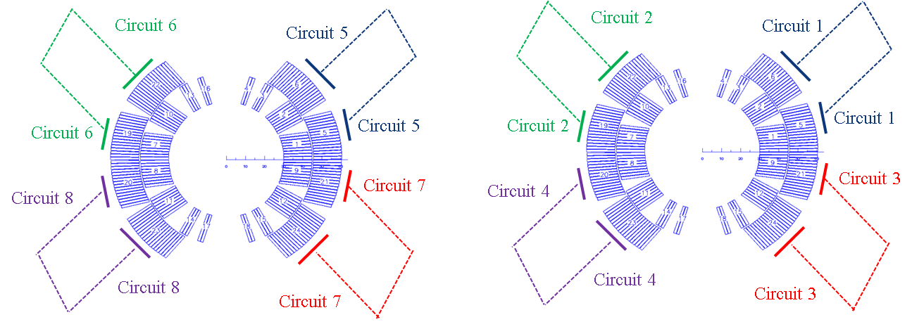
6. DS-11T vs MB
Circuit 4
Circuit 3
Circuit 2
Circuit 1
MB
11 T
https://twiki.cern.ch/twiki/pub/MP3/General_Info_13kA/main_dipole.pdf
If 1 QH power supply fails:
  Heater power supply will be replaced during the next access.
If 2 QH power supply fail:
  Beam dump and heater supply replacement.
If one heater circuit fail (1/4):
    Next access heater re-wired to the low field heater.
    During next long shut down the magnet might be replaced.
If more than two circuits fail: individual case needs to be studied.
If 1 QH power supply fails:
  Heater power supply will be replaced during the next access.
If 2 QH power supply fail:
  Beam dump and heater supply replacement.
If one heater circuit fail (1/16):
    During next long shut down the magnet will be replaced.
If more than two circuits fail: individual case needs to be studied.

Slide 41
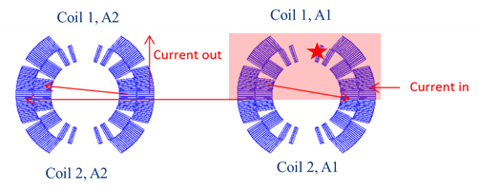
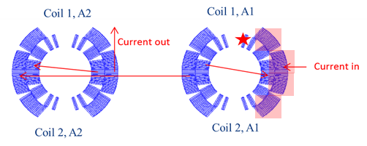
6. Failure case analysis
[A. Giannopulos and A. M. Fernandez Navarro]
 |  | Peak voltage to ground(V) | Peak turn to turn voltage(V) | T_{max}(K)
Nominal | ROXIE (1x11 T magnet) | 352(without quench back) | 78 | 318
 | TALES (1x11 T magnet) | 260(with quench back) | 75 | 325
 | TALES (2x11 T magnet) | 260(with quench back) | 75 | 325
Worst case scenario heater wiring option 1 | ROXIE (1x11 T magnet) | 1480 (without quench back) | 85 | 355
 | TALES (1x11 T magnet) | 860 (with quench back) 1500 (without quench back) | 90 | 355
 | TALES (2x11 T magnet) | 950(with quench back) 1570 (without quench back) | 90 | 339
Worst case scenario heater wiring option 2 | ROXIE (1x11 T magnet) | 1060 (without quench back) | 85 | 355
 | TALES (1x11 T magnet) | 750 (with quench back) 1100 (without quench back) | 85 | 356
 | TALES (2x11 T magnet) | 950(with quench back) 1500 (without quench back) | 95 | 339
Remark: Hot spot temperature expected to be 40 K lower in the final configuration by reducing the heater firing delay from 5 ms to 1 ms and the quench heater delay from 20 ms to 14 ms (impregnating the quench heaters with the coil).

Slide 42

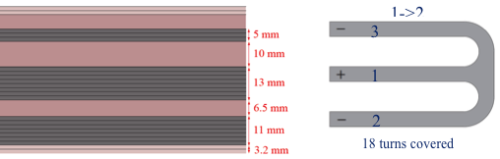
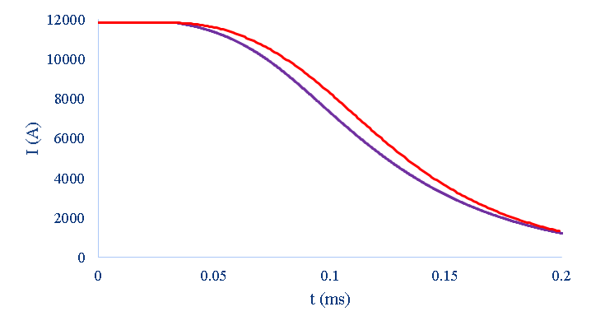
R&D activities: Inter layer quench heaters
Aim: Provide redundancy to the system
Design approach: Maximize the number of turns covered
Heater power density → P_{d} = 50-100 W/cm²
Design constraints:
  Voltage < 450 V
  Current < 150 A
Inter layer QH
60 mm
120 mm
Expected maximum tempearture with outer layer + inter layer heaters:
T_{max} = 240 ± 20 K
OL
IL+OL
[J. Rysti]

Slide 43
Contents
Introduction
Longitudinal quench propagation.
Quench heater design performance.
Quench propagation within the coil.
Hot spot temperature.
Analysis of failure case scenarios.
Summary.

Slide 44
Summary
The expected hot spot temperature for the current configuration of the 11 T is 320 K ± 20 K.
The baseline configuration considers a reduction of the quench heater delay (impregnating the heaters with the coils, current baseline) and the heater firing delay (through a hardware improvement) → T_{max} = 280 K ± 20 K.
System redundancy:
  The 11 T cryo-assembly can safely operate in case two quench heater circuits are failing: ΔT_{max}=20 K, Peak voltage to ground = 950 V (including quench back effect).
  In case four heater circuits are not operational, the computed hot spot temperature is 355 K, but the peak voltage to ground increases to 1.9 kV if all the heater circuits belong to the same aperture.
  R&D work on-going to reduce the hot spot temperature and improve the system redundancy introducing inter-layer heaters and/or CLIQ (see additional slides).
Variable detection thresholds and/or delays as a function of the magnet current are needed in order cope with the voltage spikes at low field due to the flux jumps on the superconductor.

Slide 45
References and previous studies
A.V. Zlobin, et al., 11 T Twin-Aperture Nb3Sn Dipole Development for LHC Upgrades
A.V. Zlobin et al., “Quench Protection Studies of 11T Nb3Sn Dipole Coils”, IPAC’2014, Dresden, June 2014.
A.V. Zlobin, I. Novitski, R. Yamada, “Quench Protection Analysis of a Single-Aperture 11T Nb3Sn Demonstrator Dipole for LHC Upgrades”, Proc. of IPAC’2012, New Orleans, Louisiana, USA, p.3599.
G. Chlachidze, et al., “Experimental results and analysis from 11T Nb3Sn DS dipole”, FERMILAB-CONF-13-084-TD, and WAMSDO’2013 at CERN, January 2013, CERN-2013-006.
G. Chlachidze et al., “Quench protection study of a single-aperture 11T Nb3Sn demonstrator dipole for LHC upgrades”, IEEE Trans. on Appl. Supercond., Vol. 23, Issue 3, June 2013, p. 4001205.
S. Izquierdo Bermudez, et al., Quench modeling in high-field Nb₃Sn accelerator magnets, in Proc. 25th ICEC 25 ICMC 2014
G. Willering et al., Cold powering tests of 11T Nb3Sn dipole models for LHC upgrades at CERN
S. Izquierdo Bermudez, et al., Quench Protection Studies of the 11 T Nb₃Sn Dipole for the LHC Upgrade, Submitted for publication
J. Fleiter, et al., Quench Propagation in Nb₃Sn Rutherford Cables for the Hi-Lumi Quadrupole Magnets. IEEE Trans. Appl. Superconductivity
G. Willering. https://edms.cern.ch/document/1578493/1
S. Izquierdo Bermudez, et al., 5th Joint HiLumi LHC-LARP Annual Meeting 2015 (CERN, 26-30 October 2015) https://indico.cern.ch/event/400665/overview
http://indico.cern.ch/event/365072/
http://indico.cern.ch/event/407058/
https://indico.cern.ch/event/434223/

Slide 46
Additional slides

Slide 47
Modelling strategy
Break the complex problem in simpler building blocks that are solved separately and then joined into a consistent solution.
The “key” ingredients are:
Longitudinal quench propagation
  Important because it determines the time needed to detect a normal zone
  Needs an accurate modelling. Heat equation is solved implicitly in space (finite elements) and time (multi-step finite differences) using an adaptive mesh algorithm to cope with the large disparity of length scales.
Heat transfer from heater to coil
  Important because it defines the time needed to induce a distributed quench
  Solved separately using a 2D FE COMSOL model and joined to the global solution.
Heat propagation within the coil
  Important because it determines the time needed to quench the whole magnet cross section
  Longitudinal conductor model coupled explicitly with a 2nd order thermal network.
What is not (yet) included in the model:
AC loss
Other transient effects, such as change of the apparent inductance due to dI/dt
Inputs:
Field maps and inductance from ROXIE
SUPERMAGNET [Bot 2007]

Slide 48
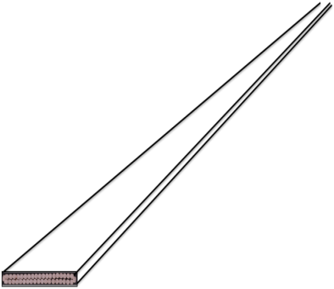

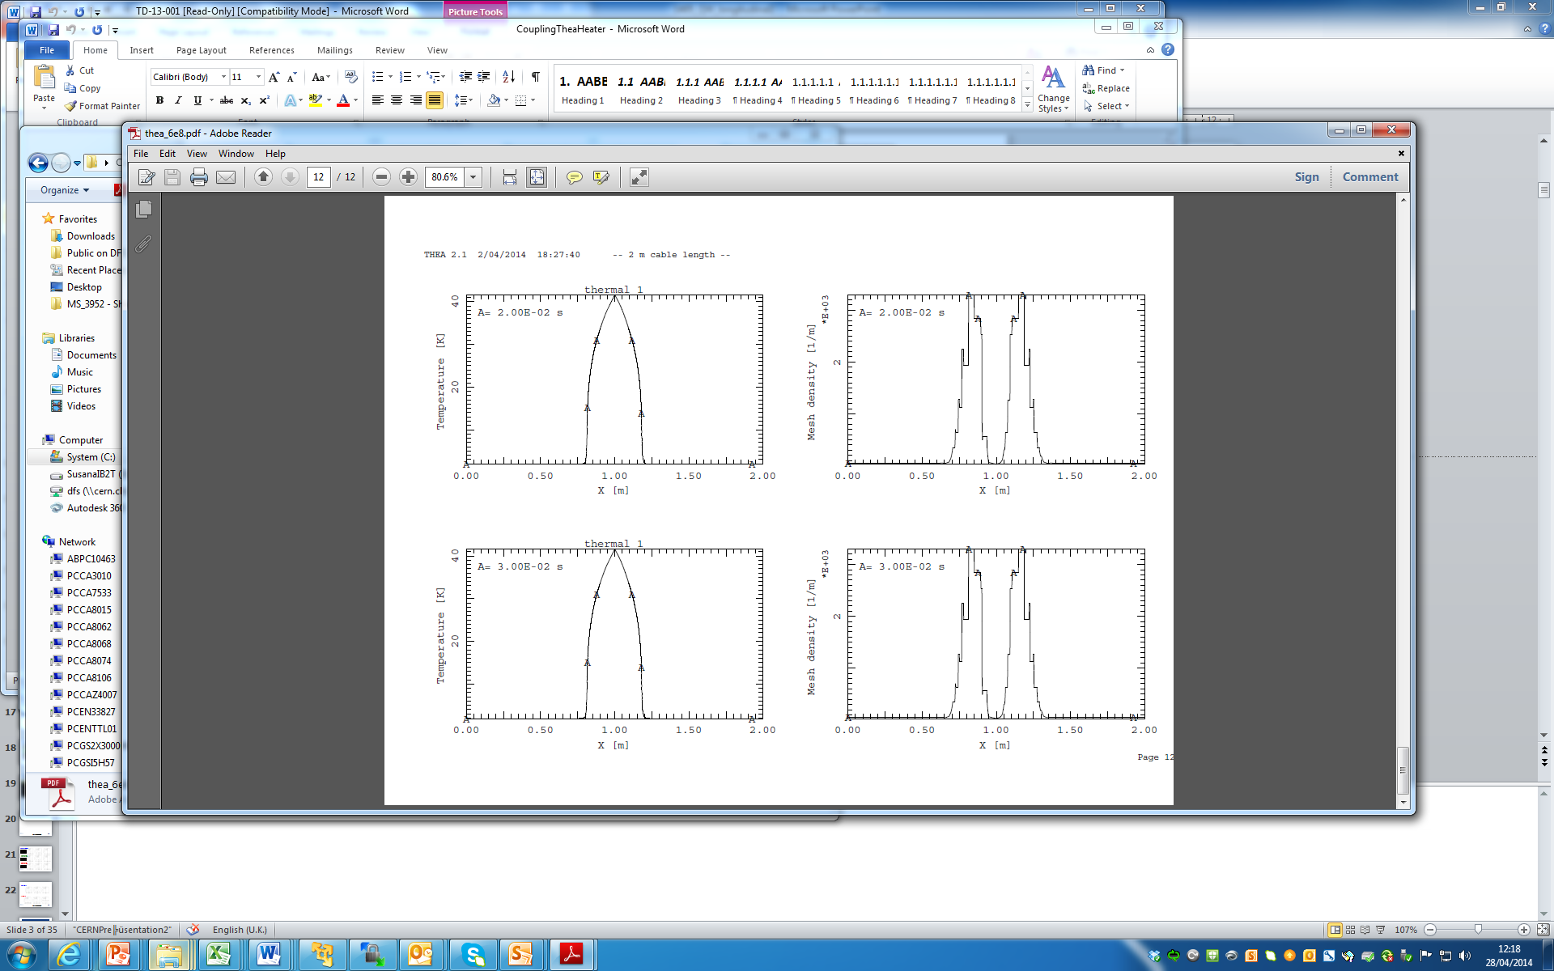
Modelling longitudinal propagation
Two principal directions:
1. Longitudinal
Length scale is hundreds of m
2. Transverse
Length scale is tenths of mm
length scale: hundreds of m
Longitudinal →
x
The conductor is a continuum solved with accurate (high order) and adaptive (front tracking) methods:
[THEA]
Temperature
Mesh density

Slide 49
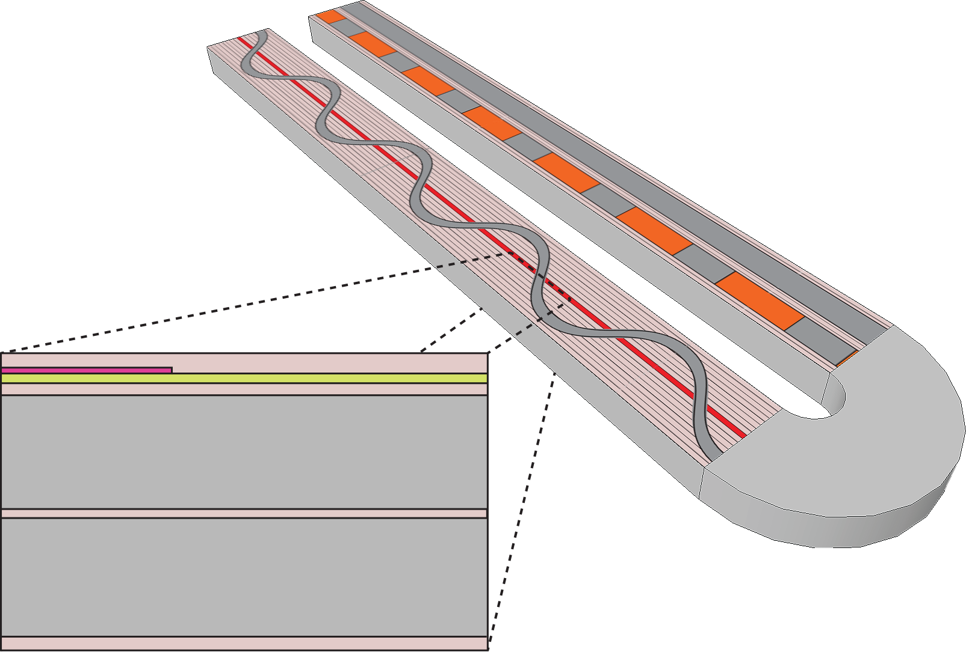

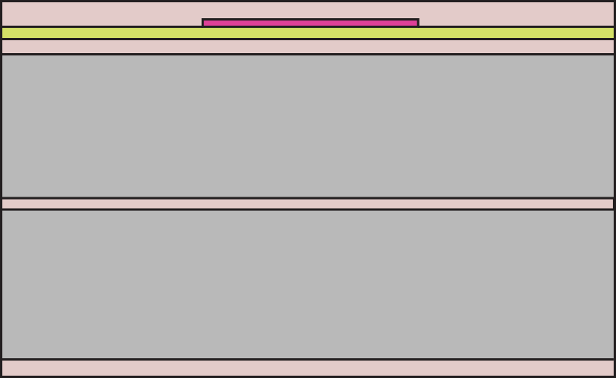


Modelling quench heater delay
2D/1D FEM simulation using COMSOL, solving the heat equation until first point in the cable reaches T_{cs}
One turn at a time.
Half of heater period is enough due to symmetry.
J. Rysti
Continuous straight heater strip reduces to 1D
T = 1.9 K
Outer layer bare cable
Inner layer bare cable

Slide 50
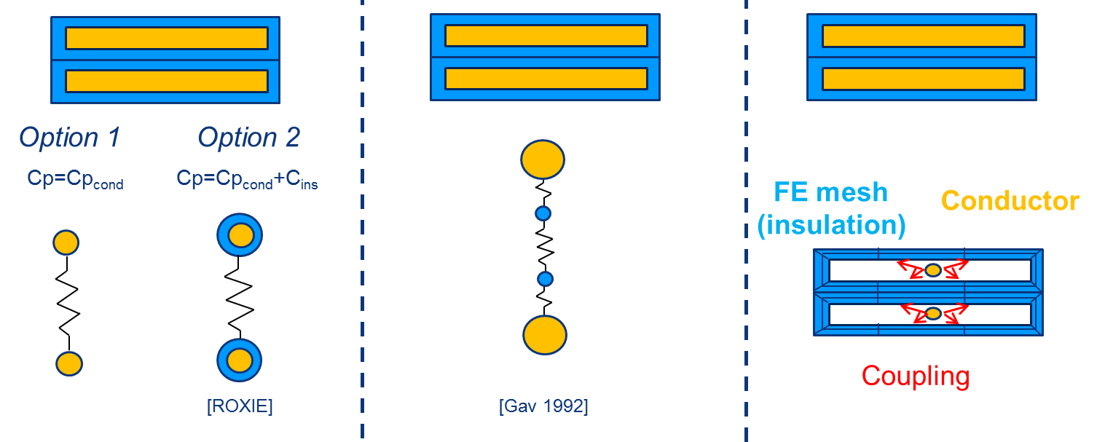
Modelling transversal heat propagation
Two principal directions:
1. Longitudinal
Length scale is hundreds of m
2. Transverse
Length scale is tenths of mm
External heat perturbation
Transverse
Power exchanged between components in the conductor
Power exchange between adjacent conductors
Joule heating
Different approaches can be follow to model the power exchange between adjacent conductors:
First Order Thermal Coupling
Higher Order Thermal Coupling
Hybrid model

Slide 51
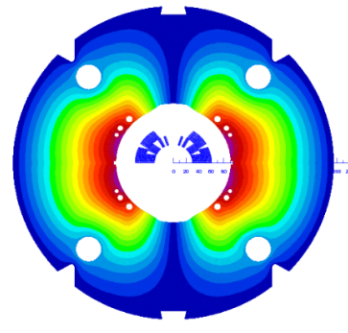
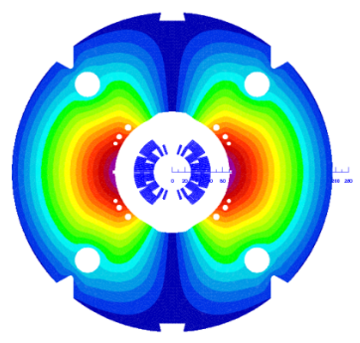
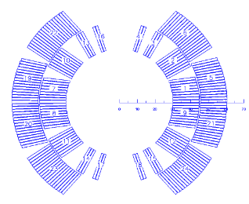

CERN magnets tested
MBHSM101
MBHSP101
MBHSP102
MBHSP103
Coil 105
(RRP 108/127)
Coil 106
(RRP 108/127)
Coil 106
(RRP 108/127)
Coil 109
(RRP 132/169)
Copper coil
Coil 107 (limiting coil)
(RRP 108/127)
Coil 108
(RRP 132/169)
Coil 111
(RRP 132/169)
Collared
Coil 106-108
Collared
Coil 109-111
MBHDP101

Slide 52



Quench heater delay - comparison to FNAL
FNAL MBHSM% insulation between heater and coil:
  0.125 mm of glass on the outer, impregnated with the coil
  0.076 mm of kapton between heater and coil
CERN MBHSM101 insulation between heater and coil:
  0.200-0.250 mm of glass on the outer, impregnated with the coil
  0.050 mm of kapton between heater and coil + about 0.025 mm glue
CERN MBHSP101 insulation between heater and coil:
  Coil 106: no glass on the outer during impregnation
  0.050 mm of kapton between heater and coil + about 0.025 mm glue
Comparable delays
Shorter delays

Slide 53


Quench heater performance
Quench heaters are effective at all magnet current level.
  In MBHDP101, quench heaters were able to start a quench down to a magnet current level of 500 A.
  The magnet is self protected for I < 1.5 kA.
  The model is not accurate in the prediction of the heater delay for the minimum quench energy experiments.
Nominal quench heater current = 150 A

Slide 54
Efficiency Low Field/High Field Heaters

Slide 55
Quench propagation within the coil
The large differences on the QI are explained by the low RRR and higher resistivity of coil 106.

Slide 56
4. Fast energy extraction test
The loss, mainly coming from inter filament coupling currents, has a beneficial contribution to the magnet protection (dI/dt for the current decay using only quench heaters is in the same order of magnitude as the dI/dt for the performed energy extraction tests)
Fast energy extraction test
(magnet protected only using a dump resistor)
Quench integral studies
(magnet protected only with quench heaters)
Significant quench back observed

Slide 57
CLIQ

Slide 58


Slide 59
1 CLIQ unit per magnet 400 V/40 mF
CLIQ + QH (#104):
  T_hotspot= 249 K
  U_maxground=400 V
Only CLIQ (#105):
  T_hotspot=280 K
  U_maxground=600 V
Only QH (#85):
  T_hotspot=325 K
  U_maxground=260 V

Slide 60



Conclusions
Simulations show no dangerous over-voltages / over-currents detected nor in the main circuit neither in the TrimPC.
More simulation work needed to asses if CLIQ induced voltage oscillations are fully compatible with the iQPS.
Reference design (Rcrow = 16 mΩ)
  No Quench: Not suitable FPA @ 11.85kA 0A/s, crowbar current -500 A
  Quench + QH: Suitable
  Quench + CLIQ: Not suitable crowbar current -600 A
Variant 01 design (Rcrow = 0.5 Ω)
  No Quench: Suitable (!) Effects of MIITS in the bypass diode to be discussed
  Quench + QH: Suitable
  Quench + CLIQ: Not suitable crowbar current -600 A
Variant 02 design (Rcrow = 0.5 Ω + reverse bypass diode 20 V)
  No Quench: Suitable (!) Effects of MIITS in the bypass diode to be discussed
  Quench + QH: Suitable
  Quench + CLIQ: Suitable
0.5 Ω
0.5 Ω
20 V

Slide 61
Heater failure case analysis.
Wiring option 1

Slide 62
Peak temperature
Cryosoft
For this analysis, we consider that all the heaters in a coil fail (very pessimistic scenario as the baseline configuration considers 2 quench heater circuits per coil, and the possibility to have 4 quench heater circuits per coil is being explored)

Slide 63

Peak voltage to ground. ROXIE no quench back
No failure: Peak voltage to ground = 352 V
H1C1A1 fails
V_{max} = 702 V
H2C1A1 fails
V_{max} = 712 V
H2C2A1 fails
V_{max} = 527 V
H1C2A1 fails
V_{max} = 530 V
H1C1A1 + H2C1A1 fails
V_{max} = 1481 V
H1C2A1 + H1C2A1 fails
V_{max} = 1009 V

Slide 64
Peak voltage to ground. ROXIE no quench back
C1A1OL
C2A1IL
C1A2OL
C2A2IL
C1A1IL
C2A1OL
C1A2IL
C2A2OL

Slide 65
Peak voltage to ground. ROXIE no quench back
No failure: Peak voltage to ground = 352 V
H1C1A1 + H1C2A1 fails
V_{max} = 1009 V
H2C1A1 + H2C2A1 fails
V_{max} = 1010 V
H1C1A1 + H1C2A1 + H2C1A1 + H2C2A1 fails
V_{max} = 2876 V

Slide 66
Heater failure case analysis.
Wiring option 2

Slide 67
Peak voltage to ground. ROXIE no quench back
No failure: Peak voltage to ground = 352 V
fails
V_{max} = 511 V
fails
V_{max} = 511 V
fails
V_{max} = 518 V
fails
V_{max} = 517 V
fails
V_{max} = 1080 V
fails
V_{max} = 1062 V

Slide 68
Peak voltage to ground – Heater failure scenarios
No failure: Peak voltage to ground = 352 V
fails
V_{max} = 1753 V
fails
V_{max} = 1753 V
fails
V_{max} = 807 V
fails
V_{max} = 631 V
fails
V_{max} = 798 V
fails
V_{max} = 630V

Slide 69
Peak voltage to ground. ROXIE no quench back
No failure: Peak voltage to ground = 352 V
fails
V_{max} = 1010 V
fails
V_{max} = 1011 V
fails
V_{max} = 1018 V
fails
V_{max} = 1010 V

Slide 70
ROXIE – TALES comparison

Slide 71

Summary
 |  | Peak voltage to ground(V) | Peak turn to turn voltage(V) | T_{max}(K)
Nominal | ROXIE (1x11 T magnet) | 352 | 78 | 318
 | TALES (1x11 T magnet) | 260 | 75 | 325
 | TALES (2x11 T magnet) | 260 | 75 | 325
Failure Case (no quench-back) | ROXIE (1x11 T magnet) | 2879 | 85 | 396
 | TALES (1x11 T magnet) | 1700 | 155 | 471
 | TALES (2x11 T magnet) | 3050 | 160 | 394
Failure Case (with quench-back) | ROXIE (1x11 T magnet)
 | TALES (1x11 T magnet) | 2800 | 190 | 408
 | TALES (2x11 T magnet) | 1900 | 125 | 356

Slide 72



ROXIE vs. TALES
ROXIE
(without quench back)
TALES
(with quench back)

Slide 73
ROXIE vs. TALES
ROXIE
(without quench back)
TALES
(without quench back)

