Slide 1
Model magnet test results and analysis - Quench performance, mechanics and operation requirements
G. Willering and C. Löffler
J. Feuvrier, O. Ditsch, J-C. Perez, F. Savary, Philippe Grosclaude and all that were involved in all production and design steps.
Review of the 11T dipoles at Collimator Section for the HL-LHC,
6 April 2016, CERN

Slide 2
Outline
Setting the scene
  MB magnet in the RB circuits
Quench behavior of 11T models at CERN
  Quench overview
  Virgin training
  Erratic/detraining quenches
  Thermal cycles
  Test at 4.3 K
  Plateau currents
Mechanics
  Improvements in modeling since the last review
  Single vs double aperture structure

Slide 3
Setting the scene: RB circuit operation
MBH magnets will replace MB magnets in the LHC RB circuits and need to be fully compatible.
Current operation: 10.98 kA, 6.5 TeV equivalent
Design operation: 11.85 kA, 7 TeV equivalent.
Example of LHC RB circuit powering in October 2015
  Total time at nominal current: 304 hours (40 %)
  Number of ramps to nominal: 80
  Maximum time at nominal current: 25 hours

Slide 4
Setting the scene: MB quenches
HWC 2015: in total 179 quenches up to 11.1 kA in MB magnets
  Average of 0.14 quenches per magnet.
Operation 2015: 5 ‘flattop’ quenches were registered.
No fixed targets set for virgin training quenches for MBH magnets in SM18, but as low as possible after thermal cycle is required.
Stable operation up to nominal current is very important.
Quenches of LHC main dipoles per sector
See LMC meeting, 8 April 2015, by G. Willering

Slide 5
Outline
Setting the scene
  MB magnet in the RB circuits
Quench behavior of 11T models at CERN
  Quench overview
  Virgin training
  Erratic/detraining quenches
  Thermal cycles
  Test at 4.3 K
  Plateau currents
Mechanics
  Improvements in modeling since the last review
  Single vs double aperture structure

Slide 6
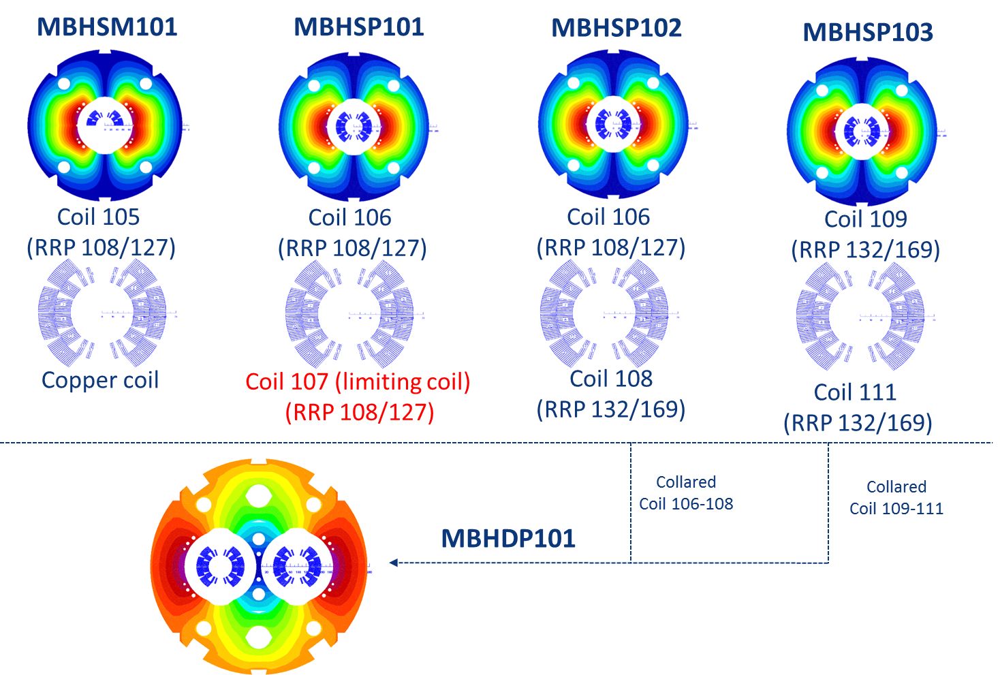
Model overview
Scheme: courtesy S. Izquierdo Bermudez
In this presentation the mirror configuration is not taken into account.

Slide 7
Quench overview at 1.9 K
 | Maximum current reached (kA) | % _{Iss}
SP101 | 11.9 | 82
SP102 | 12.8 | 88
SP103 | 12.8 | 90
DP101 | 13.2 | 94
 | coil | Quenches to nominal field | Quenches to ultimate field | Quenches to nominal field after thermal cycle
SP101 | 106 | 4 | - | 0
 | 107 | 12 | - | 8
SP102 | 106 | 3 | 17 | 1
 | 108 | 2 | 4 | 0
SP103 | 109 | 5 | 5 | -
 | 111 | 8 | 11 | -
DP101 | 106 | 0 | 2 | 0
 | 108 | 0 | 0 | 0
 | 109 | 0 | 0 | 0
 | 111 | 0 | 0 | 0
Total number of quenches at 1.9 K: 86
Very limited detraining after thermal cycles, apart from coil 107
94 % of short sample reached.

Slide 8
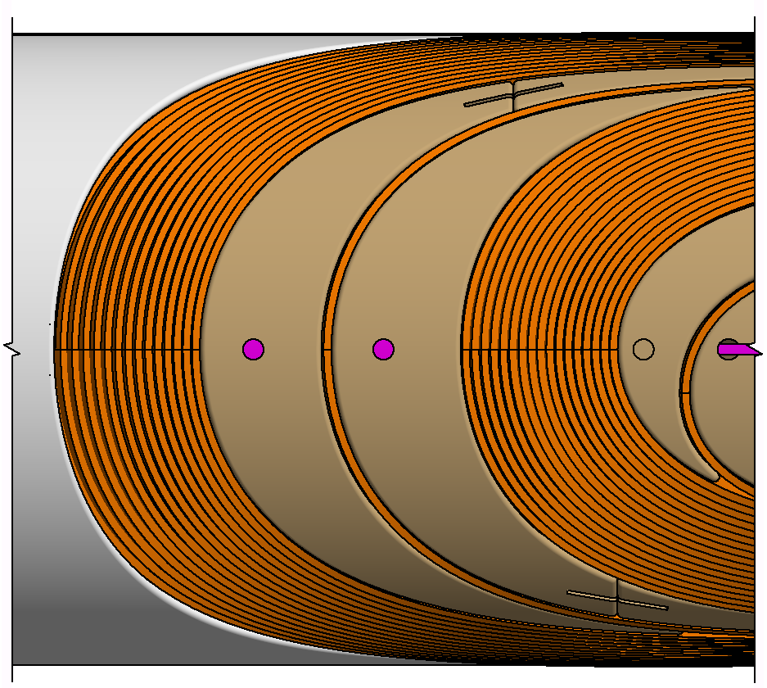
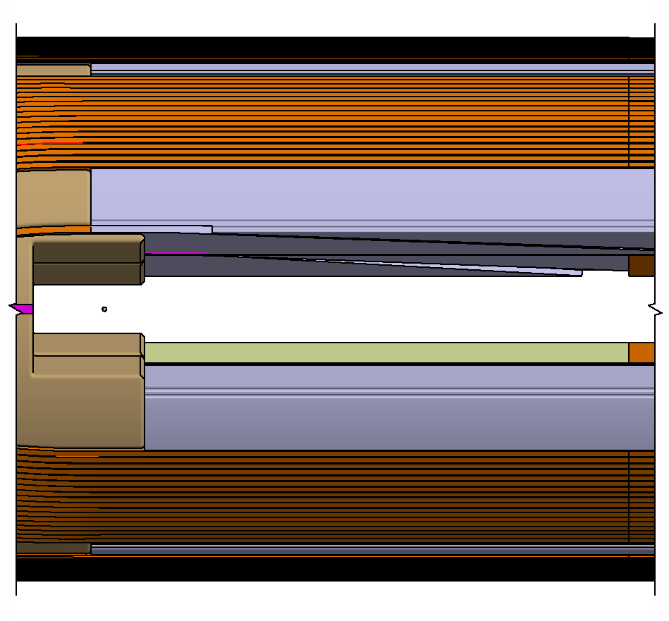
Virgin training
Including all quenches reached higher current than coil has reached before.
DP101 cannot really been seen as ‘virgin’ coil.
DP101 started with 3 ‘massive’ quenches in the midplane of coil 106. After this settling no more quenches recorded there.
Except for coil 107, the interlayer jump has a very limited number of quenches.
 |  | Pole turn |  |  |  |  | Other
 | Coil # | Interlayer jump | Transition | Straigth- section | Head | unknown poleturn | Mid-plane | Other blocks
SP101 | 106 |  | 1 | 1
 | 107 | 7 | 4 | 2
SP102 | 106 | 1 | 1 | 3 | 3 |  | 1
 | 108 |  | 1
SP103 | 109 |  | 2 | 2 | 2
 | 111 |  |  | 4 |  | 3
DP101 | 106 | 3 |  |  |  |  | 3
 | 108 |  |  |  | 1
 | 109
 | 111
 | Total | 11 | 9 | 12 | 6 | 3 | 4 | 0
Head
Transition Region

Slide 9
Erratic and/or detraining quenches
Every quench more than 100 A lower than magnet reached before. (100 A is the margin used for training in the LHC)
Most detraining quenches in the pole turns.
No specific ‘weak spot’, except in coil 107.
 |  | Pole turn |  |  |  |  | Other
 | Coil # | Interlayer jump | Transition | Straigth- section | Head | unknown poleturn | Mid-plane | Other blocks
SP101 | 106
 | 107 | 1 | 3 |  | 13
SP102 | 106 | 2 | 1 | 4 | 4 |  | 1
 | 108 |  | 1
SP103 | 109
 | 111 |  |  | 4 |  | 1
DP101 | 106 | 1 |  |  | 2
 | 108 |  |  |  | 1
 | 109
 | 111
 | Total | 4 | 5 | 8 | 20 | 1 | 1 | 0
Head
Transition Region

Slide 10
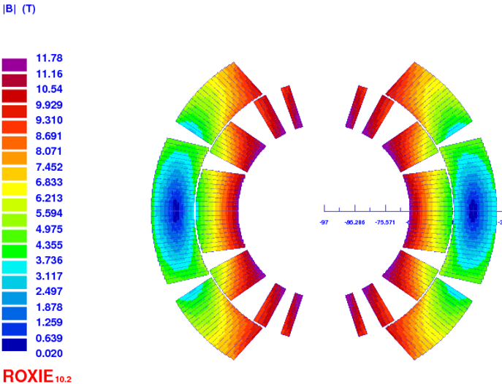
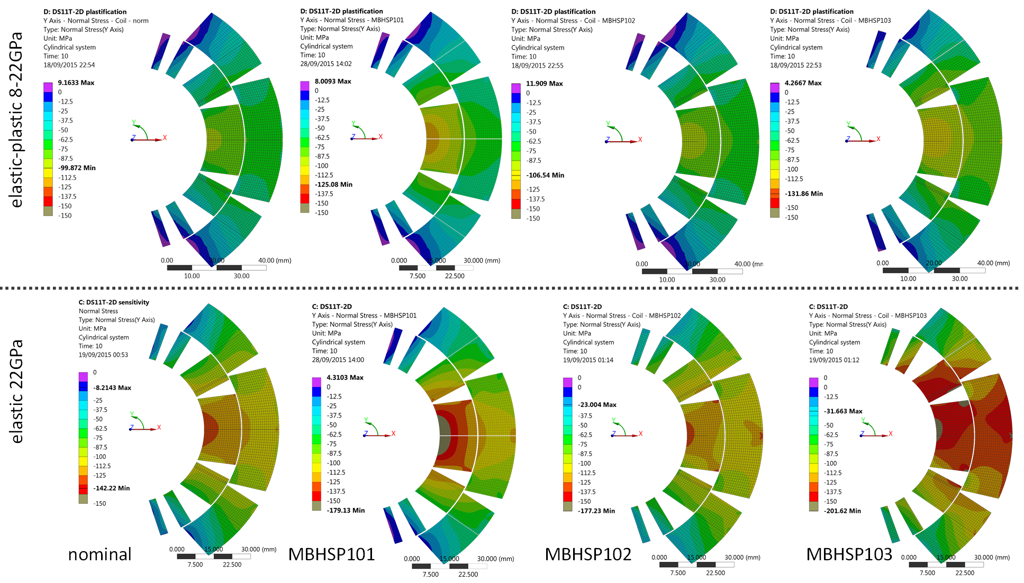
Going beyond design current
Only DP101 was tested beyond ultimate current
3 quenches at highest currents all in the same location at 13.2 kA in the midplane with exactly the same quench pattern.
The inner layer midplane turns of coil 109 and 111 quenched simultaneously.
Midplane turn inner layer has high field and high stress.
Possibly limited by I_{ss} if we take into account strain dependence.
High Field
High Stress
Roxy model by S. Izquierdo Bermudez

Slide 11
Quench performance at 4.3 K
Virgin training always at 1.9 K. Quench at 4.3 K gives large stress on the test station with up to 1.3 MJ deposited energy.
SP101 limited by coil 107 at 85 % of I_{ss} in pole turn, transition region.
SP102 limited by coil 106 at 90 % in layer jump
SP103 limited by coil 111 at 92 % in straight segment close to layer jump
Some correlation between quench locations during virgin training at 1.9 K and quenches at 4.3 K.

Slide 12
Stable behavior at high currents
In all models holding current tests were performed, up to 10 hours at nominal current and 2.5 hours at ultimate current.
Not a single quench was recorded during flattop or ramp down for all models!

Slide 13
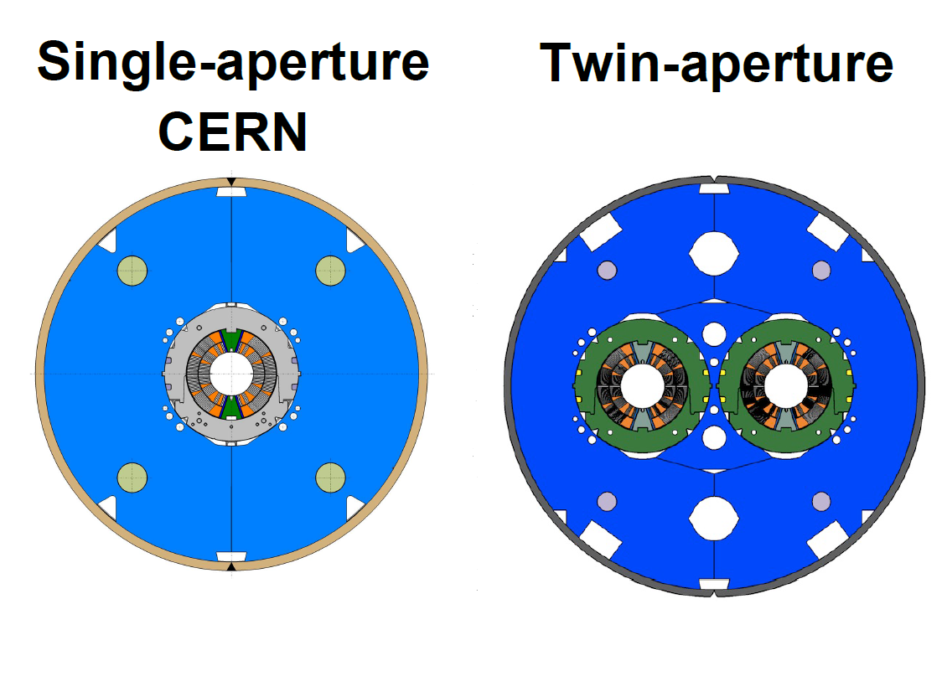
First CERN double aperture performance
Remarkable performance after re-assembly and thermal cycle.
0 training quenches to nominal
2 quenches to ultimate

Slide 14
Outline
Setting the scene
  MB magnet in the RB circuits
Quench behavior of 11T models at CERN
  Quench overview
  Virgin training
  Erratic/detraining quenches
  Thermal cycles
  Test at 4.3 K
  Plateau currents
Mechanics
  Improvements in modeling since the last review
  Tuning of stresses
  Single vs double aperture structure

Slide 15
Model progress
Since last review (december 2014)
Major step in understanding: using non-linear modeling and changed modulus describes 3 different types of observed data very well:
  10 samples of 10-stacks
  Geometric changes in coil 107 after cold powering
  Stress state in single apertures after cold powering
More research ongoing to continu the learning process and further support the assumptions.
  (more info about the test plan see the presentation by Michael Daly (CERN), Claudio Fichera (CERN) https://indico.cern.ch/event/496158/ )
E-modulus press in development, see presentation of J-C. Perez

Slide 16
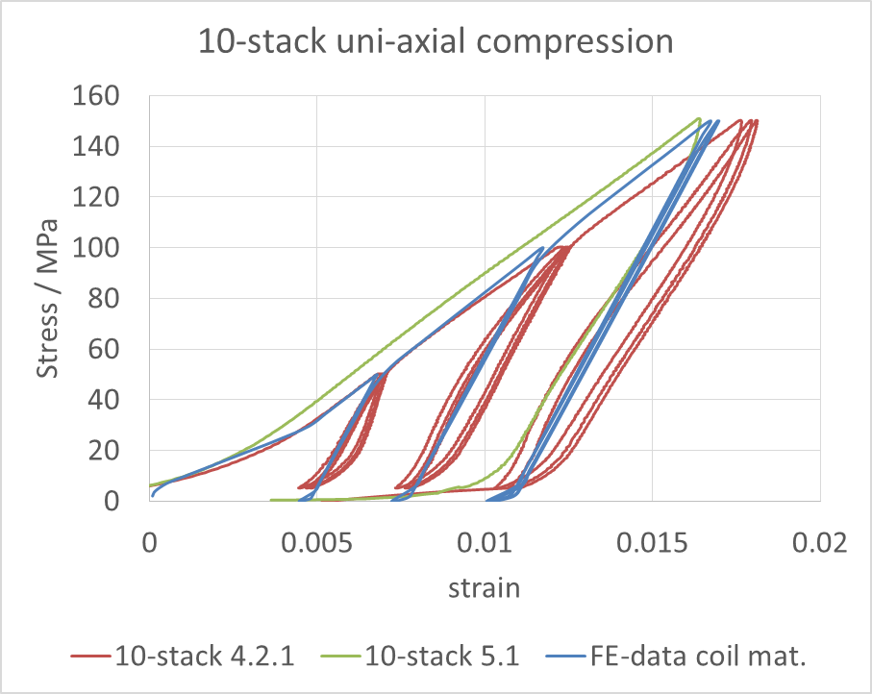
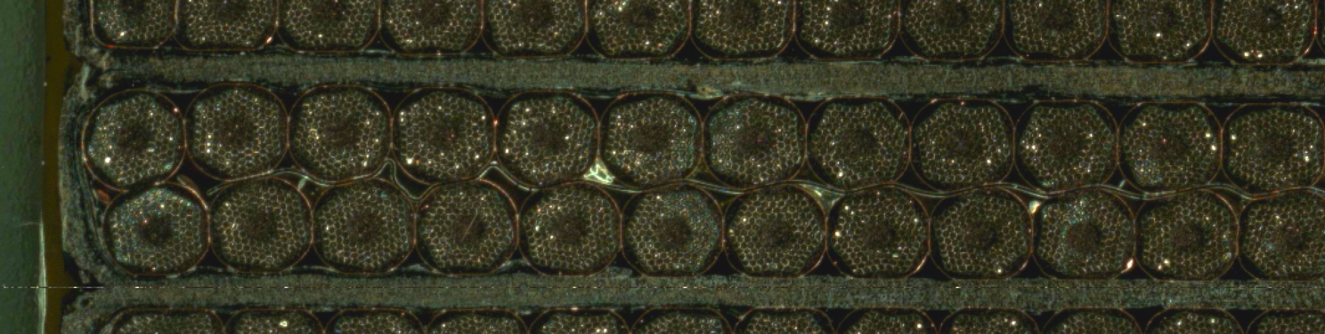
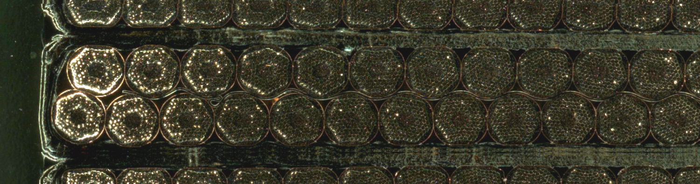
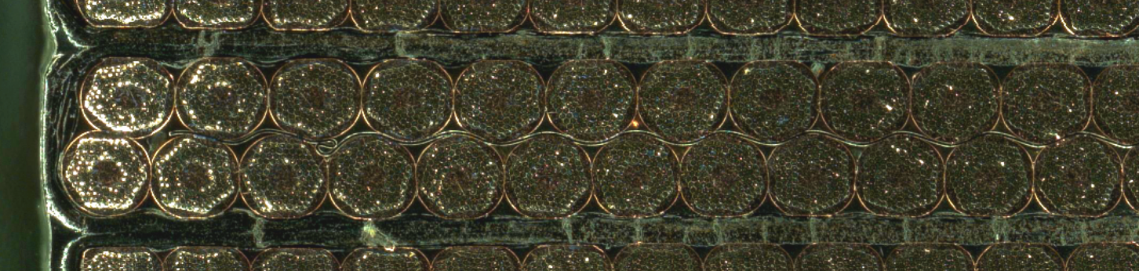
10-stacks: Compressive Strength/Cracking
Sample S2-1: 50 MPa
Sample S5-1: 150 MPa
Increasing Stress
Sample S5-2: 200 MPa
Cracks initiate as from 150MPa, and are generalized at 200 MPa.
Defects not necessarily observed in Coil 107 after test to 11T. Examination was done on multiple cross-section. Absence of cracks suggests mismatch between FE, based on linear material properties, and reality.
Coil material data defined by uniaxial 10-stack compression test (10 samples)
FEA based comparison with non-linear material properties
Material behavior assumed isotropic due to lack of data (more tests are being prepared)
Tangent modulus 10.8GPa; lin. Modulus 18.8GPa (no temperature dependency could be measured)
Test data: https://edms.cern.ch/document/1534894/1
Test performed by Oscar Sacristan de Frutos / EN-MME

Slide 17
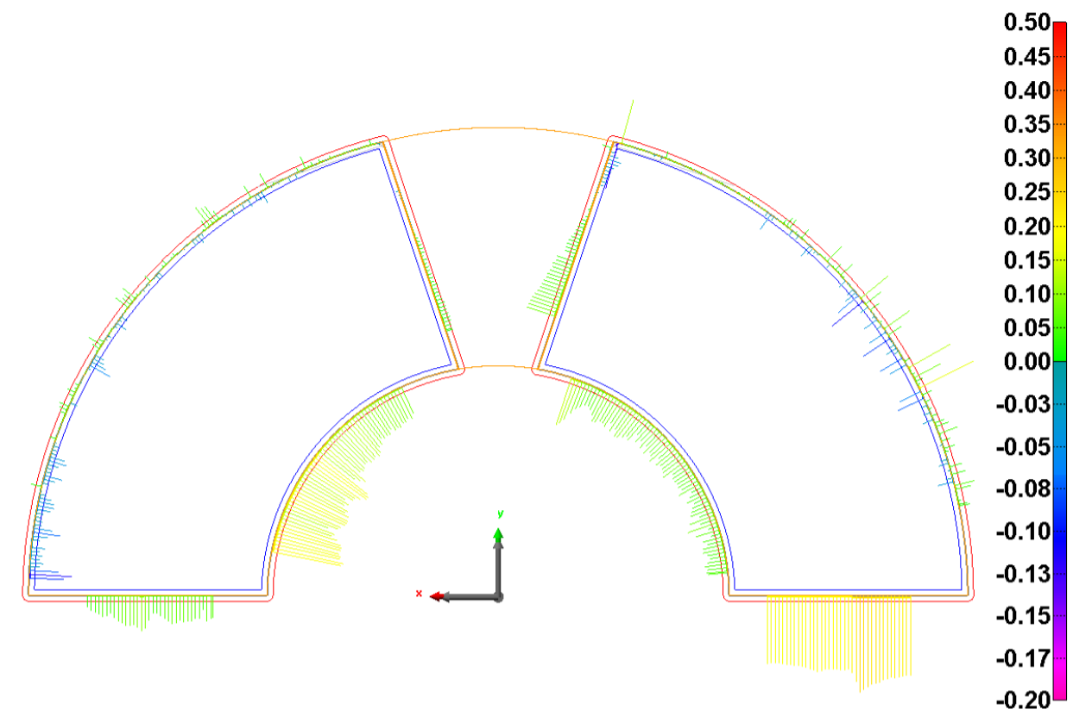
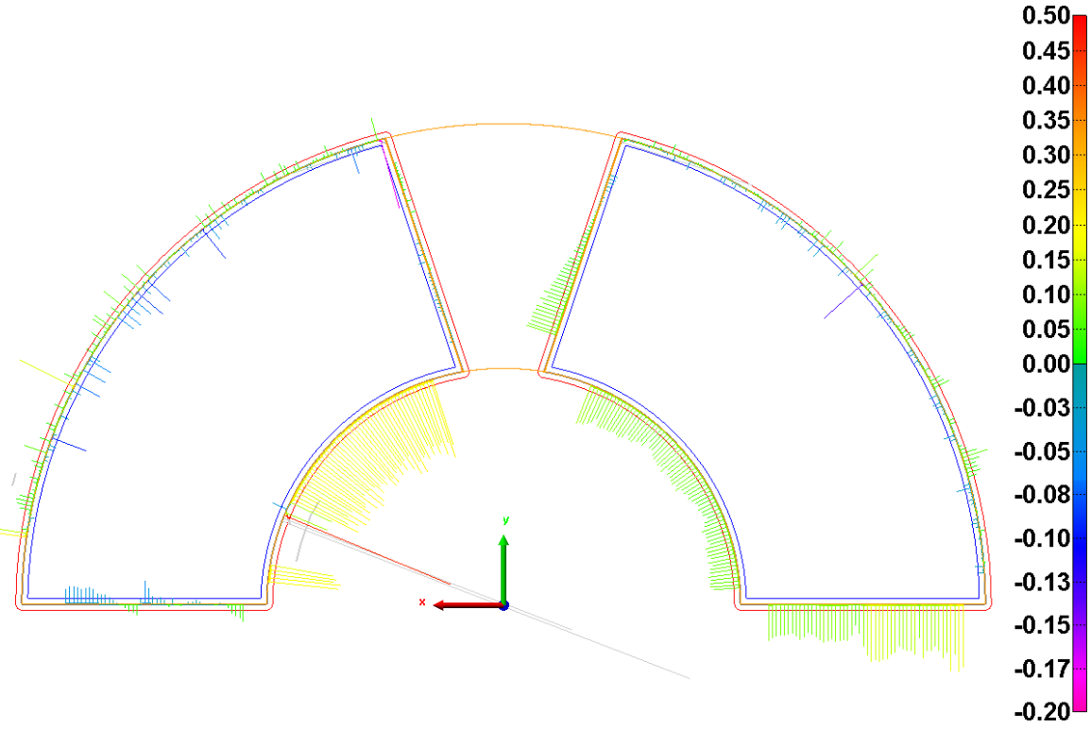
Model validation: Permanent deformation of coils after testing
11T coils can only be measured after the glued trace is removed
Only coil 107 could be measured after testing to 11T
Deformation is presented in midplane reduction
After cold test:
CERN 11T coil 107
  500mm central 60µm
  Towards heads 40µm
  Coil metrology:
    https://edms.cern.ch/project/CERN-0000152984
-0.061mm
-0.204mm
0.013mm
-0.109mm
Coil 107 after manufacturing
– virgin state
Coil 107 after testing in MBHP101

Slide 18
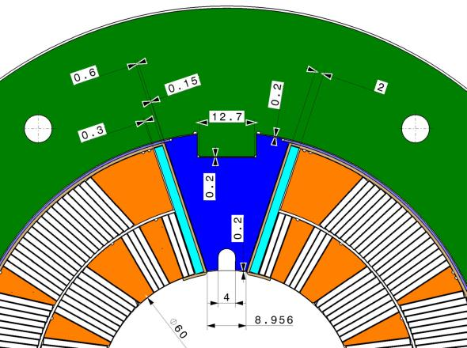

Model validation: Stress state after cold powering tests
Mechanical instrumentation and measurements by Ph.Grosclaude and M. Guinchard
Half bridge - strain gauge
Lin. Material properties module 18.8GPa coil
Non lin. Material properties / modulus 10.8 / 18.8GPa coil
Measured result
All 3 collared coils end up at the same stress after
testing

Slide 19
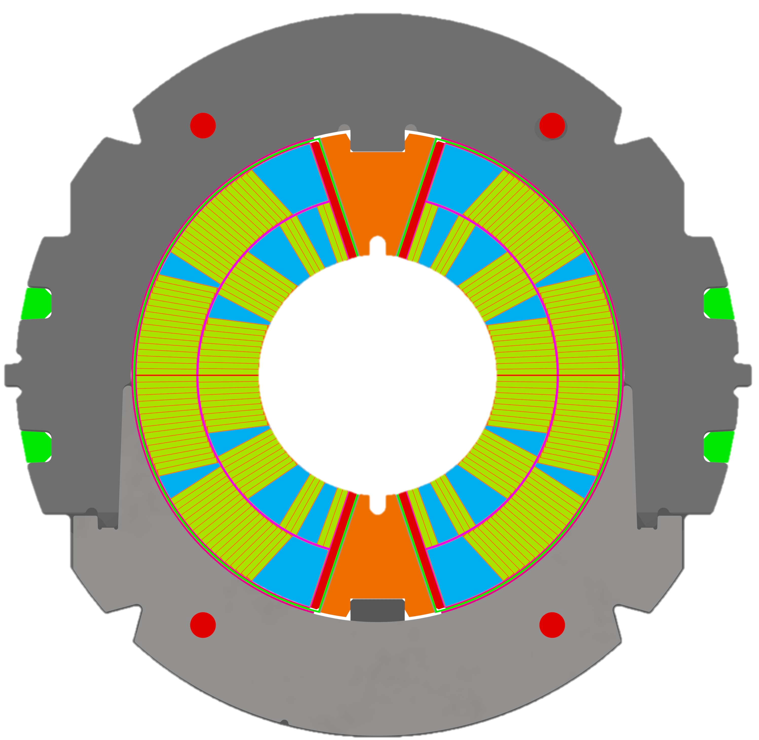
Tuning pre-stress: Parameters which determine the coil pre-stress
Lateral shim
Shimming plan:
Calculate given “arc length” by coils
Adapt lateral shims to “arc length” to create the required azimuthal excess
For fine tuning vary “pole-collar” shim
Based on FEA adapt “collar-yoke” shim
Goal: keep the azimuthal coil stress between -5 to -150MPa
Coil size up
Arc length
Coil size bottom
Pole-collar shim
Nominal values: Pole lateral=0.2mm
Pole collar=0.2mm Collar yoke=0.4mm
Coil size=0.06mm Midplane=0mm
Collar-Yoke shim

Slide 20
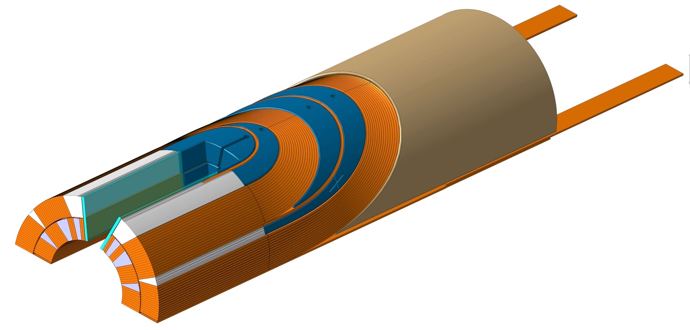
Tuning pre-stress: Summary of build models
MBHSP101 (az-excess 376+250=626µm)
  Goal was to stay under the designed pre-load (azimuthal excess of 520µm)
  Flaw during assembly, unforeseen midplane shim of 0.25mm
MBHSP102 (657µm)
  Reproduce the shimming from SP101, without the midplane shim
  The loading pole in the transition region was made from one piece, stiffer transition
  Arc excess was 25% more than “as designed” state
MBHSP103 (857µm)
  Arc excess was increased to 60% more than “as designed” state
MBHDP101
  Combination of CC102 & CC103
  Increase of “collar-yoke” shim on CC102 by 50µm (CC102 never went stable to 12T)
Transition region

Slide 21
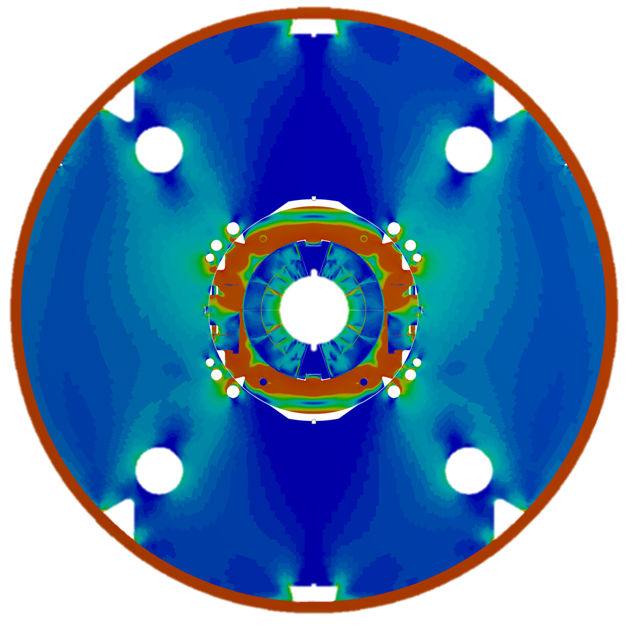
Tuning pre-stress: History of build 1in1 models
Design based on lin. Coil modulus 30GPa
(midplane shim 0.25mm)
Values represent the average azimuthal stresses in one cable. Min always in coil block 4, max always in coil block 1
Peak azimuthal stresses occurring during excitation to 12T, not during assembly. Highest stress during assembly in coil block 4 during collaring (10% lower then stresses on midplane during excitation)

Slide 22
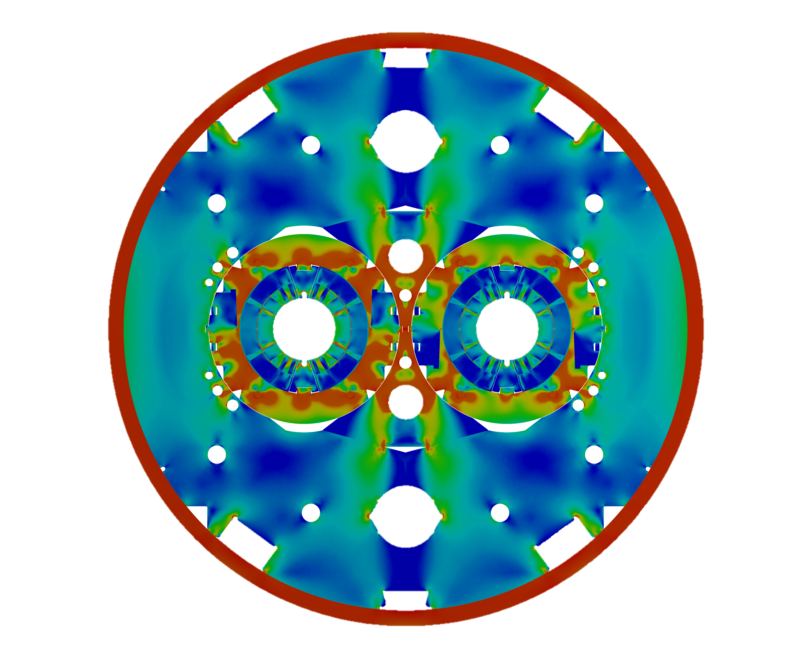
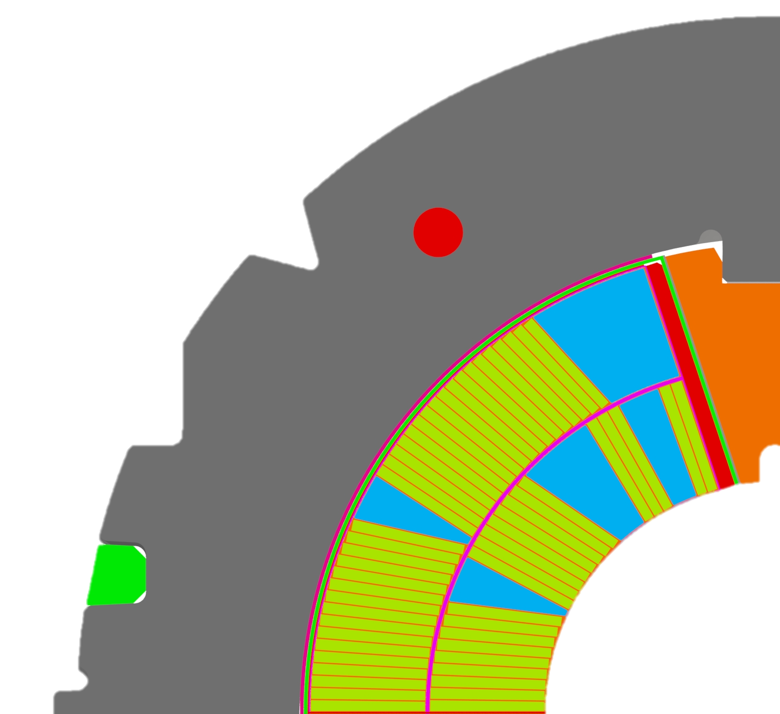
Difference between single and double aperture structure
CB 6
CB 4
CB 5
CB 1
Delta 102 Coil Block 4 = -18.8MPa
Delta 103 Coil Block4 = -28.3MPa
Delta 102 Coil Block 6 = -6.1MPa
Delta 103 Coil Block6 = -12.1MPa
Mechanical instrumentation and measurements by Ph.Grosclaude and M. Guinchard

Slide 23
Conclusions
Considerable number of training quenches up to nominal current in virgin condition, about 5 per coil (excluding coil 107)
Very few training quenches after thermal cycle
Remarkable performance with magnets in double aperture structure after reassembly: 0 quenches to nominal current, 2 quenches to ultimate.
Not a single quench at flattop.
Major steps in understanding of modeling made.
Double aperture predicted to have higher pole loading: Strong improvement of erratic/detraining quench levels.

Slide 24
Thank you

Slide 25
References and further reading
For mechanical measurements and comparison with FEA see:
  https://indico.cern.ch/event/496158/contribution/1/attachments/1226921/1796665/1602_11Tmech-inst_MSCTech_LOEF.pptx
For coil reference data and plans for mechanical characterization see:
  https://indico.cern.ch/event/496158/contribution/2/attachments/1226917/1796659/Material_Presentation_MDaly_CFichera_Final_43_v3.pptx
For more details about the FE-work on 11T (response analysis, stress analysis) see:
  https://indico.cern.ch/event/461705/contribution/0/attachments/1198897/1743732/151203_11Tmech_MSCtech_ToUpload_3.pptx
For sensitivity analysis see:
  https://indico.cern.ch/event/434223/session/1/contribution/16/attachments/1157669/1665137/1509_CERN_Model_assembly_and_sensitivity_CL.pptx
For mechanical measurements on superconducting magnets
  https://indico.cern.ch/event/487129/contribution/0/attachments/1214972/1774270/TE_MSC_Technical_meeting_21thJanuary.pptx
EDMS documents with cold powering results:
  MBHSP101: 1578771
  MBHSP102: 1578772
  MBHSP103: 1578773
  MBHDP101: 1578493

Slide 26
History of new FE Models
Initial Shimming (theoretical) | Shimming used in SP103 and DP101
Recent developments on 11T F.E. models have been presented during the
“Collaboration meeting on DS 11T Dipole grounds held at Fermilab”, September 2015:
http://indico.cern.ch/event/434223/
and during TE/MSC Technical Meetings:
“Mechanical aspects of the 11T magnet”, December 2015 https://indico.cern.ch/event/461705/
“Mechanical measurements in superconducting magnets” , January 2016:
https://indico.cern.ch/event/487129/
“Mechanical aspects of Nb3Sn magnets for HL-LHC - Session on measurement results” , February 2016:https://indico.cern.ch/event/496158/
~ 50% extra shimming elastic
18.8GPa Linear 10-18.8 GPa Non Linear

Slide 27
Virgin quench curves split out per coil

Slide 28
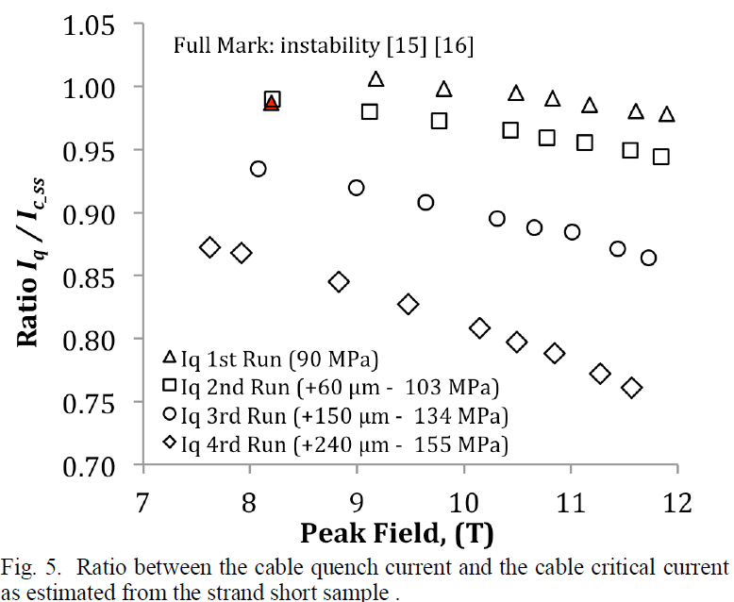
Short sample limit as function of strain
Uncertainties in calculations of strain state of conductor in the midplane.
Stress and strain data strongly depends on directiOn.
Not a lof of measurement data available, data measured on PIT cables suggest 70 % reduction of I_{q} at 12.6 T may be possible with 150 Mpa of pressure on the broad face of the cable.
Critical Current Measurements of High-Jc Nb3Sn Rutherford Cables under Transverse Compression
B. Bordini, P. Alknes, A. Ballarino, L. Bottura, L. Oberli
cern cds 1662553

Slide 29
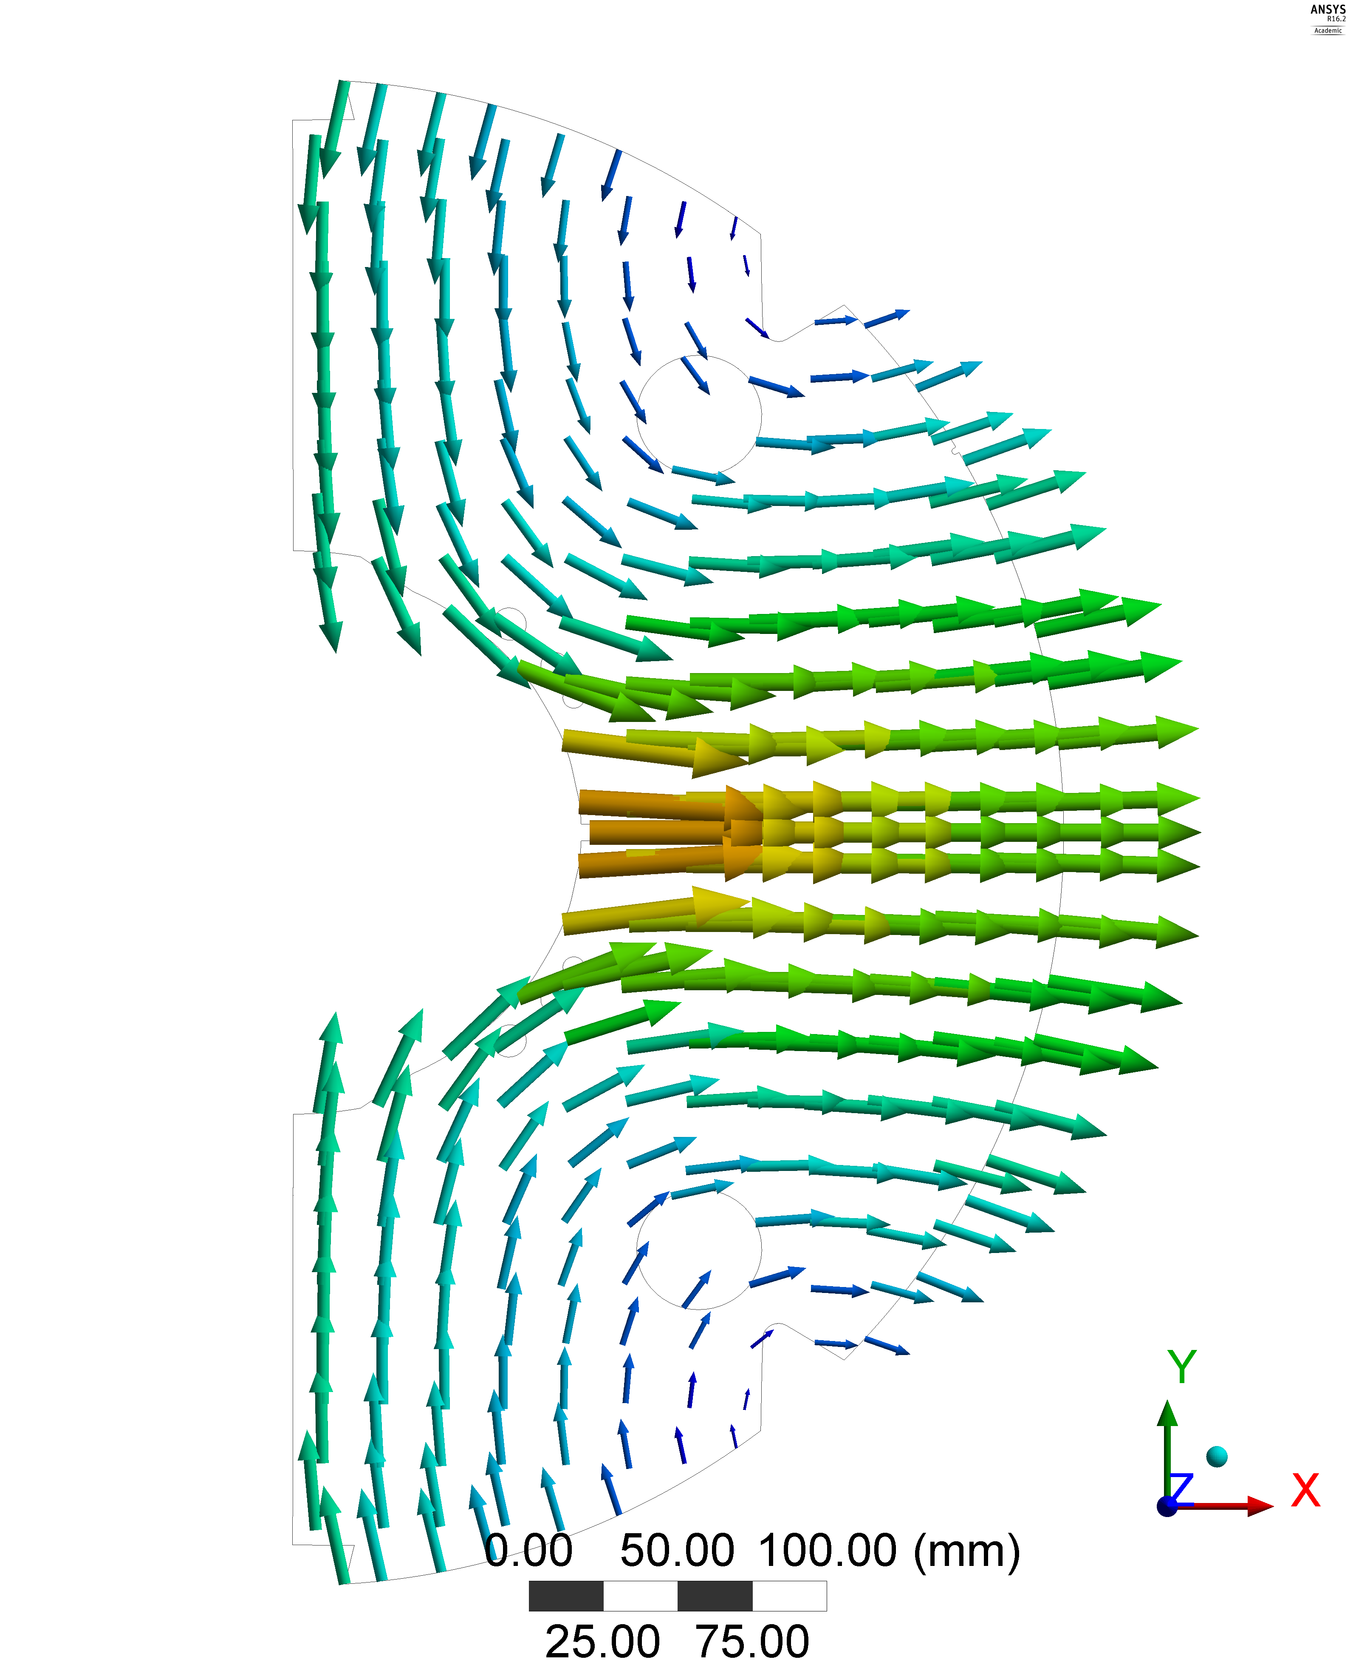
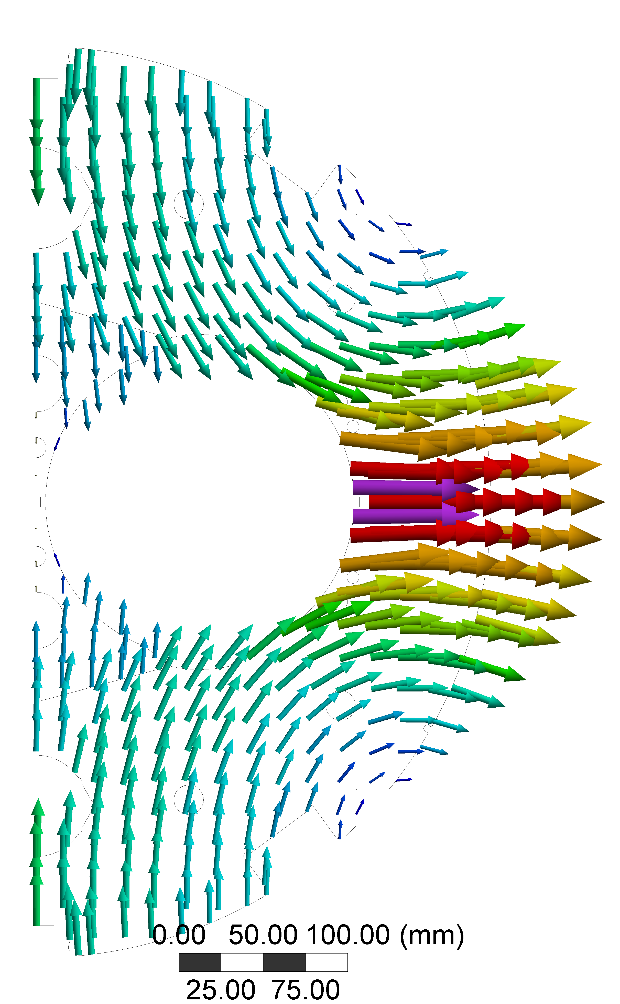
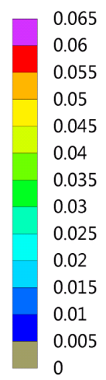
Reason for diff. in stress in block 4 – Yoke deforms differently
midplane
2in1 deforms more
Inward movement of the insert
2in1 yoke “bends” during excitation around the collared coils.
1in1
2in1

Slide 30
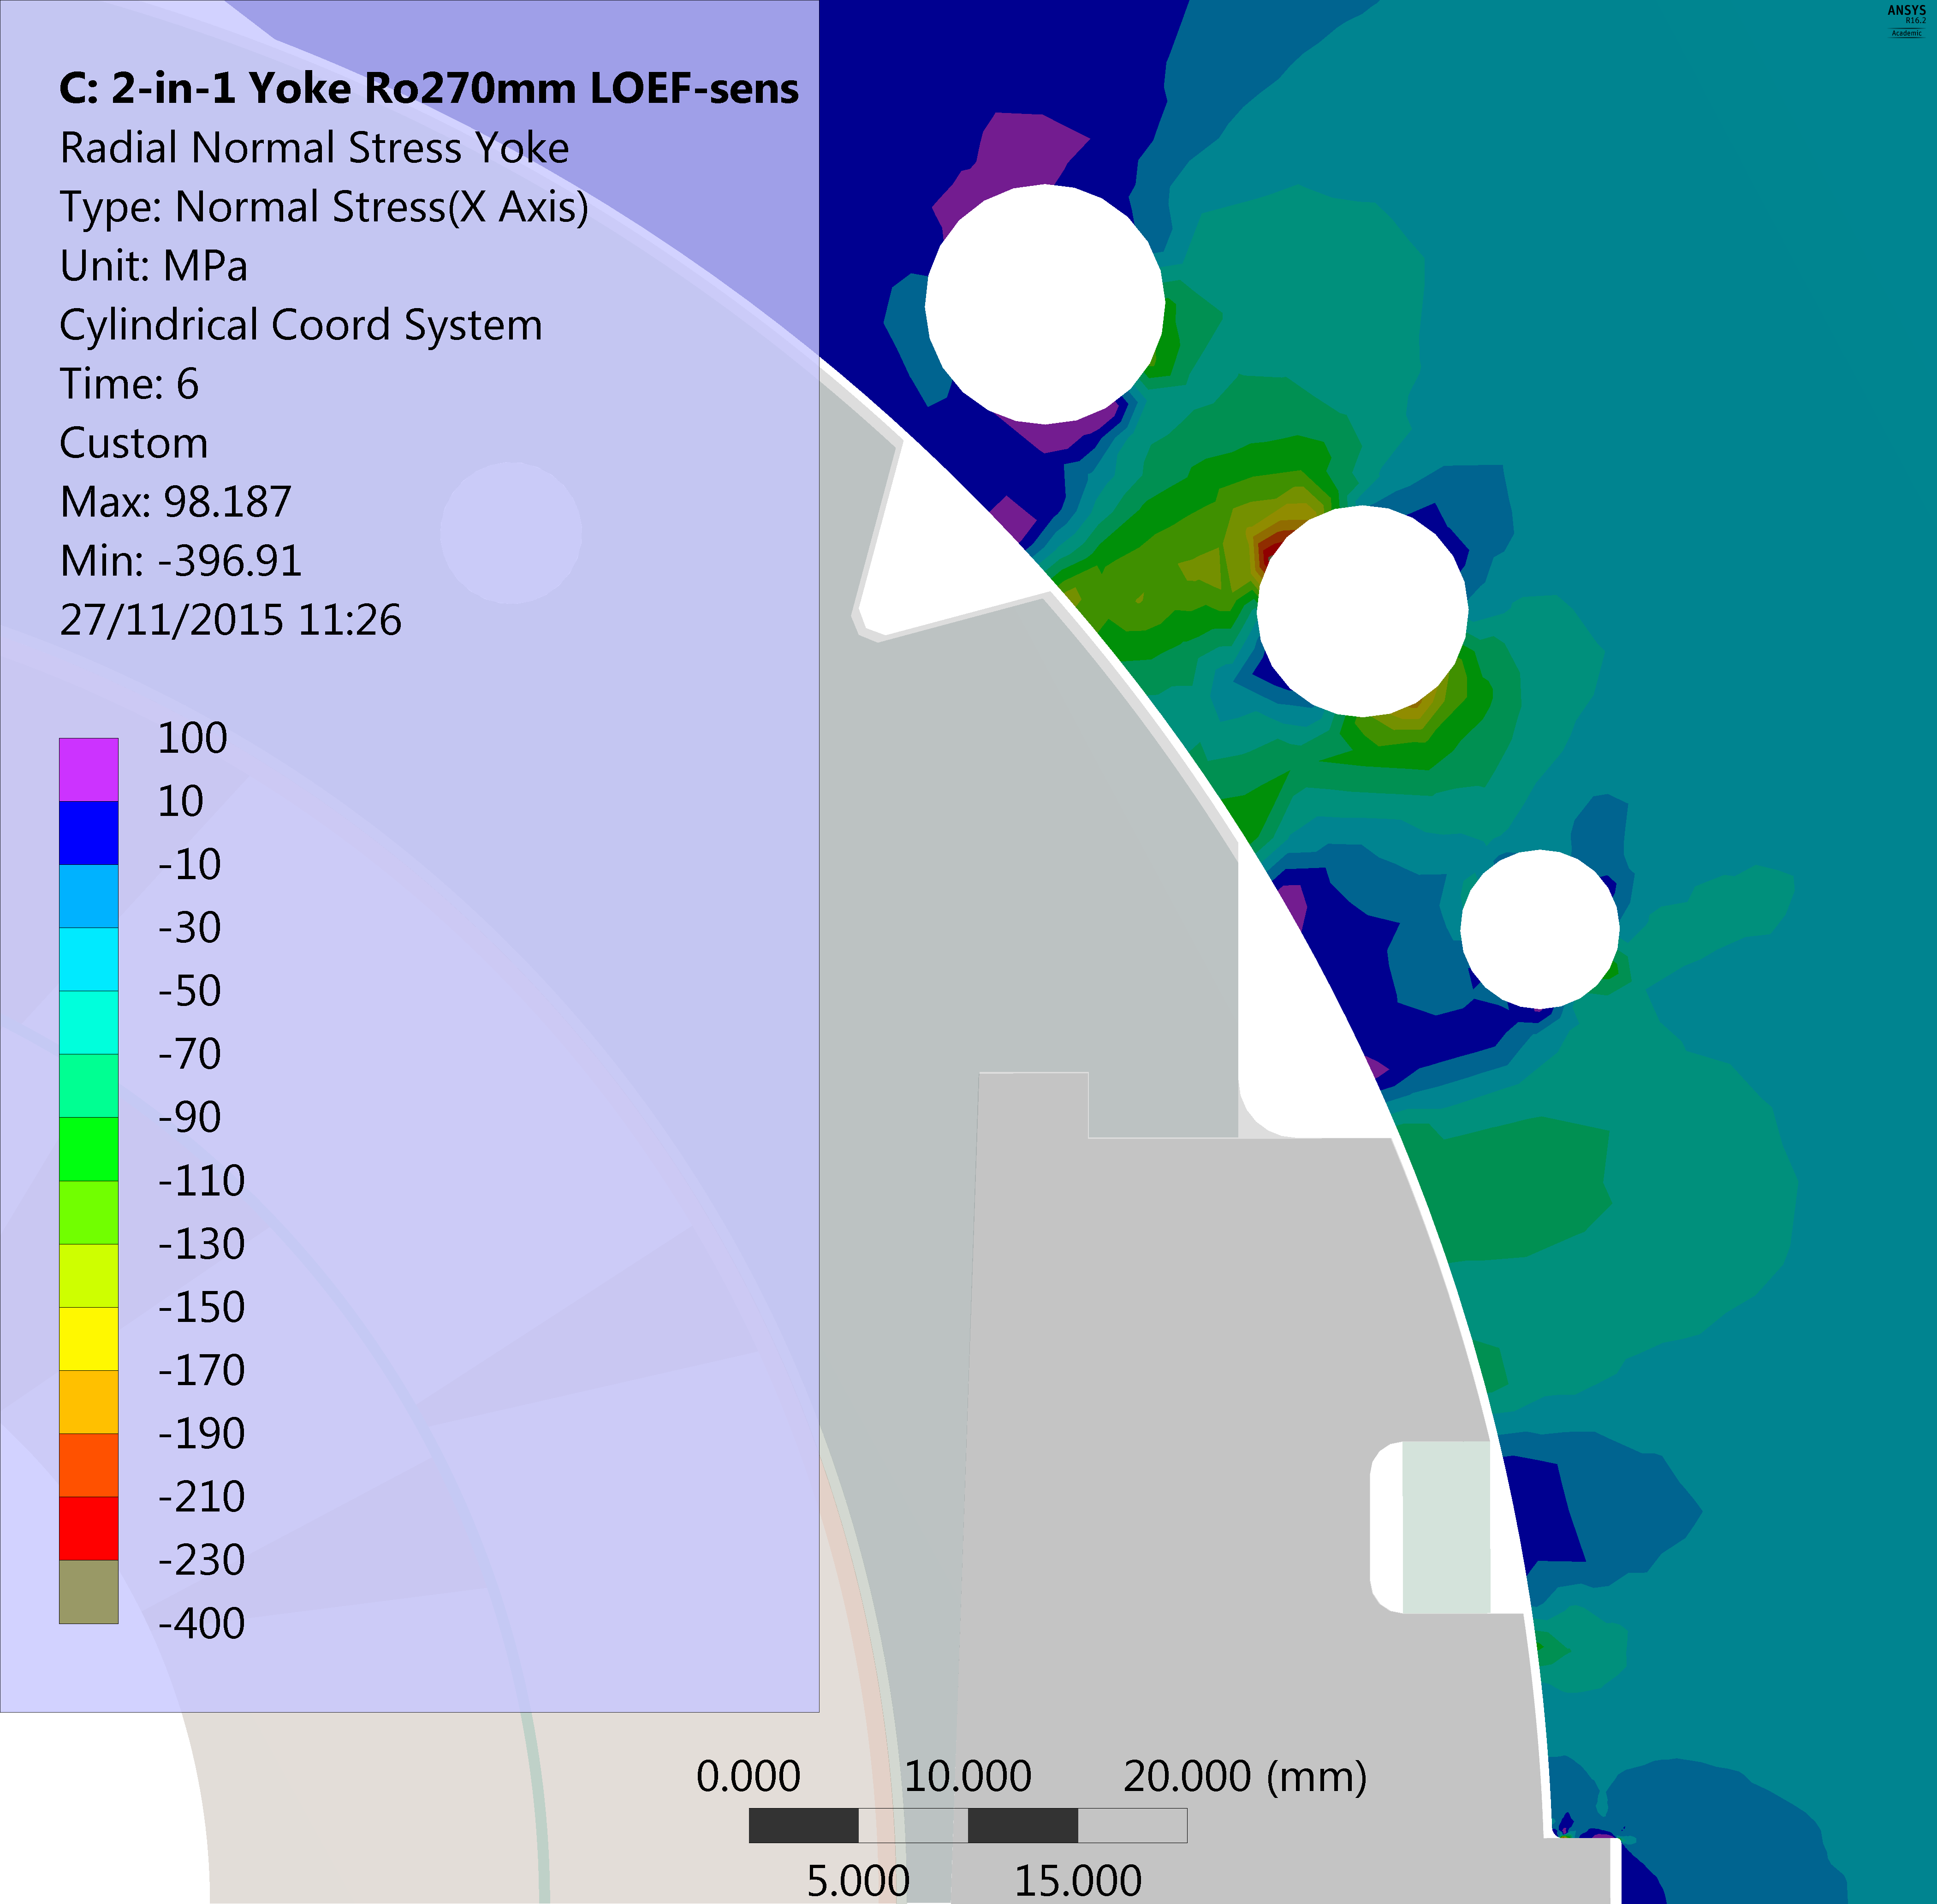
Reason for difference in block 4 – Collar to Yoke interface at 12T
2in1 stronger support at 45 degrees
2in1 yoke
45 degrees
midplane
midplane
45 degrees

Slide 31
Extremities DS11T at 12T
Max. measured force is on the 2in1
The max. EM-force per aperture is 400kN
A force of 250kN in the 2in1 is a coil movement of 0.65mm
60% 2in1 & 45% 1in1
of total force seen in the end-plate (expected was 25%)
11T
Mechanical instrumentation and measurements where carried out by our colleagues from EN-MME
Michael Guinchard <michael.guinchard@cern.ch>
Philippe Grosclaude <philippe.grosclaude@cern.ch

Slide 32
Summary of model shimming

Slide 33
FE - 2in1 - Shell to Coil - stress relation (warm)
As soon as the yoke gap is closed most force are transmitted in the yoke
Manageable risk to not over stress the coil during the welding operation
Main goal of the welding is to close the yoke gap at room temperature

