Slide 1
11T Quality Assurance
Rosario Principe
Richard Berthet, Olivier Housiaux, Sabine Menu
3rd International Review on the 11T dipoles at collimator Section for the HL-LHC
6-8 April 2016 CERN

Slide 2
Outline
  QA for WP11
  Documentation management and EDMS
  Procedures
  Drawings
  Quality Control and traceability and MTF
  Non conformities management
  Procurement
  Conclusions

Slide 3
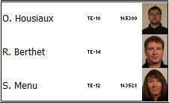
WP11 Quality Assurance
WP11 Organizational Structure
LHC-LBH-MG-0001(EDMS#1609808)

Slide 4
Mandate
In collaboration with the Technical Responsible, draft and edit the procedures
Write the related follow-up files needed to monitor the WP11 project activities
In field quality control and audit the operation compliance (MIP)
Process, analyse and archive data collected during operations
Traceability of operations (MTF)
Manage the non-conformity reports
Monitor and archive the WP11 documentation

Slide 5
Experience and Sensitive Points
Experience
  LS1 project, MSC-LMF magnet repair
  Literature
  Hilumi Quality Assurance Plan
  LHC Quality Assurance Plan
  Quality Management for the Accelerators & Technology Sector (Hardware baseline)
Sensitive Points
  Documentation Management
  Interface management
  Manufacturing and Inspection Plan (MIP)
  Design and drawings
  Procurement
  Communication (sections, institutes)

Slide 6
Documentation Management
One way to Quality within WP11
Documentation managed and named after the procedure Documentation Management LHC-LBH-QA-0005
    LHC Quality Assurance Plan
    Hilumi Quality Assurance Plan
    International standards (ISO 9001)
    NB: Regualr meetings with QAC and Hilumi PLO rappresentatives
New document? Contact the WP11 QA team
    Call +41 75 411 0232 or 5300
    E-mail to the Quality Assurance team at QA.WP11@cern.ch
WP11 Quality Team to ensure that :
    Named properly
    Available within WP11 + HL-LHC + Hardware Baseline
    Validation process respected

Slide 7
Documentation Management
WP11 documents available in EDMS (Engineering & Equipment Data Management Service)
  WP11 project structure: CERN-0000130199,
  HiLumi: CERN-000096381,
  Item catalogue: LHCPM117.
  Once validated, documentation also available in:
  LHC Hardware baseline: LHCAM273.
  Validation circuit (as discussed with Hilumi PLO):
  Engineering Check: within the technical responsibles + other stakeholders if needed
  Approval :
      Impact on WP11 uniquely → WP11
      Impact outside WP11 → HL-LHC PLO

Slide 8
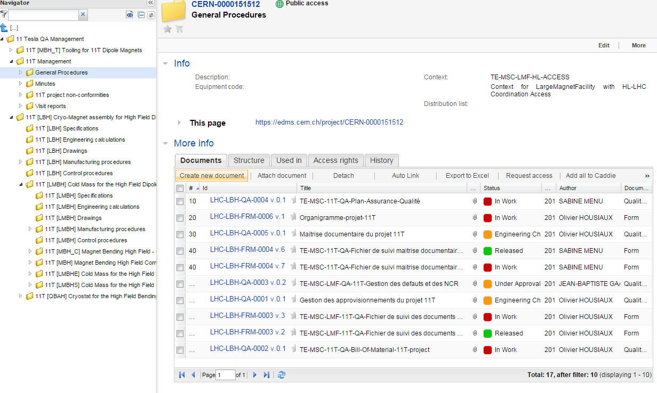
  WP11: CERN-0000130199

Slide 9
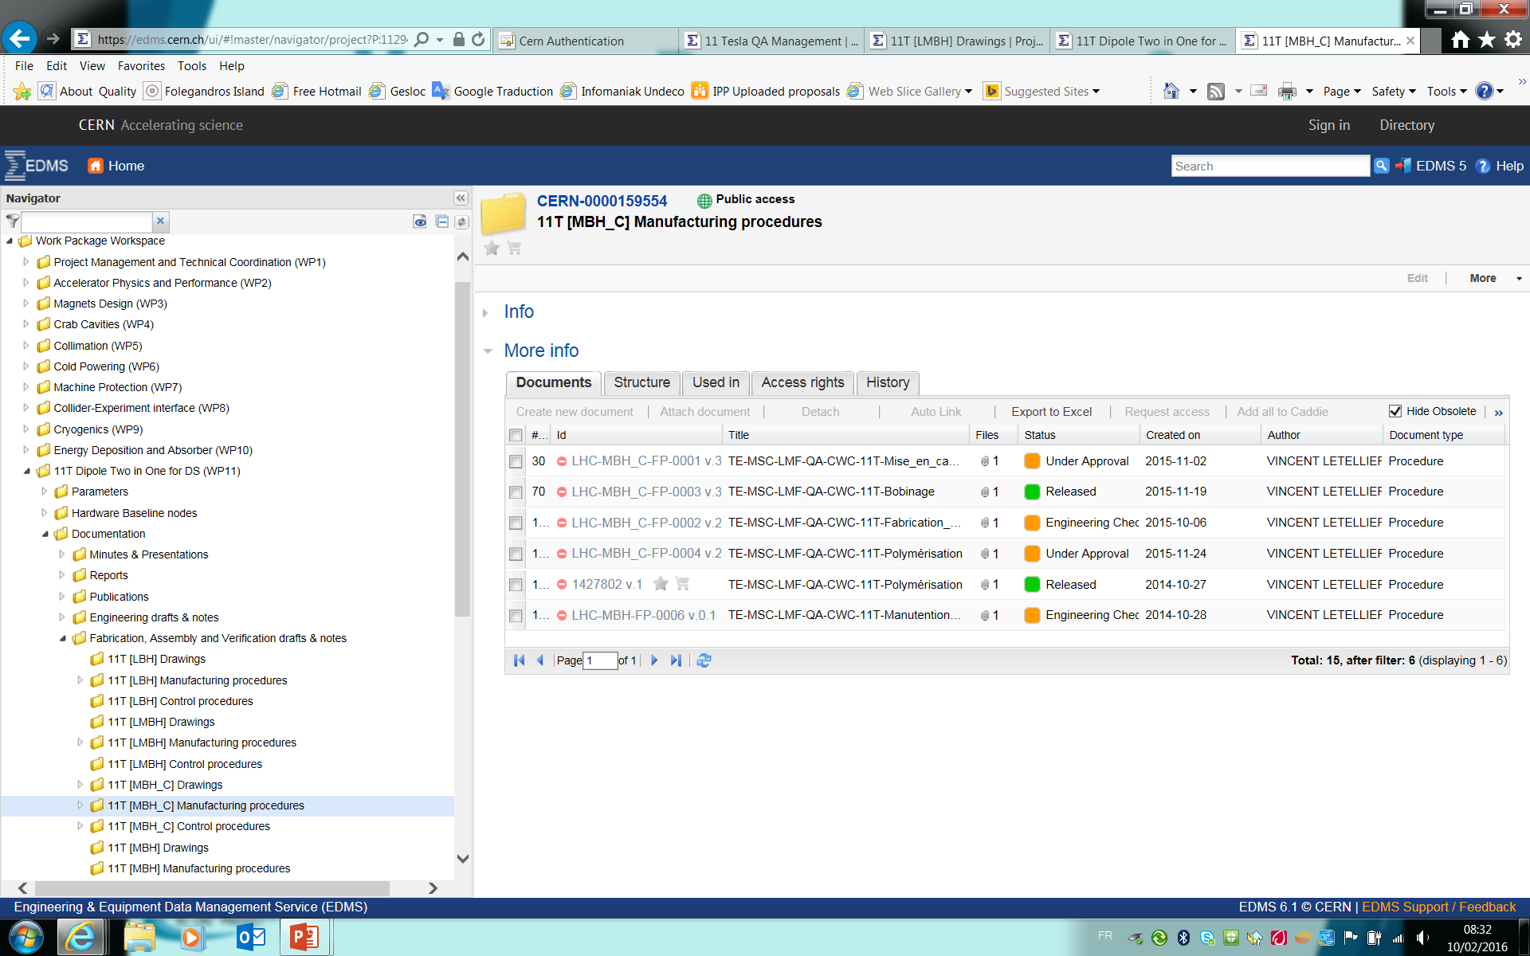
  HiLumi: CERN-000096381

Slide 10
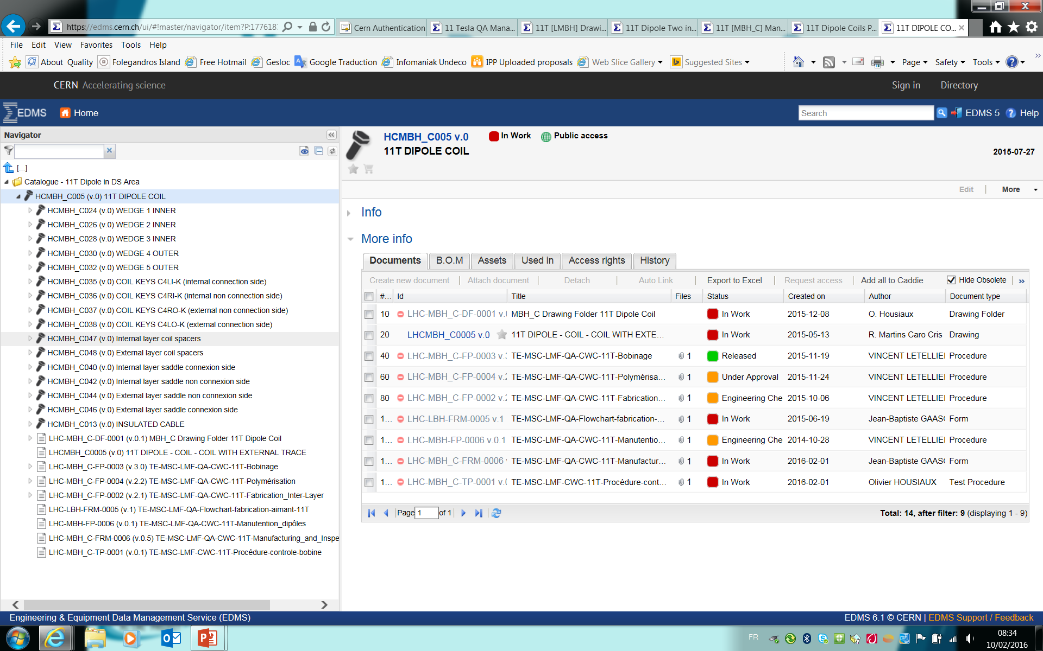
Item catalogue: LHCPM117

Slide 11
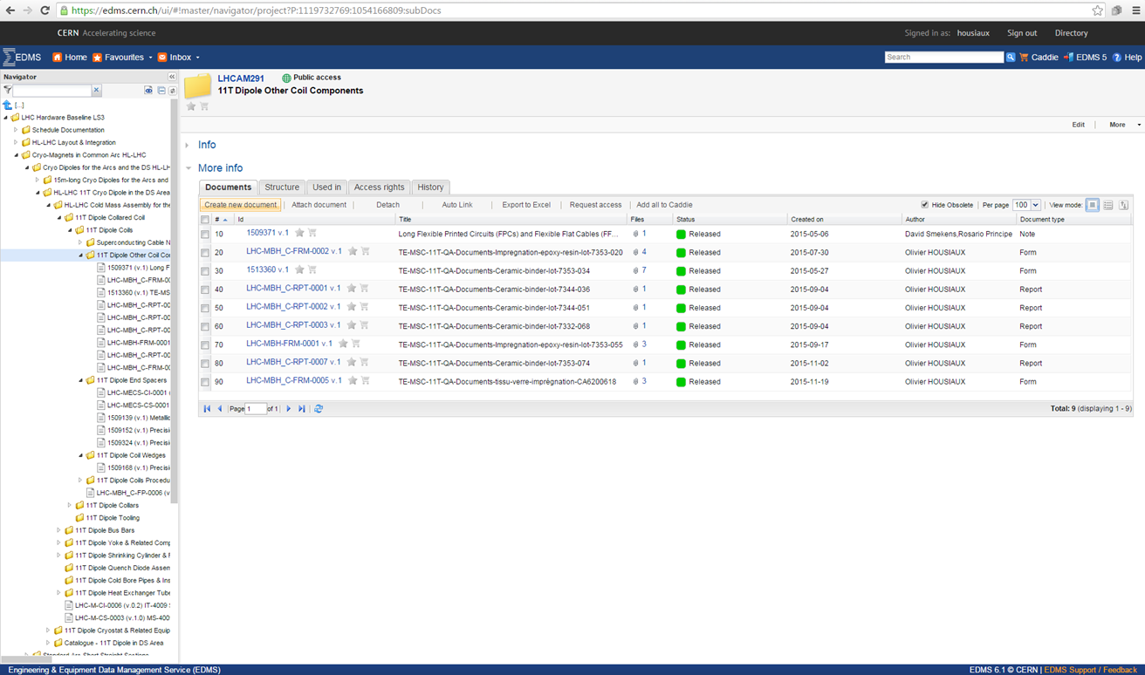
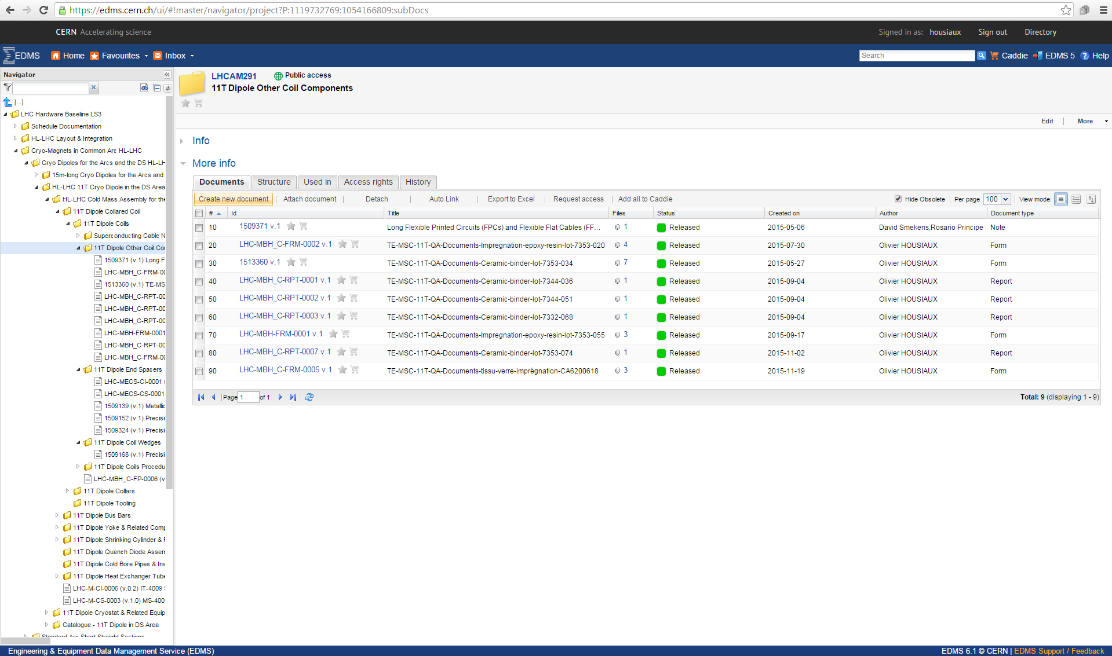
Hardware baseline: LHCAM273

Slide 12
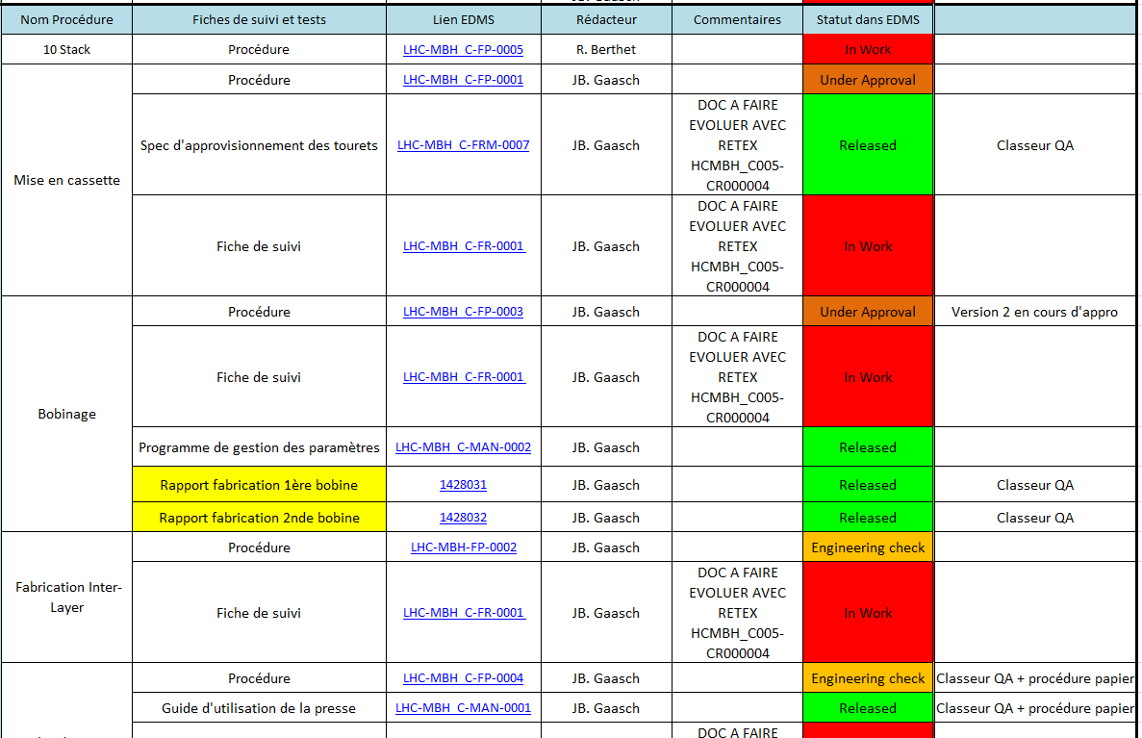
Procedures
Write and edit the QAP and all procedures for WP11 in collaboration with the Technical Responsibles

Slide 13
Drawings
Drawings provided by Project Engineer + Design Office
Today the drawings always double-controlled :
  Control 1 by the Design Office
  Control 2 by the Project Engineer
In some cases a larger approval circuit is required:
  To be sure dwgs interface correctly with:
    Other equipment families within WP11
    Other work packages within Hilumi project
    Other LHC stakeholders (transport, vacuum, et…)

Slide 14
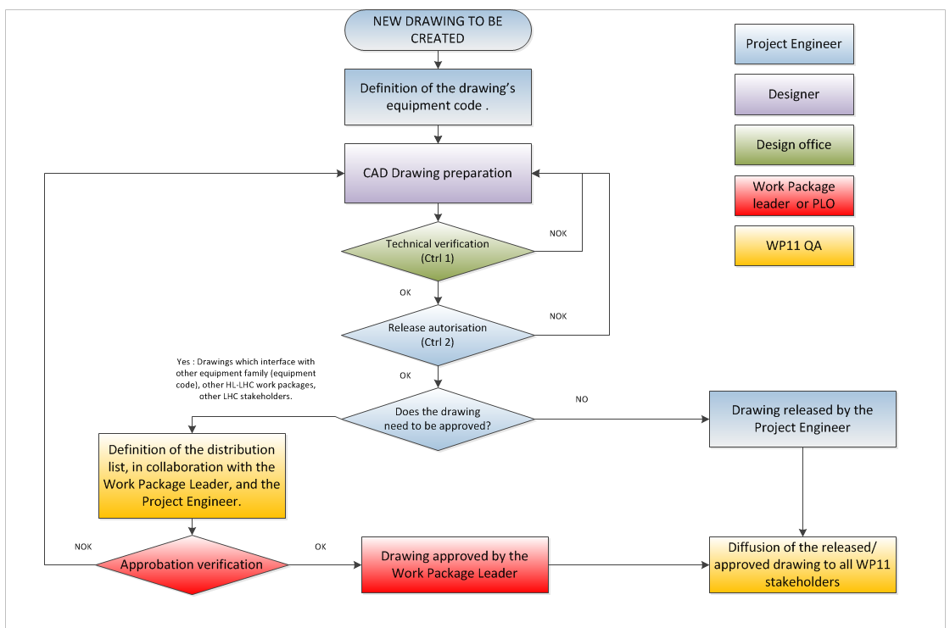
Drawings validation circuit
(Drawing and 3D Model Management and Control, LHC-PM-QA-305)

Slide 15
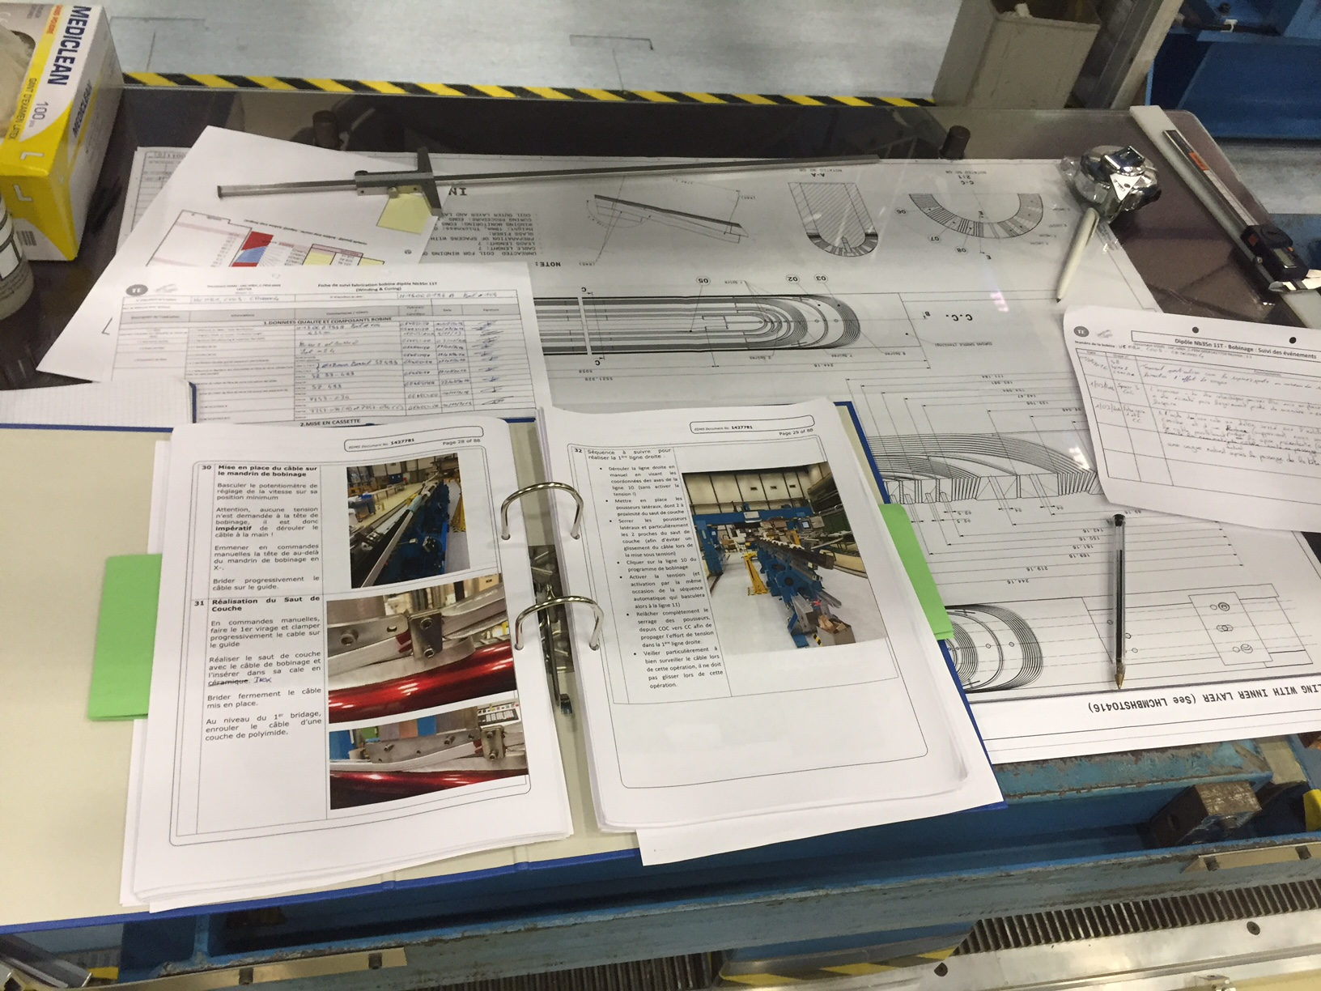
Quality control
In field quality control of any single production step
Manufacturing flowcharts
Manufacturing and inspection Plans
Fabrication Procedures
Follow-up files
Control Procedures

Slide 16
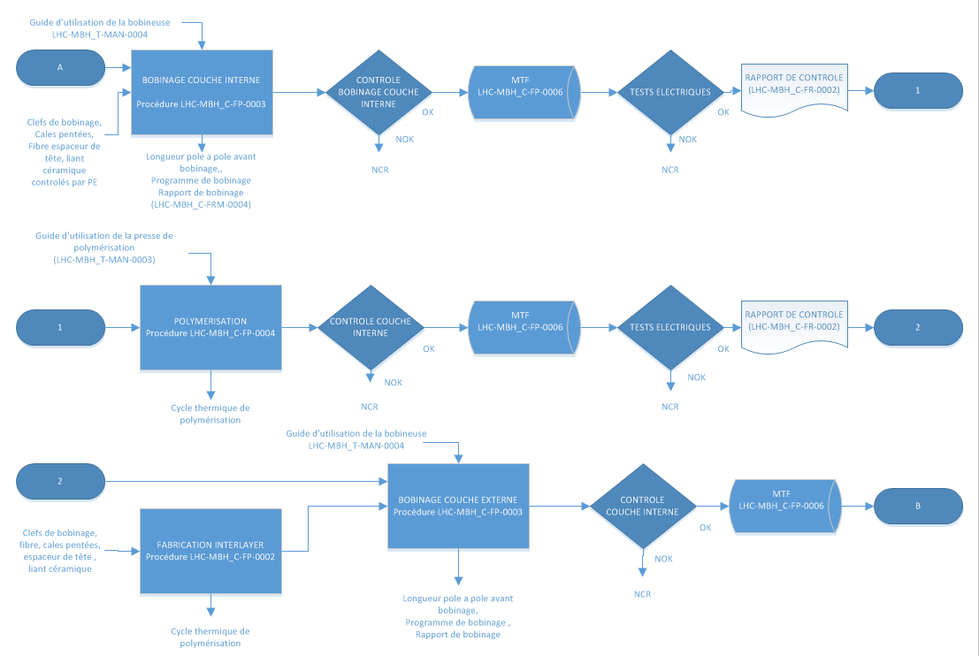
Manufacturing Flowchart
Example: Coil Manufacturing Flowchart

Slide 17
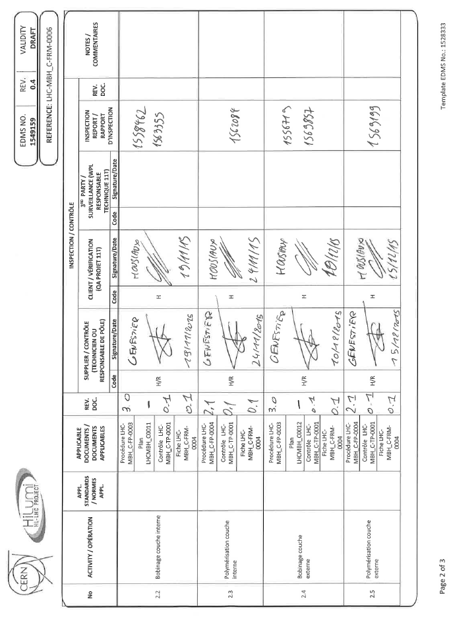
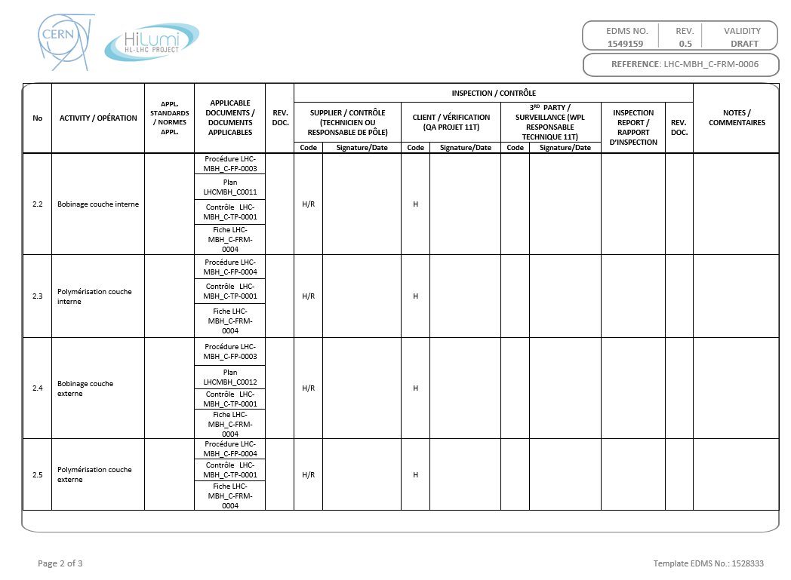
Manufacturing and Inspection Plan (MIP)

Slide 18
Manufacturing and Inspection Plan
Documentation traceability
Operation : Internal layer winding
Follow-up file
Validation
Control
Reports

Slide 19
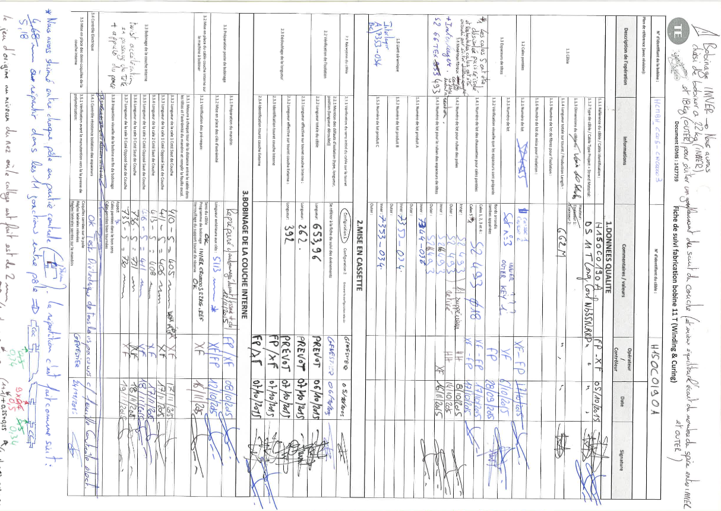
Follow-up files

Slide 20
Follow-up files

Slide 21
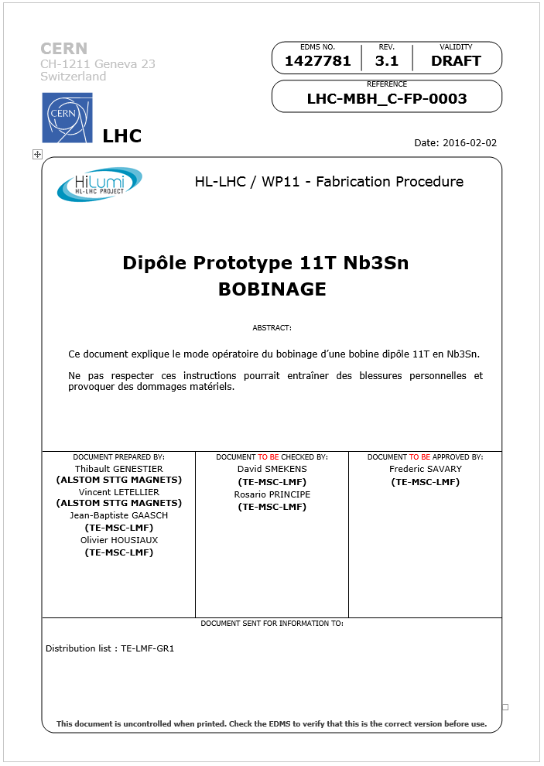
Fabrication Procedures
Naming and traceability
Validation Process

Slide 22
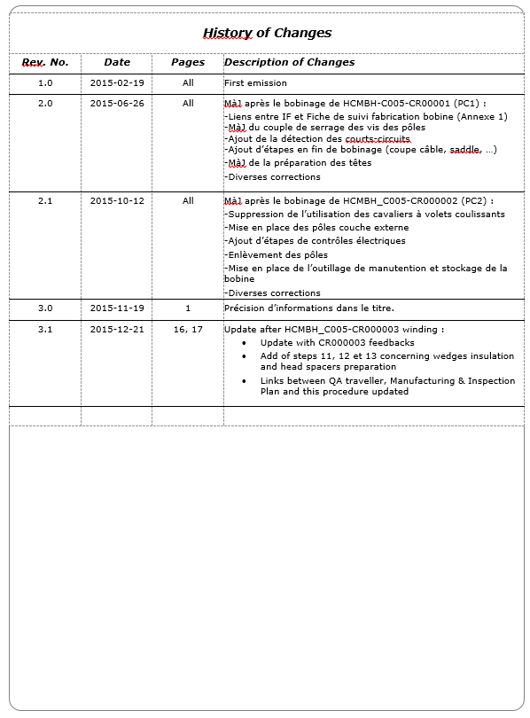
Fabrication Procedures
Traceability of modifications

Slide 23
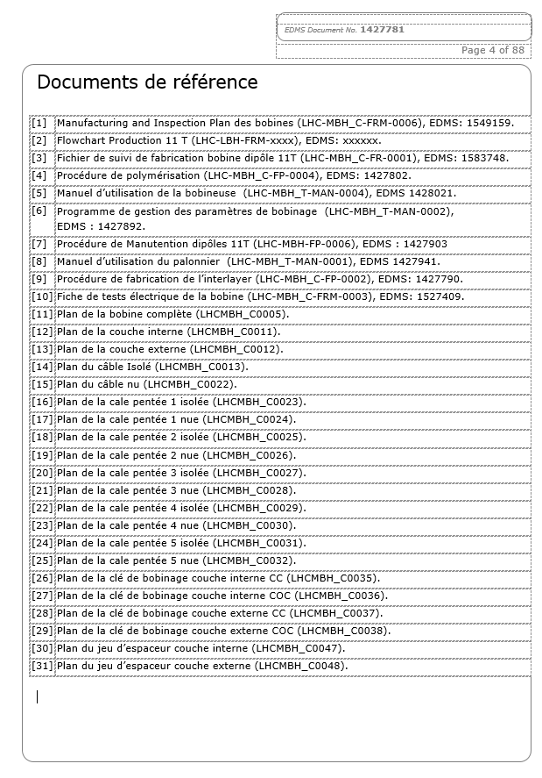
Fabrication Procedures
References (Follow up files, MIP, Flowchart…)
Drawings

Slide 24
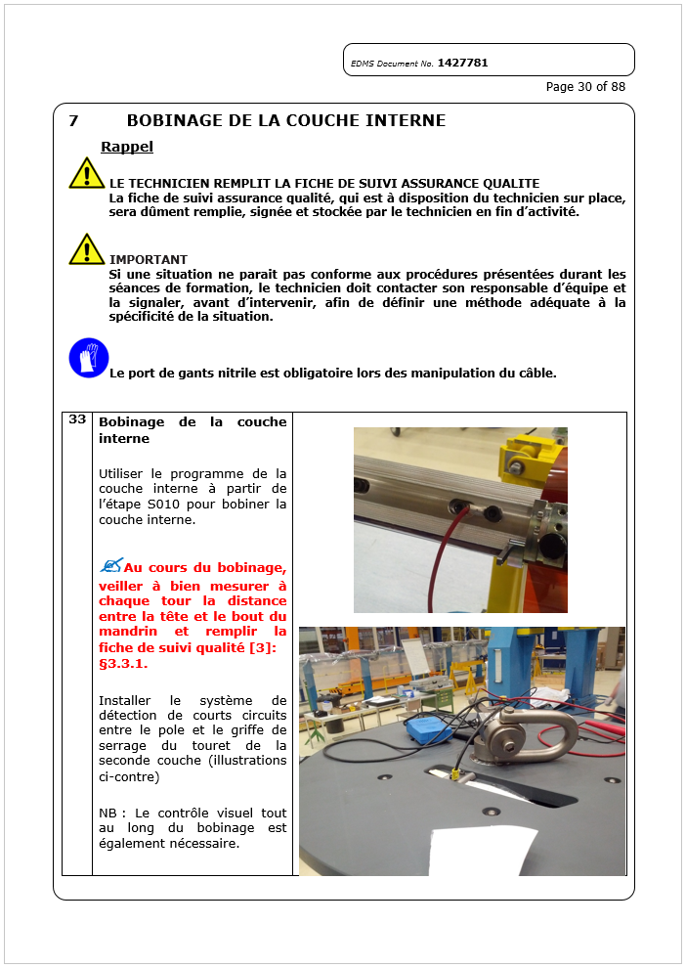
Fabrication Procedures
Quality instructions.
Information/data logging.
Manufacturing instructions

Slide 25
Control procedures
Each control step can be found in the related Control Procedure
  Inspection in field
  Documentation
  Traceability
Control procedure
Control

Slide 26
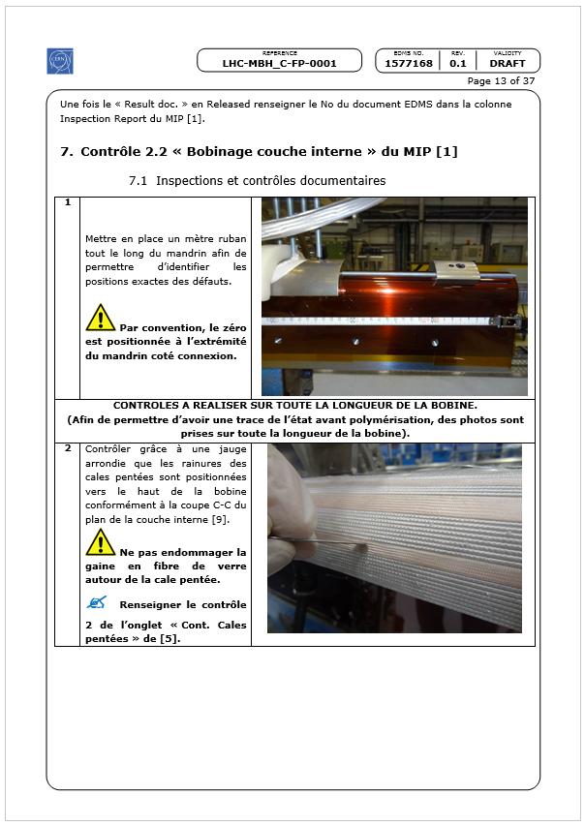
Control procedures
Quality control

Slide 27
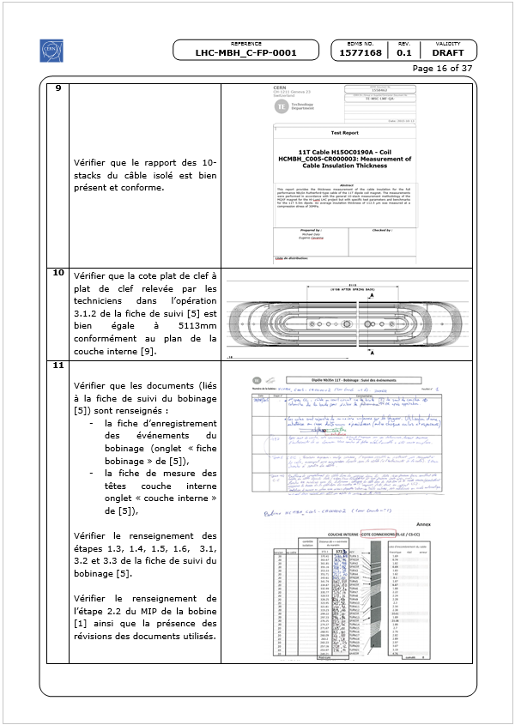
Control procedures
Documentation check

Slide 28
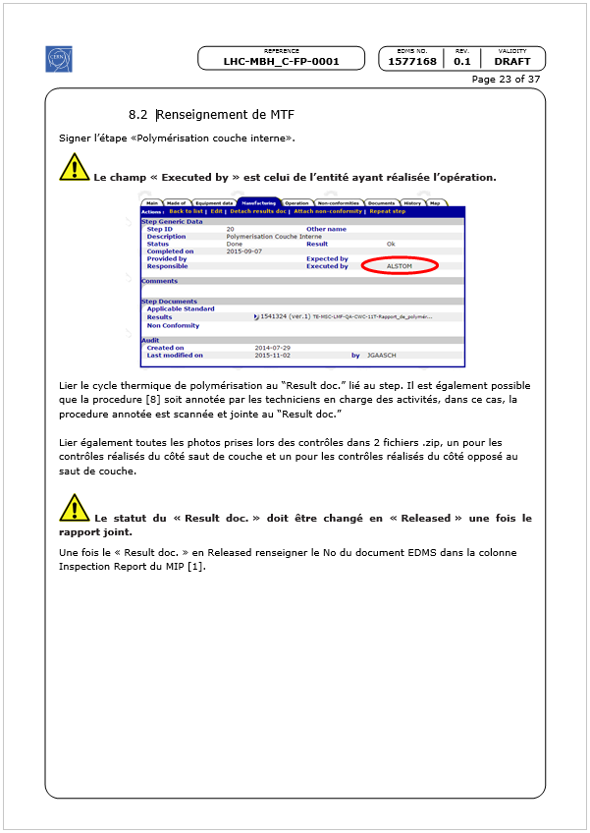
Control procedures
Traceability in MTF

Slide 29
Follow-up of the WP11 Activities
Follow-up in the Manufacturing and Test Folder (MTF)
CERN developped an interface which provides
    Traceability of the sub-equipments installed in a 11T magnet,
    Traceability of the operations,
    Retrieval of all documentation, reports, test results…
    Easy access to critical data (possibilities of reporting),
    Non conformity report management.

Slide 30
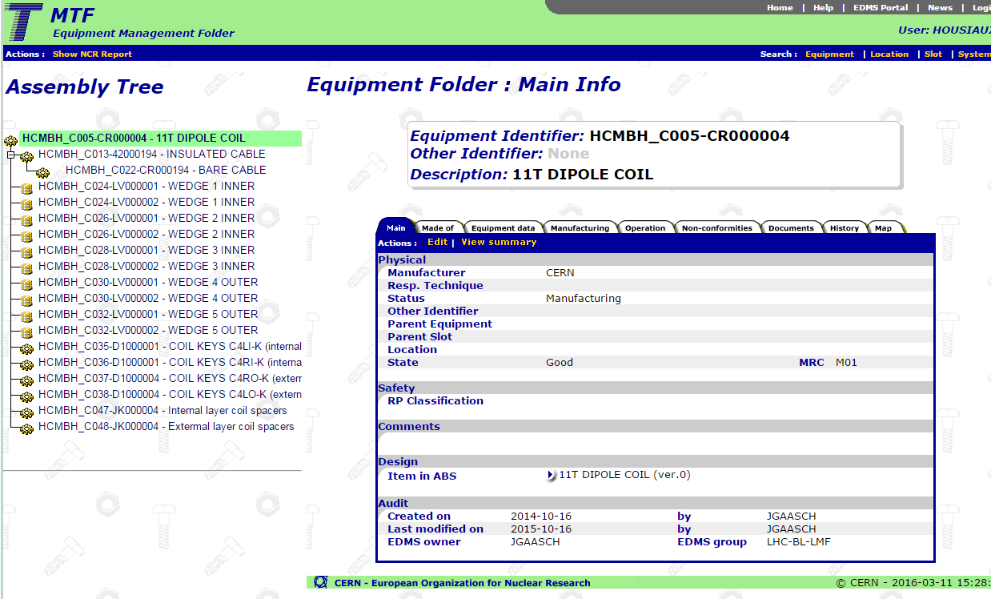
Follow-up of the WP11 Activities
Follow-up in the Manufacturing and Test Folder (MTF)

Slide 31
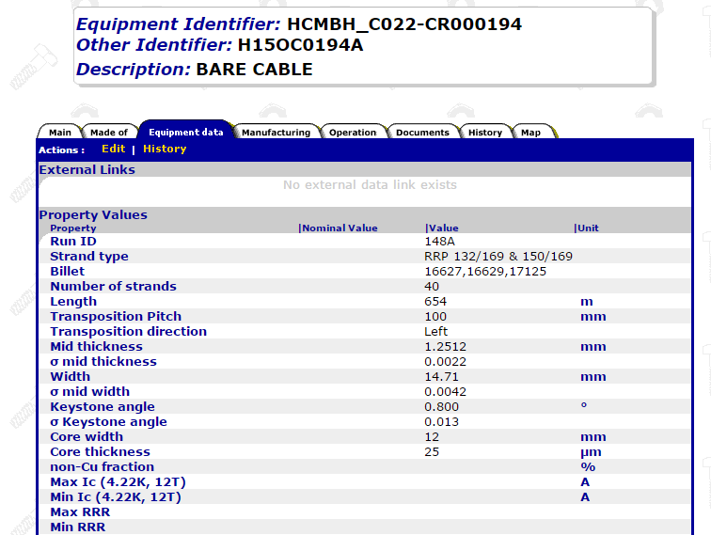
Follow-up of the WP11 Activities
Critical data :

Slide 32
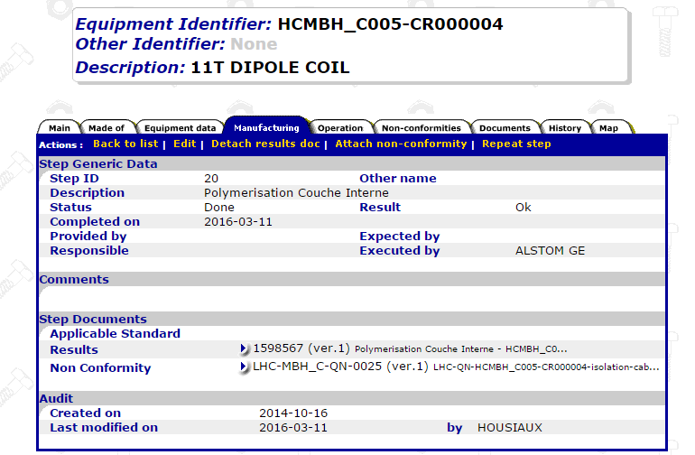
Follow-up of the WP11 Activities
Operation:
Operation traceability
Documentation
Non conformity

Slide 33
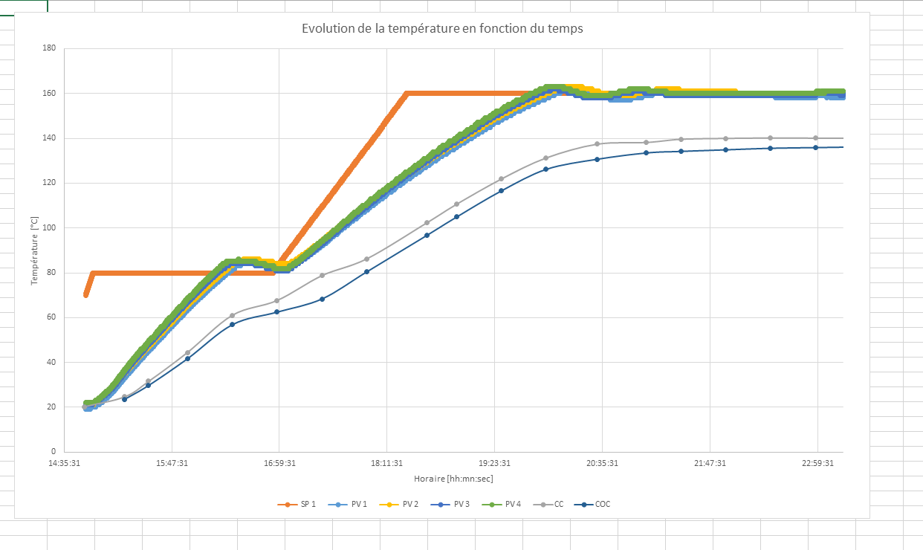
Follow-up of the WP11 Activities
Polymérisation cycle:

Slide 34
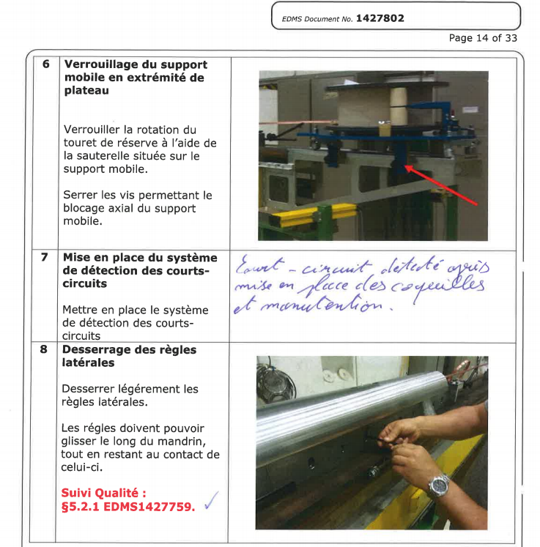
Follow-up of the WP11 Activities
Annotated procedure

Slide 35
Non conformity management
As soon as a Non-Conformity (NC) is detected:
  By technicians during manufacturing
  During Quality Control
A NC Report is opened by
  the QA responsible and the Technical Responsible
The Technical Responsible and the QA resp. define
  The proposed action to be taken in order to fix the non conformity,
  The proposed corrective action to be implemented in order to eliminate the causes of the Non Conformity,
  The criticity of the non conformity (Critical / non critical).

Slide 36
Non conformity management
The QA resp and Technical Resp. define the Criticity level
  Critical : according to LHC procedure Handling of Nonconforming Equipment (LHC-PM-QA-310): ”All nonconformities that may have an
    impact on the equipment performance, durability, interchangeability,
    interface to other LHC systems,
    health or safety are categorised as critical nonconformities”.
    In the HL-LHC project: ”Interface to other HL-LHC Work Package”.
  Non Critical : according to LHC procedure Handling of Nonconforming Equipment (LHC-PM-QA-310): ”All nonconformities that are not evaluated to be critical as defined above are categorised as noncritical nonconformities”.

Slide 37
Non conformity management
Once all the parameters are set, the QA Responsible and the Technical Responsible define the list of persons who should be involved in the validation of the non conformity (LHC systems, HL-LHC work packages and HL-LHC Project Leader Office).
Once all the parameters are set, the non-conformity’s life cycle follows the process define in the LHC procedure «Non Conformities Reporting » (LHC-PM-QA-0611).

Slide 38
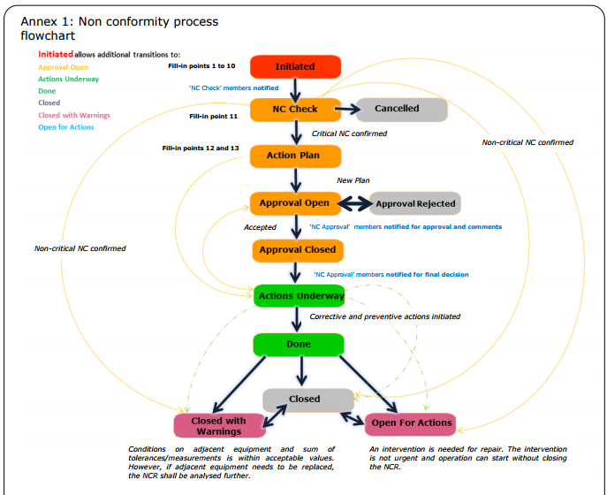
Non conformity management

Slide 39
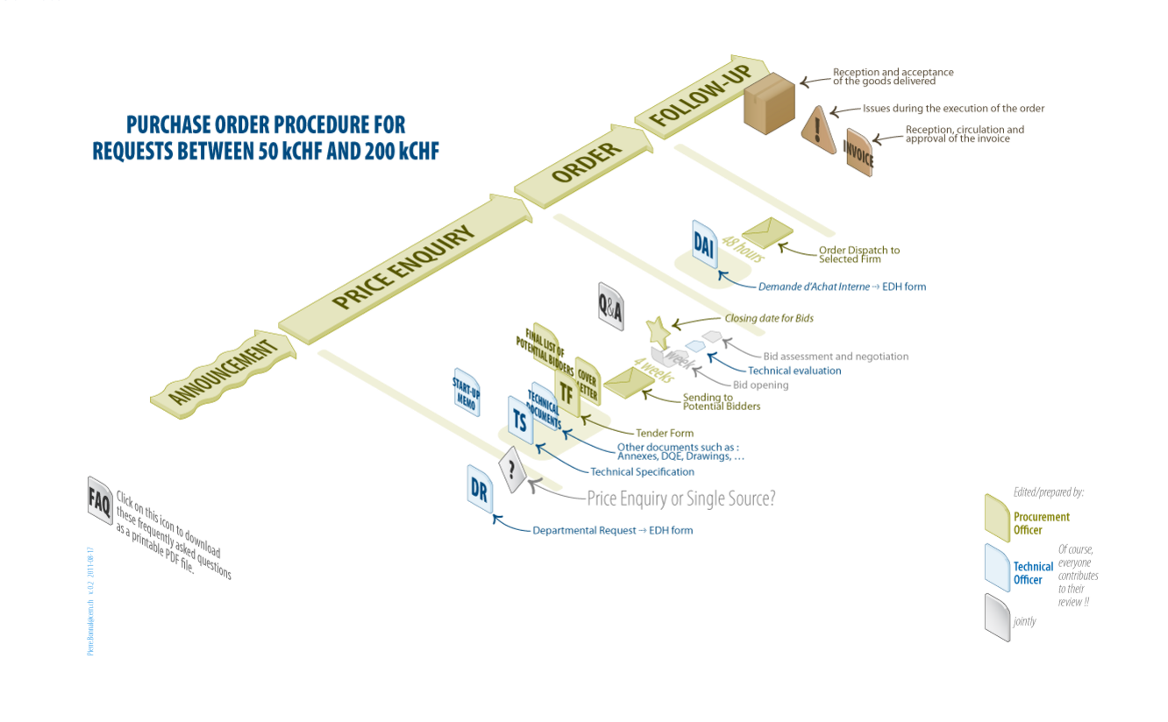
Procurement
The Procurement must comply with the rules defined by the CERN’s IPT.

Slide 40
Procurement
Reception and acceptance
Acceptance by the Technical Responsibles:
  In collaboration with Logistic Service (storage),
  In collaboration with Quality Service (traceability).
Controls to be performed before acceptance:
  Visual inspection (Logistic + Technical Responsible),
  Documentation control (Quality + Technical Responsible),
  Acceptance Sampling.

Slide 41
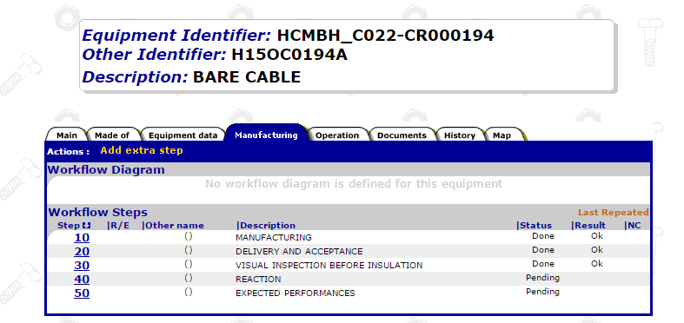
Procurement
Traceability in MTF
MTF = Manufacturing and Test Folder
Manufacturing information
Formal acceptance by the Technical Responsible

Slide 42
Conclusion
QA activity rigorous and systematic
  QA to provide 100% of the required documents
    More than 100 procedures to be provided for 11T
    + Follow-up files, Fabrication and Test reports, MIPs, et.
  Continuous improvement and upgrade of QA
    Feed-back for the production → presence in field
    Adapt immediately the documents to the working methods
  Continue the implementation of the MIP and Follow-up files
  Continue to feed MTF (info and documents)
  Share the info and communicate
    Take over the ownership of the QA system
    Shared attitude within the project

Slide 43
Thank you

Slide 44
Follow-up of the WP11 Activities
Tracability of the sub-equipments:

