Slide 1
11 T Review:
Safety and Codes
Thomas Otto
HL-LHC Project Safety Officer
With contributions by
Frédéric Savary, Hervé Prin, TE-MSC
Carlos Arregui, HSE-SEE
Francesca Viggiano, TE-HDO
11 T Magnet Review, 7.4.2016

Slide 2
Contents
CERN Safety Policy
HL-LHC Safety Organisation
HL-LHC Safety Process
Launch Safety Agreement
Pressure Equipment Directive
Next Steps

Slide 3
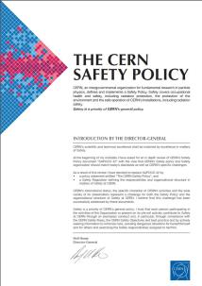
CERN Safety Policy
Excellence in matters of Safety
Objectives:
to ensure the best possible protection in health and safety matters of all persons participating in the Organization’s activities as well as of the population living in the vicinity;
to limit the impact of the Organization’s activities on the environment, and
to guarantee the use of best practice in matters of Safety.

Slide 4
CERN Safety Policy
Excellence in matters of Safety
Implementation principles
Organic units are responsible for implementing the Safety policy
HSE unit has the role of providing assistance and independent control
Specialised units have specific tasks (Medical Service, Fire Brigade …)
Establishment of a Safety Management System

Slide 5
CERN Safety Rules
Grant a high level of Safety
(European practice in occupational Safety)
Take account of the intergovernemental status of the Organization.
CERN Safety rules are based on regulations, directives and standards of the European Union, if they exist and are deemed applicable to CERN.
For cases not covered by CERN Safety Rules, the regulation applicable in the competent Host State is used.

Slide 6
Who is in Charge of Safety ?
Hierarchical Line
Consulting
Means
Rules / Advice/ Control

Slide 7
Two aspects of Safety
Conformity | Preventive Workplace Safety
Equipment | Process
Standards (ISO, EN, Eur. Dir….) | Safety Rules, best practice
Inspection | Hazard identification, risk assessment
Report on non-conformities | Safety Report, action list
Make conform | Apply rules and best practice
Conformity marking
User manual | Procedure manual
Training in use of equipment | Training the process
Safety Training
Personal Protective Equipment

Slide 8

Conformity Issues
Conformity: an item meets the essential requirements of a given (safety) standard
  “Equipment X is conform to Standard EN 1234”
Have all relevant items inspected
  HSE unit inspection service
Make conform, where necessary
  Technical measures
  Technical documentation and manuals
Train workers

Slide 9

Preventive Workplace Safety
Workplace Safety ascertains that a worker uses a conform equipment in a safe way
Risk Assessment of relevant processes
  Technical experts
  Safety (support) officers
  HSE unit experts
Put into place recommended actions
Establish process manuals
Train workers

Slide 10
HL-LHC Safety Process
Equipment Conformity
Workplace Safety
Hazard Identification of operation of the finished item
Launch Safety Agreement, fixing Safety requirements
Design, production, testing
  Collect documents for a “Safety File”
Safety Clearance by HSE unit
Install and operate
Hazard Identification of the production process
  Laboratories, Workshops
  Production facilities
  Test facilities
Workplace Risk Assessment with Action List for Supervisors
Act on recommendations
Produce, test, repair items

Slide 11
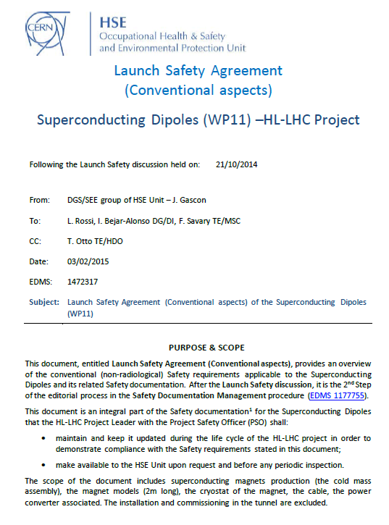
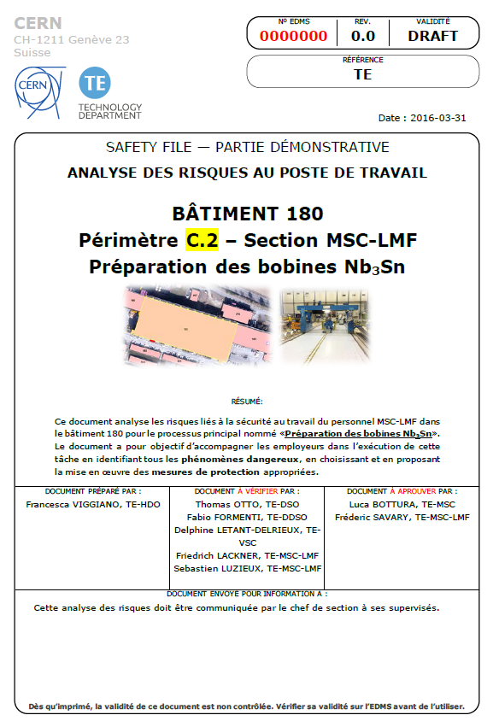
Resulting Safety Documents
Launch Safety Agreement
Workplace Safety Assessment

Slide 12
LSA: Applicable Rules and Standards
  CERN Safety Rule on Mechanical Equipment SR-M
  CERN Safety instruction on Cryogenic Equipment GSI-M4
  European Directive 97/23/EC on pressure equipment - Pressure Equipment Directive (PED)
  Cryogenic safety assessment before the start of the corresponding cryogenic activities
  Assessment contains
    a summary of the safety requirements
    the documents that are required to demonstrate compliance with these requirements and which complement the safety file.

Slide 13
LSA: Documents to Produce
Design & Engineering file:
  Risk assessment
  Result of design calculations
  Design drawings and diagrams of components, circuits
  Description and explanations necessary to understand the drawings and diagrams
  Cryogenic conformity assessment
Construction / Manufacturing file:
  Manufacturing drawings
  Material certificates for base materials and welding consumables
  Welders certificate and welding procedure approval certificate
  Non-destructive testing (NDT) personnel certificate
  Records of welding inspections
  Pressure report test
Commissioning file:
  EC declaration of conformity
  EC certification of conformity of pressure relief devices
  Instruction manual which shall include information (operation & maintenance instructions)
  HSE initial inspection report
This is due a.s.a.p.

Slide 14
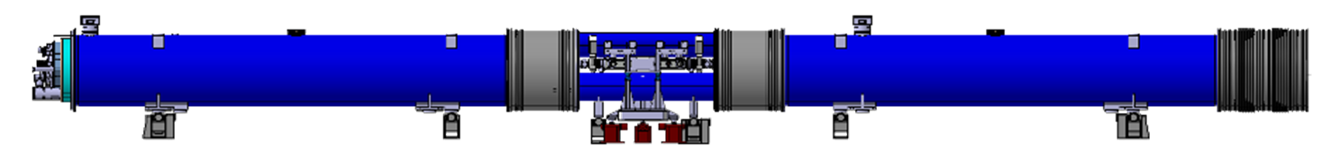
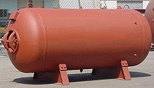
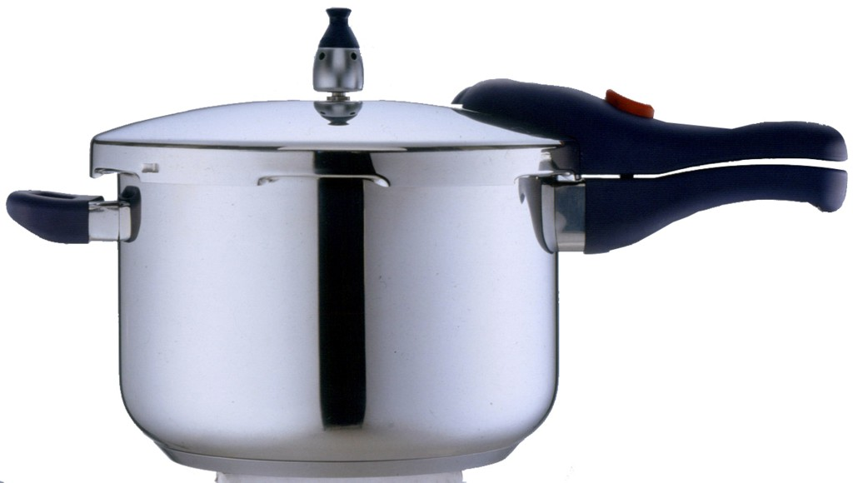
11 T Dipole as seen from a Regulator
Directive 97/23/EC of the European Parliament and of the Council
of 29. 5. 1997
On the approximation of the laws of the Member States concerning pressure equipment

Slide 15
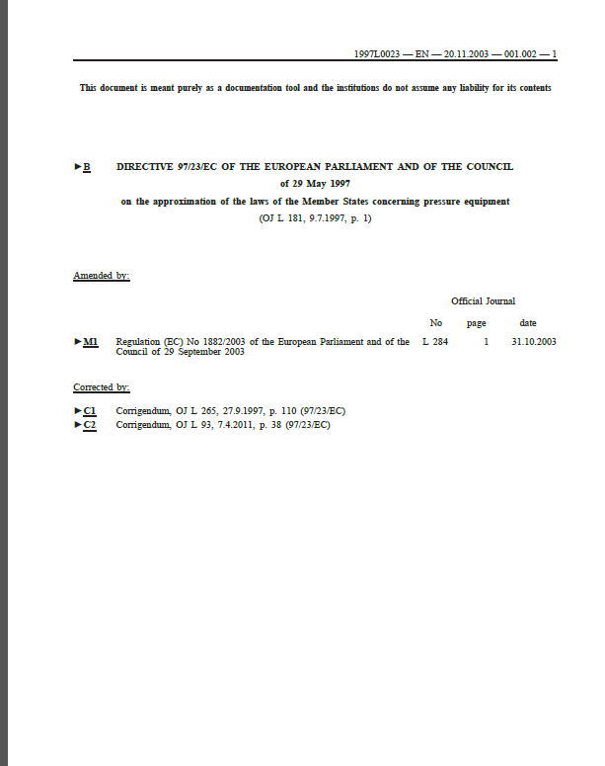
Pressure Equipment Directive
Goal: to assure end-user protection on free European market, applicable also to self-use of equipment.
Essential Safety Requirements
Classification
Conformity Assessment

Slide 16
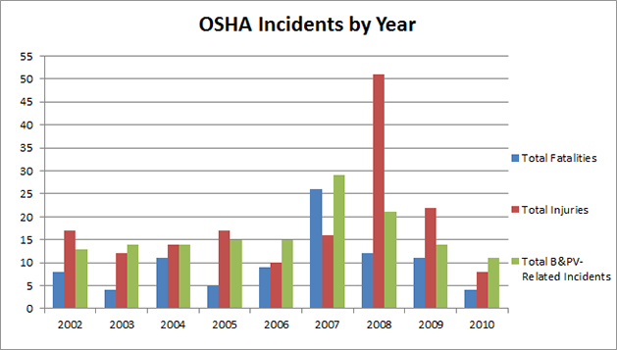
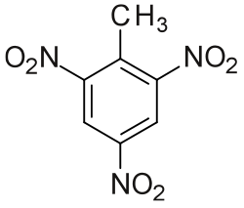
Hazards from Pressure Vessels
Explosive energy: 1000 bar L = 10⁵ J ≈250 g TNT
European legislator aims to protect consumers and users from faulty pressure equipment
Involvement of “notified bodies” to verify design, construction and to witness pressure tests.

Slide 17
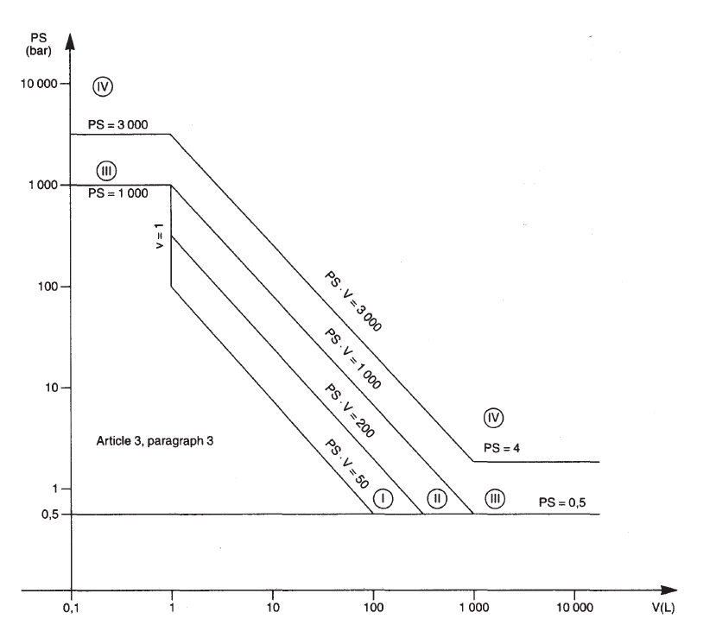
11 T Cold Mass Classification
PS = 20 bar
V = 183 L
50 bar L < PS V < 10⁴ bar L
→ Annex II Table 2
PS V = 3630 bar L > 3000 bar L
→ Category IV
If PS V < 3000 bar L ,
then Cat III possible
Is it possible ?
Is it worthwhile ?

Slide 18
Conformity Assessment
Required Conformity Assessment Modules
Category III | Category IV
B1 + D | B + D
B1 + F | B + F
B + C1 | G
H | H1
Module | Content
B | EC type examination, performed by notified body
B1 | EC design examination, performed by notified body
C1 | Conformity by type
D | Production QA, assessed by notified body
F | Product Verification, performed by notified body
G | EC unit Verification, performed by notified body
H | Full QA, assessed by notified body
H1 | Full QA, design examination and special surveillance of final assessment (notified body)

Slide 19
Next Steps
Equipment Conformity
Workplace Safety
Compile the Design and Engineering File
Agree, with HSE, on exact conditions and modalities of the conformity assessment
Note that a pressure vessel with lHe is not an ordinary one (two phases, complex thermodynamics)
Assessment of Buildings:
Bld 103 (cable production)
Bld 180 (LMF)
SMI 2 (cryostating)
SM-18 (test facility)
not started in progress terminated

Slide 20
Thank you for your Attention

Slide 21
Proof (Pressure) Test
Normally, hydraulic p[oof tets are performed at 1.43 times the design pressure
Not possible for cryogenic pressure vessels
Manufacturer has to propse and justify alternative method.
CERN HSE:
pneumatic proof test at
1.25 times the design pressure is appropriate.

