Slide 1
Quality control tests throughout production – Factory acceptance tests (WP11)
3^{td} Review Meeting of 11T DS Dipole at Collimator section for HL-LHC Project (CERN), 06 - 08th April 2016
Arnaud Foussat, MSC-LMF
With acknowledgements to Susana Izquierdo Bermudez, Felix Rodriguez Mateos, D. Smekens, S. Luzieux, H. Prin, C H Loffler, L Fiscarelli, D. Ramos Duarte, P. Fessia, R. Principe, F. Savary for their comments and contributions

Slide 2
Outline
Introduction
Quality control, manufacture and final acceptance tests
Manufacture test category on DS 11 T dipole
Electrical Hi-Pot test levels
Dimensional measurements
Magnet field quality measurements
Summary

Slide 3
Outline
Introduction
Quality control, manufacture and final acceptance tests
Manufacture test category on DS 11 T dipole
Electrical Hi-Pot test levels
Dimensional measurements
Magnet field quality measurements
Summary

Slide 4
Introduction
As part of the main in series circuit (RB) with 154 LHC dipoles (MB), the superconducting DS 11T Dipole unit shall be compliant with the overall electrical voltage levels.
The DS 11T dipole shall follow a coherent electrical quality control tests sequence during manufacture, cold tests and the ELQA LHC hardware commissioning
The manufacture tests of the dipole components (windings, collared coils, yoked coils, cold mass, bus bars, trim current leads, instrumentation) include warm dimensional, electrical and magnetic quality checks in line with the Hi-Lumi project Quality plan.
To this aim, LMF has developed a test matrix to define the QC and factory acceptance tests, including the Hi-Pot voltage levels proposal in agreement with the operation conditions.

Slide 5
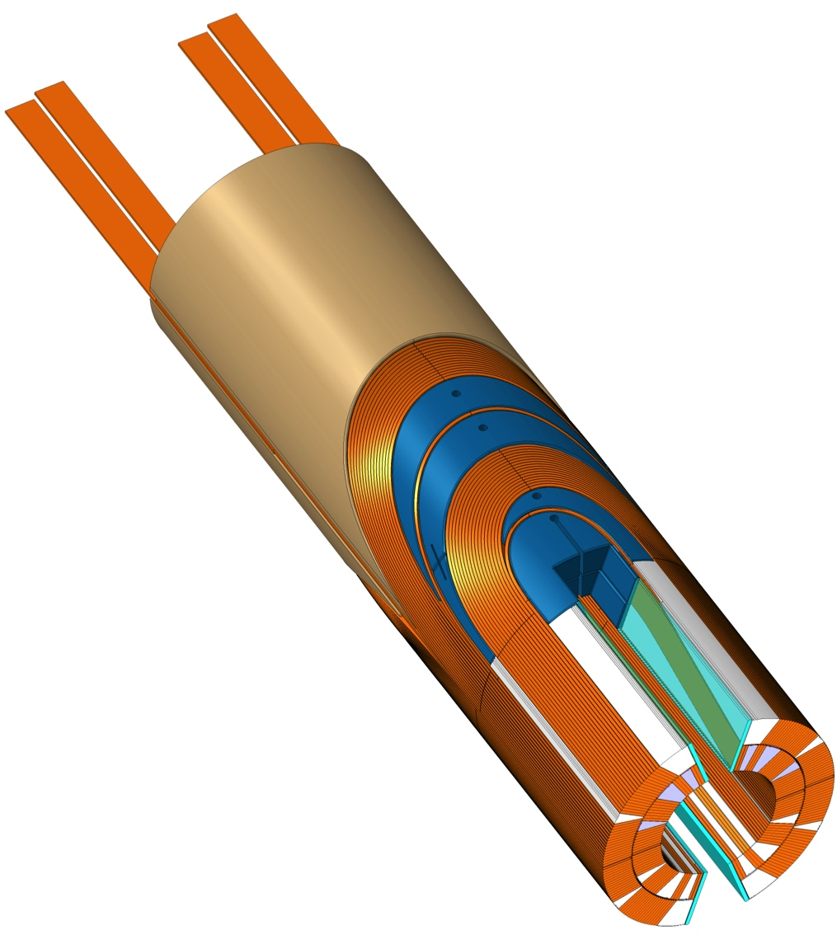
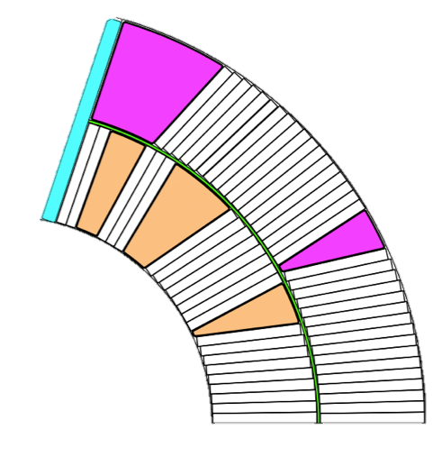
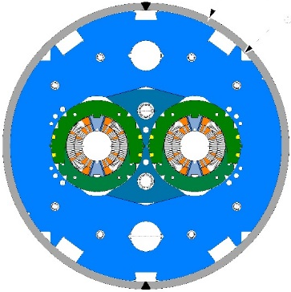
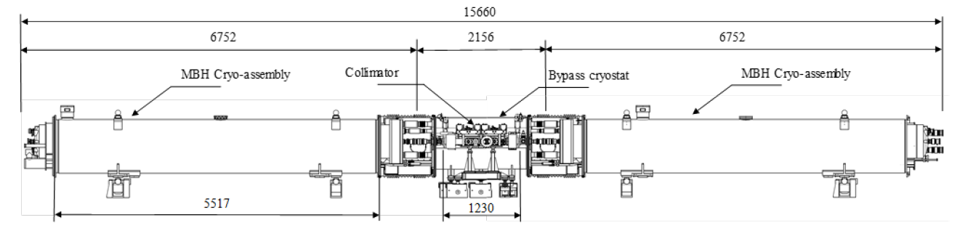
Main components and Cryo Unit dimensions
Insulated cable
Filler Wedge
Loading plate
Inter-layer
Inner ground wrap
Outer ground wrap
b
f
6
c
5
d
7
4
e
3
Mid-Plane
Filler Wedge
Loading Plate
Key
SLS Spacer w/Flex Legs
Saddle with integrated splice block
Nb₃Sn / Nb-Ti Splice
2
a
1
Fig.1 Integration view of DS11T unit

Slide 6
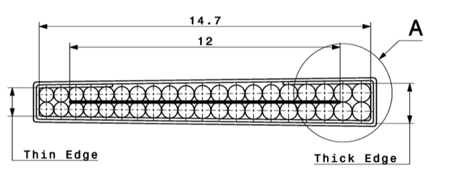
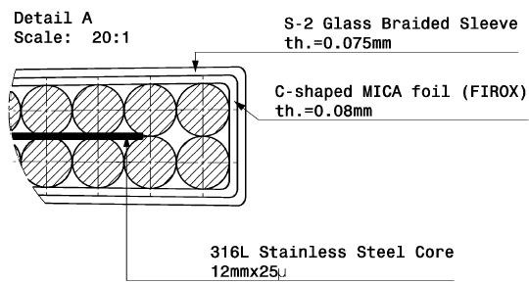
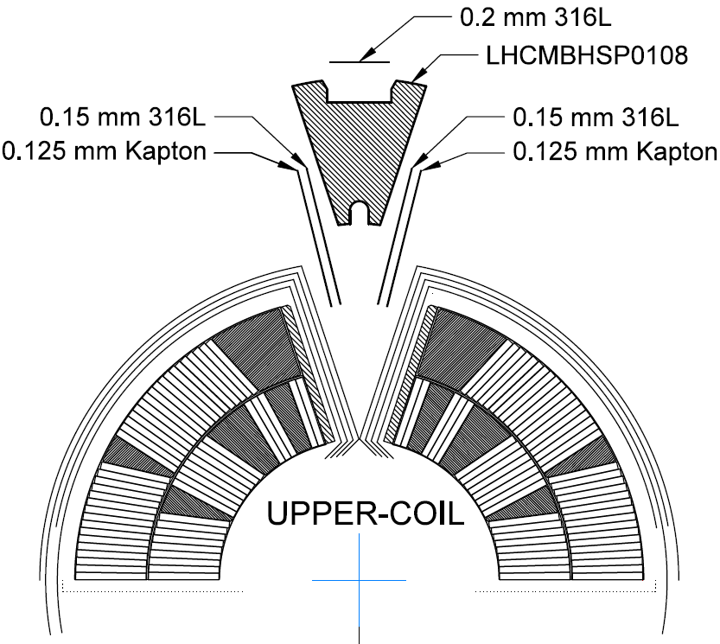

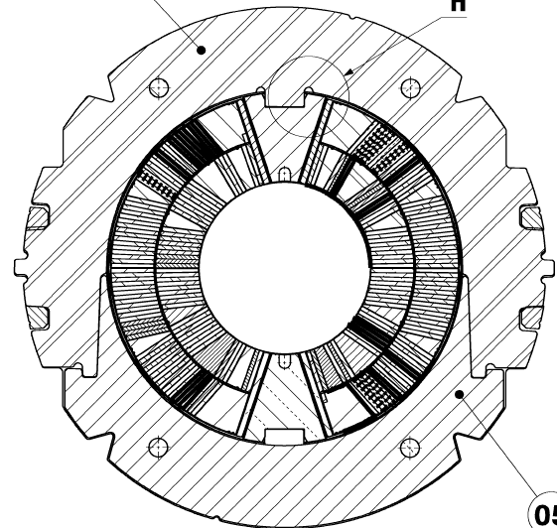
Dipole insulation system
Mica tape 80 μ thickness + E-glass;
An S2-Glass braid layer (32 threads over-braided bundles of 9 yarns for each, AGY S-2® 11TEX 636 yarn, 12 threads every 20 mm.
FIROX 80μ
S2 Glass Overbraided

Slide 7
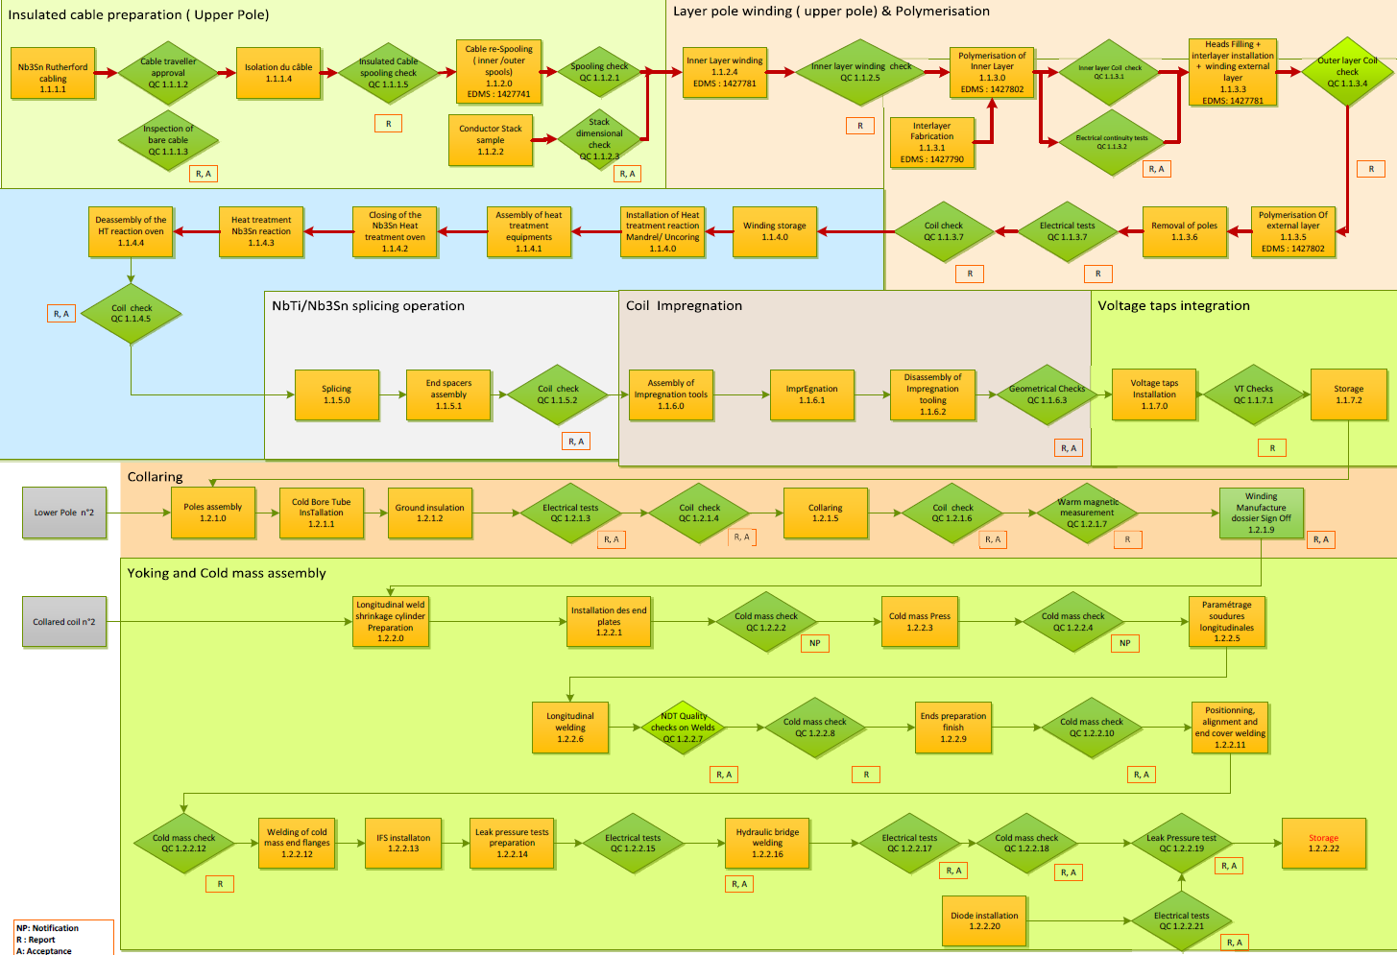
Draft WBS based 11T dipole Production & Tests flow chart
under consolidation
On going references to manufacture procedures and
report deliverables.

Slide 8
Outline
Introduction
Quality control, manufacture and final acceptance tests
Manufacture test category on DS 11 T dipole
Electrical Hi-Pot test levels
Dimensional measurements
Magnet field quality measurements
Summary

Slide 9
Quality control, manufacture and final acceptance tests
Quality control tests:
Mandatory tests performed onto the sub components and assemblies as part of dipole Manufacture Inspection Plan (MIP). Full traceability in manufacture traveller folders (MTF) ( see Appendix).
  Compliant with the 11T dipole quality control plan LHC-MBH_C-FP-0006 ( under revision, in line with past QC tests on LHC dipoles (ref IT-2997/LHC/LHC Annex B2).
  Repeated tests including coils dimensional survey, Hi-Pot electrical tests, impulse discharge, DC quality check of the insulation system at different production stage of coil components ( see next slide).
  NDT welds inspection per ISO standards ( ISO 5817 quality Lev. B, UT ISO 17640, RT EN 1435:1997)
Factory acceptance tests: Final acceptance of main dipole cold masses, validation of manufacture chain.
  Dimensional survey of complete cold mass and in-cryostat assembly;
    Safety pressure leak test on assembled cold mass, per LHC CERN Safety Requirements (Annex B33) pressure vessel directive ( see specific slide).
Final acceptance cold power tests performed under proposed 75K GHe (or 4.2 K LHe) conditions.
  to check integrity of the electrical insulation after cool down,
  measure impedance of various circuits, integrated field strength, field quality, training quenches ( see G Willering‘s talk on cold powering tests)

Slide 10
Outline
Introduction
Quality control, manufacture and final acceptance tests
Manufacture test category on DS 11 T dipole
Electrical Hi-Pot test levels
Dimensional measurements
Magnet field quality measurements
Summary

Slide 11
Manufacture tests categories
Verification of the electrical insulation integrity and impedance of various circuits [HIPot]
  DC ohmic resistance [HIPot-1]
  Transfer coil impedance at several frequencies [HIPot-2]
  Insulation resistances (continuity of instrumentation); [HIPot-3]
  Capacitance of quench heaters to ground and to coils [HIPot-4]
  High voltage qualification, leakage currents. [HIPot-5]
  Impulse responses (interturn insulation test) [HIPot-6]
Geometrical measurements of horizontal, vertical cold mass straightness, position survey of cold bore tubes, magnet interconnections, support bases, minimum inner diameter of cold bore tubes. [GeoM]
Measurements of the cold bore mid-planes tilt, parallelism of the field direction in the two apertures.[SU]
The magnetic measurement of field quality as main assembly control. Main integrated field strength as possible fine-tuning the magnetic length. (change in magnetic laminations number in the yoke blocks). [MM]
Non destructive examination of welds (RT, UT, VT, PT). [NDT]
Room temperature pressure and leak tests [PLT]

Slide 12
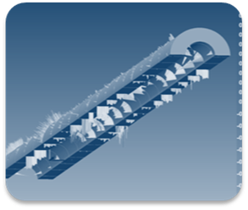
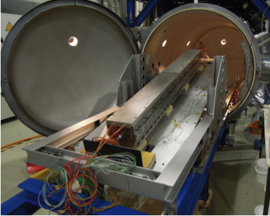
Coil Production test flow chart (1/2)
Cable Insulation
Quality control of ten-stack for dimensional check
Winding-Curing
Nb₃Sn Reaction
Test after Nb3sn intermetallic heat treatment reaction
Electrical and dimensional tests after winding of poles and after CTD- 1202 binder curing cycle
Cable Manufacture traveler checks
Hi Pot 1-3 before / after reaction
Hi Pot 1-3, GeoM
GeoM, SU
Hi Pot 1-3
GeoM
Leads Splicing
- Remove metallic spacer
- Splice Nb-Ti leads
- Install G-11 saddles
VT, NDT
Hi Pot 1-3
GeoM
Vacuum Pressure Impreg.
- Vacuum impregnation in CTD-101K of the poles (resin polymerisation)
VT, Hi pot 1,3
Coil Metrology and Electrical tests
Assess the geometry of 2D coils sections
Hi Pot 1-6, SU
3D measurement sensing arm, Laser scan

Slide 13
Coil Production test flow chart (2/2)
Coil collaring
Extern. Heaters, VTs
Post collared Coil Hi Pot test
R,L. meas.
Hi Pot 4
OD QH + VTs on flexible PCB
VTs wired to conductor
Collar alignment and assembly survey measurement.
Coil-to-ground
QH-to-coil
Inter-Turn Testing
Hi Pot 1-6,
Instrumentation T sensor, cryo heater
V line shim preparation
GeoM, SU, MM (QC)
End Connections
Coil Yoking
CM final factory acceptance tests
Hi pot 1-6 Impedance, impulse,QH to coil, coil to ground
Busbars assembly
2 IFS assembly
Longitudinal welding of shrinkage Shells
NDT (RT, UT, VT)
Busbars M3, trim cables connections
Hi Pot 1-3,5
Diode stack
GeoM , MM (QC)
SU, GeoM
SU Main CM dimensions
PLT Pressure & leak test

Slide 14
Outline
Introduction
Quality control, manufacture and final acceptance tests
Manufacture test category on DS 11 T dipole
Electrical Hi-Pot test levels
Dimensional measurements
Magnet field quality measurements
Summary

Slide 15
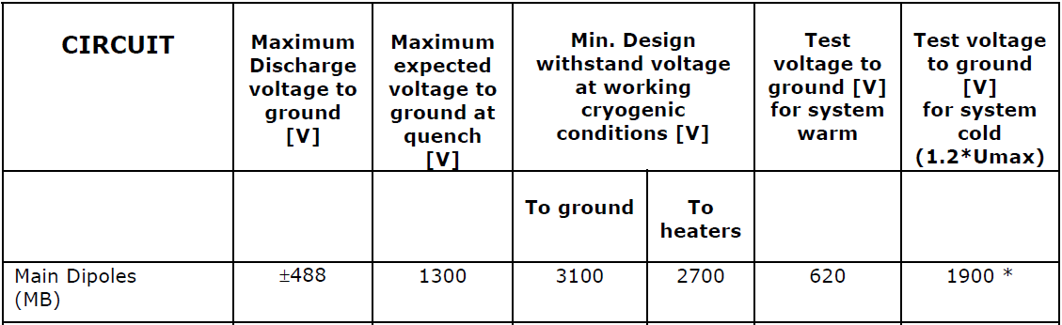
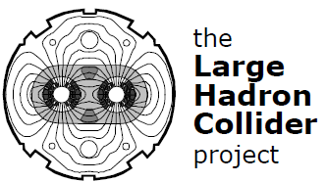
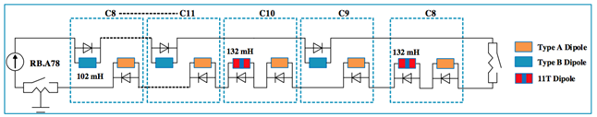
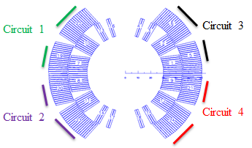
LHC Machine RB circuit test levels, 11T DS QH circuit
11T Dipole test levels shall be compliant with the MB dipole ELQA tests within RB circuit per LHC-PM-ES-0001 rev. 2.0 “Levels for DC test voltage to be considered for components within the different LHC Electrical Circuits (RB).”EDMS 90327
2100
Fig.3 2 dipole 2-in-1 in series circuit
See Cryo dipole unit circuit
in H Prin presentation
Fig.1 MB RB circuit
HF
LF
LF
Fig.2 D11T QH circuit preferred design option
HF

Slide 16
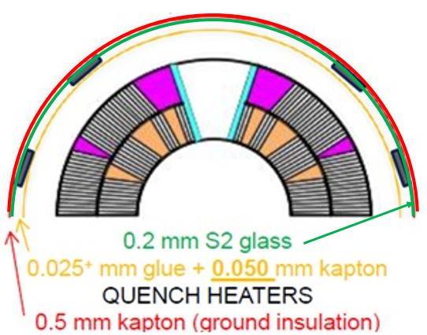
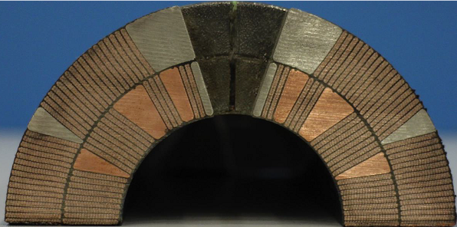
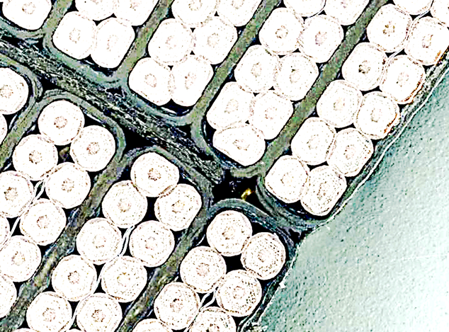
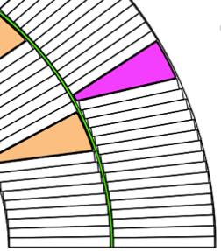
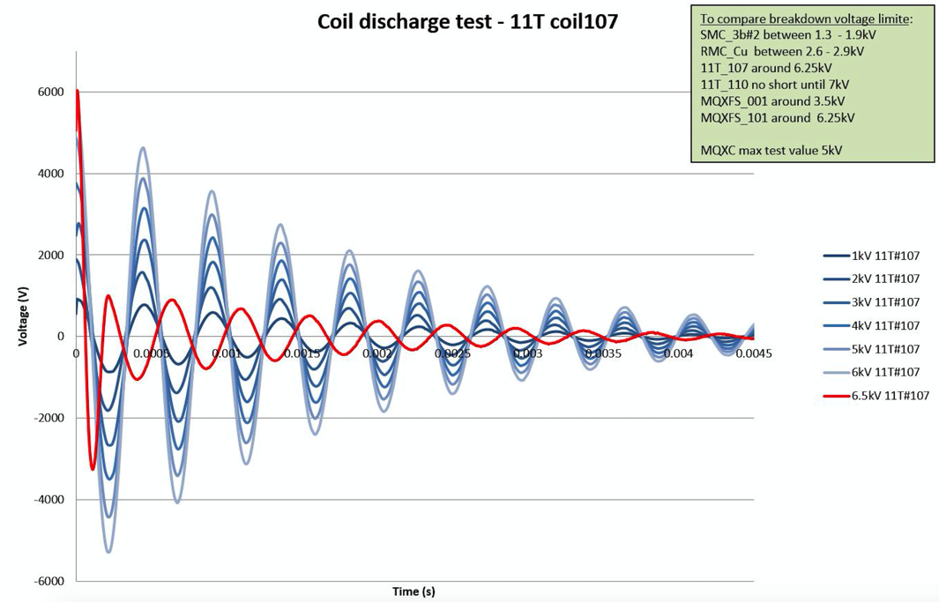
Dielectric strengths against test conditions
Two QHs circuits failure assumed scenario (then magnet repair) compliant with nominal dielectric strengths.
The splice-free layers design limits the impulse turn-to-turn terminal test level at the interlayer triple point (although only 850 V peak interlayer fault ).
Additional improvement proposal on impregnation quality of triple point, (see Fig.1).
Although successfully tested up to 7 kV limits ( t_rise < 5 us) on single coil #110, a recommended test at 85V nominal fault inter_turn voltage, i.e a total 4.7kV peak terminal (= inter layers) voltage test.
  After impregnation at high test level (≥ 85V/turn), proposed open transformer test alternative solution to reduce interlayer voltage (to be tested on DP101), (see Fig.2) with mid layer VT. (manufacture risk of VT on series to be assessed).
  At Factory acceptance at low tests level (25 V/turn). Lower terminals test level is safe within design limits.
Fig.3 Details of series coil QH insulation system
Pole side
Interlayer insulation thickness (0.79 mm) after compression impregnated with CTD101K
2 x Cable turn 0.08 Mica + 0.015 S2-glass braided sleeve
0.6 mm S2-glass interlayer cured with CTD 1202
Interlayer
Midplane
Triple point
Fig.1 Proposal to improve inter layer position S glass insulation at triple point.
Fig.2 Open transformer test layout

Slide 17
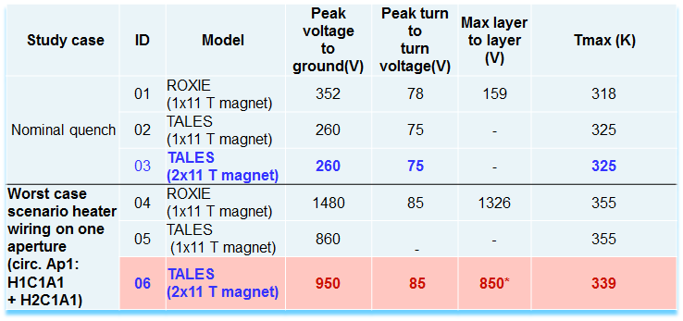
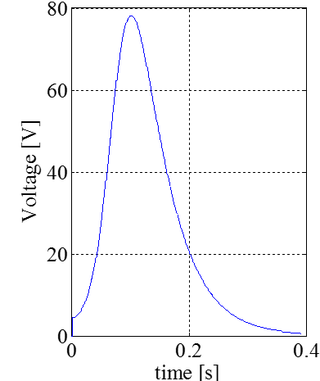
Dipole peak fault voltages
Internal fault voltages develop within 100 ms within a cryo-unit (2 DS dipoles) during a quench event with QH circuits failure under assumed GHe environment (@ 75K, 1 bar)
Nominal case [01-03]: quench :peak 515 V layer to layer, max 713 V to ground, 81 V interturns ( Roxie source)
Worst case [04-06]: Two circuits fault peak ∼ 850 V layer to layer, max 950 V to ground, 85 V interturns (TALES source)
Fig.1 Turn to turn nominal voltage
Table.1 Possible Fault voltages safety scenarii on D11T Dipole unit
Fig.2 Fault voltage to ground ( one dipole)
[Courtesy of S. Izquierdo Bermudez, A Giannopulos, A.M Fernandez Navarro ]

Slide 18
11 T dipole voltage test levels
A global strategy of test voltages by HVWG to adapt when possible test levels to environment conditions and type of defects by use of scaling factor;
Extraction voltage V_ee of 500 V is added to peak ground fault voltage
** This test level at dry air is excessive with respect to the ground insulation thickness and associated defects. Over a 0.5 mm gap, a breakdown voltage of 2500V under air @ 1 bar is sufficient under Paschen conditions to detect insulation damage.
Test voltage level to ground of 5kV DC in air shall be tested on short model coils and confirmed on the series by HVWG.
See Cold acceptance voltage test levels at 4.2K in G. Willering’s presentation.
Worst case voltage to ground is 950 V (*) in DS 11T unit under GHe 75K, 1 bar.
Manufacture test level in dry air * @ RT, 1 bar
(950+500)*4.2= 6090 V (eq. Paschen voltage level under air condition for a given gap distance) U_test dry air = 2*6090+500=12680 V** => Recommended LHC test level of 5 kV DC to ground
(* quench back error bars to be confirmed)

Slide 19
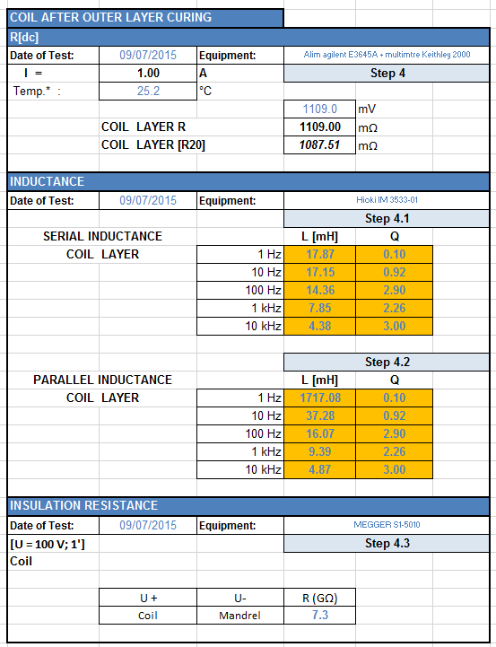
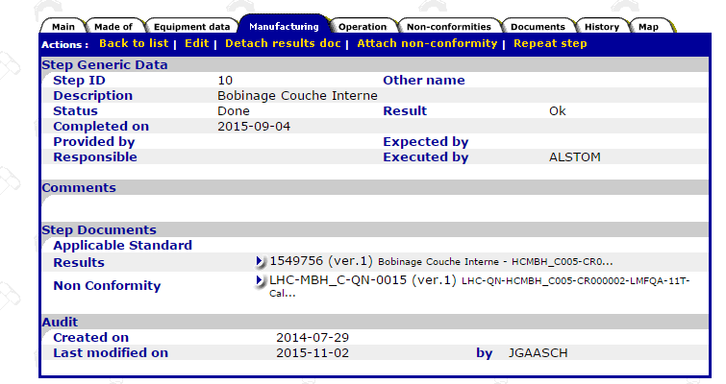
  Table 01 _ MANDATORY Quality control tests before & after heat treatment
Electrical resistance and continuity tests after winding of poles and after curing of ceramic binder
WBS ID | TEST | OBJECT | CONDITIONS | LIMITS
1.1.1.1 | DC resistance (conductors) of the total cable length and the electrical insulation of the layer shall be continuously monitored at low voltage. | Pole | I=1.00A | comparison with reference coil Any short circuit between turns or from a layer to ground can be detected and repaired
1.1.1.2 | Complex impedance | Pole | f=1.0Hz to 10.0kHz | comparison with reference coil (Repeated after curing of CTD 1202 Ceramic binder)
1.1.1.3 | Insulation resistance of copper wedges | Pole | V=500V, I < 0.5μA, t = 30 s, ( Megger : BM21) | R>1000 MΩ (Repeated after curing of Ceramic binder)
Acceptance tests after Nb3Sn heat treatment reaction
WBS ID | TEST | OBJECT | CONDITIONS | LIMITS
1.1.2.1 | DC resistance (conductors) | Pole | I=1.00A | comparison with reference coil.
1.1.2.2 | Complex impedance, Q measurement | Pole | f=1.0Hz to 10.0kHz | comparison with reference coil
1.1.2.3 | Insulation resistance of copper wedges | Pole | V=500V, I < 0.5μA, t = 30 s, ( Megger : BM21) | R>1000 MΩ

Slide 20

Table 03 _ MANDATORY acceptance tests: After vacuum pressure Impregnation of the coils (Inner and Outer layers) (Highest Hi-Pot levels)
WBS ID | TEST | OBJECT | CONDITIONS | LIMITS
1.1.3.1 | DC resistance (conductors) of the total cable length and the electrical insulation of the layer shall be continuously monitored at low voltage. | Pole | I=1.00A | comparison with reference coil. Any short circuit between turns or from a layer to ground can be detected and repaired
1.1.3.2 | Complex impedance | Pole | f=1.0Hz to 10.0kHz | comparison with reference coil
1.1.3.3 | Insulation resistance of copper wedges | Pole | V=500V, I < 0.5μA, t = 30 s, ( Megger : BM21) | R>1000 MΩ
1.1.3.4 | Discharge (interturn voltage) test, | Pole | V= 85 V/turn ( to be confirmed * ) (maximum terminal test impulse voltage Inner & outer layers: 4.7 kV) See proposed solution to lower the resultant interlayer test voltage by transformer layout; | comparison with reference coil
Recommended additional tests: | Visual inspection of insulation |  |  | In particular on curved ends
1.1.3.5 | Ground insulation |  | Measurement of insulation resistance (V = 2500 V, I < 8 μA, t = 30 s)
* Note a dedicated electrical test program on double aperture model coils to confirm inter turn test levels and test method.

Slide 21
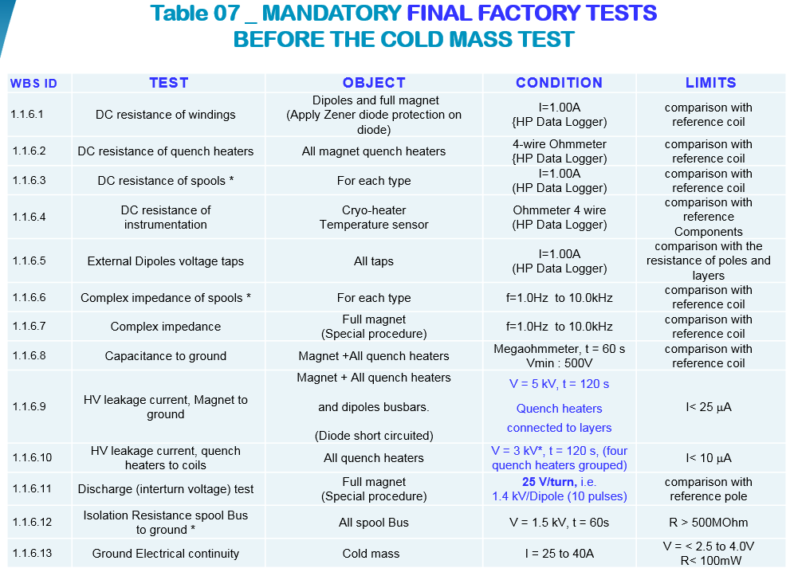

Slide 22
Outline
Introduction
Quality control, manufacture and final acceptance tests
Manufacture test category on DS 11 T dipole
Electrical Hi-Pot test levels
Dimensional measurements
Magnet field quality measurements
Summary

Slide 23
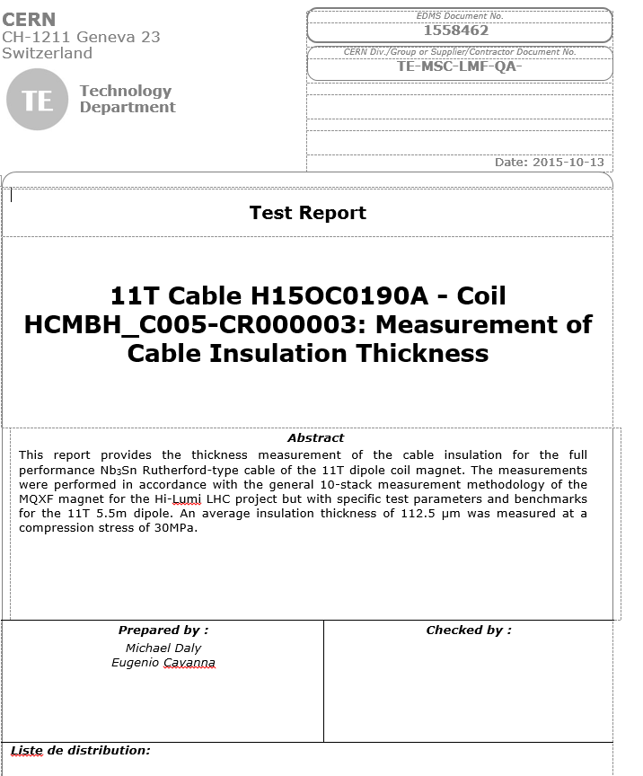
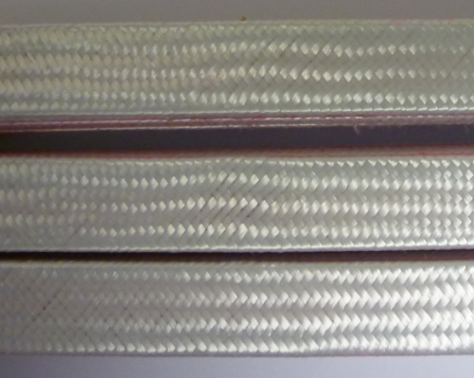
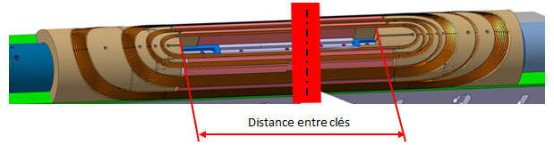
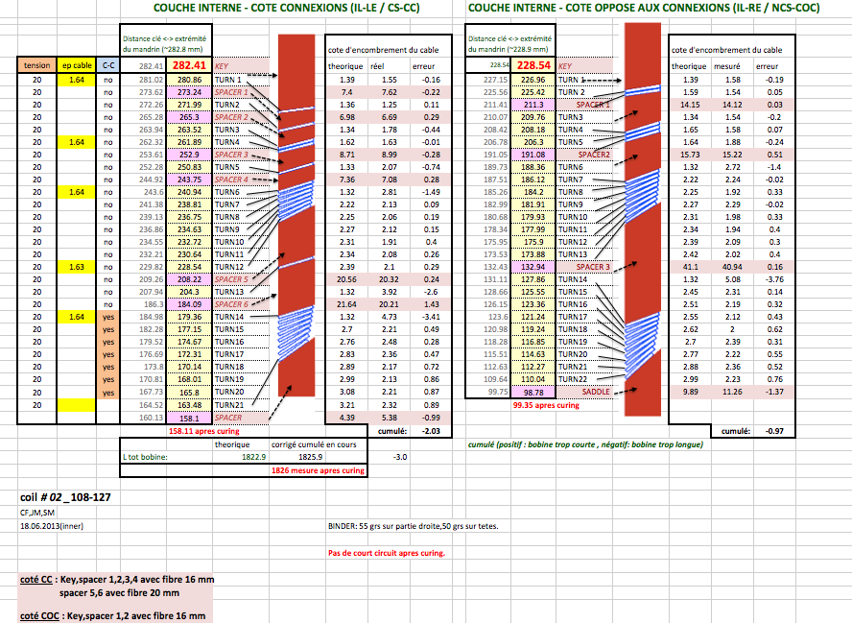
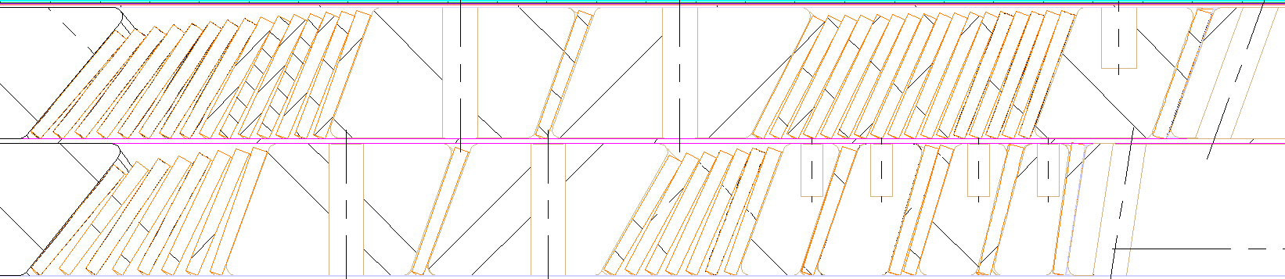
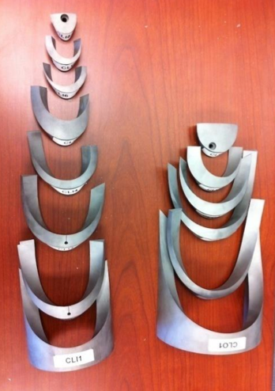
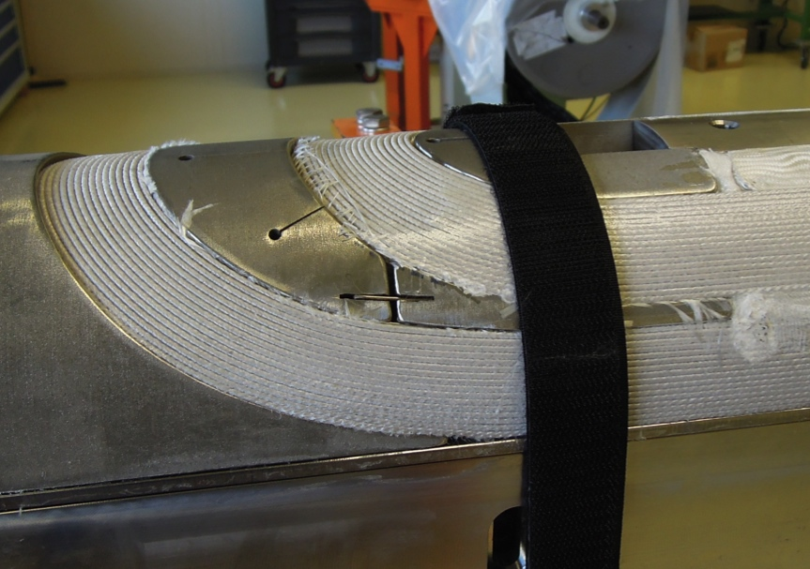
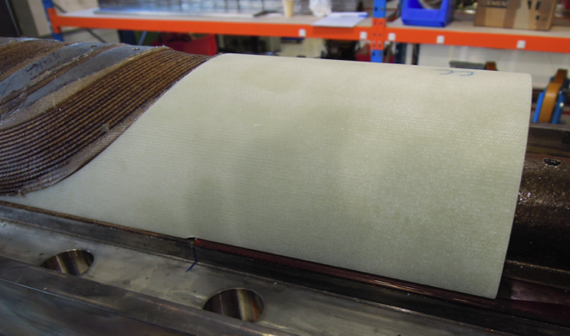
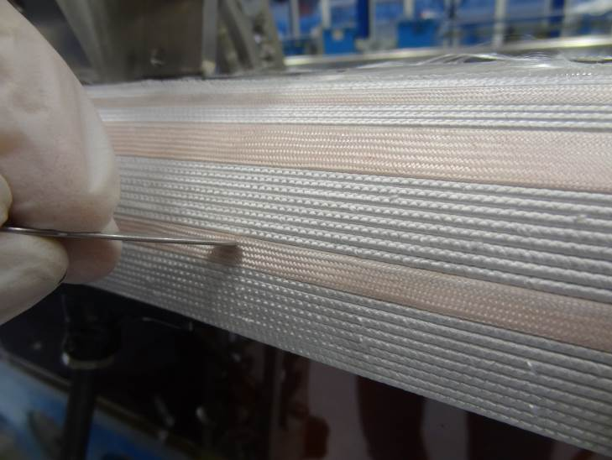
Winding dimension control before / after reaction
Insulation thickness control on 10-stack cable sample to proceed with winding operation (Hold Point)
Check of wound cable edges position along mandrel wrt theoretical Roxie position (QC test).
Check of this inner layer inter keys distance (5113 mm per LHCLMBH_0005) after ceramic binder curing and HT reaction (5108 mm) as benchmarked data (QC test).
.
Data from D. Smekens
1) End spacers dimension check
2) wedge insulation checks
3) After winding, holder before curing stage
4) G11 end saddle installed, post reaction

Slide 24
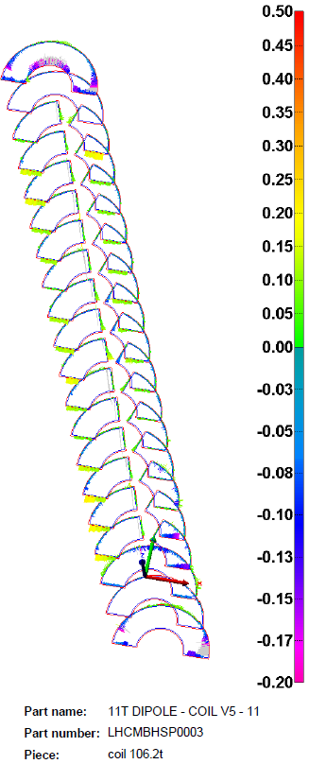
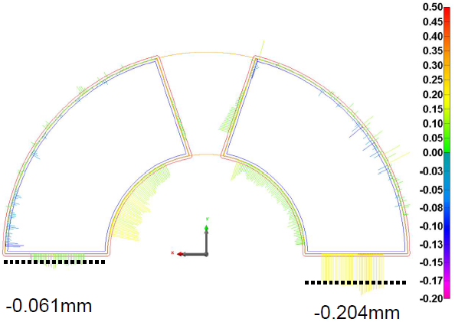
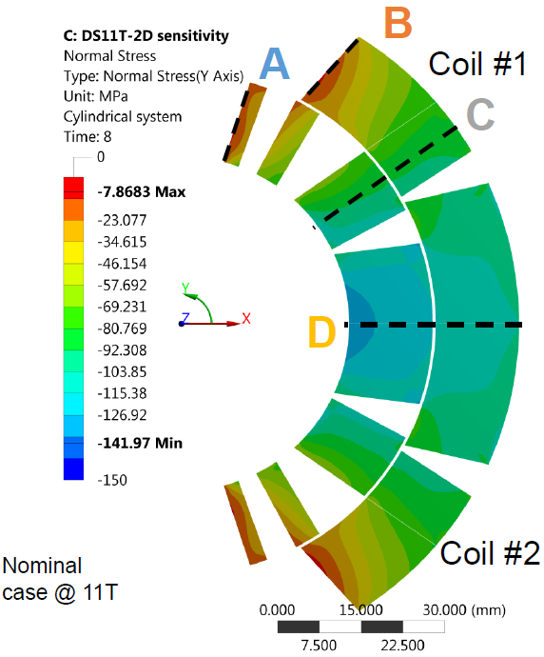
Post impregnation geometrical inspection
  Most important evaluation basis for theoretical collaring shim thickness to meet field quality requirements and admissible coil preload.
  Survey of azimuthal cross sections shape tolerance (every 100 mm along 5.5 m length) (QC check);
  Provisional boundary achievable targets of cross sections azimuthal size deviation of ± 0.12 mm. ( to be confirmed on short models fabrication)
  A midplane aperture interference of 0.14 mm causes a - 25 MPa azimuthal stress maximum variation, [see C. H. Loffler analysis graph ]
    Impact on allowed field harmonics of a 0.125 mm mid plane shim ( short models #101-103 : Δb3 ∼ 4.2 , Δ b5 ∼ 1.5 units [ See Roxie calc. by S. Izquierdo Bermudez]
Fig. 1,2. Coil 107 survey example
with local oversized midplane of -0.2 mm

Slide 25
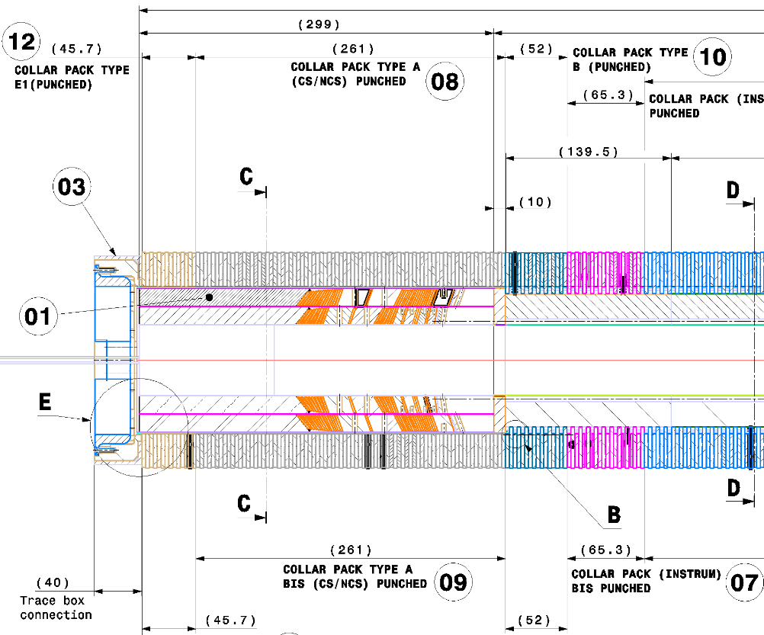
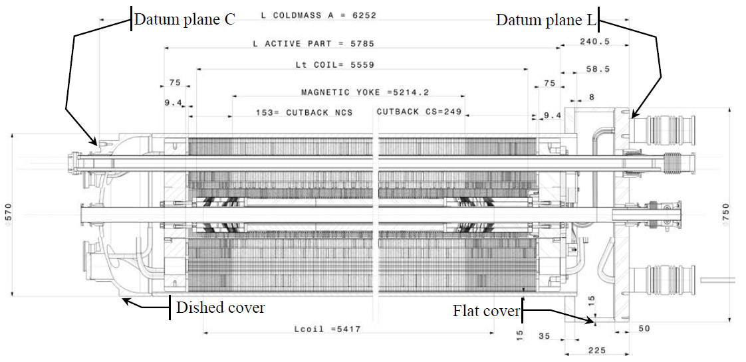
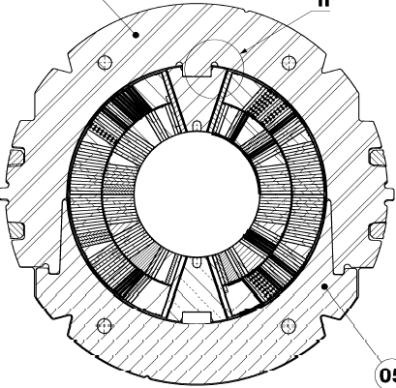
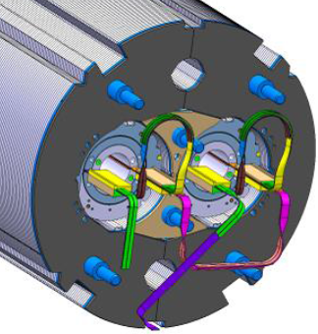
Post collaring, yoking dimension measurements, alignment requirements.
Theoretical geometric axes and reference horizontal planes of the cold bore tubes, V1 and V2, as basis of all the positioning during cold mass completion;
On first of a kind aperture, some intermediate measurements of collars deformation in the horizontal and vertical planes. ( target peak azimuthal pre-stress of -125 Mpa, differential deformation of 0.25 mm (tbc));
Before and after completion of the collaring, “go” gauge in cold bore tubes (inner minimum diameter 49.65 mm) and use of survey mole for bore alignment check;
After collaring, optional flatness & straightness survey check on a flat surface (flatness or + 0.3 mm over one metre) at several points;
Check of length vertical and the horizontal straightness ( < 1 mm) and the V1- V2 equivalent plane twist after welding of shells ( < 4 mrad to be confirmed wrt Units alignment Beam Optics requirements).
Fig.1 Collared coil section
Fig.2 Longitudinal section of the cold mass assembly MBH_001

Slide 26
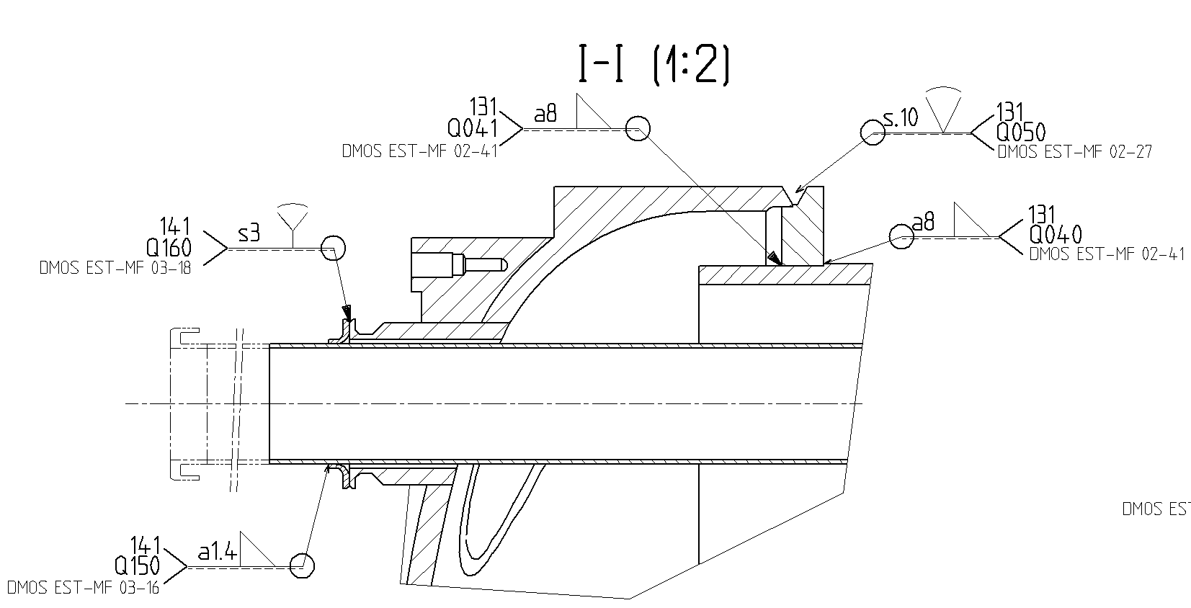
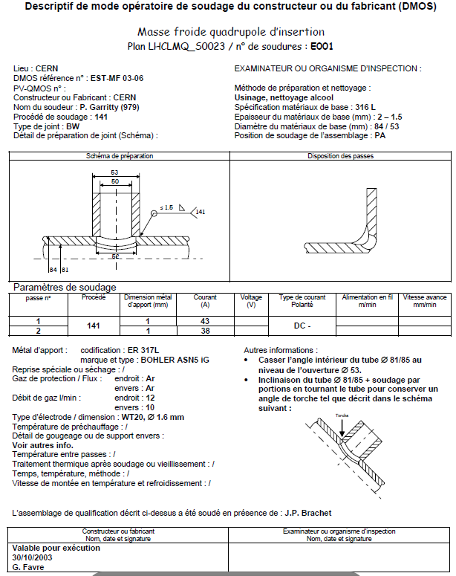
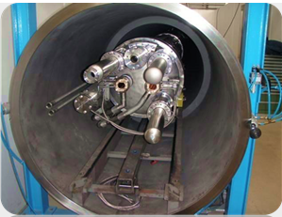
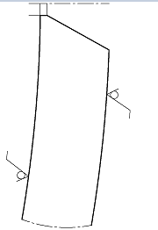
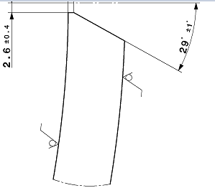
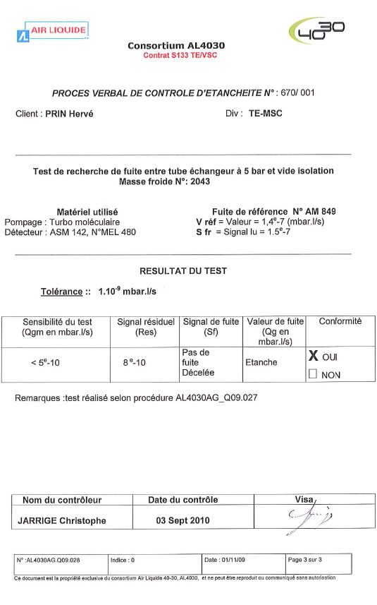
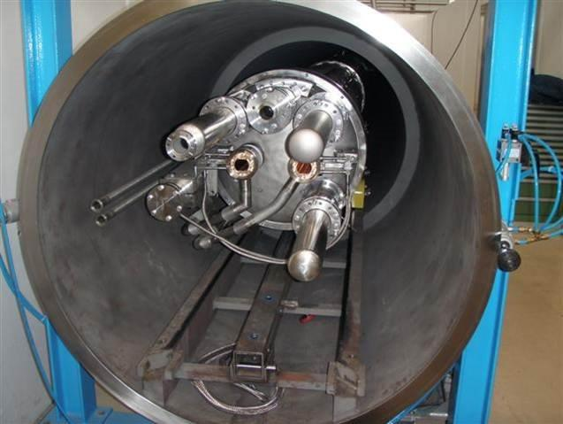
Quality control and Final safety cold mass tests
Each 316LN austenitic stainless steel weld is performed per DMOS ( WPQS Weld Process Quality Specifications) based on weld map drawings.
Radiographic per LHC-MMS/98-198 Rev.2.0 Annex B33, class C as best effort;
Safety UT inspection test on new longitudinal weld, based on ISO 5817 quality level B and NDT ISO 17640 (NDT procedure under qualification).
Cold mass proof tested under static GHe pressure at 26 bars abs. in accordance with CERN safety rules per LHCMB_ A_CI _0022 compliant with the harmonized European standard EN 13458:2002 sec 6.5 – part 2 on cryogenic vessels.
Fig1 .Weld map with DMOS reference (WPQS)
Fig.3 New shell joint bevel geometry
Fig.2 Dipole pressure leak test station

Slide 27
Outline
Introduction
Quality control, manufacture and final acceptance tests
Manufacture test category on DS 11 T dipole
Electrical Hi-Pot test levels
Dimensional measurements
Magnet field quality measurements
Summary

Slide 28
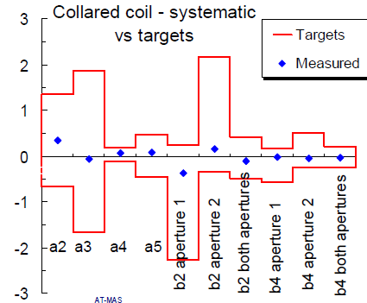
Magnetic Field quality production measurements
MM on the series production of 11-T dipoles for HiLumi are not intended as a means for steering the field quality, like in large series, but to screen out anomalies in the early stage of production
  Control acceptance limits set on MB at 4.2K of ±3.5 σ (warning) and at ±7 σ (alarm) based on firstly produced units (~30) will not be used as such on the short HiLumi MBH series ( 12 +2 magnets off) but as a quality control mean.
Use of the rotating coil technique for tests at ambient temperature after assembly of the (i) collared coil and (ii) cold mass,
On 11T dipoles, the nominal bounds values will be
based on short-model coils experience and prototype
  best knowledge and not related to the targets
  for beam dynamics. ( see slide in appendix and
  L Fischarelli‘s talk on current short models
  knowledge on sigma an, bn)
Example of past LHC MB field harmonics boundaries targets

Slide 29
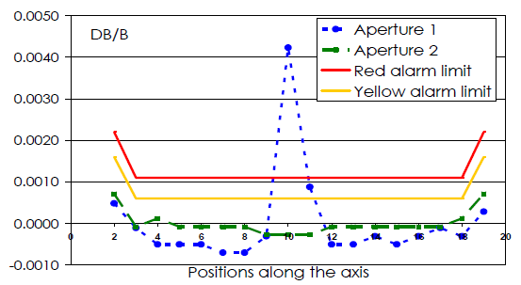

MM on 11 T dipole
At ambient temperature during assembly phase:
  Measurement with rotating coils with limited current excitation of ±10 A
  Evaluation of local and integrated TF, multipoles, magnetic angle
    After collaring (collared coils)
    After welding of shell (cold mass)
    The whole production
  AC mole for magnetic axis verification ( to be confirmed on prototypes)
Magnet name | Type | Qty | When | Total length (m) | Double aperture | Cold/Warm | MM equipment at warm | Cryostat | MM equipment at cold
MBHSP | model | 6 | 2015/6 | 2 | n | C and W | Rotating coils (R22 sliding shafts) | Vertical | Rotating coils (R22 vertical shafts)
MBHDP | model | 2 | 2015/6 |  | y
MBH | proto | 1 | 2017 | 6 | y |  | Rotating coils (traveling mole) | Horizontal | Rotating coils (long ceramic shafts with anticryostat)
 | series | 6 | 2018/9 |  | y
MBHSP | model | 4 | 2018 | 2 | n | C and W | Rotating coils (R22 sliding shafts) | Vertical | Rotating coils (R22 vertical shafts)
MBHDP | model | 1 | 2018 |  | y
MBH | proto | 1 | 2019 | 6 | y |  | Rotating coils (traveling mole) | Horizontal | Rotating coils (long ceramic shafts with anticryostat)
 | series | 6 | 2020 |  | y
L. Fiscarelli,
Main field anomaly in collared MB coil 2002

Slide 30
SUMMARY
Quality controls and acceptance tests are identified along the dipole production flow, under consolidation;
Several crucial quality control tests relate to Nb3Sn coils technology like impregnation, heat treatment stages;
Further pending dedicated mechanical and electrical strength tests planned to confirm tests level values vs insulation quality and shimming manufacture range;
Acceptance Hi-Pot test levels carefully chosen in compliance with new RB LHC circuits operation conditions and the worst case scenario;
Design of dielectric strength compatible with worst case scenario on a Cryo dipole unit;
A WBS-based manufacture quality control matrix is in place on the 11 T dipole production, with on going implementation of monitor control points and Factory acceptance tests.

Slide 31
References
“Voltage withstand levels for electrical insulation tests …” EDMS 90327 .
Withstand voltages ref MQX review indico 478951
“ELQA Qualification of the superconducting circuits during hardware commissioning” EDMS 7881973.
“Guidelines for the insulation design and electrical tests …” EDMS 1264529
LHC-S-ES-0003, Safety during Individual System Tests and Hardware Commissioning. P. Cruikshank et al., EDMS 615783.
L. Bottura et al, “Controlling Field Quality in Magnet Production,” 2003 Particle Accelerator Conference, Portland, USA, May 2003,
B. Bellesia “Influence of Austenitic Steel Collar Dimensions on Magnetic Field Harmonics in the LHC Main Dipole”, CERN LHC-Project-Note-377, 2005
E.Todesco, “Status report on field quality in the main LHC dipoles”, Proceedings of European Particle Accelerator Conference, 2002, JAcoW., LHC Project Report 579
E. Wildner, Production follow-up of the lhc main dipoles through magnetic measurements at room temperature
F. Borgnolutti et al, Reproducibility of the coil positioning in Nb3Sn magnet models through magnetic measurement
M Bajko, Quench heater failure, LHC Risk Review, 6th of March 2009

Slide 32
Thank you for your attention and to all contributors from TE-MSC,
LMF members, and Hi-Lumi interfacing WPs members

Slide 33
BACK UP SLIDES

Slide 34
Definition
EXTRACTION VOLTAGE (Vee)
  When a quench is detected, the QPS system will open the circuit interlock loop and the energy extraction switches. The maximum voltage seen in the circuit versus ground will be at the extremity of the electric chain Vee.
MAXIMUM VOLTAGE REACHED DURING A QUENCH (Veeq)
  Veeq=Vq+Vee. If there is no energy extraction Veeq=Vq. If not known Vee is to be assumed to be equal to 450 V. This value is based on present LHC design practice.

Slide 35
Code and standards on welds
EN 287-1:1992 Approval testing of welders for fusion welding. Steels EN 288-3:1992 Specification and approval of welding procedures for metallic materials. Welding procedure tests for the arc welding of steels EN 970:1997 Non-destructive examination of fusion welds. Visual examination EN 1435:1997 Non-destructive examination of welds. Radiographic examination of welded joints EN 571-1:1997 Non-destructive testing. Penetrant testing. General principles EN 895:1995 Destructive tests on welds in metallic materials. Transverse tensile test EN 10002-1:1990 Tensile testing of metallic materials. Method of test at ambient temperature EN 876:1995 Destructive tests on welds in metallic materials. Longitudinal tensile test on weld metal in fusion welded joints EN 875:1995 Destructive tests on welds in metallic materials. Impact tests. Test specimen location, notch orientation and examination ISO 148:1983 Steel Charpy impact test (V-notch) EN 10045-1:1990 Charpy impact test on metallic materials. Test method (V- and Unotches) EN 910:1996 Destructive tests on welds in metallic materials. Bend tests ISO 7438:1985 Metallic materials Bend test EN 1321:1997 Destructive test on welds in metallic materials. Macroscopic and microscopic examination of welds EN 10204: 1995 Metallic products – Types of inspection documents (includes Amendment A1) EN 25817:1992 Arc-welded joints in steel. Guidance on quality levels for imperfections
safety test on welded joints

Slide 36




Two-in-One 11T Dipole system
Create space in the dispersion suppressor regions of LHC, i.e. by replacing a standard MB by a pair of 11T dipoles (the 11T dipole is also called MBH) to install additional collimators (TCLD)
Cryo-Assembly : 2 x 11T dipoles (2 x 5.5m) + Collimator (3 m)
Inductance of the Two 11T Magnets in Series ≈ 130 mH
By-pass cryostat
15660 mm
11 T dipole cold mass
Interconnect
Space for Collimator

Slide 37

MBH dipole parameters

Slide 38

Test results MTF receptacle

Slide 39
  General comments about the Mandatory electrical test
Measurement of the DC resistance: The resistance measurements of the quench heaters (4-wire ohmmeter).
High voltage (HV) leakage current tests: For the HV leakage current test of the dipole to ground, the quench heaters shall be connected to the dipole.
High voltage (HV) leakage current tests: Before and after the HV leakage test, the insulation resistance shall be checked using a test voltage of 1 kV, I ≤ 1 μA, t = 60 s.
Pulse discharge (interturn voltage) test: The discharge test shall comprise 10 pulses at intervals of 1 second.
Pulse discharge (interturn voltage) test: The positive pole of the test generator (+ HT) shall be attached to the external connection of a layer or a pole.
Pulse discharge (interturn voltage) test: The first test results for each layer will serve as reference data for all subsequent tests. Special attention shall therefore be paid to the documentation of the measurement condition and the test results, in particular for those carried out under load.

Slide 40


Short Model Magnet MBHSP101: List of Drawings
“Project Breakdown Struture (PBS)”, version 4"
https://dfs.cern.ch/dfs//Workspaces/s/shortmod/Develop/labo 927/HFM
/DS Dipole 11T/Magnets Construction/HCMBHSP0001_101/MBHSP0101_PBSv4.pdf
Drawing Information Easy Link
Purpose: display the drawing information.
Syntax:
https://edms.cern.ch/cdd/owa/c4w_02.drawing_info?num= CERN_Drawing_Number [?ind= revision_index ]
Example:
https://edms.cern.ch/cdd/owa/c4w_02.drawing_info?num=LHCMBHSP0003

Slide 41
P : Test of pole : 1 layer test, Nb-Ti, no splice version
PBR : Test of pole : Nb3Sn, before reaction
PAR : Test of pole : Nb3Sn, after reaction
PBI : Test of pole : Nb3Sn, before impregnation
PAIM : Test of pole : Nb3Sn, after impregnation still in the mould PAI : Test of pole : Nb3Sn, after impregnation still out of the mould
PHE : Test of pole : Nb3Sn, after impregnation still out of the mould 0.1 bar He
BC : Test of collared coil before collaring or pre-collaring
APC : Test of collared coil after pre-collaring
AC : Test of collared coil after collaring
AI : Test of the magnet after interconnection
FINAL : Final Test of the magnet before delivery

Slide 42

Cogebi Firox® turn Mica insulation tape

Slide 43

Cryogenic DS 11T unit electrical connections

Slide 44

Dipole Unit electrical circuit connections
Baseline Cryo unit circuit configuration of 2 dipoles of 5.5 m connected in series and protected with an unique diode
OL_1p1
IL_p1
IL_p2
OL_p2

Slide 45
Global strategy of main test Voltage (HVWG)
Step: –n to –1 : In fabrication process
Step 1 in SM18
Step 2 in SM18
Step 3 in SM18
From modelling, the worst case in operation is obtained:
Vq
Vee
Vpa
E.g. Vmax r =
Vq+Vee+Vpa
Rated level
V rated= f1 * Vmaxr + X
f1 and X are safety factor and margin
(for LHC : f1= 2 and X= 500 V)
1st test level at arrival to test bench
V test air = f2 *
V_{rated}
f2 is an equivalence between 75 K He and 300 K air
1st test level at cold in the test bench
V test LHe = f3 *
V_{rated}
f3 is an equivalence between 75 K and
4.2 K in He
1st test level after cold test in air but possible with He gas
V test LHe = f4
V_{rated}
f4 is an equivalence between 75 K and
300 K in He
75 K, 1 bar , He (gas)
75 K, 1 bar , He (gas)
300 K, 1 bar , AIR
4.2 K, 1 bar, He (liquid)
300 K, 1 bar , He (gas)
Global power abort, all the circuits of a powering sector are switched off almost simultaneously and the energy extraction (ee) is activated in the entire subsector.
Test station is limited to 3000 V
This test is not revealing the default as we are in air applying gas conditions . This can be corrected by pressurised He.
These are not easily reproducible conditions, therefore values have to be scaled to test in
air, LHe, GHe
MQX review Feb 2016, F. Rodriguez Mateos

Slide 46

Single dipole internal electrical connections

Slide 47

Standard cable traveller certificate data
QA team within 11T checks cable certificate
Witness sample RRP 108-127 type Nb3sn strand measured during HT

Slide 48
Young modulus equivalent measurement
After LHC MB series pole assembly, the equivalent modulus of elasticity were measured under dedicated press.
These series of measurements were the basis for the evaluation of the reproducibility of the coils during the production and for providing supplementary information for the definition of the shim in view of the collaring operation.
Nb3Sn cable wind and react coils technology will not accommodate such test due to cable bending limitations
Some development cables stacks samples are manufactured to support the characterisation of anisotropic as-built impregnated cable material.
Possible further investigation route of resonance frequency dynamic response of impregnated pole to define equivalent E modulus (Ref ASTM E1875 − 08)

Slide 49
Assembly azimuthal stress levels on dipole

Slide 50

Selection of worst case scenario
Test voltages are defined from assumed worst case scenario for which coil shall not endure degradation of insulation system.[1]
Design QH faults cases have been considered based on TALES results including quench back effects and 2 dipoles in a cryo-unit [2] ( at moment, over conservative ROXIE voltage results)
  1 QH circuit failure ( HF and LF heating station lost per pole)
  2 QH circuits failure ( either on same or different pole).
During operation a Power Supply Abort* event (Ref Lorenzo Bortot, TE-MPE, [2]) shows a bipolar voltage +/-450 V (VPA) at nominal, or + 900V in case of common mode short to ground but developing in 0.6s (compared to QH failure voltages time rise of 0.1s) so not added.
Circuit extraction energy voltage Vee is considered at 500V on LHC to be added to worst case voltage.
* Global power abort, all the circuits of a powering sector are switched off almost simultaneously and the energy extraction (ee) is activated in the entire subsector
([2] Results table from ROXIE by S. Izquierdo Bermudez MSC-MDT
and TALES by Alejandro Manuel Fernandez Navarro MPE-PE
EDMS no XXXXX)

Slide 51
Paschen curves in GHe vs. Air conditions
Reference from C.R. Huffer

Slide 52

Failure mode vs Test levels
(Very) worst scenario: Past analysis [1] considered that all the heaters in a coil fail (pessimistic scenario as the baseline configuration considers 2 quench heater circuits per coil.
Recent analysis considered that all the heaters in a coil fail (very pessimistic scenario as the baseline configuration considers 2 quench heater circuits per coil;
Worst case failure scenario on DS 11T dipole drives the peak test voltage
Ap.1 Dipole 1
Ap.1 Dipole 2
Ap.2 Dipole 1
Ap.2 Dipole 2
Each DS11 T cryo-assembly is made out of 2 x 5.5 m magnets connected in series and protected by one cold diode stack
Quench protection review, Sept 2015 Susana Izquierdo Bermudez
52

Slide 53
Transient voltage time rise
11T Dipole peak fault voltage developing time within 110 ms
Turn to turn peak voltage
Courtesy of S. Izquierdo Bermudez

Slide 54
Summary table of Worst case voltage levels
Study case | ID | Model | Peak voltage to ground(V) | Peak turn to turn voltage(V) | Max layer to layer (V) | Tmax (K)
Nominal quench | 01 | ROXIE (1x11 T magnet) | 352 | 78 | 159 | 318
 | 02 | TALES (1x11 T magnet) | 260 | 75 | - | 325
 | 03 | TALES (2x11 T magnet) | 260 | 75 | - | 325
Worst case scenario heater wiring on one aperture (circ. Ap1: H1C1A1 + H2C1A1) | 04 | ROXIE (1x11 T magnet) | 1480 | 85 | 1326 | 355
 | 05 | TALES (1x11 T magnet) | 860 | - | - | 355
 | 06 | TALES (2x11 T magnet) | 950 | 85 | 850* | 339

Slide 55

Table 04 _ MANDATORY Acceptance tests
After collaring
WBS ID | TEST | OBJECT | CONDITION | LIMITS
1.1.4.1 | DC resistance of windings | Poles, dipoles and full magnet | I=1.00A {HP Data Logger) | comparison with reference coil
1.1.4.2 | DC resistance of quench heaters | All magnet quench heaters | 4-wire Ohmmeter {HP Data Logger) | comparison with reference coil
1.1.4.3 | Complex impedance | Poles Dipoles and full magnet | f=1.0Hz to 10.0kHz (Soft:Promit 2001) | comparison with reference coil
1.1.4.4 | Capacitance to ground | Dipoles + quench heaters (Per aperture) Magnet + quench heaters | Megaohmmeter, t = 60 s Vmin. : 500V | comparison with reference coil
1.1.4.5 | Capacitance to dipole | All quench heaters (Per aperture) | Megaohmmeter, t = 60 s Vmin. : 500V | comparison with reference coil
1.1.4.6 | HV leakage current, Poles to ground | Dipoles | V= 5 kV, t = 300 s Quench heaters connected to layers | I< 15 μA
1.1.4.7 | HV leakage current, quench heaters to coils | Dipoles | V = 3 kV, t = 300 s, (quench heaters per aperture grouped), (*) | I< 10 μA
1.1.4.8 | Discharge (interturn voltage) test | Poles | 77 V/turn, i.e. 4.3 kV per pole (10 pulses). (Soft: EDMA) | comparison with reference pole
1.1.4.9 | Discharge (interturn voltage) test | Dipoles (full magnet) | 50 (25)V/turn, i.e. 2.8 kV total (10 pulses) (Soft: EDMA) | comparison with reference magnet
1.1.4.10 | Discharge (Q.H. connections integrity) test | Q.H. 1 circuits (2 strips) is series | V= 0.8kV (400V/strip), c =2 μF (5 pulses), (**).(Soft: EDMA), | comparison with reference
Recommended intermediate tests:
- Measurement of insulation resistance during collaring
Continuous recording of DC resistance of poles during collaring
Measurement of insulation resistance after collaring, press open (R > 1000 MΩ: Coils + Q.Hs to ground: 5 kV, 30 s QHs to coils: 3 kV, 30 s)

Slide 56
Table 05 _ MANDATORY electrical tests:
After the welding of the shrinking cylinder, the poles interconnection and the busbar connection (without ENDCAPS) (Part 1/2)
WBS ID | TEST | OBJECT | CONDITION | LIMITS
1.1.4.1 | DC resistance of windings | Poles, dipoles and full magnet | I=1.00A (Data Logger) | comparison with reference coil
1.1.4.2 | DC resistance of quench heaters | All magnet quench heaters | 4-wire Ohmmeter (Data Logger) | comparison with reference coil
1.1.4.3 | DC resistance of spools | For each type | I=1.00A (Data Logger) | comparison with reference coil
1.1.4.4 | DC resistance of instrumentation | Cryo-heater Temperature sensor | Ohmmeter 4 wire (Data Logger) | comparison with reference Components
1.1.4.5 | Complex impedance of spools | For each type | f=1.0Hz to 10.0kHz | comparison with reference coil
1.1.4.6 | Complex impedance | Poles ; Dipoles and full magnet | f=1.0Hz to 10.0kHz | comparison with reference coil
1.1.4.7 | Capacitance to ground | Magnet +All quench heaters | Megaohmmeter, t = 60 s Vmin : 500V | comparison with reference coil
1.1.4.8 | Capacitance to dipole | All quench heaters | Megaohmmeter, t = 60 s Vmin : 500V | comparison with reference coil
1.1.4.9 | HV leakage current, Magnet to ground | Magnet + All quench heaters and dipoles busbars. | V= 5 kV, t = 300 s Q.H. connected to magnet | I< 25 μA
1.1.4.10 | HV leakage current, quench heaters to coils | All quench heaters | V = 3 kV*, t = 180 s, (quench heaters grouped) | I< 20 μA

Slide 57

Table 05 _ MANDATORY electrical tests:
After the welding of the shrinking cylinder, the poles interconnection and the busbar connection (without ENDCAPS) (Part 2/2)
WBS ID | TEST | OBJECT | CONDITION | LIMITS
1.1.4.1 | Discharge (interturn voltage) test | Poles | 77 V/turn, i.e. 4.3 kV per pole (10 puls) (Soft:EDMA) | comparison with reference pole
1.1.4.2 | Discharge (interturn voltage) test | Dipoles (full magnet) | 50 (25)V/turn, i.e. 4 kV total (10 puls) (Soft:EDMA) | comparison with reference magnet
1.1.4.3 | External voltage taps | All taps | I=1.00A (HP Data Logger) | comparison with the resistance of poles and layers
1.1.4.4 | HV leakage current MB bus bars | External Bus to Internal Bus | V = 5kV t = 180s | I< 10 μA
1.1.4.5 | HV leakage current QF;QD bus bars to ground | All Q Bus to ground | V = 5kV t = 180s | I< 10 μA
1.1.4.6 | HV leakage current QF;QD bus Bus to Bus | Bus QF and QD ext. To Bus QF and QD int. | V = 5kV t = 180s | I< 10 μA
1.1.4.7 | Isolation Resistance spool Bus Bus to Bus | Bus 1,3,5,7,9,11,13,15,17,19 To Bus 2,4,6,8,10,12,14,16,18,20 | V = 1.5kV t = 60s | R > 500MOhms
1.1.4.8 | Isolation Resistance spool Bus to Bus QF & QD | Spool Bus Slot ext. To Bus QF Spool Bus Slot int. To Bus QD | V = 1.5kV t = 60s | R > 500MOhms
1.1.4.9 | Isolation Resistance spool Bus to Ground | All spool Bus | V = 1.5kV t = 60s | R > 500MOhms
1.1.4.10 | Continuity tests of spool and connected busbar | All spool Bus | I=1 A | This test may be suppressed if DC resistance of spools includes the busbar also
1.1.4.11 | Localisation of spool voltage taps (to be on terminal “A”) | All voltage taps of each spool | I=1 A | Check that voltage tap is on correct side of spool

Slide 58
Table 06 _ MANDATORY TESTS AFTER THE ASSEMBLING OF THE IFS AND BEFORE THE ASSEMBLING OF THE “LINE N” JUMPER
WBS ID | TEST | OBJECT | CONDITION | LIMITS
1.1.5.1 | HV leakage current QF;QD bus Bus to Ground | All Q Bus | V = 5kV t = 120s (Diode short circuited) | I< 10 μA
1.1.5.2 | DC resistance of spools * | For each type | I=1.00A (HP Data Logger) | comparison with reference coil
1.1.5.3 | Complex impedance of spools * | For each type | f=1.0Hz to 10.0kHz (Soft:Promit 2001) | comparison with reference coil
1.1.5.4 | Isolation Resistance spool Bus * to Ground | All spool Bus | V = 1.5kV t = 60s | R > 500Mohms
NOTE: The measurements will be done through the IFS exit connector
* ONLY in case of STANDARD TEST configuration of the cold mass

Slide 59
Table 07 _ MANDATORY FINAL FACTORY TESTS
BEFORE THE COLD MASS TEST
WBS ID | TEST | OBJECT | CONDITION | LIMITS
1.1.6.1 | DC resistance of windings | Dipoles and full magnet (Apply Zener diode protection on diode) | I=1.00A {HP Data Logger) | comparison with reference coil
1.1.6.2 | DC resistance of quench heaters | All magnet quench heaters | 4-wire Ohmmeter {HP Data Logger) | comparison with reference coil
1.1.6.3 | DC resistance of spools * | For each type | I=1.00A (HP Data Logger) | comparison with reference coil
1.1.6.4 | DC resistance of instrumentation | Cryo-heater Temperature sensor | Ohmmeter 4 wire (HP Data Logger) | comparison with reference Components
1.1.6.5 | External Dipoles voltage taps | All taps | I=1.00A (HP Data Logger) | comparison with the resistance of poles and layers
1.1.6.6 | Complex impedance of spools * | For each type | f=1.0Hz to 10.0kHz | comparison with reference coil
1.1.6.7 | Complex impedance | Full magnet (Special procedure) | f=1.0Hz to 10.0kHz | comparison with reference coil
1.1.6.8 | Capacitance to ground | Magnet +All quench heaters | Megaohmmeter, t = 60 s Vmin : 500V | comparison with reference coil
1.1.6.9 | HV leakage current, Magnet to ground | Magnet + All quench heaters and dipoles busbars. (Diode short circuited) | V = 5 kV, t = 120 s Quench heaters connected to layers | I< 25 μA
1.1.6.10 | HV leakage current, quench heaters to coils | All quench heaters | V = 3 kV*, t = 120 s, (four quench heaters grouped) | I< 10 μA
1.1.6.11 | Discharge (interturn voltage) test | Full magnet (Special procedure) | 25 V/turn, i.e. 1.4 kV/Dipole (10 pulses) | comparison with reference pole
1.1.6.12 | Isolation Resistance spool Bus to ground * | All spool Bus | V = 1.5 kV, t = 60s | R > 500MOhm
1.1.6.13 | Ground Electrical continuity | Cold mass | I = 25 to 40A | V = < 2.5 to 4.0V R< 100mW
* ONLY in case of FULL TEST configuration

Slide 60
Current applied final tests on Short Models
Final Test of the magnet before delivery - FINAL
Test code | Title | Type | Object | Short description | Priority | Test condition | Time [sec] | Tolerances | Equipment
FINAL 1 | RDC | Resistance | Pole | RDC of coils in serie and Vtaps | MQC | 6A | NA | Previous measured value +/- 1% | A, B
FINAL 2 | RDC QH | Resistance | QH | RDC of each Q.H. | MQC | 1A | NA | Previous measured value +/- 1% | A, B
FINAL 3_XXXX | RDC instrumentation | Resistance |  | RDC of instrumentation | MQC | 1A / 4 wires | NA | Previous measured value +/- 1% | A, B
FINAL 4 | Capacitance | Capacitance | Coil, QH | Q.H. to coils | MQC | 1kHz | NA | Compare to previous assembly | F
 |  |  |  | All coils to ground
FINAL 5_XXXX | Capacitance | Capacitance |  | Instrumentation to coils between which they are | MQC | 1 kHz | NA | Compare to previous assembly | F
FINAL 6 | Inductance | Inductance | Coil | L of all coils in series | MQC | 100 Hz, 1 KHz | NA | Compare to previous assembly | F
FINAL 7 | Dielectric | Current leakage | Coil, QH | Coils + Q.H to ground | MQC | V_{QH[i]} = 1000V | 30 sec. | >1000 MΩ; < 10 μA | C
 |  |  |  | All coils to all Q.H. |  |  | 5 min
 |  |  |  | All coils to ground |  | V_{T[i]} = 1000V
FINAL 8_XXXX | Dielectric | Current leakage |  | All coils + All instrumentation to ground | MQC | V_{T[i]} = 1000V | 30 sec. | >1000 MΩ; < 10 μA | C
 |  |  |  |  |  |  | 5 min
FINAL 9 | Discharge test | Discharge | Coil | All coils in series | INV | 750V | 1 pulse | Previous test | D, G, I, K
 |  |  |  |  | MQC | 1000V
FINAL 10 | Q.H. RDC | Resistance | QH | Resistance each Q.H. | Opt | 1A | NA | Previous tests | A, B
FINAL 11 | Q.H. insulation resistance | Insulation | QH | Q.H. to ground | MQC | V_{QH[i]} = 1000V | 30 sec. | >1000 MΩ; < 10 μA | C
 |  |  |  | Q.H. to coils |  |  | 5 min
 |  |  |  | Strip to strip if on different circuits
FINAL 12_XXXX | Insulation resistance | Insulation |  | instrumentation to ground | MQC | 1 kV | 30 sec. | > 1000 MΩ | C
 |  |  |  | instrumentation to coils
FINAL 13 | Q.H. discharge | Discharge | QH | Discharge each single Q.H. | MQC | 900 V (or 80A) | 1 pulse | Compare initial I and tau with reference | D, H, I
FINAL 14 | Q.H. RDC | Resistance | QH | Resistance each Q.H. | MQC | 1A | NA | FINAL10 | A, B
FINAL 15 | Q.H. insulation resistance | Insulation | QH | Q.H. to ground | MQC | V_{QH[i]} = 1000V | 30 sec. | >1000 MΩ; < 10 μA | C
 |  |  |  | Q.H. to coils |  |  | 5 min
 |  |  |  | Strip to strip if on different circuits

Slide 61
Electrical tests (in liquid helium) before powering the magnet
WBS ID | Item | Aim of the test | Criteria
1.1.7.1 | Temperature sensor | Electrical continuity, resistance | I < 1 mA, R [ mΩ] to calibration table
1.1.7.1 |  | Insulation resistance to ground | V = 20 V , R > 10 MΩ
1.1.7.1 | Cryogenic Heater | Electrical continuity, resistance, integrity under nominal power | R = 100 Ω ± 5%, 40 W
1.1.7.1 |  | Insulation resistance to ground | V = 700 V R > 10 MΩ
1.1.7.1 | Quench heaters | Electrical continuity, resistance, integrity under nominal powering | I = 0.1 A, R [ mΩ] to nominal value *
1.1.7.1 |  | Insulation resistance to coils | V = 2.7 kV, 120 s I < 20 μA
1.1.7.1 |  | Insulation resistance to ground (together with coils, voltage taps) | V = 3.1 kV, 120 s I < 20 μA
1.1.7.1 | Dipole voltage taps | Electrical continuity and localisation | 1 A < I < 10 A V [mV] = f (T,I)
1.1.7.1 |  | Insulation resistance to ground (together with coils, quench heaters) | V = 3.1 kV, 120 s I < 20 μA
1.1.7.1 | Dipole coils and busbars | Insulation resistance to ground (together with voltage taps, quench heaters) | V = 3.1 kV, 120 s I < 20 μA
1.1.7.1 | Dipole coils | Interturn insulation | Complex impedance Z(ω) Impulse test as at 293 K in case of doubt
1.1.7.1 | Cables splices | Electrical resistance: internal splices external splices total resistance | I= 11’850 A R_{int} < 0.5 n Ω / splice R_{ext} < 0.4 n Ω / splice R_{tot}< 1 n Ω
1.1.7.1 | Spool pieces voltage taps | Electrical continuity | 0.1 A < I < 1 A V [mV] = f (T,I)
1.1.7.1 | Spool pieces and voltage taps | Insulation resistance to ground (together with coils) | V = 1.3 kV, 30 s, (for MCS, MCD and MCO) V =1.5 kV, 30 s, I < 6.0 μA
* Discharge of a capacitor bank of total capacitance equal to 7.05 mF and charged to 900 V.

Slide 62


Results from mechanical stress sensitivity analysis
A variation of twice 70 micrometers thick midplane shim will contribute to 26 % increase over peak -120MPa compressive stress i.e -31 MPa.
Courtesy C Hannes Loffler, sept 2015

Slide 63

Impulse discharge test voltage
Impulse testing is unique way to test inter-turn and inter layers insulation strength (see last damage case of MB 3004)
The 56 layers poles of MBH do not allow to test with safety factor of 2 like on LHC MBs, i.e up to 170 V interturns ( 9.5kV peak interlayer voltage !)
At this stage, recommendation to test at nominal of 85 V interturns i.e 4.7kV discharge voltage ( 5.5 times the nominal fault peak interlayer voltage)*.
  * Further dielectric characterization tests on interlayer insulation shall allow to refine impulse test level with some margins ( #coil 110 up to 6kV)
  Assessment of line effect to be checked against 11T dipole network of net capacitances
  ( see Marchevsky’s presentation [4])
[4] Marchevsky, impulse discharge tests at CERN MQX review, Feb 2016

Slide 64

Coils Insulation impulse tests results
Impregnation of the mica insulated cable is very good (based on autopsies on coils 104, 107 and SMC 11T02 ⁽¹⁾)
Record electrical tests on #110: >7kV discharge ; 107: >6kV discharge, after cold testing and decollaring
New development ongoing to increase the performance with a thinner and better mica tape based on muscovite
Courtesy of F.-O. PINCOT - TE/MSC
Notes:
Topics for discussion: electric test levels used at FNAL; agreement on perfomance criteria of the insulation system for an accelerator

Slide 65
Recommended intermediate tests after the tack welding of each end covers
Insulation to ground of all (dipoles, quadrupoles, auxiliaries) busbars circuits, including the diode stack bypass
Insulation to ground of instrumentation wiring
Insulation tests after forming and installation of the Instrumentation Feedthrough System tube:
    Dipoles wiring applicable voltage: V = 1 kV,
    Spool pieces wiring applicable voltage: V = 1 kV,
    Instrumentation wiring applicable voltage: V = 4.5 V.
Mandatory Tests And Procedure before and after the Mounting of the protection Diode Stack
Diode stack polarity shall be checked before the mounting of the diode stack and then proceed with the installation.
At any insulation tests, it is imperative to connect together (short circuit) the two taps wires 012 and 013.
Any testing after the mounting of the diode shall be done AC (~ 10 kHz) with Zener diode stack protection circuit connected in parallel to the diode stack as described in the Diode Handling Engineering Specification (see LHC Annex B31). The same precaution must be taken for resistance and continuity tests with the diode stack already in place

Slide 66
Limits on magnetic field quality
  Our experience so far… random component of multipoles computed from measurement on three sections x two magnets (short models)
 |  |  |  | measured sigma |  |  | expected sigma
 |  |  | n |  | bn | an |  | bn | an
 |  |  | 2 |  | 1.52 | 1.47 |  | 1.93 | 2.87
 |  |  | 3 |  | 0.92 | 1.13 |  | 1.24 | 1.66
 |  |  | 4 |  | 0.59 | 0.61 |  | 0.60 | 1.00
 |  |  | 5 |  | 0.43 | 0.55 |  | 0.31 | 0.64
 |  |  | 6 |  | 0.18 | 0.30 |  | 0.18 | 0.38
 |  |  | 7 |  | 0.06 | 0.05 |  | 0.11 | 0.20
 |  |  | 8 |  | 0.06 | 0.05 |  | 0.06 | 0.06
 |  |  | 9 |  | 0.04 | 0.23 |  | 0.03 | 0.05
 |  |  | 10 |  | 0.01 | 0.02 |  | 0.01 | 0.03
 |  |  | 11 |  | 0.04 | 0.14 |  | 0.01 | 0.02
Courtesy of L . Fischarelli

