Slide 1
To support 11 T Review

Slide 2
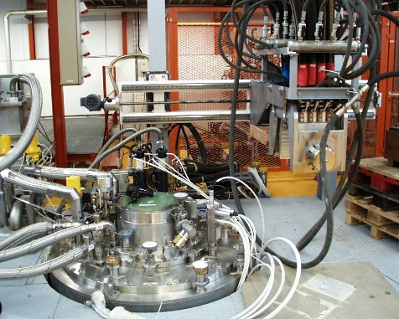
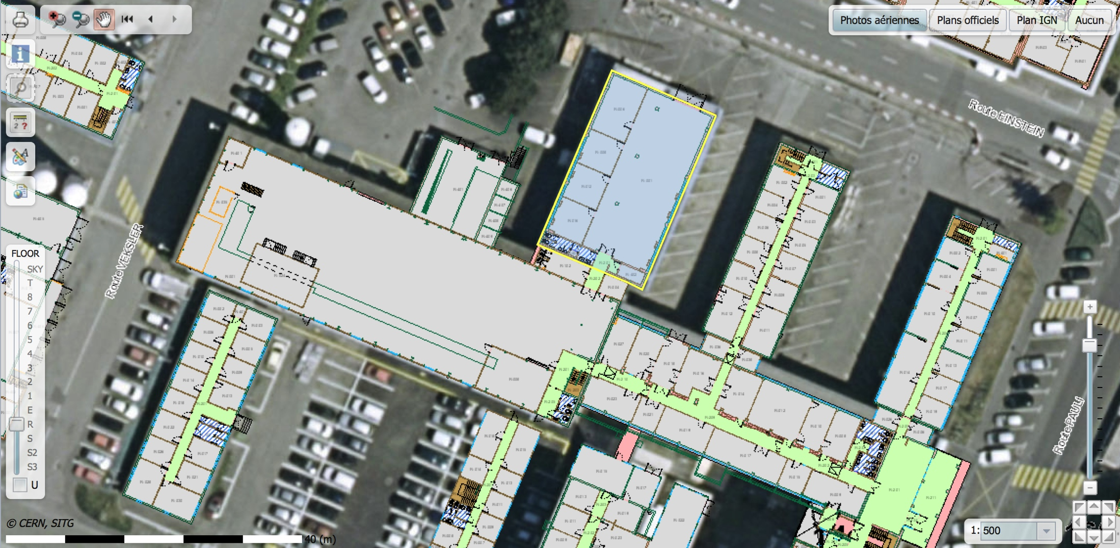
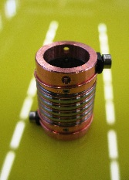
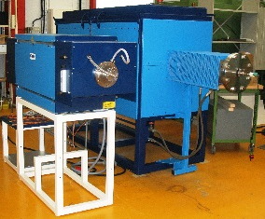
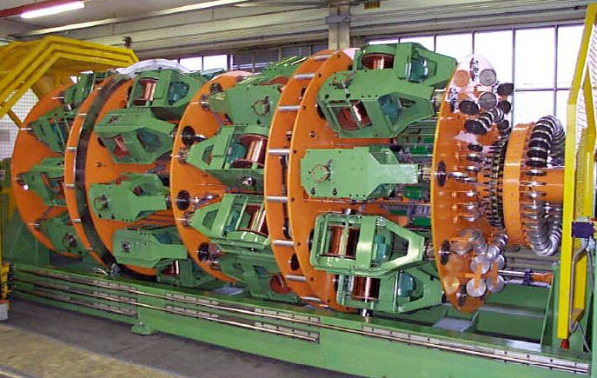
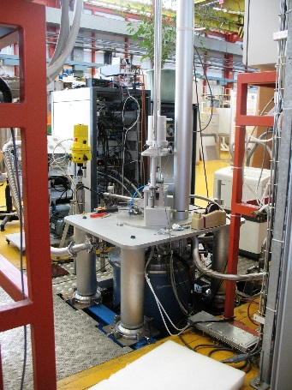
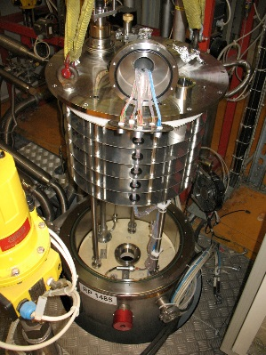
Superconductors laboratory and cabling (103/163)
1400 m²
Sample preparation area
(approx. 100 m²)
AC 250 cabling machine (KWB)
40 spools (30 kg, 5 km at 1 mm)
FReSCa
HT ovens (2)
SC test area
12 T… 15T, 1.9/4.2 K, 1…4 kA (4 test stands)
10 T, 1.6…100 K VSM (1 test stand)
RRR (1 test stand)

Slide 3
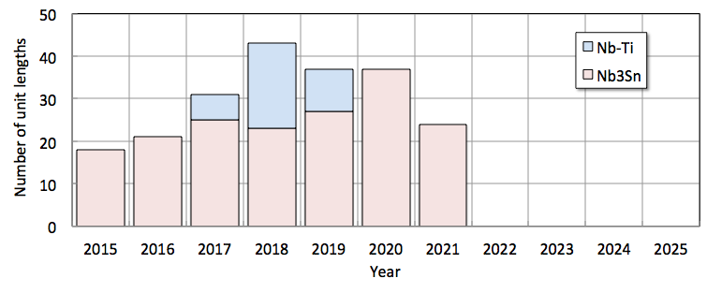
Cable production
Nb-Ti cables for MCBXF, MCBRB and MCBYY
Cable running speed (Nb₃Sn): approximately 2 m/min
UL required for 11 T and QXF: 650…750 m
Cabling time for 1 UL: 1 day
Present maximum production rate: 1 run per 2 weeks (max 25 runs/year)
There is margin to increase production rate and cable multiple UL’s in one run (Nb-Ti)

