Slide 1
Transfer function

Slide 2
TRANSFER FUNCTION (TF)
Discrepancy ~ 50 units between measured and expected values.
Possible sources of error
  Iron properties
  Packing factor of the yoke laminations
  Geometric

Slide 3
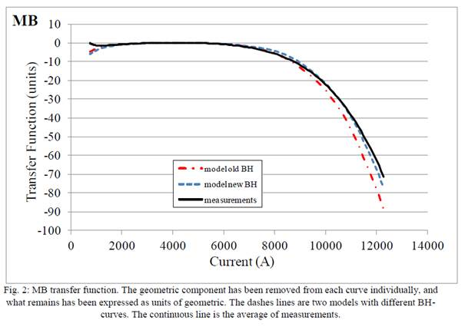
Comparison to MB dipole
At the same level of saturation we have similar agreement in the case of the MB dipole
[P. Hagen]

Slide 4
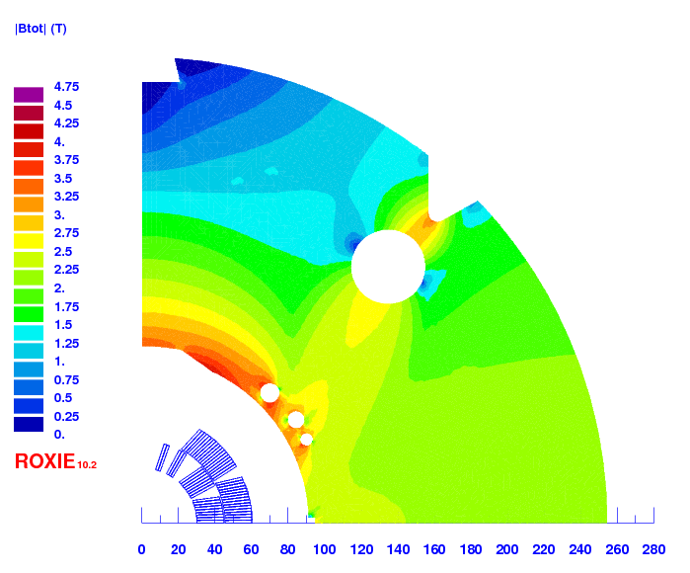
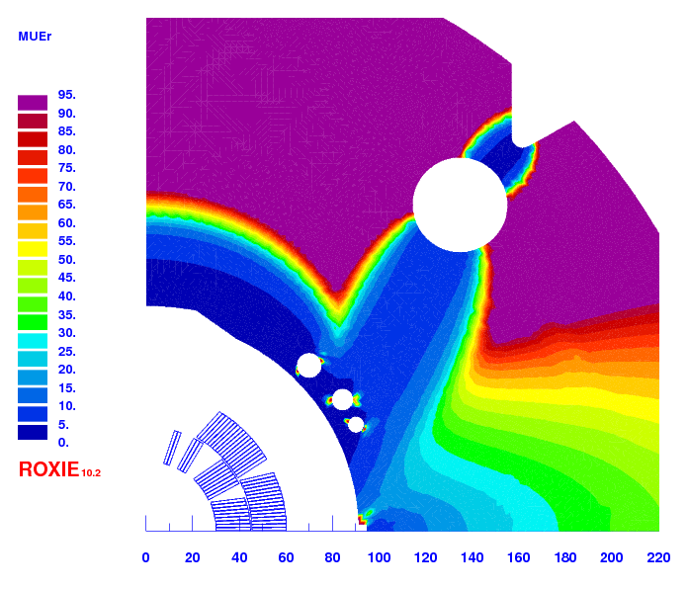
Saturation @ I_{mm} = 11.25 kA

Slide 5
Data from production
REF: Production of Low-Carbon Magnetic Steel for the LHC Superconducting Dipole and Quadrupole Magnets. LHC Project Report 898
Sample 950155
Review of data available from LHC production on going →trace back what are the most relevant samples to look at.

Slide 6
Further investigation on the iron MP
Critical!!
No impact!
Analysis made based on BH data from the LHC MB production show the same saturation as the one obtained using “BH IRON LHC”
BH DATA | diff in the TF (units)
bh iron LHC | REF
bhiron2 (ROXIE standard) | -26
bh fit as in Stephan's book | -9
bh sample 955310 | -2
bh sample 954231 | 0
bh sample 950155 | 0
bh tentem (opera) | -49

Slide 7
Importance of iron characterization at higher field levels
A shift of + 0.1 T at H>2.0E+4 A/m with respect to the “LHC production data” is enough to fit MBHSP101 and MBHSP102 measurements

Slide 8
  TF:Packing factor of the yoke laminations
The difference can be partly explained by the 100 % packing factor of the iron laminations observed during magnet assembly
[C. Loffler]
Difference in computed transfer function for 98.5% and 100% packing factor
With the packing factor we can potentially explain ~ 15 units (out of 50)

Slide 9
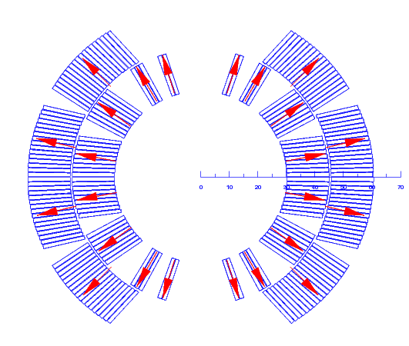
TF: Geometric
REMARK: Analysis performed using standard ROXIE bh data (bhrion2)
Design assumptions on coil/yoke warm2cold dimensions
  Yoke shrinkage = 2 mm/m
  Coil shrinkage = 3 mm/m
5 units less of saturation if yoke shrink. = 0 mm/m (goes in the good direction), but 5 units more of saturation if coil shrink. = 0 mm/m (goes in the bad direction)
Yoke shrinkage (coil shrinkage = 0 mm/m)
Yoke shrink. | TF 20A | TF 11.25 kA | units of sat
0 mm/m | 9.941E-04 | 9.479E-04 | -465
2 mm/m | 9.949E-04 | 9.481E-04 | -470
Coil shrinkage (yoke shrinkage = 0 mm/m)
Coil shrink. | TF 20A | TF 11.25 kA | units of sat
0 mm/m | 9.941E-04 | 9.479E-04 | -465
3 mm/m | 9.960E-04 | 9.502E-04 | -460
If the coil is shifted outwards radially, the iron saturation increases (goes in the bad direction). In addition to that, only ~13 units for 350 µm radial shift, so big radial displacement (inwards) is needed to explain 50 units of discrepancy.

Slide 10
TF: Summary
Measured saturation is lower than the one predicted by the model. Sources of error:
  BH data: the discrepancy can be reduced from 70 units to 50 units, if bh data from LHC production is used instead of the standard roxie bh2 data. A shift of + 0.1 T at H>2.0E+4 A/m with respect to the “LHC production data” is enough to fit MBHSP101/MBHSP102/MBHSP103 measurements
  Packing factor of the iron laminations: discrepancy can be reduced from 50 units to 35 units if a packing factor of 100 % instead of 98.5 % is considered.
  To explain 35 units of discrepancy by shifting radially the coil, the coil should be moved inwards by almost 1 mm, which is unrealistic

Slide 11
Decay and snapback

Slide 12
Decay and snapback
Definition of decay and snapback. Behaviour in the LHC MB dipoles
snapback
decay
N. Aquilina

Slide 13
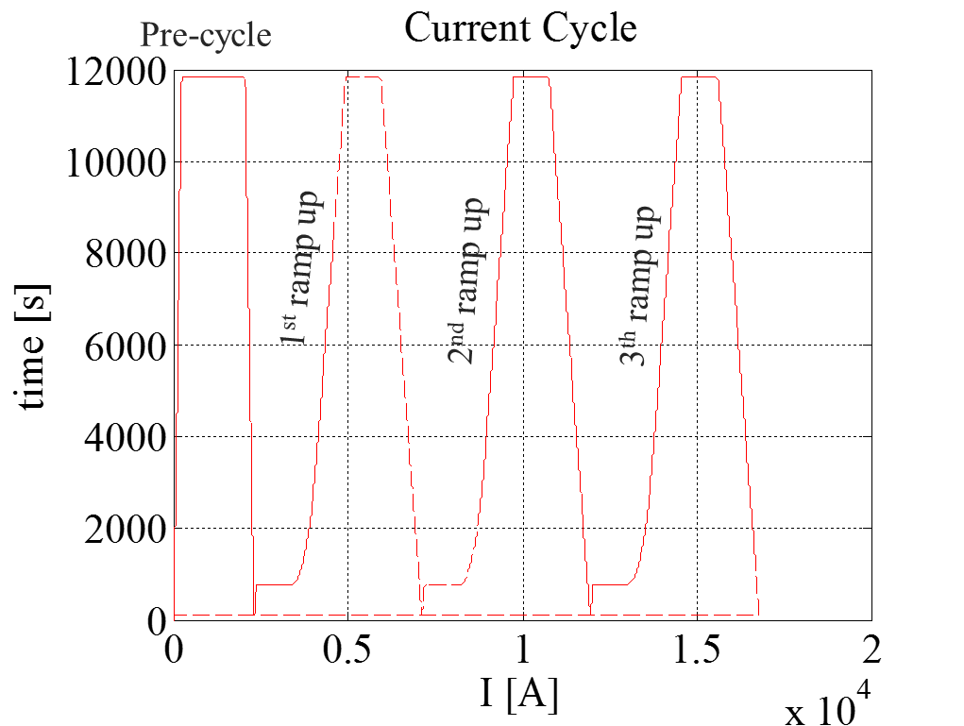
MBHDP101
Different state of magnetization in the 1st ramp up
Increase of magnetization at the injection plateau!!
Snapback?
Decay?
2nd & 3rd ramp up
1st ramp up

Slide 14
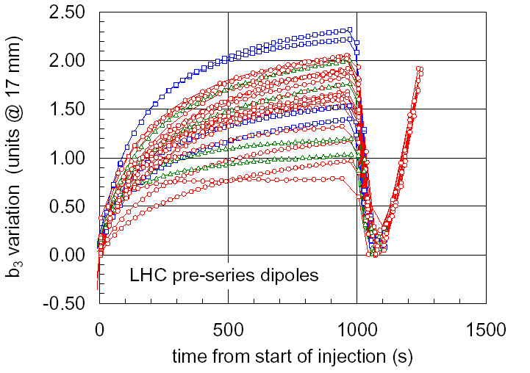
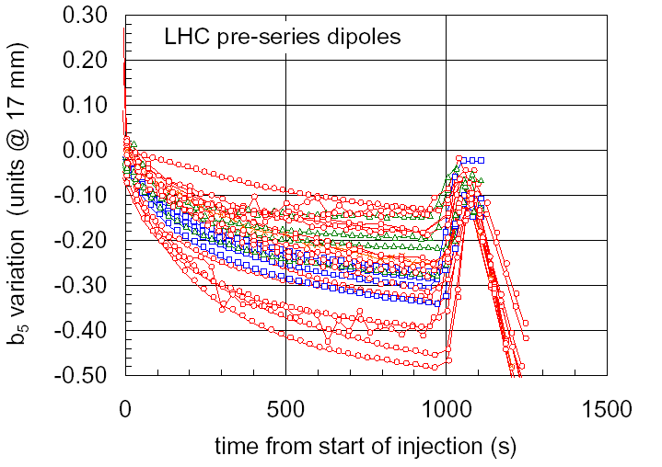
LHC MB vs. 11 T
Sign inversion on the harmonics! It seems that in the 11 T the strand magnetization is increasing instead of decreasing.
Bottura

Slide 15
Main field
Main field noisy, but an increase on magnetization is also visible!
Injection Plateau

Slide 16
LHC MB vs. 11 T
Sammut (magnets on the test bench, not under LHC standard operation cycle)
Make plots for the 11 T

Slide 17
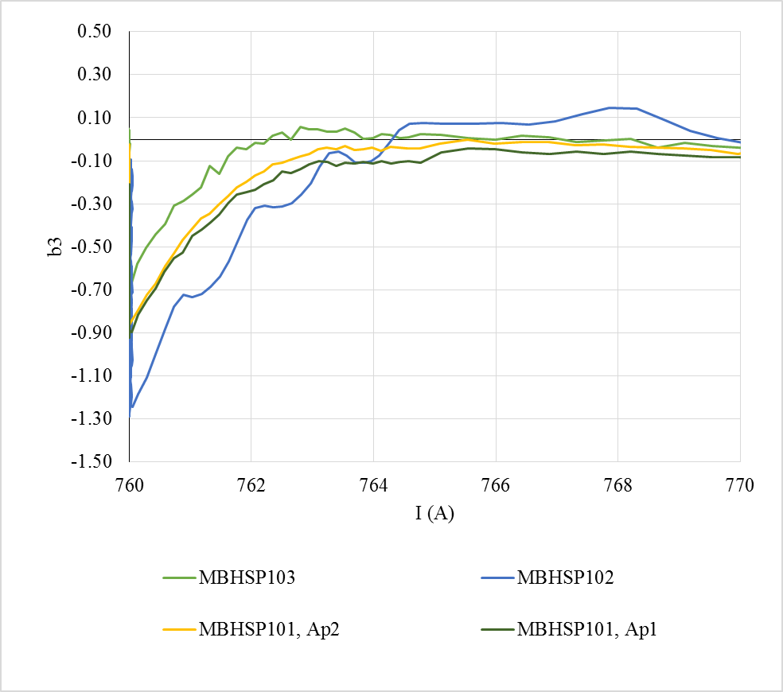
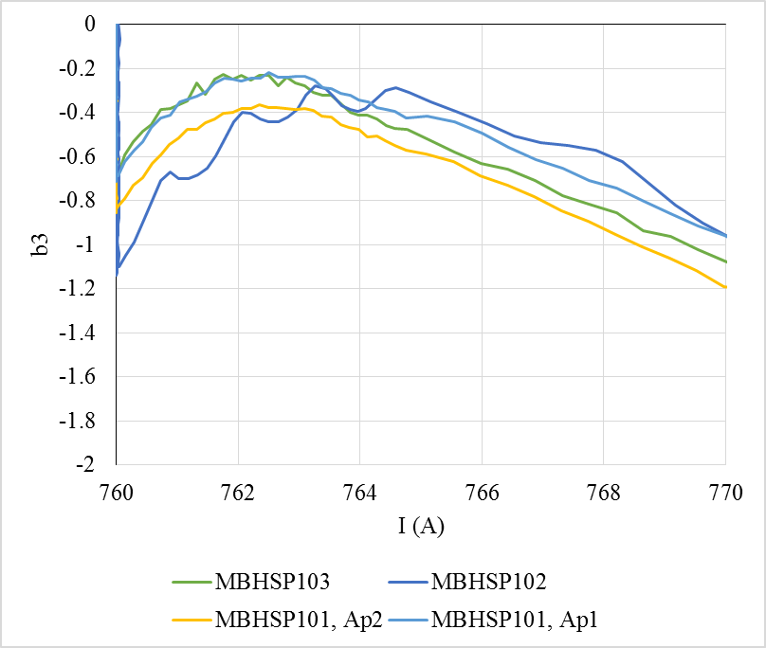

SB Exponential fitting
$$b_{3}^{snap−back}\left(t\right)=b_{3}^{decay}e^{−\left(\frac{I_{inj}−I(t)}{∆I}\right)}$$
SB only
SB + PC

Slide 18
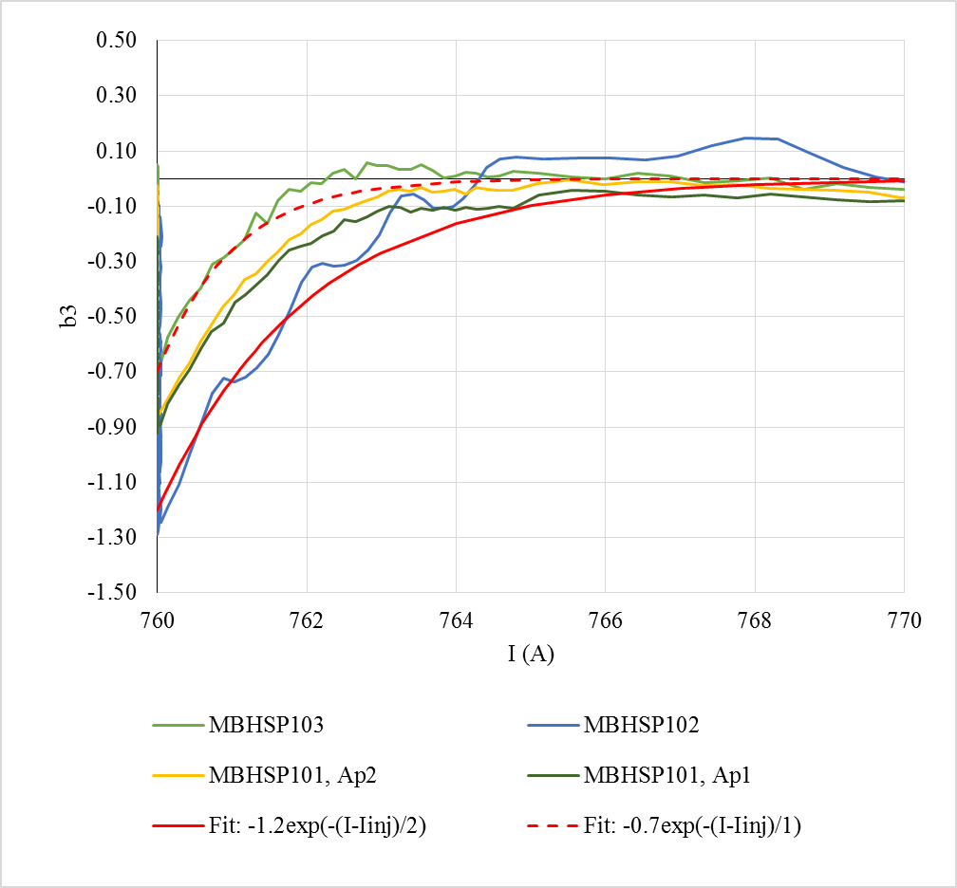
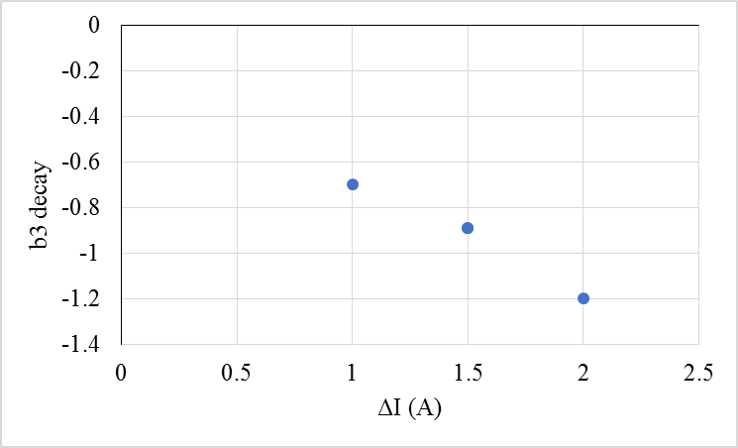



SB Exponential fitting
$$b_{3}^{snap−back}\left(t\right)=b_{3}^{decay}e^{−\left(\frac{I_{inj}−I(t)}{∆I}\right)}$$
$$g_{3}^{SB}\sim 0.6units/A$$
Remark: in the LHC dipoles $\sim 0.2units/A$
 | b3-decay | ΔI (A)
MBHSP102 | -1.2 | 2
MBHSP103 | -0.7 | 1
MBHDP101-Ap1 | -0.89 | 1.5
MBHDP101-Ap2 | -0.89 | 1.5
Analysis done with the data on the central segments.

Slide 19
LHC MB vs. 11 T
The ‘shape” of the field harmonics due to strand magnetization is similar for the LHC-MB dipoles and for the 11 T.
    What can be the origin of this different behaviour in terms of decay and snapback?
The only difference is that in the 11 T dipole inner and outer layer are wound together, and in the LHC-MB there is a splice in between the layers

Slide 20
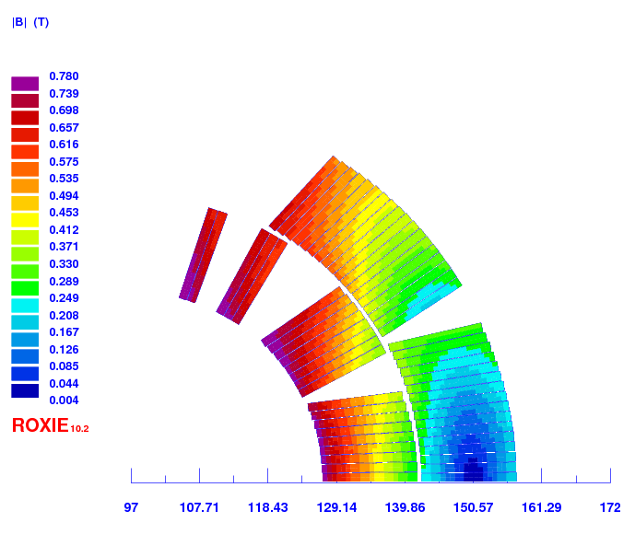
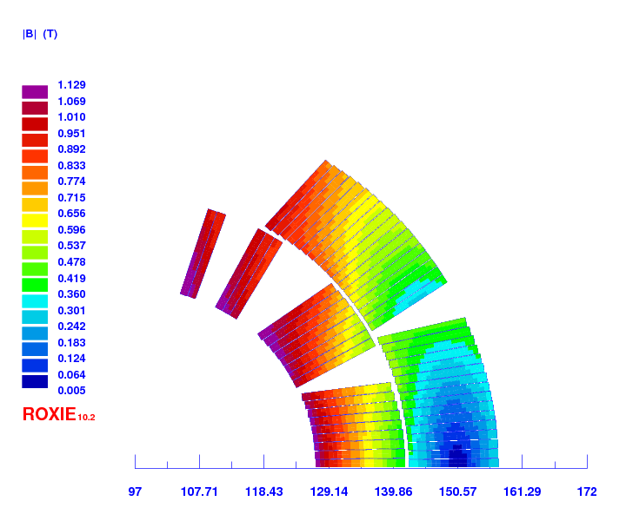

Injection level study
760 A
1100 A
Fiscarelli
Remember, for B lower than ~ 2 T, flux jumps are visible in the strand magnetization data. In the three current levels, the field in the coil is < 2T.
1700 A

Slide 21
Injection level study

Slide 22
Consistency checks
From: L. Bottura. Decay and Snap-back in LHC Main Magnets; Prepared for the Mini-Workshop on Decay and Snapback in Superconducting Magnets. Fermilab, November 8th, 2002.
Consistency checks:
current distribution depends on powering history ✓
  Flattop current study and flattop duration study, same trend than LHC-MB dipoles

Slide 23
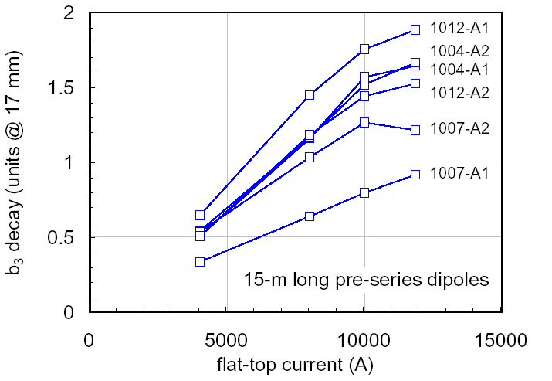
Flat top current study
Decay increase (in absolute value) at increasing the flat-top current, both in LHC dipoles and 11 T.
LHC MB
11 T
Bottura
Fiscarelli
LHC: scaling for long magnets similar to short models

Slide 24
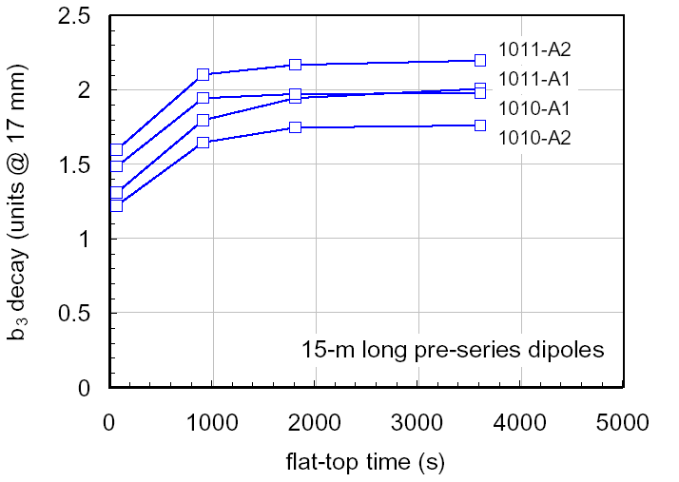
Flat top current duration
Decay decrease at increasing flat-top duration, both in LHC dipoles and 11 T.
Saturation of decay & SB
LHC MB
11 T
Bottura
Fiscarelli

Slide 25
Consistency checks
From: L. Bottura. Decay and Snap-back in LHC Main Magnets; Prepared for the Mini-Workshop on Decay and Snapback in Superconducting Magnets. Fermilab, November 8th, 2002.
Consistency checks:
current distribution depends on powering history ✓
larger decay & SB observed close to the ends of long magnets, where current imbalance is larger X
  We don’t see this, but maybe we don’t have enough statistics, and this is only clearly seen in long magnets.

Slide 26
Consistency checks
From: L. Bottura. Decay and Snap-back in LHC Main Magnets; Prepared for the Mini-Workshop on Decay and Snapback in Superconducting Magnets. Fermilab, November 8th, 2002.
Consistency checks:
current distribution depends on powering history ✓
larger decay & SB observed close to the ends of long magnets, where current imbalance is larger X
current distribution saturates for times comparable (or longer) than the characteristic time ✓
  Longer characteristic time in the 11 T magnet when compared to the LHC MB.

Slide 27
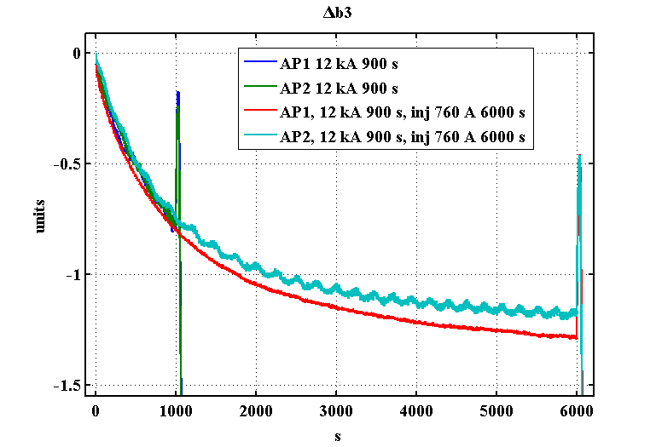
Injection time
Longer time constant for the 11 T.
The smaller amplitude of the decay in the 11 T is due to this longer time constant.
  They saturate to more or less the same value (I would expect Δb3 to be larger in the 11 T as strand magnetization is 10 times larger)
Sammut

Slide 28
Consistency checks
From: L. Bottura. Decay and Snap-back in LHC Main Magnets; Prepared for the Mini-Workshop on Decay and Snapback in Superconducting Magnets. Fermilab, November 8th, 2002.
Consistency checks:
current distribution depends on powering history ✓
larger decay & SB observed close to the ends of long magnets, where current imbalance is larger X
current distribution saturates for times comparable (or longer) than the characteristic time ✓
current distribution change does not depend on temperature changes ✓
  If the magnet is tested again, can we do a machine cycle at 4.2 K?
the SB does not depend on the acceleration ramp, quasi-DC process ✓

Slide 29
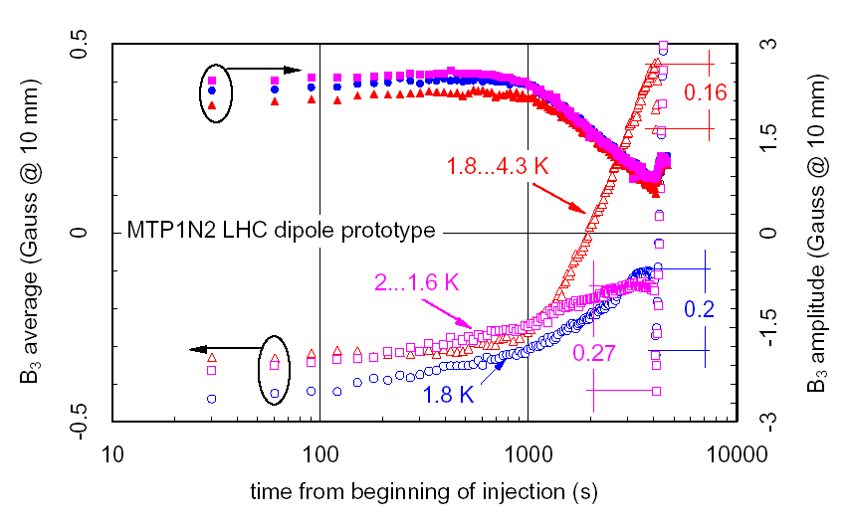
Temperature
LHC MB
Bottura

Slide 30
Consistency checks
From: Decay and Snap-back in LHC Main Magnets; Prepared for the Mini-Workshop on Decay and Snapback in Superconducting Magnets. Fermilab, November 8th, 2002.
Consistency checks:
current distribution depends on powering history ✓
larger decay & SB observed close to the ends of long magnets, where current imbalance is larger X
current distribution saturates for times comparable (or longer) than the characteristic time ✓
current distribution change does not depend on temperature changes ✓
the SB does not depend on the acceleration ramp, quasi-DC process ✓

Slide 31
Ramp Rate Dependence
20A/s
40A/s
80A/s
-10A/s
40 A/s not usable, there is a small drift on the current at 760 A (1A)
It is compared to the three standard machine cycle (RR=10 A/s)

Slide 32
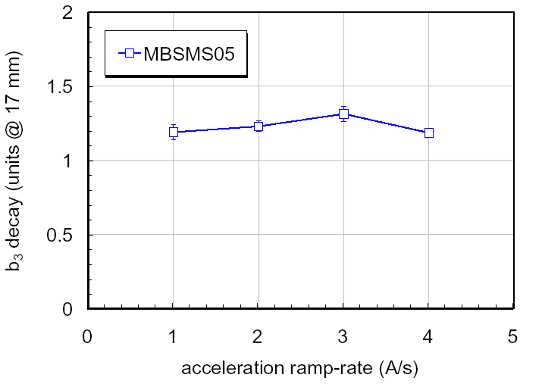
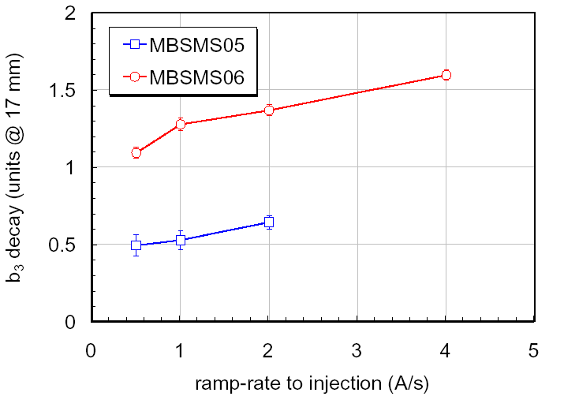
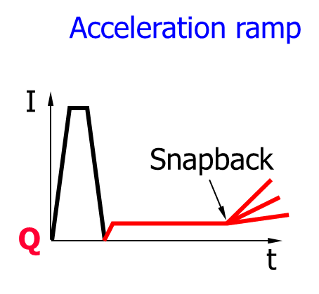
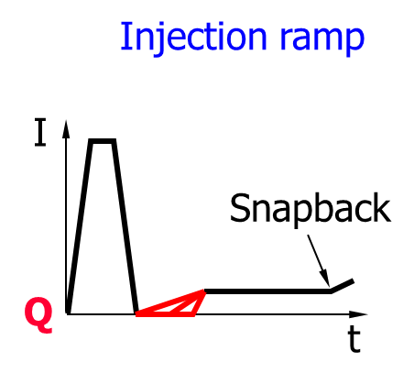
Ramp rate
Bottura
Bottura
LHC MB
LHC MB
There is no dependence on the ramp rate in MBHDP101.
The frequency of the acquisition is not enough to capture the decay at RR=20A/s and RR=80 A/s

Slide 33
Consistency checks
From: Decay and Snap-back in LHC Main Magnets; Prepared for the Mini-Workshop on Decay and Snapback in Superconducting Magnets. Fermilab, November 8th, 2002.
Consistency checks:
current distribution depends on powering history ✓
larger decay & SB observed close to the ends of long magnets, where current imbalance is larger X
current distribution saturates for times comparable (or longer) than the characteristic time ✓
current distribution change does not depend on temperature changes ?
  We need more data to check this
the SB does not depend on the acceleration ramp, quasi-DC process ✓

