Slide 1
LHCb: status and plans for the online system upgrade
Paolo Durante
paolo.durante@cern.ch
on behalf of the LHCb collaboration

Slide 2
Outline
New readout system
  Slow & fast control
  Optical links
  Readout board
  Event building
  Data centre
Online mile-stones

Slide 3
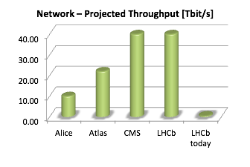
Run3 upgrade
Higher luminosity from LHC
Sub-detectors will upgrade
Removal of hardware trigger
  Inefficient at high luminosity
  New readout electronics
Filter farm will need to handle:
  Larger event size (~50KB to ~100KB)
  Larger event rate (~1MHz to ~40MHz)
New challenges for
DAQ & High-Level Trigger
Detector
Hardware trigger
Data acquisition
High Level Trigger farm
CERN long term storage
Offline physics analysis
2020

Slide 4
Run3 Online System
Dimensioning the system:
  ~10 000 optical links
    detector to surface (~350 m)
    up to 4.8 Gbps/link
  ~500 readout nodes
  (up to ~24 links/node)
  ~40 MHz event rate
  ~100 KB event size
High bisection bandwidth in event builder network
  ~32 Tb/s aggregate bandwidth
  Leverage emerging 100G technologies
Global configuration and control via ECS subsystem
Global synchronization via TFC subsystem
Detector front-end electronics
UX85B
Clock & fast commands
Clock & fast commands
x500
Event Builders (PC + readout board)
TFC
throttle from PCIe40s
Event Builder network
6 x 100 Gbit/s
6 x 100 Gbit/s
Point 8 surface
subfarm switch
subfarm switch
Online storage
Eventfilter Farm
~ 80 subfarms

Slide 5
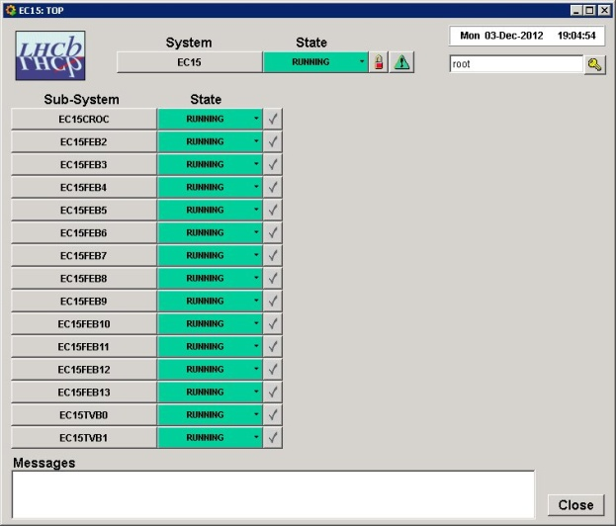
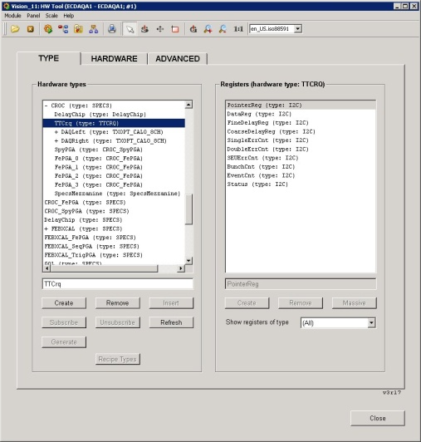
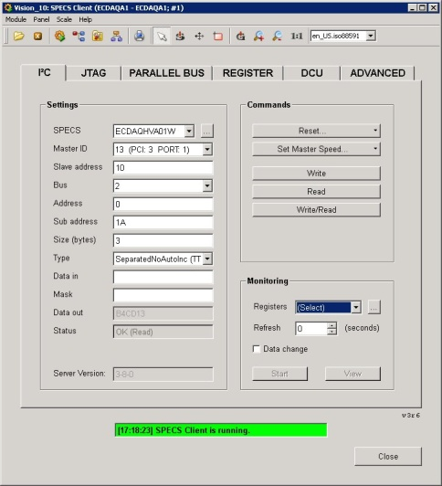
ECS (Experiment Control System)
  Controls and monitors all subsystems
    DAQ, TFC, HLT, farm…
  Continuity from current implementation
    JCOP / DIM / WinCCOA / SMI++ / Recipes
  Already able to drive current readout board prototype, from input to output
  Frontends rely on GBT-SCA hardware by EP-ESE
  Low-level components are being implemented
Operation UI
HW Description UI
WinCC-OA
Control PC
Firmware
GbtServ
DIMServer
PCIe library P
FPGA
PCIe driver P
Test UI
PCIe40
PCIe
Host PC

Slide 6
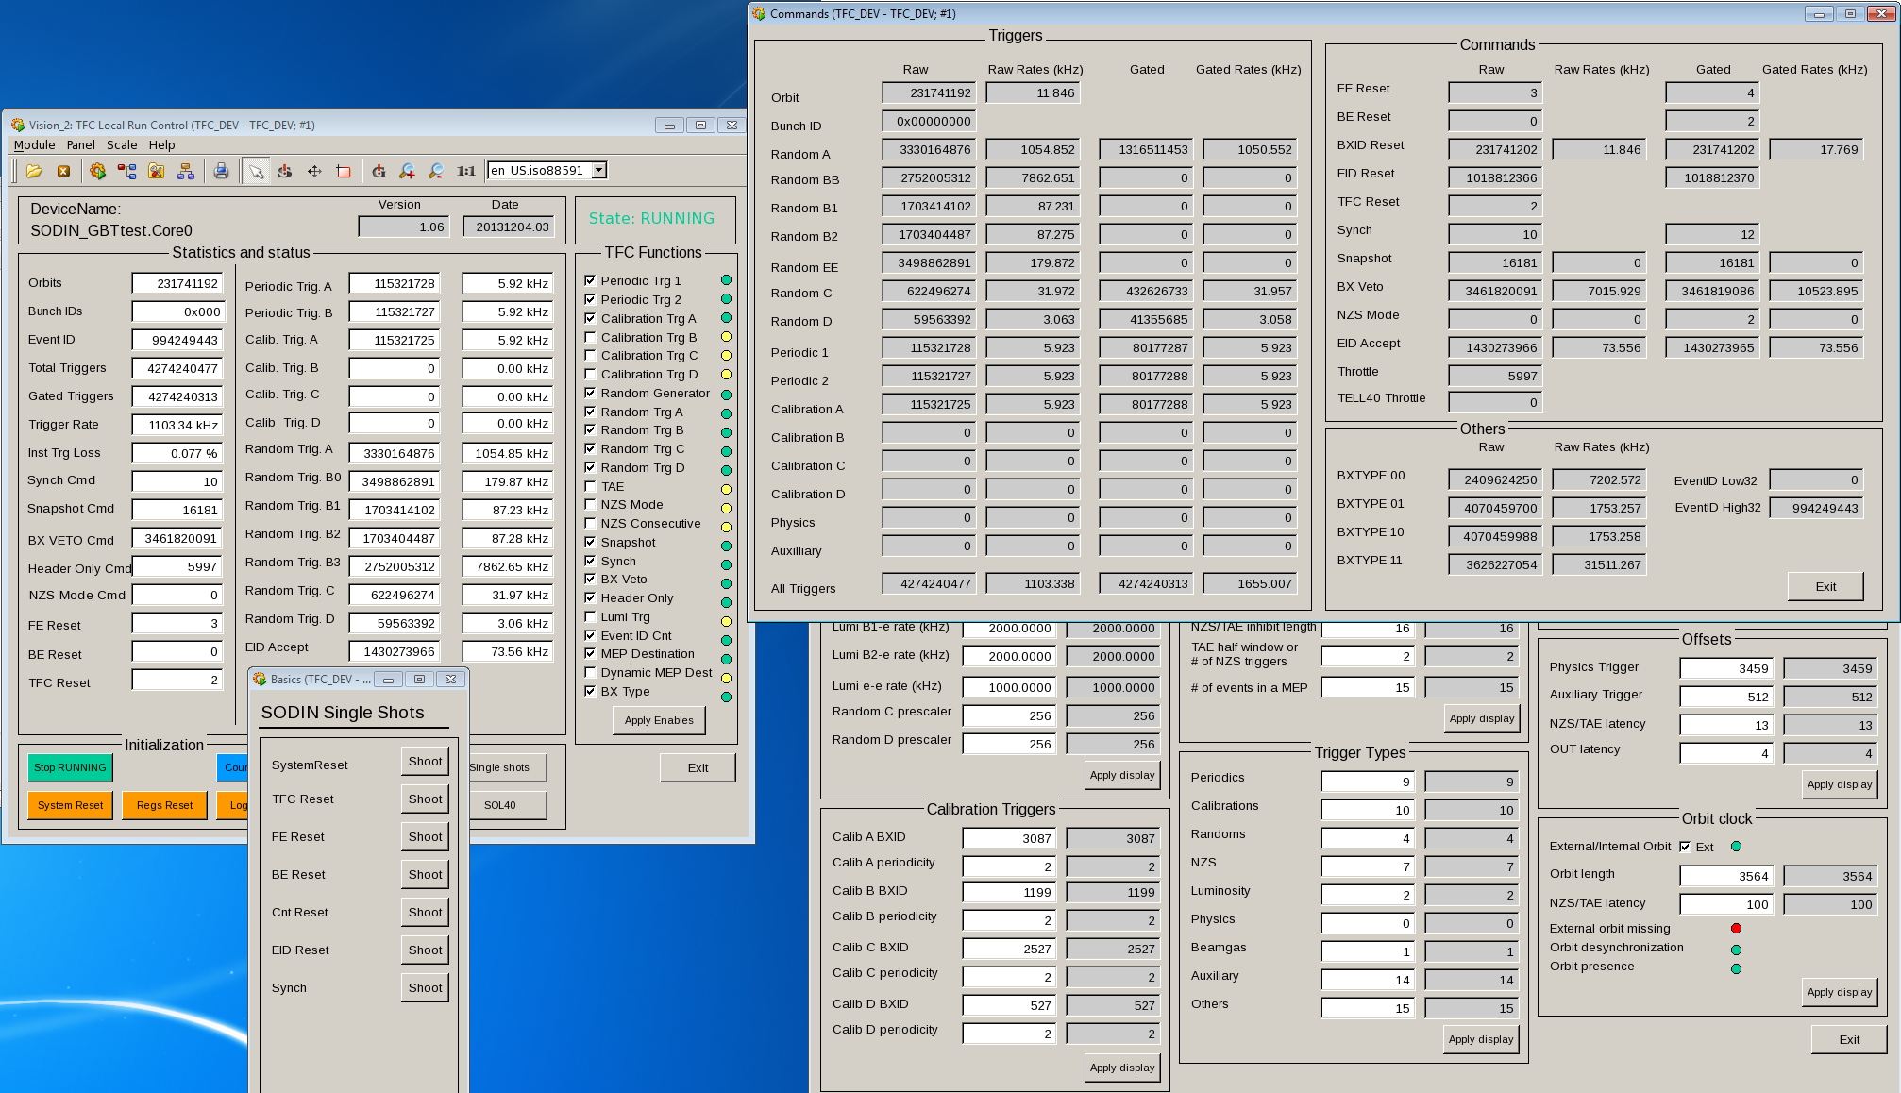
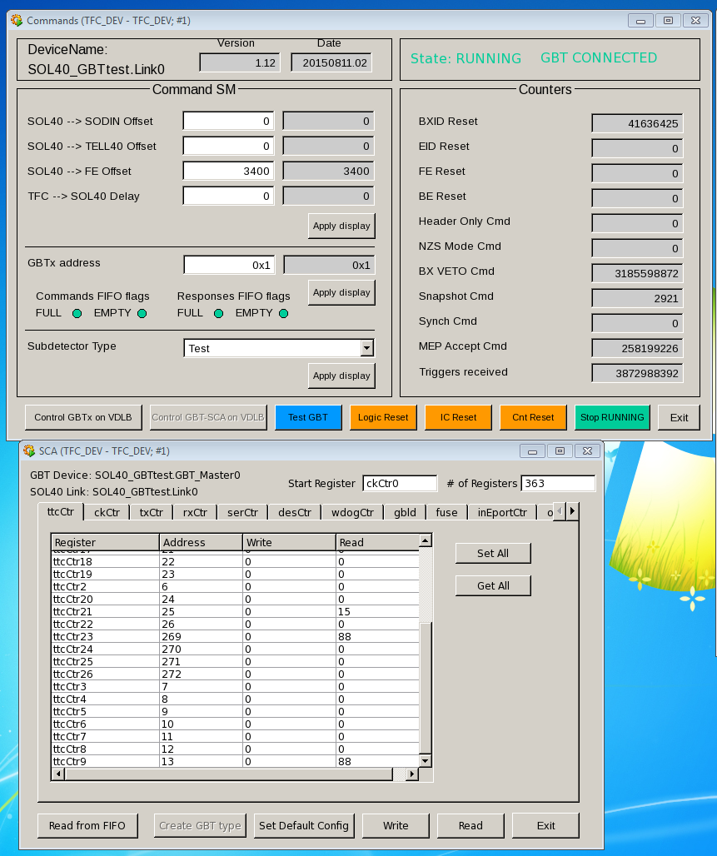
TFC (Timing & Fast Control)
Current status
  Already integrated in firmware
  Uses same readout board hardware
  as the DAQ (PCIe40)
  Can send fast commands to frontends
    SciFi, UT, Muon ASICS already being tested
  Programmable internal throttle for bandwidth regulation
Ongoing work
  PON (Passive Optical Network)
  technology integration
  (with EP-ESE)
  Clock phase tests on readout board
  (with CPPM)
  Continue feedback and compliance testing with frontend experts

Slide 7
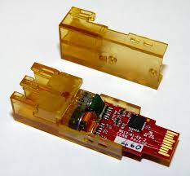
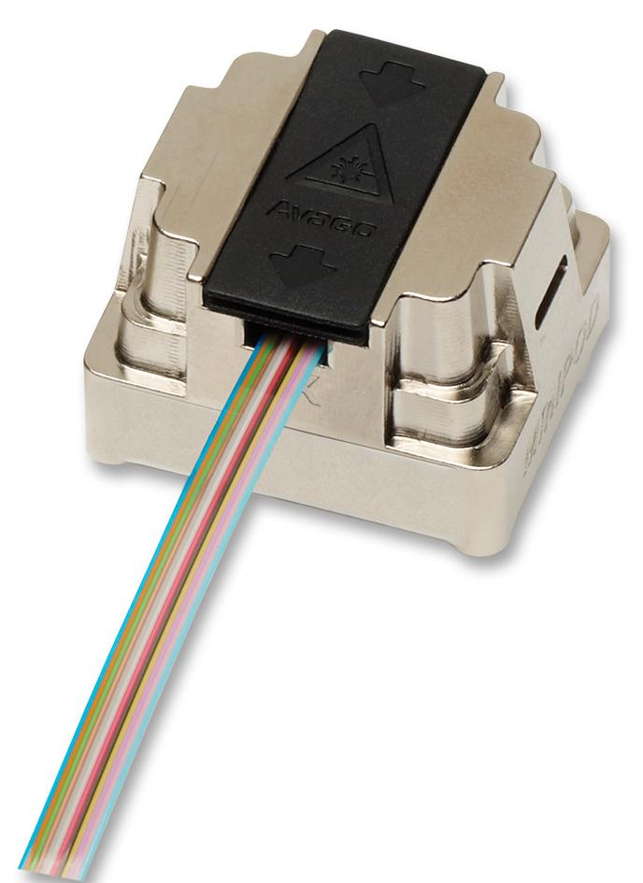
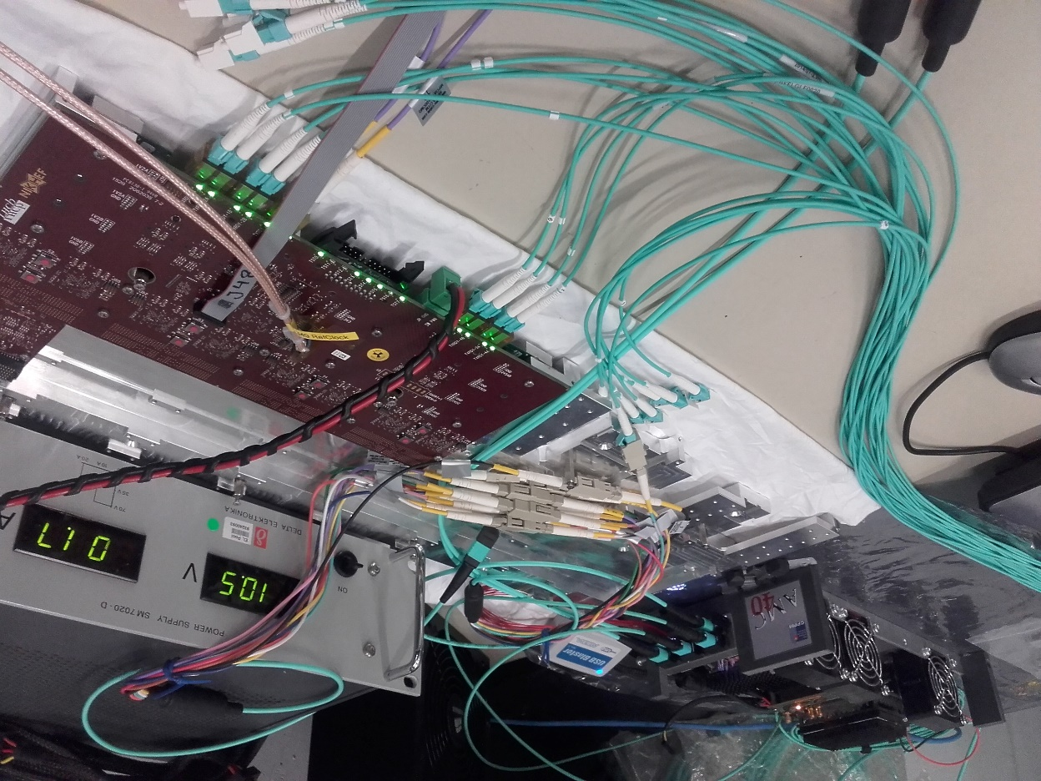
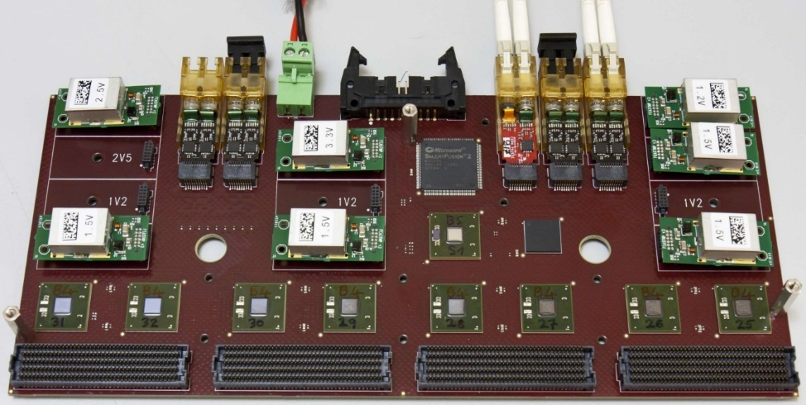
Long-distance optics
VTRx
MiniPOD™
Counting room on surface
  Power, cooling, space constraints in underground area
  ~350 meter distance
Based on EP-ESE technology
  Rad-hard Versatile Link on frontends
  Initially qualified for ~100m
Fiber infrastructure by EN-EL
  Pilot installation at end 2014
Loopback tests in 2015
  ~9 months, ~700 meters
  Avago MiniPOD transceivers
  Bit Error Rate < 10⁻¹⁸
  Full system equivalent: < 5 errors/day
  LHCC milestone
Continued tests in 2016
  Versatile TX on frontend prototype
  MiniPOD RX on readout board prototype

Slide 8
Readout boards / Event builders
Detector front-end electronics
UX85B
Clock & fast commands
Clock & fast commands
x500
Event Builders (PC + readout board)
TFC
throttle from PCIe40s
Event Builder network
6 x 100 Gbit/s
6 x 100 Gbit/s
Point 8 surface
subfarm switch
subfarm switch
Online storage
Eventfilter Farm
~ 80 subfarms

Slide 9
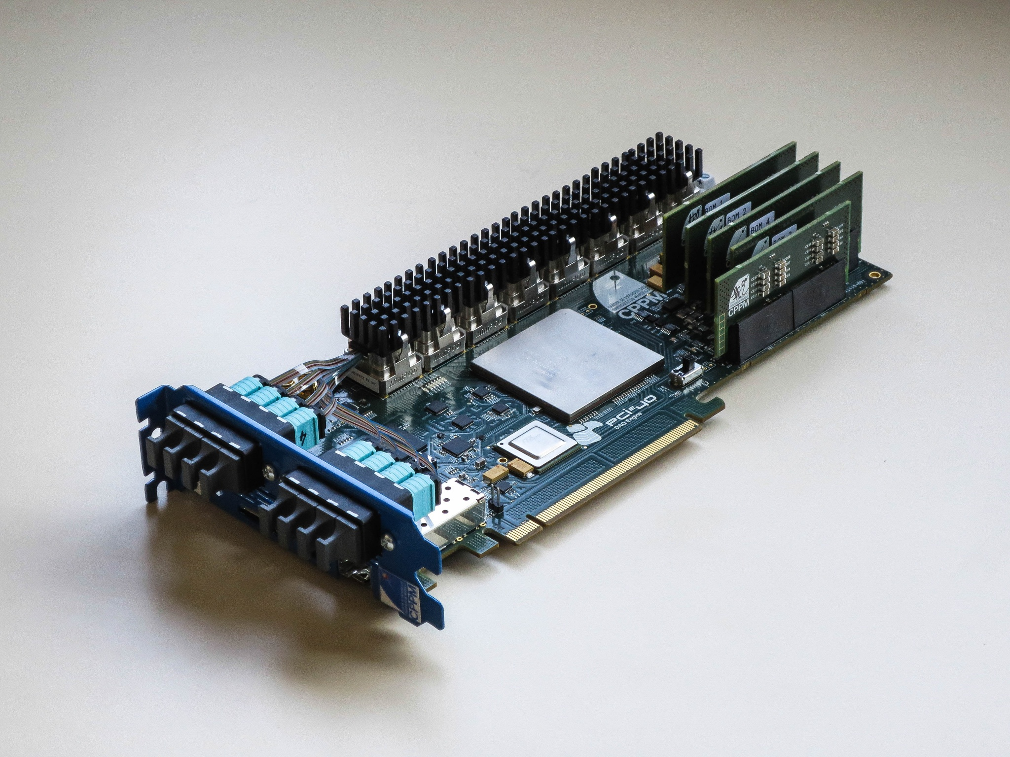
Readout board hardware (PCIe40)
PCI Express add-in card
  Altera Arria10 FPGA
  100Gbps DMA engine
  to event-builder memory
High-density optical IO
  Up to 48 transceivers (Avago MiniPODs)
  Reuse same HW for timing distribution system
Decouple FPGA from network
  Maximum flexibility in network technology
Exploit commercial technologies
  PCI Express Gen3 interconnect
  COTS servers designed for GPU acceleration
2nd generation readout board
  Developed at CPP Marseille
Pre-production launched
  Ready end of Q2
Market survey completed
  Tender in H2 2016

Slide 10
Readout board firmware
Common architecture for all subdetectors
Joint effort of LAPP, CERN, CPPM
Highly configurable through frontend-specific parameters
Handles ECS, TFC & DAQ, subdetector-specific logic
xM
N+M = 24
FE(s) data
xN
Low Level Interface
ODIN 40
SOL 40
xN
TFC decoder
Throttle
resets
TFC data
If GBT mode
xM
x1
x6
xM
xM
xM
If Widebus mode
BCID
Alignment
TFC
Processing
Data
Processing
Event
ID
MEP building
Error
Recovering
Raw Data
Decoding
xM
xM
ECS - BAR0
Low Level Interface
Computer Network
CCPC

Slide 11
Readout unit dataflow
A single Readout unit must sustain ~400Gbps IO bandwidth
Optimize memory bandwidth
  Design for zero-copy operations and RDMA over the network
  Organize dataflow according to topology and IO resources
  Exploit full network bandwidth
PCIe40
PCIe40
Memory
CPU
CPU
Memory
Memory
CPU
CPU
Memory
FILTER
network
DAQ
network
DAQ
network
FILTER
network

Slide 12
Event-building software (DAQPIPE)
Recreate distributed event-building dataflow of LHCb Run3
Modular architecture, “drivers” for each network technology under evaluation
Leverage existing HPC sites to assess scalability
Close collaboration with the industry through CERN OpenLab
Already achieving ~86Gbps with Infiniband EDR
  Meets our target
  Reduced scale setup
Off-site tests for Infiniband EDR and Intel Omni-Path currently ongoing…
Data
generator
Readout module
Dataflow
manager
Builder
unit
Event-builder core
Ethernet
driver
InfiniBand
driver
Omni-Path
driver

Slide 13
128node InfiniBand scalability (CINECA)
Performance limited
by non-exclusive
utilization of cluster

Slide 14
Future data centre at Point 8
 | Turnkey commercial solution (Requires minimal support from CERN engineering groups) | Leverage existing infrastructure at Point 8
Building | Buy pre-fabricated containers from a commercial supplier | Accommodate the farm in an existing building (SX8 hall)
Cooling | Cooling solution depends on the vendor (e. g. free air cooling) | Passive rear-door heat exchangers using primary water from existing cooling towers Compatible with DCLC for hot spots Test setup at the pit to evaluate performance with on site “warm” cooling water
A review to decide the most cost-effective solution will take place in April.

Slide 15
Online mile-stones
Q1 2016: long-distance fibres validation (successful)
Q2 2016: event-building with 32-port switch (successful)
  Thanks to the Bologna, CNAF and Ferrara teams
  → would be good to repeat this in a lab-setup (better tuning etc…)
Q2 2016: event-builder scalability to 600 nodes
  Achieved with 128 nodes, larger scale test still this year
  need to get a slot from external HPC sites (France, US…)
Q2 2017: data-centre solution defined
Q4 2017: full DAQ network test
Q3 2018: network technology decision
Q3 2019: ready for commissioning

Slide 16
Thank you for your time

Slide 17
Setup
Patch Panel
SX8
(Gas Building)
Patch Panel
UX8
Bunker
BER tester
~ 350 m
AMC40
Review of TDR suggested a test installation at P8 to ensure the viability of the long distance read-out
Installed 3 Trunk cables with 144 fibers each from different providers at P8
  1 x 144 Fibers from Fibernet, pre-connectorized
  1 x 144 Fibers from CERN, pre-connectorized
  1 x 144 Fibers from CERN, spliced
All 432 Fibers have been tested and have expected Attenuation
Currently Measuring the spliced fibers
  Worst case scenario due to additional attenuation of splice point
Testing on loop with 2 x 350m
  Higher attenuation than in final setup
  AMC40 transmitter has more optical power though
  Longer fiber just about compensates for the stronger transmitter
17

Slide 18

Result so far
Setup has been running for over 9 months now
10¹⁸ bits tested so far
0 Errors
BER < 10⁻¹⁸ with 95% confidence
CL = Confidence Level
N = Number of bits tested
E = Errors
BER_{s} = Specific Error Rate
Confidence | 63% | 74% | 95%
Aggregated BER | < 3.1 x 10⁻¹⁸ | < 4 x 10⁻¹⁸ | < 9 x 10⁻¹⁸
Error rate for 12k fibers | < 16 / day | < 20 / day | < 45 / day
18

Slide 19
Timing distribution at LHCb
LHC orbit
RF2TTC
TTCoc(BST)
BST
LHC clock
L0 (LVDS)
Trigger
splitter
MEP Req. (GbE)
MEP Req. (GbE)
Local trigger
L0
MEP Requests
ODIN
Readout Supervisor
ODIN
Readout Supervisor
BPIM
ODIN
Readout Supervisor
MUNIN
Throttle Switch
THOR
TFC Switch
TTCtx
Optical transmitter
TTCtx
Optical transmitter
TTCtx
Optical transmitter
TTCtx
Optical transmitter
TTCtx
Optical transmitter
TTC system
Unidirectional
1:32 max split ratio
Low bandwidth
Obsolete components
Very low payload for
Bunch synchronous data
TTCoc
Optical splitter
TTCoc
Optical splitter
TTCoc
Optical splitter
TTCoc
Optical splitter
TTCrx
TTCrx
VELO
L0 FE
ECAL
L0 FE
TTCrx
TTCrx
FREJA
TTC monitoring
TTCrx
TTCrx
TTCrx
TTCrx
VELO
L0 FE
VELO
L0 FE
VELO
L0 FE
VELO
L0 FE
VELO
L0 FE
VELO
L0 FE
TTCrx
VELO
TELL1
TTCrx
TTCrx
ECAL
TELL1
HUGIN
Throttle OR
HUGIN
Throttle OR
TTCrx
VELO
L1 FE
VELO
L1 FE

Slide 20
Upgrade proposal 1:TTC over GBT
From TFC point of view, we ensure constant:
LATENCY: Alignment with BXID
FINE PHASE: Alignment with best sampling point
Some resynchronization mechanisms envisaged:
Within TFC boards
With GBT
  No impact on FE itself
Loopback mechanism:
re-transmit TFC word back
allows for latency measurement + monitoring of TFC commands and synchronization
Courtesy: Federico Alessio (CERN)

Slide 21





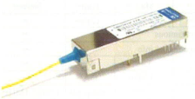
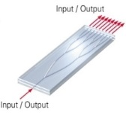

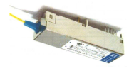
Upgrade proposal 2:TTC over PON
Major topology of growing Access Network Market known as:
  Fiber To The X (FTTx) (http://en.wikipedia.org/wiki/Fiber_to_the_x)
Point-to-MultiPoint (P2M)
One single fibre in charge of both downstream and upstream transmissions (using wavelength multiplexing technique)
FTTH
ONU1
1
B
1
1
1
1
1
1
2
B
1
3
1
1490nm
1
1
1
FTTC
OLT
1
2
B
1
3
1
1
2
B
1
3
1
ONU2
2
B
1
1
1
2
2
2
3
3
3
2
2
2
2
2
2
1310nm
1
2
B
1
3
1
3
3
3
3
B
3
ONU3
3
Courtesy S. Baron et al. (CERN)
https://indico.cern.ch/event/400951/
3
3
3
FTTB

Slide 22
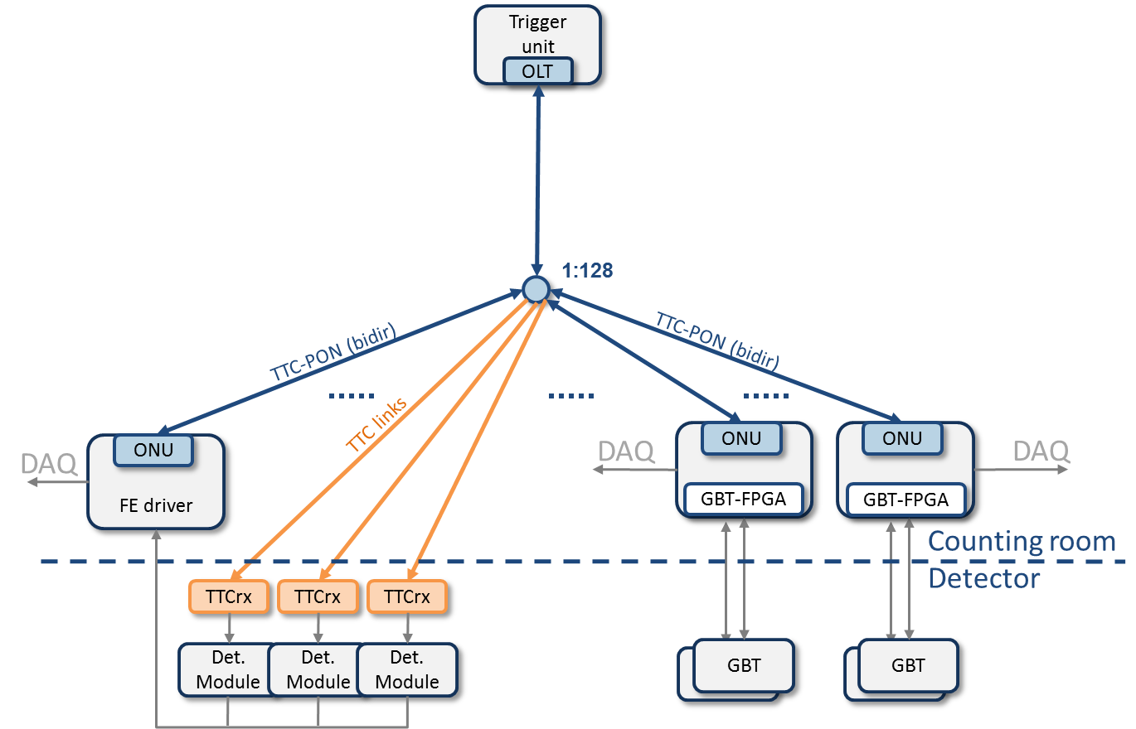
TTC-PON
OLT: Optical Line Terminal
ONU: Optical Network Unit
Standard: XG-PON1
Fixed latency downstream
Line rate
  Down: 9.6 Gb/s
  Up: 2.4 Gb/s
Wavelength:
  Down: 1577nm
  Up: 1270nm
Bidirectional
Range: 1-1000m
Split ratio: 1:128
Error detection

Slide 23
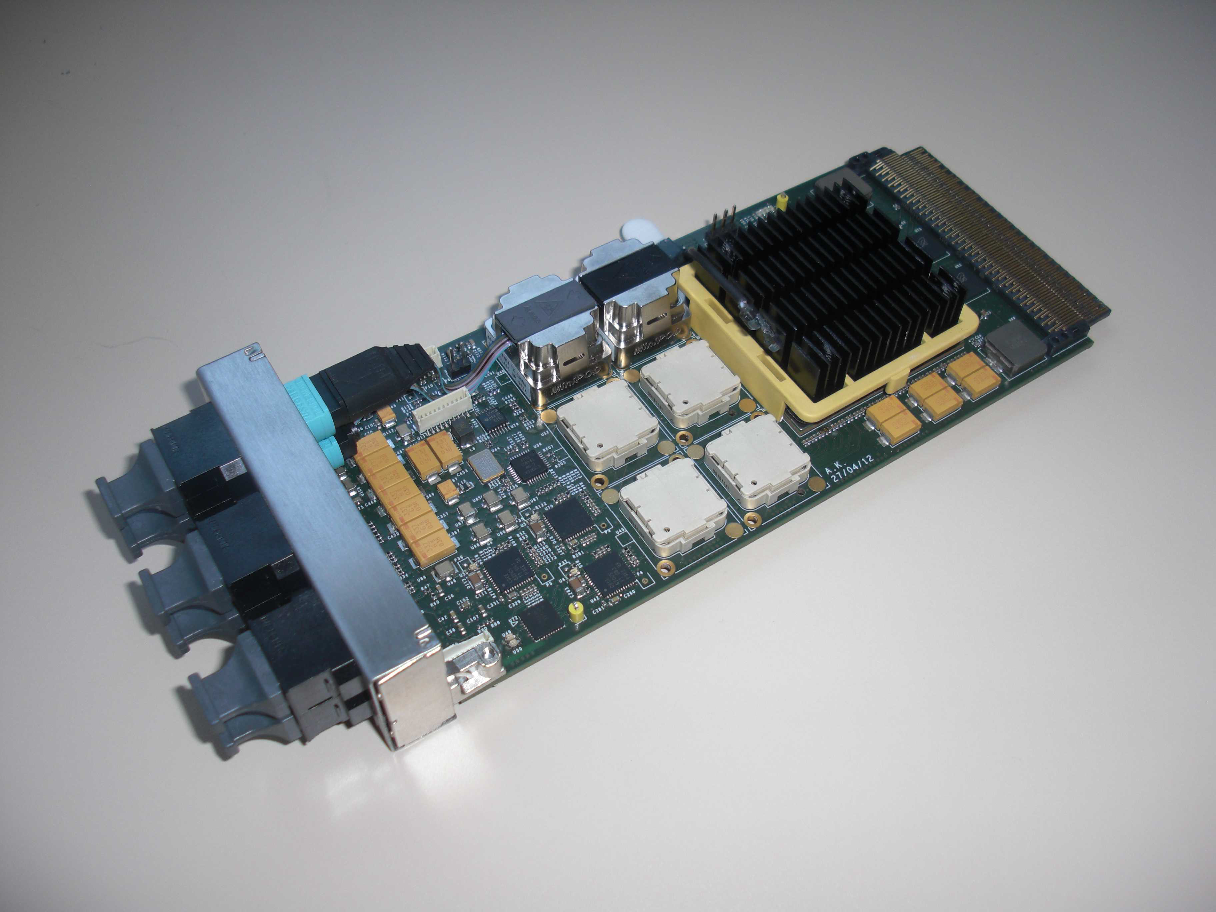
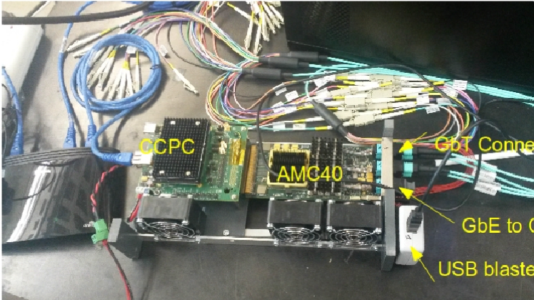
AMC40 readout board
Philosophy: one common board for DAQ and timing/control
1st generation readout board
  Developed at CPP Marseille
Mezzanine for ATCA crate
Altera Stratix V FPGA
≤36 bidirectional optical links
  Avago MiniPODs
  GBT / GWT / 10GbE protocols
Produced and made available to the collaboration (MiniDAQ1)
Firmware designed for migration to 2nd generation readout board

Slide 24
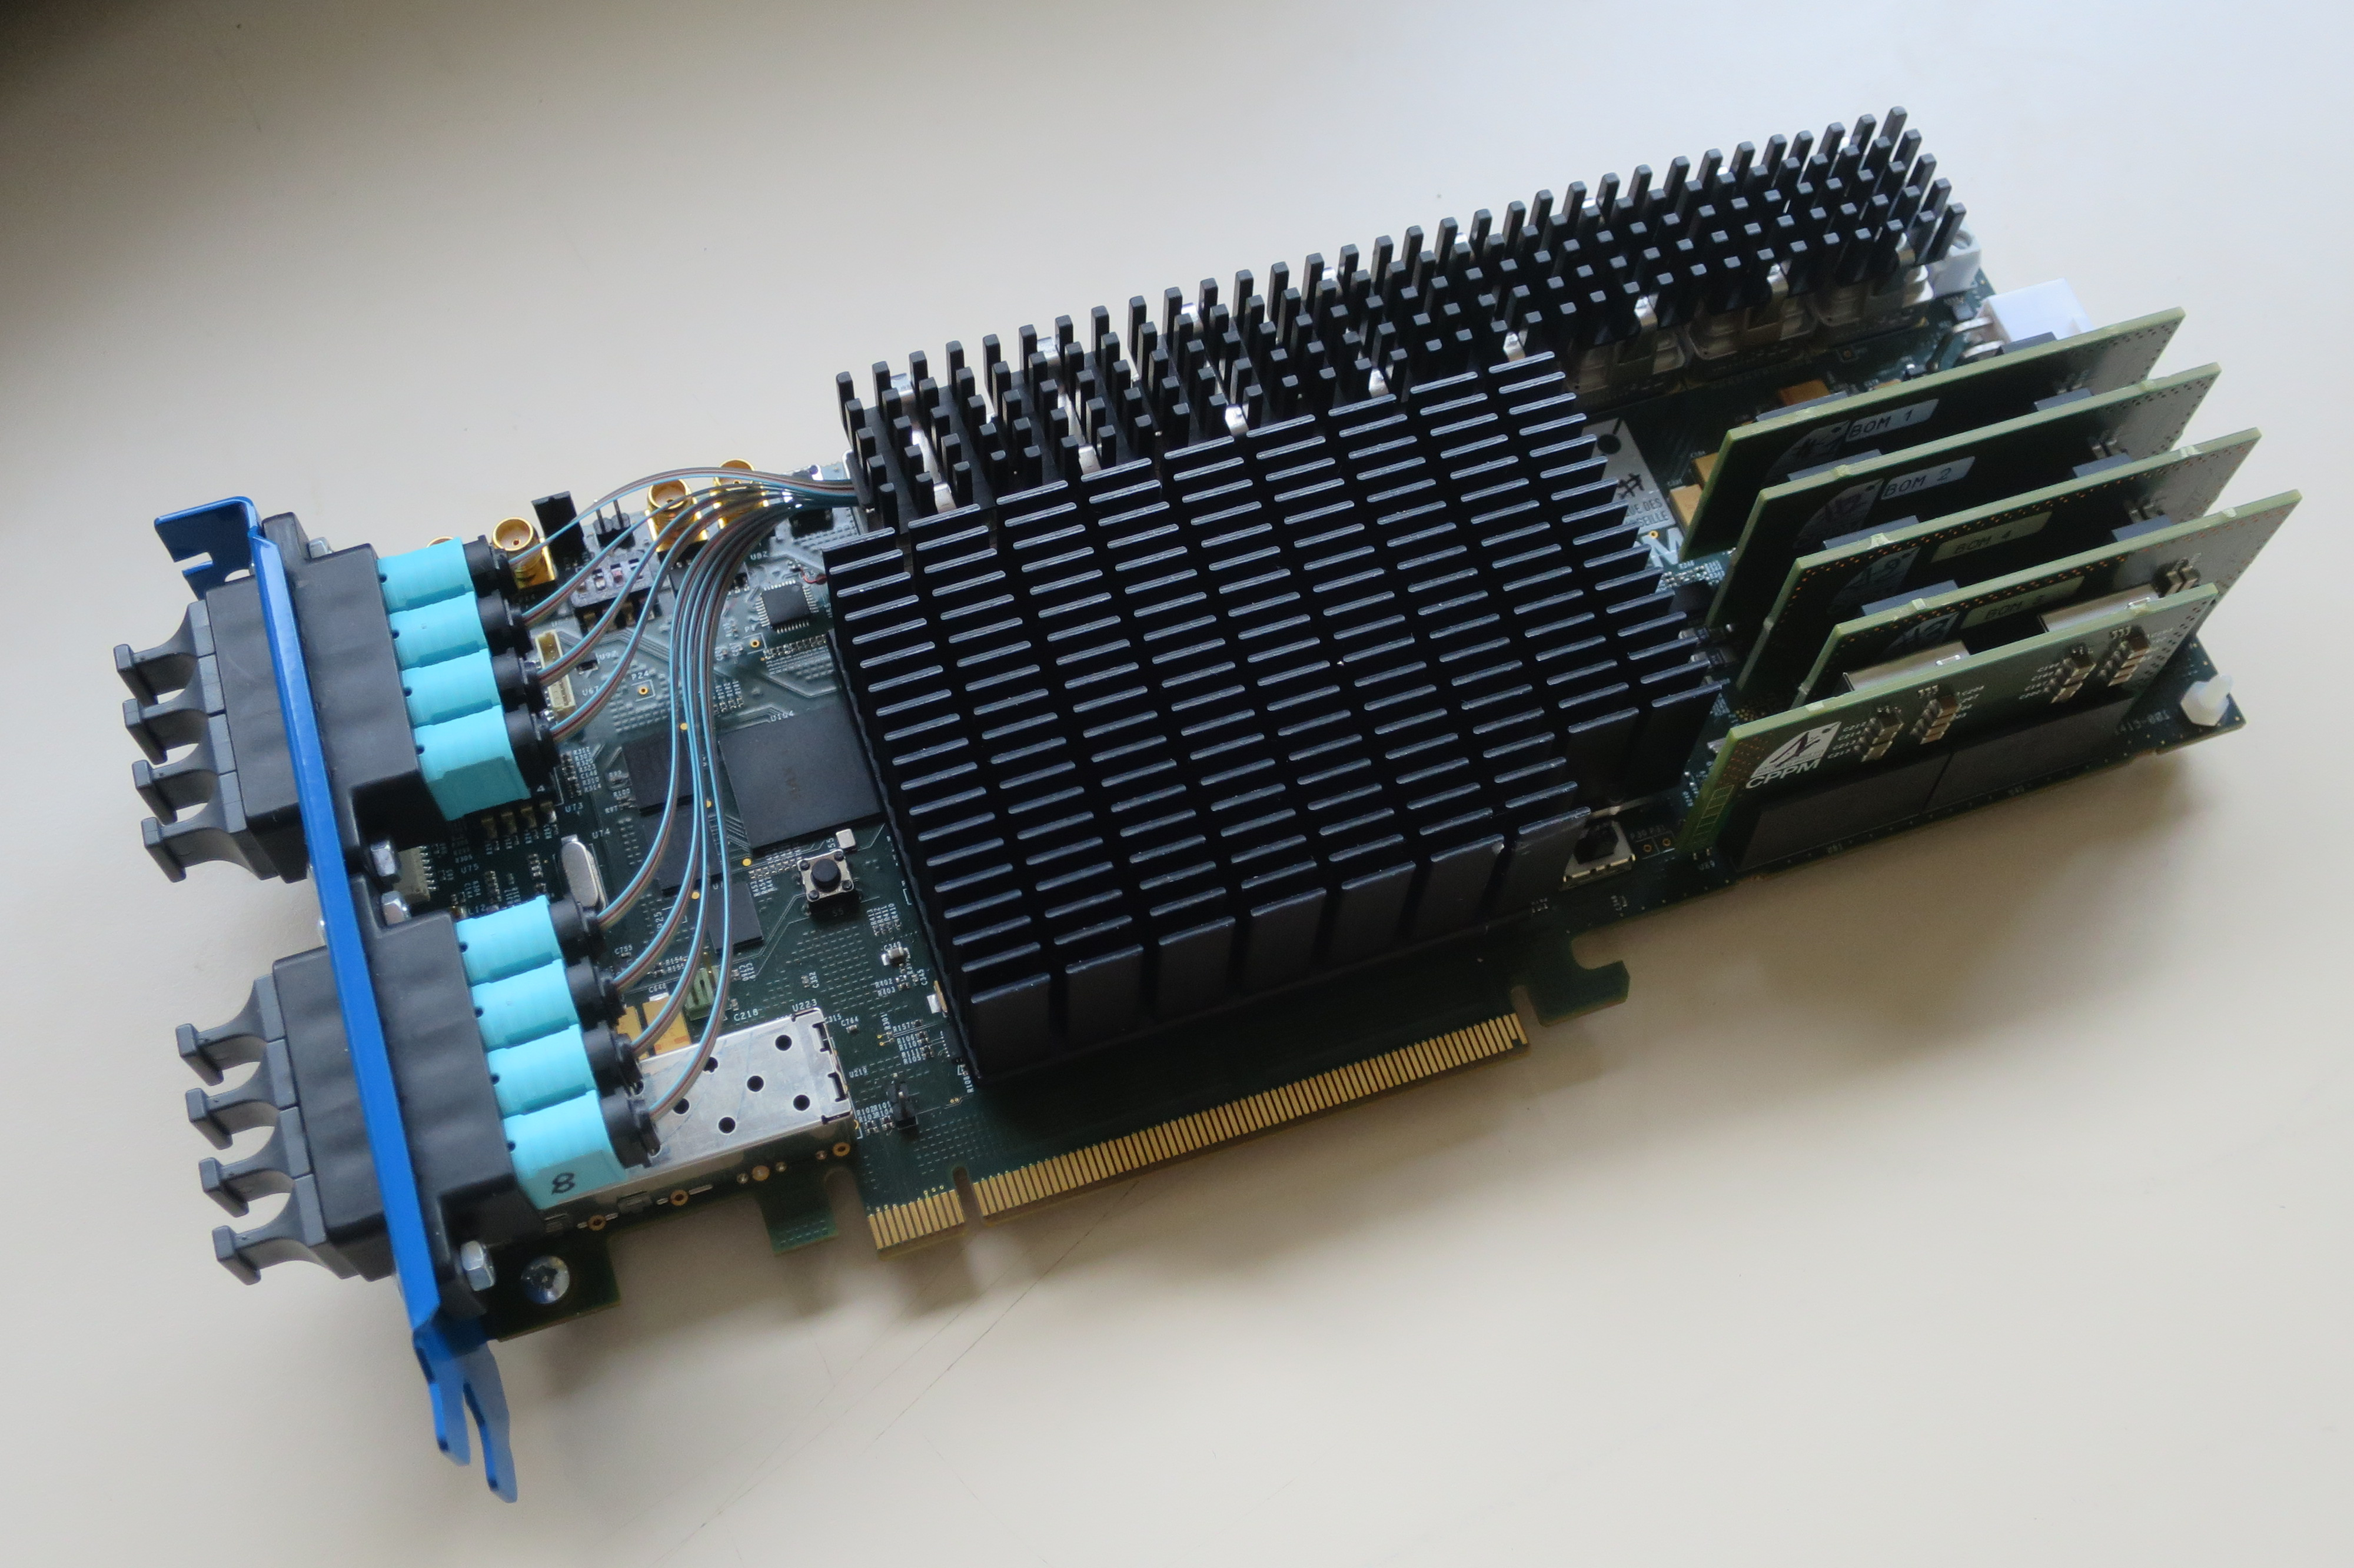
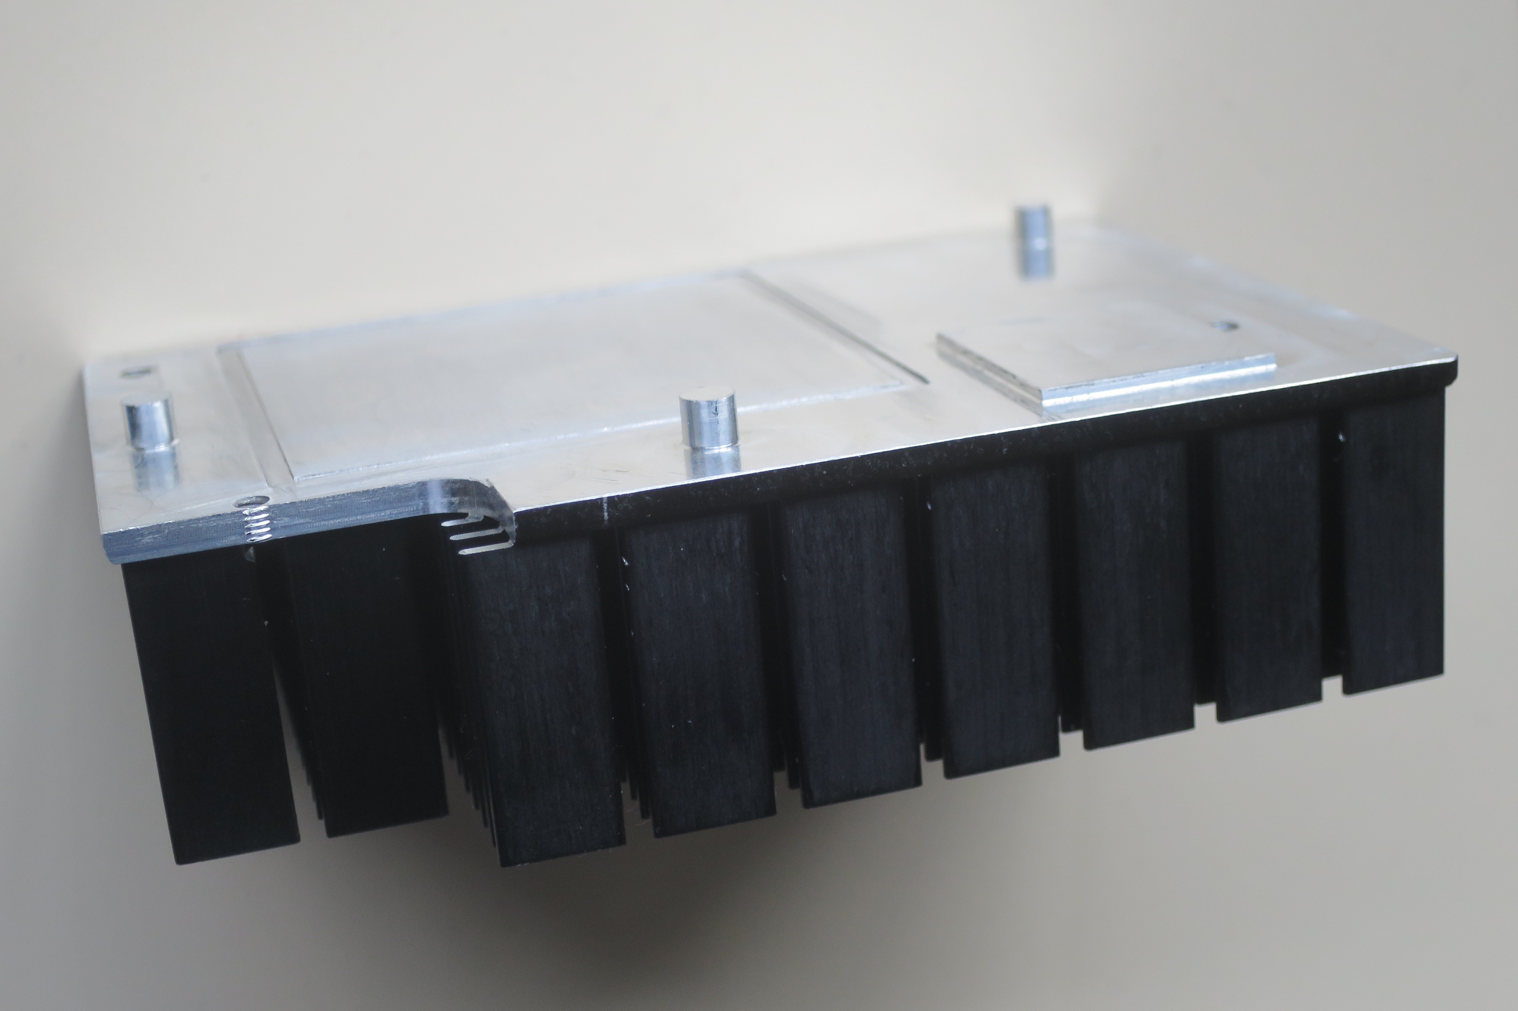
PCIe40 status
Current status
  Low-Level Interface available
    Slow control through PCIe
    100Gbps DMA
    On-board communication (I2C, SPI)
    Filtered PLL clock
    CvP (programming via PCIe)
    Temperature and current monitoring
  New custom heat-sink design
  Procurement ongoing after tender
Next plans
  x24 GBT integration
  PON tests for timing distribution
  Optical links characterization
    Eye aperture
    BER
  Cooling characterization
    f( firmware, airflow, heat-sink )
  Monitoring via IPMI

Slide 25
PCIe Gen3 DMA performance
1 interface (optimized)
2 interfaces (unoptimized)

Slide 26
Firmware status
AMC40
PCIe40
Readout over GBT / WideBus
Fixed-size frontend protocol
6 optical links
Front-end configuration via
GBT-SCA
Data monitoring inside FPGA
UDP output protocol over 10GBASE-R
Embedded FE data generator
Data verification outside FPGA
Configurable data rate throttle
Variable-size FE protocol
… all of the previous, plus:
HW-specific low level interface
PCI Express Gen3 DMA interface & driver
Increase number of optical links
Integrate LLI & DMA into firmware
Implement remaining frontend protocols

Slide 27
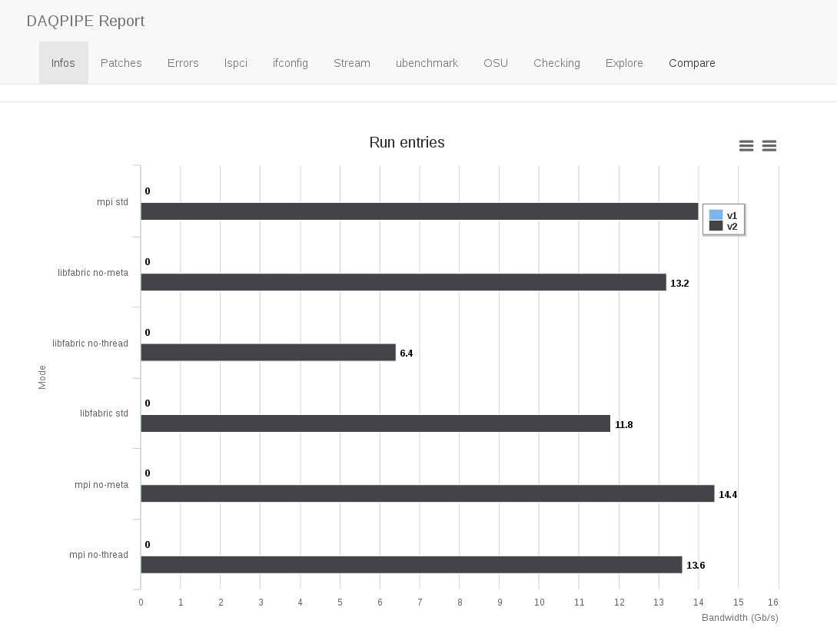
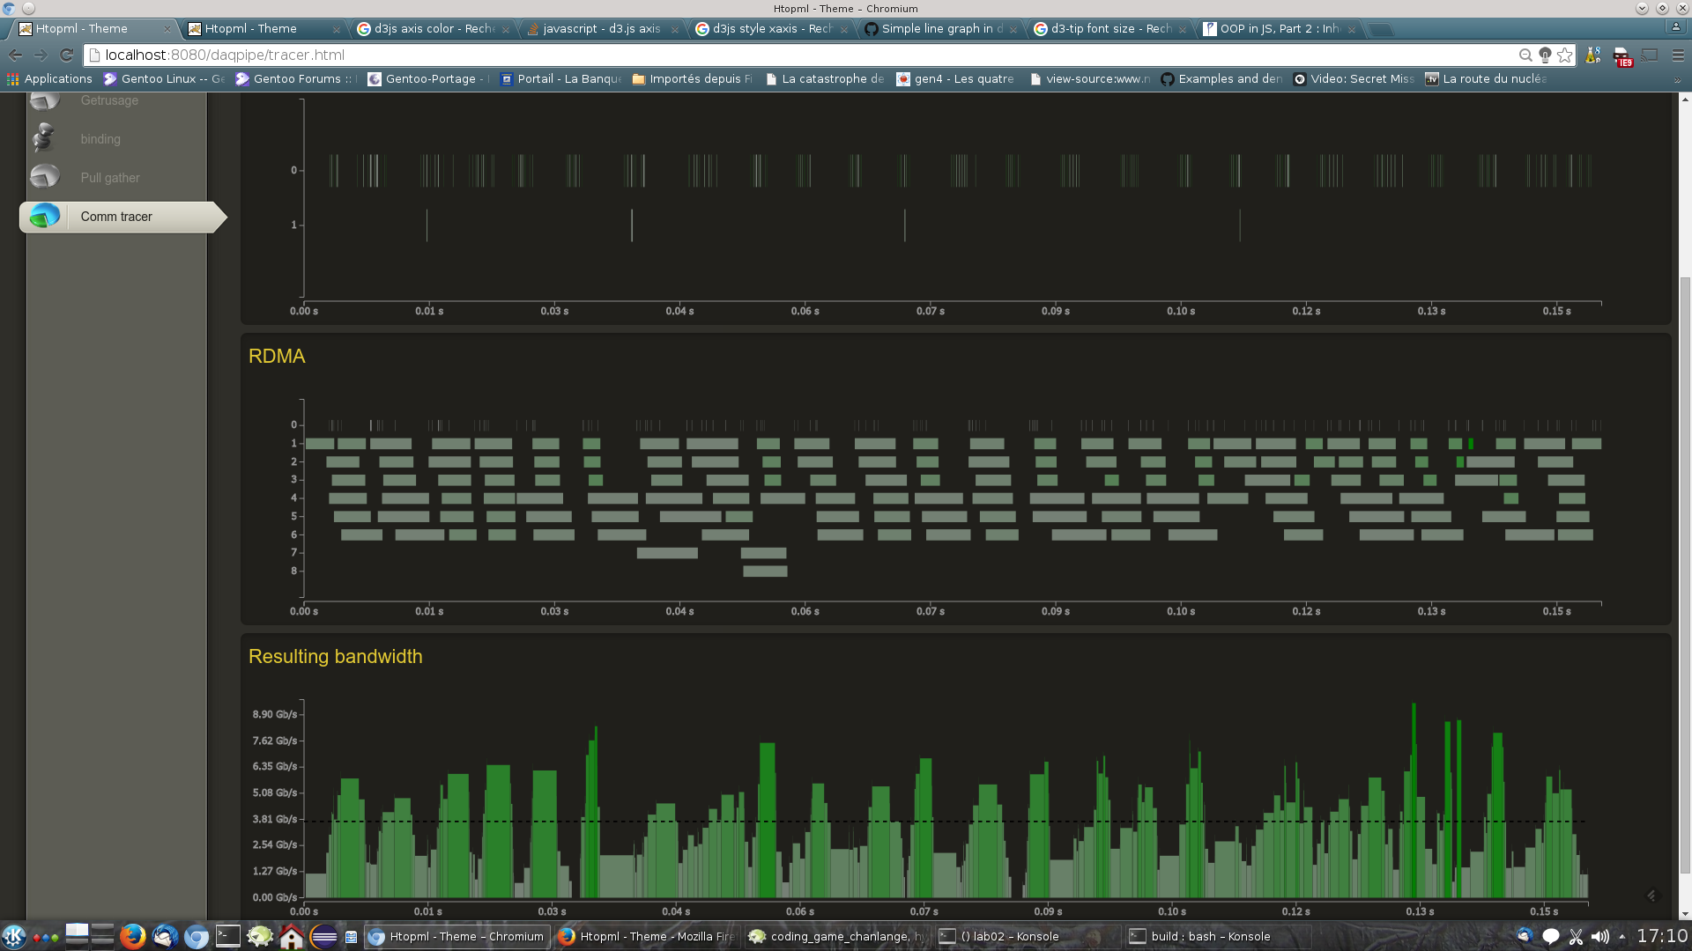
Event-building software performance
DAQPIPE now supports following APIs:
Libfabric
MPI
TCP
Implemented automatic benchmarking and reporting
(with web-based interface)
On-the-fly monitoring (htopml)
Benchmarks of
Intel Omni-Path
Infiniband EDR
currently in progress!
Already observing 86 Gb/s on EDR

