Slide 1
THE ALTARELLI COCKTAIL
AND OTHER MEMORIES
Luigi Di Lella
Physics Dept., University of Pisa
When and where I first met Guido
Guido and the experiments at the CERN
proton – antiproton (SppS) collider
Guido Altarelli Memorial Symposium
CERN, 10th June 2016

Slide 2
When and where I first met Guido:
at the beginning of 1970 on the occasion of a meeting
at the Nevis Laboratories of Columbia University to discuss
new results from an experiment performed by Leon Lederman
(the Lab Director) and his group at the the Brookhaven 30 GeV
proton synchrotron (AGS) to search for muon pairs produced
in proton – nucleus collisions.
The experiment had rather poor dimuon mass resolution
(muon momentum measured using counters and residual range in Iron)
but very high ‘‘luminosity’’
(it used the full AGS proton beam and a thick Uranium target)
The results were interesting and puzzling

Slide 3
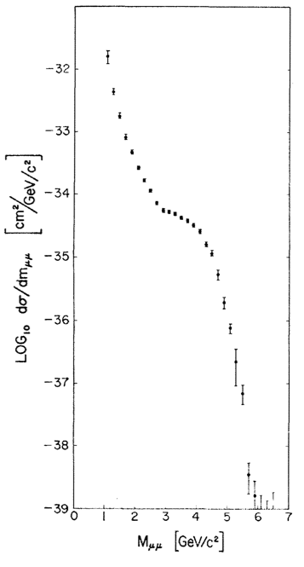
The measured dimuon
invariant mass distribution
J.R. Christenson et al., PRL 25 (1970) 1523
The ‘‘shoulder’’ above 3 GeV
is most likely the J/Ψ distorted by
the poor mass resolution 4 years
before its official discovery in 1974.
It was not taken seriously by the authors.
The continuum distribution had
no obvious explanation at that time
In 1968 experiments at SLAC on
deep-inelastic electron – nucleon scattering
had given evidence for electrically charged,
point-like constituents (named ‘‘partons’’
by Feynman)
Lederman had the ‘‘feeling’’ that the dimuon
continuum had something to do with partons.

Slide 4
A discussion of the dimuon results with theorists was needed
but there are no theorists at the Nevis Labs
(the Nevis Labs are the working place of Columbia experimental particle physics
groups and are located at ~30 km distance from the Columbia Physics Department
in Manhattan).
Lederman looked for theorists with knowledge of parton physics
in the New York area and found three at the Rockefeller University:
Guido Altarelli
Richard Brandt
Giuliano Preparata
They came to the Nevis Labs on a Saturday and presented their ideas
on possible mechanisms capable of producing muon pairs
in hadron collisions.

Slide 5
They discussed an operator representation for the behaviour
of the product of two electromagnetic currents near the light cone,
taking into account constraints from the SLAC deep-inelastic
scattering experiments and Regge theory.
I was not familiar with most of these concepts, nevertheless
I understood from Guido’s presentation that, in the framework
of the parton model they were talking about parton – antiparton
annihilation.
However, nobody knew at that time what these partons and
antipartons were:
Partons had not yet been identified as quarks;
Gell-Mann himself had often declared that, in his opinion,
quarks were not physical particles but only useful
mathematical concepts to describe the known SU(3) hadron
multiplets.

Slide 6
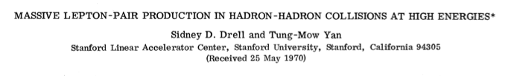
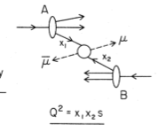

Today the production of lepton pairs in hadron collisions
is known as the Drell – Yan process from the authors of the
first theoretical paper describing the reaction in terms of
parton – antiparton annihilation:
S.D. Drell and T.M. Yan, Phys. Rev. Lett. 25 (1970) 316

Slide 7
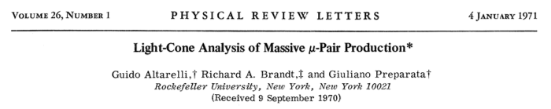
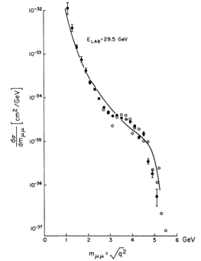
The paper by Altarelli, Brandt and Preparata was published
soon after:
This paper presents a fit to the
dimuon mass distribution measured
by the Lederman group

Slide 8
The Altarelli cocktail
Guido and the experiments at the proton – antiproton collider
Following the discovery of the W and Z bosons at the CERN pp Collider
(SppS) in 1983, further analysis of those data had found a few peculiar
unexpected events which, at first sight, seemed to be inconsistent with
Standard Model backgrounds.
These events were presented at the 4th Topical Workshop on Proton – Antiproton
Collider Physics in Bern, Switzerland, 5 – 8 March 1984, and published soon after.
They produced much excitement and lots of theoretical papers were written
to explain them, all based on new physics beyond the Standard Model.
Most of these events (but not all) had hadronic jets in the final state and large
missing transverse momentum.

Slide 9

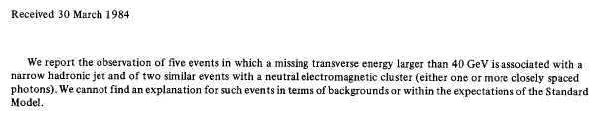
In its first phase (1981 – 85) UA2 had only partial calorimetric coverage
Large missing transverse momentum could result from undetected,
high-p_{T} particles or hadronic jets.
However, UA2 also presented “peculiar” events:
An e⁺e⁻γ event consistent with the Z mass, with all three particles
quite energetic and at large angles from each other;
Three events containing a W → e ν decay and associated high-p_{T} jet(s)
consistent with a unique value of the W + jet(s) invariant mass.

Slide 10
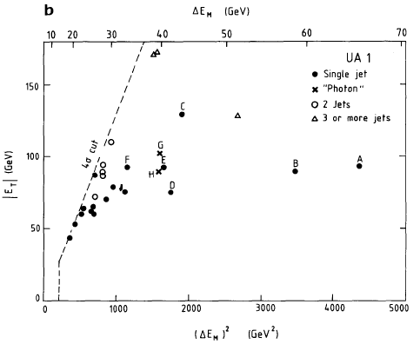

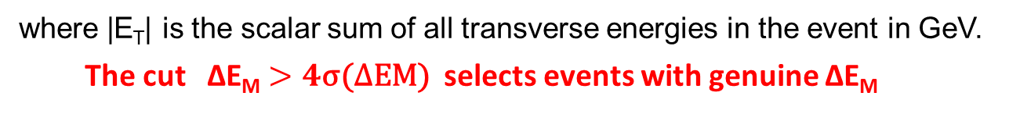
In the UA1 detector events with no genuine missing transverse momentum
( ΔE_{M} ) may have ΔE_{M} > 0 because of measurement errors:
$$\text{σ}\text{(∆}\text{EM}\text{) }≈0.7\text{√}\text{|}\text{ET}\text{| }$$
where |E_{T}| is the scalar sum of all transverse energies in the event in GeV.
The cut ∆E_{M} $>4\text{σ}\text{(∆}\text{EM}\text{) }$ selects events with genuine ∆E_{M}
Events with W leptonic decays
are excluded
Events A, B, C, D were named “monojets”

Slide 11
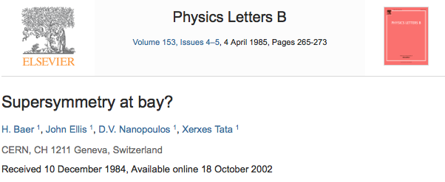

It was initially suggested that monojet events might provide evidence
for SuperSymmetry (in this case the large missing P_{T} in the event would
be associated with the Lightest SUSY particle escaping detection).
Example of a paper showing the excitement of those times:
and also the title of a lecture course presented at the Yukon Advanced Study
Institute on Quarks and Leptons, Whitehouse, Yukon, August 1984:
(CERN-TH 4017/84)

Slide 12
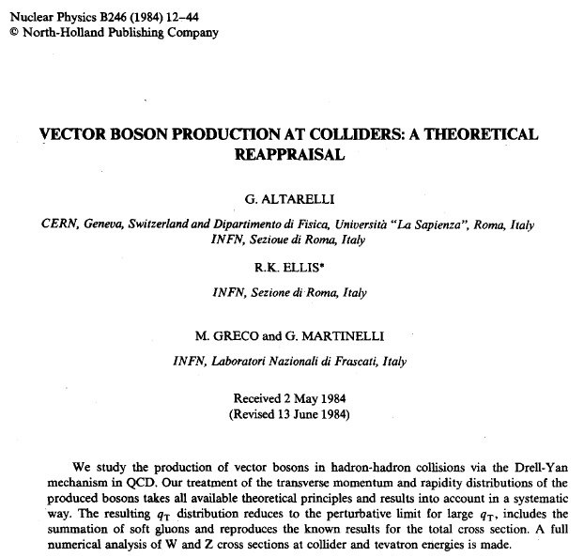
Meanwhile Guido and his collaborators were working on a precise evaluation
of the W and Z boson transverse momentum from QCD effects:

Slide 13
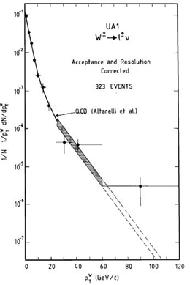
Their predictions describe well the W p_{T} distribution as measured by UA1
from all data taken before 1986
At high W p_{T} the W is seen to recoil against a high p_{T} hadronic jet

Slide 14
Another run took place at the CERN SppS collider in 1984.
The centre-of-mass energy was increased from 540 to 630 GeV
and the total integrated luminosity in UA1 and UA2 went from
~130 to ~400 nb⁻¹.
Preliminary results were presented at the 5th Topical Workshop on
Proton – Antiproton Collider Physics, Saint Vincent, Aosta Valley (Italy),
25th February – 1st March 1985
From the Introduction by the Workshop Chairperson (Mario Greco):
….. But the highlights of the 1984 Berne Meeting were the presentations of a few unexpected events, in particular those with high missing transverse energy, which could hardly be accounted for in the Standard Model. These events have generated much excitement and great expectations in the high-energy physics community …. The new data taken from September 1984 to the end of the year at higher center-of-mass energy will certainly shed some light on the possibility that new physics is starting in the
O(100 GeV) energy region.

Slide 15
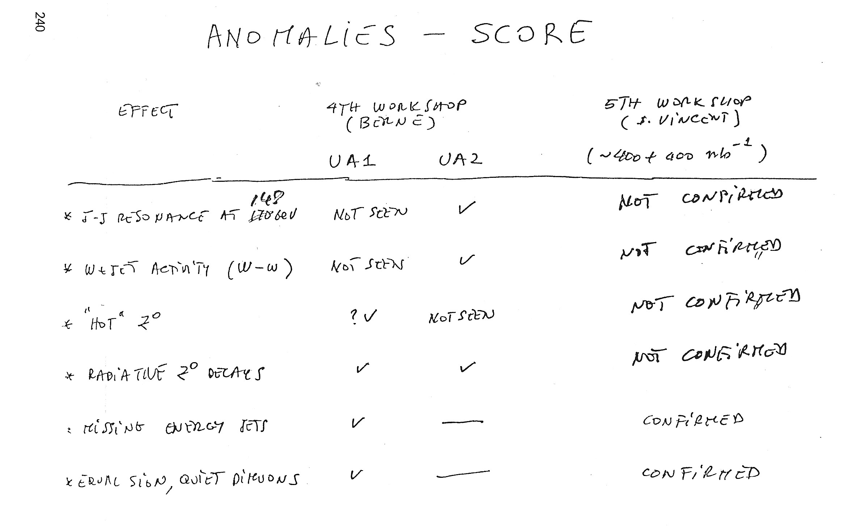
Carlo Rubbia reported on “UA1 UPDATE”
(only the copy of his slides is available in the Workshop Proceedings)
(there were no new anomalous events in UA2

Slide 16
Guido’s contribution in the discussion following Rubbia’s
presentation:
We agree that it is not possible to explain all UA1 monojet events
in terms of a single Standard Model process, such as Z + gluon
→ ν ν (invisible) + jet ;
However, one should try a “wisely composed cocktail” of known
processes, such as:
two or three W → τ ν followed by τ hadronic decay;
a couple of Z + gluon → ν ν (invisible) + jet;
one or two W + gluon → e(μ)ν + jet with the charged lepton
escaping detection;
and also (perhaps) a genuine two-jet event with one jet mismeasured.
An estimate of the background to the monojet events
from Altarelli’s cocktail was attempted and presented at
the Workshop on the day following Guido’s suggestion.

Slide 17
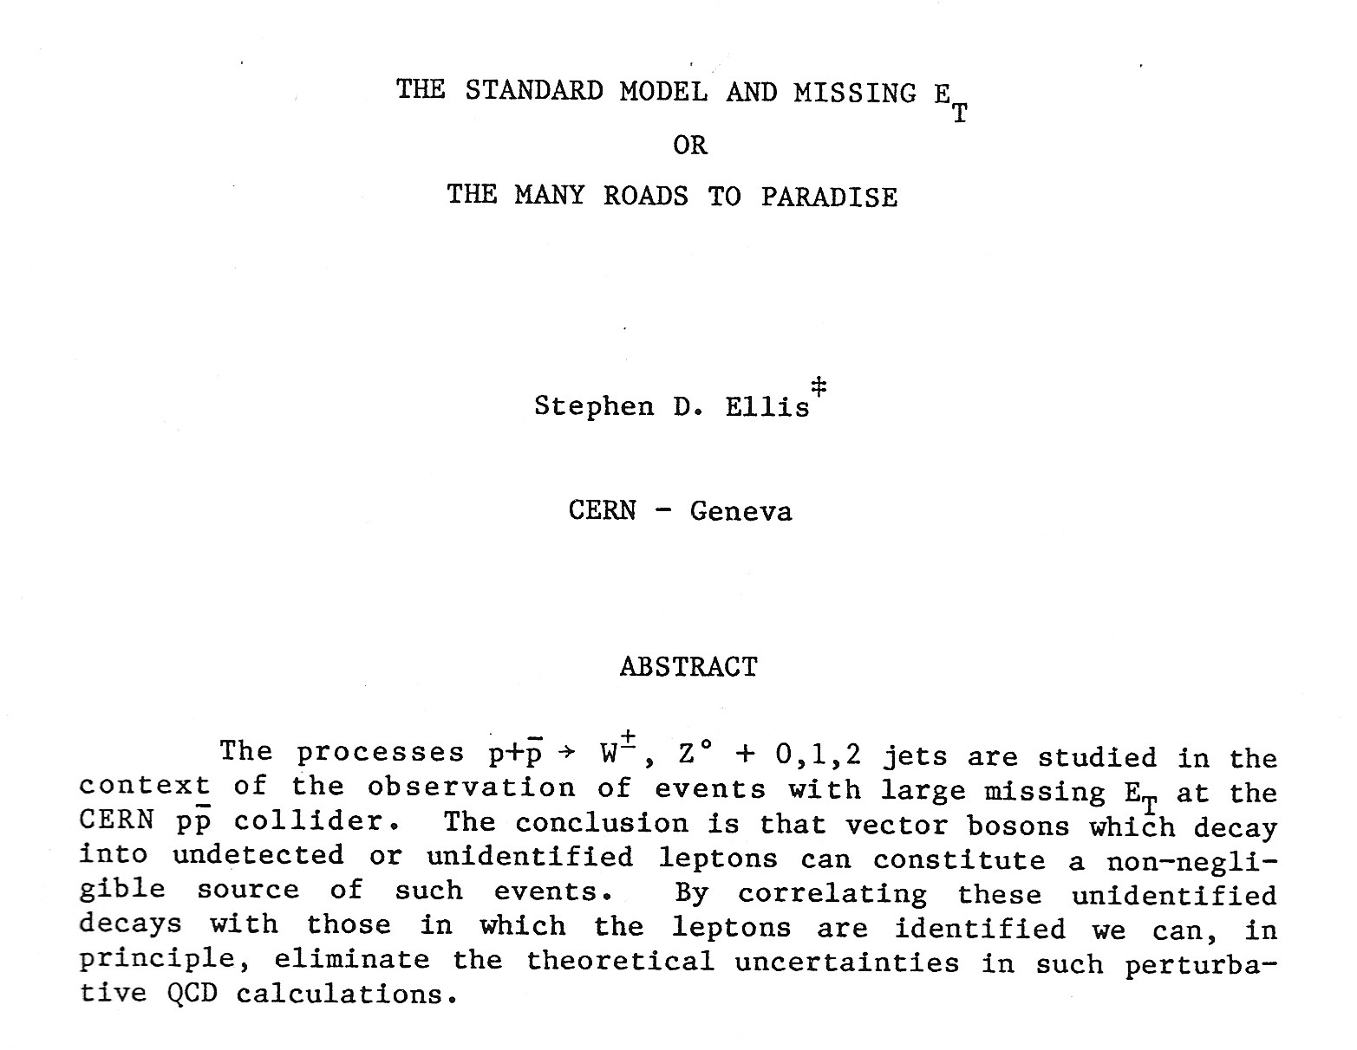
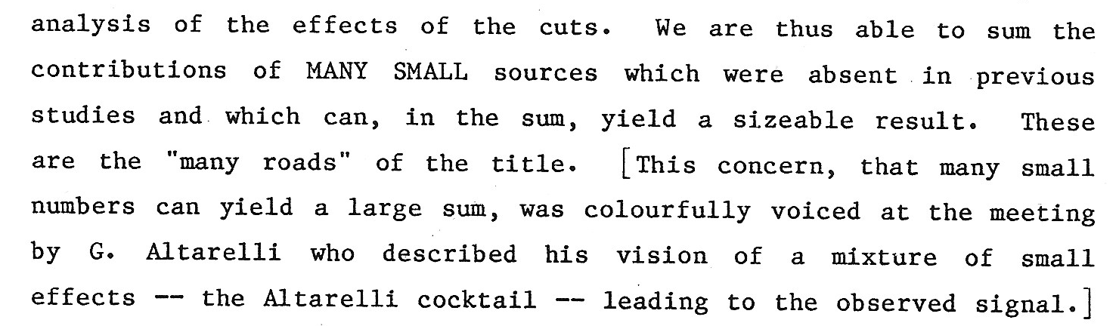
……
…….

Slide 18
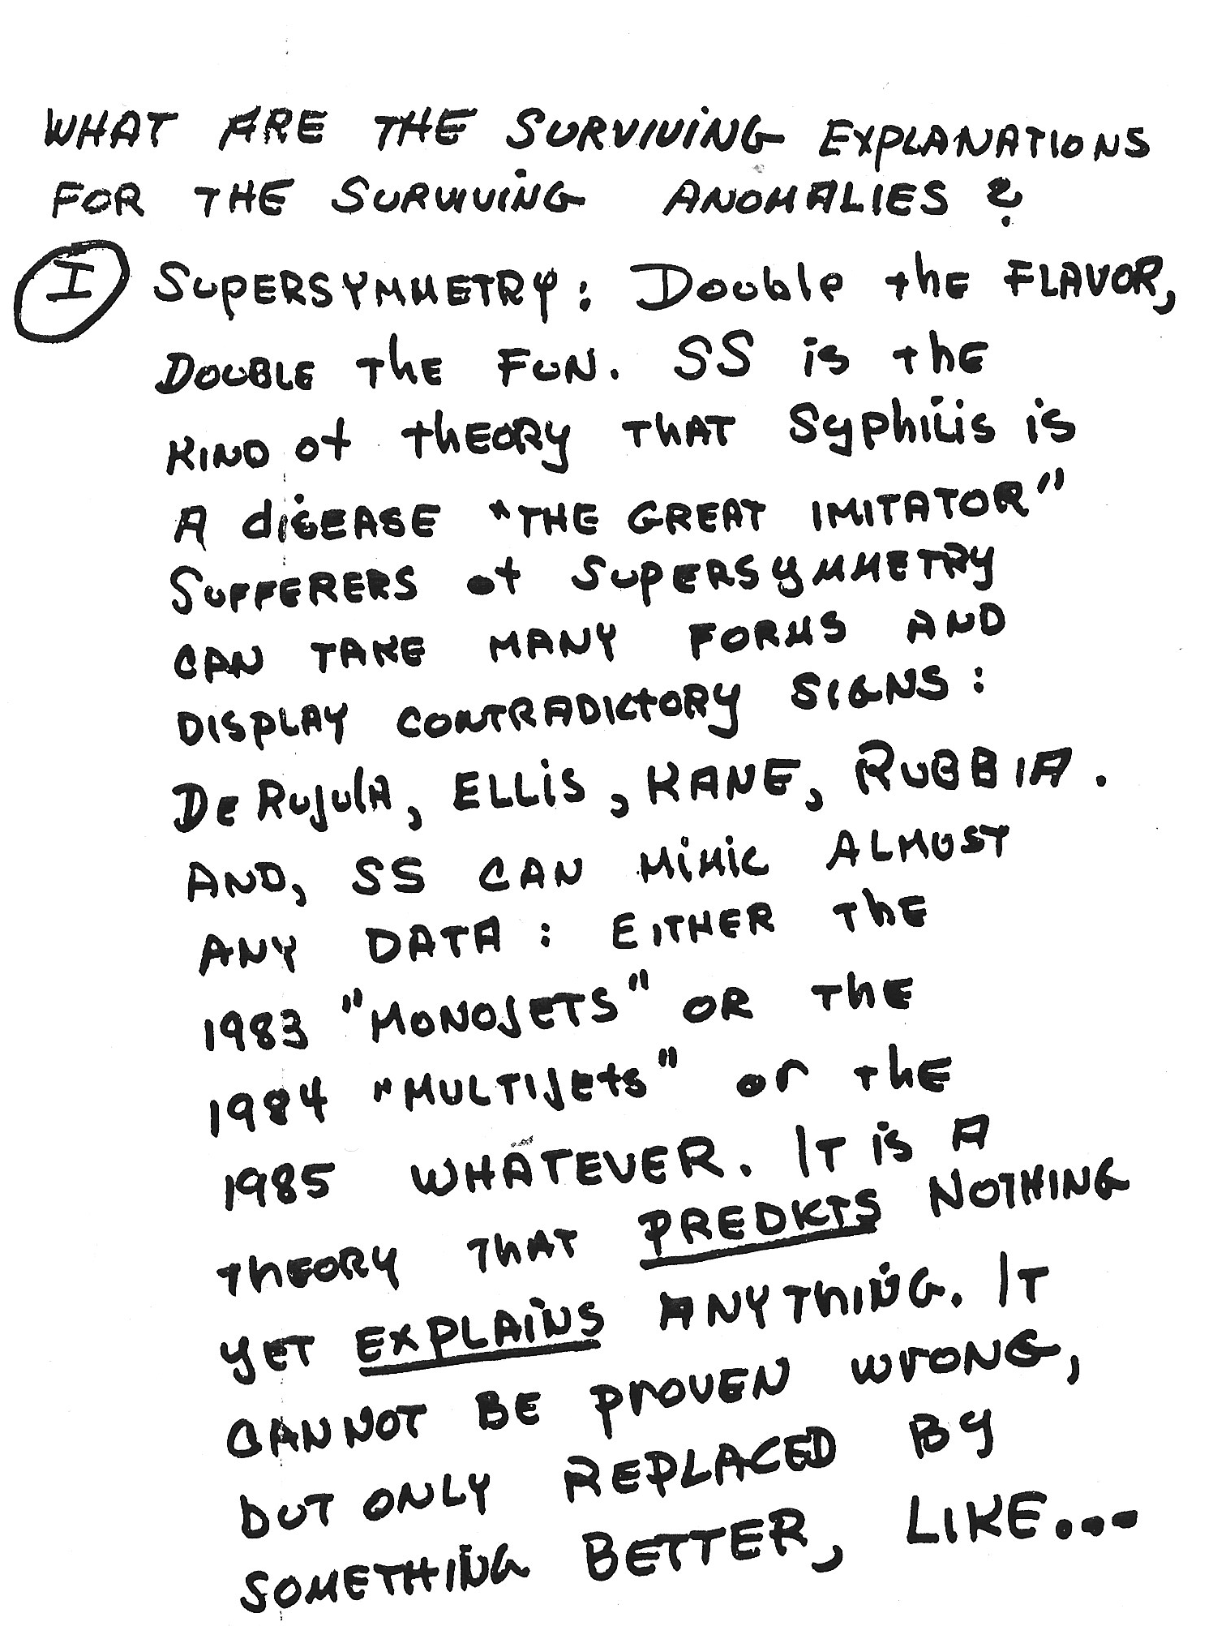
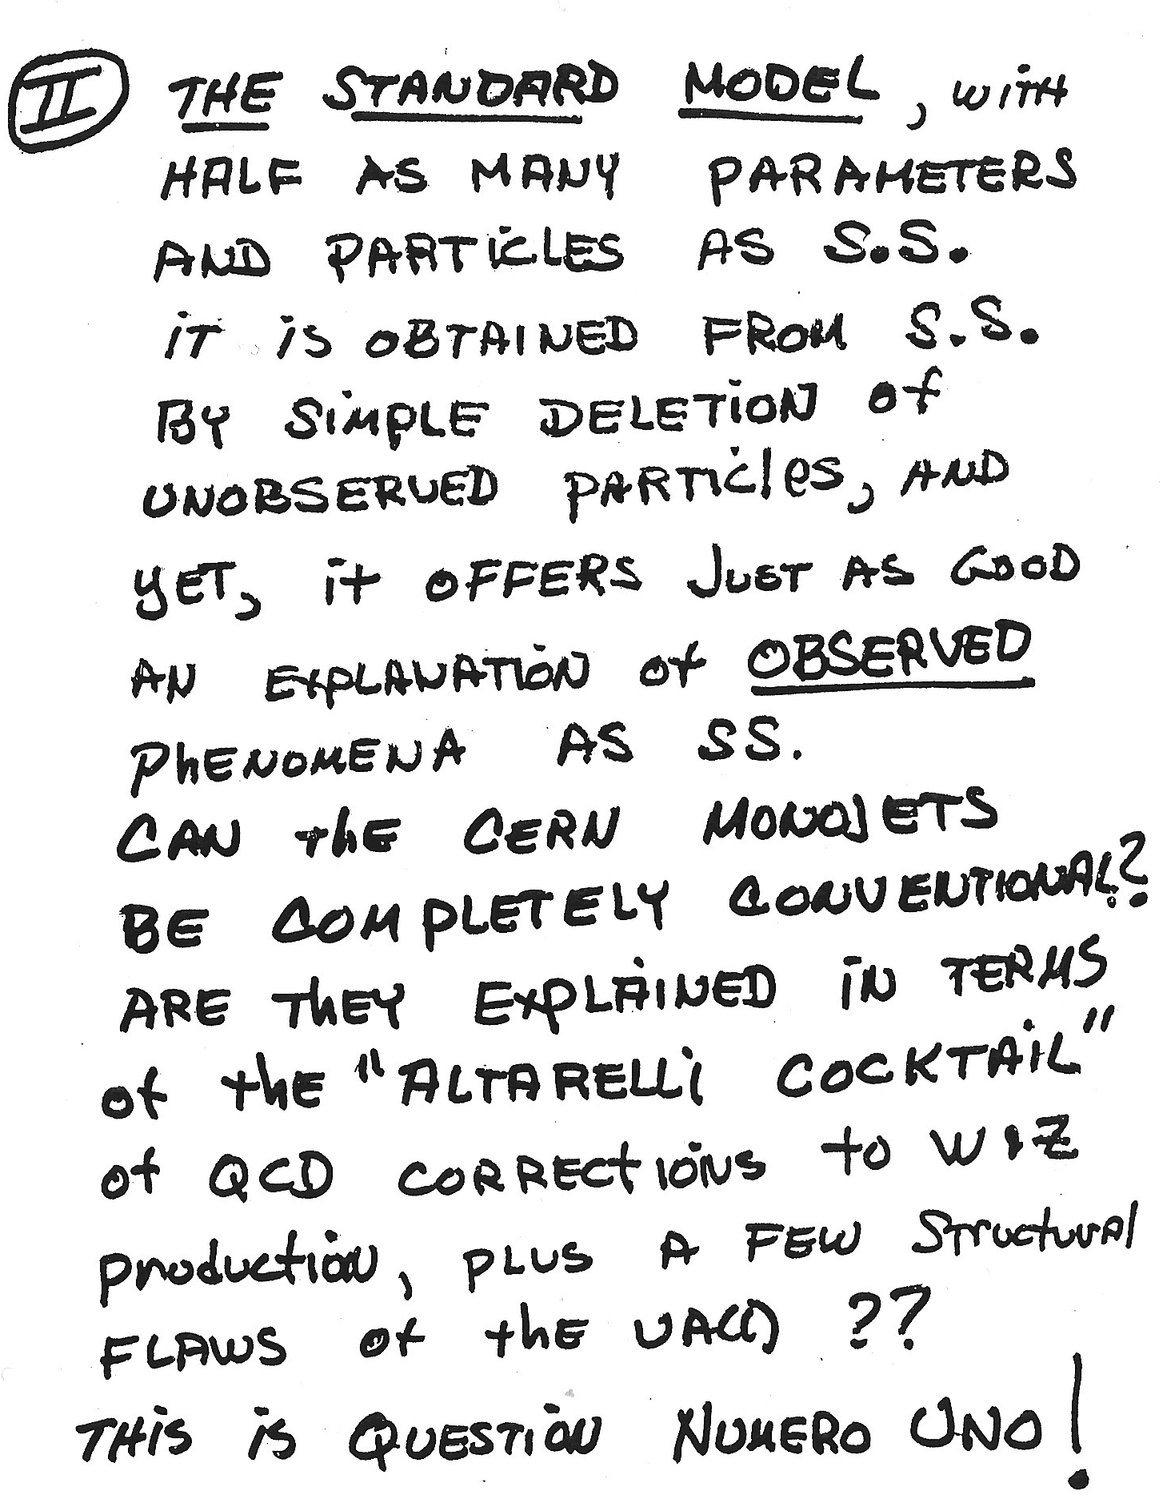
From the Summary Talk “Where we are and where we are going” by S.L. Glashow
(only the copy of his slides are available in the Workshop Proceedings)
( here S.L. Glashow compares
SuperSymmetry to a disease
and gives a short list of people
affected by the disease )

Slide 19
From the Workshop “Experimental Summary” by R.F. Schwitters:
For now, the Altarelli cocktail is as good an explanation of the reported data as any.
…….
The overwhelming conclusion of this Workshop is that the Standard Model is alive
and well.
Guido’s comment at the 1985 Workshop marked the beginning
of the end of SUSY speculations to explain the UA1 monojet events.
With his suggestion to try a “wisely composed cocktail” he called on
the particle physics community (theorists and experimentalists)
to stop wishful thinking about new physics and to start a serious,
quantitative background evaluation.
Subsequent work along these guidelines concluded that indeed
all anomalous results from the SppS collider could just be explained
by the Standard Model.

Slide 20
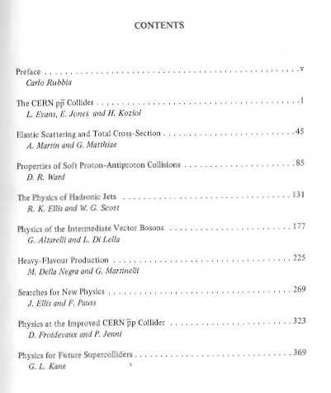
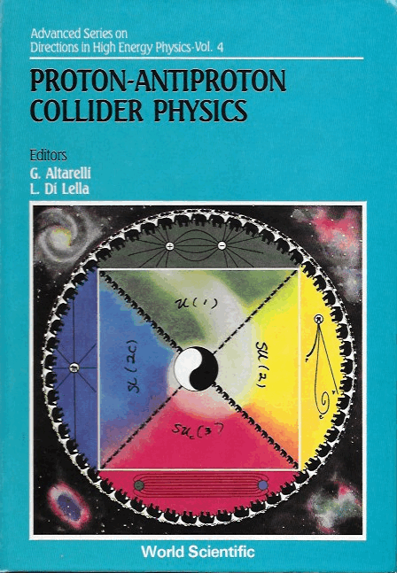
1986 – 88: Working with Guido as
Editors of a book
*
*
also published as CERN-TH- 5258-88
(published in February 1989)

Slide 21
1987 – 90: the last years of the CERN proton – antiproton collider
Luminosity increased ~10 times
Physics goals:
Search for the top quark
(observable at the SppS only if W → tb decay is kinematically allowed)
Searches for new physics
Final results:
No top quark seen
No evidence for new physics
2065 W → eν , 251 Z → e⁺e⁻ collected by UA2 allowing a precise measurement
of the mass ratio M_{W} / M_{Z}
(experiments measuring the electron energy with scintillation calorimetry suffer from
a systematic uncertainty of ~1% on the energy scale which largely cancels in the mass ratio)
At the beginning of 1989 Guido suggested that the measured ratio M_{W} / M_{Z}
could be used together with the first precise measurement of the Z mass at LEP
(expected by the end of 1989) to obtain a precise determination of M_{W}
(an important measurement because M_{W} depends strongly on the top quark mass
through radiative corrections involving a tb loop).
Guido also provided help in estimating the final systematic uncertainty on M_{W}
(measuring the W mass is harder than measuring the Z mass at hadron colliders
because the neutrino longitudinal momentum cannot be measured)

Slide 22
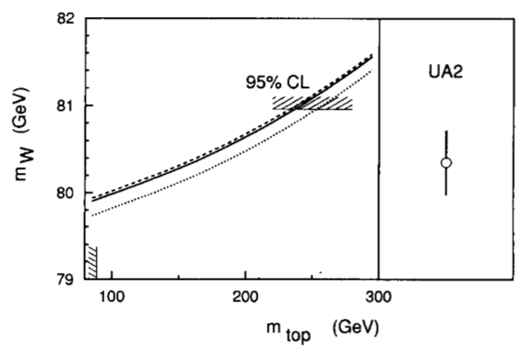
We measured M_{W} / M_{Z} = 0.8813 ± 0.0036 ± 0.0019
Using the first LEP result, M_{Z} = 91.175 ± 0.021 GeV,
we obtained M_{W} = 80.35 ± 0.33 ± 0.17 GeV
M_{H} ≈ 100 GeV
M_{H} ≈ 1000 GeV
+50
−60
From this result we obtained m_{top} = 160 GeV
(4 years before the top quark discovery at Fermilab)
A NICE EXAMPLE OF FRUITFUL INTERACTION BETWEEN GUIDO
AND AN EXPERIMENTAL GROUP

Slide 23
ADDITIONAL PERSONAL COMMENTS
Over the last 30 years I have often consulted Guido on various physics
subjects for which I needed some explanation or clarification.
I always found him willing to help, kind, patient and very clear in explaining
even very difficult theoretical details. He often tried a different explanation
if I failed to understand the first one he had offered, until he was convinced
that I had fully understood the problem.
The last time I consulted Guido was at the beginning of May 2015, when
I asked him a question about the differences of the neutrino mixing matrix
for Dirac and Maiorana neutrinos. As usual, when I left him I knew more physics
than before.
As for most of my experimental colleagues, I will miss his physics insight, his
wisdom and his human qualities.

