Slide 1

Jets in the medium: Uli’s playground
Peter Jacobs
Lawrence Berkeley National Laboratory

Slide 2
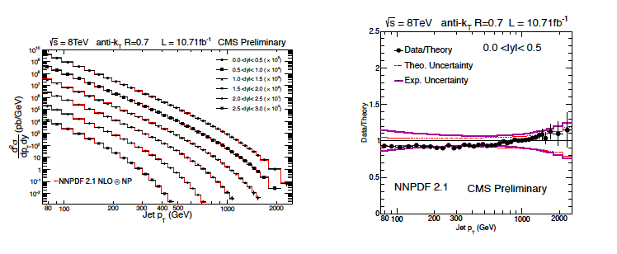
Jets in vacuum
Magnificent achievement of QCD
needed 30 years of development in theory, experiment, and algorithms to connect the two
Infrared and colinear-safe (IRC) jet reconstruction algorithms:
Integrate out all hadron degrees of freedom
Same procedures applied pQCD theory and experiment
Enables direct, precise and improvable comparison of theory/experiment
  ➔ jets measure partons

Slide 3
Jet quenching via jet reconstruction
Initial concept:
  Jets are a precision tool for QCD in vacuum
    ➔ well-controlled probe of QGP, both theoretically and experimentally
Jet reconstruction integrates all hadronic degrees of freedom
    Measure energy flow and redistribution: jet quenching at the partonic level
  Can we use reconstructed jets to study jet quenching with precise connection between theory and experiment?
  The technology of jet reconstruction is complex, especially in the heavy ion environment
    If, in the end, jet measurements and their interpretation are just really complicated, we will not have succeeded
    Ultimately, their interpretation must be transparent in order for us to see clearly what these measurements are telling us about the Quark-Gluon Plasma
    Uli’s leadership is essential for this program to succeed

Slide 4
Partonic jet quenching: observables
Observables should be calculable in field theory
at least in vacuum: start from rigorous basis, then extend to in-medium
Minimize the need for Monte Carlo modeling
“Infrared-safe” and collinear-safe observables: very low cuts on hadron p_{T} (preferably at limit of tracking)
Minimize fragmentation bias of jet population
Trigger bias should be calculable without modeling of backgrounds
  Prefered triggers: hadron (selected “inclusively”), photon, Z

Slide 5
Partonic jet quenching: observables (cont’d)
Partial list of observables:
Inclusive high p_{T} hadrons (parameterized by collinear FFs)
Inclusive jet cross sections and semi-inclusive jet yields
  R_{AA}, I_{AA},…
  Variation with R
Moliere scattering in-medium
Jet mass
Subjets
…?
Coincidence observables: choice of trigger varies geometric and flavor biases

Slide 6
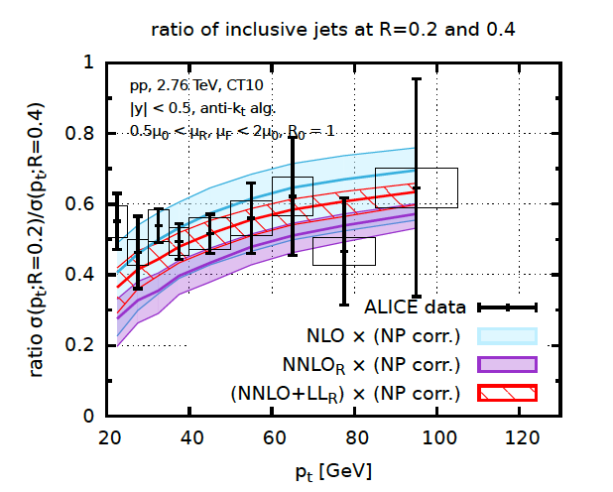
Transverse jet shape: inclusive jets in vacuum
arXiv:1602.01110
arXiv:1602.01110
Phys Rev D90 (2014) 7, 072006
σ(R=0.5)/σ(R=0.7)
R
Jets with different R sensitive to different components of shower
Incl cross section vs. R is sensitive probe of intra-jet structure
Calculable in vacuum at NNLO + LL resummation

Slide 7
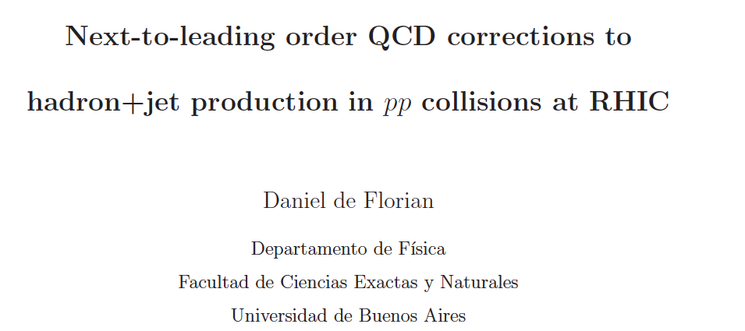
Coincidence observable: hadron+jet correlations
trigger
hadron
Phys.Rev. D79 (2009) 114014
arXiv:0904.4402
Recoil jet
R
Initial motivation: spin dependence of h+jet inclusive cross section in polarized pp collisions

Slide 8
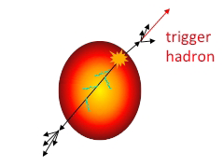
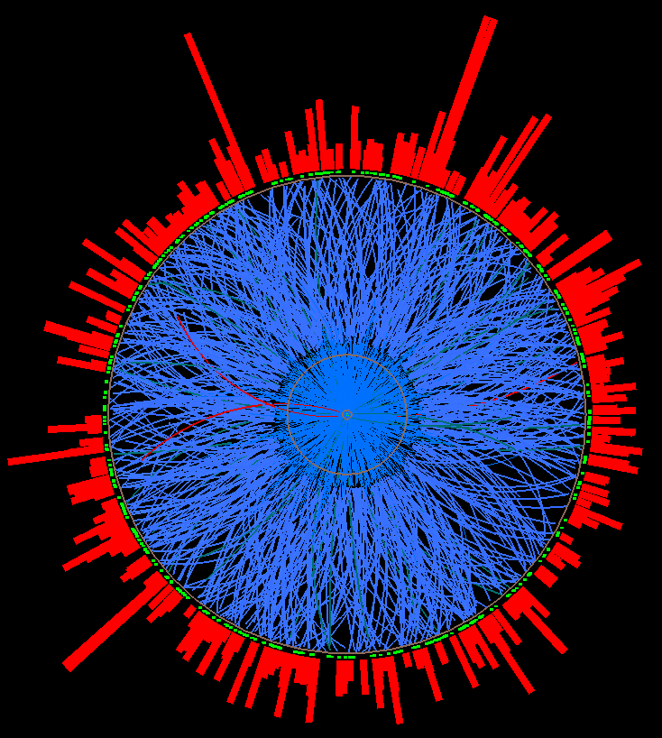
Measuring jet quenching with h+jet: semi-inclusive recoil jet yield
Trigger-normalized yield of jets recoiling from a high p_{T} hadron trigger
Measurable
Calculable in pQCD (in vacuum)
Semi-inclusive: event selection only requires trigger hadron
Trigger hadron selected “inclusively”
experimentally clean; trigger bias theoretically calculable
Count all recoil jet candidates:
uncorrelated background corrected at level of ensemble-averaged distributions
jet selection does not impose fragmentation bias
Recoil jet
acceptance
Trigger
hadron
Expected geometric bias: surface, not tangential
Large path length for recoil
Model studies: T. Renk, PRC74, 024903; H. Zhang et al., PRL98 212301;…

Slide 9
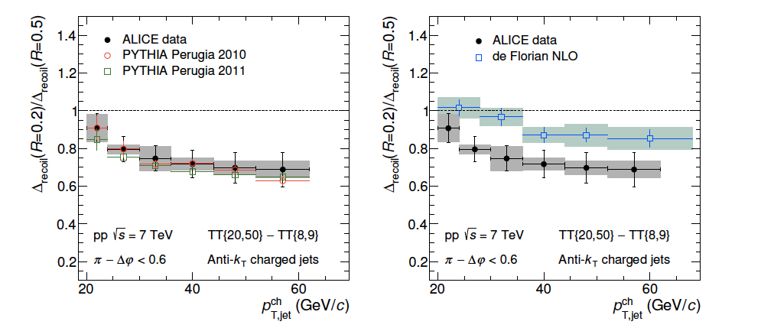
Transverse jet shape II: recoil jets in vacuum
trigger
hadron
Semi-inclusive h+jet, pp √s=7 TeV
ratio of recoil jet yield for different R
ALICE: JHEP 09 (2015) 170
R
h+jet in vacuum: recoil yield vs R
pQCD picture similar to inclusive cross section ratio: need NNLO
Well-described by PYTHIA

Slide 10
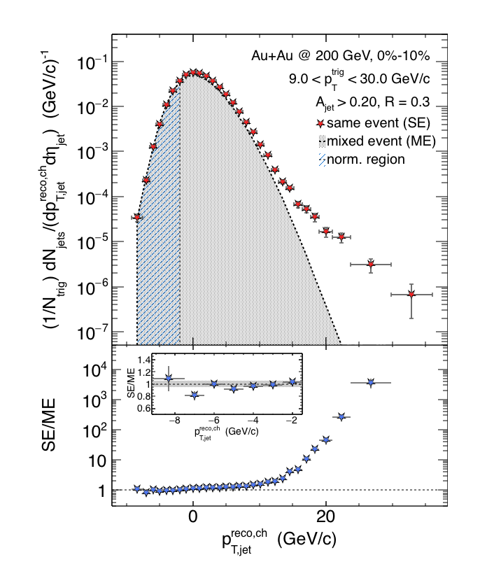
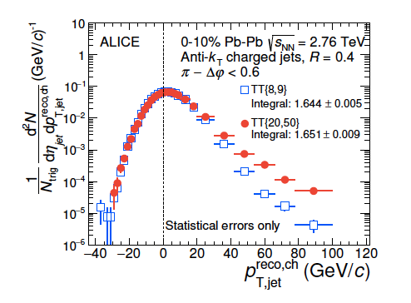

Recoil jet spectrum at RHIC and LHC
arXiv:1512.08784
JHEP 09 (2015) 170
Signal+
bkgd
uncorrelated
background
Preliminary

Slide 11
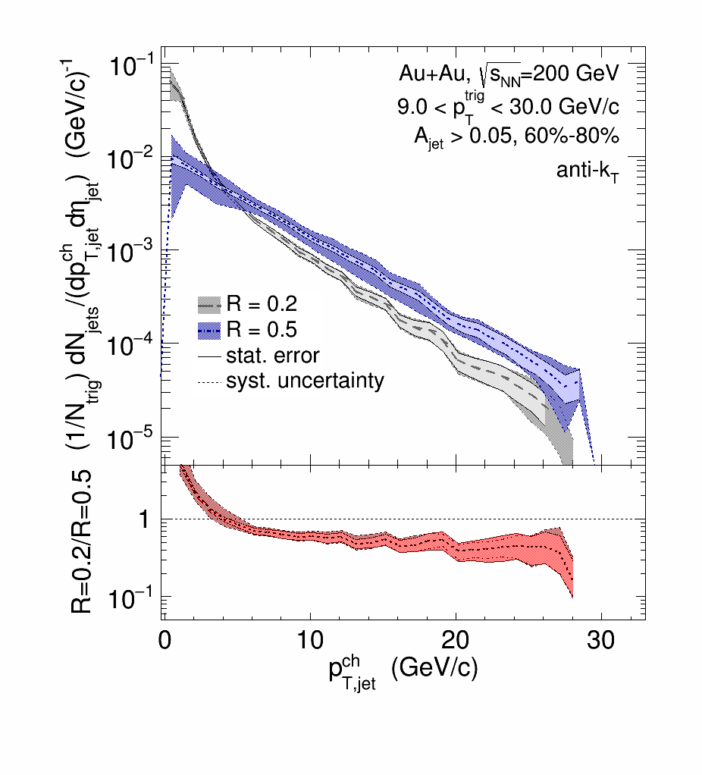
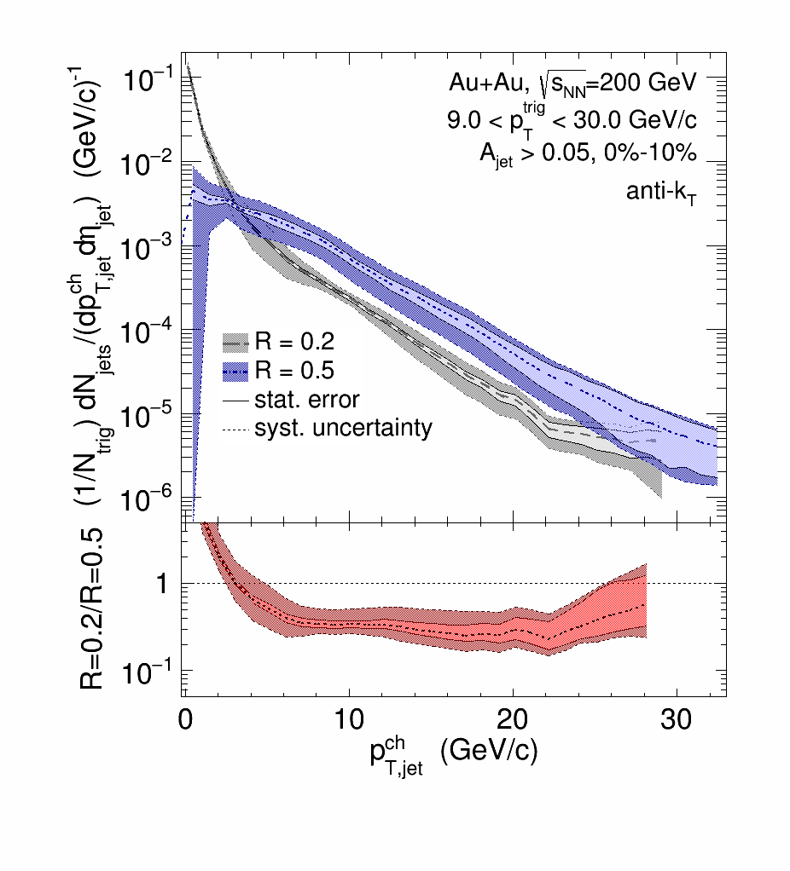
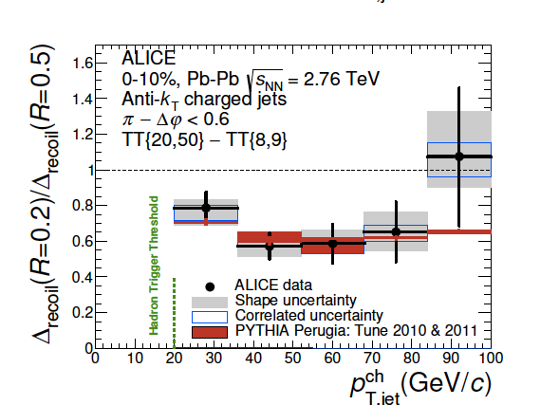
Jet quenching: intra-jet broadening
Au+Au peripheral
Au+Au central
0.5
Preliminary
Preliminary
Au+Au central
R
0.3
ALICE: JHEP 09 (2015) 170
arXiv:1512.08784
Ratio 0.2/0.5 for peripheral and central consistent within uncertainties
compatible with some broadening within R<0.5
future measurements will reduce uncert.
ALICE: similar picture in overlapping p_{T} range

Slide 12
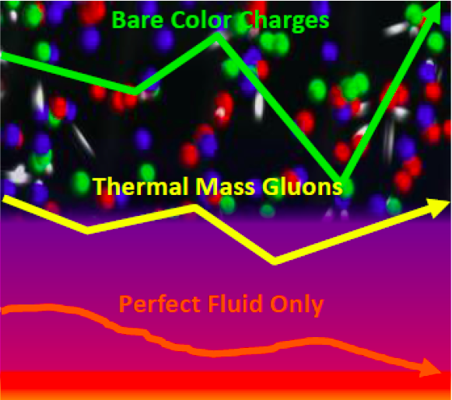
In-medium jet deflection
Multiple soft scattering
Single Moliere scattering
Measure recoil jet acoplanarity relative to trigger axis
(a.k.a. decorrelation)
Δφ

Slide 13
arXiv:1607.01932
Vacuum parton shower: Sudakov resummation
Medium-induced broadening: <qhat*L>
Vacuum broadening smaller at RHIC than LHC
Optimum observable: low jet p_{T}, vary R
Δφ
R=0.3
R=0.3
R=0.4
Predicts small but observable effect
→ direct measurement of qhat…?

Slide 14
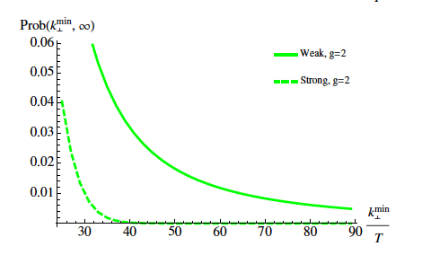
Inter-jet broadening: secondary scattering off the QGP
Discrete scattering centers or effectively continuous medium?
d’Eramo et al, arXiv:1211.1922
Distribution of momentum transfer k_{T}
Strong coupling:
Gaussian distribution
Conjecture for weak coupling: Δφ distribution dominated by single hard Molière scattering at “sufficiently large” Δφ
vacuum QCD effects fall off more rapidly
“sufficiently large” not yet known
?
Δφ

Slide 15
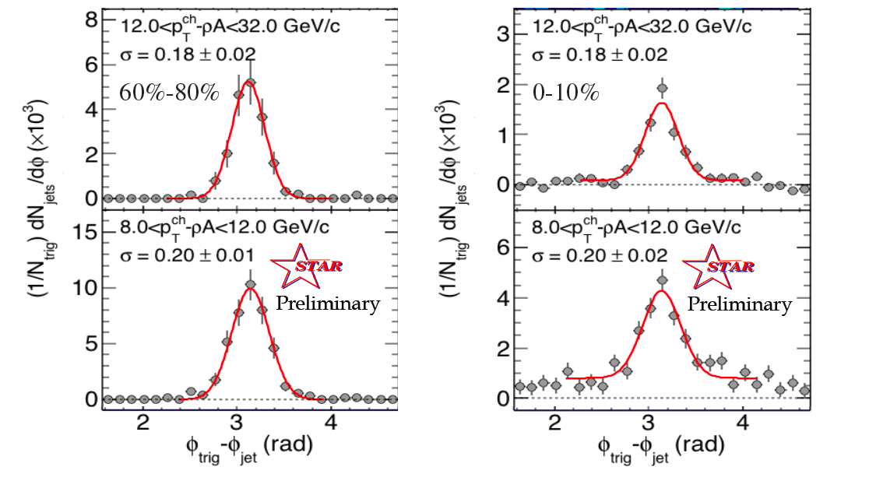
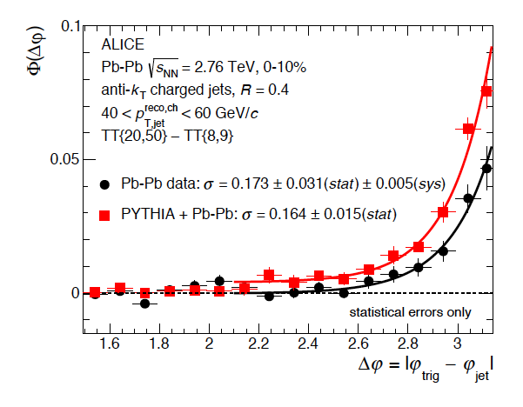
Interjet broadening: RHIC and LHC
AuAu √s_{NN}=200 GeV
PbPb √s_{NN}=2.76 TeV
arXiv:1512.08784
JHEP 09 (2015) 170
Low jet p_{T} of special interest: largest effects expected
current measurements consistent with zero yield
QCD calculation of scattering in q/g gas can indicate integrated luminosity needed for significant measurement
Δφ

Slide 16
Assessment and next steps
Strategy: “IRC-safe” measurements of medium-induced shower broadening and scattering with reconstructed jets
Full dynamic range of jet p_{T} and R at RHIC and LHC
  ⟹Enables comparison to theory calculations without modeling of hadronization (beyond collinear FFs)
First results: proof of principle
Charged-particle jets, small datasets: limited precision
Up next: calorimetric jets, higher int lumi (both RHIC and LHC)
Theory/data comparison for precise constraints on quenching mechanisms, measurements of QGP parameters:
  Embed theory calculations into accurate dynamical model of collision
  IS fluctations, viscous hydro expansion, hadronization,…

Slide 17

JETSCAPE Collaboration
Consortium of theorists and experimentalists to create a next-generation heavy ion event generator
Flexible framework for event generation
Combine current MC simulators and fluid-dynamical models
GPU parallelization for speed
Statistical analysis using bayesian techniques
PIs:
  Duke: Steffen Bass, Robert Wolpert
  McGill: Charles Gale, Sangyong Jeon
  MIT: Gunther Rolad
  Ohio State: Uli Heinz
  Texas A&M: Rainer Fries
  LBNL: Barbara Jacak, Peter Jacobs, Xin-Nian Wang
  Wayne State: Abhihit Majumder, Joern Putschke, Loren Schweibert
  LLNL: Ron Soltz

Slide 18
Partonic jet quenching in JETSCAPE
Partonic
Hadronic

Slide 19

Happy Birthday Uli !

